Slide 1




Methane emission estimates of localized sources from Sentinel-5 Precursor, PRISMA, EnMAP and EMIT using a cross-sectional-flux method
21st International Workshop on Greenhouse Gas Measurements from Space (IWGGMS-21), 9-12 June 2025, Takamatsu, Japan
Michael Buchwitz, Oliver Schneising-Weigel, Stefan Noël, Maximilian Reuter, Michael Hilker, Jonas Hachmeister, Heinrich Bovensmann, Hartmut Boesch
University of Bremen, Institute of Environmental Physics, Germany
Frances Reuland, Adam Brandt
Department of Energy Science and Engineering Doerr School of Sustainability, Stanford University, CA, USA
Taylor Adams, Eric A. Kort
Department of Climate and Space Sciences and Engineering, University of Michigan, Ann Arbor, MI, USA
v2, 2-June-2025

Slide 2


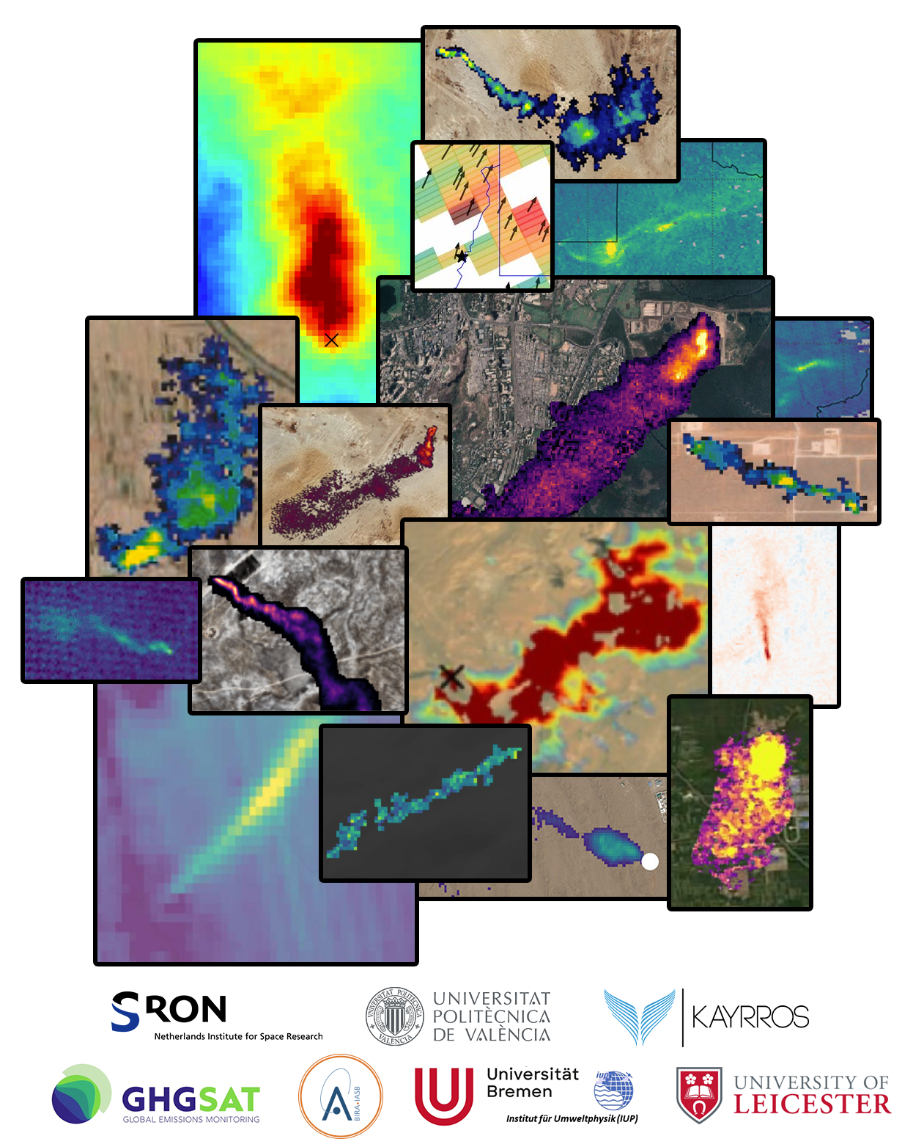








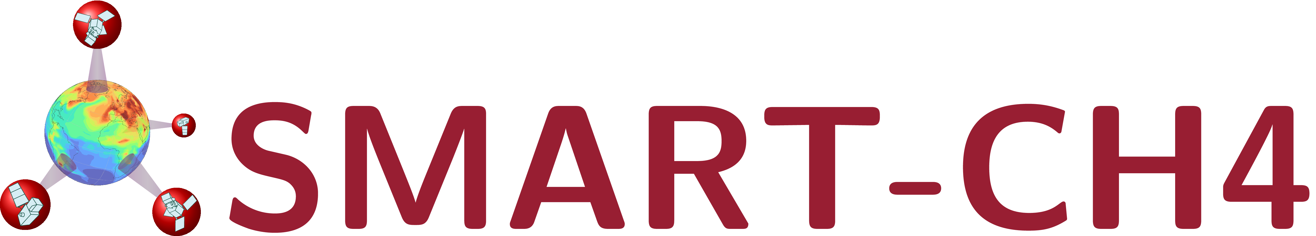

IUP-UB: Funding through various projects
Methane
Emissions
Detection
Using
Satellites
Assessment (MEDUSA)

Slide 3
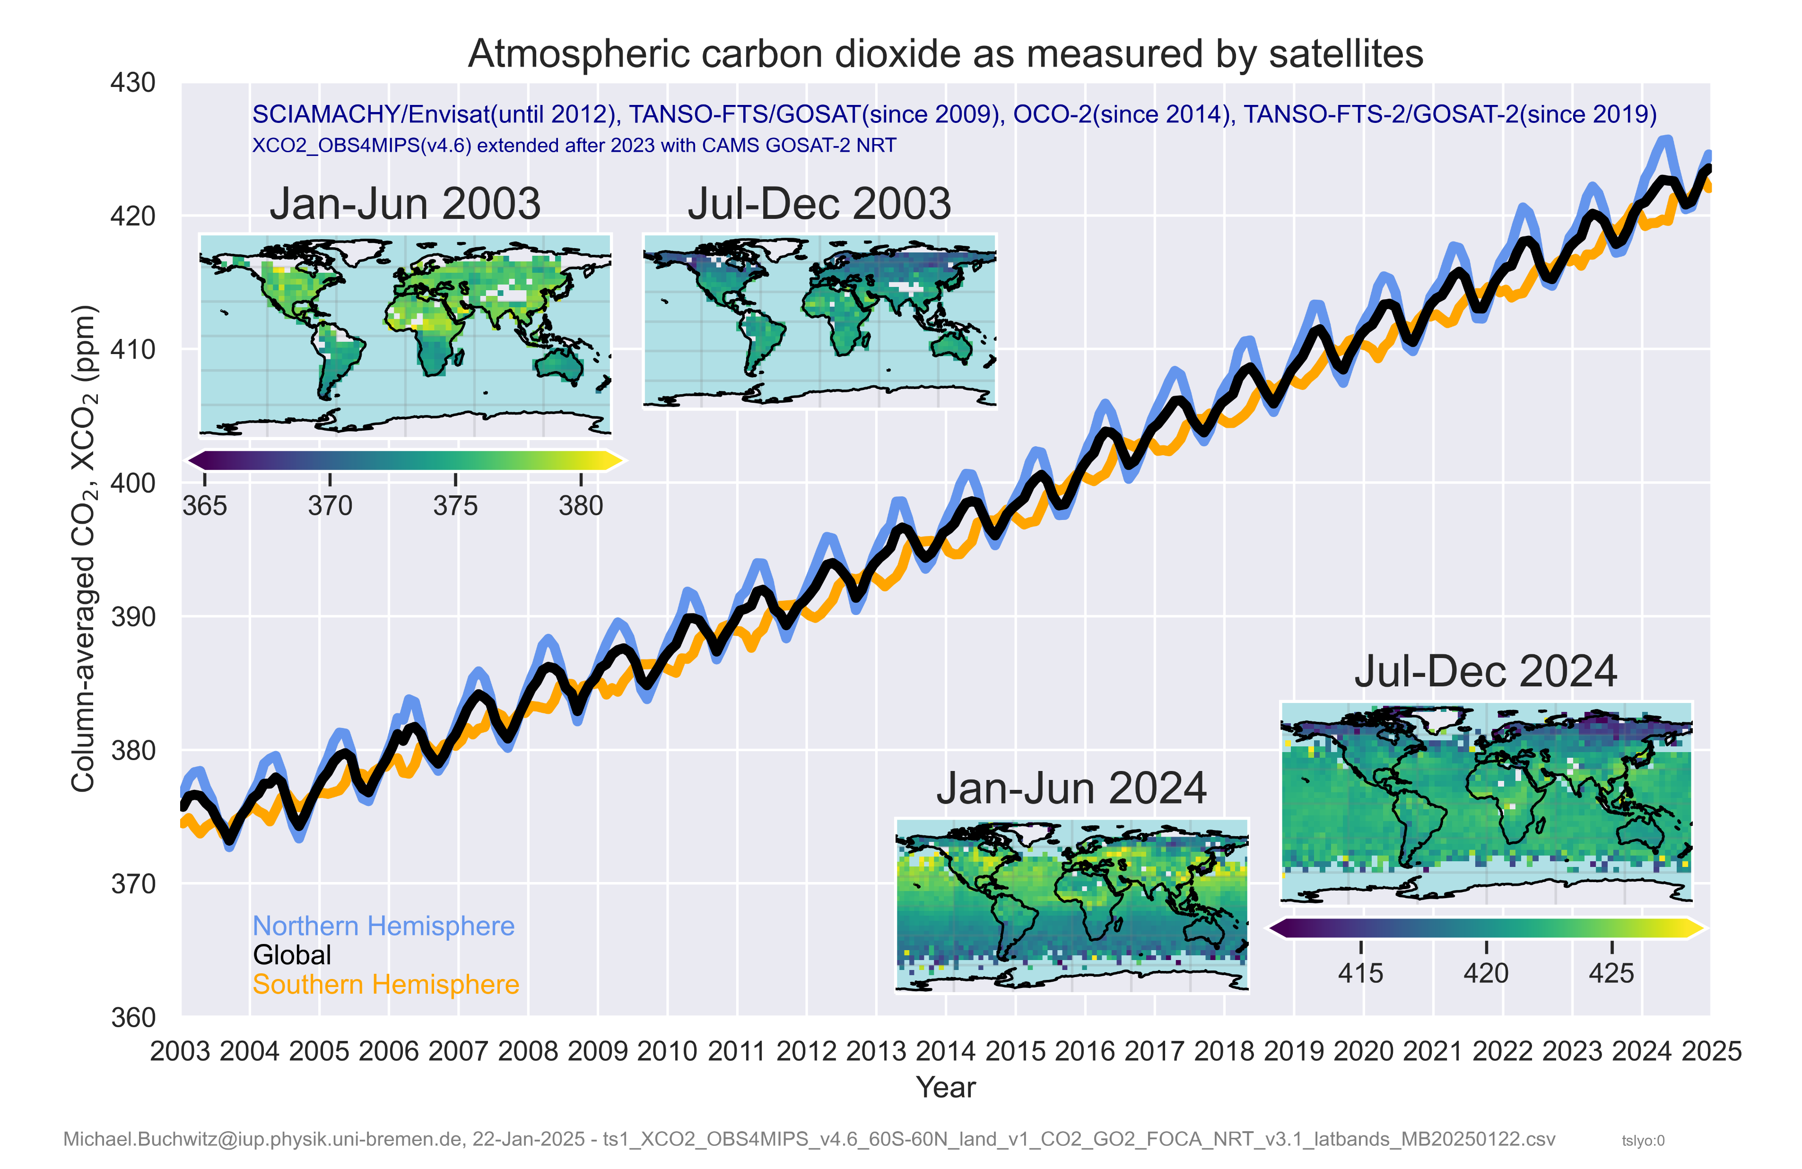
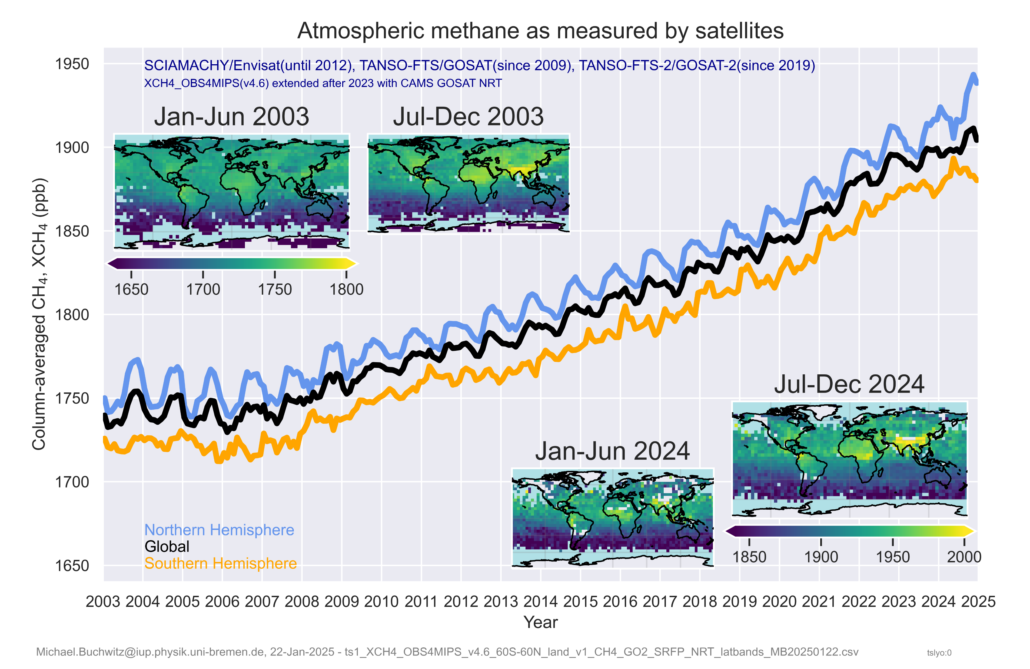
Satellite XCO2 and XCH4 retrievals …
CCI Integration Meeting, ECMWF, 14-16 March 2011
SCIAMACHY
SCIAMACHY
GOSAT
GOSAT
OCO-2
GOSAT-2
GOSAT-2
+ TROPOMI/S5P, PRISMA, EnMAP, EMIT, …
+ future S5, GOSAT-GW, CO2M, …
See also: https://climate.copernicus.eu/esotc/2024/trends-climate-indicators

Slide 4
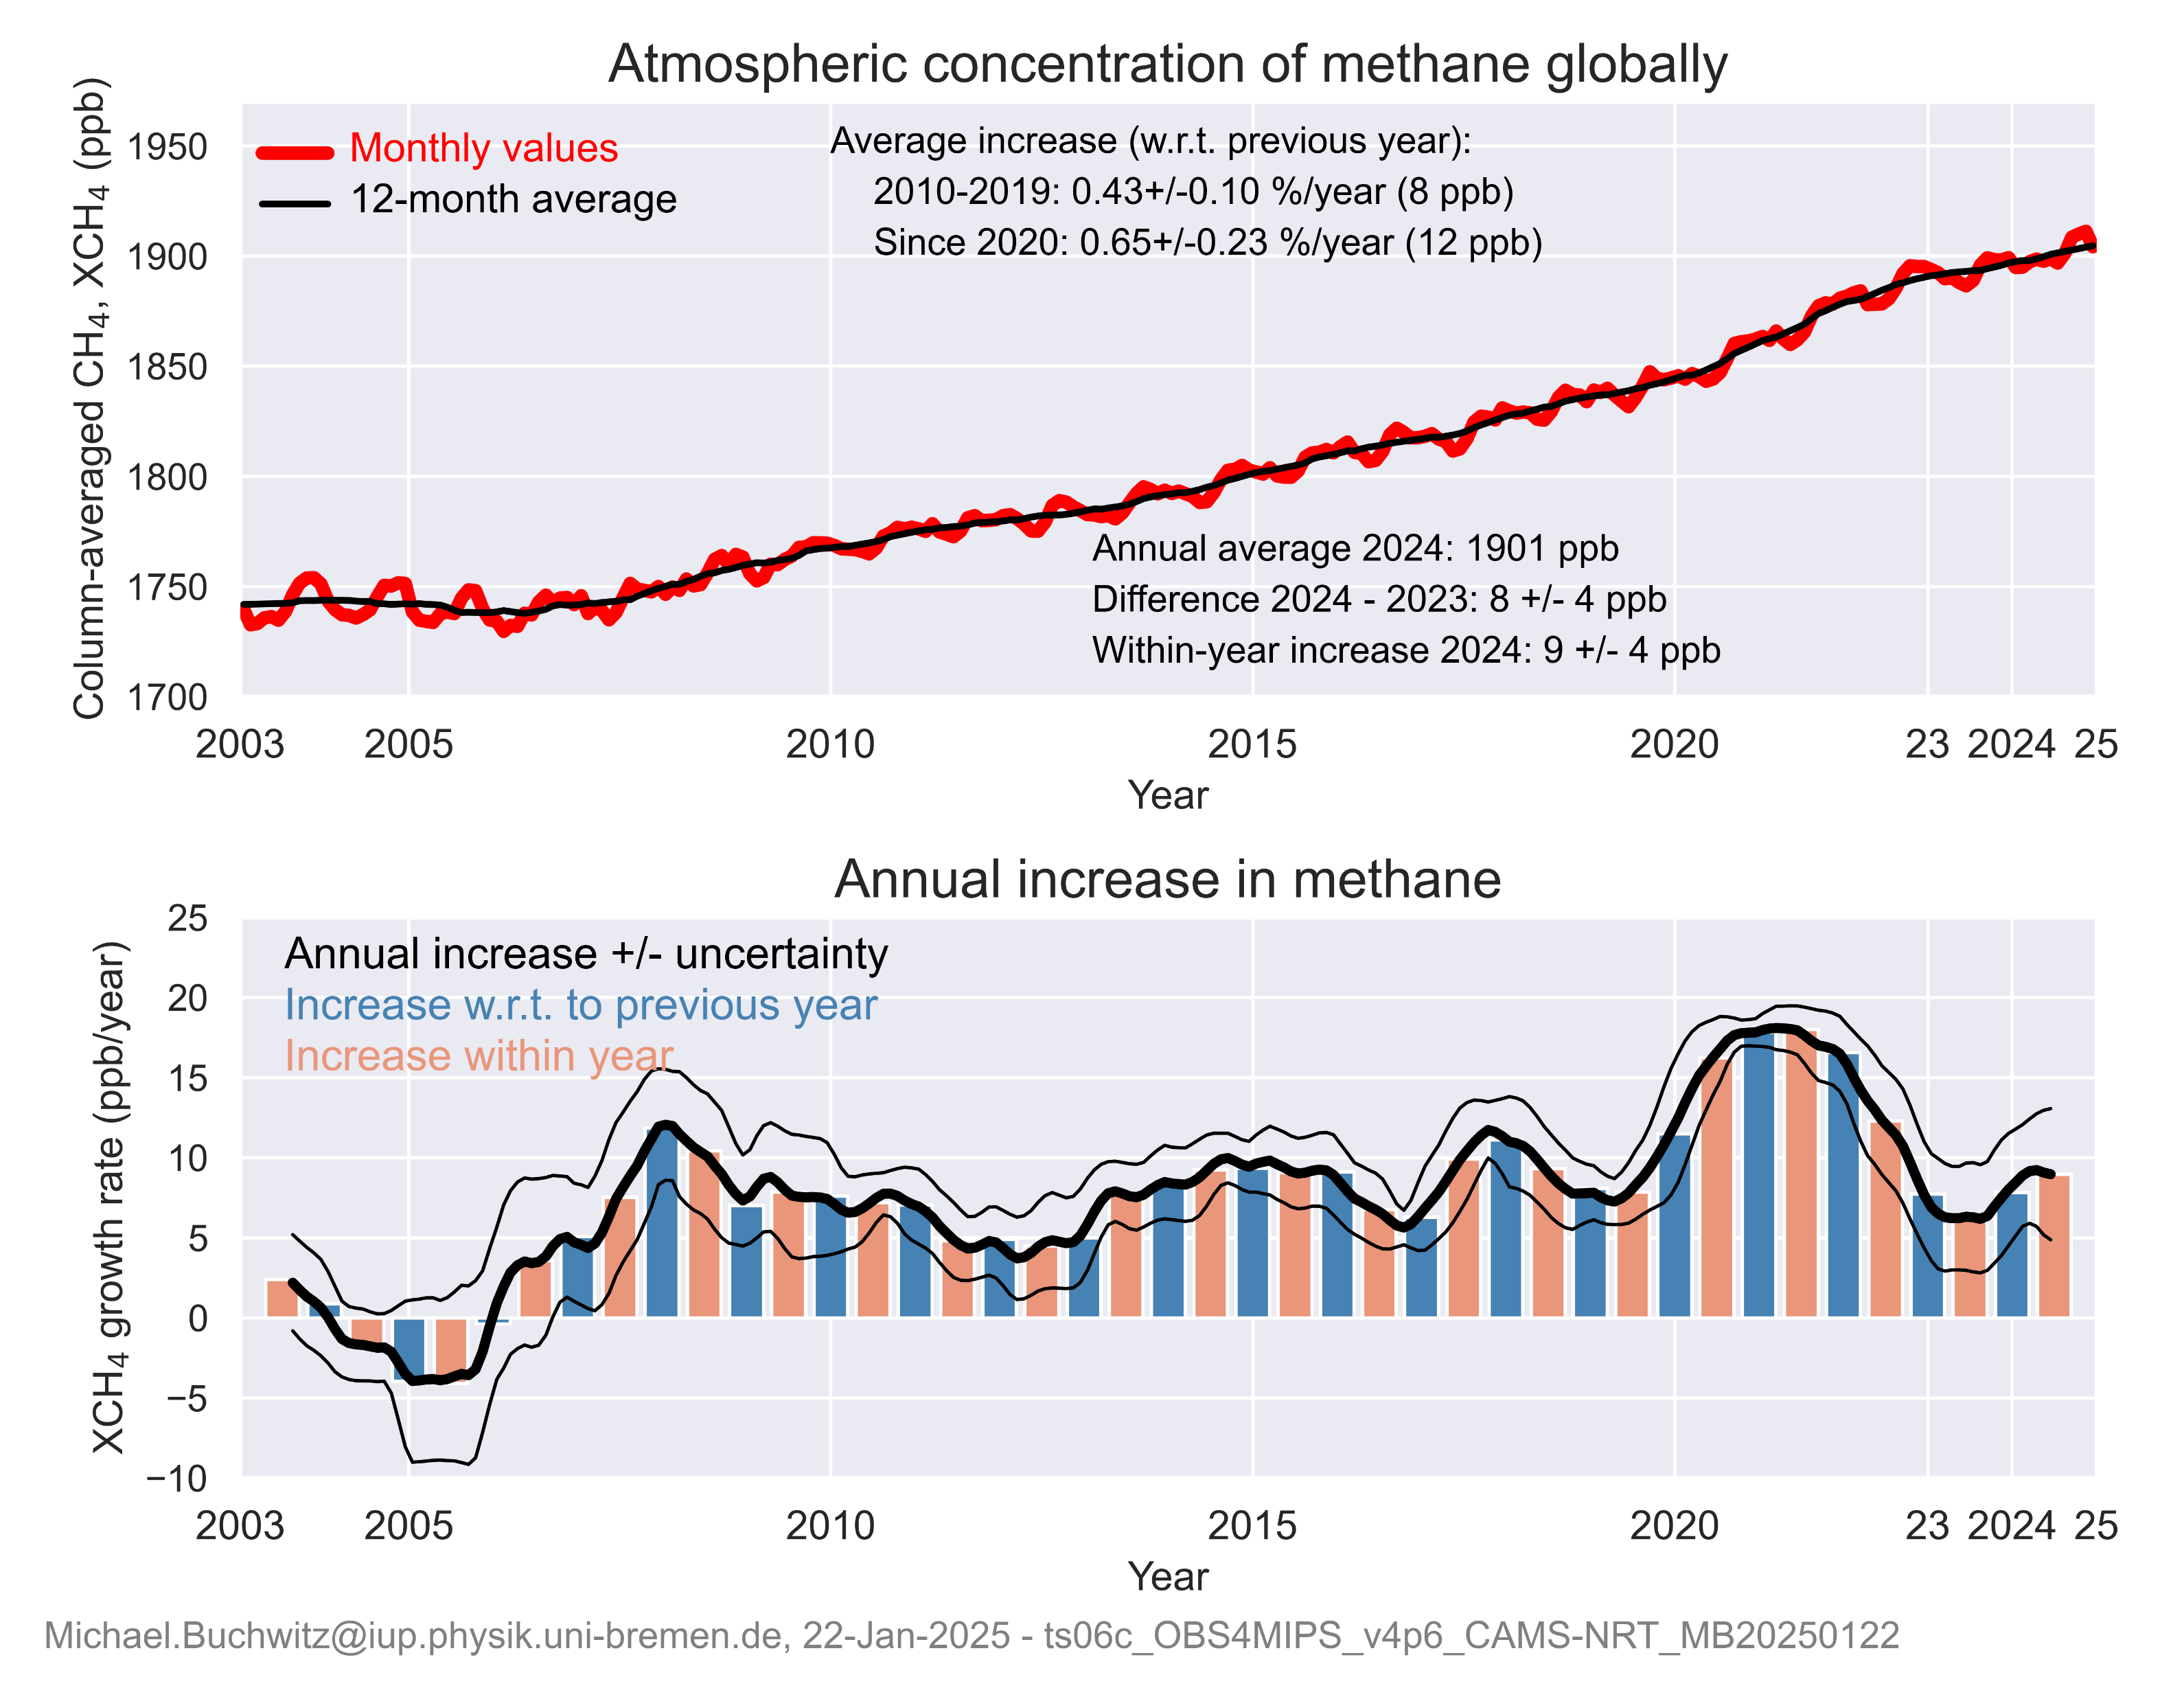
Satellite XCH4 retrievals …
CCI Integration Meeting, ECMWF, 14-16 March 2011
SCIAMACHY
GOSAT
Methane growth rate in 2024
high (~ 8 ppb) but not record high
GOSAT-2
+ TROPOMI/S5P, PRISMA, EnMAP, EMIT, …
+ future S5, GOSAT-GW, CO2M, …
See also: https://climate.copernicus.eu/esotc/2024/trends-climate-indicators

Slide 5
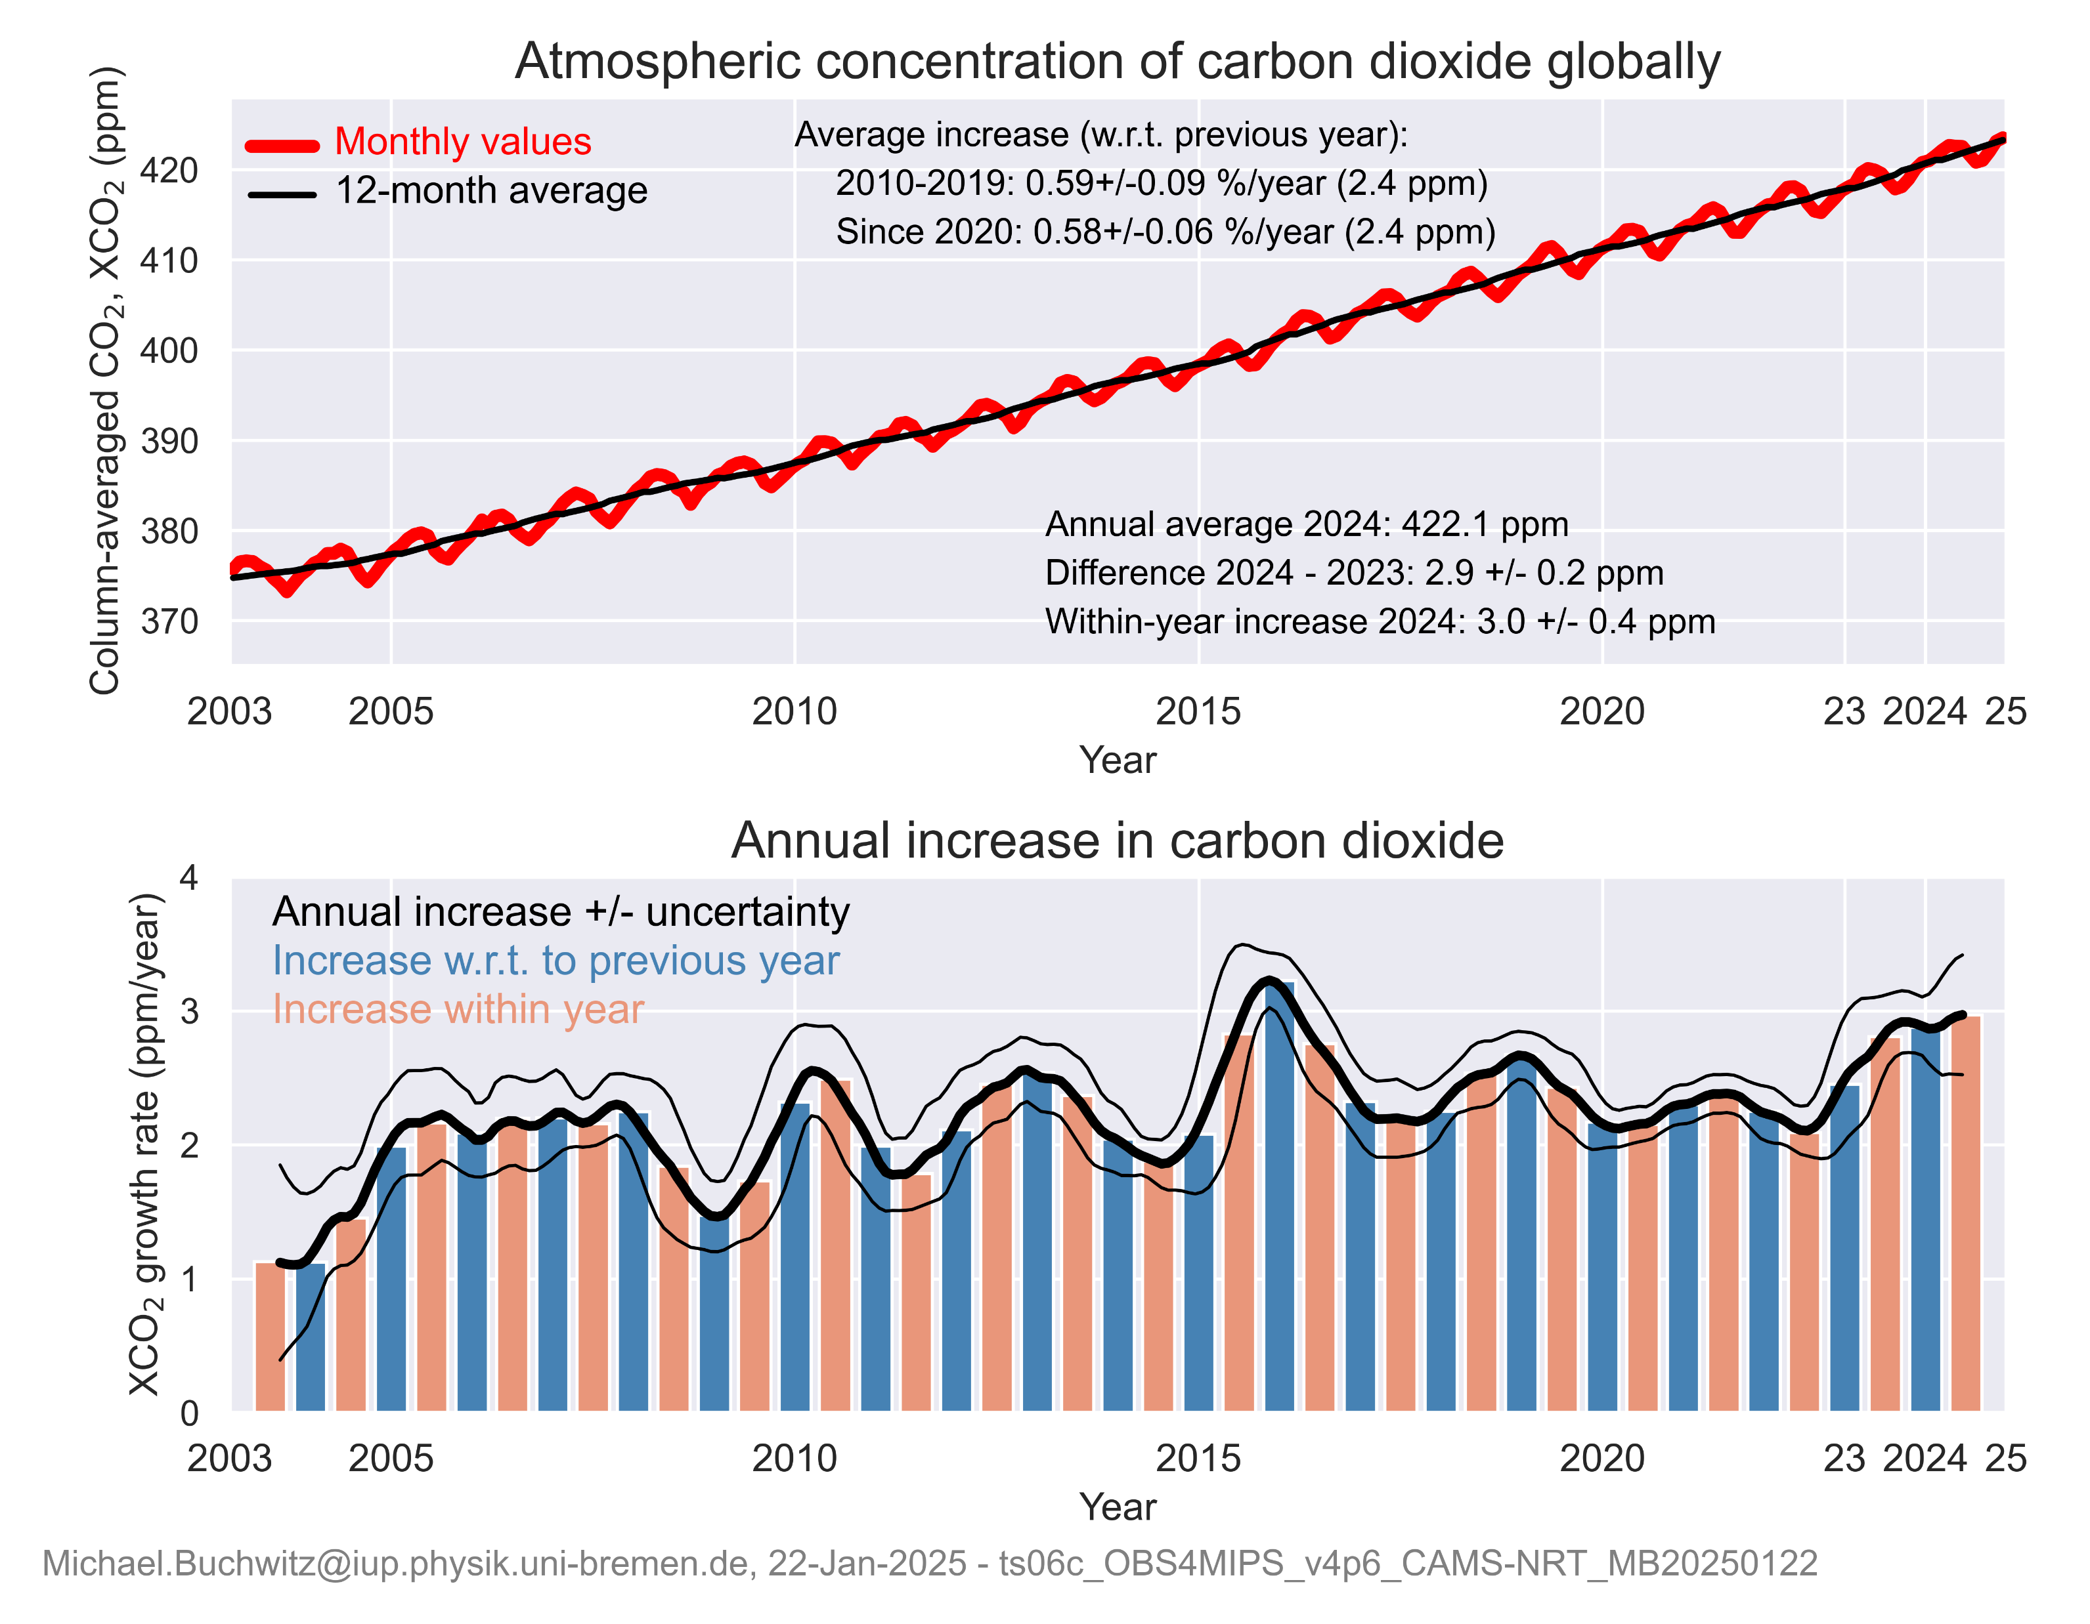
Satellite XCO2 retrievals …
CCI Integration Meeting, ECMWF, 14-16 March 2011
SCIAMACHY
GOSAT
OCO-2
XCO2 growth rate very high in 2024: ~ 3 ppm !
GOSAT-2
See also: https://climate.copernicus.eu/esotc/2024/trends-climate-indicators

Slide 6
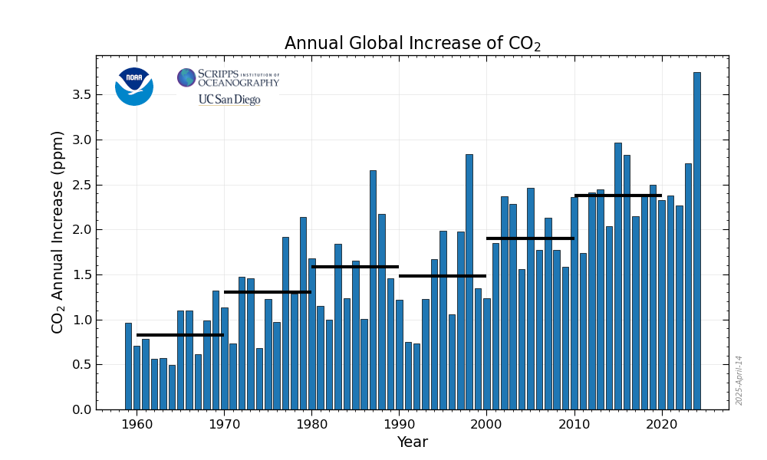
XCO2 and surface CO2 growth rates …
CO2 surface data:
3.75 ppm (global)
3.33 ppm (Mauna Loa)
CCI Integration Meeting, ECMWF, 14-16 March 2011
XCO2 growth rate very high in 2024: ~ 3 ppm !
See also: https://climate.copernicus.eu/esotc/2024/trends-climate-indicators

Slide 7
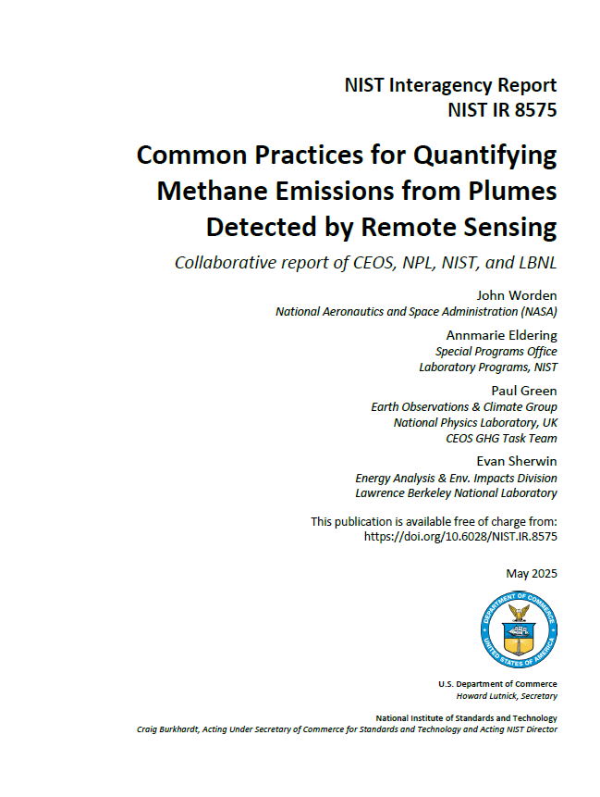
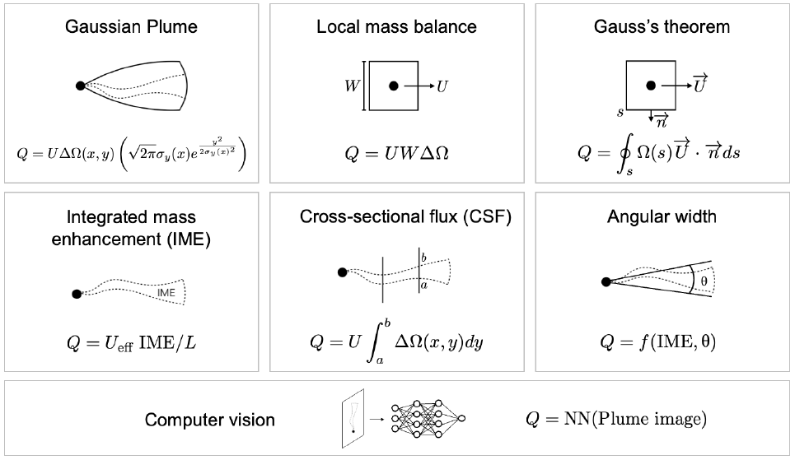
Emission estim. algos for localized sources
https://doi.org/10.6028/NIST.IR.8575
Integration of column enhancements times wind speed along transects perpendicular to wind / plume direction
Δy
Q[t/h] = ΔΩ[t/km²] * Δy[km] * U[km/h]
Emission ~ Column enhancement * Wind speed
ΔΩ
U

Slide 8
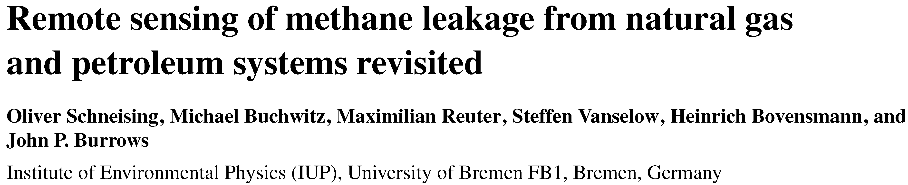
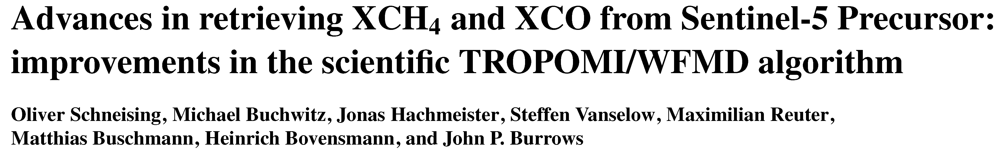
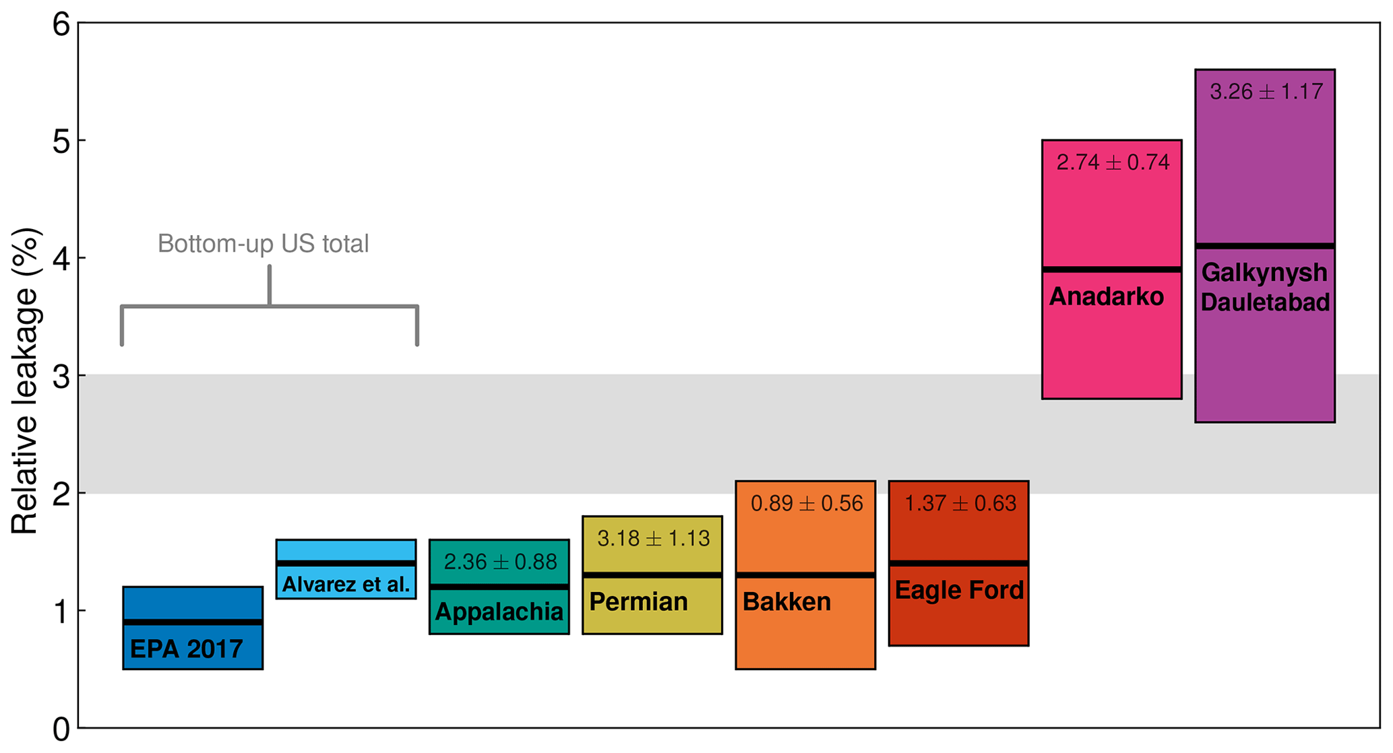
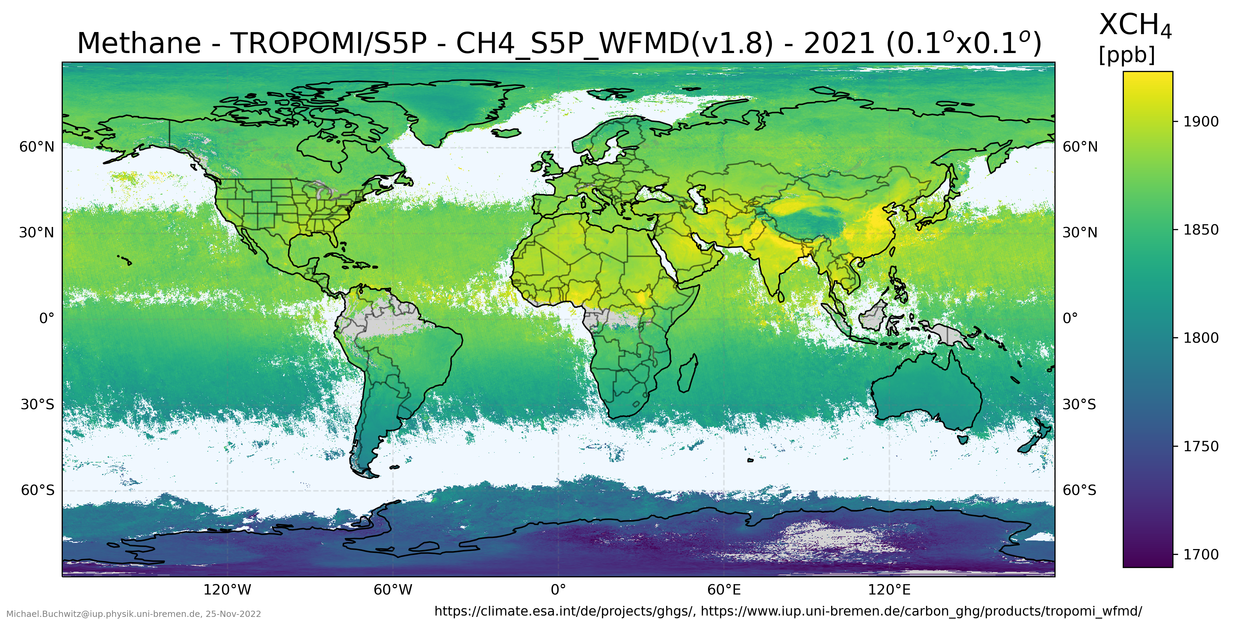
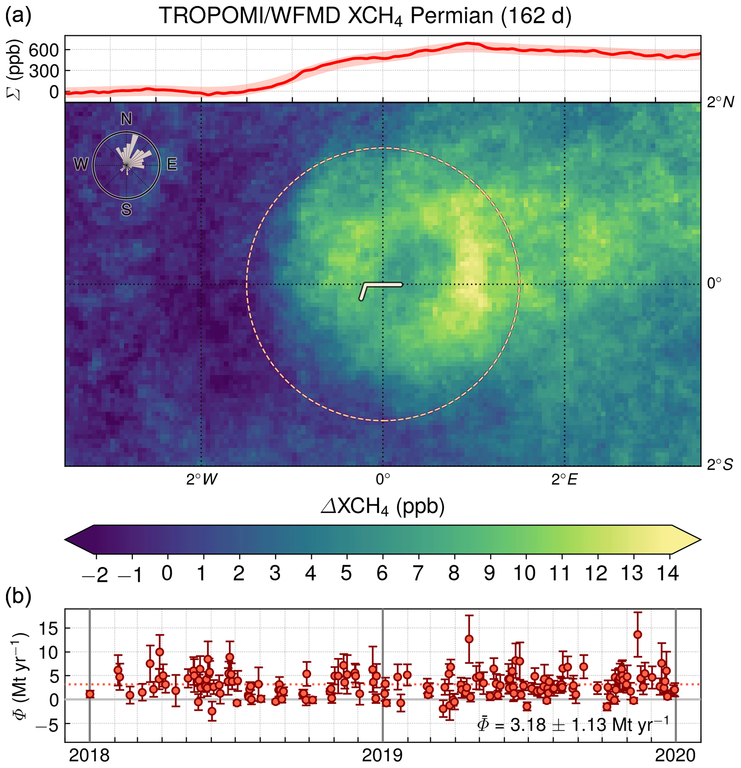
TROPOMI/S5P XCH₄ & methane emissions
Schneising et al., ACP, 2020
Schneising et al., AMT, 2023
Emissions & relative leakage from oil & gas fields
Emission estimates via Cross-Sectional-Flux (CSF) method
for 2018-2019
wind
Available from:
https://www.iup.uni-bremen.de/carbon_ghg/products/tropomi_wfmd/
https://climate.esa.int/en/projects/ghgs/
https://catalogue.ceda.ac.uk/

Slide 9
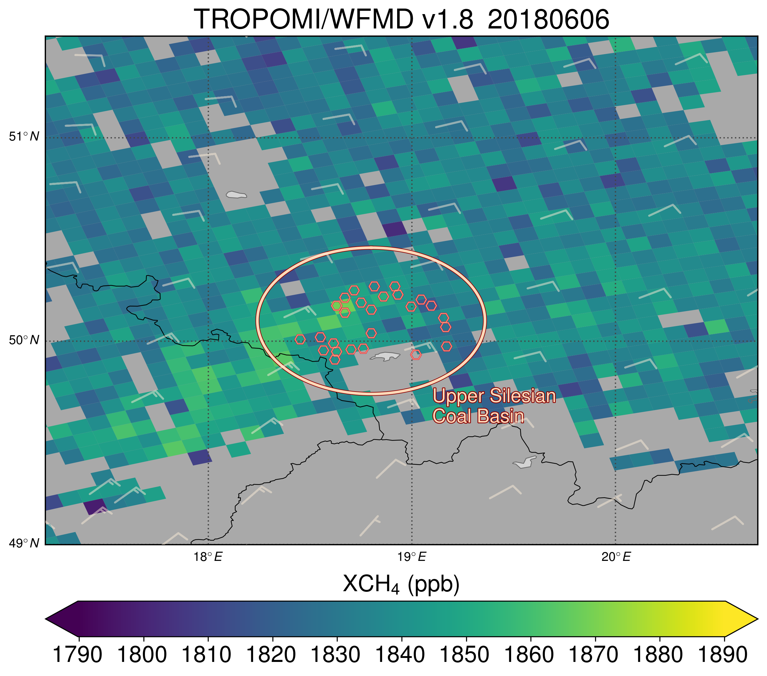
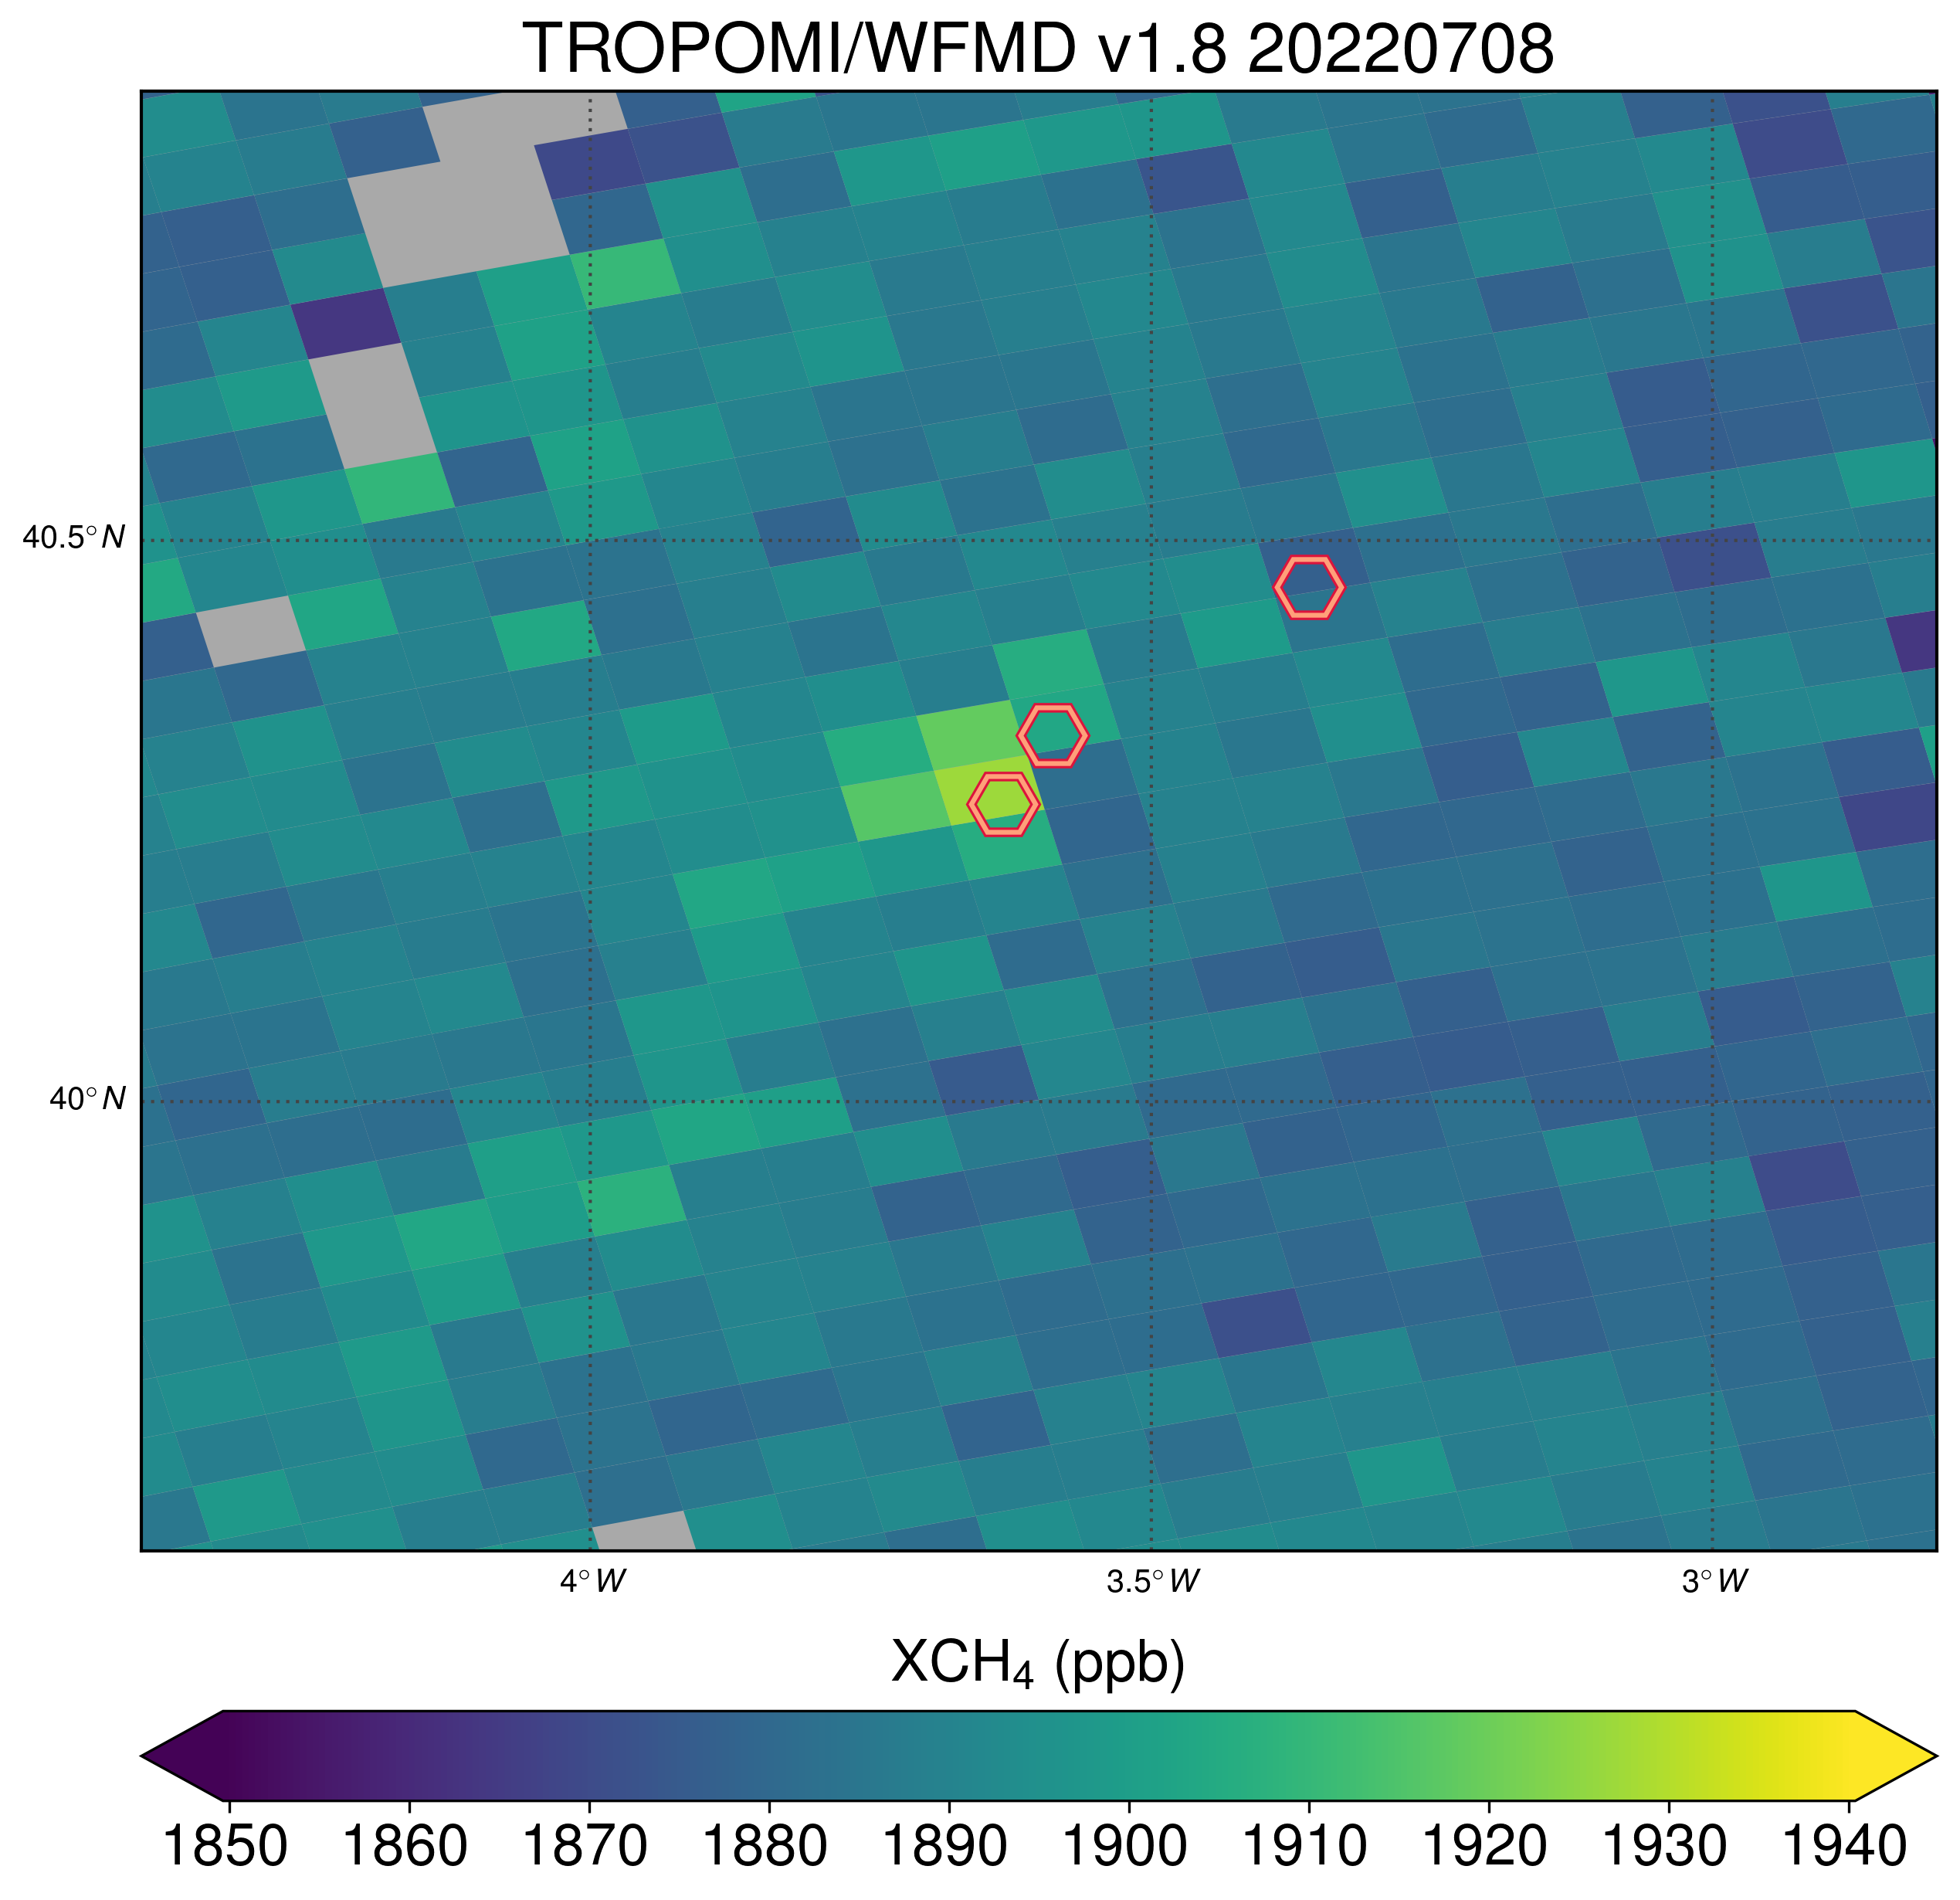
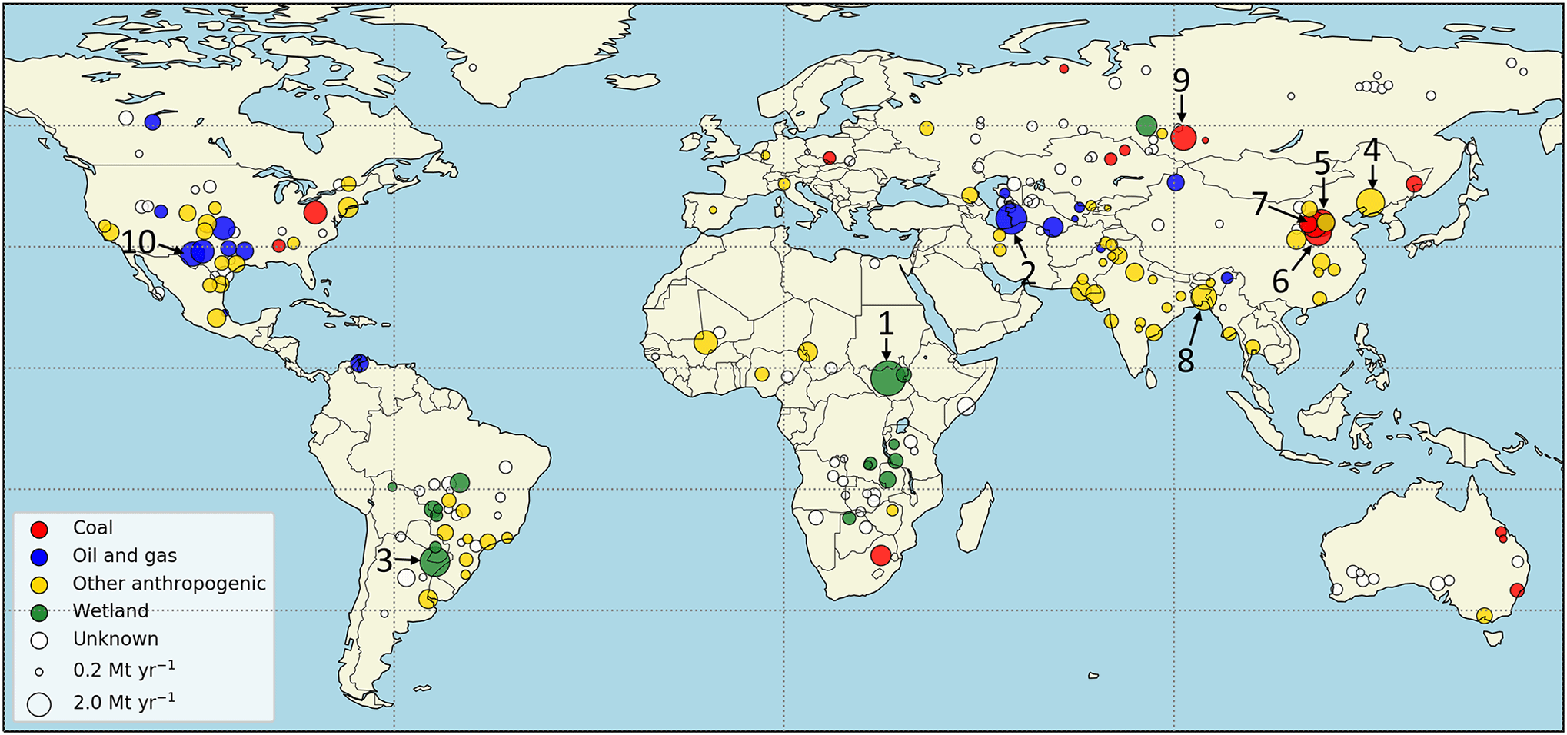
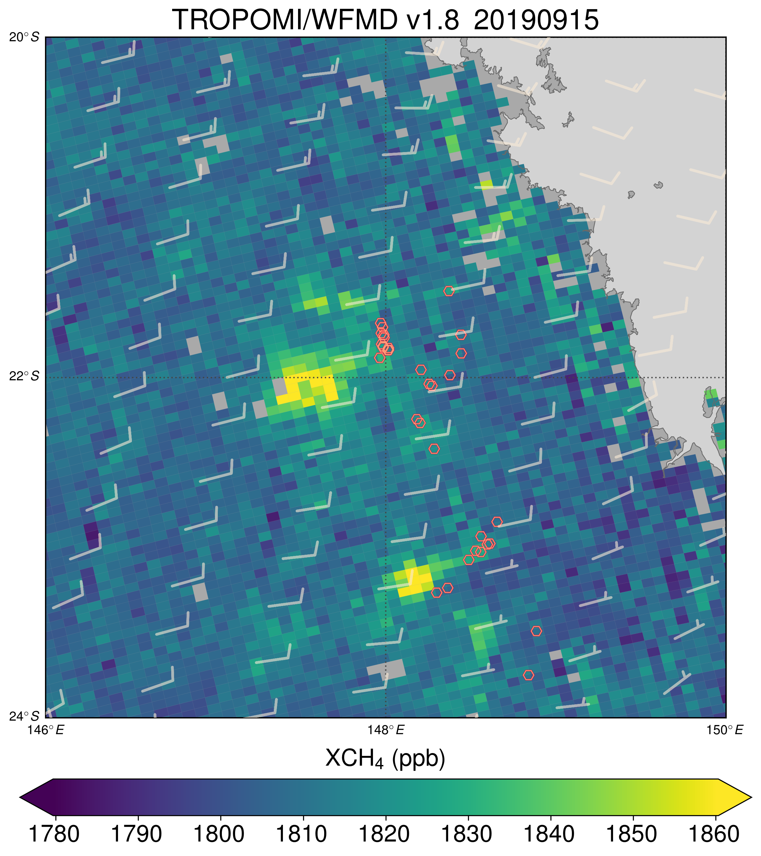
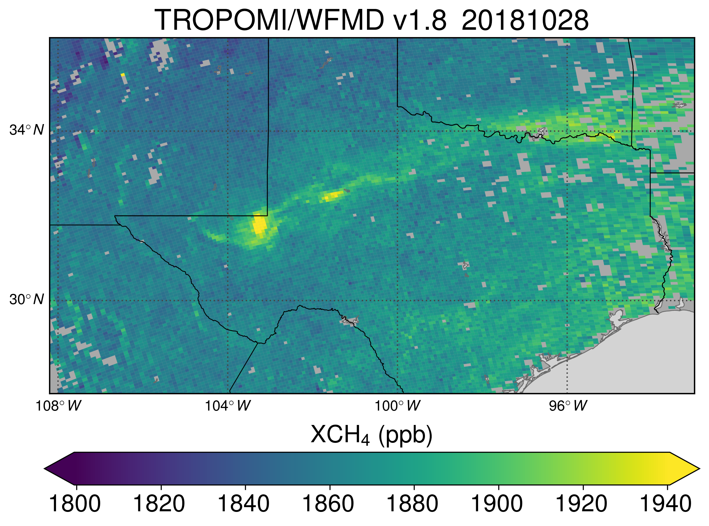
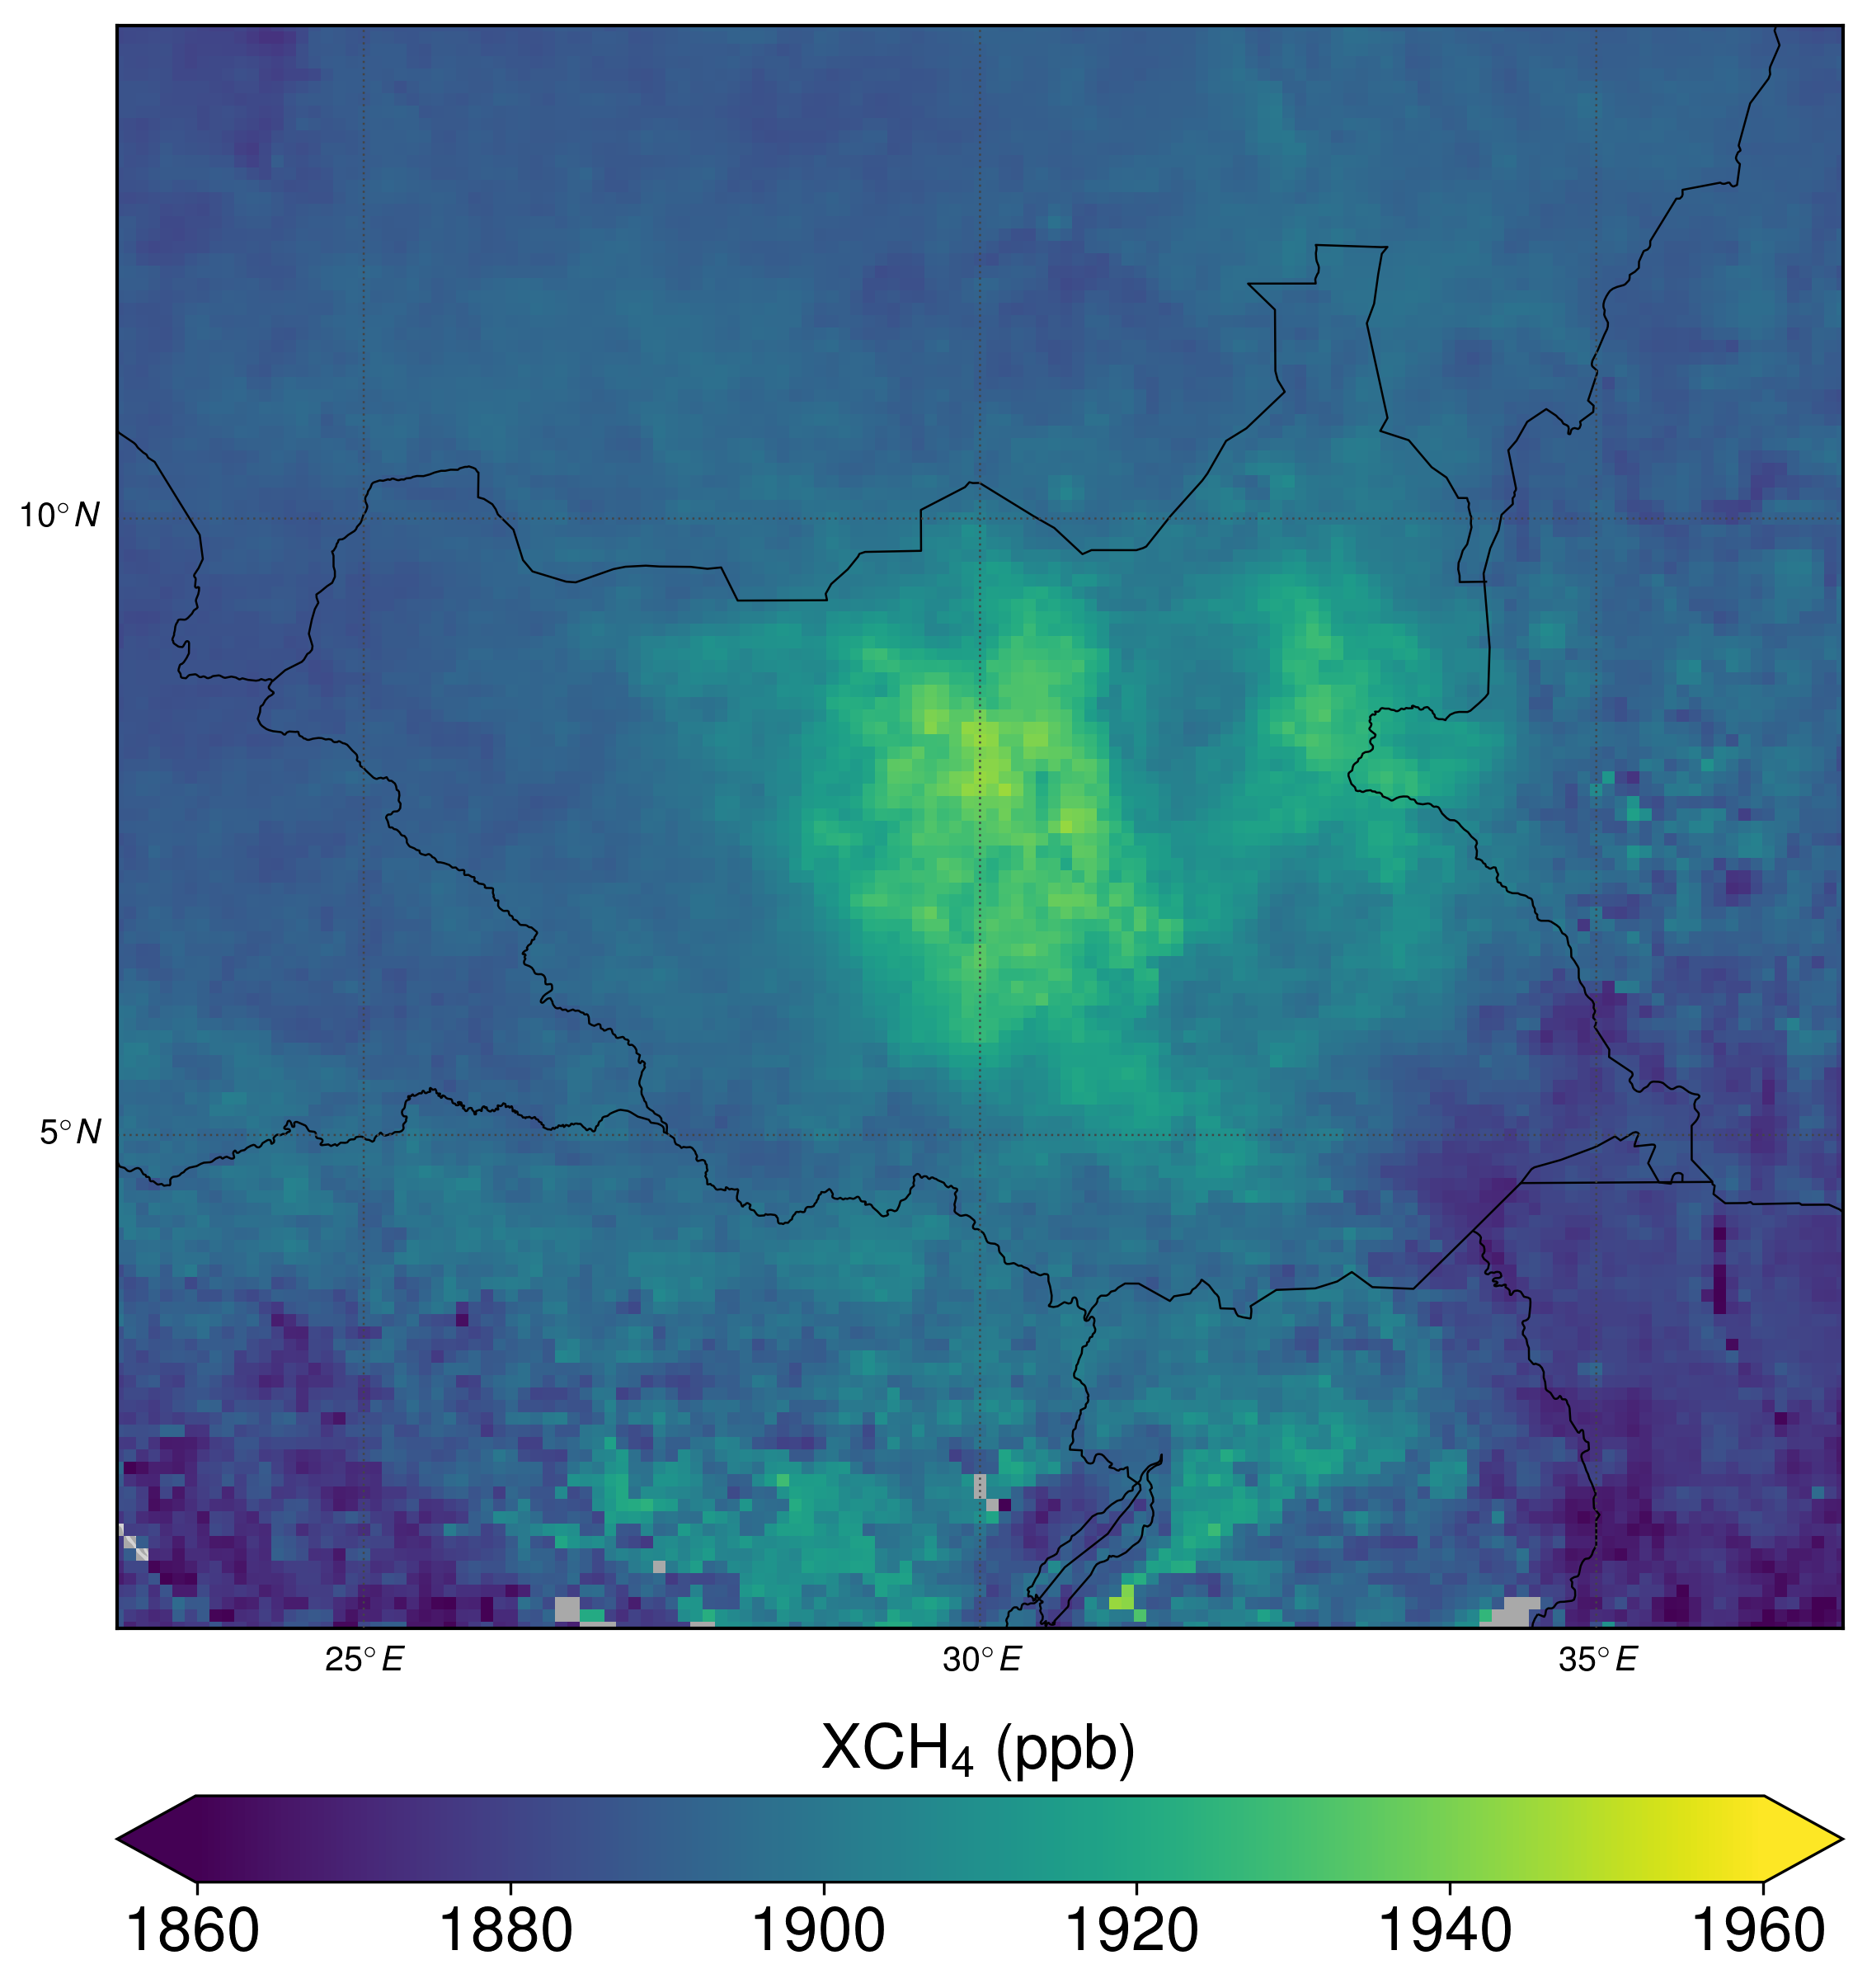
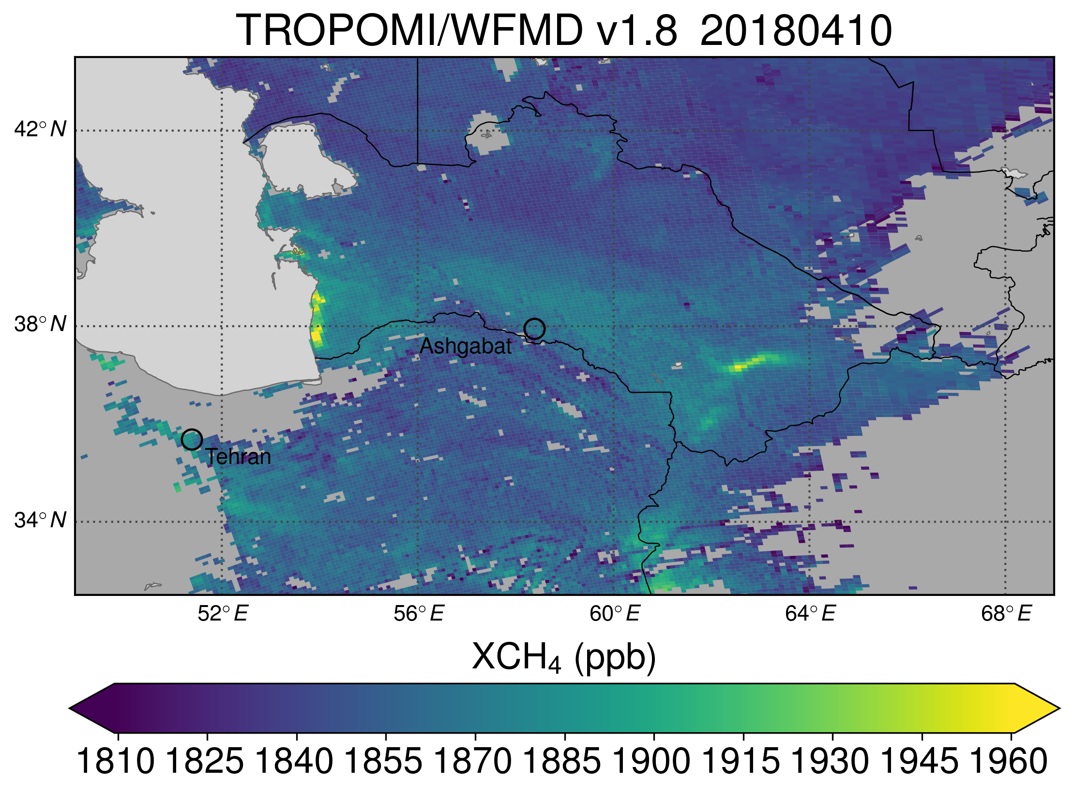
Potential persistent emission hotspots
Emission estimates based on TROPOMI/S5P WFMD v1.8 XCH4 retrievals & mass balance method:
USCB
Coal
Madrid
Landfills
Automated persistent hotspot detection, quantification, and source type assignment based on monthly data
Vanselow et al., ACP, 2024
Queensland
Coal
Permian
Oil and gas
www.esa.int
South Sudan
Wetland
Turkmenistan
Oil and gas
217 Potential Persistent Source Regions (PPSRs) detected (2018 - 2021)

Slide 10
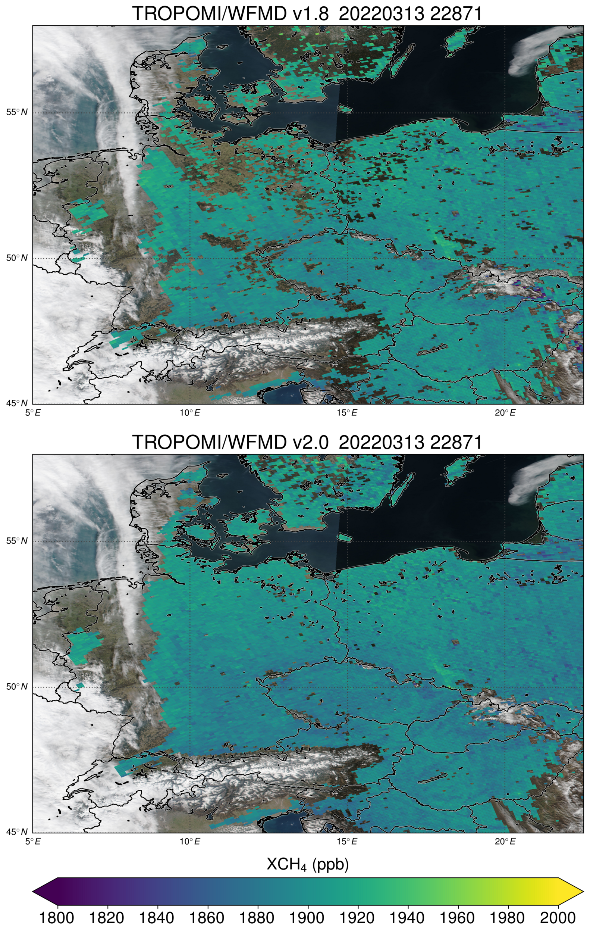
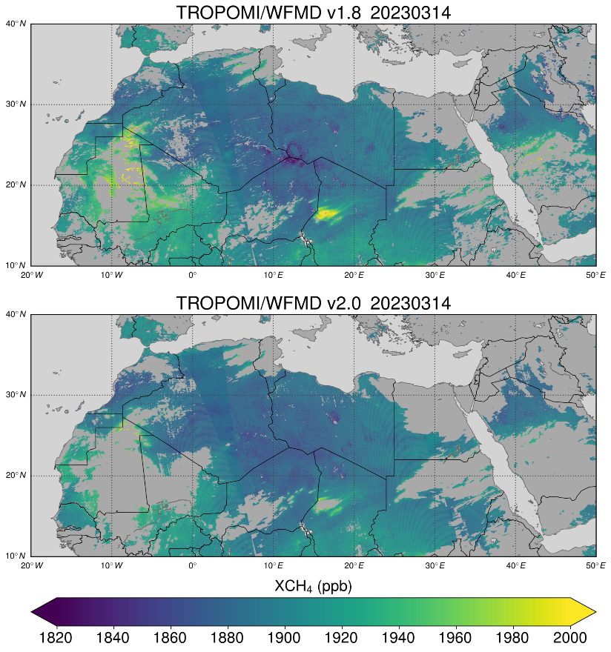
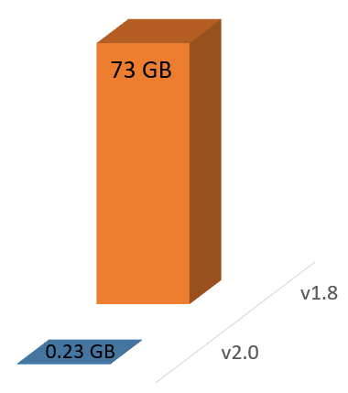
TROPOMI/S5P XCH₄ WFMD v2.0
New
v2.0
v1.8
v1.8
Bodélé Depression (Chad)
Challenging retrieval conditions (surface + dust storms)
v2.0
Filesize:
Random Forest
XGBoost
v2.0
TROPOMI/WFMD v2.0
Better resource efficiency due to reduced memory consumption of machine learning quality filter
Improved accuracy and precision according to validation with TCCON
More rigorous filtering of specific aerosol events over bright surfaces
Otherwise, higher data yield, especially for mid and high latitudes
Available from: https://www.iup.uni-bremen.de/carbon_ghg/products/tropomi_wfmd/

Slide 11
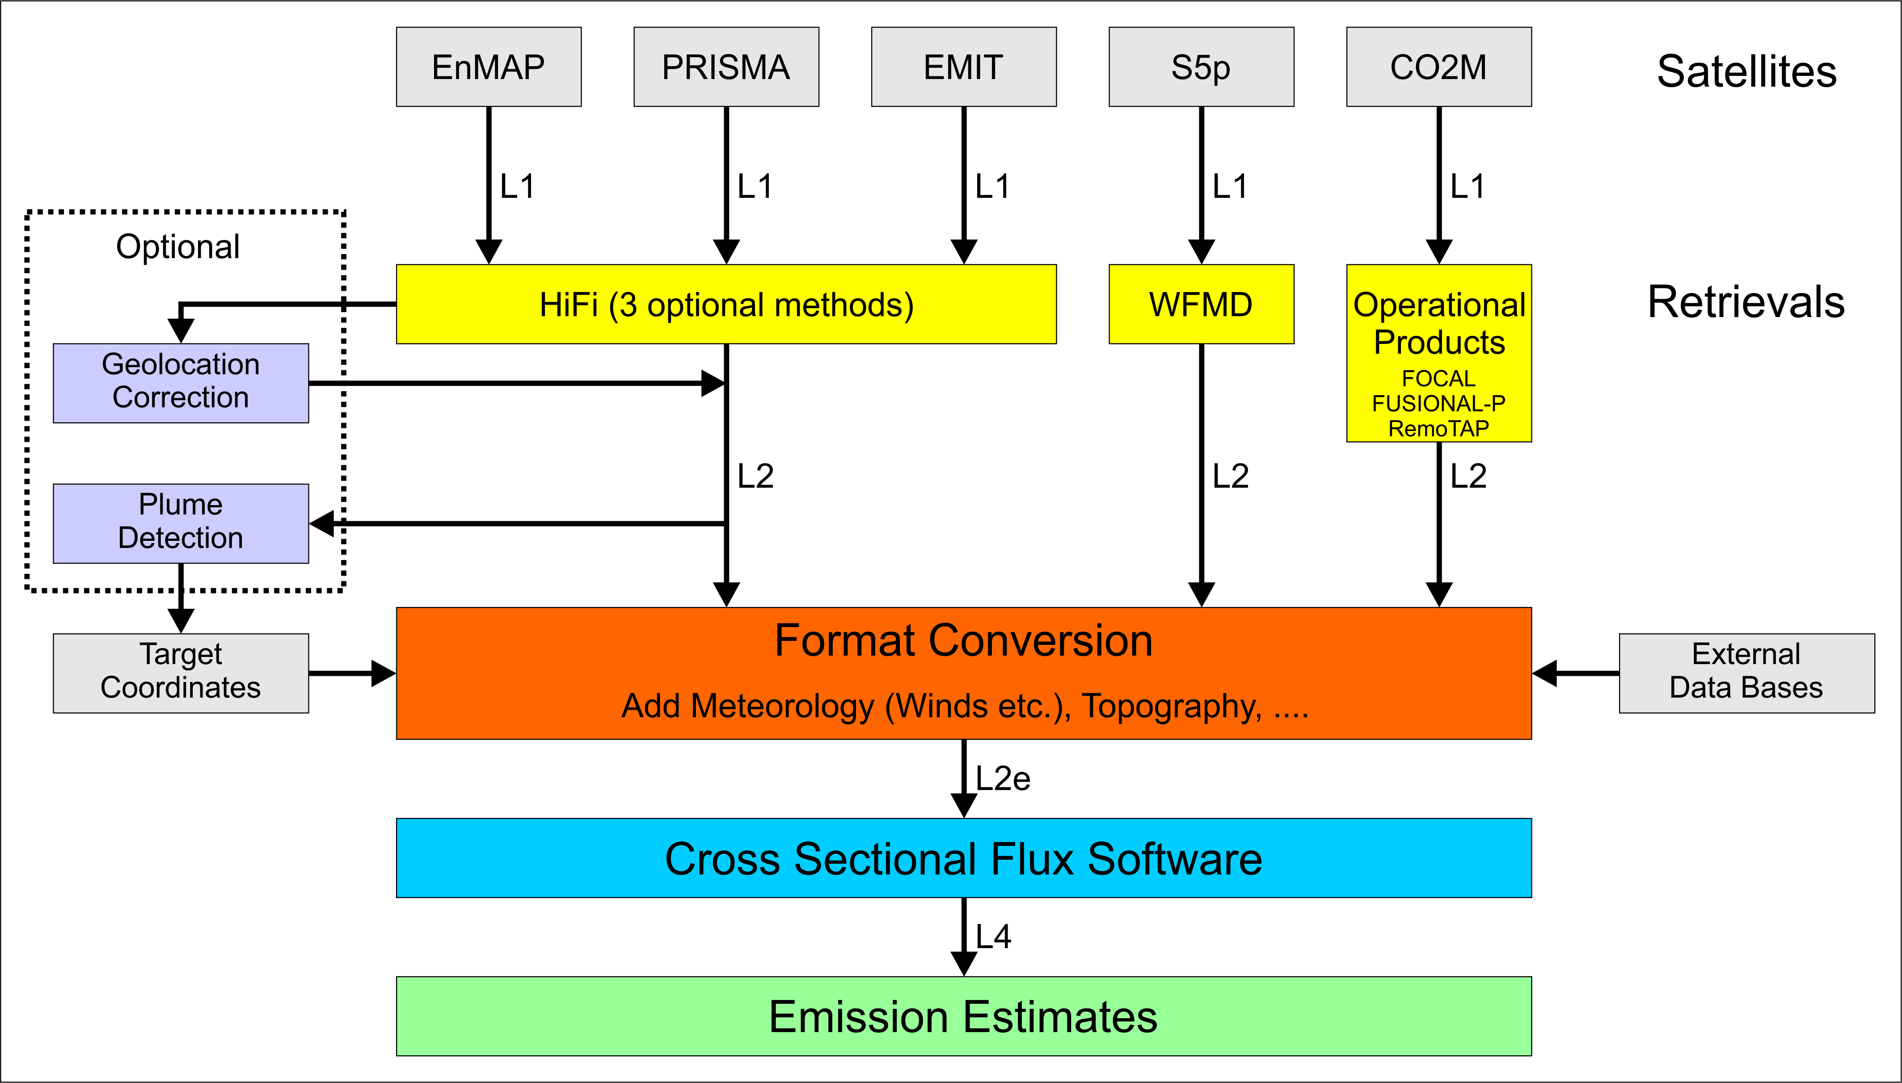
Emissions: Cross-Sectional-Flux (CSF) algo
Level 1 (L1)
L1 -> L2
(*)
(*) Current baseline: Matched Filter (MF)
Level 2 (L2)
L2 -> L2e
L2e -> L4
Level 4 (L4)

Slide 12
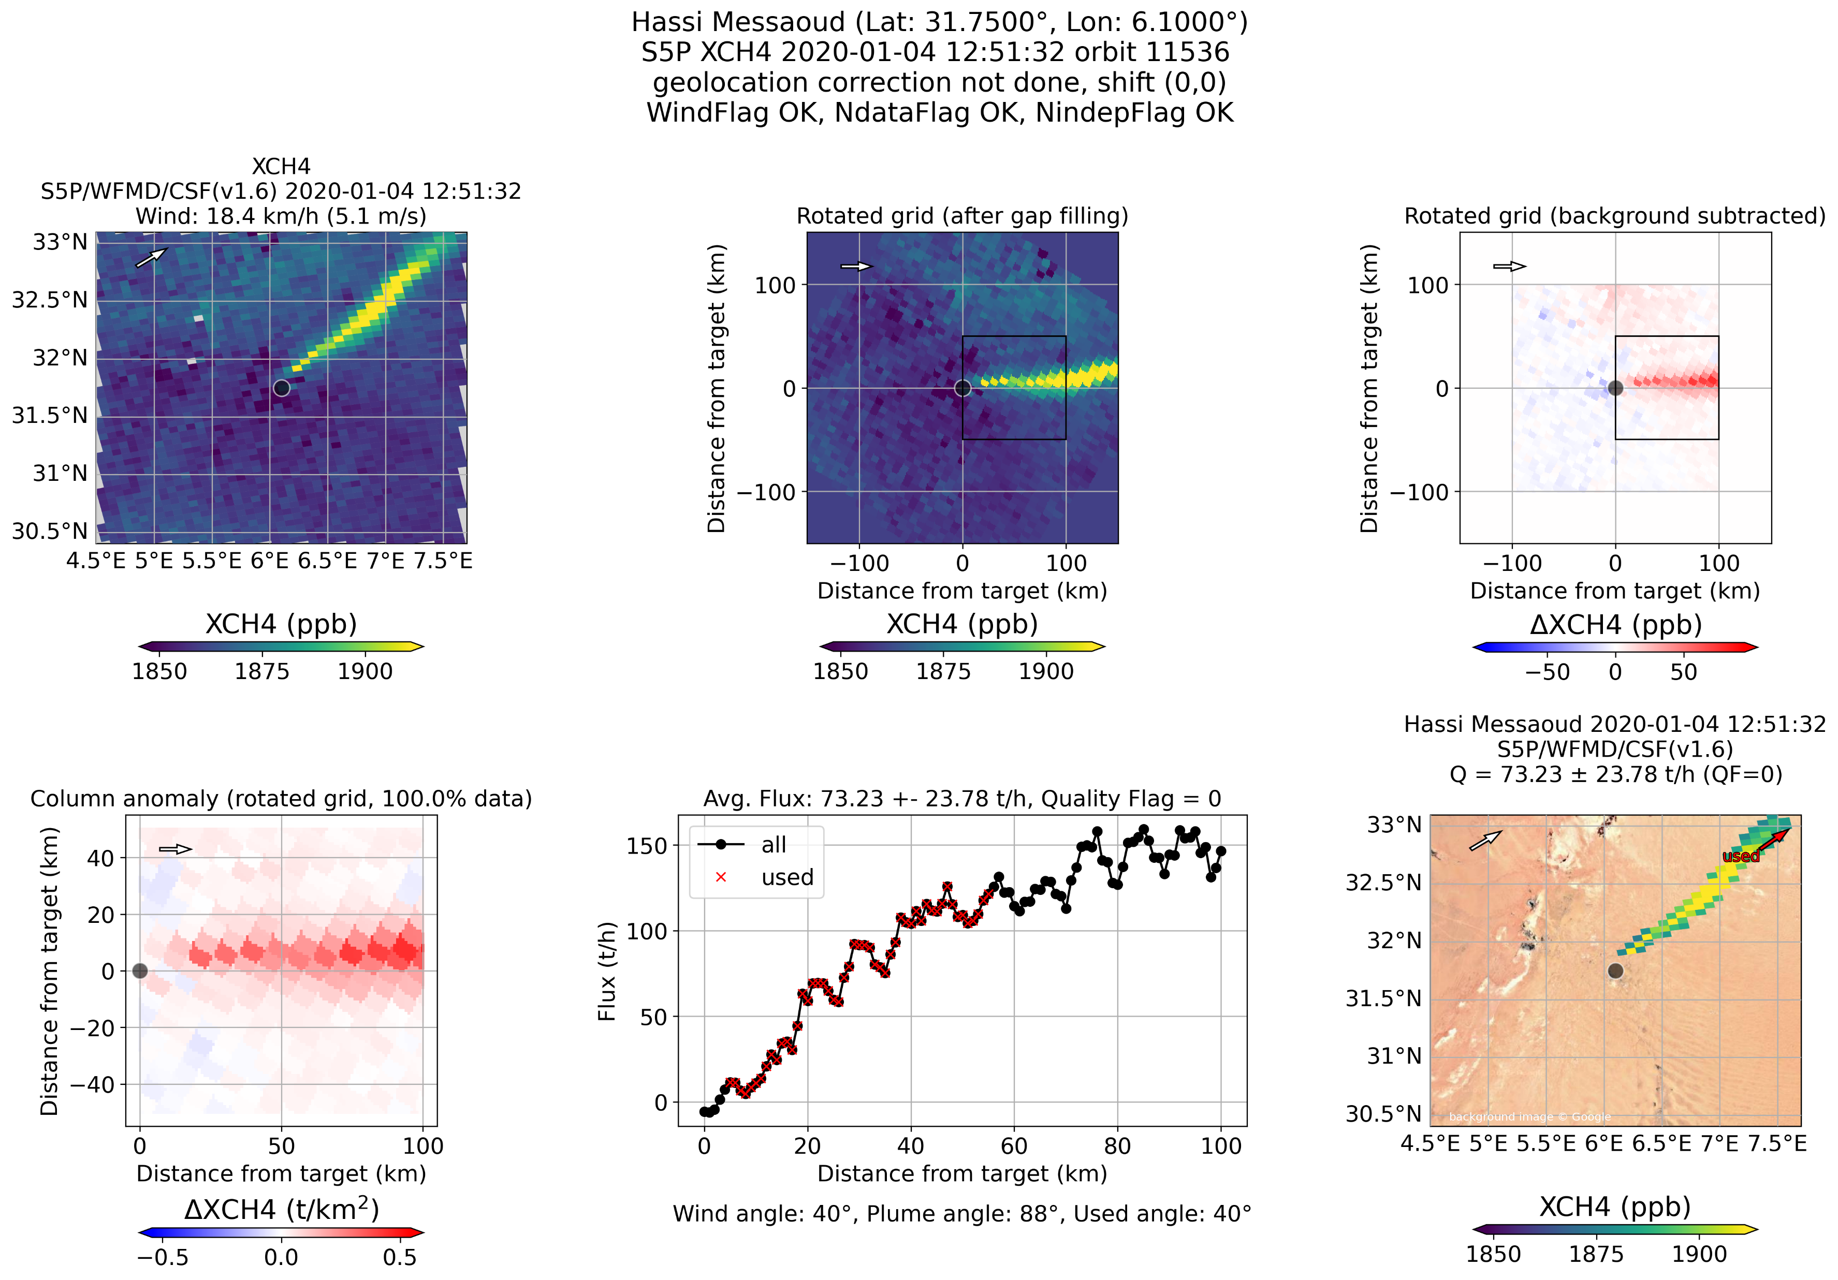
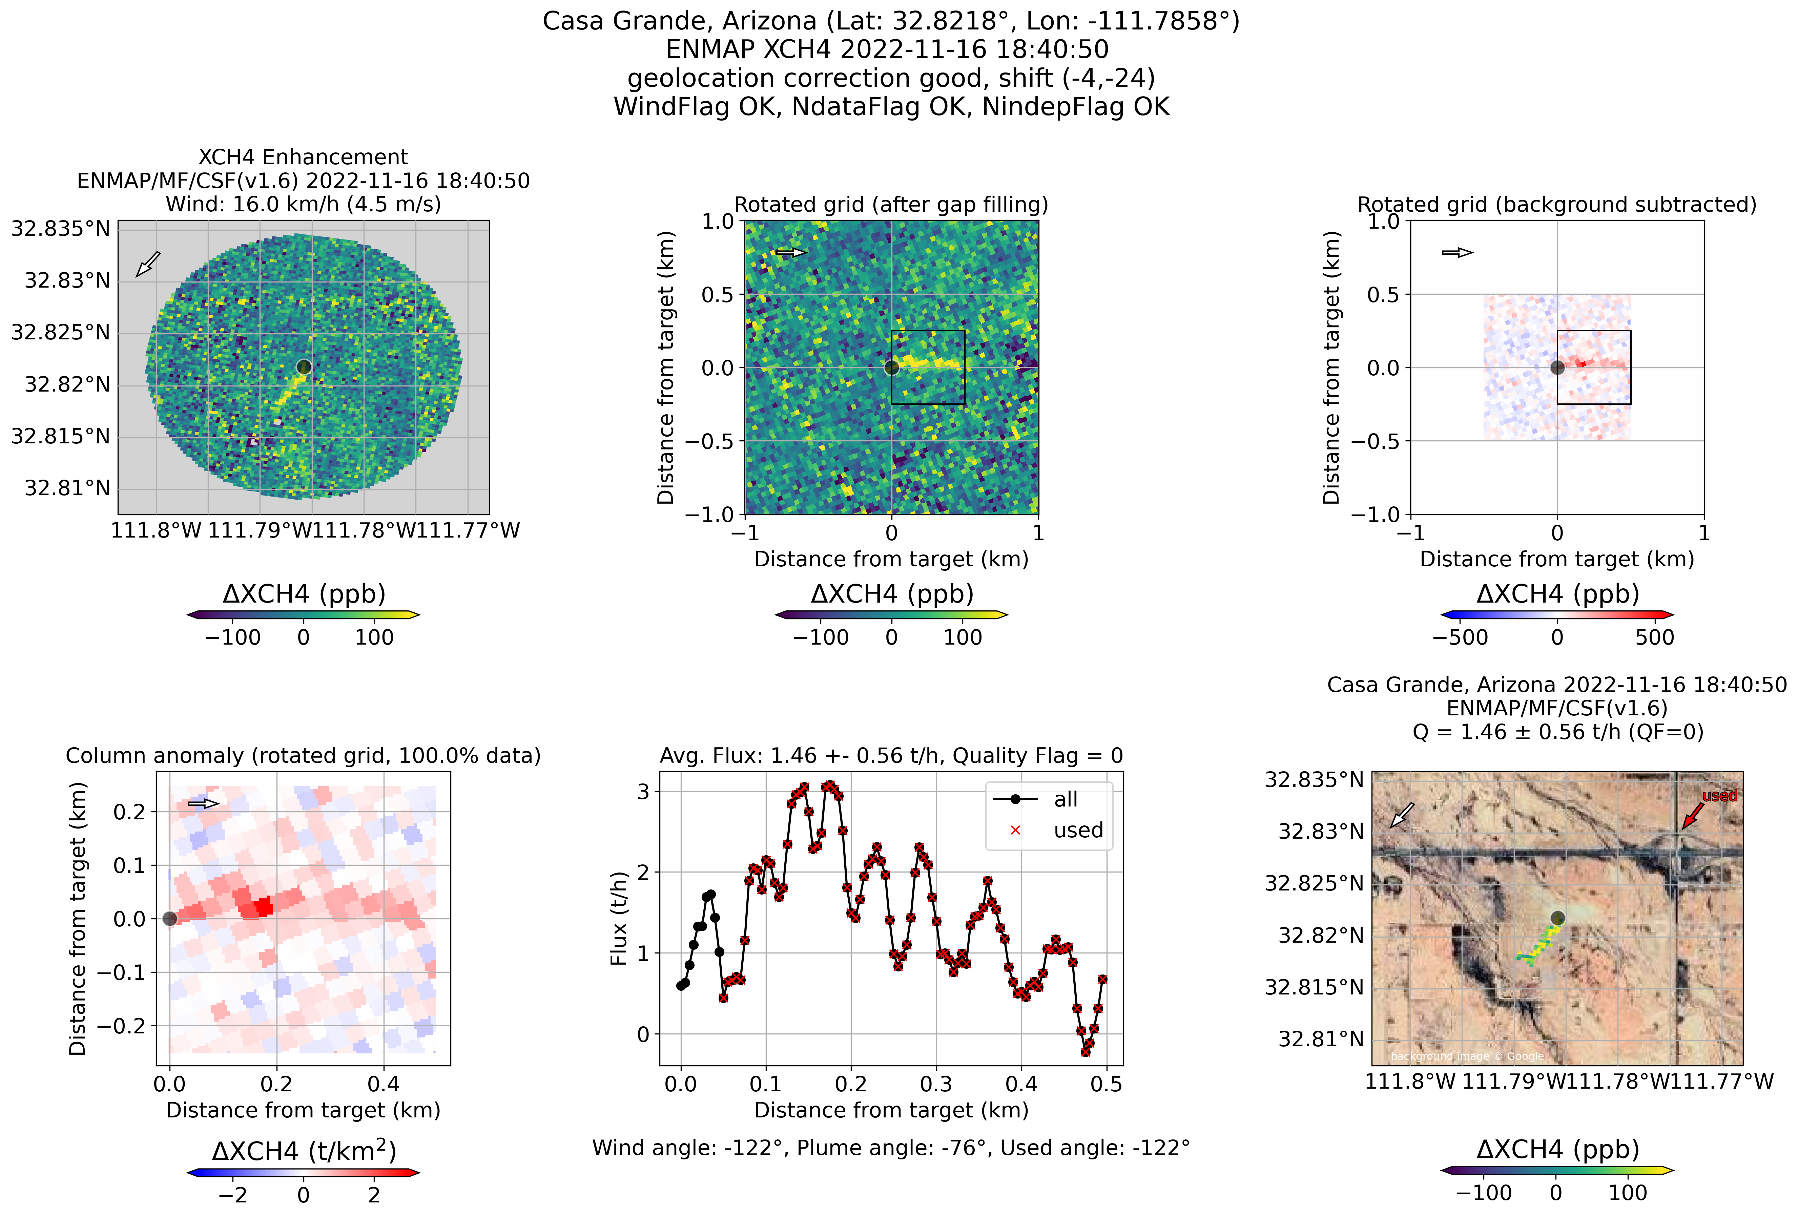
Methane emission estimates: CSF method
TROPOMI/S5P (CSF v1.6)
EnMAP (HiFi-MF & CSF v1.6)
Input: Level 2: XCH4 WFMD v1.8
Input: Level 1
73 +/- 24 t/h (Qual=OK)
1.5 +/- 0.6 t/h (Qual=OK)
3 hours after overpass
Box size (default): 100 x 100 km²
Wind: PBL average (ERA5)
Box size (default): 0.5 x 0.5 km²
Wind: 10 m (ERA5)
Released: 1.1 t/h
(Sherwin et al., 2022)
Uncertainty (1-sigma): Several terms added quadratically: (i) Stddev of emissions per cross-section,
(ii) wind (variability + 0.5 m/s), (iii) other (20%)
Quality flag: Qual=OK (QF=0) means:
Enough data in box (e.g., > 90% of area covered)
Wind not too low (wind speed > 1 m/s)

Slide 13
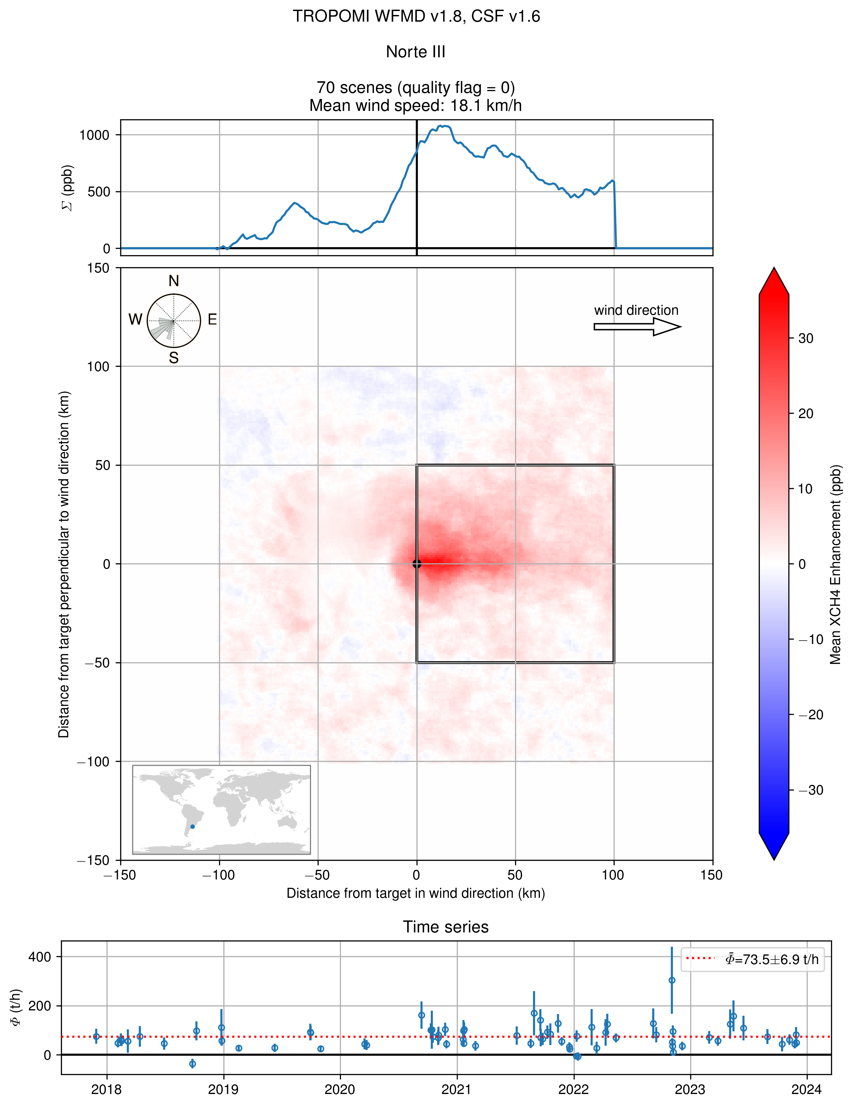
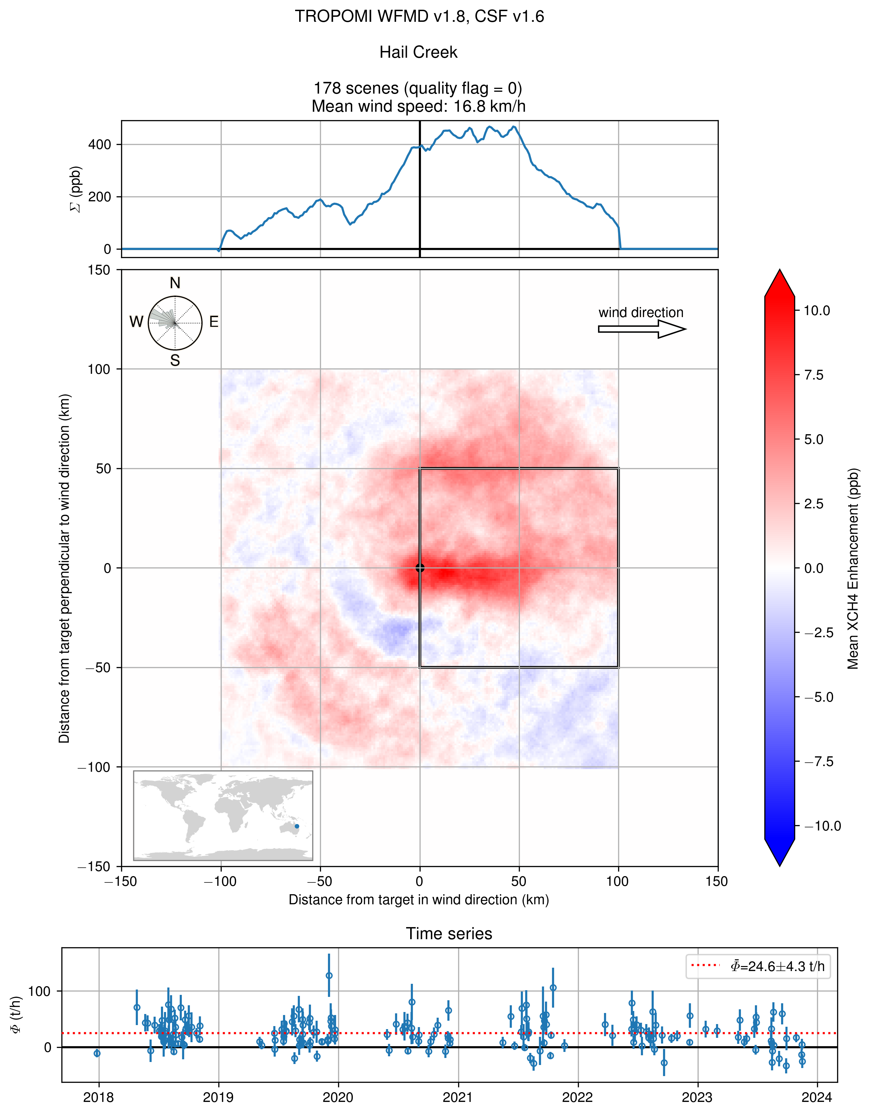
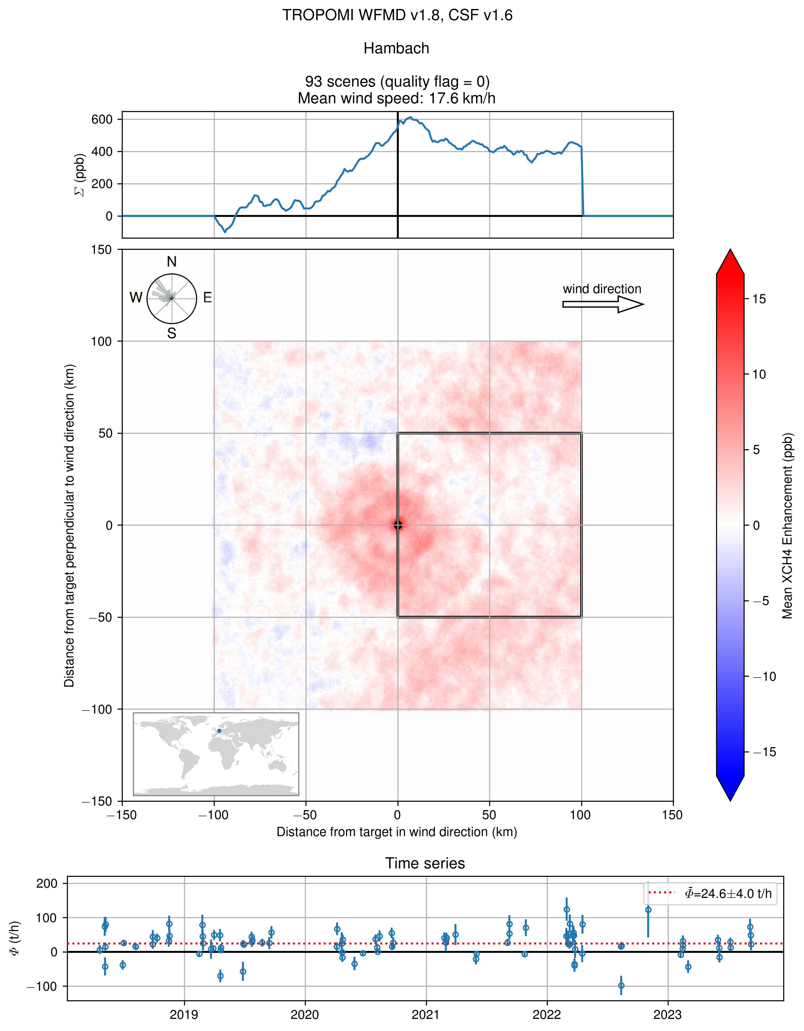
Methane: S5P/WFMD: ΔXCH4 rotat. & avg.
Norte III landfill
Buenos Aires, Argentina
Open coal mine
around Hail Creek, Australia
Open coal mine
around Hambach, Germany
Clear average plume
indicating strong isolated source
Average plume but also strong near-by sources
No average plume but local enhancement (challenging conditions)
(->talk Julia Marshall)

Slide 14
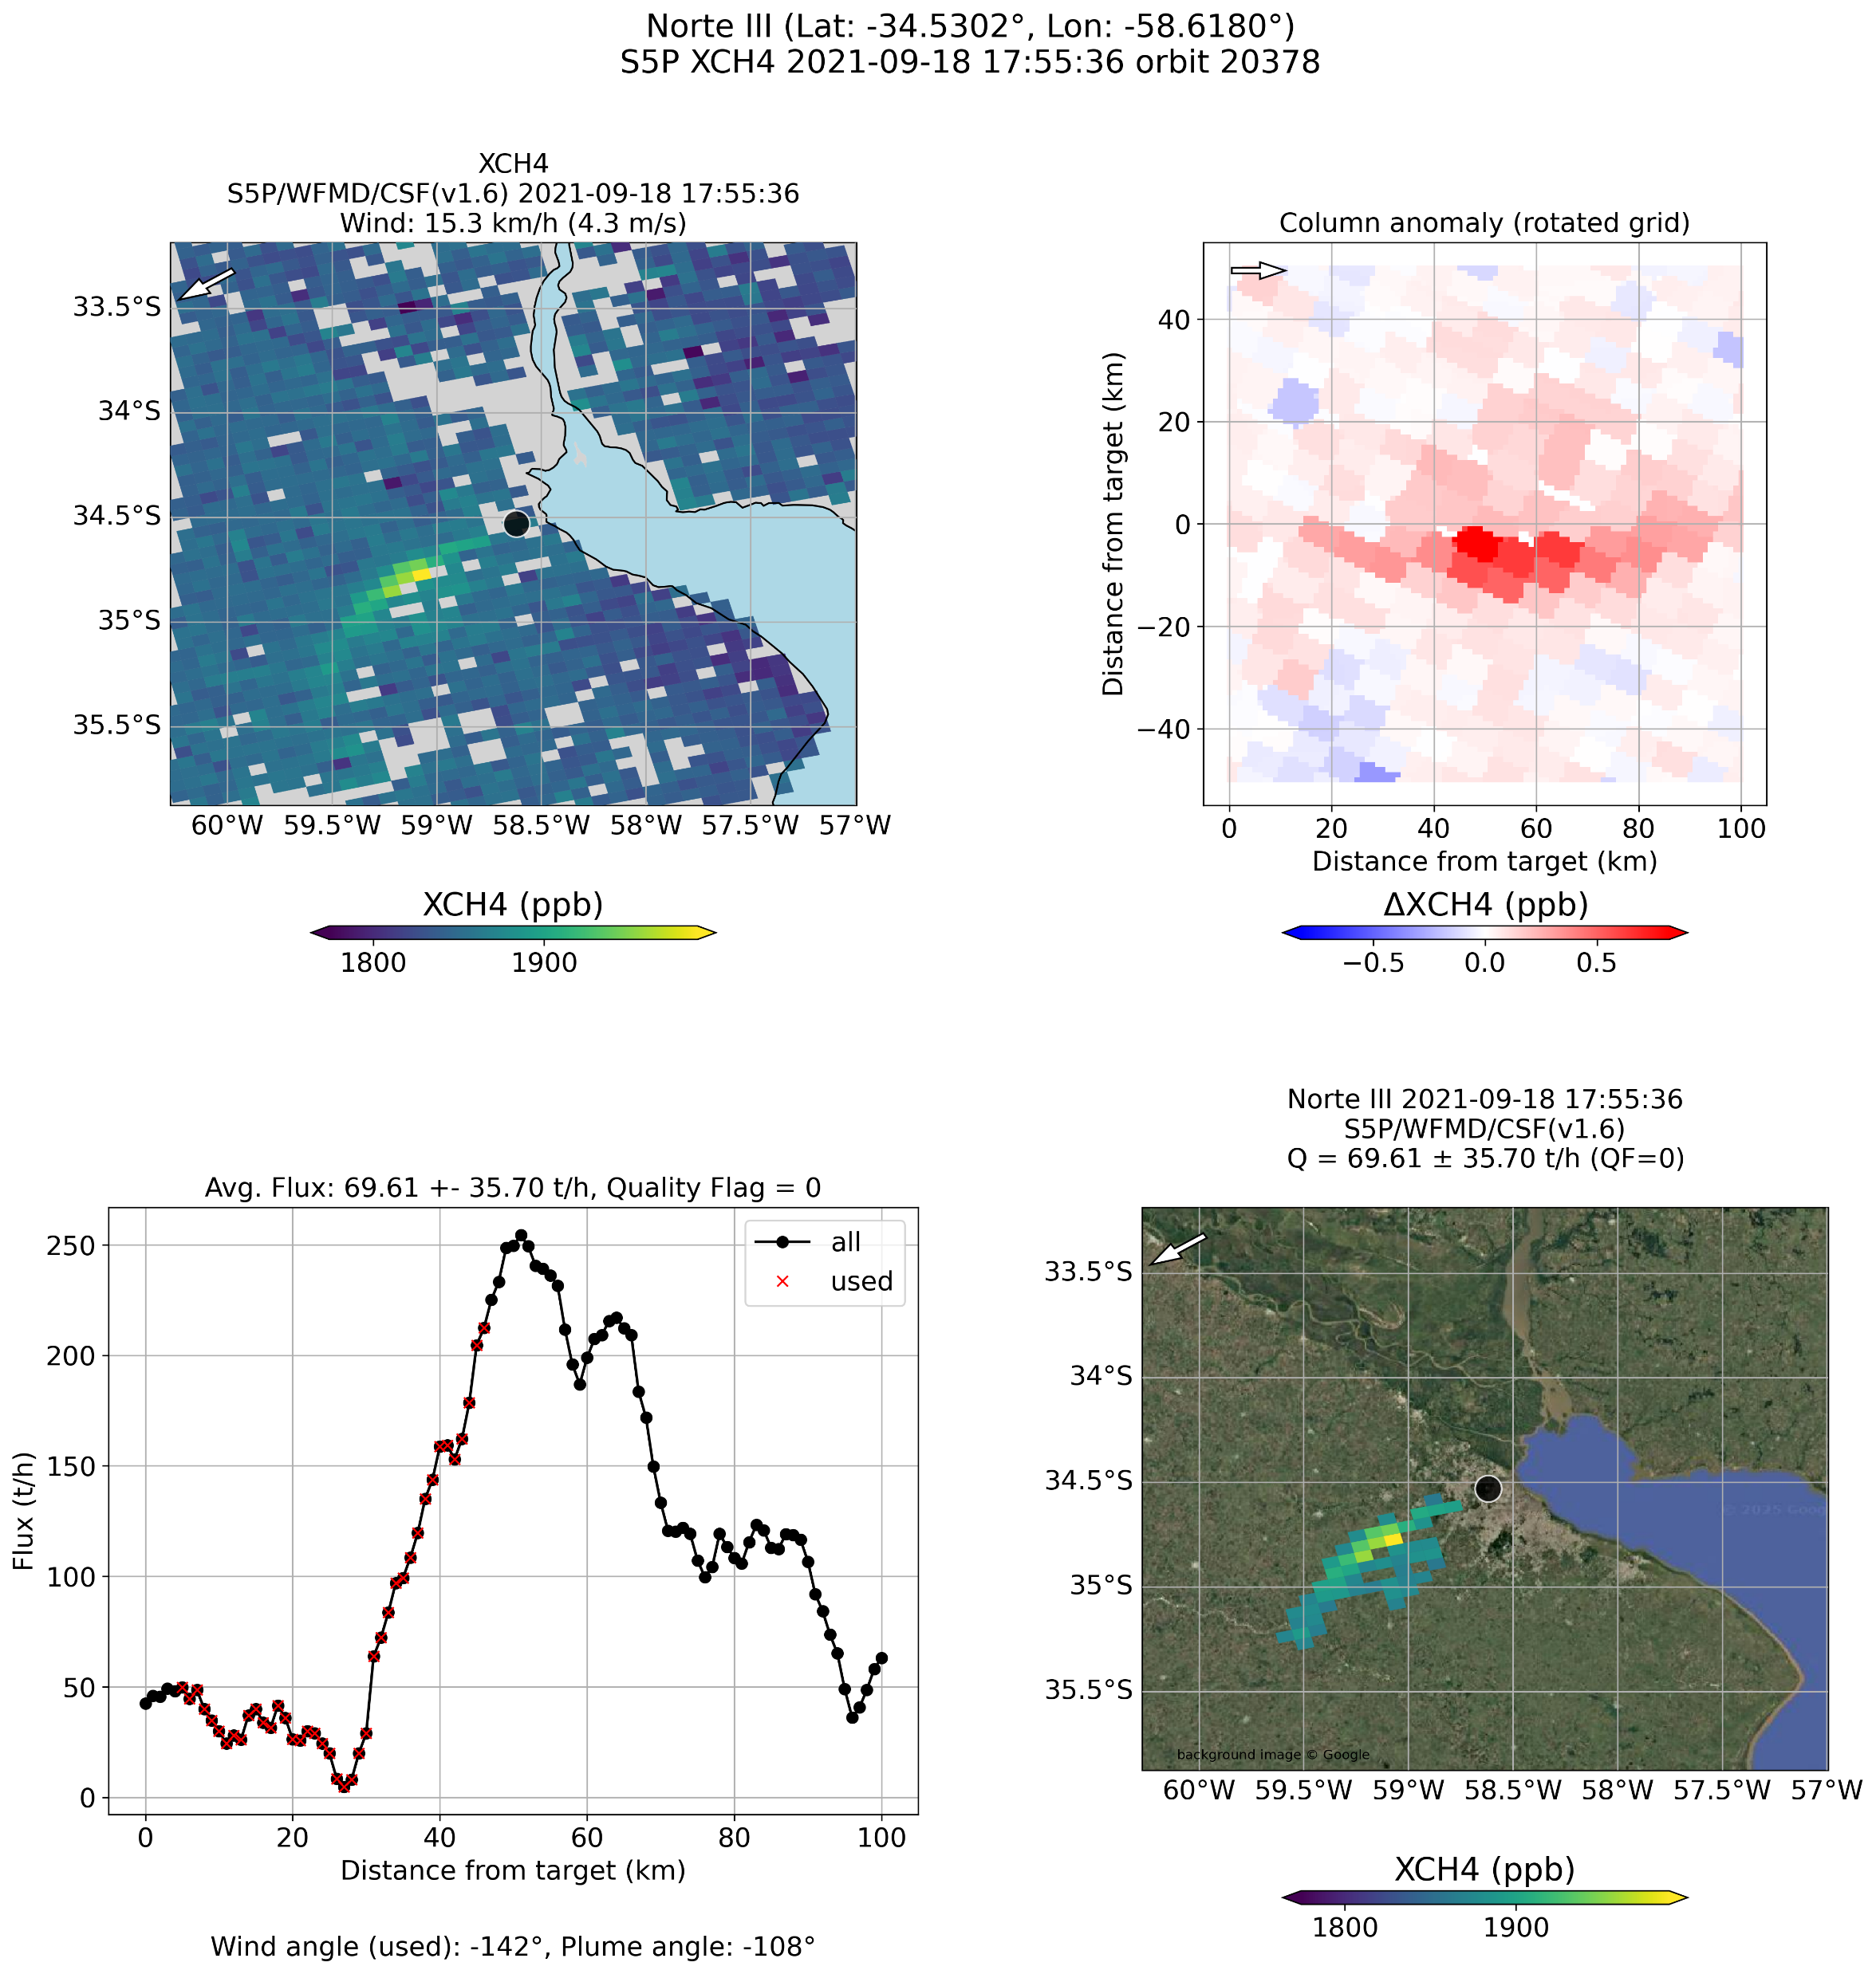
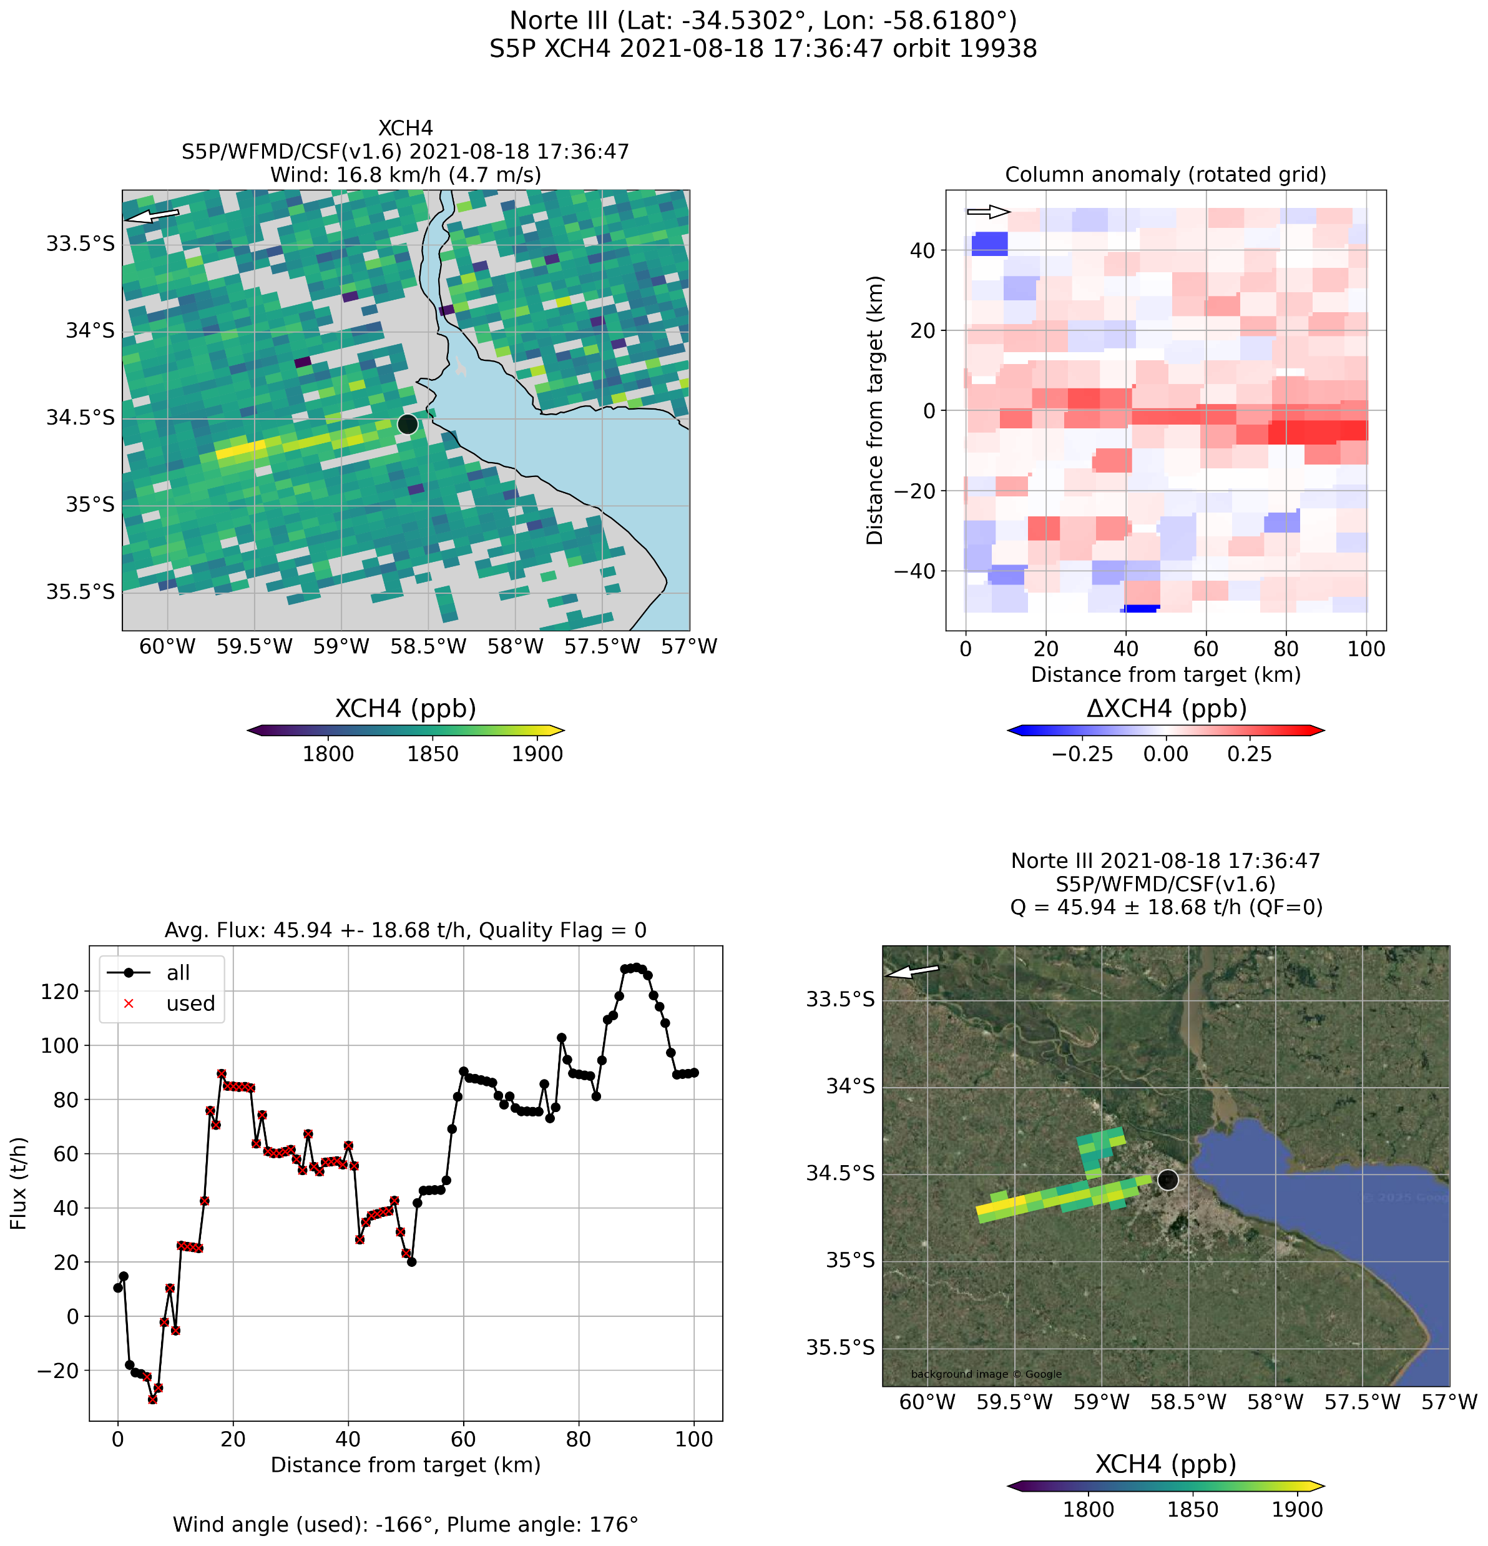
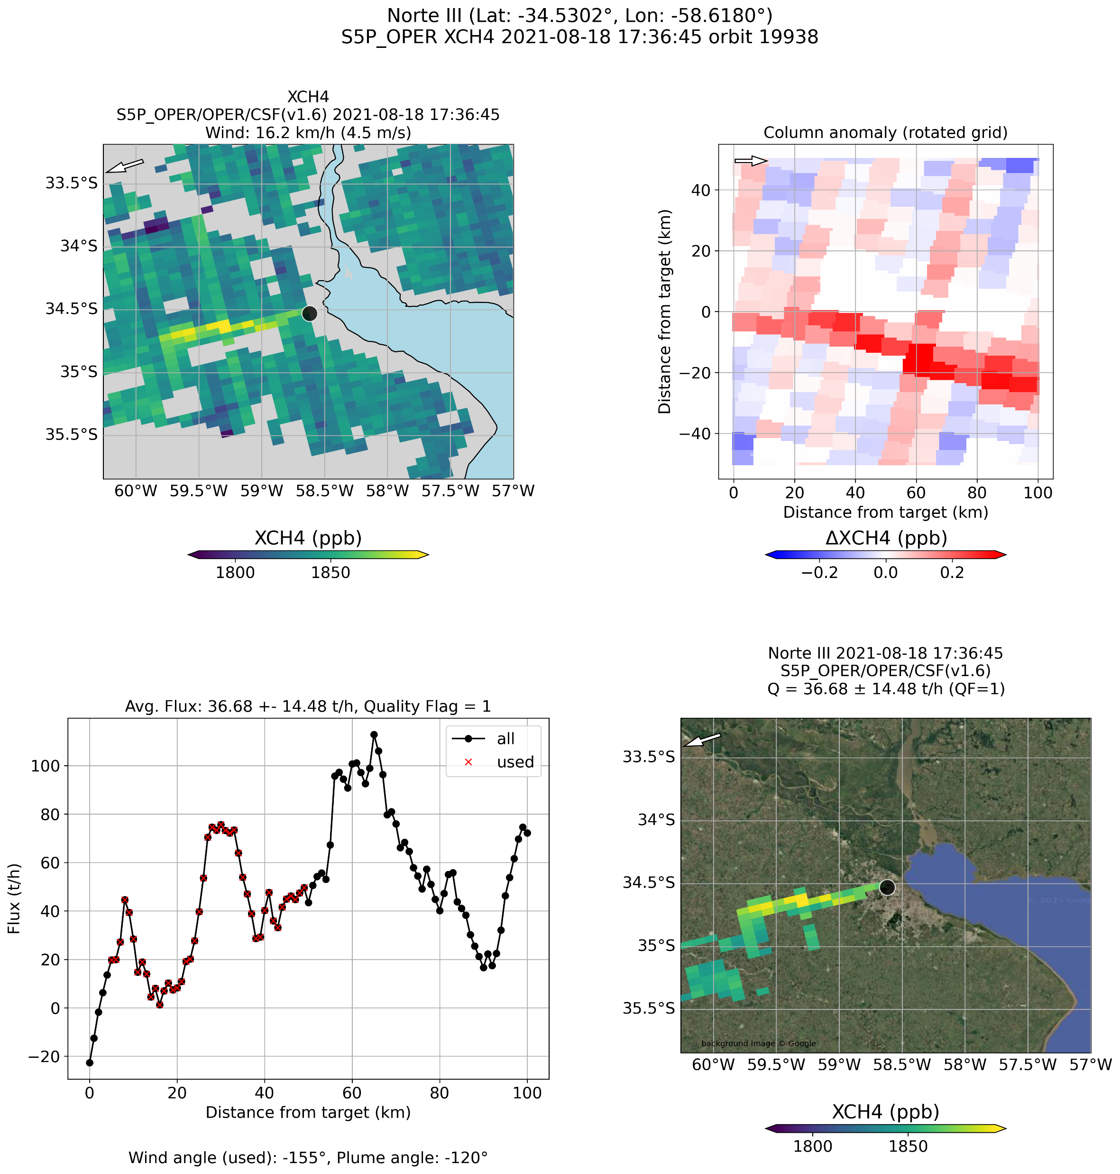
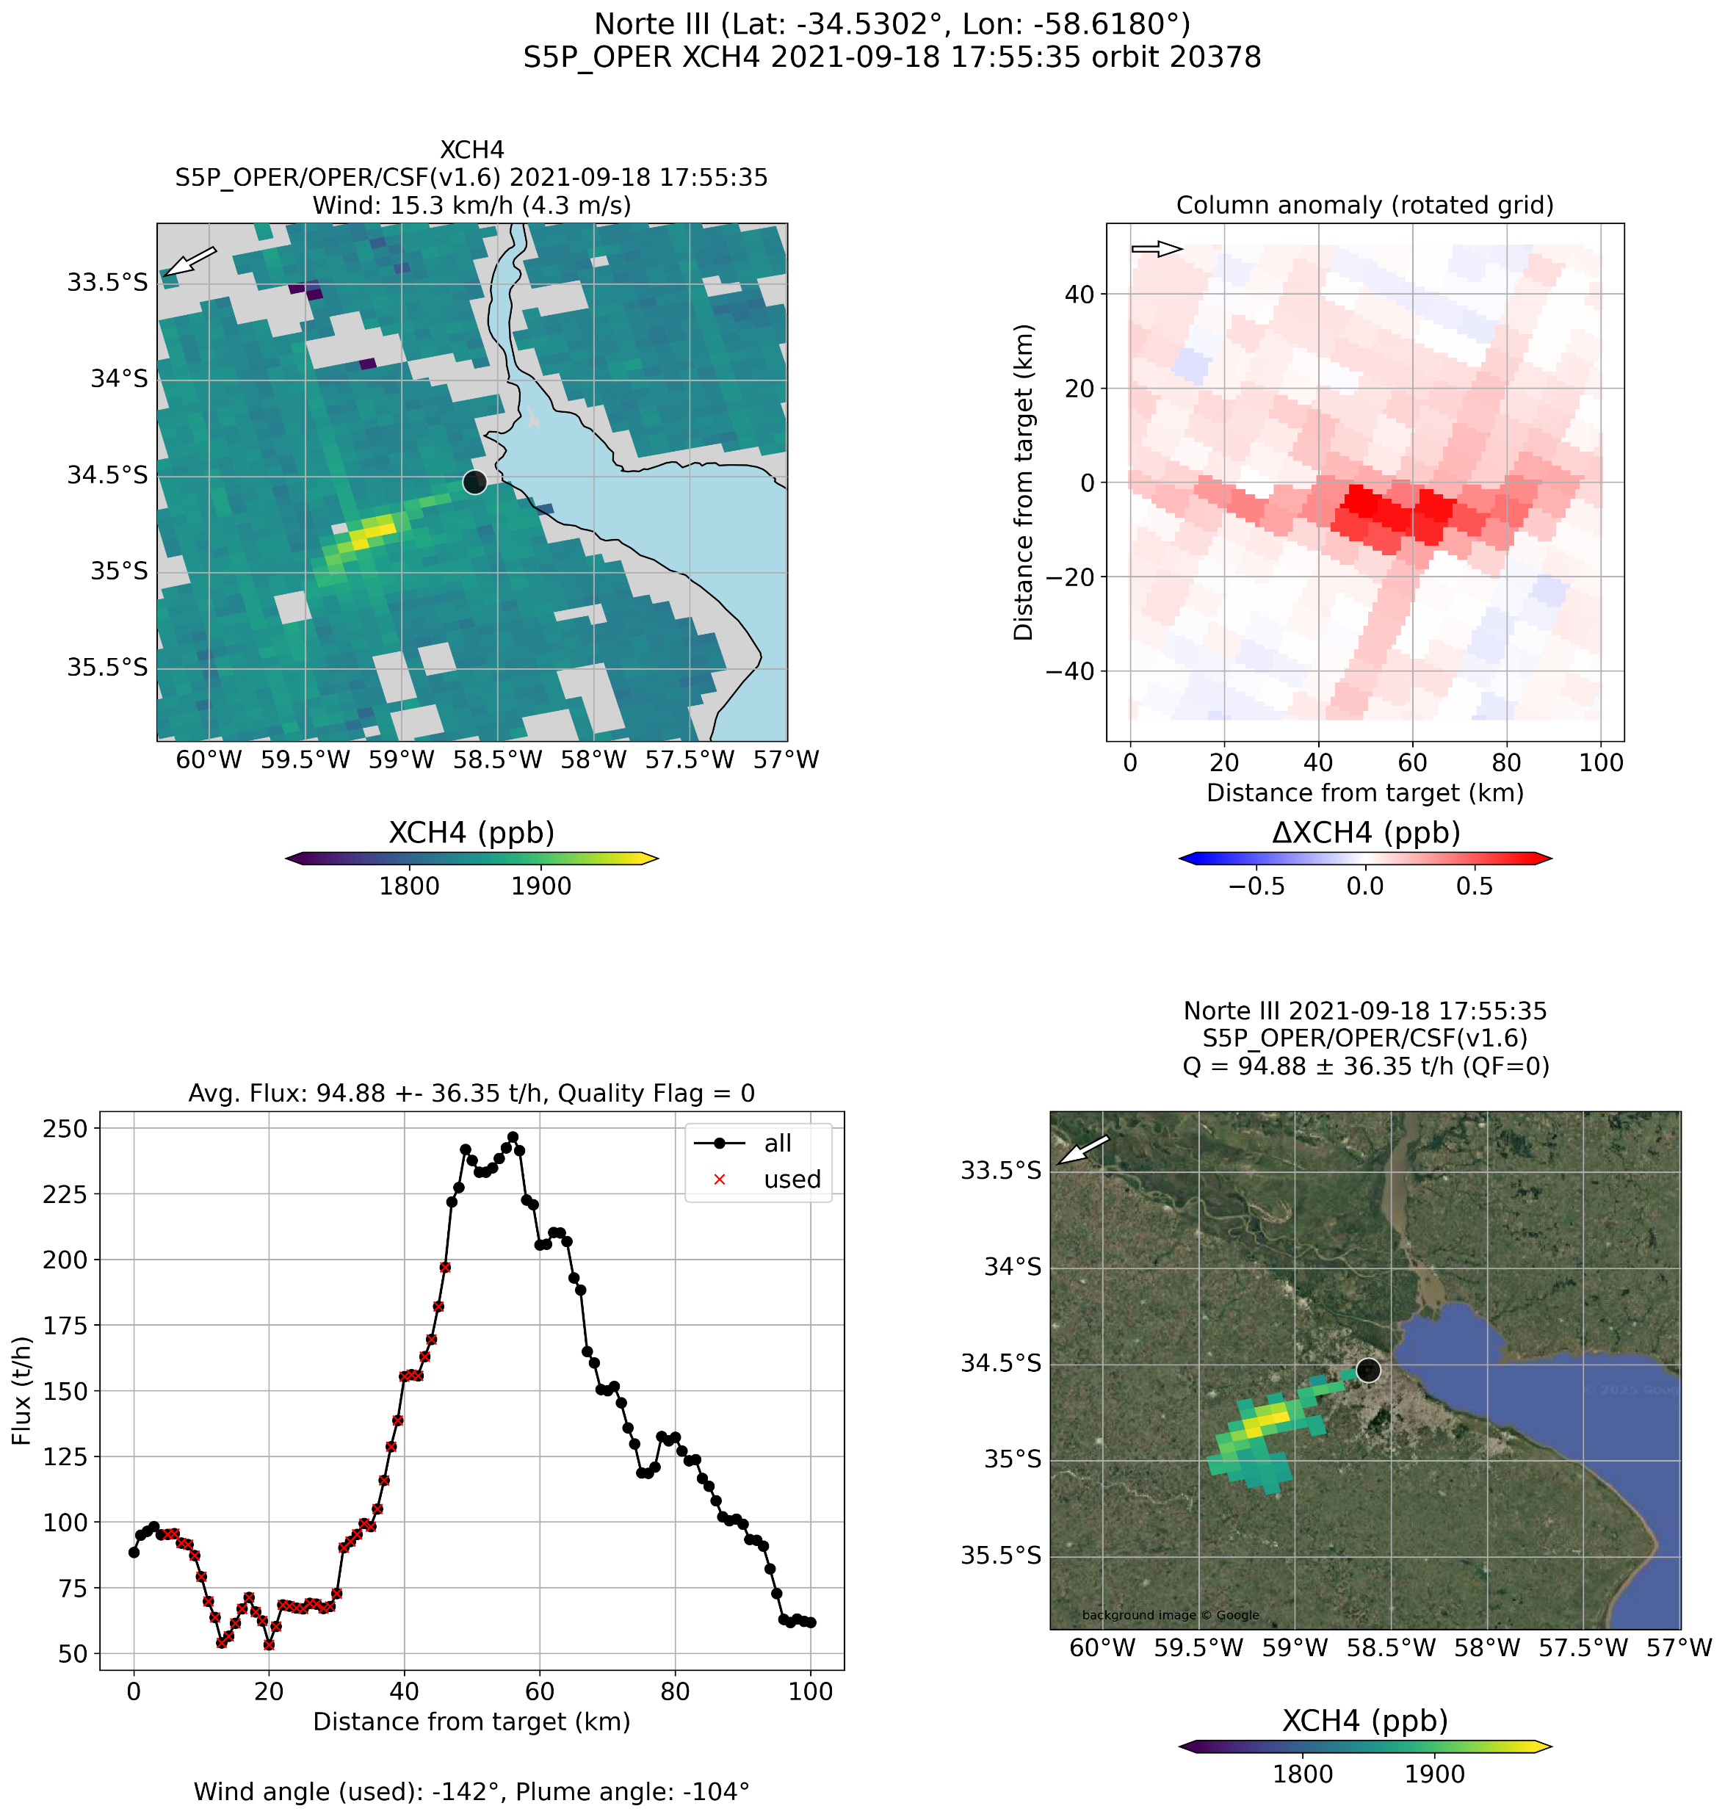
Methane: S5P/WFMD&OPER/CSF: Norte III
IUP-UB CSF (v1.6) algorithm applied to 2 different XCH4 data products:
Scientific WFMD v1.8
OPERational v02
2021-09-18
WFMD
2021-08-18
WFMD
OPER
70 ± 36 t/h (QF=0)
OPER
95 ± 37 t/h (QF=0)
46 ± 19 t/h (QF=0)
37 ± 15 t/h (QF=1)
OPER product used as is, i.e., without correction for striping, etc.

Slide 15

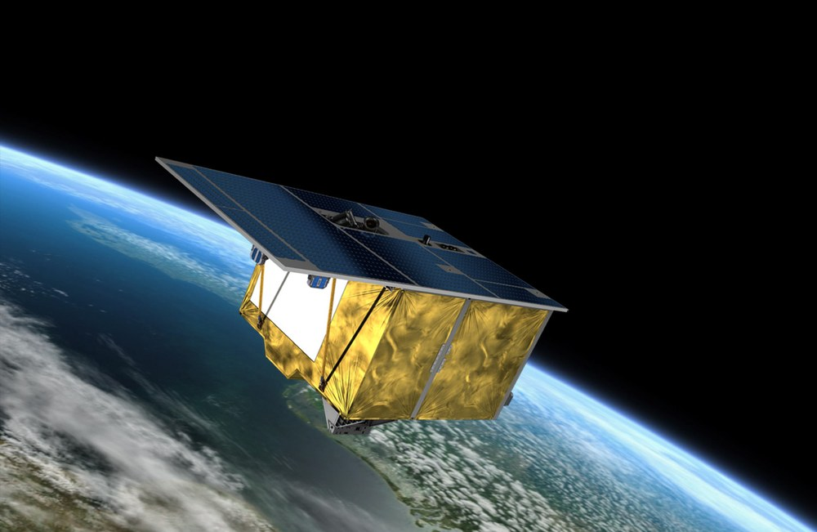
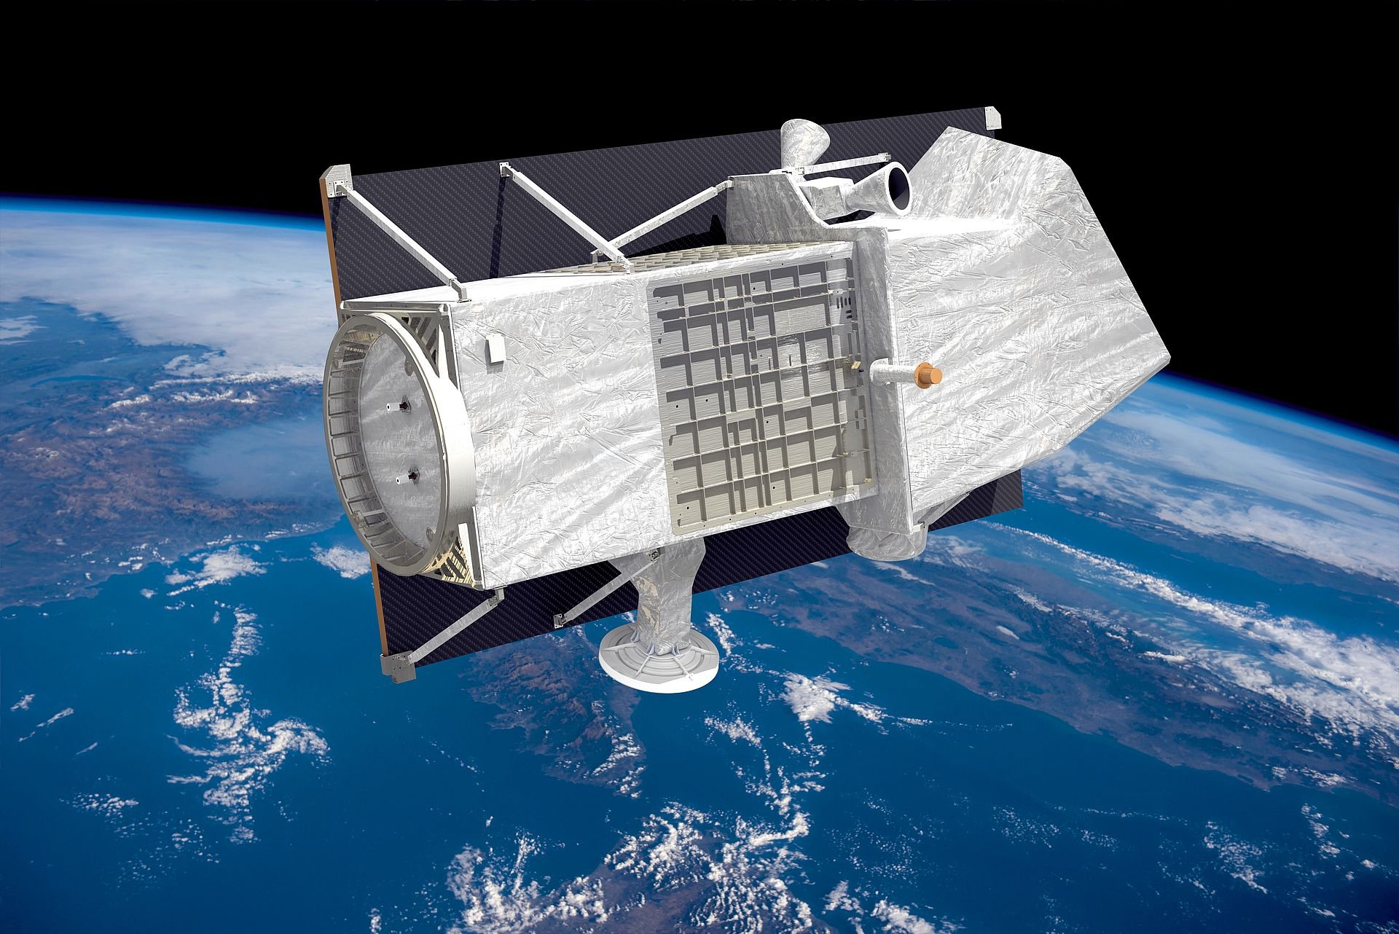
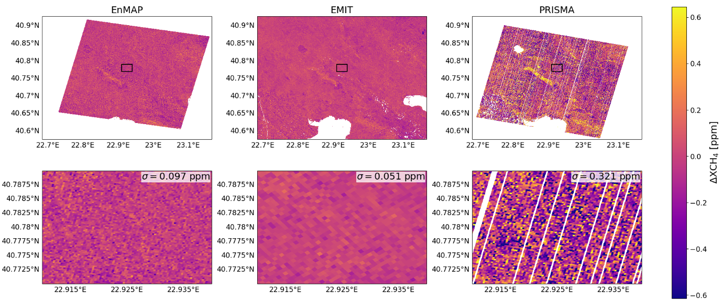


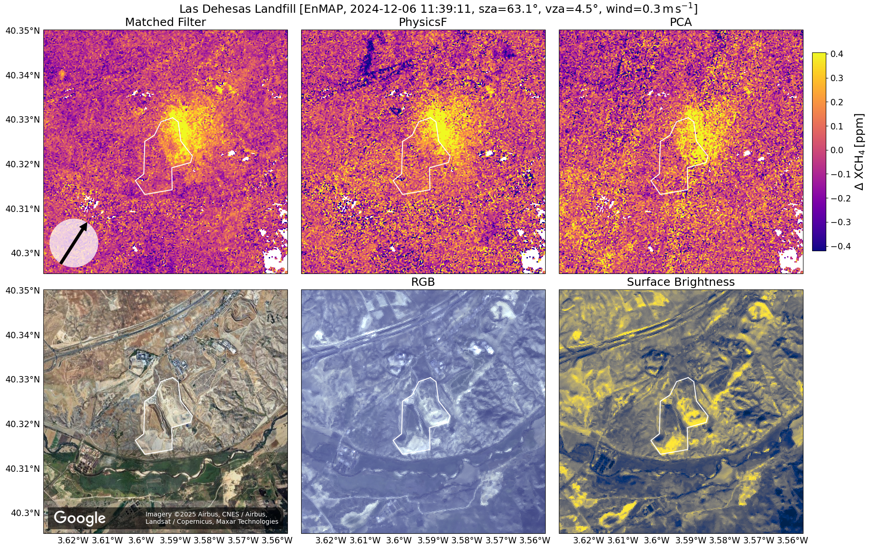
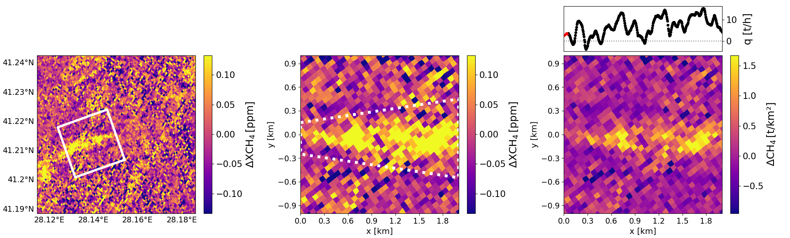
Hyperspectral Imager (HI) @ 30m/60m res.
EnMAP
EMIT
PRISMA
Methane enhancement retrievals:
Three methods under development („HiFi“)
  Differ primarily w.r.t. forward model F & measurement error covariance matrix Sε
  PhysicsF (PF) (low order „DOAS polynomial“ e.g. for surface reflectivity, …)
  Principal Components Analysis (PCA) (PCs instead of polynomial)
  Matched Filter (MF) (e.g., no polynomial but Sε from image)
Methane emissions: CSF algorithm
Matched Filter
PhysicsF
PCA

Slide 16
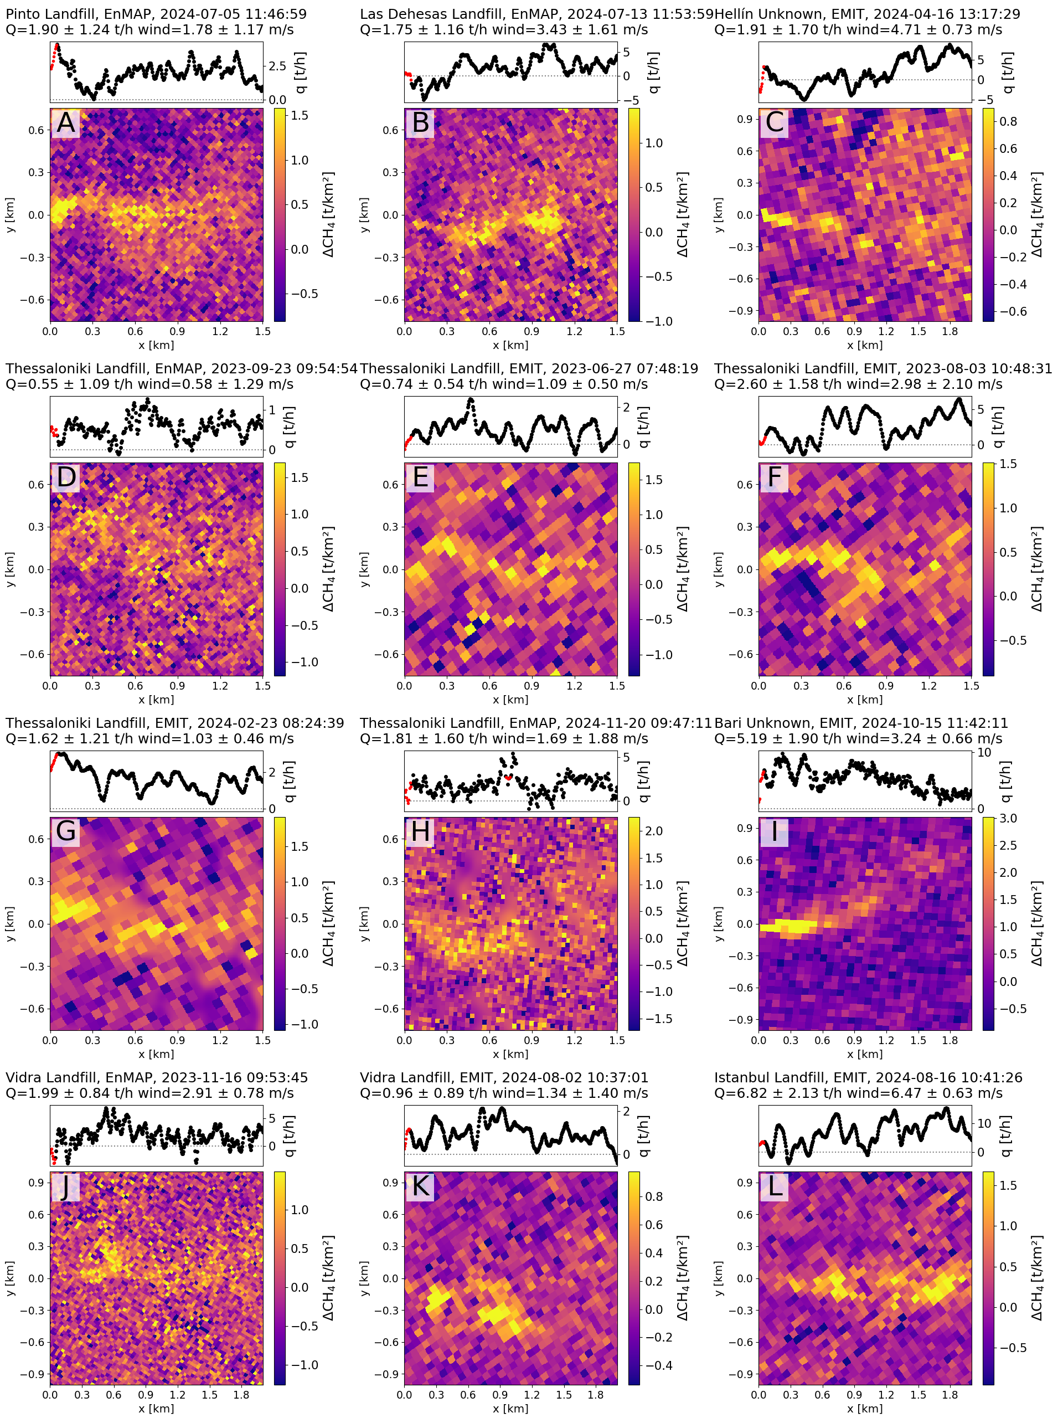
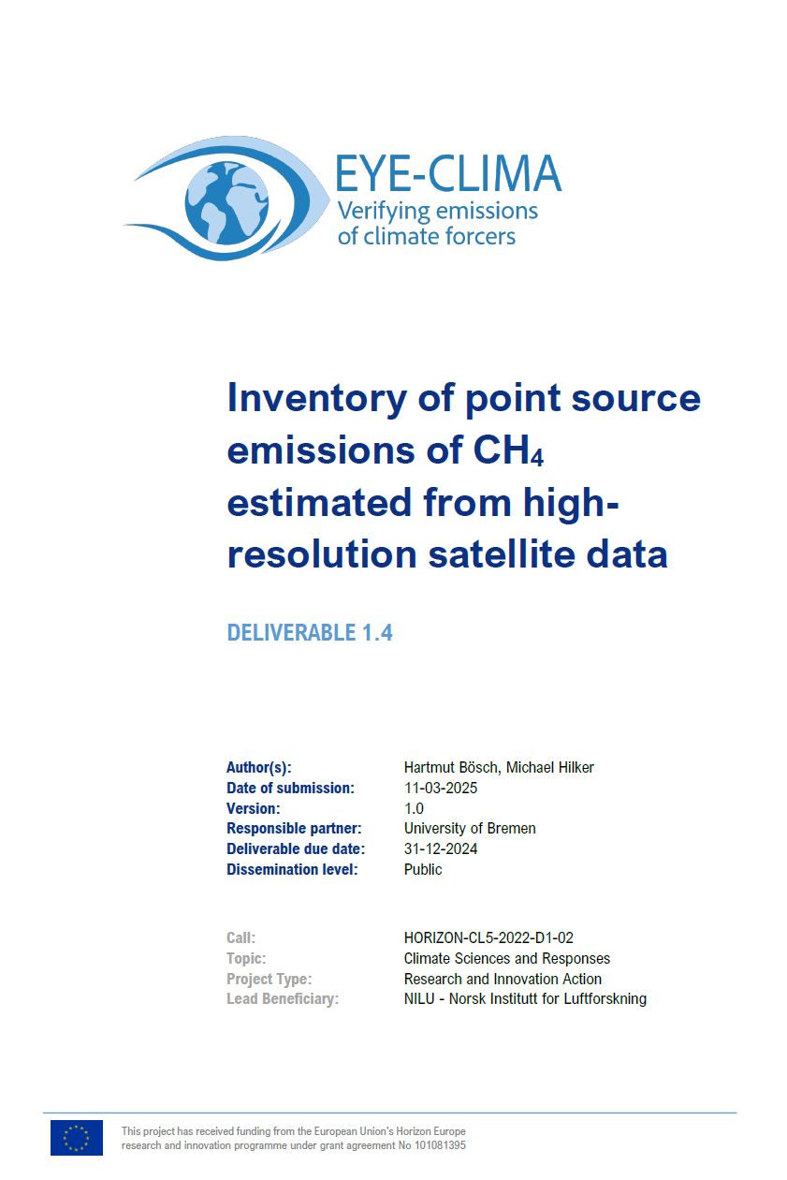
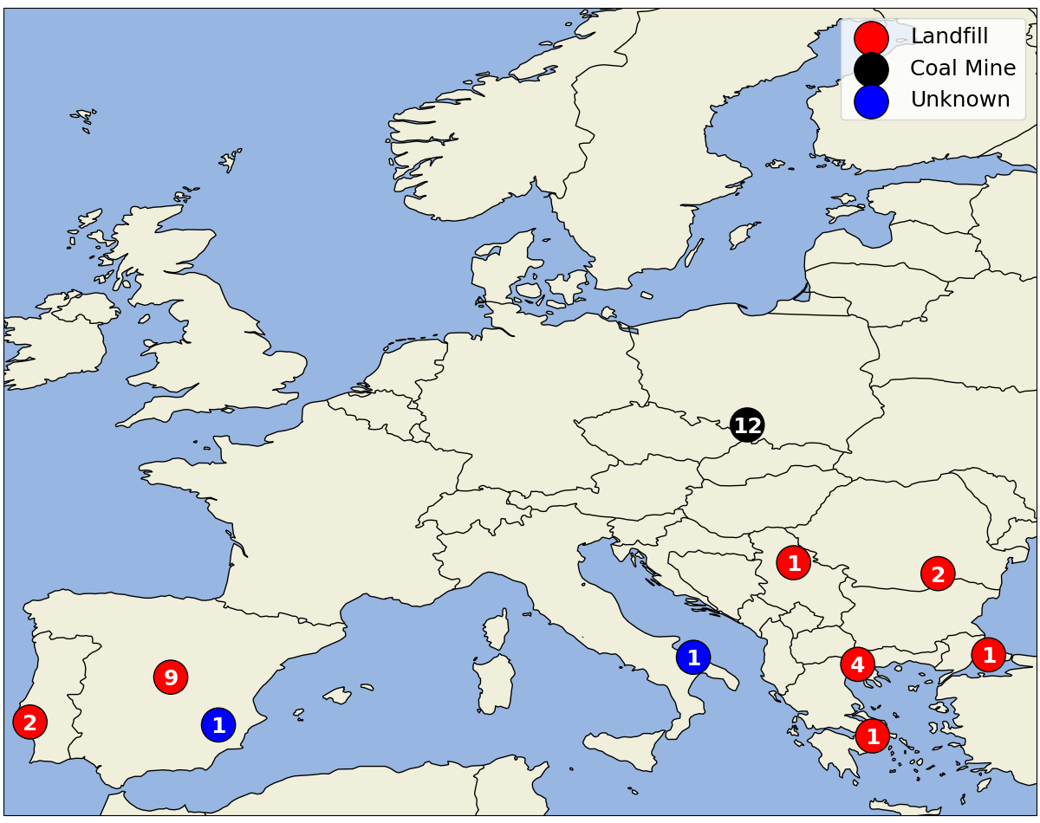
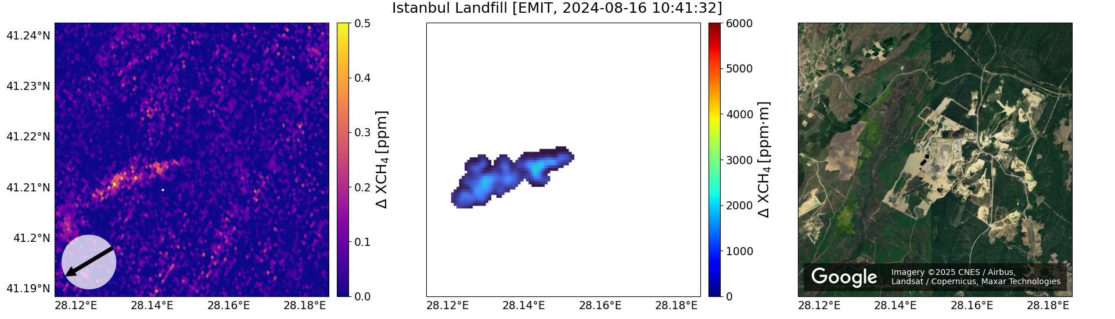
European localized emission sources
CSF method applied to EnMAP and EMIT
https://eyeclima.eu/

Slide 17
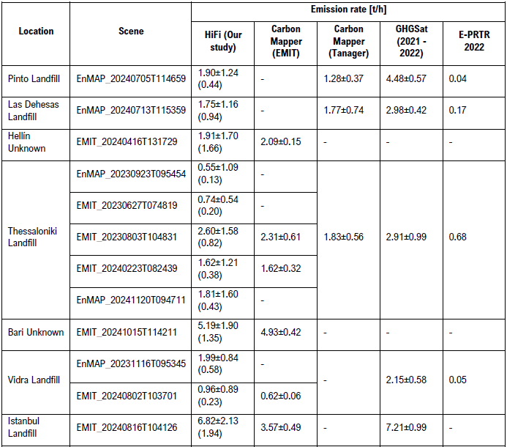
European localized emission sources
CSF method applied to EnMAP and EMIT
Comparisons of landfill emission estimates:
(§)
https://eyeclima.eu/
(§)
https://data.carbonmapper.org/
Same EMIT scene

Slide 18


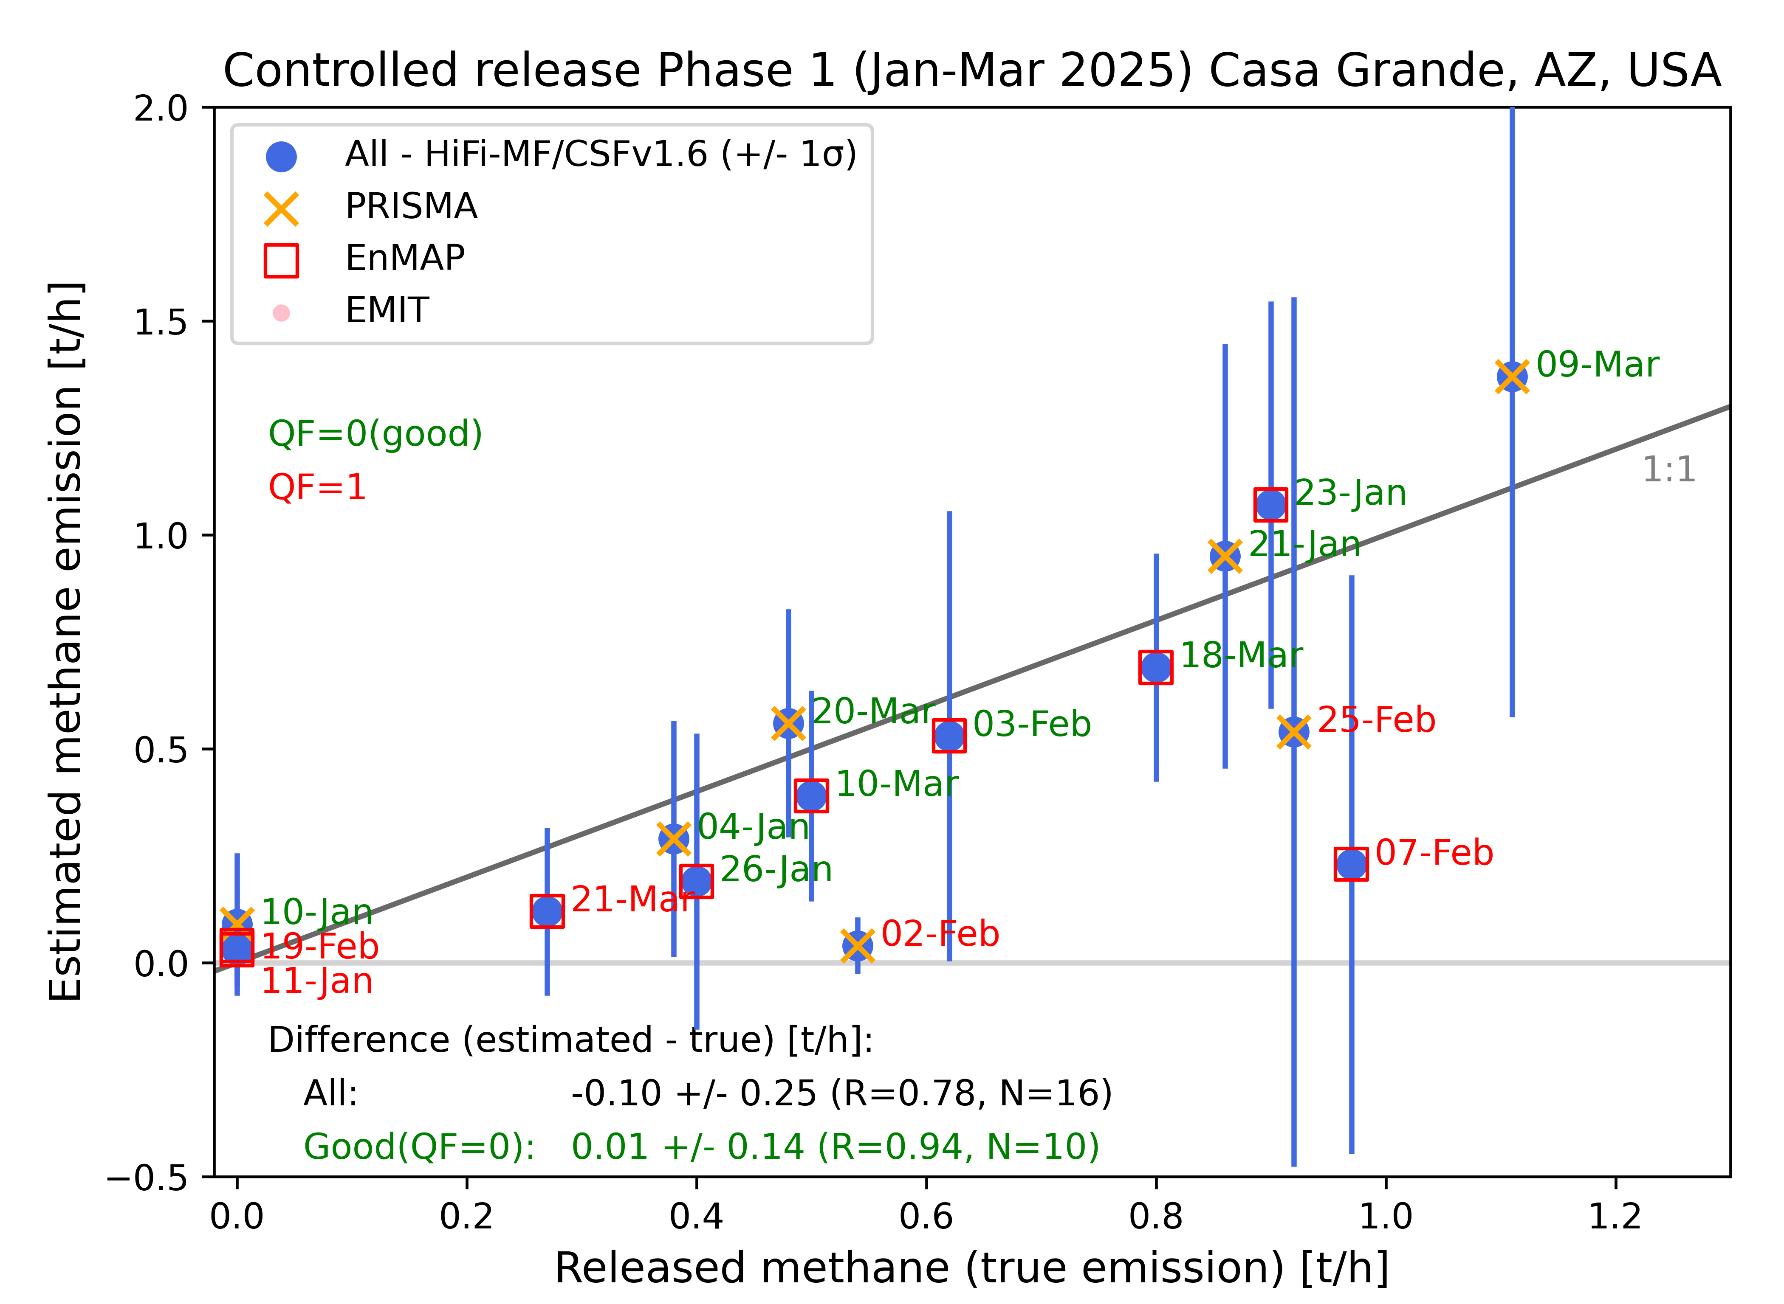
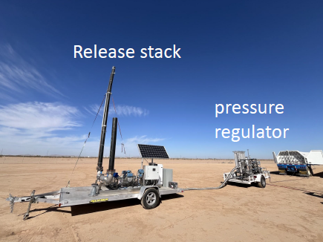
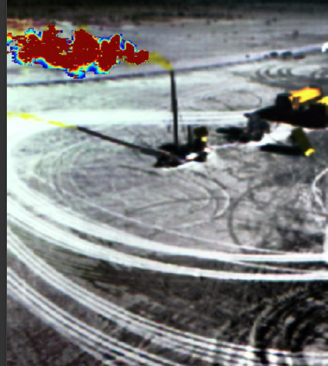
Stanford-Michigan Controlled Releases
2024 – 2025 Methane Controlled Releases
Single-blind test:
Satellite-derived emissions submitted in April 2025
„True emission“ information provided in May 2025

Slide 19
Summary & conclusions
TROPOMI/S5P WFMD XCH₄ data product:
  WFMD v1.8 product (Schneising et al., 2023) used to identify emission hotspots (Vanselow et al., 2024)
  Improved WFMD v2.0 XCH4 and XCO product available (https://www.iup.uni-bremen.de/carbon_ghg/products/tropomi_wfmd/)
Methane emission estimates via S5P and Hyperspectral Imagers:
  Cross-Sectional-Flux (CSF) algorithm
  First results from S5P, PRISMA, EnMAP, EMIT
  Emission estimates European localized sources (EYE-CLIMA)
  Detailed comparisons within MEDUSA (ongoing)
  Participation Stanford-Michigan Controlled Releases 2024/25

