Slide 1
Nitrogen Oxides in the Troposphere
sources, distributions, impacts, and trends
Lecture at the ERCA 2018
Grenoble, January 19, 2018
Andreas Richter
Institute of Environmental Physics
University of Bremen
Bremen, Germany
( richter@iup.physik.uni-bremen.de )

Slide 2
Overview
What is NO_{x}?
What is it doing in the troposphere?
Why should we care?
Where does it come from?
How can it be measured?
Is it changing with time?

Slide 3
Simplified NOx Chemistry in the Troposphere
surface reactions
night
HONO
HO₂ or RO₂
NO₂
H₂O,
surface
N₂O₅
OH
NO₃
NO
nitrate aerosol
hν
O₃
NO
O₃
NO₂
hν
HNO₃
NH₃
OH
HOONO
day
RO₂
RO₂NO₂
e.g. PANs => transport
emission
adapted from M. Jenkin

Slide 4
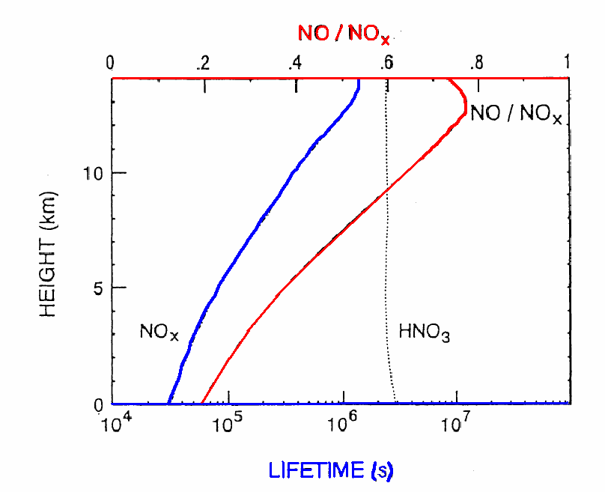
Some facts on NO_{x} in the Troposphere
NO and NO₂ are rapidly converted into
each other and are therefore combined to
NO_{x} = NO + NO₂
the ratio [NO] / [NO_{x}] is about 0.2 at the
surface but increases towards higher
altitudes (temperature dependence of
O₃ + NO reaction)
the atmospheric lifetime of NO_{x} is short
close to the surface (hours) and increases
towards higher altitudes (days)
lifetime is longer in winter than in summer (lower [OH])
the short lifetime results in little transport, both vertically and horizontally, at least in the form of NO_{x}
=> NO_{x} is found close to its sources
PAN has a long lifetime and can be transported and re-release NO_{x} when temperature increases
Ehhalt D.H. et al., (1992) Sources and distribution of Nox in the upper troposphere at northern mid-latitudes. J Geophys Res 97: 3725–3738

Slide 5
Why should we care about NOx in the Troposphere?
NOx
is a key species in tropospheric ozone formation
leads to formation of HNO₃ and thereby acid rain
contributes to eutrophication
acts directly as a greenhouse gas (NO₂, at least locally)
acts indirectly on climate through
  ozone formation
  Impact on [OH] and thus lifetime of other greenhouse gases such as CH₄
can contribute to aerosol formation

Slide 6
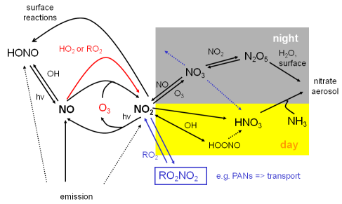
The Role of NOx in Ozone Chemistry
Background conditions
photolysis of NO₂ is the only known way
to produce O₃ in the troposphere
O₃, NO₂, and NO are in photostationary
state (Leighton relationship):
    [O₃][NO₂] / [NO] = J_{NO2} / k_{O3 + NO}
at very low [NO] / [O₃] ratio, destruction
of O₃ by HO₂ dominates over O₃ production
Polluted conditions
if NO is oxidized to NO₂ by HO₂ or RO₂ instead of O₃, ozone is catalytically formed by NO
how much O₃ can be formed in the presence of NO_{x} is eventually limited by the amount of CO, CH₄, and other hydrocarbons available
at high NO_{x} concentrations, O₃ levels are reduced by reaction with NO and NO₂ in particular at night (“titration”)

Slide 7
NOx and acid Rain
normal rain should have a pH of about 5, but much lower values are often observed in industrialised areas
SO₂ emissions have been the main reason for acid rain
as SO₂ emissions decreased, NO_{x} became relatively more important
HNO₃ is formed through several paths and its wet and dry deposition is one of the main sinks for nitrogen oxides:
  NO₂ + OH + M → HONO₂ + M
  N₂O_{5(g)} + H₂O _{(g,l)} → 2HNO_{3(g, aq)}
  NO_{3(aq)} + H₂O_{(l)} → HNO_{3(aq)} + OH_{(aq)}
  NO₃ + RH → HNO_{3(g)} + R
the effects of acid rain are most pronounced
on freshwater fish and forest ecology, but also on buildings

Slide 8
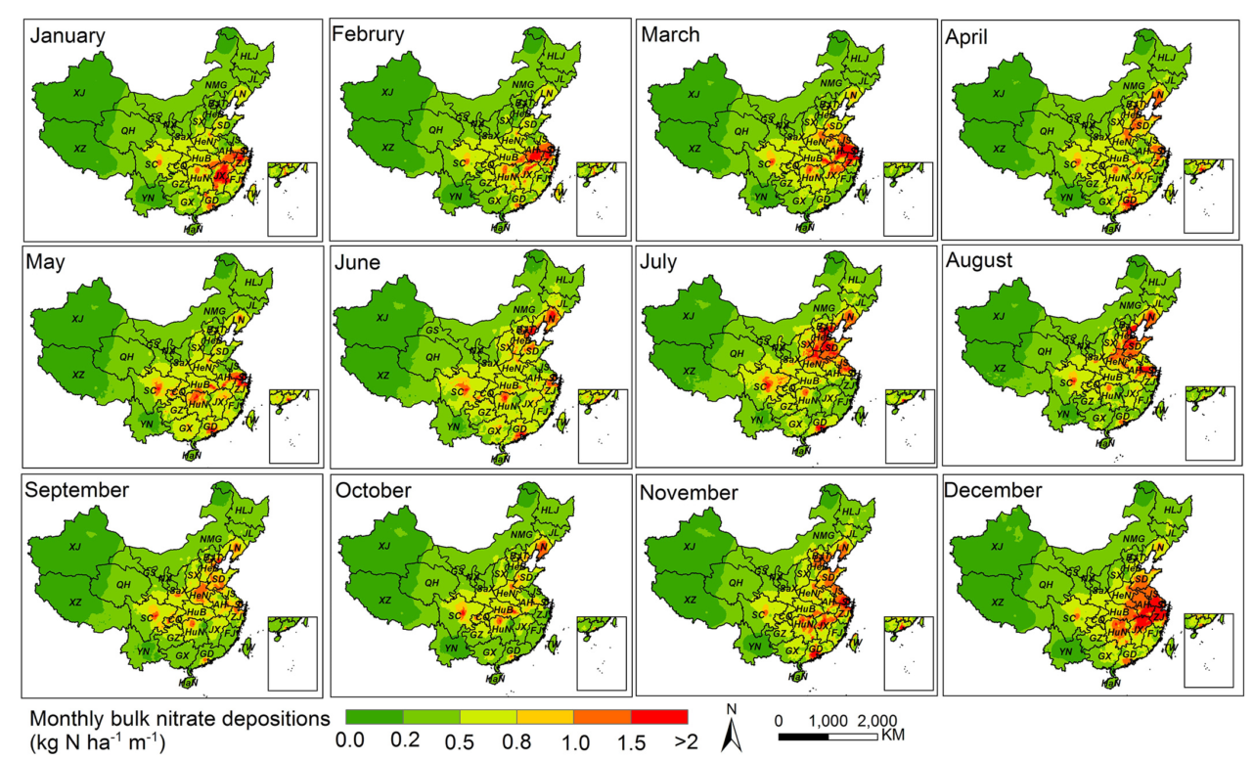
NOx and acid Rain: Example
Liu et al., Remote sensing of Environemnt, 199,93-106, 2017
Nitrate deposition in China 2010 – 2012 based on OMI NO₂ observations and precipitation

Slide 9

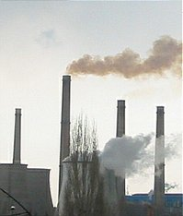
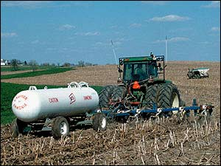
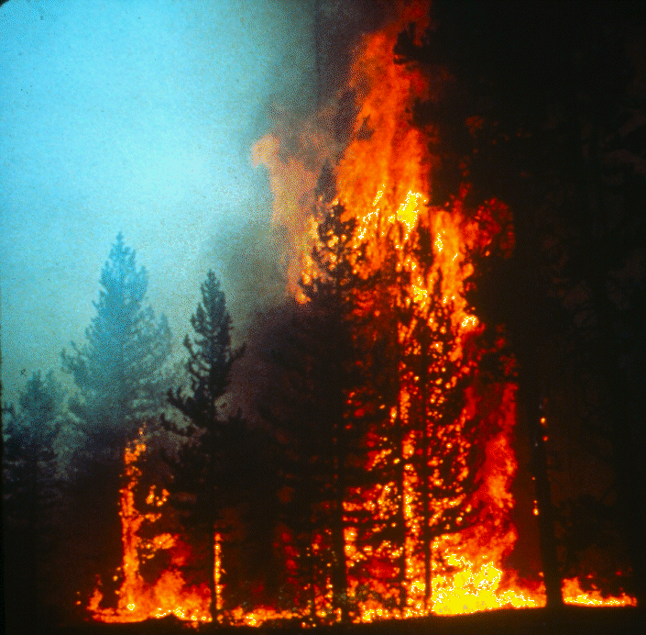

Sources of NOx in the Troposphere
Main sources of NO_{x} (in Tg N / yr) are
fossil fuel combustion 22.0 (15 – 29)
fires 6.7 (3 – 10)
microbial soil emissions 5.5 (3.3 – 7.7)
lightning 2.0 (1 – 4)
oxidation of biogenic NH₃ 1.0 (0.5 – 1.5)
aircraft 0.5 (0.5 – 0.6)
stratosphere 0.5 (0.4 – 0.6)
R. Delmas et al., Nutrient Cycling in Agroecosystems, 48, 51 – 60, 1997

Slide 10
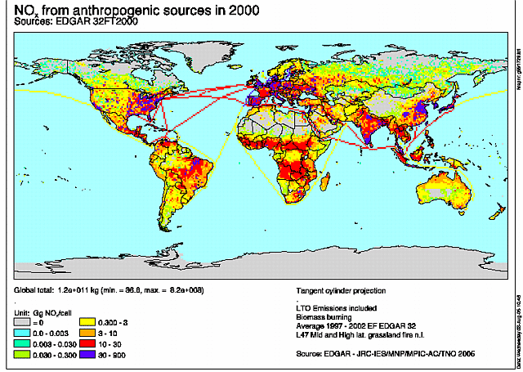
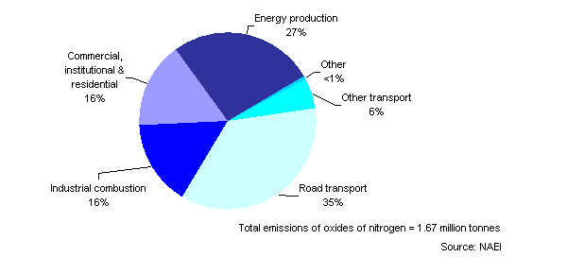
Anthropogenic NOx Sources
including biomass burning!
anthropogenic emissions concentrated in a few industrialised areas
largest emissions in cities and from power plants
emissions per capita very unevenly distributed
=> future?
http://www.mnp.nl/edgar/model/v32ft2000edgar/edgarv32ft-prec/edgv32ft-nox-map.jsp
http://www.environment-agency.gov.uk/commondata/103196/1162897?referrer=/yourenv/eff/1190084/air/1158715/1162725/
UK, 2004
road transport has large importance
energy production is second, depending on energy mix

Slide 11
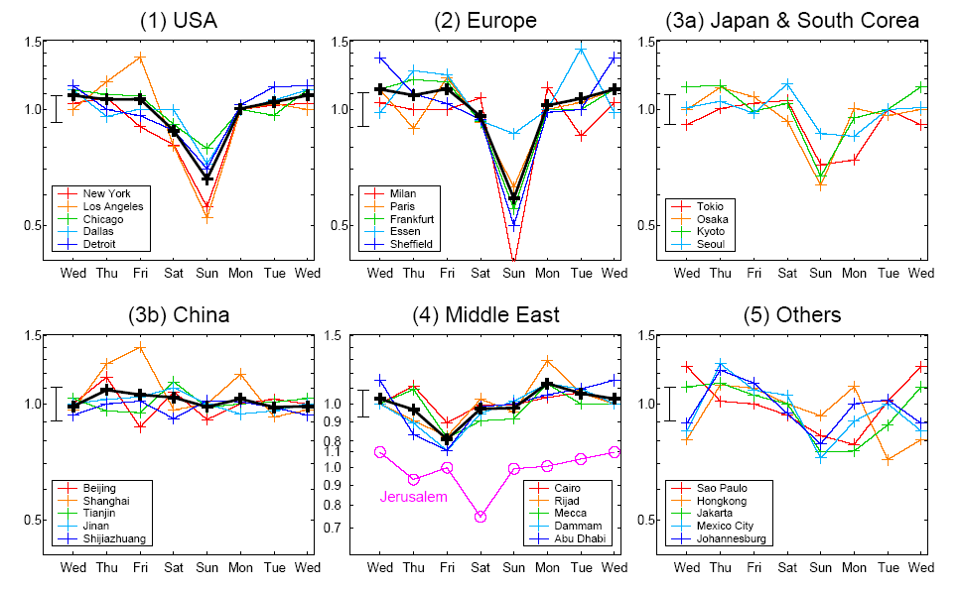
Anthropogenic NOx Sources: Example
Beirle et al., Atmos. Chem. Phys., 3, 2225–2232, 2003
Normalised tropospheric NO₂ columns retrieved from
GOME satellite measurements show clear weekly cycle
over industrialised areas
anthropogenic NO_{x} emissions dominate

Slide 12
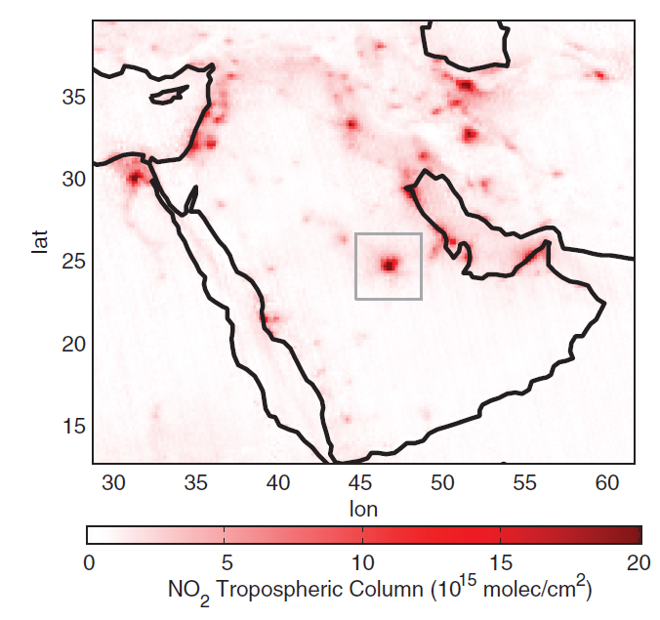
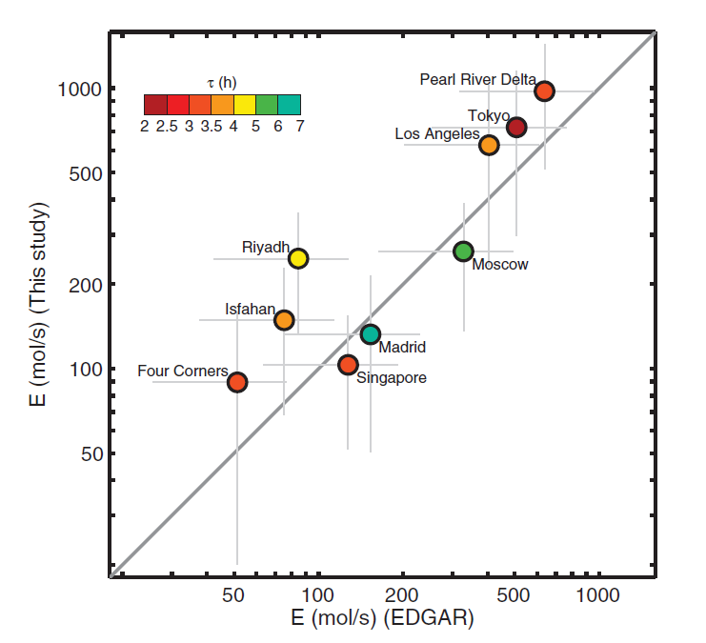
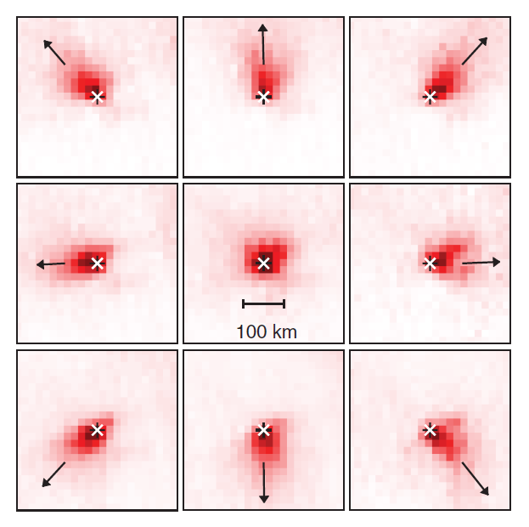
Anthropogenic NOx sources: Lifetime
For large and isolated point sources, OMI observations can be sorted by wind direction
Plume model provides lifetime
Column + lifetime gives emissions
Beirle, et al., Megacity Emissions and Lifetimes of Nitrogen Oxides Probed from Space, Science 333, 1737 (2011); DOI:10.1126/science.1207824

Slide 13
Soil Sources of NOx
NO and N₂O are emitted from microbial activities in the soil, both during nitrification (NH₄⁺ → NO₃⁻) and denitrification (NO₃⁻ → N₂)
function of soil moisture and texture, inorganic nitrogen availability, the carbon to nitrogen ratio, temperature and precipitation
typical parameterisation using T, precipitation and fertilisation
usually observed as strong pulses after fertilisation and rain
in ecosystems with dense vegetation cover (e.g. rain forests), part of the NO_{x} emitted is lost by NO₂ deposition
NO_{x} soil emissions seem to be underestimated in current models
potential for increases as use of fertilizers increases, but strong dependence on actual practices used

Slide 14
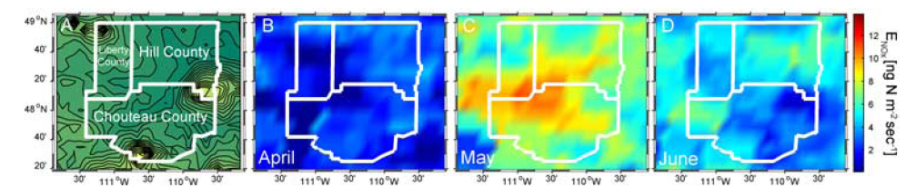
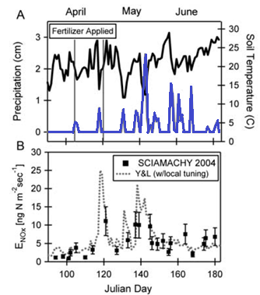
Soil Sources of NOx: Example
Chouteau, Hill and Liberty Counties in North-Central Montana, USA
harvested cropland, low population density, no large stationary NO_{x} sources
NO₂ columns retrieved from SCIAMACHY satellite data are large after fertilisation and subsequent precipitation
Bertram, T. H., et al., (2005), Satellite measurements of daily variations in soil NOx emissions, Geophys. Res. Lett., 32, L24812, doi:10.1029/2005GL024640

Slide 15
NOx from Biomass Burning
biomass burning is happening on large scales on a regular basis as part of
  agricultural practices
  wild fires
  domestic fires
it is a significant source of NO_{x}
the amount of NO_{x} emitted per biomass burned varies strongly between different biomass types (savannah, tropical rain forests, boreal forests)
large amounts of NO_{x} are emitted in the tropics, much less e.g. in Alaska or Siberia
in big fires, enough heat is produced to start pyroconvection and to inject NO_{x} in the upper troposphere
fires can be observed by their IR signature (i.e. MODIS), NO₂ can be observed by UV/vis observations

Slide 16
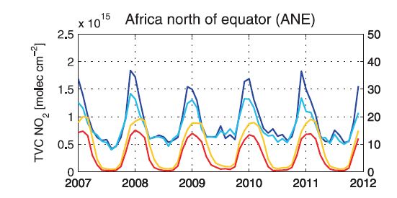
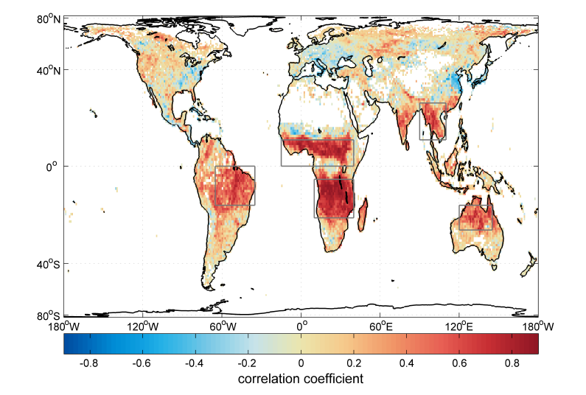
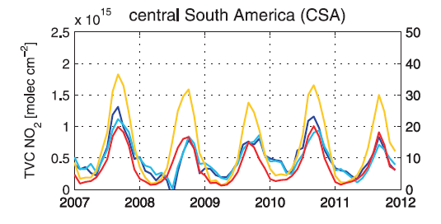
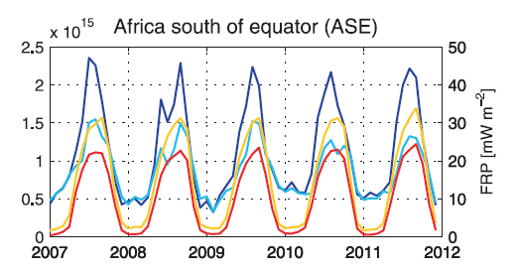
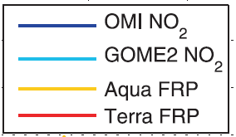
NOx from Biomass Burning
Schreier, S.F., : The empirical relationship between satellite-derived tropospheric NO₂ and fire radiative power and possible implications for fire emission rates of NOx, Atmos. Chem. Phys., 14, 2447-2466, doi:10.5194/acp-14-2447-2014, 2014

Slide 17
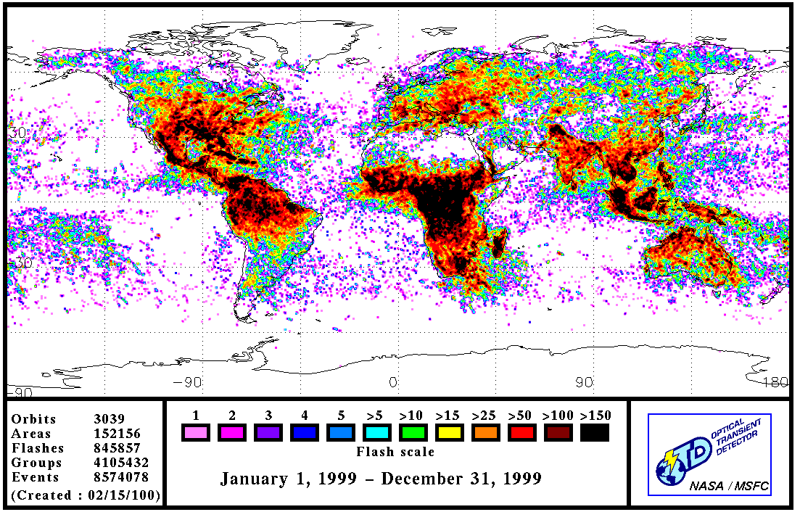
NOx from Lightning
at very high temperatures (> 2000 K)
O₂ + M → O + O + M
O + N₂ → NO + N
N + O₂ → NO + O
(Zel’dovitch mechanism).
lightning NO_{x} is computed from the
product of lightning dissipation energy
and NO yield per Joule of discharge
estimates have varied dramatically in the past:
1.2 Tg ... 200 Tg N / yr
recent estimates cluster around 2..5 Tg N / yr
estimates are based on lightning counts from space and in situ measurements of NO in individual thunderstorms
lightning NO_{x} in models often parameterised by cloud height or convective precipitation
the relevance of lightning NO_{x} is that it is injected in the upper troposphere, where ozone formation is very efficient
http://thunder.nsstc.nasa.gov/data/OTDsummaries/

Slide 18
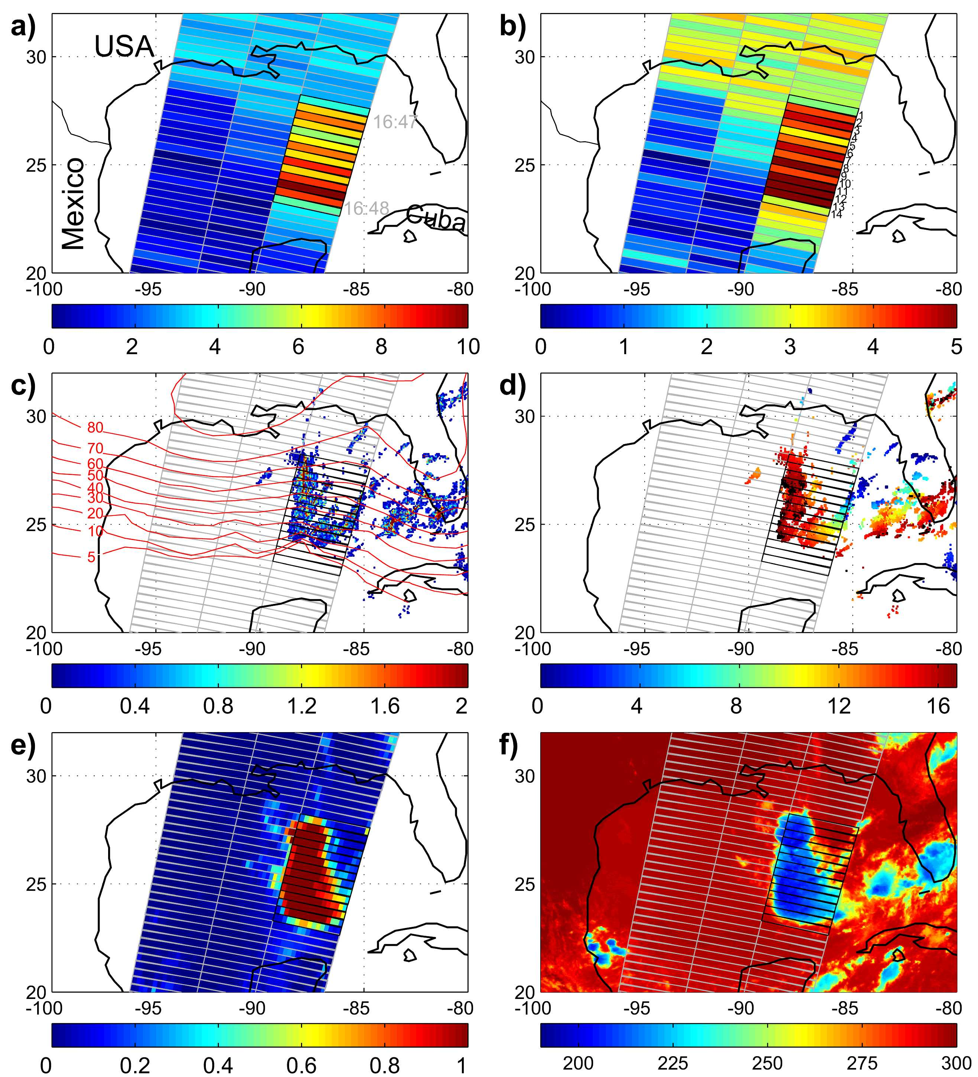
NOx from Lightning: Example
GOME trop. NO₂SCD (10¹⁵ molec/cm²)
Cloud fraction
NO₂ columns retrieved from GOME satellite data
coincident measurements of clouds, lightning and NO₂ in space and time
no indication for pollution impact
direct evidence without a priori assumptions
NLDN flashes (time of last lightning event)
Beirle et al., Estimating the NOx produced by lightning from GOME and NLDN data: a case study in the Gulf of Mexico Atmos. Chem. Phys., 6, 1075-1089, 2006

Slide 19
Measurements of NOx
Challenges
high spatial and temporal variability
what is a representative measurement location?
vertical distribution
Techniques
in-situ using chemiluminescence
locally using absorption spectroscopy
globally using remote sensing in the visible spectral range

Slide 20
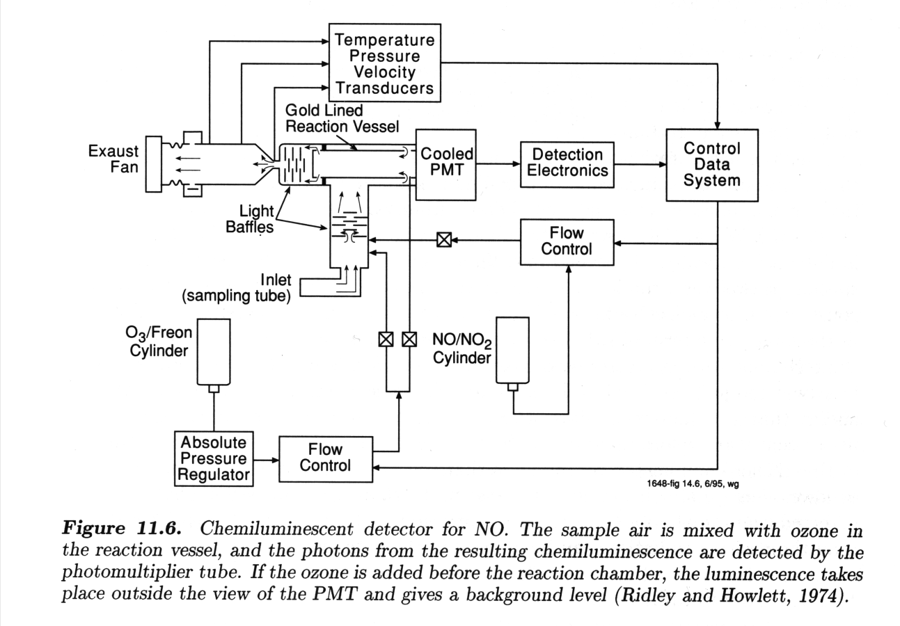
in-situ NOx Measurements
Idea:
In some exothermic reactions, part of the energy is released as photons that can be measured by a photomultiplier.
O₃ + NO -> NO₂* + O₂
NO₂* -> NO₂ + hν
NO₂* + M -> NO₂ + M
The emitted intensity depends on the effectiveness of quenching which is proportional to the pressure and the concentrations of [O₃] and [NO].
If pressure and [O₃] concentration are kept constant, the intensity is proportional to the concentration of the NO.
NO₂
O₃

Slide 21
Long Path DOAS measurements
Instrument:
open path Differential Optical Absorption Spectroscopy (DOAS) system using a lamp as light source
retro reflectors for simplified set-up
white cells (multi reflection) for enhanced light path possible
advantages:
measurements at night
well defined light path
extension to UV (no ozone layer in between)
disadvantages:
relatively short light path
need for bright lamp (+ power)
usually not fully automated
spectrometer
detector
quartz fibre
retro reflectors
telescope
open path through the atmosphere
lamp

Slide 22
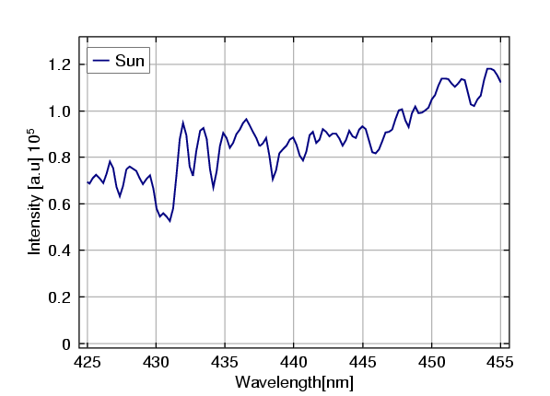
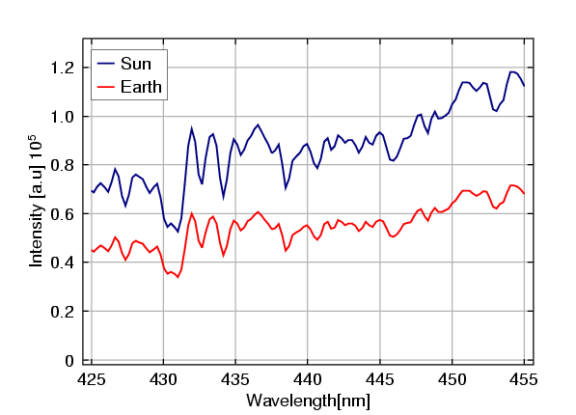
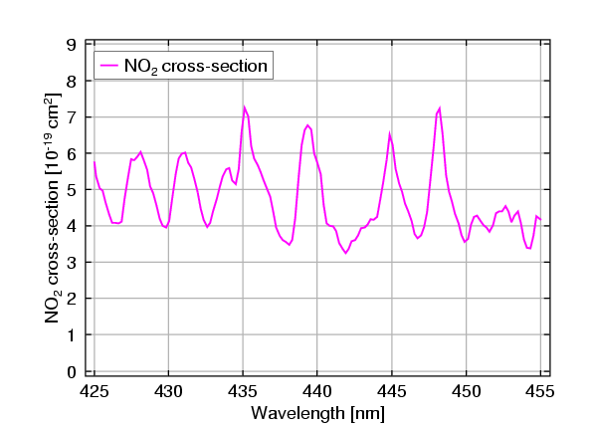


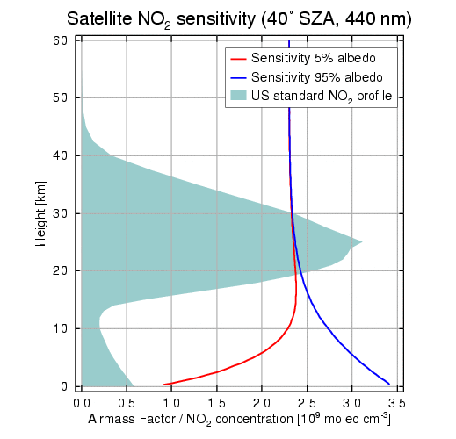
Satellite NO₂ Measurements
DOAS analysis
Total Slant Column
Tropospheric Slant Column
SCIATRAN RTM (airmass factor)
Tropospheric Vertical Column

Slide 23
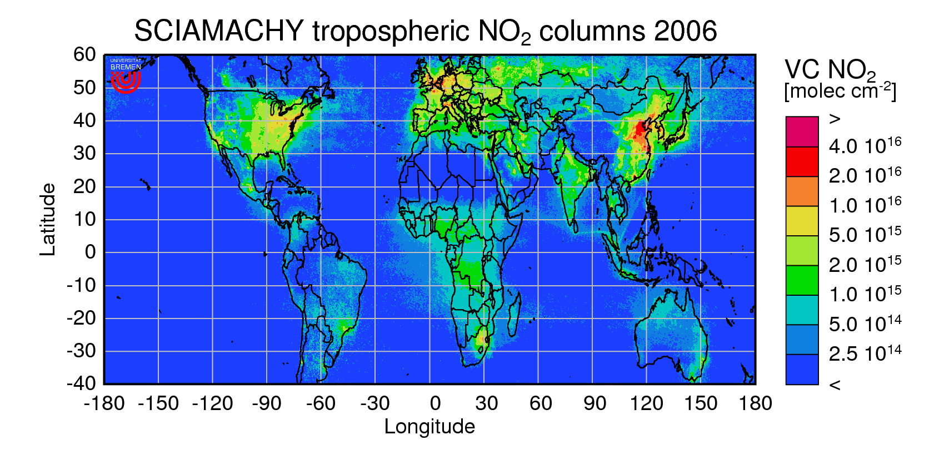
Satellite NO₂ Measurements: Example
ships
anthropogenic
pollution
biomass burning
transport

Slide 24

Satellite NO₂ instruments
GOME
07.95 – 06.03 (full coverage)
4 channels 240 – 790 nm
0.2 – 04 nm FWHM
nadir viewing
320 x 40 km² ground pixel
sun-synchronous orbit
global coverage in 3 days
SCIAMACHY
08.02 – 04.12
8 channels 240 – 1700 nm
and 2 – 2.4 μm
0.2 – 04 nm (1.5 nm) FWHM
nadir viewing
+ limb + solar / lunar occultation
60 x 30 km² typical ground pixel
sun-synchronous orbit
global coverage in 6 days
TROPOMI on Sentinel 5 Precursor
imaging spectrometer
launched 10.2017
Up to 3.5 x 7 km² ground pixel
global coverage in 1 day
GOME-2 A and B
similar to GOME
launched 10.06 and 10.2012
80 x 40 km² ground pixel
global coverage in 1.5 days
OMI
imaging spectrometer
launched 07.04
13 x 24 -120 x 24 km² ground pixel
global coverage in 1 day

Slide 25
NOx Emission Estimates
“bottom up”
using statistical data on activities (e.g. number and type of cars, average mileage, average fuel consumption)
and data on emission factors (x g NO emitted per l fuel)
“top down”
using measurements of e.g. NO₂ or other species influenced by NO_{x}
applying a model to establish the connection between emissions and atmospheric concentrations (or columns)
iterating emissions in the model to improve agreement between model prediction and measurements
the more measurements, the better => satellite data should be optimal, but accuracy and lack of vertical resolution is a problem

Slide 26
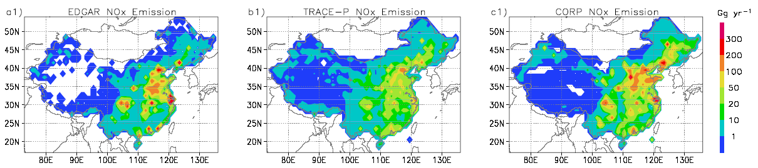
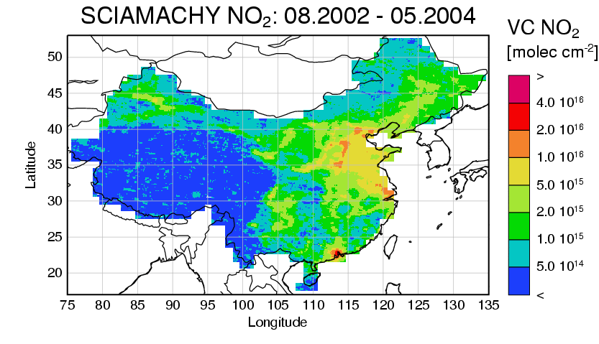
Example: Bottom up Emission Estimates for China
Problem:
depending on the data source and approach used, emission inventories differ significantly
political considerations can interfere (in both directions)
→ comparison with independent data e.g. from satellites can help
Ma, J. et al., Comparison of model-simulated tropospheric NO2 over China with GOME-satellite data, Atmospheric Environment, 40, 593–604, 2006

Slide 27

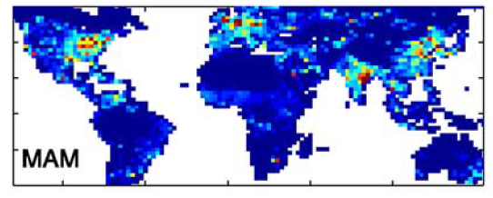

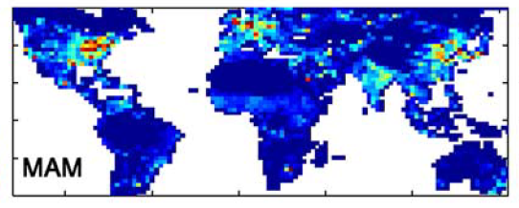

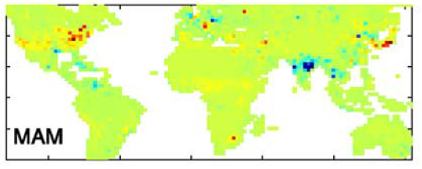

Example: Top Down Emission Estimates
Approach:
GEOS-CHEM model
GOME NO₂ columns
linearized relation between NO_{x} emission and NO₂ column determined for each grid cell from model
error weighted combination of a priori (GEIA) and a posteriori emissions
improved emission inventory with reduced uncertainties
Martin, R. et al.,, Global inventory of nitrogen oxide emissions constrained by space-based observations of NO2 columns, J. Geophys. Res., 108(D17), 4537, doi:10.1029/2003JD003453, 2003.

Slide 28
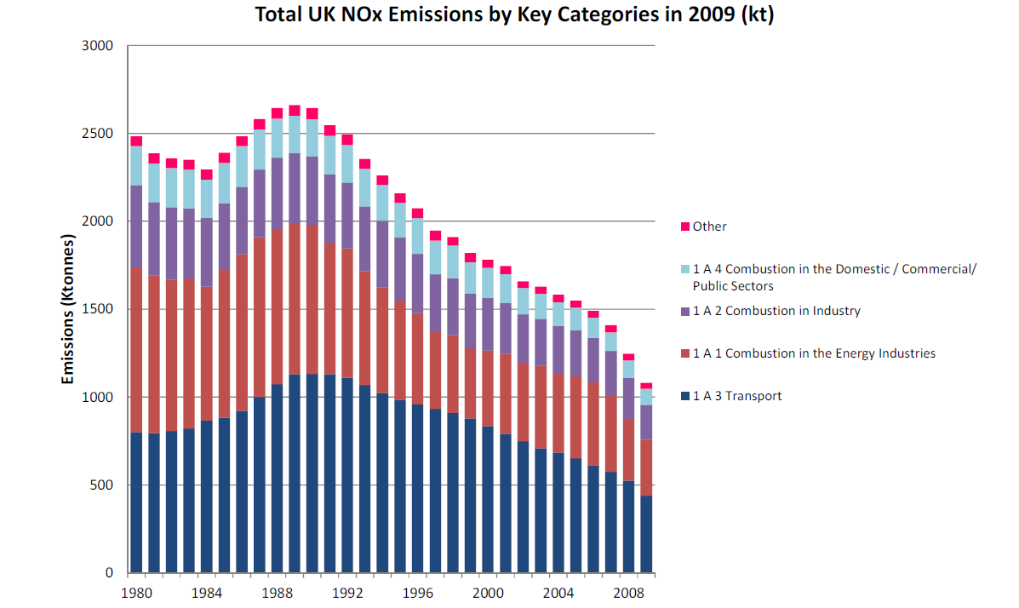
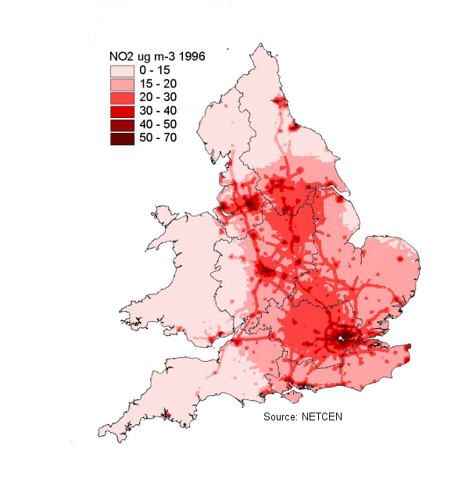
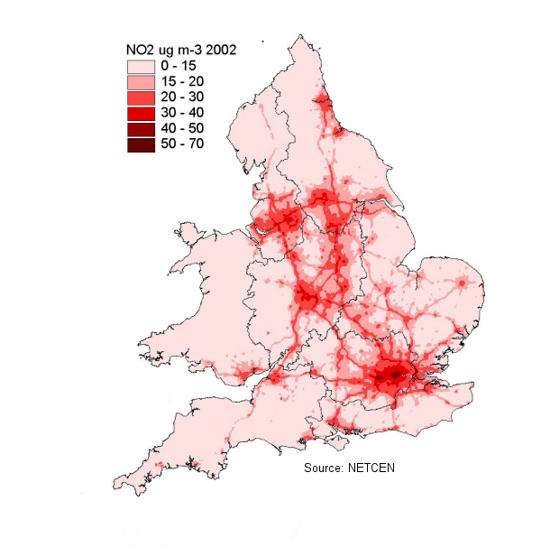
NOx Emission Trends
NO_{x} emissions in
Europe, the US and
Japan are decreasing:
switch from coal and oil to natural gas
use of catalytic converters
“export” of heavy industry
As a result, NO₂ levels
have fallen as expected,
but not the ozone levels.
UK
http://www.environment-agency.gov.uk/commondata/103196/1162888?referrer=/yourenv/eff/1190084/air/1158715/1162725/
1996
2002

Slide 29
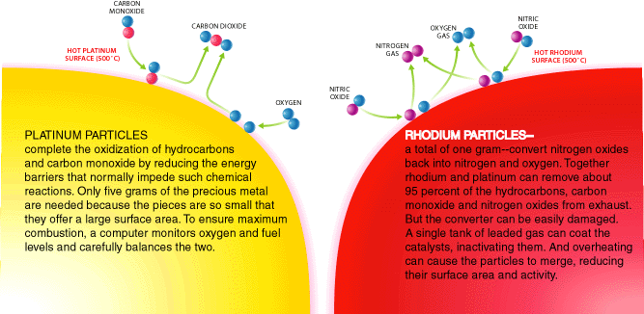
NOx reductions: Catalytic Converter
In principle, if fuel would be fully oxidized, cars should only emit H₂O and CO₂. However, in practice not all hydrocarbons are oxidized and NO is formed from N₂ and O₂.
oxidation of hydrocarbons and CO on platinum
2CO + O₂ → 2 CO₂
conversion of NO to N₂ and O₂ using H₂ and CO from the exhausts on rhodium:
2NO →N₂ + O₂

Slide 30
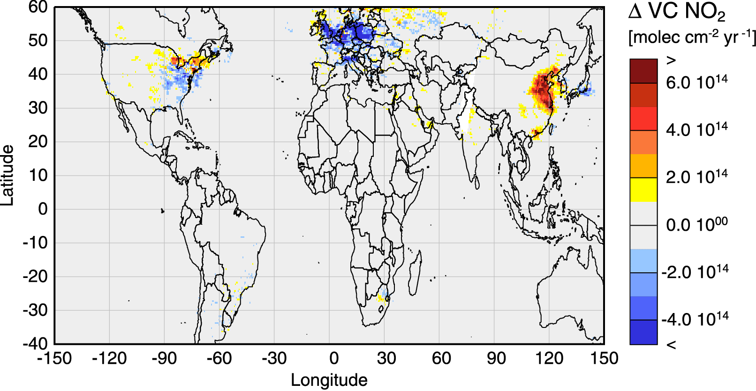
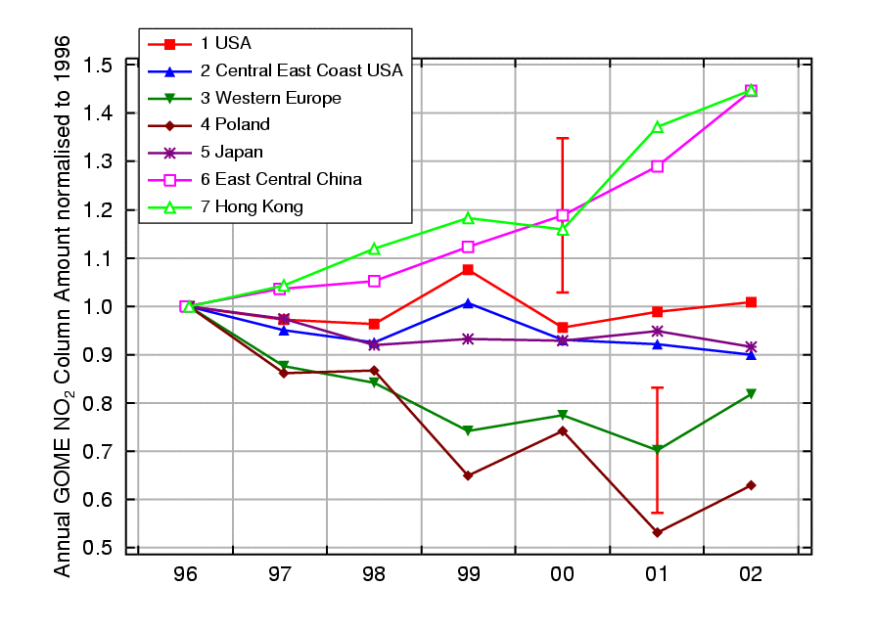
Satellite NO₂ Trends: The Global Picture
GOME annual changes in tropospheric NO₂
1996 - 2002
7 years of GOME satellite data
DOAS retrieval + CTM-stratospheric correction
seasonal and local AMF based on
1997 MOART-2 run
cloud screening
NO₂ reductions in Europe and parts of the US
strong increase over China
consistent with significant NO_{x} emission changes
A. Richter et al., Increase in tropospheric nitrogen dioxide over China observed from space, Nature, 437 2005

Slide 31
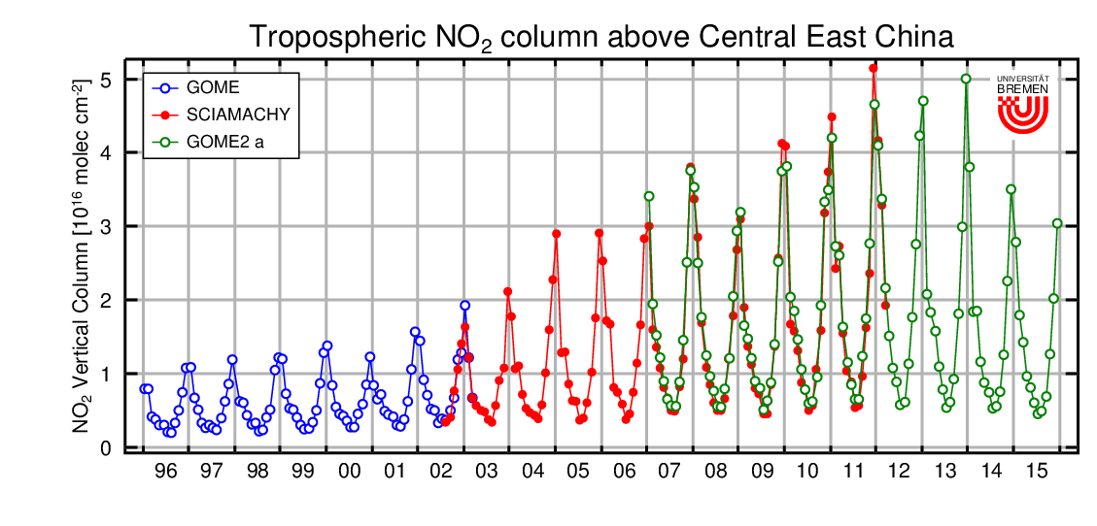
Satellite NO₂ Trends: The Global Picture
GOME annual changes in tropospheric NO₂
1996 - 2002
7 years of GOME satellite data
DOAS retrieval + CTM-stratospheric correction
seasonal and local AMF based on
1997 MOART-2 run
cloud screening
NO₂ reductions in Europe and parts of the US
strong increase over China
consistent with significant NO_{x} emission changes
A. Richter et al., Increase in tropospheric nitrogen dioxide over China observed from space, Nature, 437 2005

Slide 32
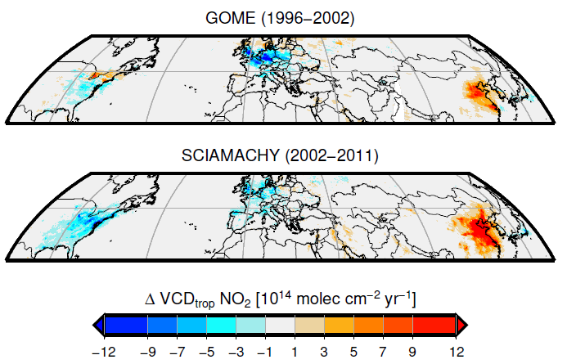
Satellite NO₂ Trends: The Global Picture
Hilboll, A., Richter, A., and Burrows, J. P.: Long-term changes of tropospheric NO₂ over megacities derived from multiple satellite instruments, Atmos. Chem. Phys. 13, 4145-4169, doi:10.5194/acp-13-4145-2013, 2013

Slide 33
Satellite NO₂ Trends: Caveats
What can explain the observed increase in NO₂ over China?
A GOME instrument drift
  => this should affect Japan as well but not SCIAMACHY
A change in viewing conditions as a result of changes in cloud cover, aerosol loading or vertical transport
  => there is no indication for this from the GOME data themselves
A change in NO to NO₂ partitioning at constant NO_{x} levels, for example as a result of a change in O₃
A change in NO₂ losses, for example as a result of decreased OH concentrations
An increase in NO₂ concentrations as a result of increased NO_{x} emissions

Slide 34
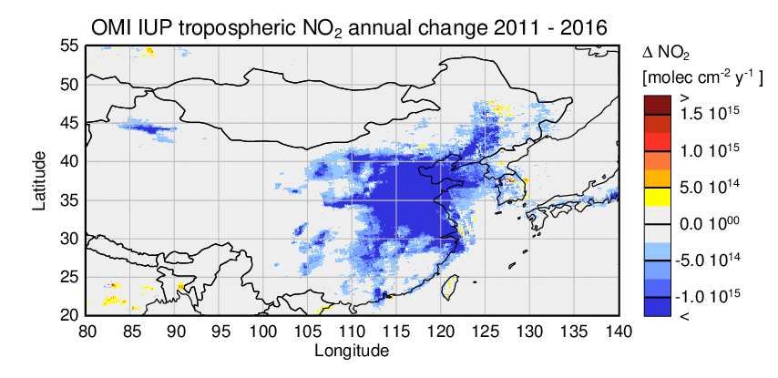
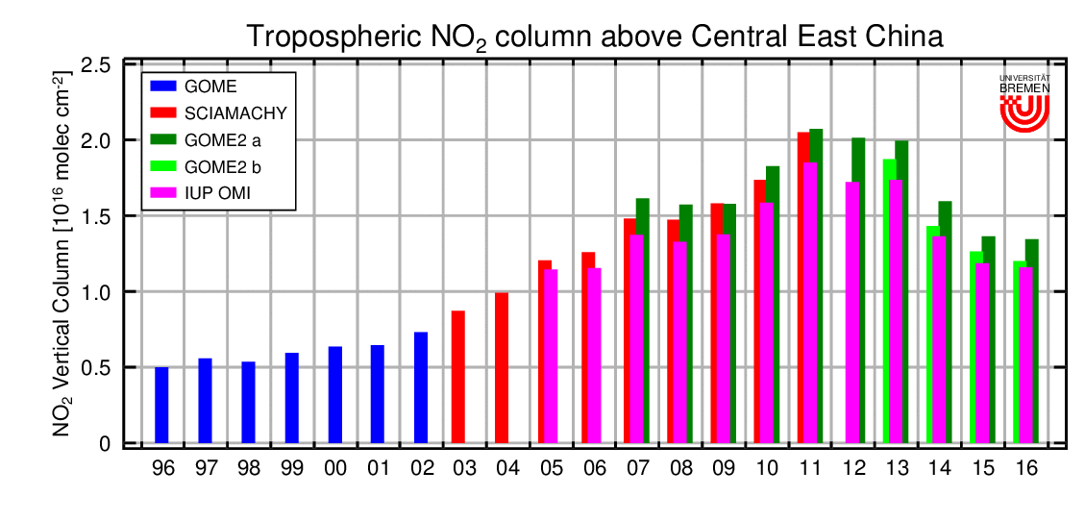
Satellite NO₂ trends: The last years
2011 – 2016:
NO₂ reduction nearly everywhere in China
Increase in NO₂ in Taiwan, Russia, India
2011 - 2016
Longterm evolution:
NO₂ maximum in
2011 – 2013
Then: rapid decrease
stabilisation in 2016
Data from all satellite instruments consistent
xx

Slide 35
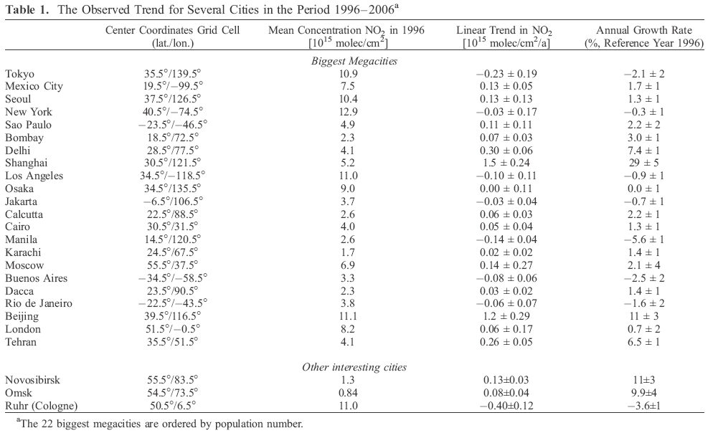
Satellite NO₂ Trends over large cities
van der A, R. J.et al. (2008), Trends, seasonal variability and dominant NOx source derived from a ten year record of NO2 measured from space, J. Geophys. Res., 113, D04302, doi:10.1029/2007JD009021.

Slide 36
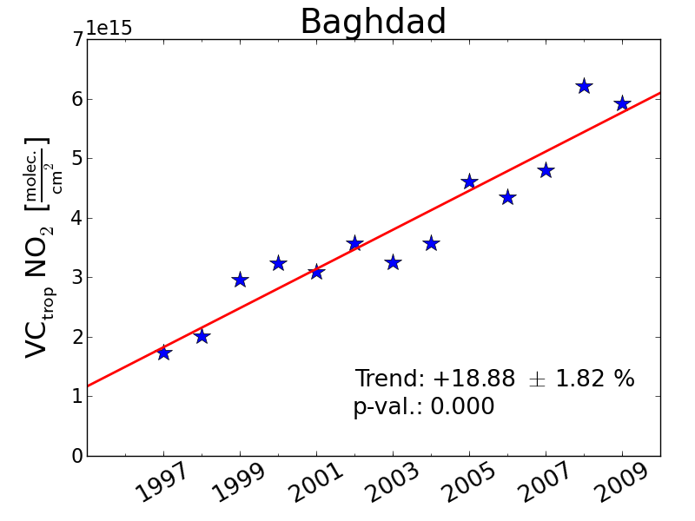
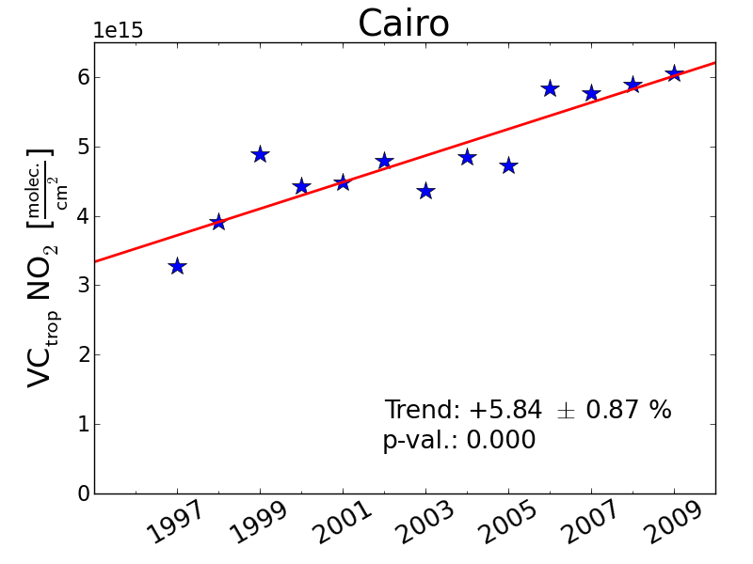
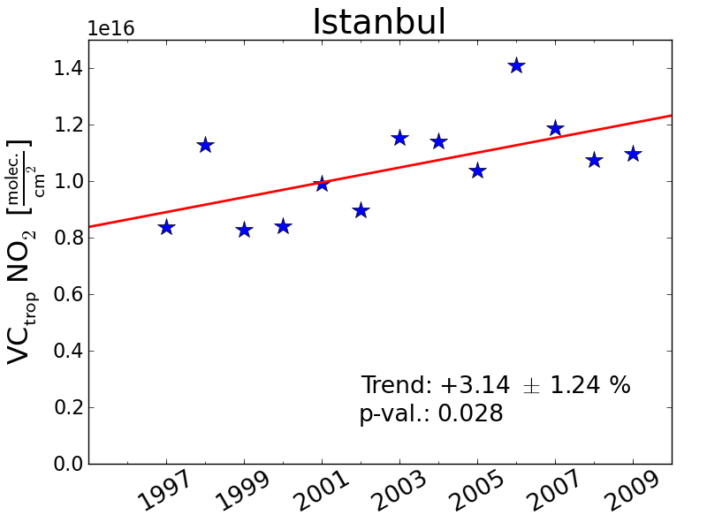
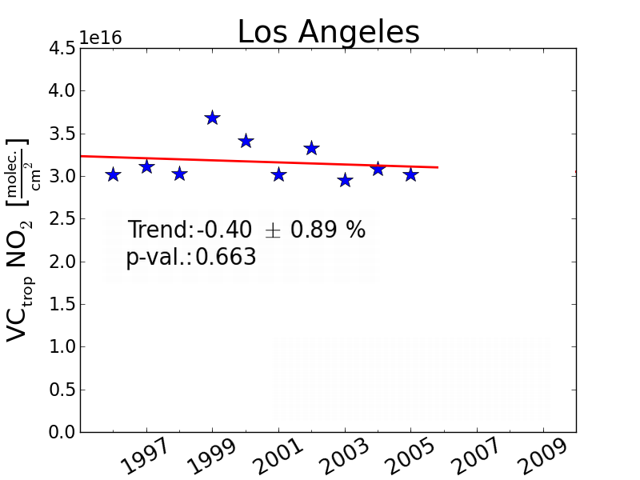
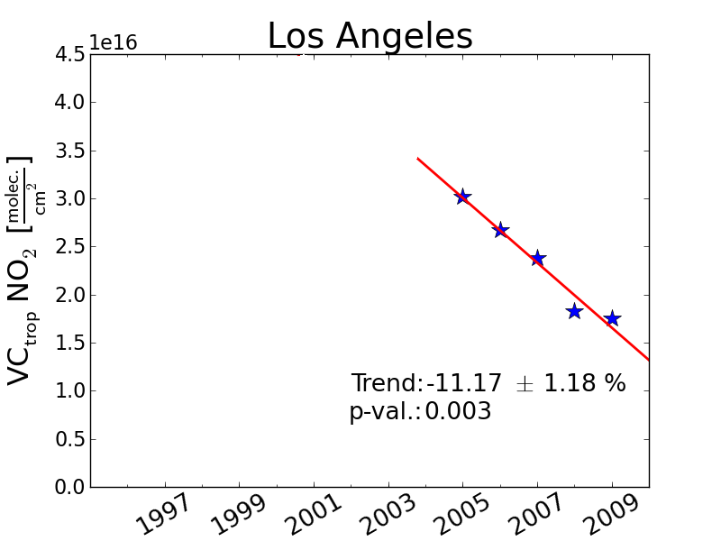
Satellite NO₂ Trends over large cities
NO₂ levels are changing in cities throughout the world. Contributing factors are
Urbanisation
Population growth
Increase in standard of living
changes in fuels used
Improvements in emission controls

Slide 37
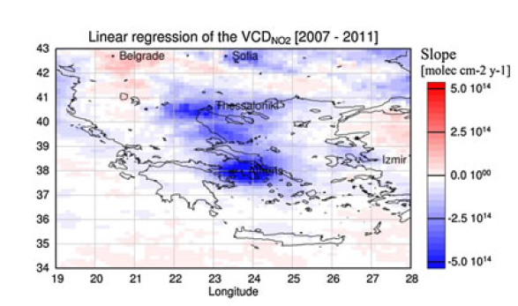
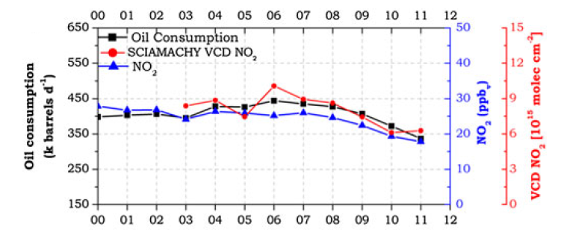
Satellite NO₂ Trends over large cities
Decreasing NO₂ trend over Greek cities
from 2007 – 2011
Both in satellite and surface data
Link to oil consumption
Effect of economic crisis
Vrekoussis, Met al., Economic crisis detected from space: Air quality observations over Athens/Greece, Geophys. Res. L ett., 40, doi:10.1002/grl.50118., 2013

Slide 38


NO₂ Trends above Middle East
Do conflicts have an impact on NO₂ pollution?
OMI data show consistent increase in NO₂ levels throughout the Middle East from 2005 – 2010
Israel shows no increase (pollution reduction)
After 2010, large reductions are seen in many countries, in particular in Syria and Iran
Saudi-Arabia and Kuwait implemented air pollution control measures
2005 - 2010
10¹⁵ molec cm²
Lelieveld, J., et al.: Abrupt recent trend changes in atmospheric nitrogen dioxide over the Middle East,
Sci. Adv., 1(7), doi:10.1126/sciadv.1500498, 2015.
2010 - 2014
10¹⁵ molec cm²

Slide 39


NO₂ Trends: Comparison with bottom up estimates
How do the satellite derived trends compare to bottom up estimates?
the latest bottom-up inventories agree qualitatively with satellite data
summer values agree even quantitatively
satellite problems in winter?
strong seasonality in emissions?
Q. Zhang et al., NOx emission trends for China, 1995–2004: The view from the ground and the view from space, J. Geophys. Res., 112, D22306, doi:10.1029/2007JD008684., 2007

Slide 40


NO₂ Trends: Comparison with bottom up estimates
GOME and SCIAMACHY
EDGAR v4.2
Overall pattern in emission data base is correct
Increase in China is underestimated
Increase in India and Middle East is overestimated
Decrease in Europe / US is underestimated
Hilboll, A., Richter, A., and Burrows, J. P.: Long-term changes of tropospheric NO₂ over megacities derived from multiple satellite instruments, Atmos. Chem. Phys. 13, 4145-4169, doi:10.5194/acp-13-4145-2013, 2013

Slide 41


NO₂ Trends above Europe
How do the satellite derived trends compare to bottom up estimates?
GOME and SCIAMACHY data over Europe + CHIMERE
Comparison to two versions of EMEP emissions
Excellent agreement in some regions, disagreement in others
Konovalov, I.et al., Satellite measurement based estimates of decadal changes in European nitrogen oxides emissions,
Atmos. Chem. Phys., 8, 2623-2641, 2008

Slide 42


NOx Emissions from Shipping
Ship emissions:
large source of NO_{x}, SO_{x} and aerosols
relevant input into marine boundary layer
well defined NO₂ patterns in Red Sea and Indian Ocean in GOME-2 data
consistent with pattern of shipping
With estimate of NO₂ lifetime, NO_{x} emissions can be estimated => agreement within error bars.
But: error bars still large (mainly from lifetime)
A. Richter et al., Satellite Measurements of NO2 from International Shipping Emissions,
Geophys. Res. Lett., 31, L23110, doi:10.1029/2004GL020822, 2004
A. Richter et al..: An improved NO2 retrieval for the GOME-2 satellite instrument, Atmos. Meas. Tech., 4, 1147-1159, doi:10.5194/amt-4-1147-2011, 2011
Franke et al., Atmos. Chem. Phys., 9,
7289-7301, 2009

Slide 43

Changes in NOx Emissions from Shipping
Trade and cargo volume is increasing
NO₂ over shipping regions shows similar trend
Economic crisis in 2008 created clear signature in both, trade volume and shipping NOx
de Ruyter de Wildt, M., H. Eskes, and K. F. Boersma (2012), The global economic cycle and satellite-derived NO2 trends over shipping lanes, Geophys. Res.Lett., 39, L01802, doi:10.1029/2011GL049541.

Slide 44

NOx Emission Trends: predictions
more or less constant in industrialised areas
increases in developing countries
large increases in Asia
large increases from shipping
Eyring et al., Atmos. Chem. Phys. Discuss., 6, 8553–8604, 2006

Slide 45


Diurnal variation of NOx emissions
SCIA – OMI tropospheric NO₂ August 2006
SCIAMACHY:
morning orbit (10:00 LT)
OMI:
noon orbit (13:30 LT)
expected changes in
photochemistry
=> less NO₂ around noon
emissions
=> depends on sources
=> SCIAMACHY 10-40% higher than OMI for most anthropogenic source regions
=> SCIAMACHY lower than OMI for biomass burning regions
F. Boersma et al., Intercomparison of SCIAMACHY and OMI tropospheric columns:
observing the diurnal evolution of chemistry and emissions from space J. Geophys. Res., 113, D16S26, doi:10.1029/2007JD008816

Slide 46




Diurnal variation of NOx emissions
Comparison with GEOS-Chem:
diurnal variation over biomass burning not correct
diurnal emission profile needs to be taken into account
better agreement is achieved
but: it’s only two points...
=> Geostationary needed
F. Boersma et al., Intercomparison of SCIAMACHY and OMI tropospheric columns: observing the diurnal evolution of chemistry and emissions from space J. Geophys. Res., 113, D16S26, doi:10.1029/2007JD008816

Slide 47

Are Emissions changing from NO to NO₂?
Conventional Wisdom:
all NO_{x} is emitted as NO
rapid conversion to NO₂ via reaction with O₃
Recent Developments:
measurements hint at up to 20%
of NO₂ emissions
oxidizing particulate traps in
diesel engines oxidize NO
this is going to increase!
Effects:
change in NO₂ concentrations in rural areas
effect on top-down emission estimates
shift in NO_{x} / NO_{y} chemistry
Primary NO₂ in London
David Carslaw. www.iaqm.co.uk/text/resources/no2_carslaw.pdf

Slide 48
Summary
NO_{x} (NO + NO₂) in the troposphere is relevant for ozone chemistry, acid deposition
NO_{x} emissions are both natural (soils, lightning, fires) and anthropogenic (fossil fuels, fires), the latter dominating
NO_{x} can be measured in-situ, NO₂ also by spectroscopic methods both locally and from satellite
satellite measurements provide interesting insights in many aspects of NO_{x} emissions and chemistry
NO_{x} emissions are changing with decreasing values in the already industrialised countries (improved technology, fuel changes) and increasing values in the industrialising countries (intensified used of fossil fuels) with some short term effects of economic crisis
technological changes can have unexpected results on NO_{x} emissions (e.g. diesel engines, soot filters)
=> we are not going to run out of interesting NO_{x} topics anytime soon!

Slide 49

Thank you for your attention
and
questions please!
http://www.animationlibrary.com/animation/25494/Alarm_jumps/

