Slide 1
Satellite Remote Sensing of Tropospheric Composition
Principles, results, and challenges
Lecture at the ERCA 2018
Grenoble, January 18, 2018
Andreas Richter
Institute of Environmental Physics
University of Bremen
Bremen, Germany
( richter@iup.physik.uni-bremen.de )

Slide 2
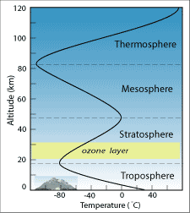
Overview
What is Remote Sensing?
How can the troposphere be probed by remote sensing?
What is the sensitivity of remote sensing measurements?
A few examples for tropospheric satellite observations
What is the future of satellite remote sensing?
https://media.quizizz.com/resource/gs/quizizz-media/questions

Slide 3
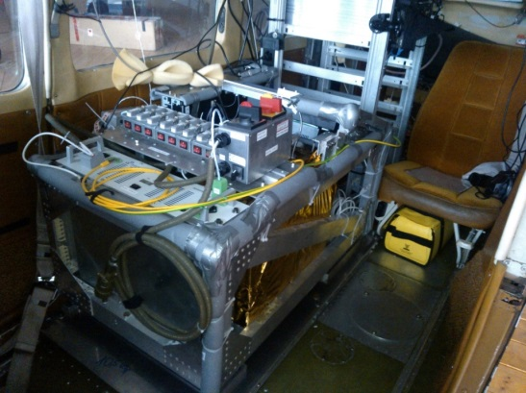
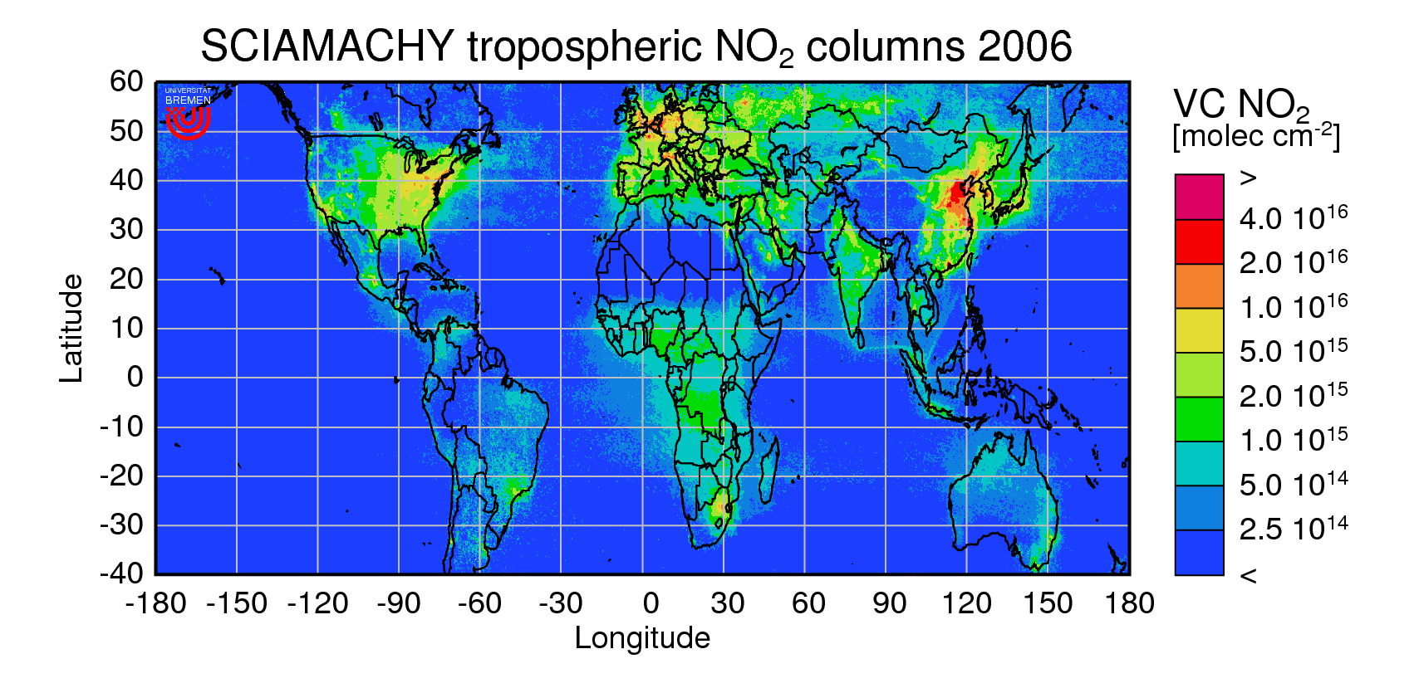
Who am I?
Leading UV/vis remote sensing group at Institute of Environmental Physics, University of Bremen, head: Prof. John Burrows.
Working on all aspects of UV/vis remote sensing
  Instruments (ground, airborne, satellite)
  Radiative transfer
  Retrieval algorithms
  Data interpretation
Some atmospheric topics I‘m interested in
  NOx emissions, distributions
  and chemistry
  Emission changes / trends
  Halogen chemistry in
  polar regions
www.doas-bremen.de

Slide 4


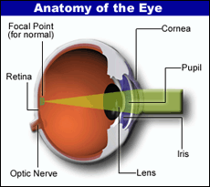

The Eye as a Remote Sensing Instrument
eye: remote sensing instrument in the visible wavelength region (350 - 750 nm)
signal processing in the eye and in the brain
colour (RGB) and relative intensity are used to identify surface types
large data base and neuronal network used to derive object properties

Slide 5


The Eye as a Remote Sensing Instrument
eyes are scanning the environment with up to 60 frames per second
170° field of view, 30° focus

Slide 6
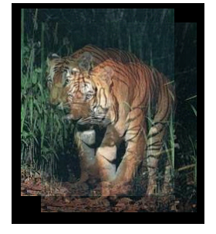
The Eye as a Remote Sensing Instrument
stereographic view, image processing, and a large data base enables detection of size, distance, and movement
!!!

Slide 7
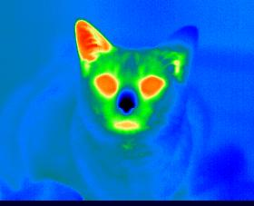
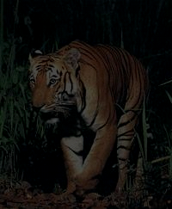
The Eye as a Remote Sensing Instrument
the human eye is a passive remote sensing instrument, relying on (sun) light scattered from the object
no sensitivity to thermal emission of objects unlike in some other animals
?
8-14 microns image of a cat

Slide 8

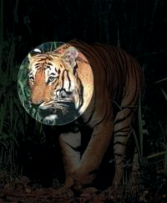
The Eye as a Remote Sensing Instrument
We can also apply active remote sensing by using artificial light sources
!!!

Slide 9
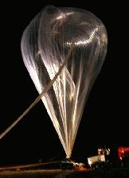

Schematic of Remote Sensing Observations
Validation
Changed Radiation
Radiation
Sensor
Object
What we already know
Measurement
A priori information
What we see
Data Analysis
Final Result
Forward Model
What we should see

Slide 10
The Electromagnetic Spectrum
nearly all energy on Earth is supplied by the sun through radiation
wavelengths from many meters (radio waves) to nm (X-ray)
short wavelength = high energy
radiation interacts with atmosphere and surface
  absorption (heating, shielding)
  excitation (energy input, chemical reactions)
  re-emission (energy balance)

Slide 11
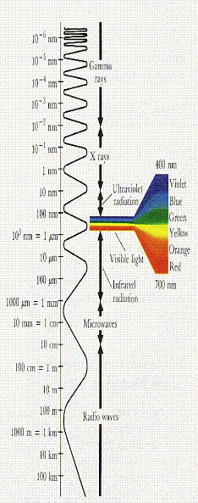
Wavelength Ranges in Remote Sensing
UV: some absorptions + profile information
aerosols
vis: surface information (vegetation)
some absorptions
aerosol information
IR: temperature information
cloud information
water / ice distinction
many absorptions / emissions
+ profile information
MW: no problems with clouds
ice / water contrast
surfaces
some emissions + profile information

Slide 12

Radiative Transfer in the Atmosphere
passive sensor, UV / visible / IR
Atmosphere
Absorption
Scattering from a cloud
Emission from
a cloud
Transmission through a cloud
Scattering
Emission
Cloud
Aerosol / Molecules
Scattering within a cloud
Scattering / reflection on a cloud
Transmission through a cloud
Scattering / Reflection on the ground
Emission from
the ground
Absorption on the ground

Slide 13
Typical light paths: UV
altitude
Dark surface
Strong Rayleigh scattering
Most photons are scattered above absorption layer
=> Low sensitivity to BL signals!
sensitivity

Slide 14
Typical light paths: visible
altitude
Brighter surface
Significant Rayleigh Scattering
Many photons are scattered above absorption layer
=> Reduced sensitivity to BL signals!
sensitivity

Slide 15
Bright surface (snow, ice): UV and visible
altitude
Surface reflection dominates
Multiple scattering in surface layer
=> Enhanced sensitivity to BL signals!
sensitivity

Slide 16
Typical light paths: NIR
altitude
Bright surface (except for oceans)
Negligible Scattering
Very good sensitivity to BL signals …
But only over land
sensitivity

Slide 17
Typical light paths: thermal IR
Radiation is emitted from different altitudes
Sensitivity to surface layer depends on thermal contrast
=> Usually low sensitivity to BL signals!
altitude
sensitivity

Slide 18
Thermal IR with high thermal contrast (deserts)
Radiation is emitted from different altitudes and from the surface
If surface is hotter than lower atmospheric layer, good sensitivity to BL signals!
altitude
sensitivity

Slide 19
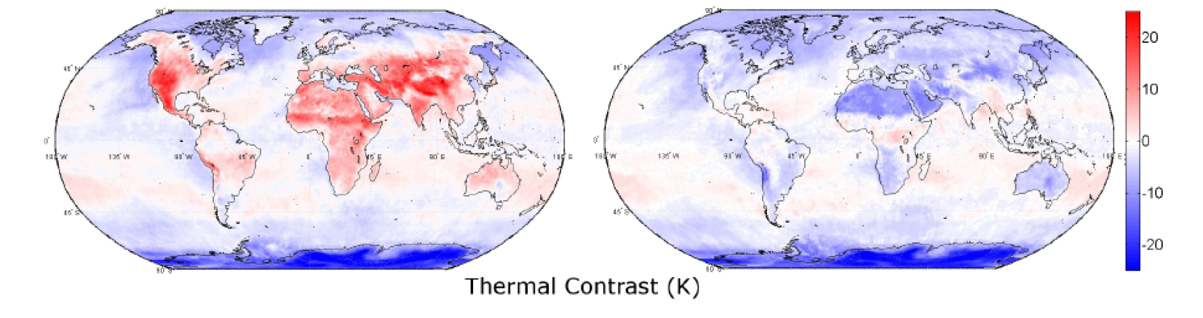
Example: Thermal Contrast IASI
Day Night
Clerbaux, C., et al., Atmos. Chem. Phys., 9, 6041–6054, 2009
Thermal contrast (temperature difference between surface and first atmospheric layer) is highest in the morning over barren land
Vertical sensitivity varies in space and time

Slide 20
Vertical sensitivity of satellite measurements
The sensitivity of the satellite measurements depends on the altitude of the absorbing layer
This is often expressed in the form of weighting functions which give the sensitivity of the signal as function of altitude of the trace gas layer
As the vertical distribution can usually not be (completely) determined from the measurements, a priori information is needed in the retrieval
The dependence of the retrieved quantity on the real atmospheric profile depends on both, the sensitivity of the measurements and the assumptions made in the a priori
This is often expressed as averaging kernels which describe the sensitivity of the retrieved quantity on the amounts of trace gas in the different altitudes in the atmosphere
Comparison of satellite retrievals with other measurements are only meaningful if the averaging kernels are accounted for

Slide 21
Vertical sensitivity of satellite measurements
In the retrieval process, the vertical sensitivity is accounted for
For IR measurements, it can be well estimated from the temperature measurements
For UV/vis measurements, aerosols and surface reflectance are often a problem
Where there is no sensitivity, the a priori will be retrieved
altitude
altitude
sensitivity
concentration
A priori
Estimated sensitivity
real profile
retrieved profile

Slide 22
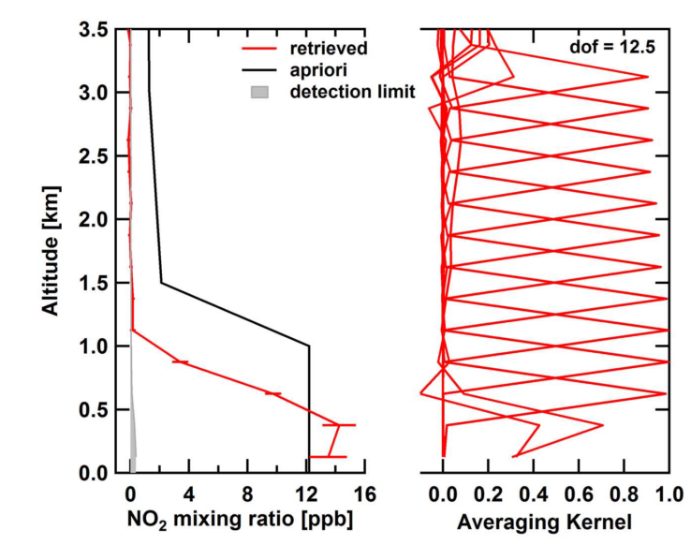
Example: Averaging Kernels for airborne NO₂ measurements
Aircraft flying successively at different altitudes (“missed approach”)
Very large sensitivity at flight altitude
Sharp and well separated averaging kernels
Large number of degrees of freedom (DOFS)
Good profile retrieval
Baidar et al., Atm. Meas. Tech., 2013

Slide 23
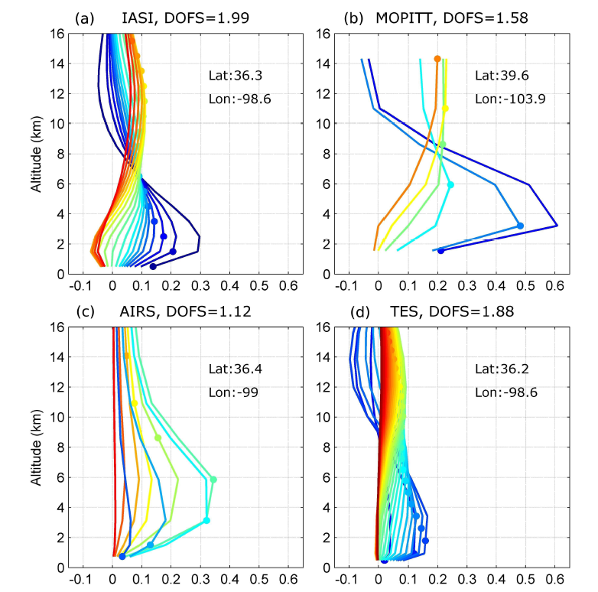
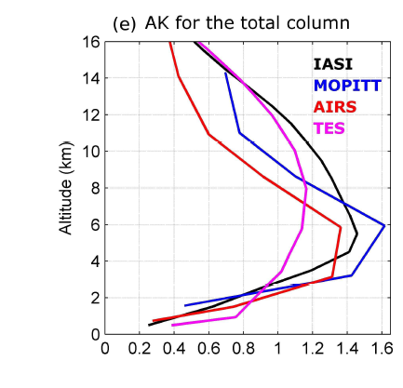
Example: Averaging Kernels for satellite CO
Depending on spectral resolution and wavelength, the number of degrees of freedom (DOFS) varies, as well as the shape of the averaging kernels
George et al., Atmos. Chem. Phys., 9, 8317–8330, 2009

Slide 24
How do we get vertical resolution in nadir IR observations?
Thermal infrared measurements have intrinsic altitude information from
Pressure broadening
Temperature dependence of line strengths
Pressure shift
The amount of vertical information depends on
Spectral resolution of the measurement
Signal to noise ratio
The molecule
Thermal contrast
Low p
High p
intensity
wavenumber

Slide 25
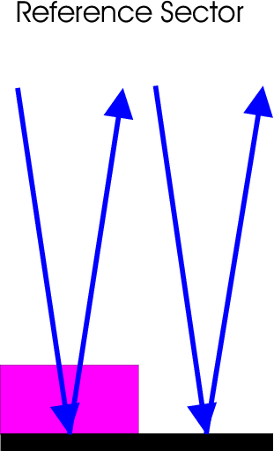
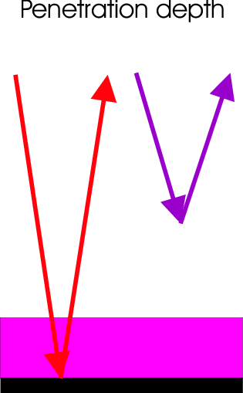
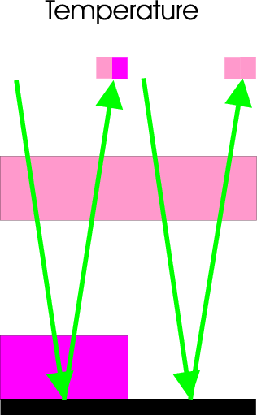
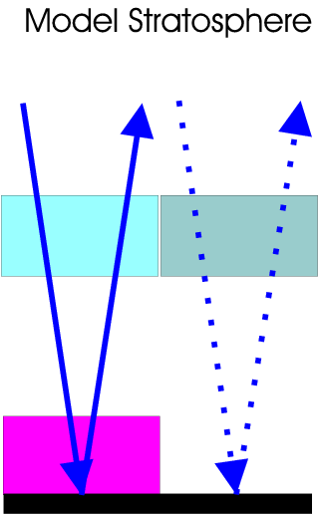
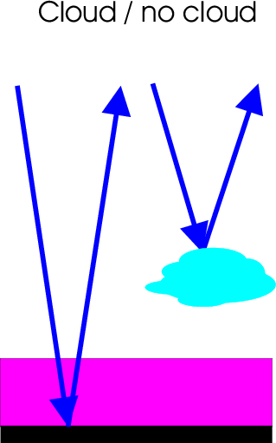
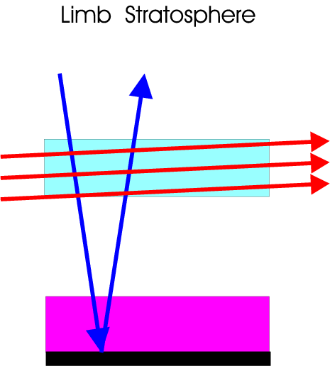
How do we get vertical resolution in nadir UV/vis observations?
Assimilated Stratosphere
Basic problem:
Nadir measurements contain stratospheric and tropospheric absorptions and in many cases no intrinsic vertical information

Slide 26
Clouds in UV/vis : Shielding Effect
50% cloud cover but only 6,25% surface contribution!
the part of an absorber profile situated below a cloud is basically “hidden” from view for the satellite
only through thin clouds over reflecting surfaces, sensitivity towards the lower part of the profile is still relevant
the shielding effect is larger than expected from the geometrical size of the cloud because of its brightness
Rayleigh scattering
albedo = 0.75
albedo = 0.05

Slide 27
Clouds in UV/vis : Albedo Effect
some photons are scattered before reaching the absorber
the part of an absorber above a cloud is better visible from space as the ratio of photons that go through it increases through the albedo effect
Rayleigh scattering
most photons are absorbed on the ground
albedo = 0.05

Slide 28
Clouds in UV/vis : Albedo Effect
many photons are scattered below the absorber
the part of an absorber above a cloud is better visible from space as the ratio of photons that go through it increases through the albedo effect
Rayleigh scattering
altitude
albedo = 0.75
cloud
albedo = 0.05
sensitivity

Slide 29
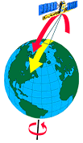
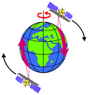
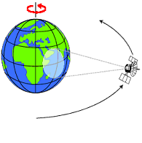
Satellite Orbits
(Near) Polar Orbit:
orbits cross close to the pole
global measurements are possible
low earth orbit LEO (several 100 km)
ascending and descending branch
special case: sun-synchronous orbit:
  overpass over given latitude always at the same local time, providing similar illumination
  for sun-synchronous orbits: day and night branches
Geostationary Orbit:
satellite has fixed position relative to the Earth
parallel measurements in a limited area from low to middle latitudes
36 000 km flight altitude, equatorial orbit
http://www2.jpl.nasa.gov/basics/bsf5-1.htm
http://www.ccrs.nrcan.gc.ca/ccrs/learn/tutorials/fundam/chapter2/chapter2_2_e.html

Slide 30
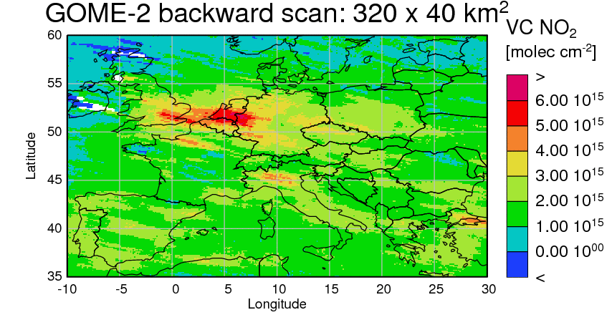
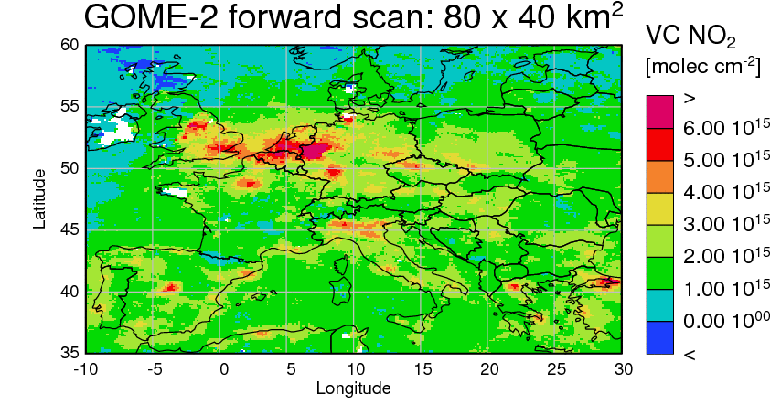
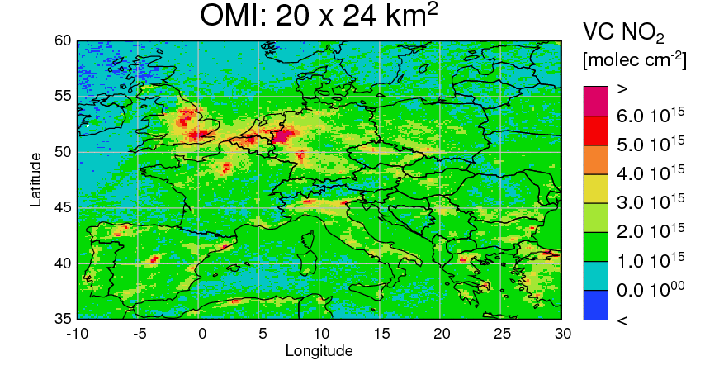
Effect of Spatial Resolution: Example NO₂
OMI: 13:30 LT
For species with short atmospheric life time, horizontal variability is large
Spatial resolution of sensor is relevant for interpretation
Spatial resolution also influences cloud fraction
Time of overpass may also play a role!

Slide 31
Why do we need satellite measurements?
not all measurement locations are accessible (atmosphere, ice, ocean)
remote sensing facilitates analysis of long time series and extended measurement areas
for many phenomena, global measurements are needed
remote sensing measurements usually can be automated
often, several parameters can be measured at the same time
on a per measurement basis, remote sensing measurements usually are less expensive than in-situ measurements

Slide 32
What is problematic about satellite measurements?
remote sensing measurements are always indirect measurements
the electromagnetic signal is often affected by more things than just the quantity to be measured
usually, additional assumptions and models are needed for the interpretation of the measurements
usually, the measurement area / volume is relatively large
validation of remote sensing measurements is a major task and often not possible in a strict sense
estimation of the errors of a remote sensing measurement often is difficult

Slide 33
Comparison of different observation options
Nadir:
view to the surface
good spatial resolution
little vertical resolution
Limb:
good vertical resolution,
but only in the UT/LS region
large cloud probability
UV/vis/NIR:
sensitivity down to surface
relevant species observable
limited number of species
daytime only
no intrinsic vertical resolution in nadir
aerosols introduce uncertainties in light path
IR:
large number of potential species
day and night measurements
some vertical resolution in nadir
weighted towards middle troposphere
problems with strong absorbers
problems with dark (solar IR) or
cold (thermal IR) surfaces

Slide 34

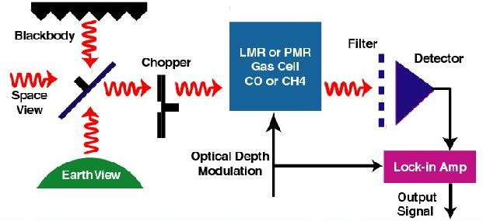
MOPITT
Instrument: IR gas correlation spectrometer with pressure modulation
Operational since March 2000
Spatial resolution: 22 x 22 km²
Day + night measurements
Global coverage: 3.5 days
Species: CO (1 – 2 DOFS)

Slide 35
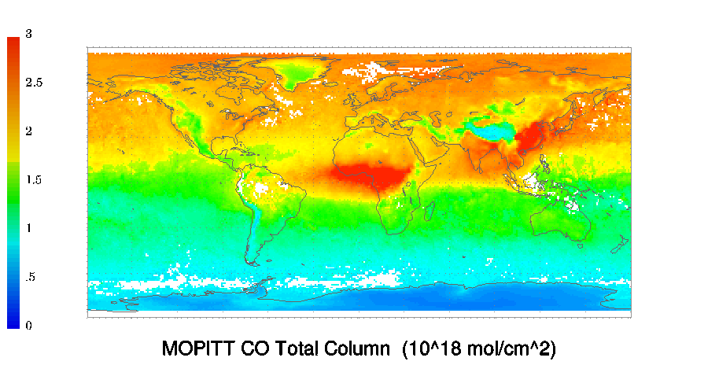
MOPITT: CO column
MOPITT CO column January 2009
CO total column [101⁸ moelc cm⁻²]
Hemispheric gradient
Topography
Pollution in Asia
Biomass burning in Africa
http://www.acd.ucar.edu/mopitt/

Slide 36
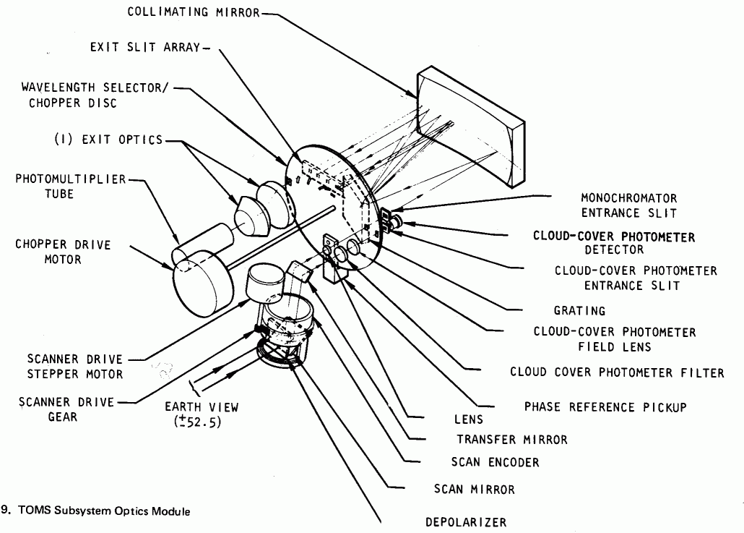
TOMS
Instrument: UV discrete (6) wavelengths grating spectrometer
Operational: October 1978 - 2004
Spatial resolution: 50 x 50 km²
Global coverage: 1.5 days
Species: O₃, SO₂

Slide 37
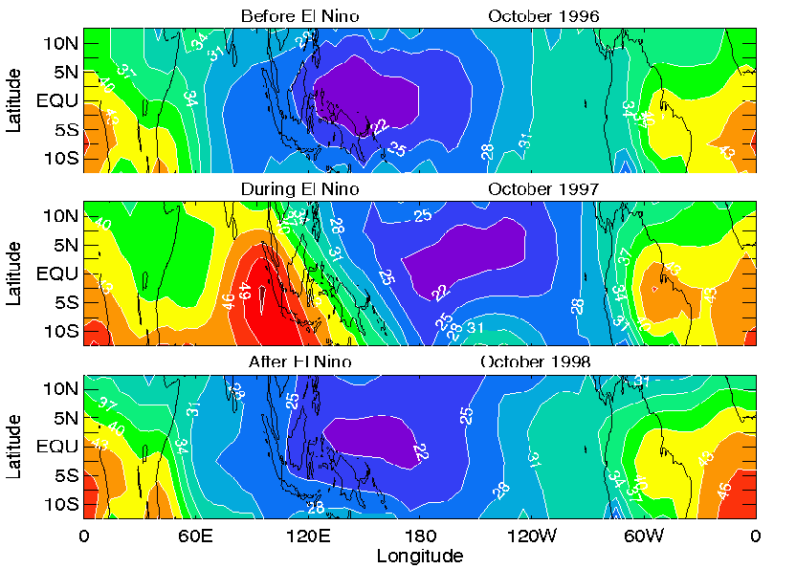
TOMS: Ozone columns
Large scale tropospheric ozone patterns retrieved using the cloud slicing method
During El Nino year, clear ozone maximum over Indonesia
Origins: photochemical smog from biomass burning and change in circulation pattern
Ziemke, J. R et al., (2001), “Cloud slicing”: A new technique to derive upper tropospheric ozone from satellite measurements, J. Geophys. Res., 106(D9), 9853–9867

Slide 38

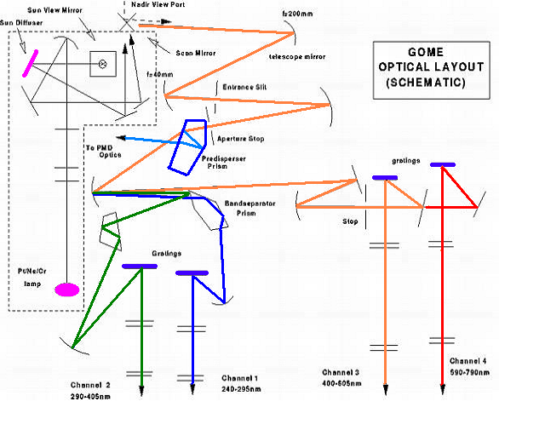
GOME / GOME-2
GOME-2 A
on MetOp A since 1.2007
80 x 40 km²
1.5 days
40 x 40 km²
3 days
GOME-2 B
on MetOp B since 1.2013
80 x 40 km²
1.5 days
Instrument: 4 channelUV/vis grating spectrometer
Operational on ERS-2 7.1995 – 6.2003 - 2011
Spatial resolution 320 x 40 km²
Global coverage: 3 days
Species: O₃, NO₂, HCHO, CHOCHO, BrO, IO, SO₂, H₂O

Slide 39
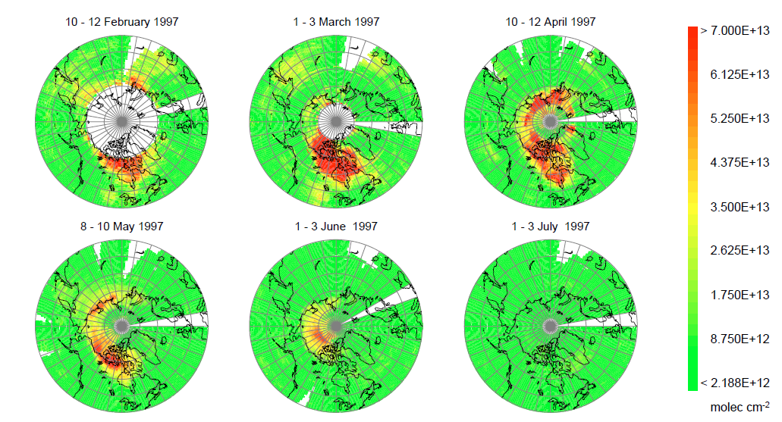
GOME: Polar springtime BrO
Richter, A. et al., GOME observations of tropospheric BrO in Northern Hemispheric spring and summer 1997, Geophys. Res. Lett., No. 25, pp. 2683-2686, 1998.
Large regions of enhanced boundary layer BrO in polar spring
Autocatalytic release of Br from sea salt from aerosols / frost flowers /
ice surfaces
Rapid ozone destruction and link to Hg chemistry

Slide 40
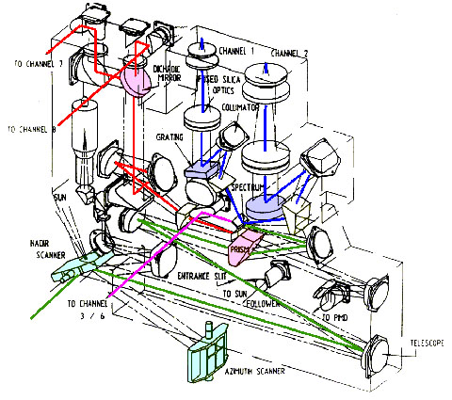
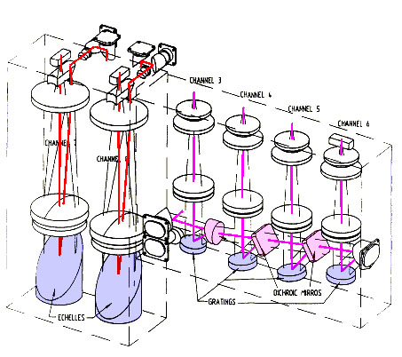
SCIAMACHY
    scanner modules
    telescope
    pre-disperser
    UV channels 1-2
    Vis channels 3-4
    NIR channels 5-6
    SWIR channels 7-8
www.sciamachy.de
Instrument: 8 channel UV/vis/NIR grating spectrometer
nadir, limb + occultation measurements
Operational on ENVISAT 8.2003 – 4.2012
Spatial resolution (30) 60 x 30 km²
Global coverage: 6 days
Species: O₃, NO₂, HCHO, CHOCHO, BrO, IO, SO₂, H₂O, CH₄, CO₂, CO

Slide 41
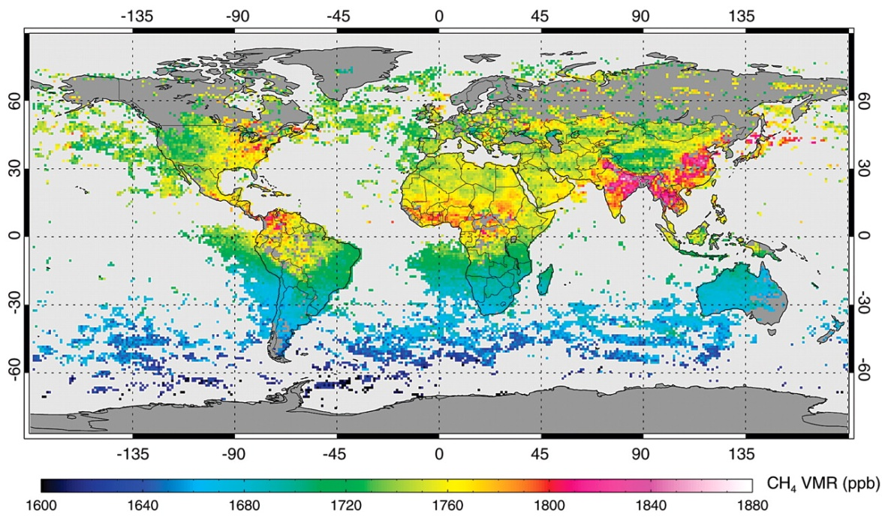
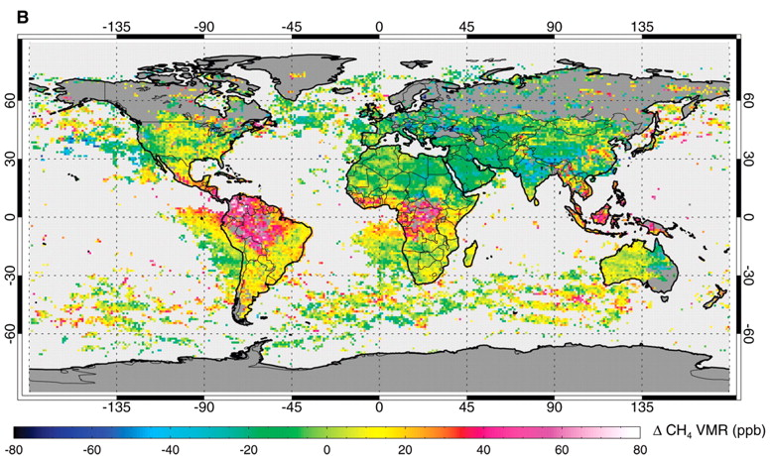
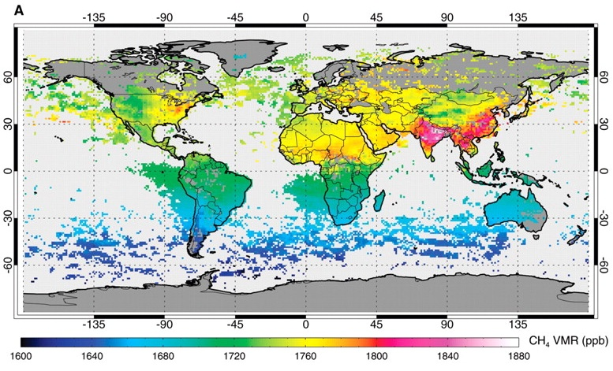
SCIAMACHY: Methane: The missing tropical source
SCIAMACHY
SCIAMACHY measurements and atmospheric models agree well over most of the globe
In the tropics, the model underestimates SCIAMACHY measurements
This indicates a tropical CH₄ source missing in current models
Important to assess impact of anthropogenic activities
Effect is smaller using current satellite data version but still there
SCIAMACHY – TM3
TM3 (model)
Frankenberg et al., science, 308. no. 5724, pp. 1010 - 1014
DOI: 10.1126/science.1106644, 2005

Slide 42
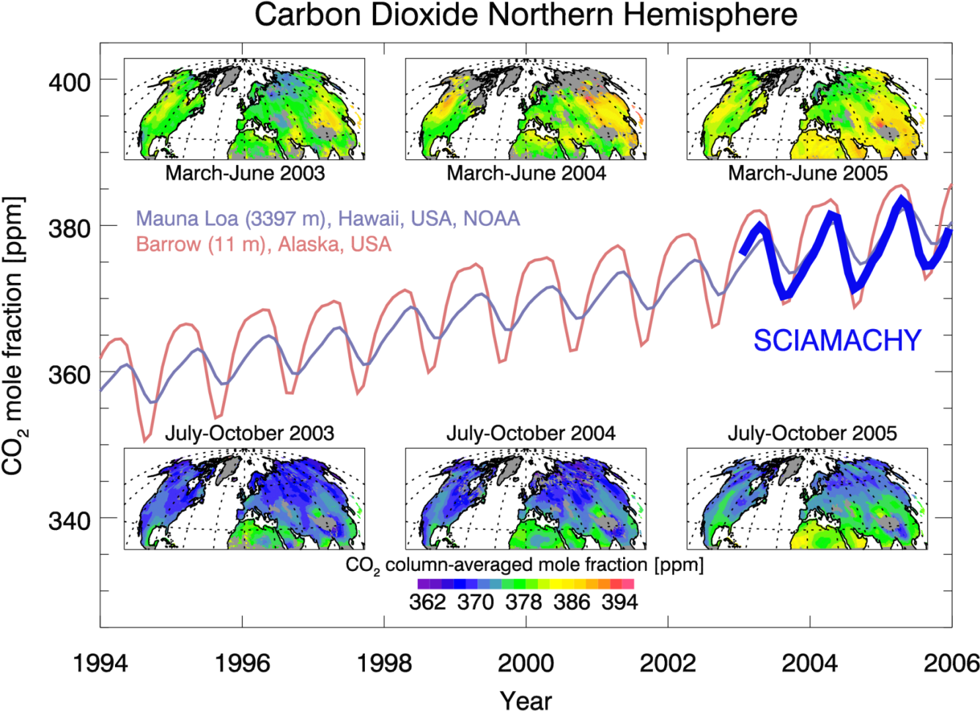
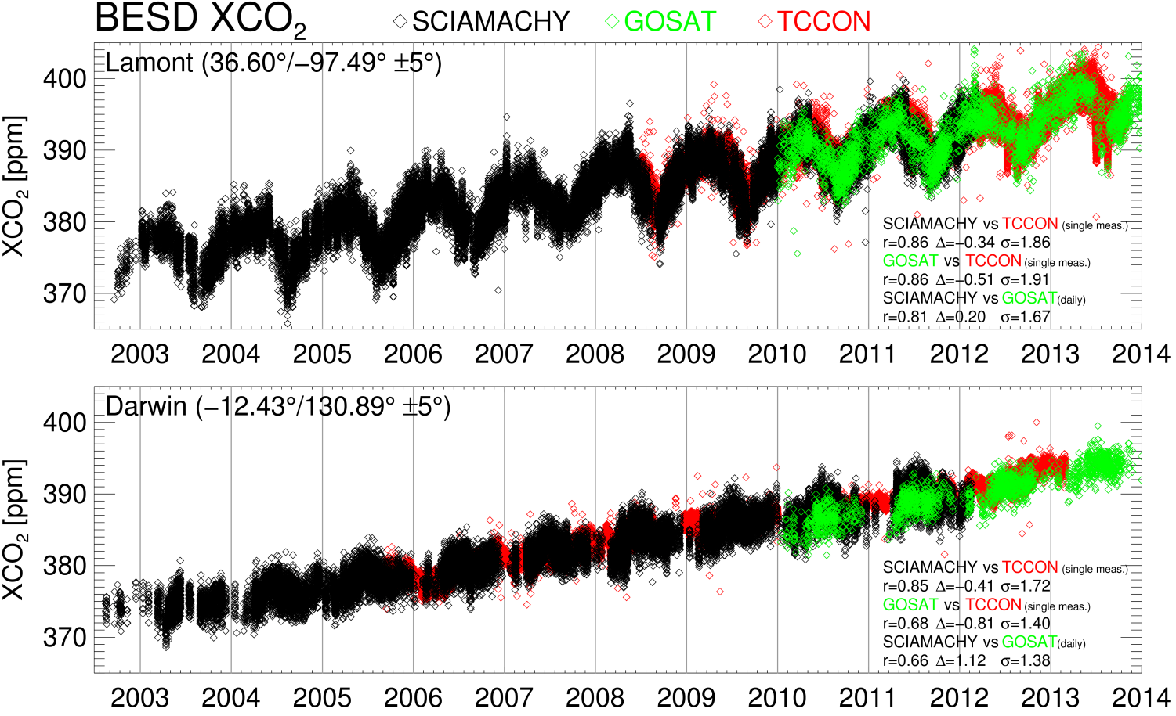
SCIAMACHY: CO₂ in the Northern Hemisphere
SCIAMACHY and GOSAT: CO₂
Buchwitz et al., ACP, 2007;
Schneising et al., ACP, 2008
Buchwitz et al., personal communication, 2014
Detection of annual cycle
Detection of year-to-year increase
Detection of spatial variability
Not yet accurate enough for Kyoto monitoring on country level

Slide 43

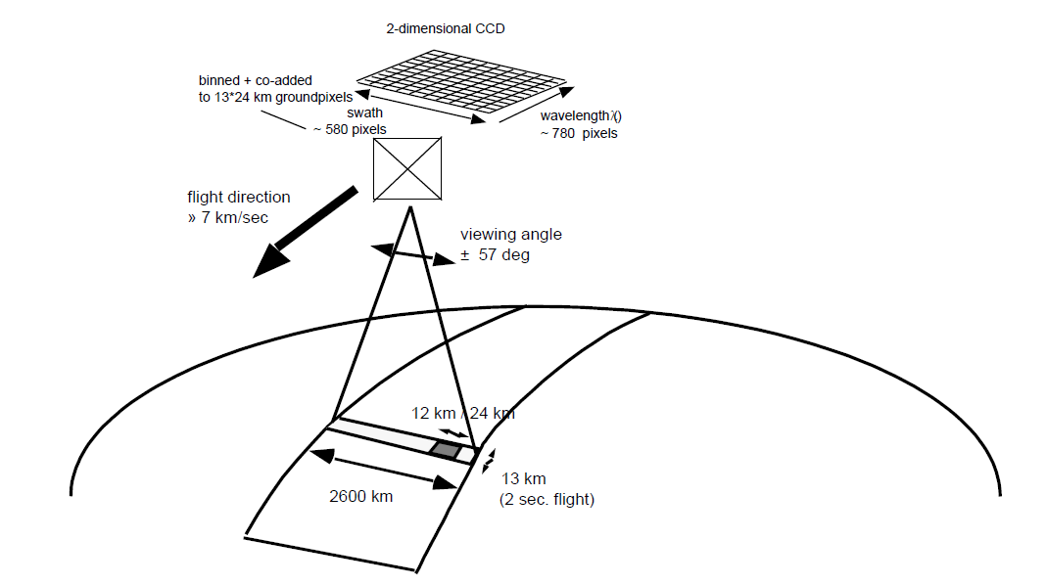
OMI
Instrument: UV/vis imaging grating spectrometer (push-broom)
Operational on Aura since October 2004
Spatial resolution: up to 13 x 24 km²
Global coverage: 1 day
Species: O₃, NO₂, HCHO, CHOCHO, BrO, SO₂
www.knmi.nl/omi/

Slide 44
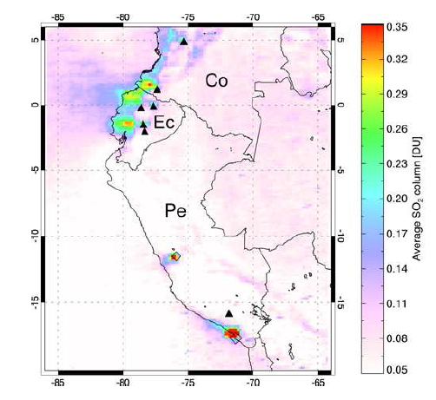
OMI: SO₂ columns
SO₂ signals from volcanoes in Ecuador and Columbia
Clear signature of Peruvian copper smelters
Very large sources of local pollution
Effect of (temporary) shut down and (permanent) implementation of emission reductions (H₂SO₄ production) can be monitored
9.2004 – 6.2005
Carn, S. A., et al., t (2007), Sulfur dioxide emissions from Peruvian copper smelters detected by the Ozone Monitoring Instrument, Geophys. Res. Lett., 34, L09801, doi:10.1029/2006GL029020.

Slide 45

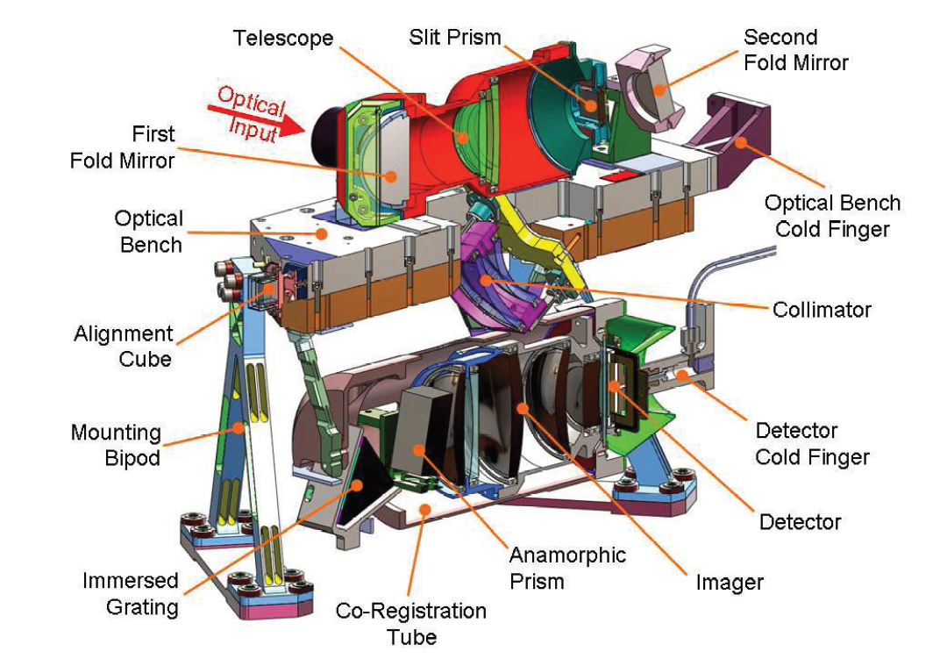
TROPOMI on Sentinel 5-P
Instrument: UV/vis/SWIR imaging grating spectrometer (push-broom)
Launched October 2017, operational from July 2018
Spatial resolution: up to 3.5 x 7 km²
Global coverage: 1 day
Species: O₃, NO₂, HCHO, CHOCHO, BrO, SO₂, H₂O, CO, CH₄, CO₂
www.tropomi.eu

Slide 46
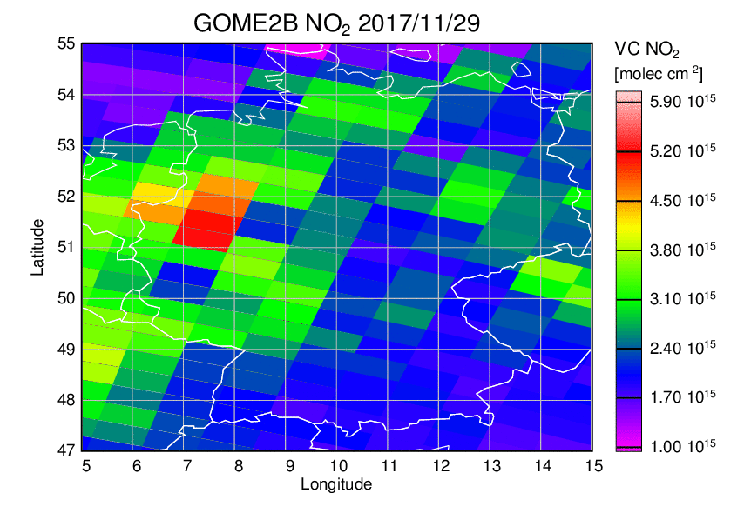
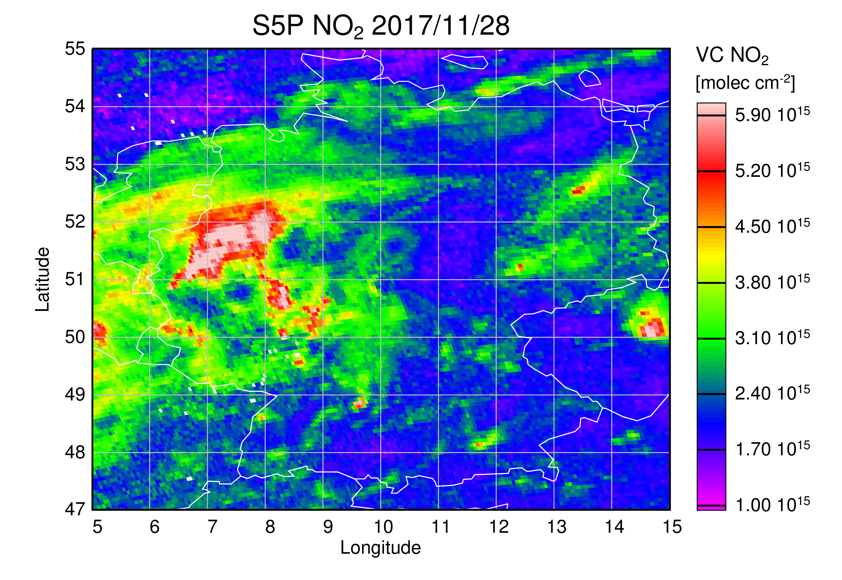
S5P: NO₂ columns
Preliminary!
Preliminary test data from December 2018, IUP Bremen analysis, not quantitative, no cloud screening, no error flagging, no QA
Very large improvement in spatial detail, separation of cities and power plants, atmospheric transport, …

Slide 47
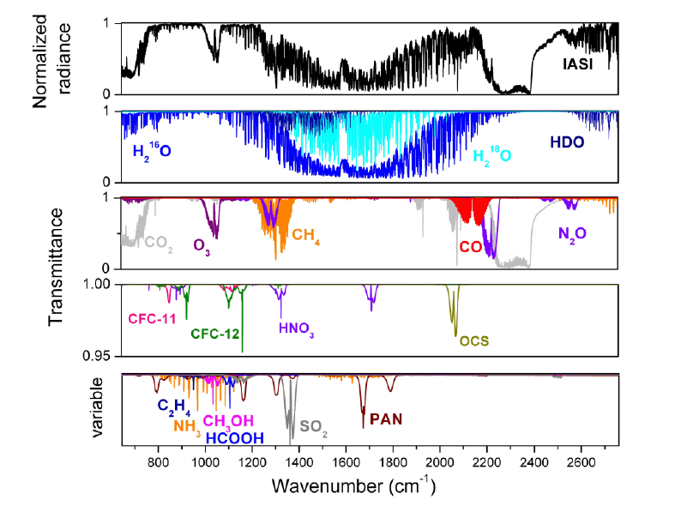
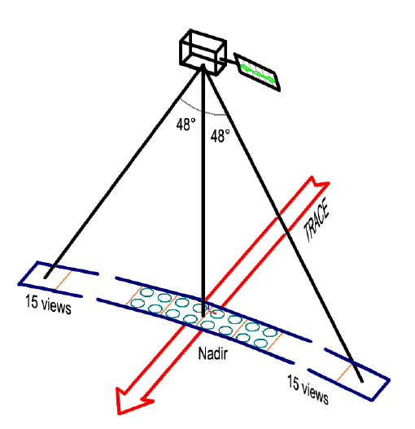
IASI
Clerbaux, C., et al., Atmos. Chem. Phys., 9, 6041–6054, 2009
Instrument: IR Fourier Transform Spectrometer, 0.5 cm⁻¹
Operational on MetOp-A since Jan. 2007, on MetOp-B since 1.2013
Spatial resolution: circular, 12 km diameter
Global coverage 2x per day (day and night)
Species: H₂O, HDO, CH₄, O₃, CO, HNO₃, NH₃, CH₃OH, HCOOH, C₂H₄, SO₂, CO₂, N₂O, CFC-11, CFC-12, HCF-22, OCS, ...

Slide 48
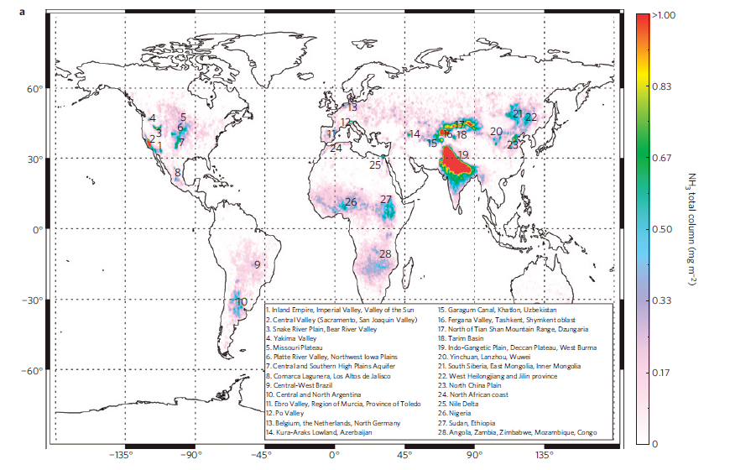
IASI: NH₃
Clarisse et al., nature geoscience, doi:10.1038/ngeo551, 2009
First global measurement of Ammonia
Ammonia hot-spots where intense agriculture / livestock leads to high emissions
Relevant for particulate formation and acidification / eutrophication

Slide 49
Summary and Conclusions
Satellite observations of tropospheric composition in the UV/vis, NIR and thermal IR provide consistent global datasets for many species including major air pollutants such as O₃, CO, NO₂, and HCHO
The measurements are averaged horizontally and vertically which makes them difficult to compare to point measurements
Remote sensing in an indirect method that necessitates use of a priori information in the data retrieval which has an impact on the results
Visible and NIR measurements provide good sensitivity to the boundary layer, the thermal IR has intrinsic vertical information
In spite of the relative large uncertainties involved in satellite remote sensing, they provide a unique source of information on the composition of the troposphere

Slide 50
What is the future of satellite measurements of tropospheric trace gases?
Satellite measurements will be improved by
  Better spatial resolution (Sentinel 5P, Sentinel 5, CARBONSAT)
  Better temporal resolution (geostationary observations Sentinel 4)
  Better coverage of species and vertical resolution (extension of the wavelengths covered (from UV to IR)
  Better precision (higher spectral resolution in the IR)
  High vertical resolution (active systems)
The usefulness of satellite data will be improved by better integration with other measurements
Satellite data will be strongly integrated in atmospheric models

Slide 51
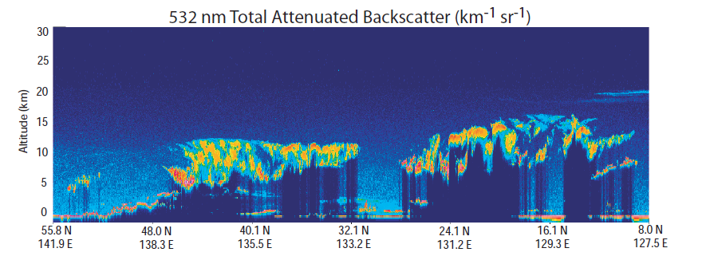
Active measurements: CALIOP aerosol
http://www-calipso.larc.nasa.gov/

Slide 52

Thank you for your attention
and
questions please!
www.doas-bremen.de
http://www.animationlibrary.com/animation/25494/Alarm_jumps/

