Slide 1
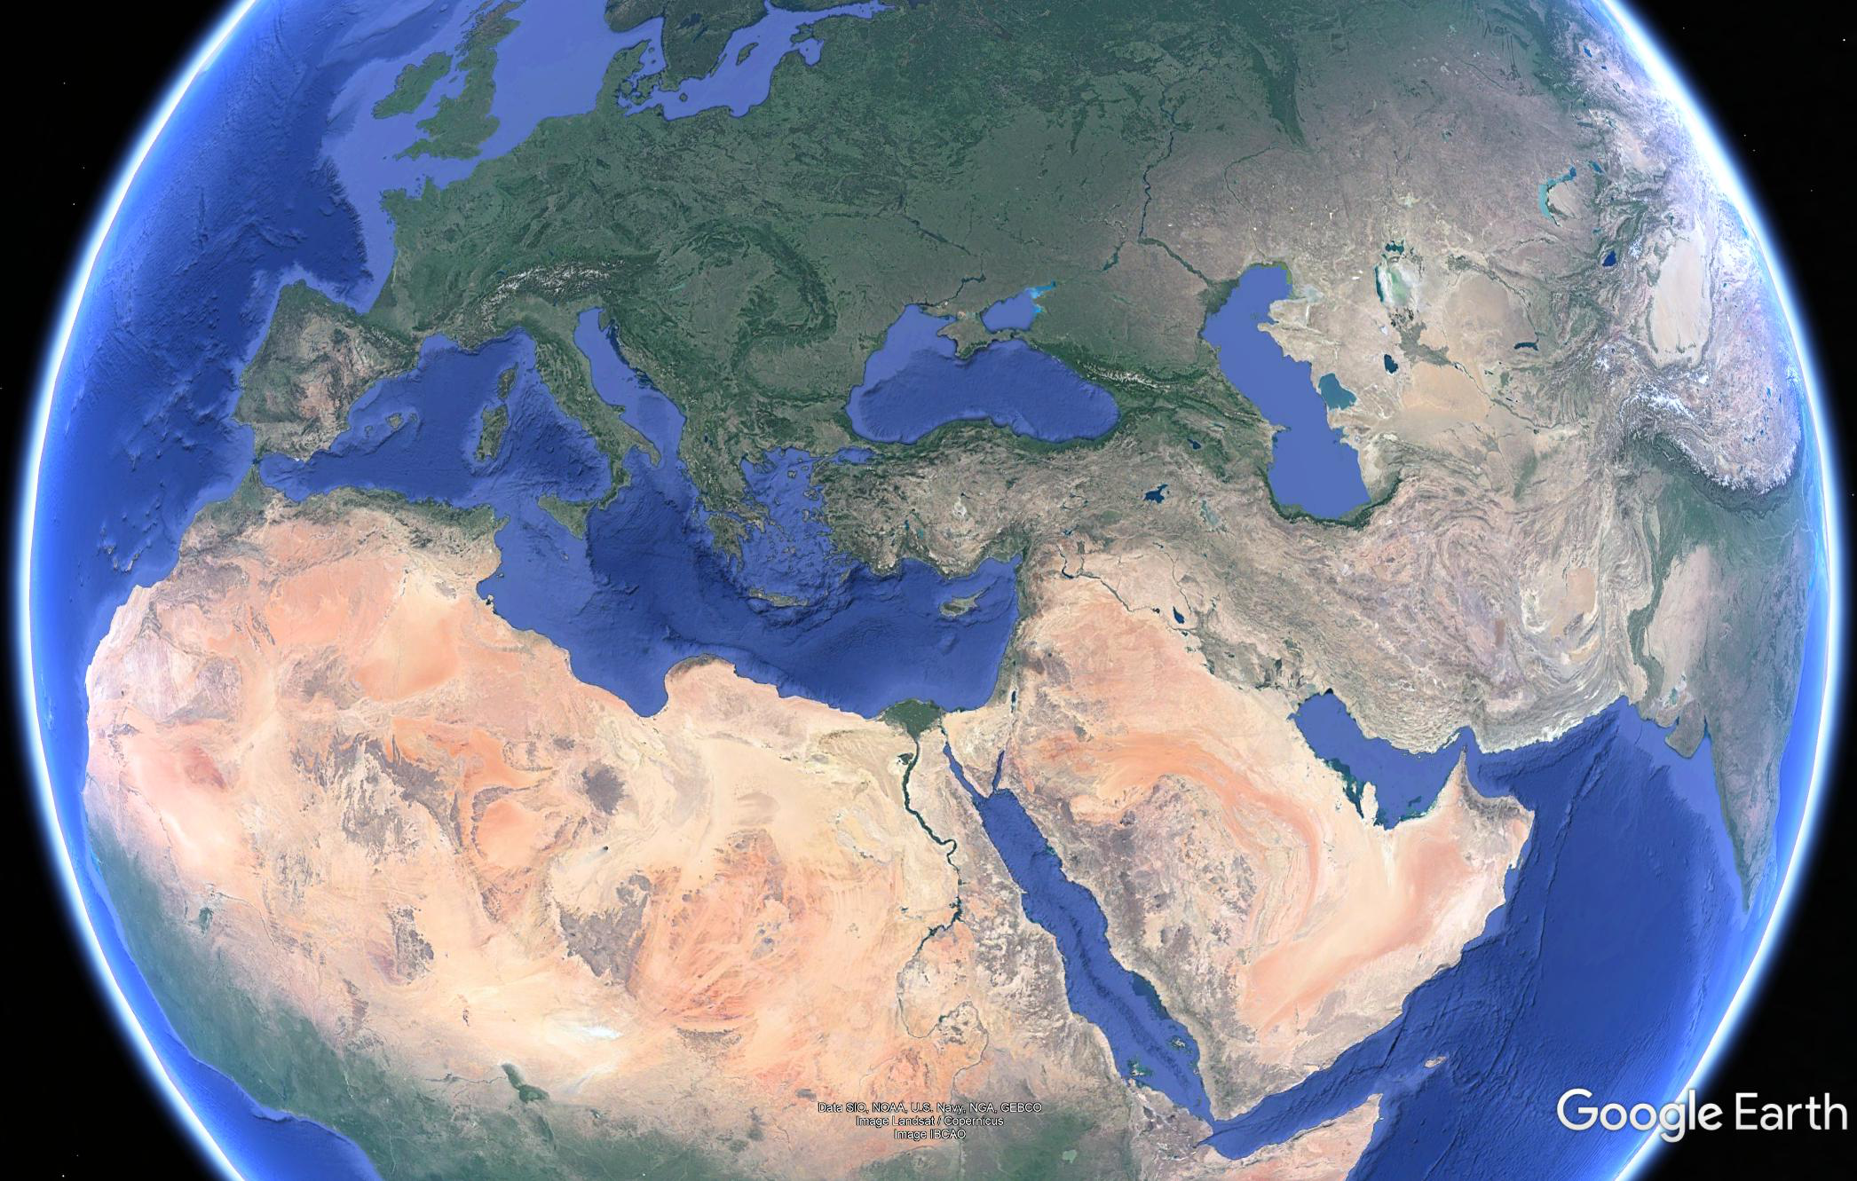

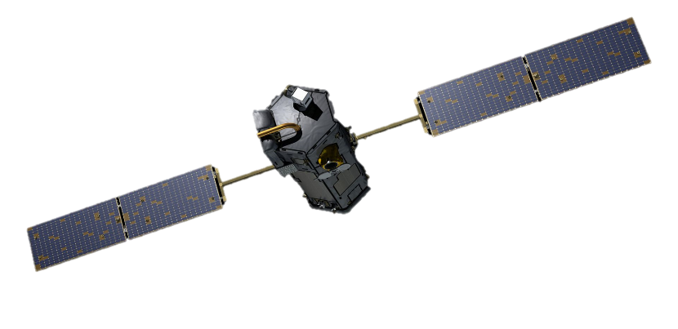





One year of TCCON observations in Cyprus:
Data Variability and Validation/Calibration
OCO-2/OCO-3 Validation Group Meeting, 6-7 October 2020
Authors: Rousogenous C.¹, Petri C.², Warneke T.², Quéhé P.Y.¹,
Laemmel Th.³,Ramonet M.³, Notholt J.², Vrekoussis M.^{1,2}, Sciare J.¹
¹: Climate and Atmosphere Research Centre (CARE C), The Cyprus Institute (CyI)
^{2:} Institute of Environmental Physics, Bremen, Germany
³: LSCE/IPSL, CEA-CNRS-UVSQ, Université Paris Saclay, Gif-sur-Yvette, France

Slide 2
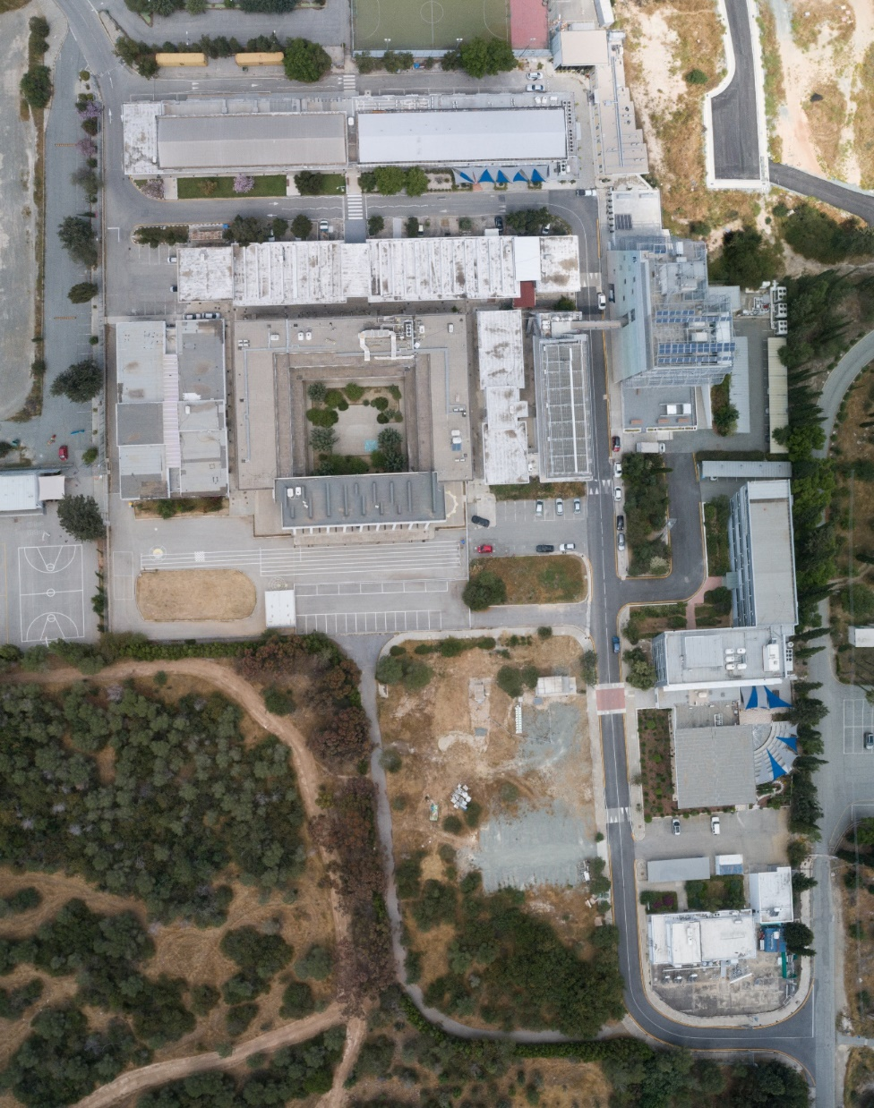
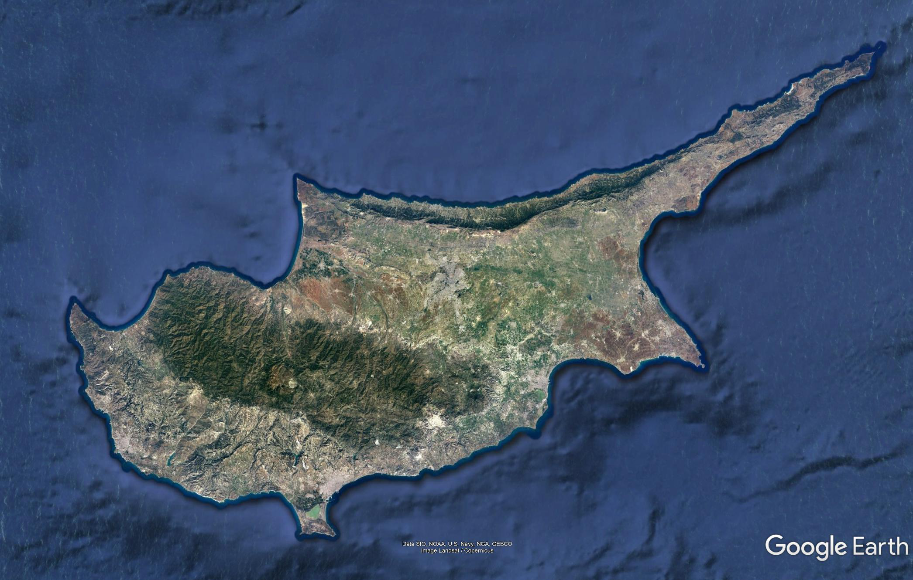
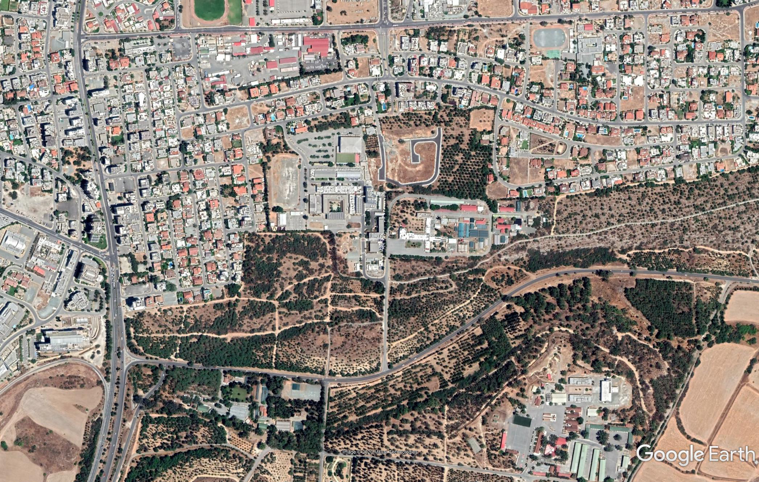

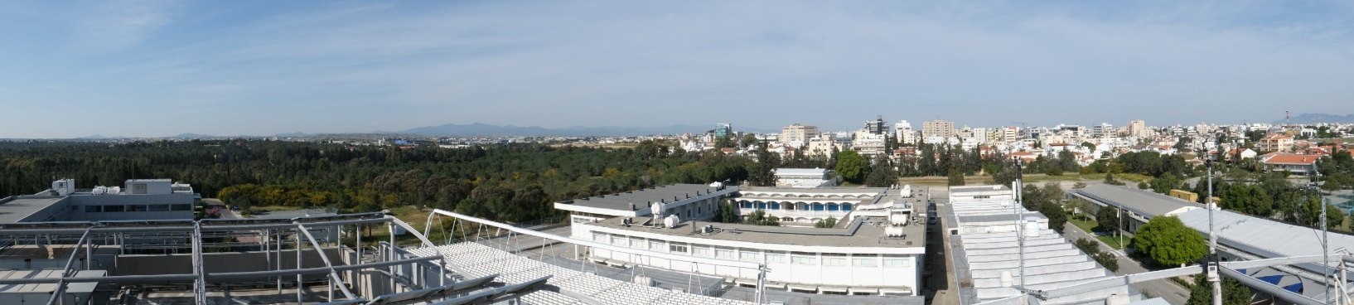
TCCON Nicosia: Location
PICARRO
CIMEL, AERONET/PHOTONS
PREDE, Skynet
In a sub-urban area
Next to a small forest
On the CyI building
35.141° N, 33.381° E, 185 m a.s.l.
Climate: Subtropical, Mediterranean, semi-arid
Population: ~ 100k
Area: ~ 110 km2
TCCON
TCCON
185 m a.s.l.
190 m a.s.l.
PICARRO Inlet
Surface Measurements of CO2, CH4, CO, H2O

Slide 3
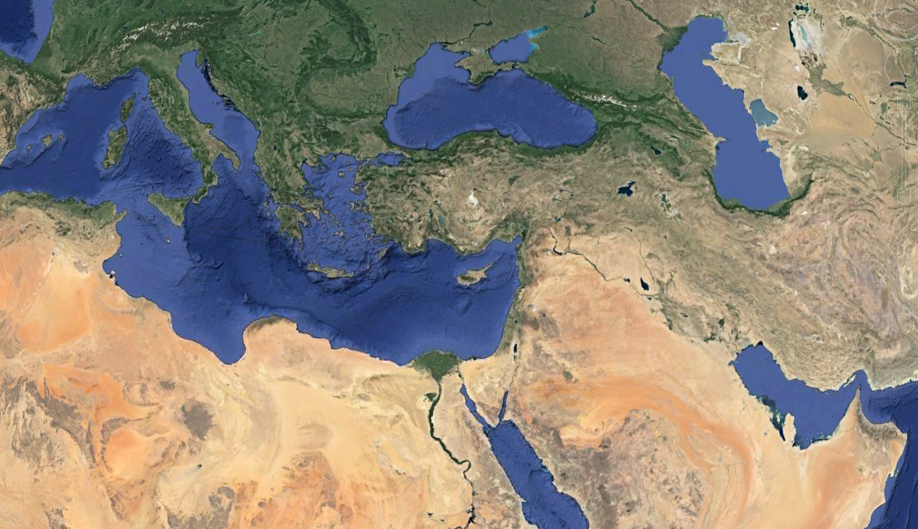
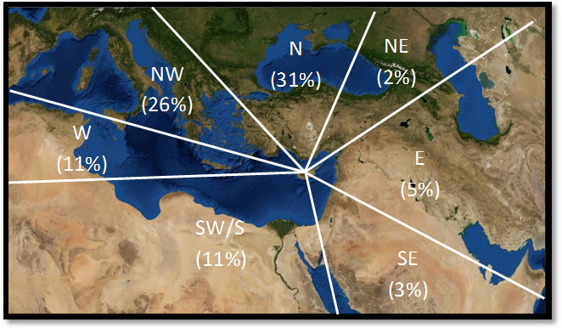
Air Masses in Cyprus: Long-range transported pollution from natural
& anthropogenic sources and seasonal variability
Pollution
Western Europe
Pollution
Eastern Europe
+ Turkey
Sea Salt
Pollution
Middle East
Dust
Dust

Slide 4
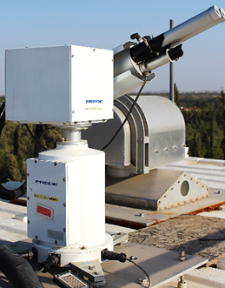
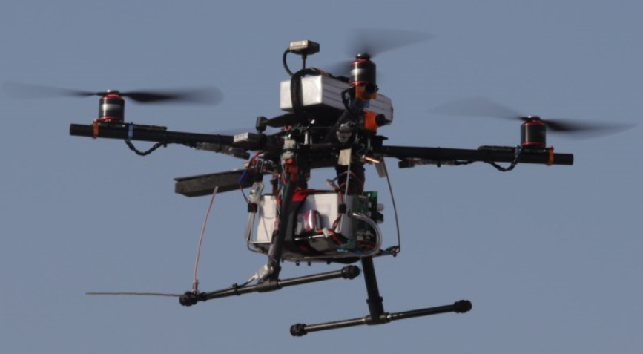
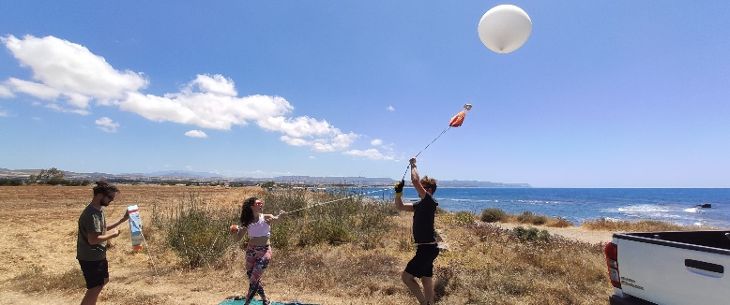

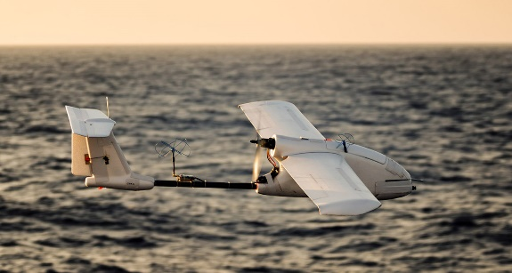
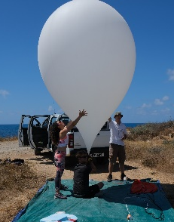
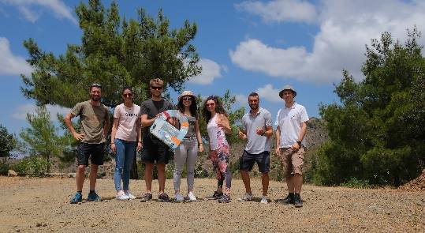
Auxiliary Activities
Airborne
Remote Sensing
In-Situ
GHGs
GHGs
Vertical Profiling
Surface Mapping
GHGs
AOD
GHGs
EM27/SUN - COCCON
(to purchase)
PREDE Sky Radiometer
(NIES)
Operational since:
24/07/2020
PICARRO 1
Co-located
Surface measurements
for 1 year
Field Campaigns
SenseAir AB CO2
Integration on UAV
(Tested)
Passive AirCore
Collaboration with LSCE
Active AirCore
on board UAS (In Progress)
17 – 30 June 2020 Campaign
5 Flights → 3 profiles
LGR ABB CO2, CH4
Integration on UAV
(In progress)
Co-located Measurements
Field Campaigns In the MENA Region
Repeat Campaign
Summer 2021
PICARRO 2
Background
Measurements
ICOS Station
(West Coast)
CO2 Sensor
PICARRO 3 Measurements In the Free Troposphere (Mt. Troodos)
Materialized
In progress
Ceiling Altitude: 2.5Km a.g.l.

Slide 5
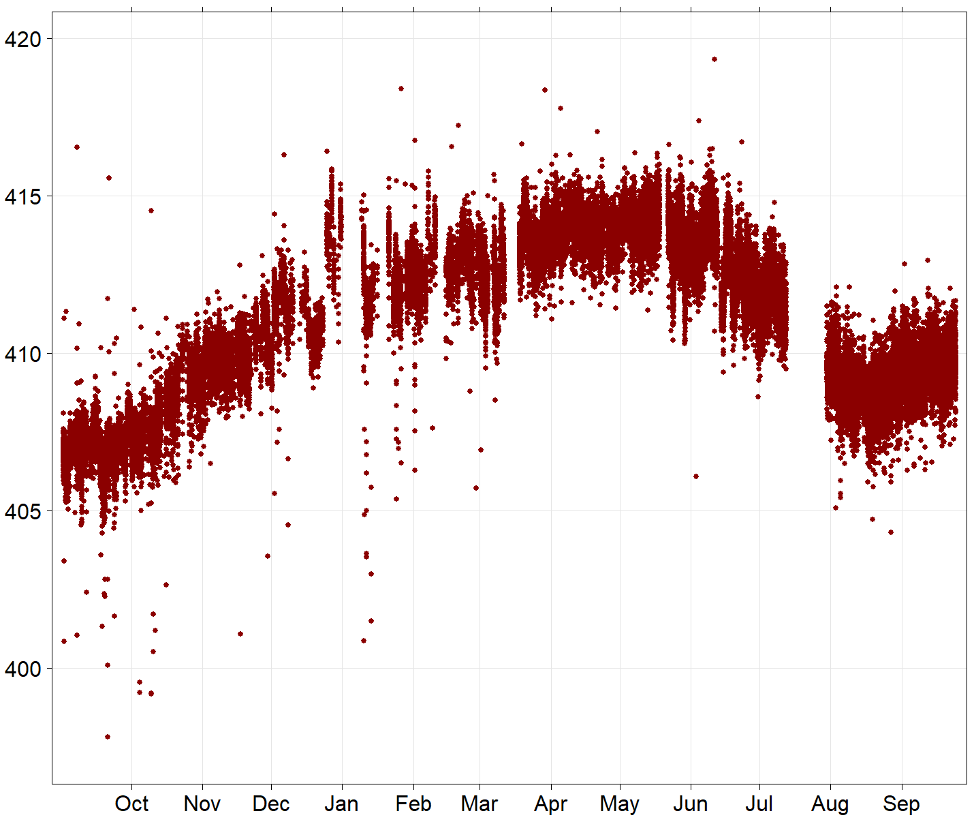
TCCON Nicosia:
Data Coverage and Variability
XCO2 (ppm)
Malfunction of Solar Tracker Controller
1 Year of XCO2 data
High data coverage
300 – 340 sunny days per year
Up to 14 hrs of sunlight per day
Perfect location for solar absorption measurements

Slide 6
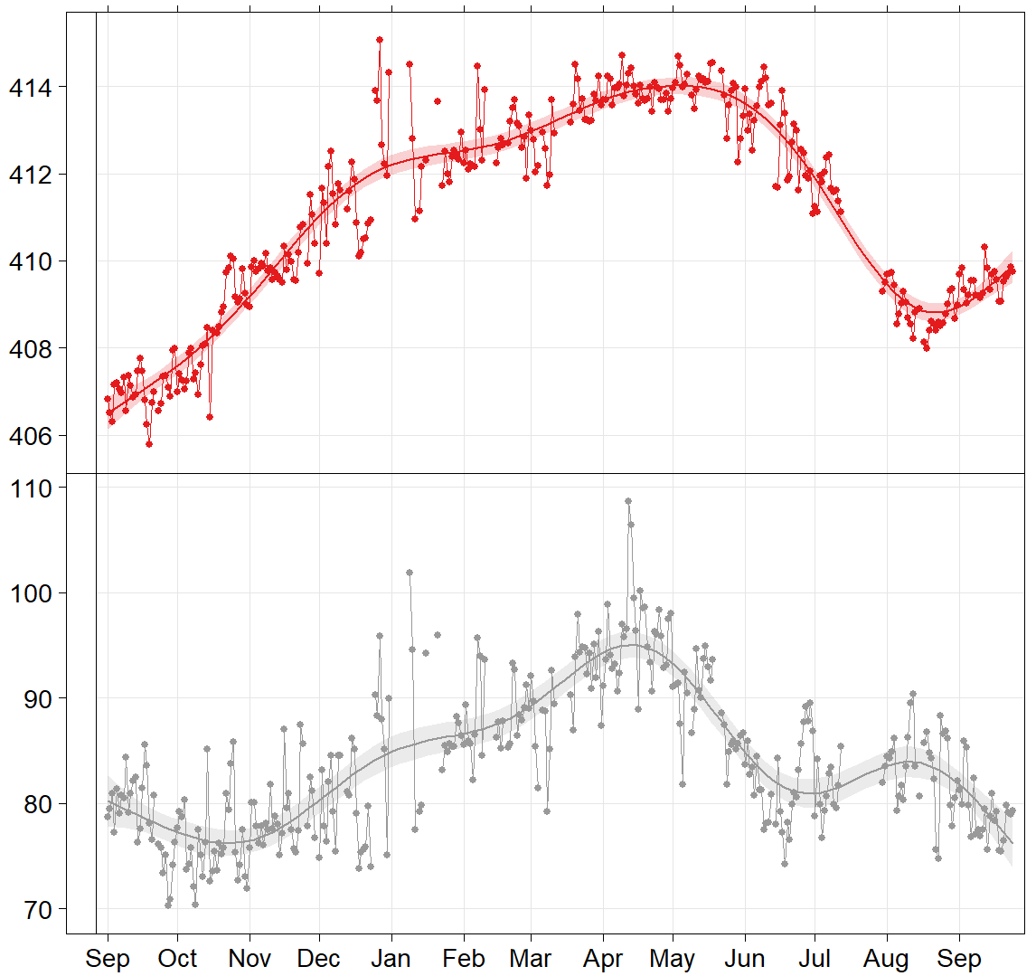
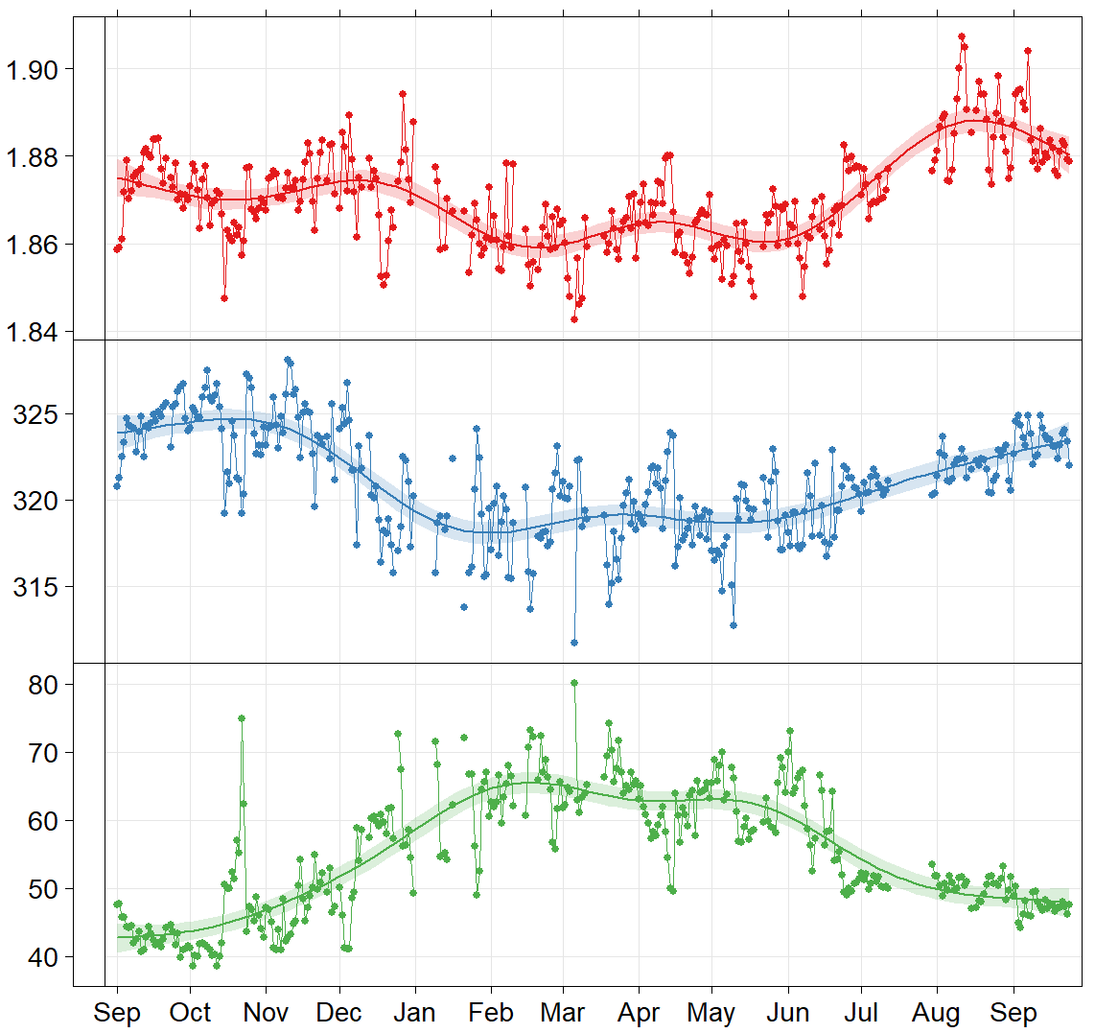


TCCON Nicosia: 1 Year of Data, 31/08/2019 - Now
AirCore Campaign
Daily means of Xgas
High variability
Tropopause altitude variations
Many validation targets
CO2 (ppm)
5 x OCO-2 Validation Targets
22 x OCO-3 Validation Targets
CH4 (ppm)
CO (ppb)
N2O (ppb)
HF (ppt)

Slide 7

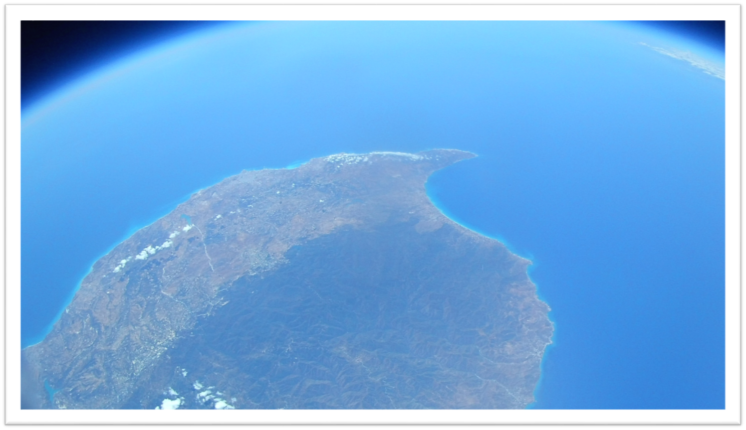

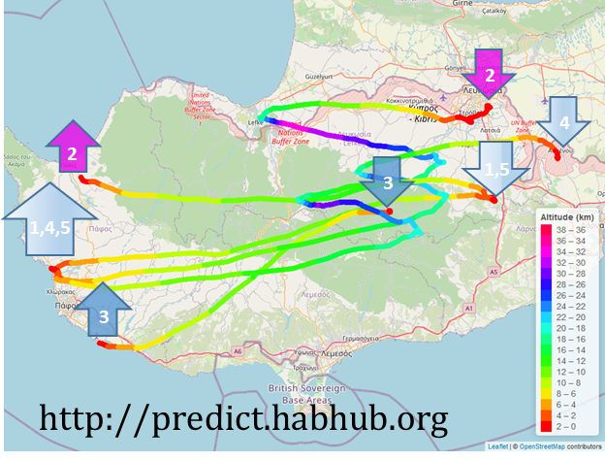
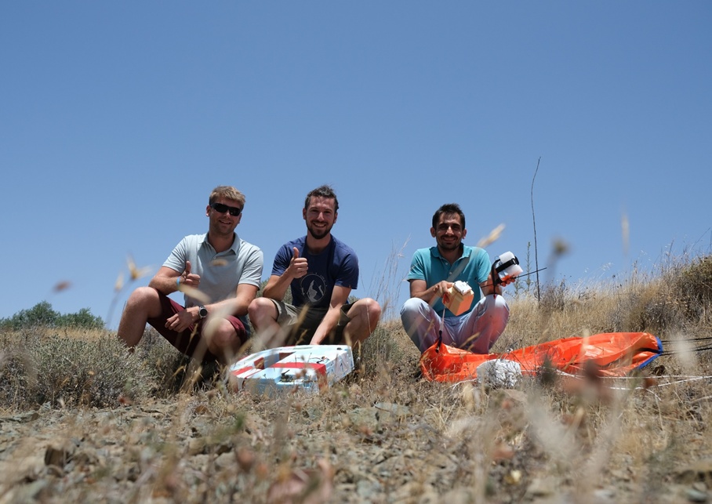
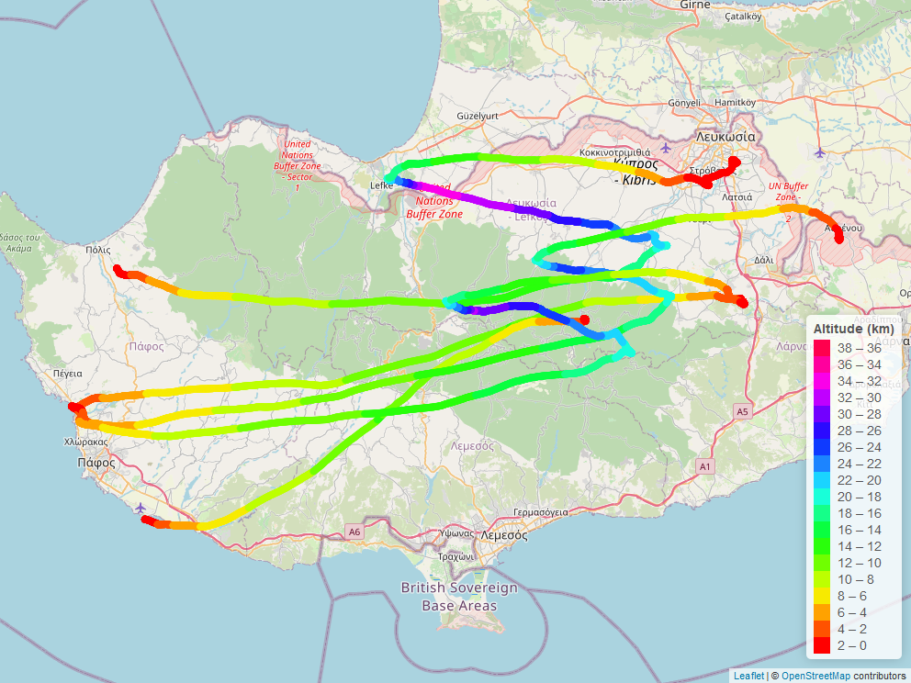
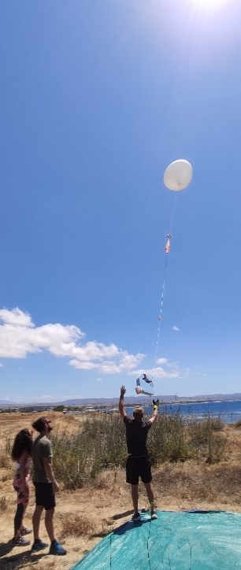
  June 2020, First AirCore Campaign in Cyprus
17 – 30 June
2020
@ 33 Km
2
4
2
1,5
3
1,4,5
3
http://predict.habhub.org

Slide 8
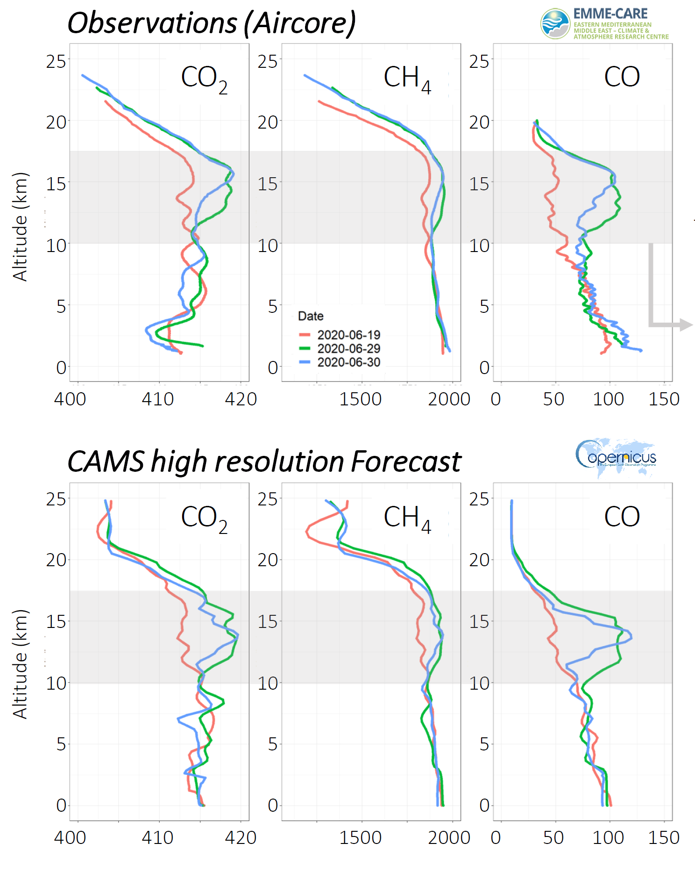
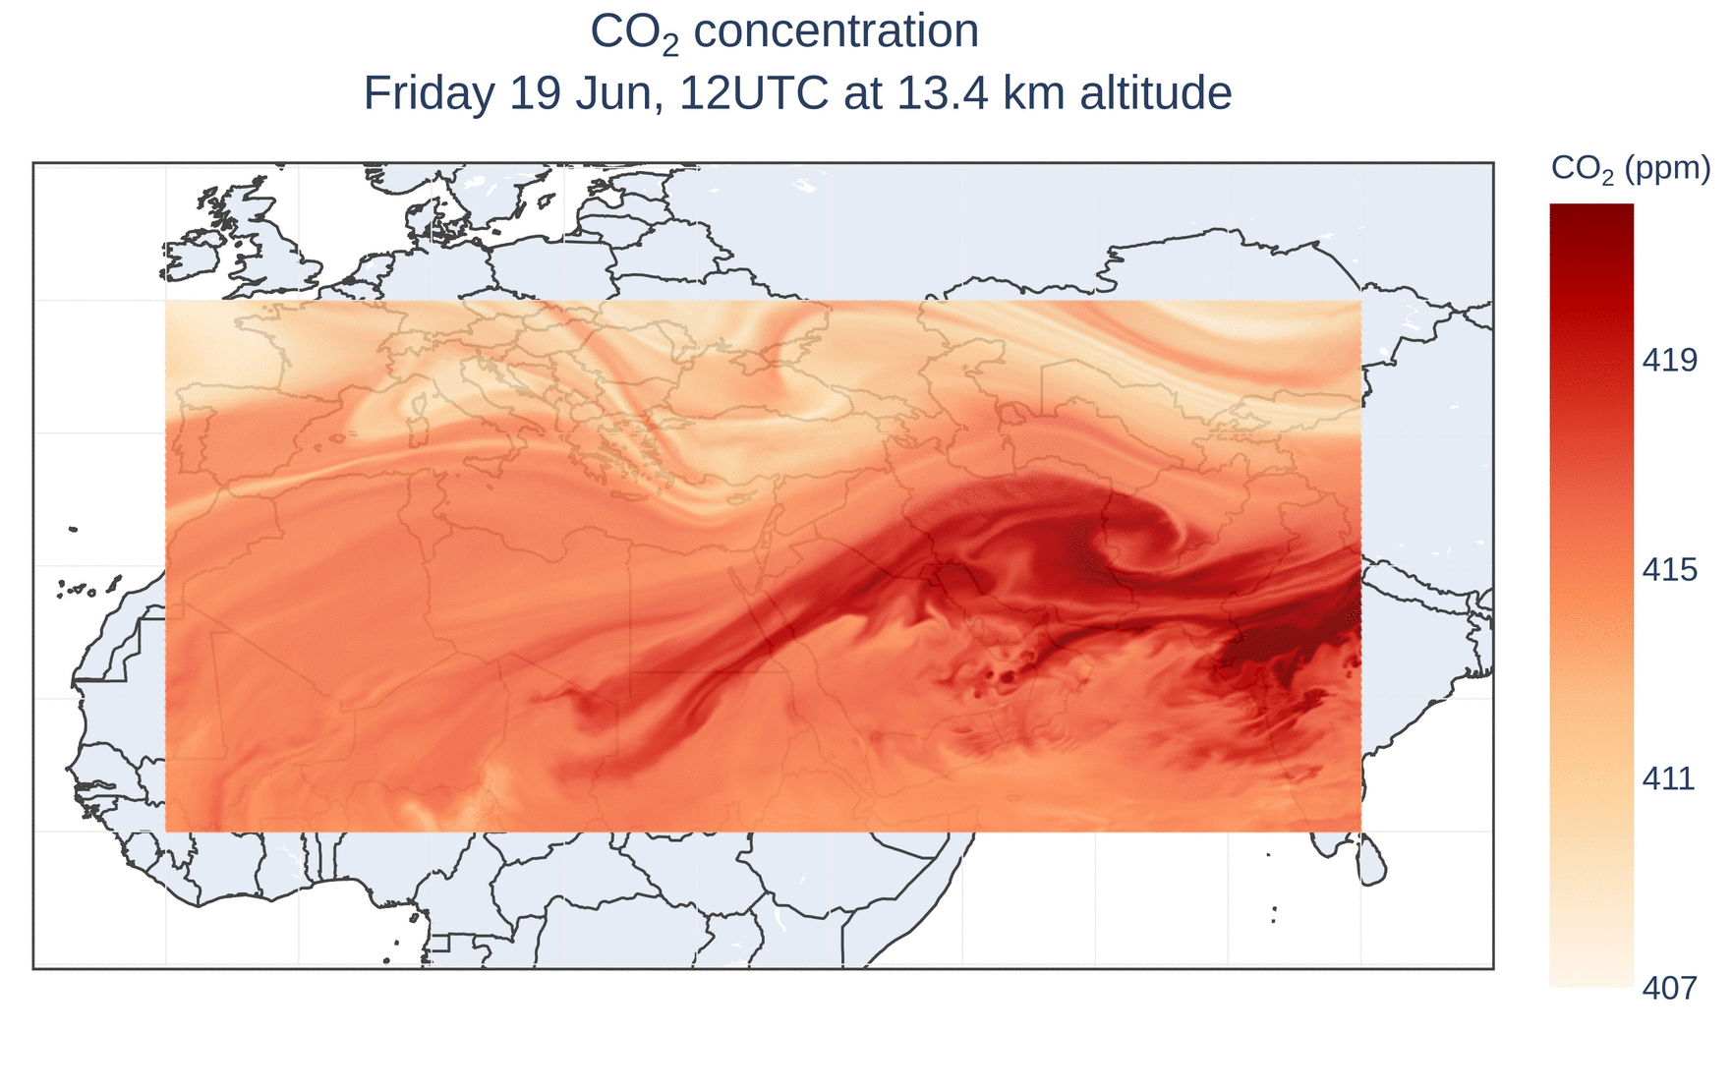




First AirCore Profiles for Cyprus & Comparison with CAMS Models
Action: In collaboration with LSCE and the French Aircore (AC) program, AC activities have been initiated last June in Cyprus within the framework of the EMME-CARE (Eastern Mediterranean and Middle East – Climate and Atmosphere Research).
Objective: Start a regular program of vertical profiles of greenhouse gases concentrations, combined with surface and total column observations to be integrated in ICOS and TCCON European networks.
Distinct difference between the profile on the 19th and the ones from 29th & 30th in the upper troposphere lower stratosphere (UTLS) layer.
Asian Summer Monsoon: Transport of constituents to the tropopause level from intense convection and large scale circulation.
Figures Credit: M.Ramonet

Slide 9
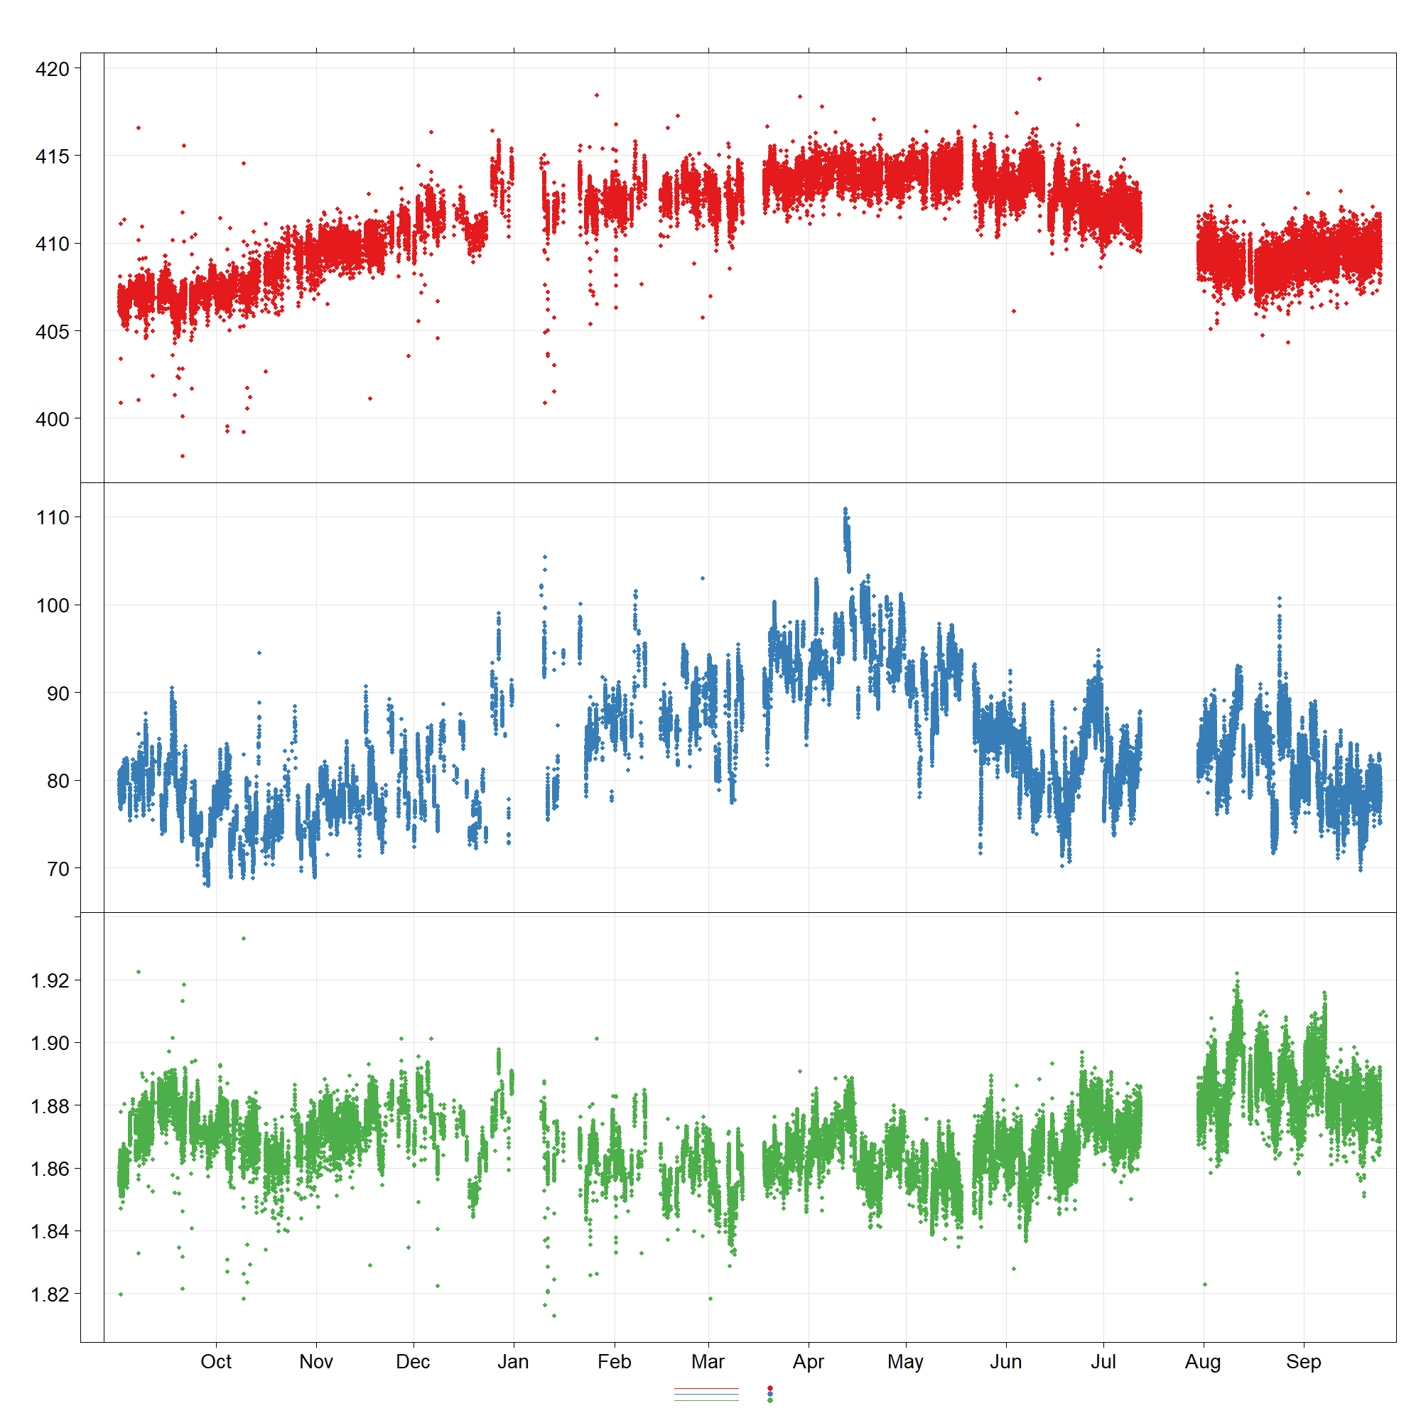
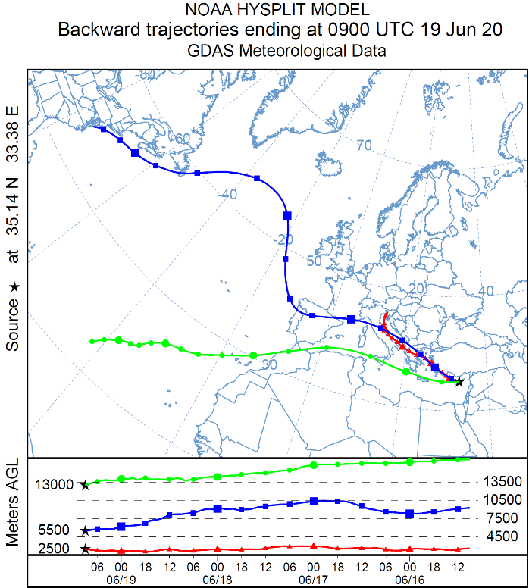
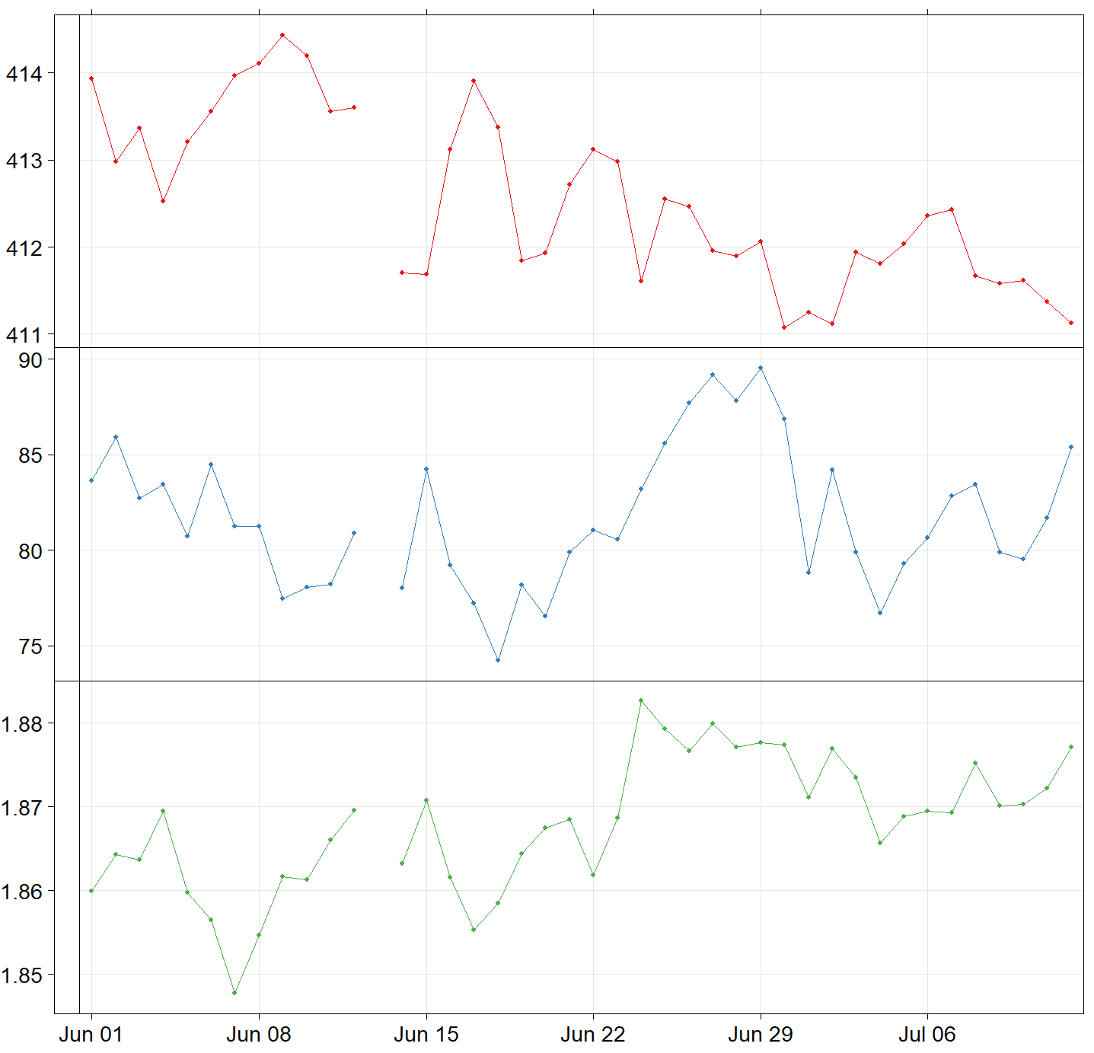
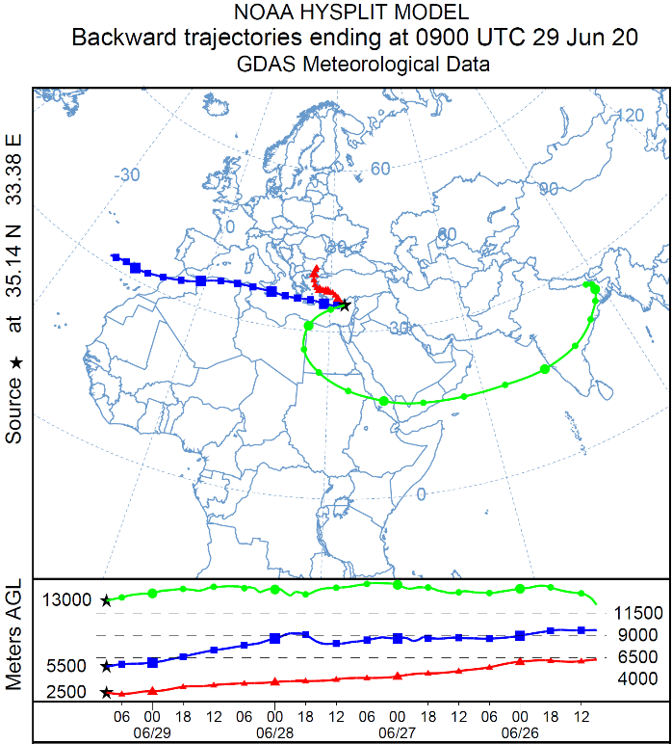
TCCON Detects Asian Summer Monsoon (ASM) Long-range Pollution Transport during AirCore Campaign
CO2 (ppm)
CO2 (ppm)
AC 19/06/2020
AC 29/06/2020
AC 30/06/2020
CO (ppb)
Asian Summer Monsoon
CO (ppb)
CH4 (ppm)
CH4 (ppm)

Slide 10
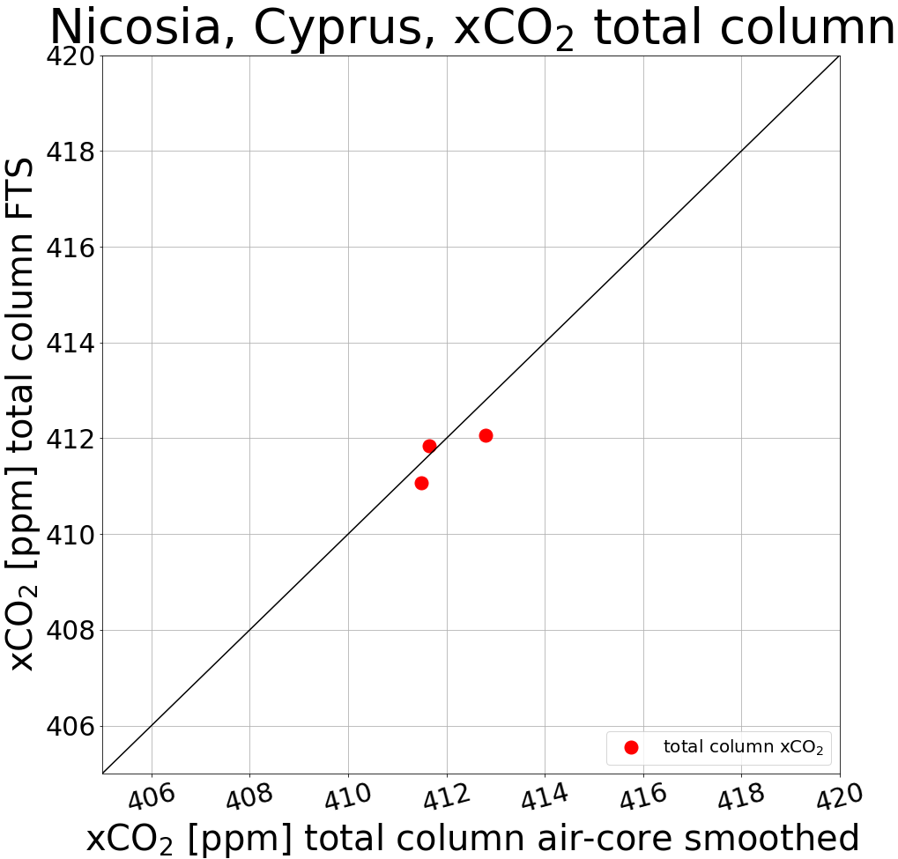
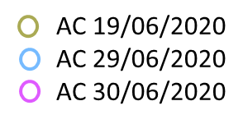
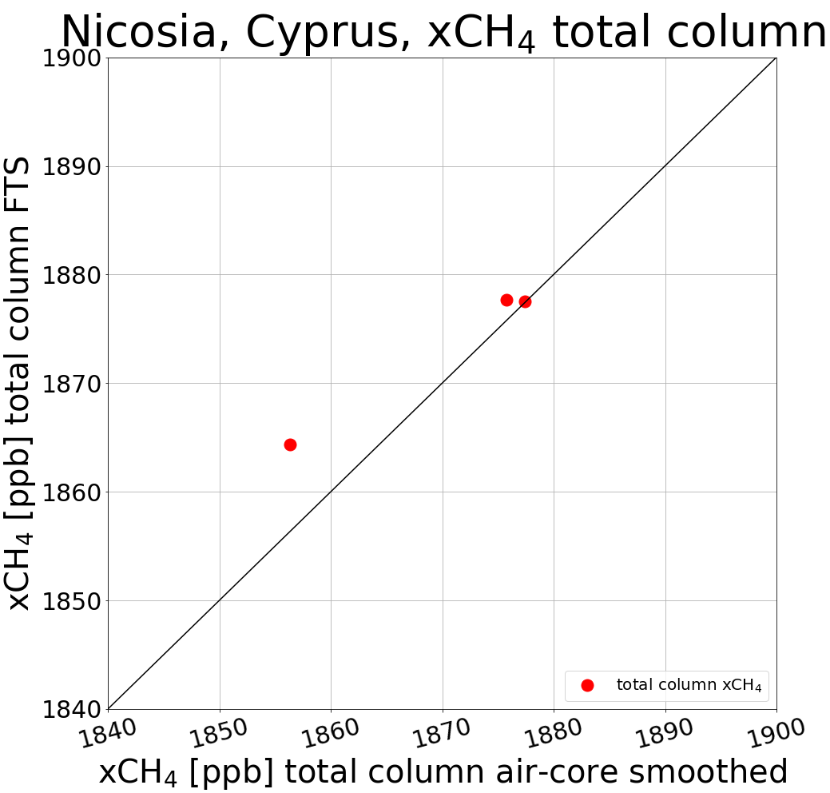
AirCore – TCCON Preliminary Comparison: XCO2 and XCH4
TCCON Vs AirCore observations have good agreement
|Δ XCO2|: 0.2 – 0.75 ppm
up to 0.2% diff
|Δ XCH4|: 0 – 8 ppb
up to 0.4% diff
For the Xgas (aircore) calculation:
Above AirCore profile → scaled TCCON a priori
Below AirCore profile → from surface to 1st AC measurement extrapolation of bottom AC measurement up to surface pressure

Slide 11
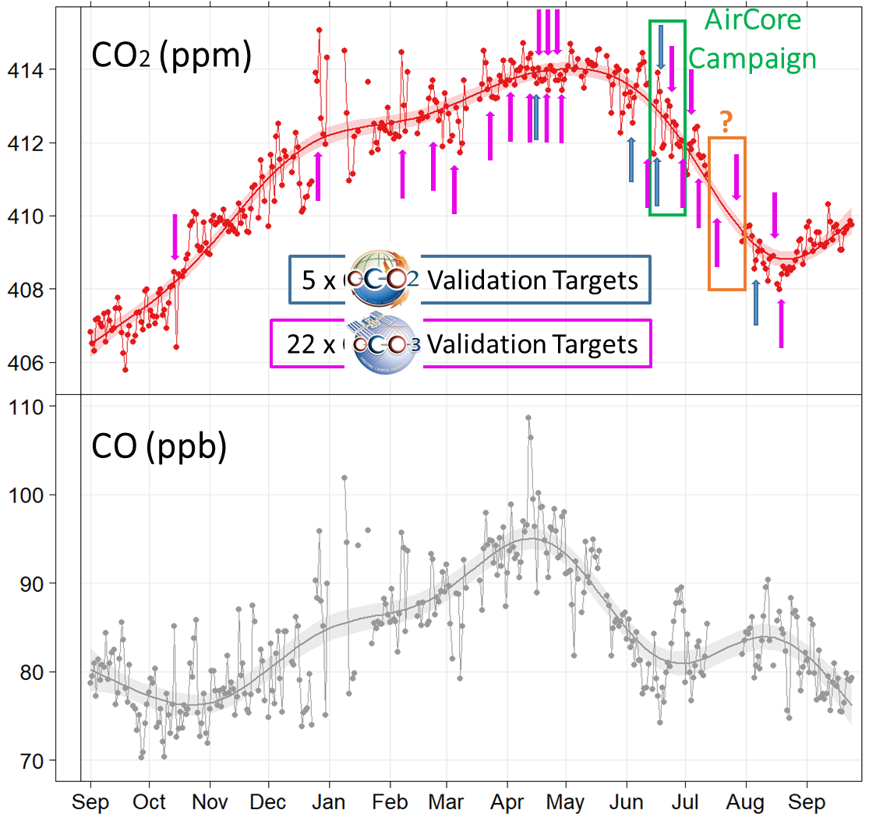
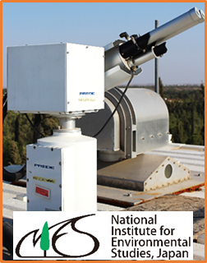
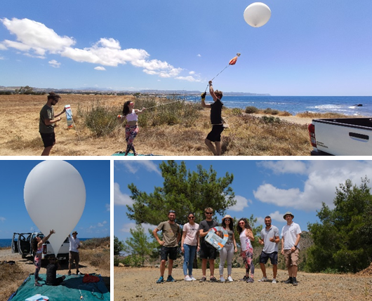
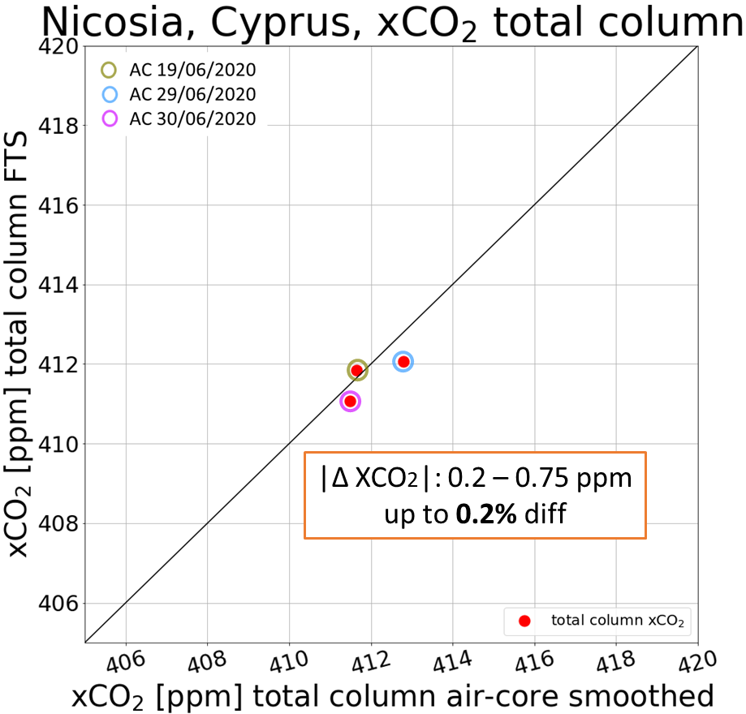
Conclusions
TCCON Nicosia successfully installed in Cyprus and has continuous measurements for 1 year
Proximity to 3 continents and different air masses render variability in the gases.
AOD Measurements compliment remote sensing measurements
AirCore campaign successful with promising agreement with TCCON and plans for enhancing our capability for AC launches.

Slide 12
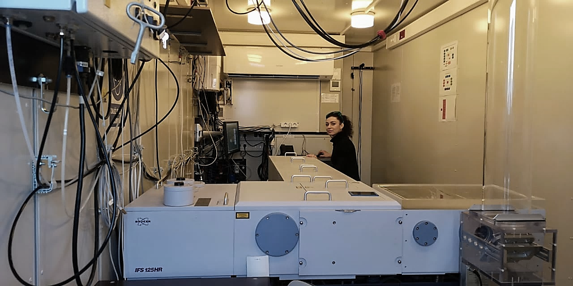
Thank you!
Questions? ☺
Constantina Rousogenous
PhD Student/Graduate Research Assistant
Climate and Atmosphere Research Center (CARE-C)
The Cyprus Institute
20 Konstantinou Kavafi Street, 2121, Nicosia, Cyprus
Tel: +357 22208614 | Email: c.rousogenous@cyi.ac.cy
Web: cyi.ac.cy | emme-care.cyi.ac.cy | cao.cyi.ac.cy
Acknowledgements
C. Keleshis¹
C. Constantinides¹
P. Antoniou¹
J. Pernin⁴
C. Crevoisier⁴
G. Oesterman⁵
¹: USRL, The Cyprus Institute, Nicosia, Cyprus
⁴: LMD/IPSL, CNRS, Ecole polytechnique, Université Paris-Saclay, Palaiseau, France
⁵: Jet Propulsion Laboratory, California Institute of Technology, NASA, USA

