Slide 1
New PoLArization ALgorithm
SQWG PM4
Sep 2015
P. Liebing, IUP Bremen

Slide 2
Outline
Suggestions for changes to polarization algorithm
Suggestions for changes to polarization correction
Some more things that need discussion
Update on V9.02

Slide 3
New Algorithm: General
Synchronize and integrate 40 Hz PMD data
TN: find relevant wavelength/pixel #, calculate effective delay, apply to 40Hz PMD data synchronized to BCPS
Filter for spikes (Limb)
Algorithm in TN, though, if someone has a better idea?
Mirror model calibration of virtual sum and PMD signal
NOTE: Bad pixels in VS, see below!
Correct unpolarized ratio for cluster coverage
Correct unpolarized ratio with unpolarized scale factor (no more SMR IB!)
Data as ASCII file, monthly for nadir, yearly for limb
Linear interpolation between data points?
Compute average μ_{i}(PMD,DET) (IT dependent!)
Algorithm in TN
Use PMD 4 and 7 iteratively

Slide 4
New Algorithm: Other PMDs, Nadir
Retrieve q,u from RTM LUT, calculate RTM polarization angle
LUTs in form of SCIATRAN data (ASCII) f(month, RO #)
Interpolation between geometrical points necessary
NOTE: Optimized for IT=0.25s, larger no problem, smaller?
Might require change of loops over ITs!
Compute polarization sensitivity
TN
If glint: use RTM value for u directly
Use PMD4/7 to detect glint (TN)
Else if sensitivity≥0.2: Apply polarization angle algorithm
TN

Slide 5
New Algorithm: Other PMDs, Nadir
Else: use u(R) model:
Use u(R) and calibrated reflectance
Reflectance as average around fixed wavelengths (TN)
Apply (possibly cos(θ) dependent) parameterization u(R)
TN, data as LUT
Several options, not yet clear which method/data are going to be used
Derive q with u(R)
TN

Slide 6
New Algorithm: Other PMDs, Limb
u(R) model everywhere:
Use u(RTM) and calibrated reflectance
LUTs in form of SCIATRAN data (ASCII) f(month, lat)
Interpolation between geometrical points (TH, SZA, AZ) necessary
Reflectance as average around fixed wavelengths (TN)
u(R) parametrization (cos(θ), TH, R)
LUTs as ASCII, some fudging of geometry and reflectance necessary (limits)
Derive q with u(R)
TN

Slide 7
New Algorithm: Other PMDs, Limb
Algorithm should be applied iteratively using polarization corrected reflectance (?)
Option: Use effective MMEs from in-flight fits rather than V9 key data
Above TH=Z₁: Use q(R), u(R) directly(at least PMD 5)
Above TH=Z₂: use last values (even and odd TH steps separately)
TH limits tbd
Further option: TH dependent correction to unpolarized scale factor
Data as ASCII

Slide 8
Polarization Correction
In principle as before
Improve nadir UV parametrization (between ~300 and 370 nm)
Use new GOME approach, i.e., parameters as f(O3 column and effective albedo)
Needs O3 columns from previous L2
RTM for albedo?
UV correction for limb:
Proposed algorithm in TN by Stefan
Uses q(R),u(R) relationship – needs calibrated R for each pixel >= 260 nm
Iterative approach (pol. corr.)
Possibly use q(370nm), u(370nm) from LUT rather than PMD 1

Slide 9
Things to do (IUP)
Describe/document algorithm: started
Provide IB scale factor f(α,t): needs to be redone for V9.02
Optimize Z₁, Z₂, TH corr.
Provide SCIATRAN data for LUTs: can be delivered w/format description
At least 2 different ones
Rayleigh (over land)
BRDF (v=7m/s, over ocean)
(?) Thick ice cloud as lower limit
Provide slopes for u(R) as tables or parameterization:
Nadir: needs to be decided/done
Limb: ready, only needs reformatting

Slide 10
Things to do (DLR)
Implement algorithm
Build SCIATRAN LUT and develop interpolation routines
Optimize PMD synchronization (w/IUP)
Limb: Spike filter (?)
Read and apply all LUTs (u(R), TH corr.)
Implement Gome-style polarization correction for Nadir UV
Implement Limb UV correction:
Needs additional LUTs (SCIATRAN, high-res.)

Slide 11
Things to Discuss
Bad Pixel Mask!
Old concept had smoothed or clipped M-Factors, new one (OBM M-Factors) doesn’t
For Virtual sum we integrate over all wavelengths in PMD range, using interpolated (offset corrected) signal for bad pixels
Calibrate:
S(interpolated)*M1*M-Factor, where M_Factor≈±10000 ….
Solution: Interpolate M-Factors over bad pixels, too
That requires an adequate bad pixel detection
Current BDPM not good enough for limb!
I made my own, which is fixed in time (for ch. 6+)
Includes the ones which have been masked by V8 BDPM
For consistency, this should be used for Virtual sum and limb cloud algorithms

Slide 12
Things to Discuss
Limb MMEs!
There are still significant differences between V9 and fits to RTM
Highly collinear data, even with 1 year integration
Fits to RTM very model dependent
Which are the correct MMEs?
Check retrieved polarization
For PMDs 1-3, polarization is ½ of expected with V9.00 (and mostly also V9.02, mind the time dependence)
“Solution”: To apply effective MMEs from in-flight fits:
For polarization correction, V9.02 KD have to be trusted

Slide 13
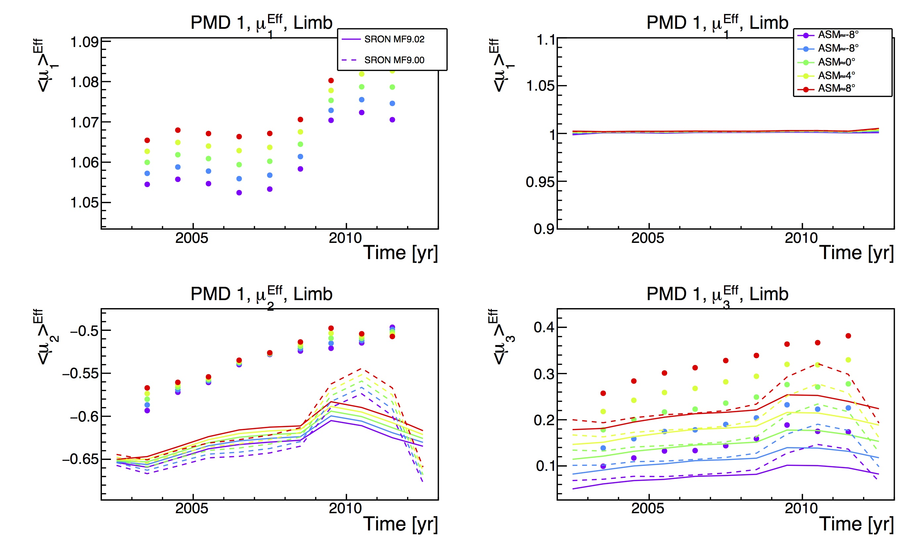
PMD 1 Effective MMEs vs. V9.02, Limb
Effective PMD sensitivities vs. time (1 year average)
Model: SCIATRAN (q,u)(R)
μ₁
M_{PMD}/M_{DET}
μ²
μ³

Slide 14
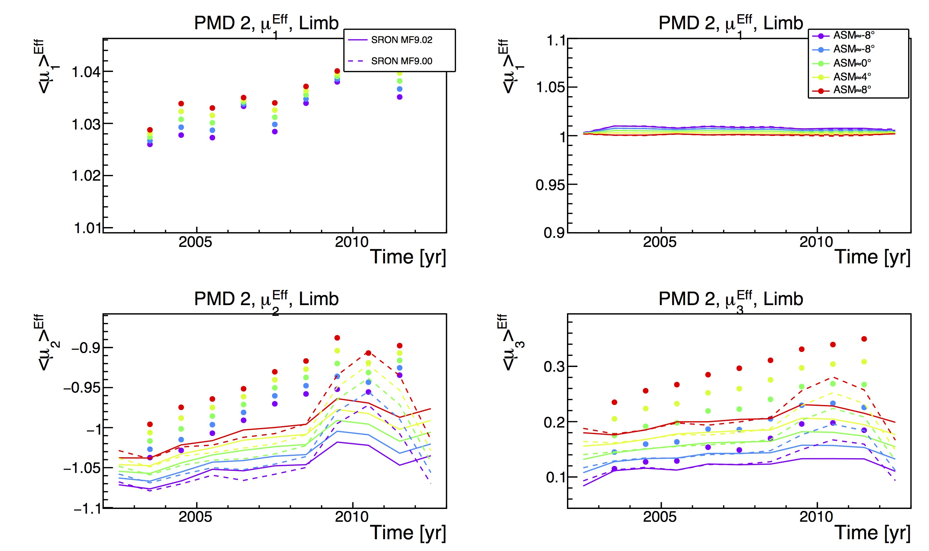
PMD 2 Effective MMEs vs. V9.02, Limb
Effective PMD sensitivities vs. time (1 year average)
Model: SCIATRAN (q,u)(R)
μ₁
M_{PMD}/M_{DET}
μ²
μ³

Slide 15
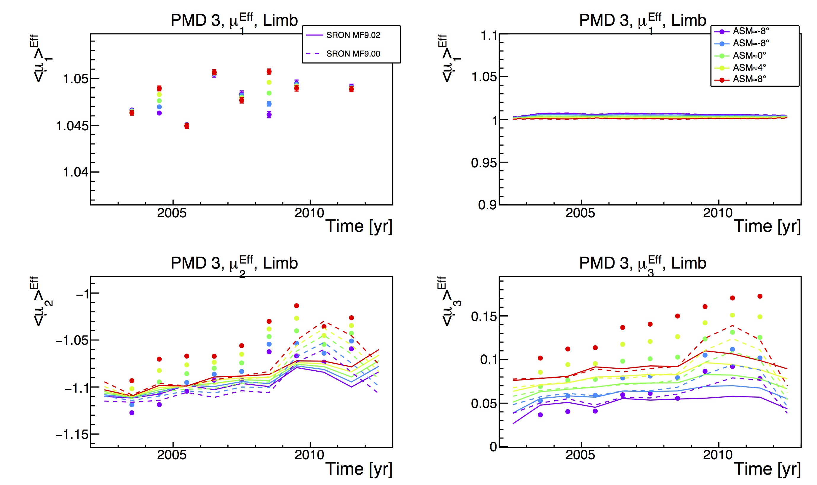
PMD 3 Effective MMEs vs. V9.02, Limb
Effective PMD sensitivities vs. time (1 year average)
Model: SCIATRAN (q,u)(R)
μ₁
M_{PMD}/M_{DET}
μ²
μ³

Slide 16
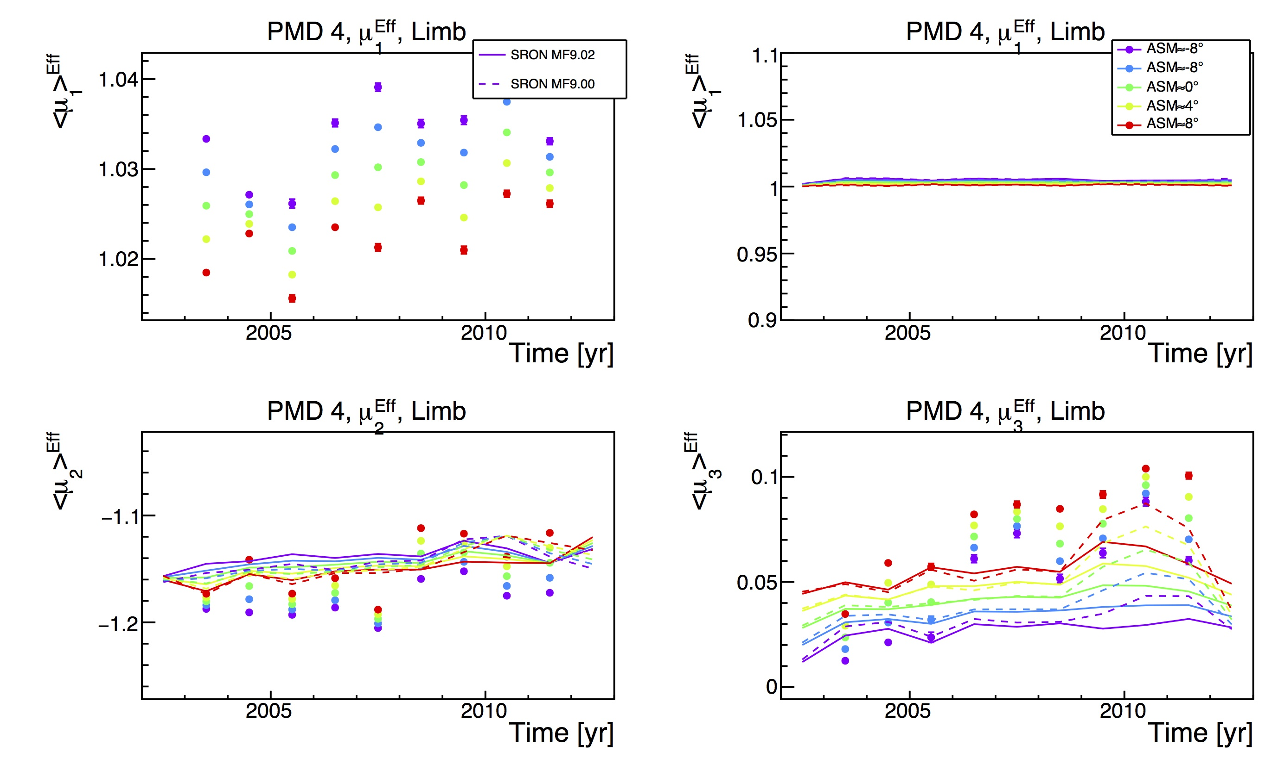
PMD 4 Effective MMEs vs. V9.02, Limb
Effective PMD sensitivities vs. time (1 year average)
Model: SCIATRAN (q,u)(R)
μ₁
M_{PMD}/M_{DET}
μ²
μ³

Slide 17
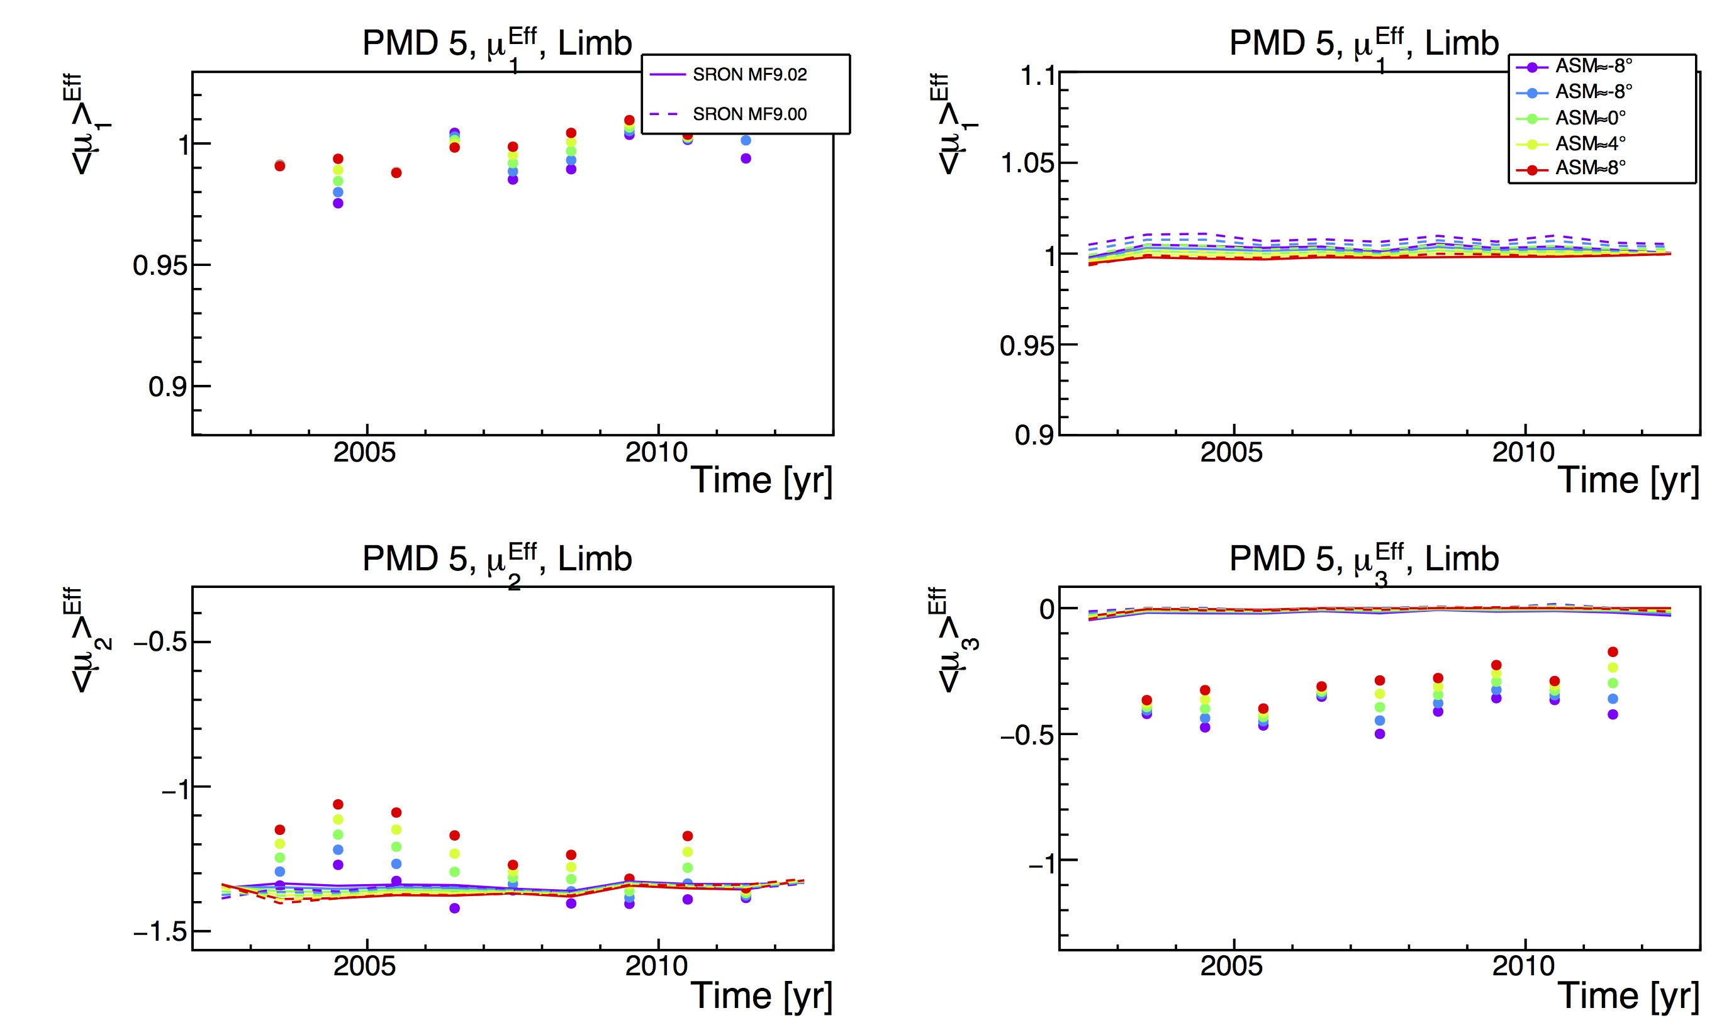
PMD 5 Effective MMEs vs. V9.02, Limb
Effective PMD sensitivities vs. time (1 year average)
Model: SCIATRAN (q,u)(R)
μ₁
M_{PMD}/M_{DET}
μ²
μ³

Slide 18
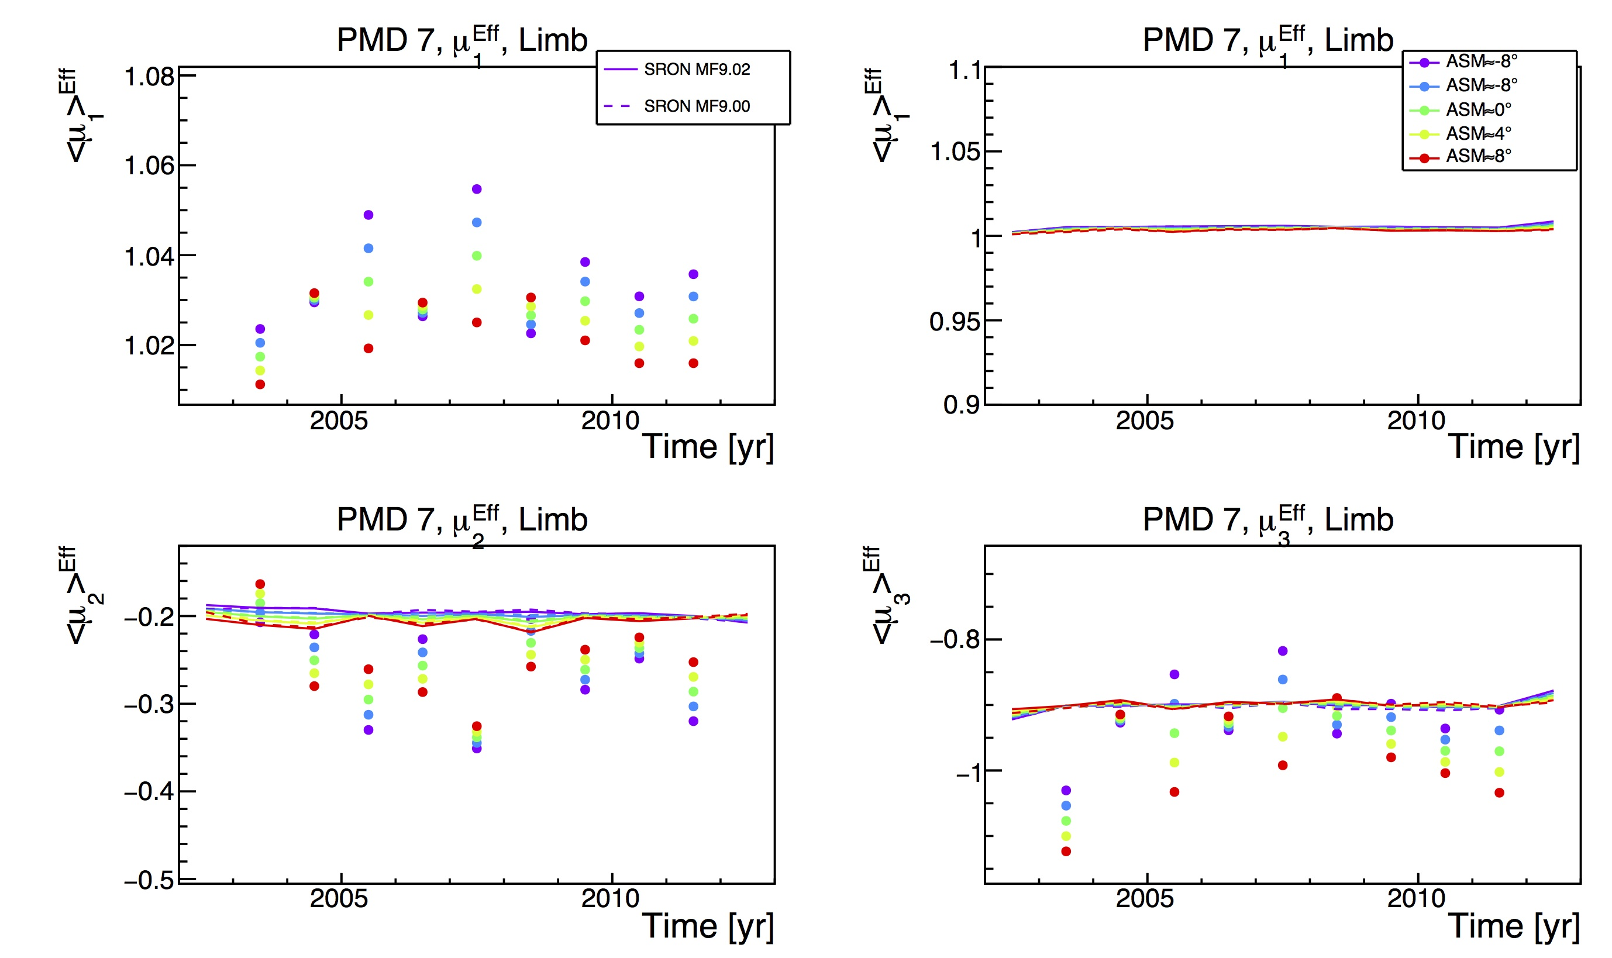
PMD 7 Effective MMEs vs. V9.02, Limb
Effective PMD sensitivities vs. time (1 year average)
Model: SCIATRAN (q,u)(R)
μ₁
M_{PMD}/M_{DET}
μ²
μ³

Slide 19
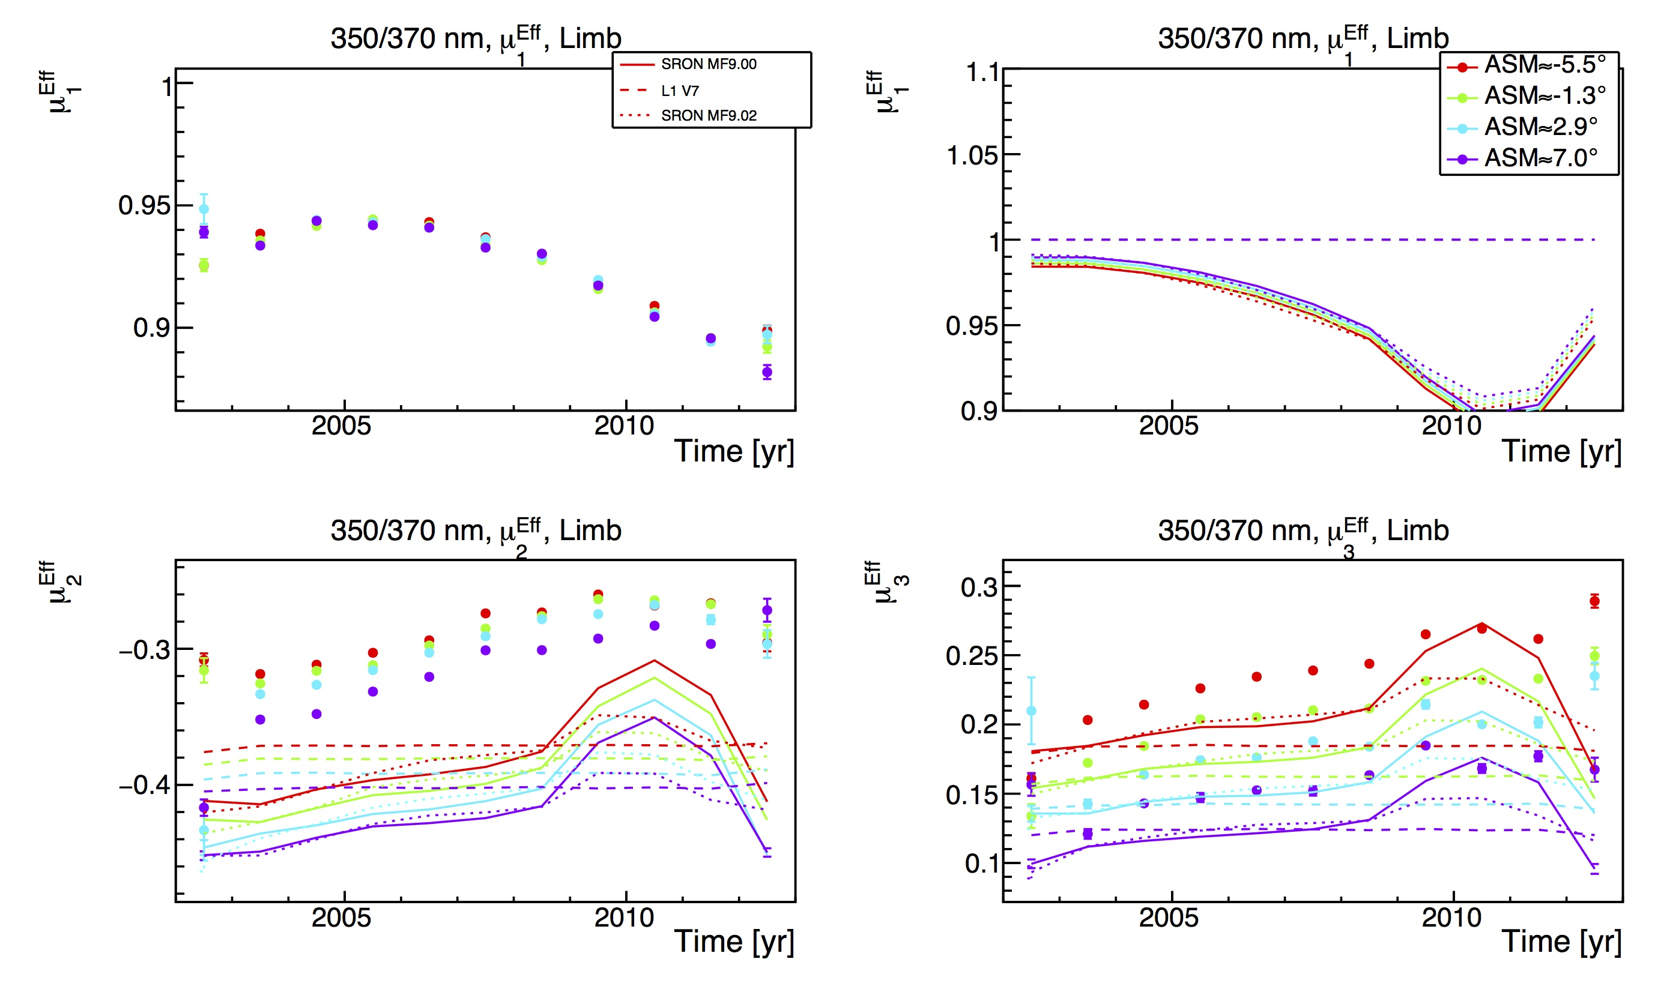
350/370 Effective MMEs vs. V9.02, Limb
Effective 350/370 nm sensitivities vs. time (1 year average)
Model: SCIATRAN (q,u)(R)
μ₁
M_{PMD}/M_{DET}
μ²
μ³

Slide 20
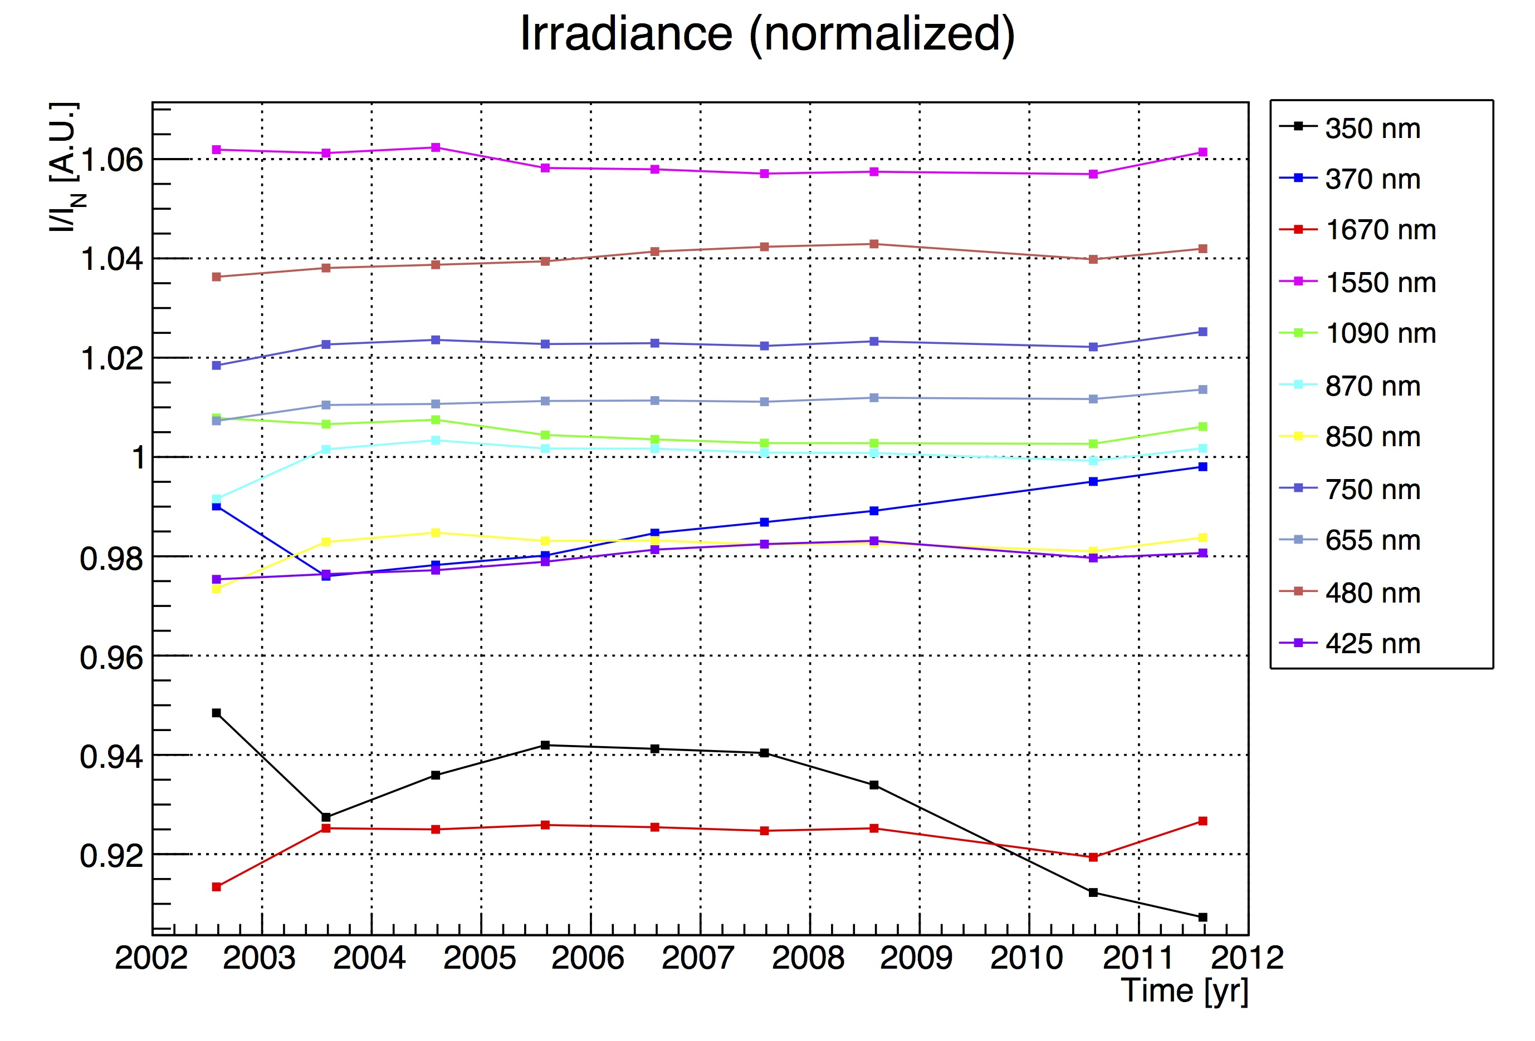
V9.02 Degradation Correction
SMR (State 62) Time Dependence of Irradiance after application of all corrections:
Some wavelength vary by 1% or more!

Slide 21
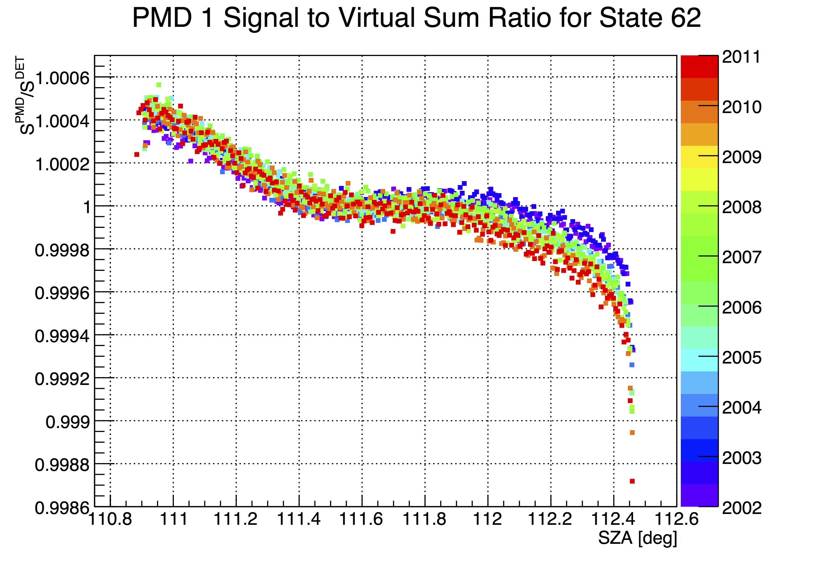
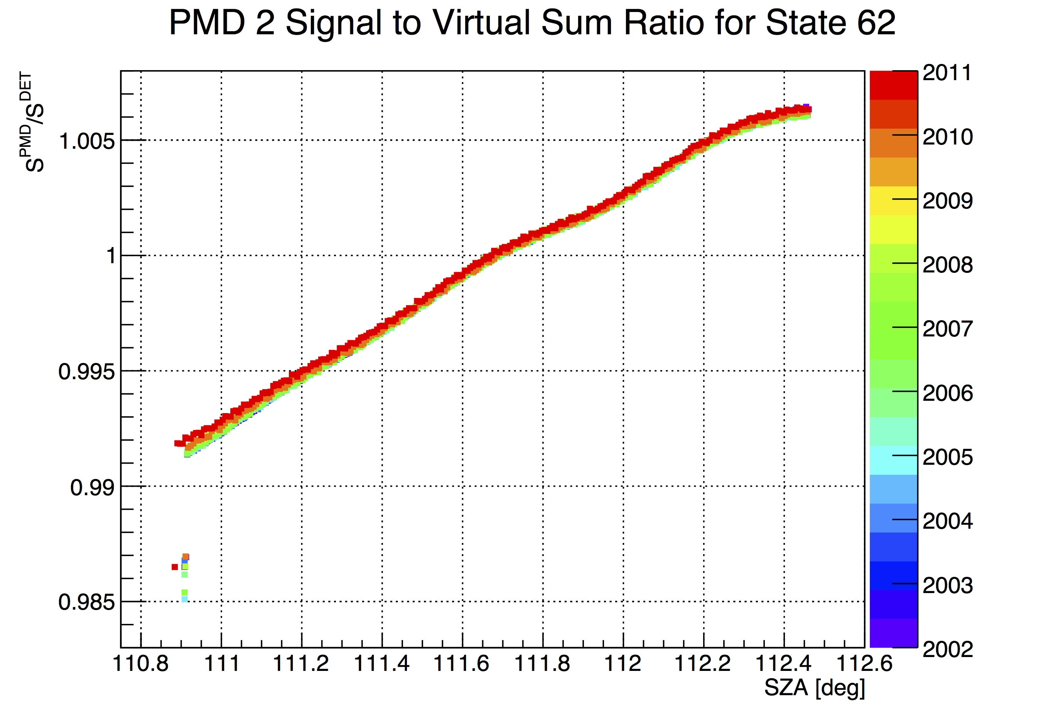
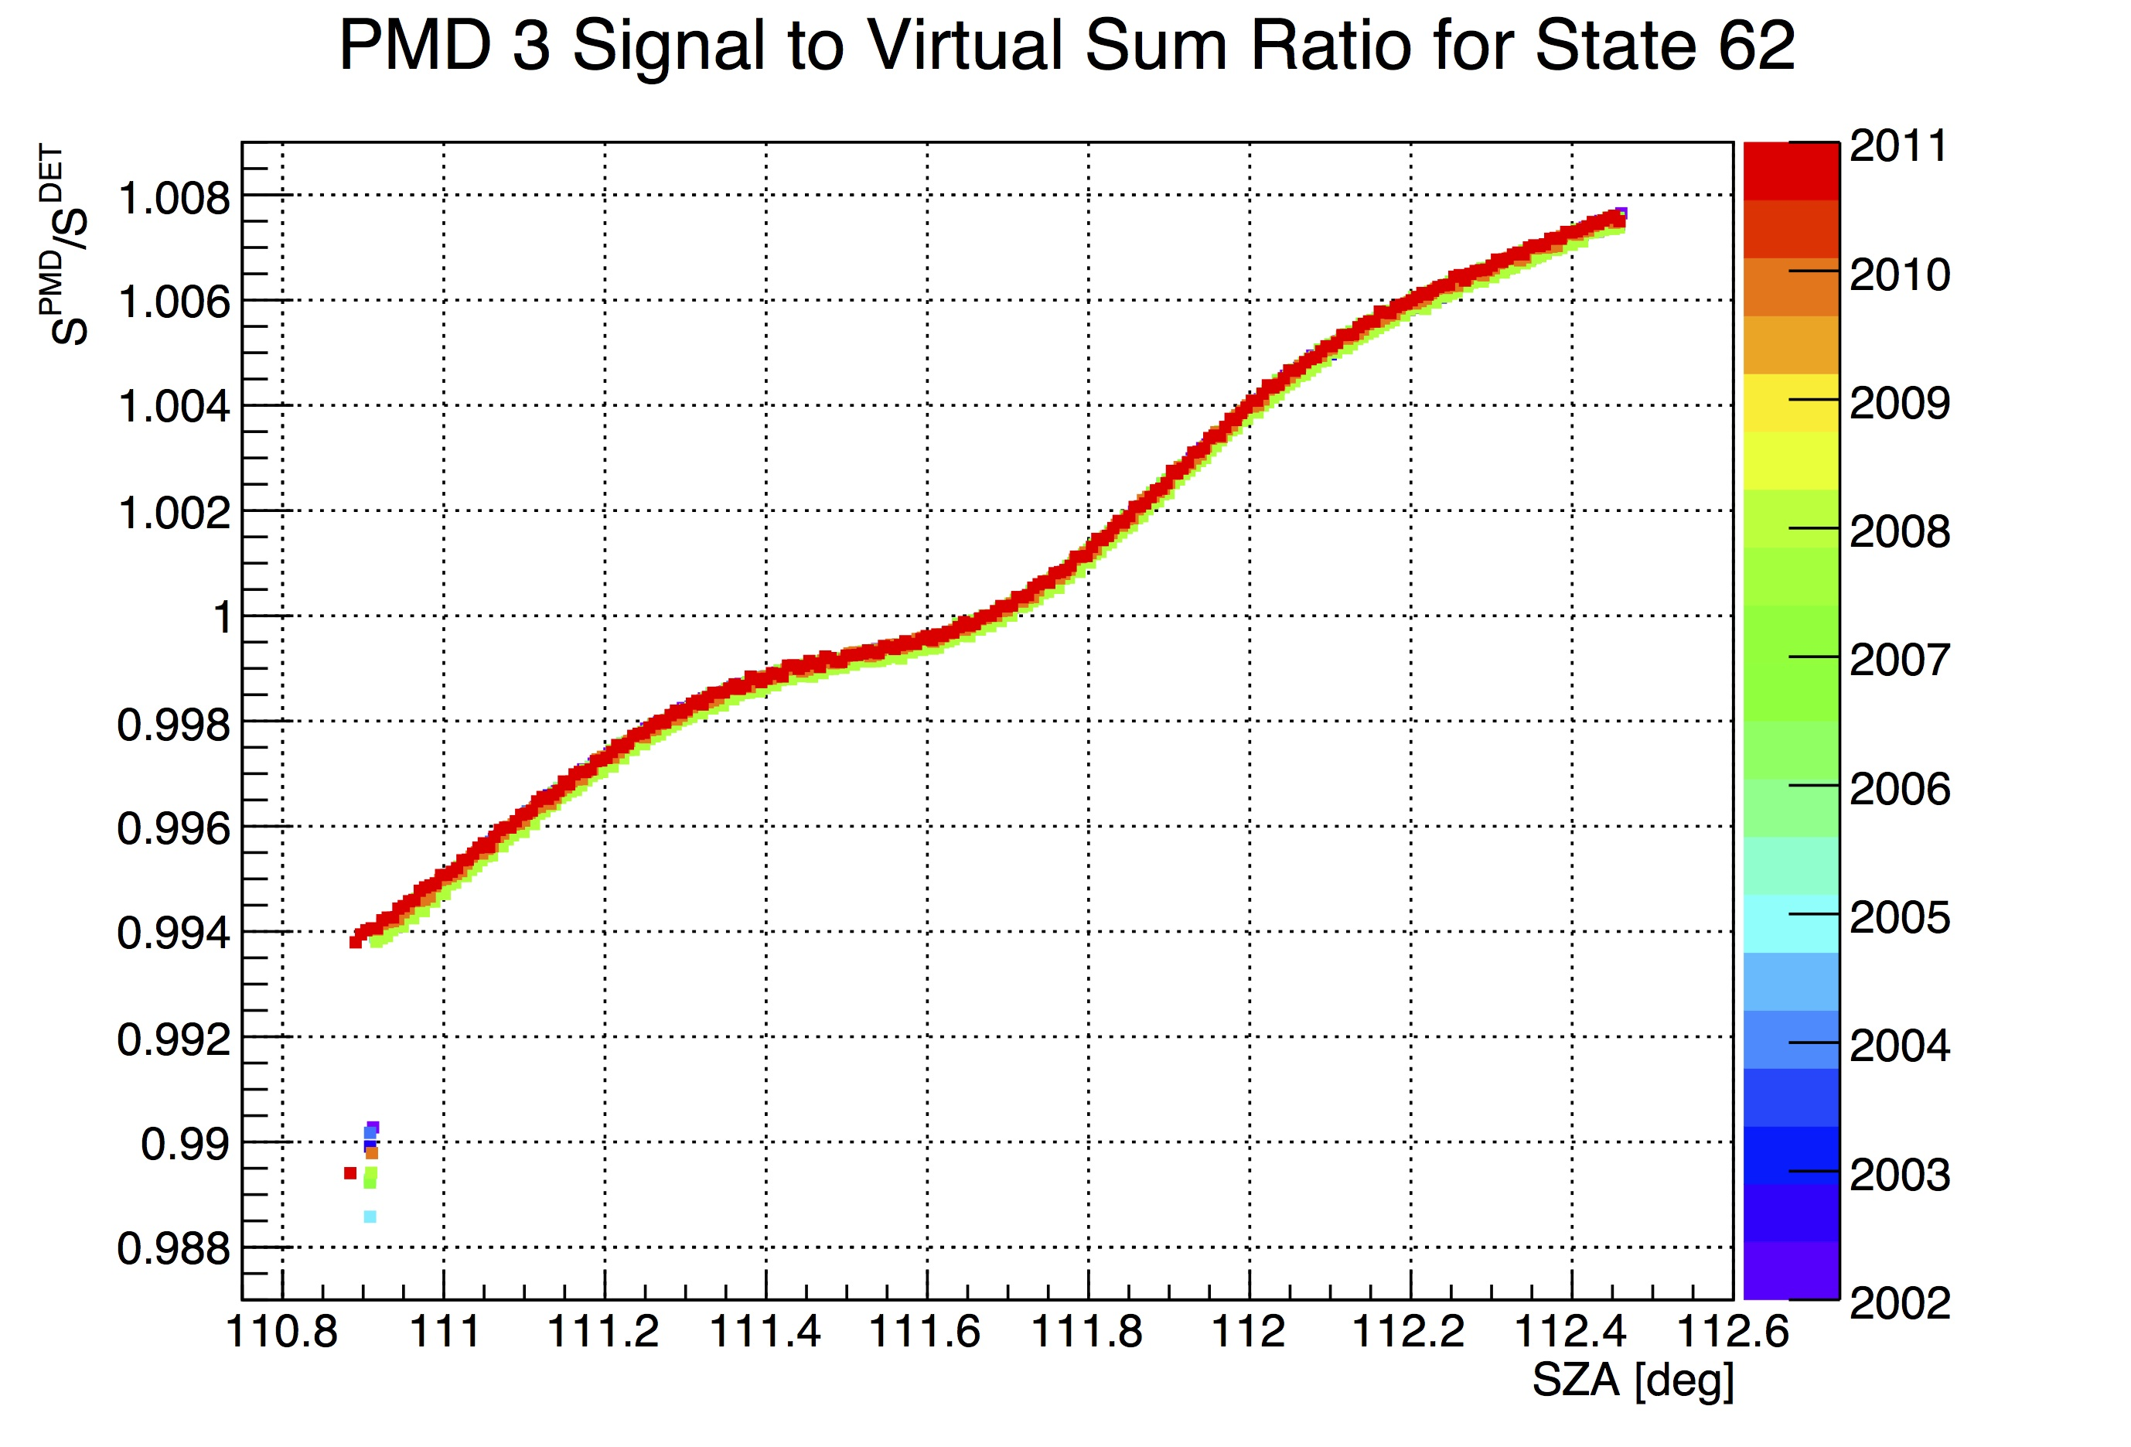
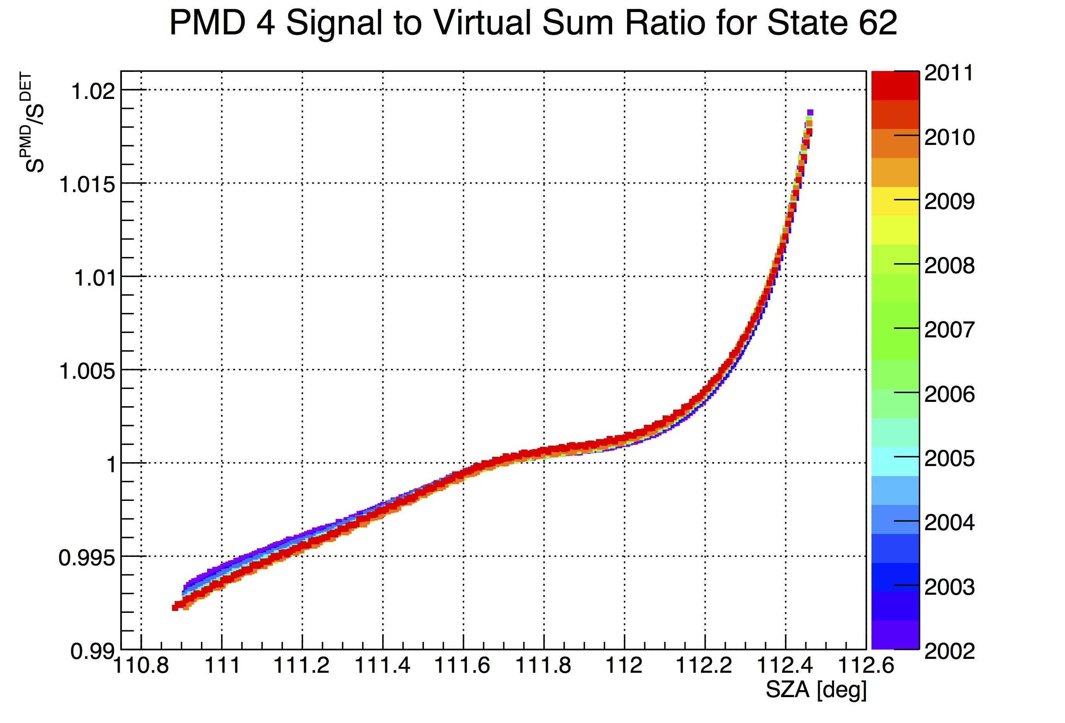
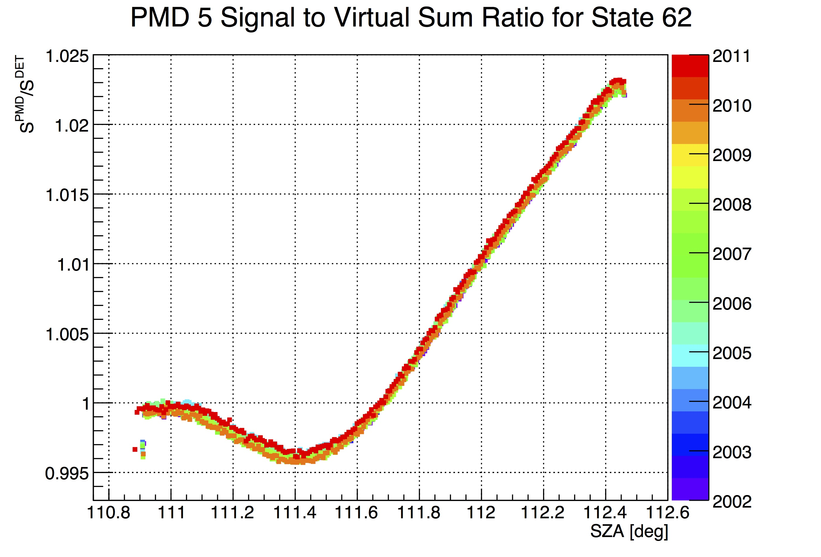
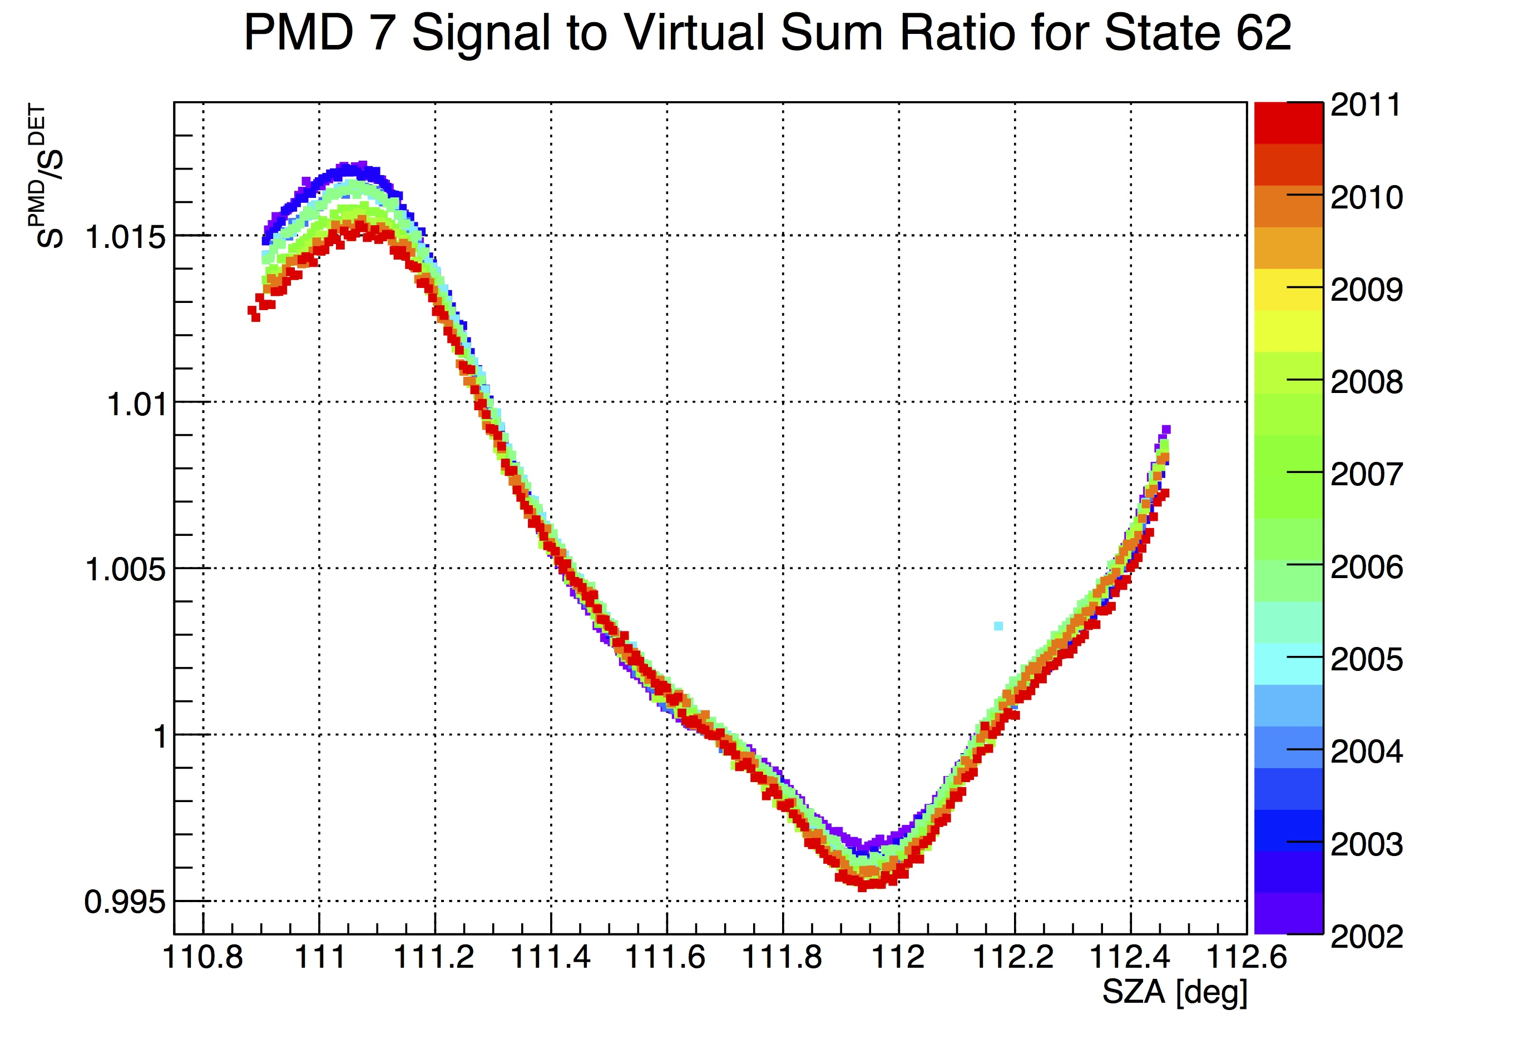
SMR In-Band Signal
SMR (State 62) SZA/AZ/Time/?? Dependence of PMD/Virtual Sum Ratio after application of all corrections

Slide 22
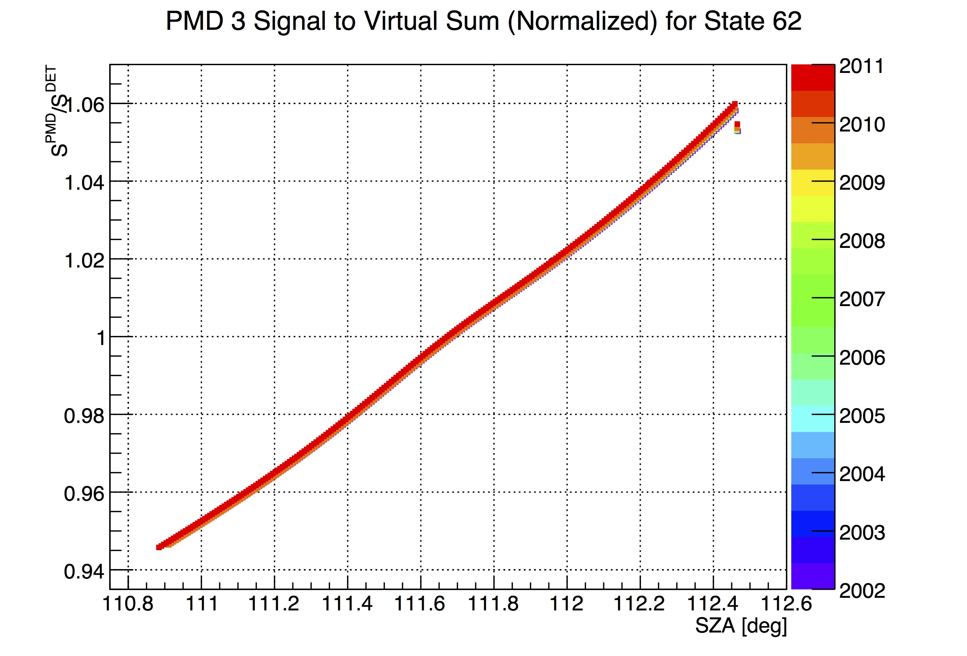
V8 Memory Effect?
SMR (State 62) Time Dependence of Virtual Sum after application of all corrections:
Offset for 1st readout in state: Memory effect?
V8 L1b data!

Slide 23
Backup

Slide 24
Motivation For New Algorithm
For channels 2,3,4 and 6 we only measure 1 Stokes component, but need 2
That 1 component is not in the direction we need (i.e., q)
Need to make assumptions about the polarization angle
Depending on assumptions and algorithm, large errors can be generated when the polarization angle is in the direction where “instrument” is not sensitive
That happens more often than you think

Slide 25
Current Polarization Algorithm
Original L0-1 algorithm:
Problem when denominator small and/or u₀/q₀ large or q₀ small

Slide 26
New Polarization Algorithm
Change polarization frame so that u=0 (assumes known polarization angle)
Rotate MM:
Problem when denominator small (i.e., no polarization sensitivity in this direction)

Slide 27
Alternative for Limb and Insensitive Nadir Regions
Assume a value for u, e.g., u=u(R)
P fixed between 0.5 -1.5 or as f(R, TH, cosθ)
Can in be applied in nadir for data with low sensitivity, too
Use PARASOL slopes (?)
Possibly slopes derived from yet another fit method of mine
That would need yet another RTM reference for thick clouds

