Slide 1
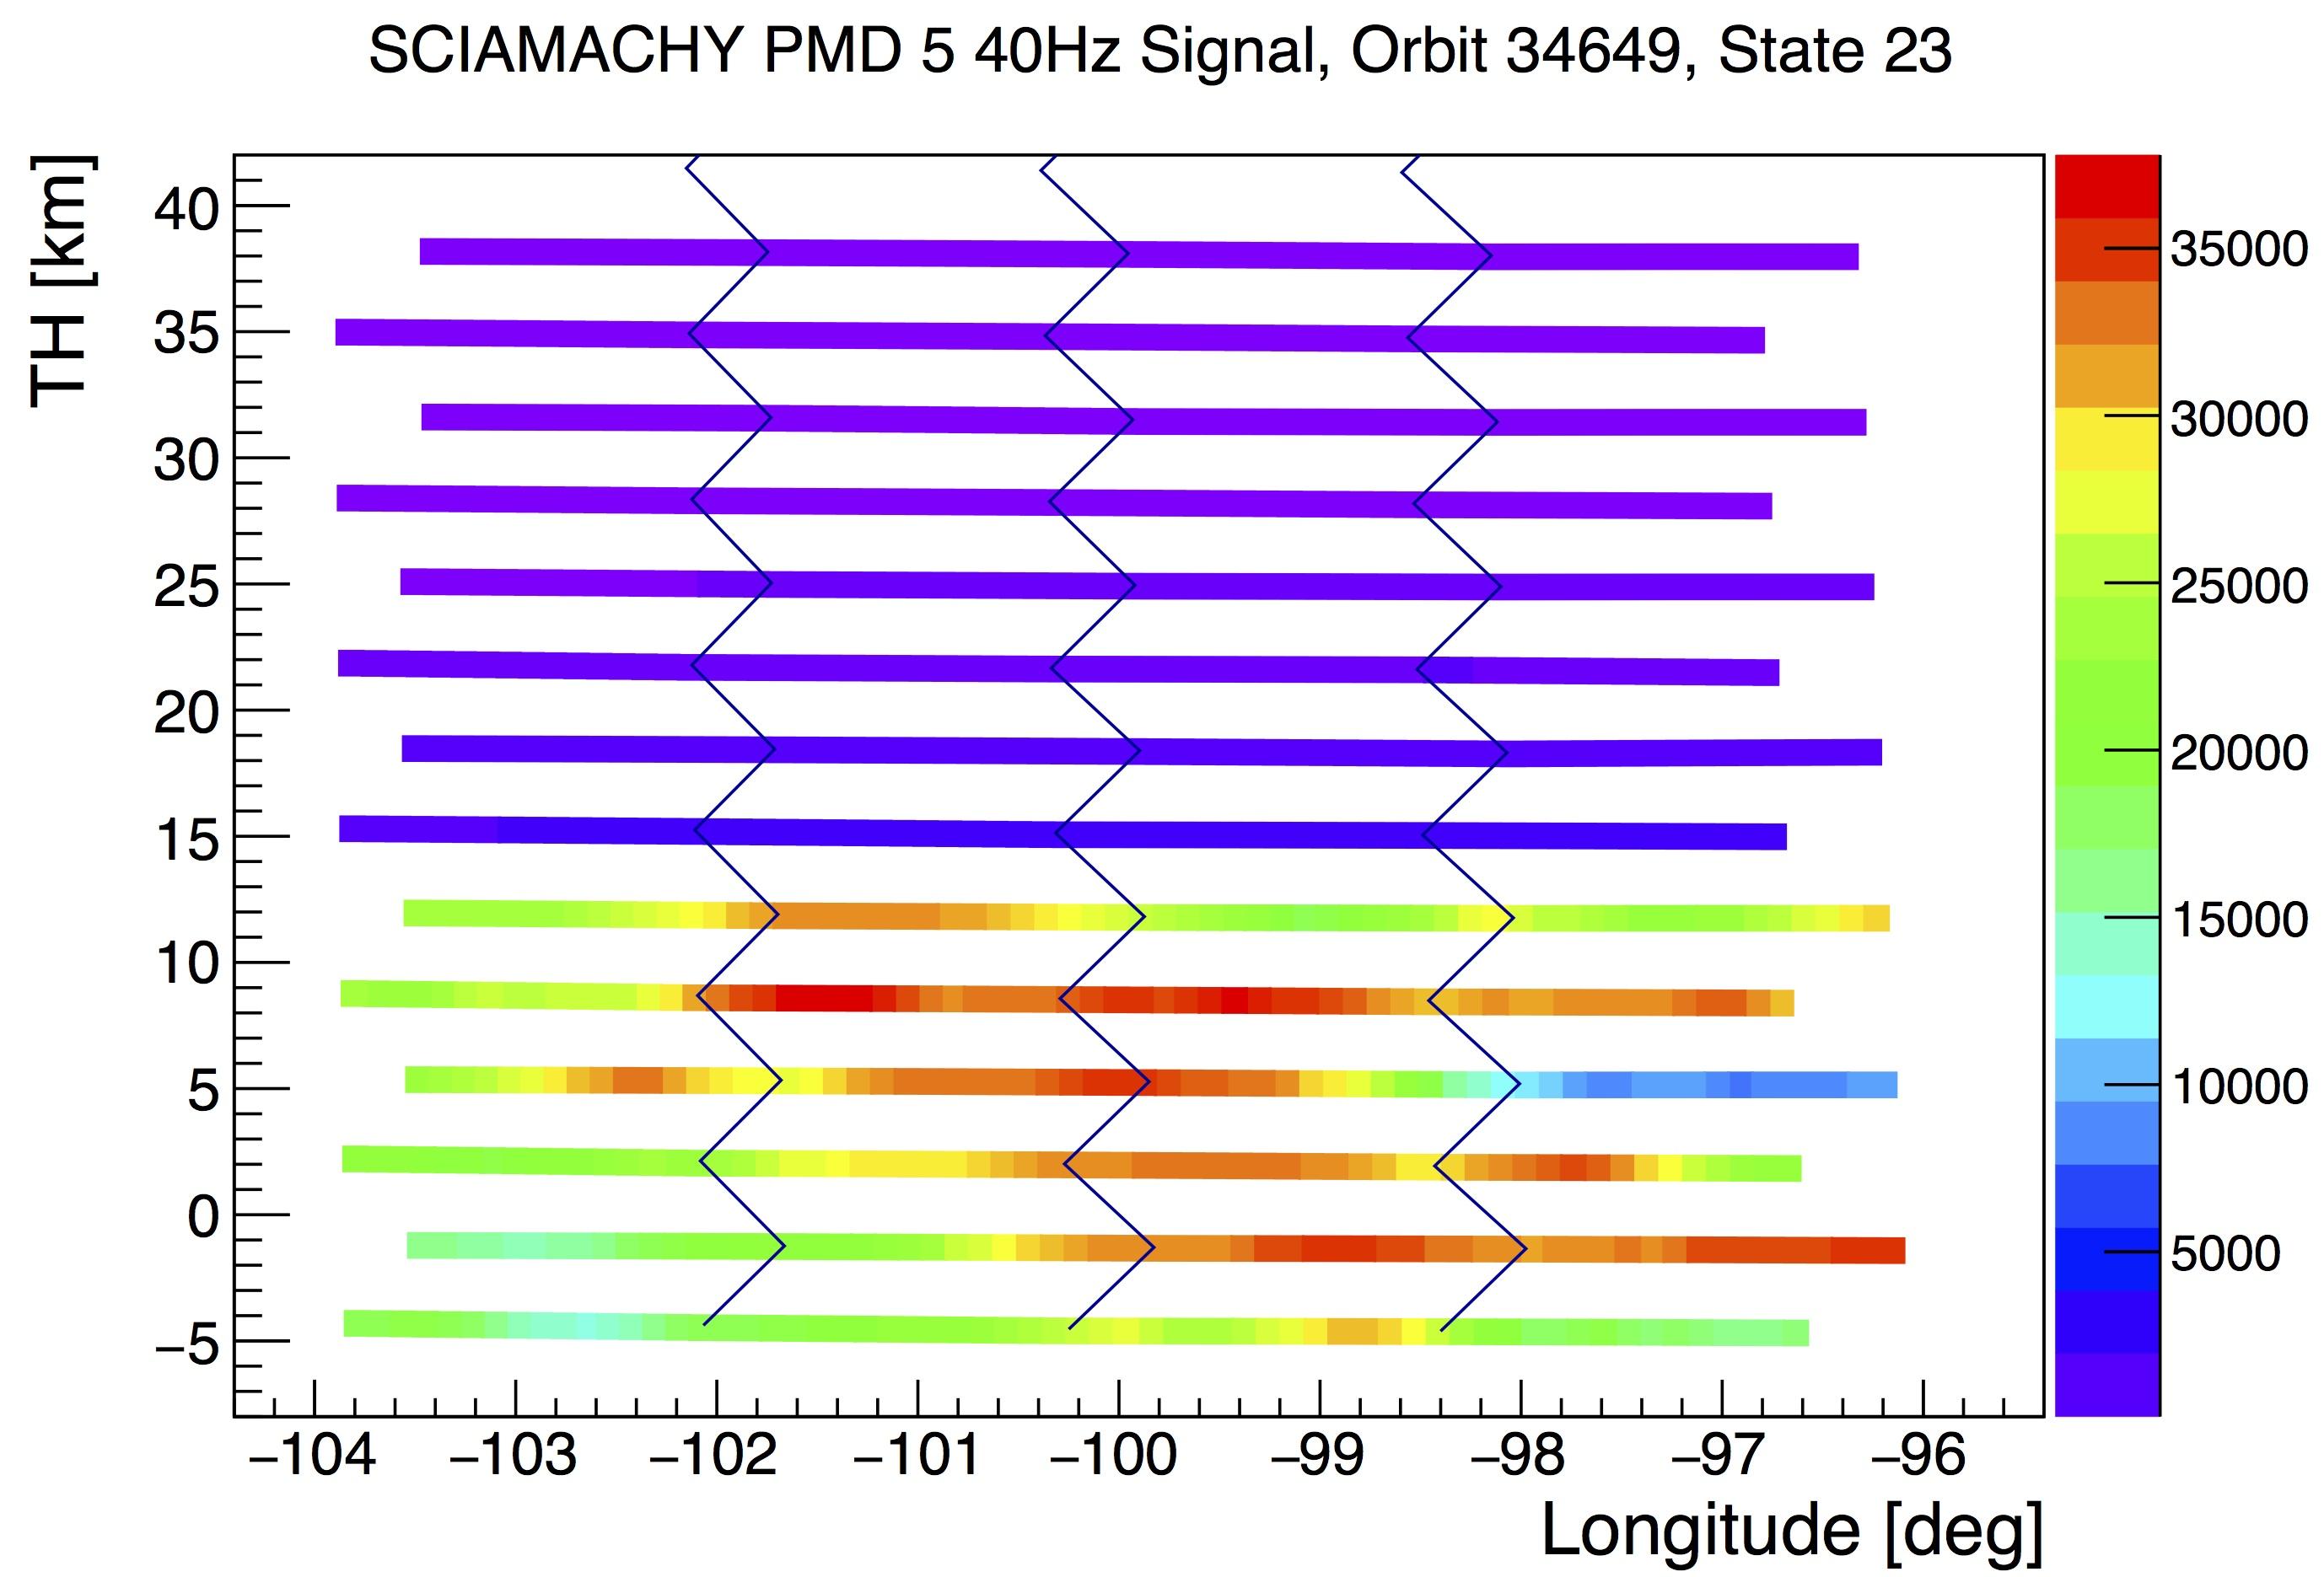
A NEW Algorithm for LIMB Cloud detection
P. Liebing, A. Rozanov, F. Azam, IUP Bremen, Germany

Slide 2
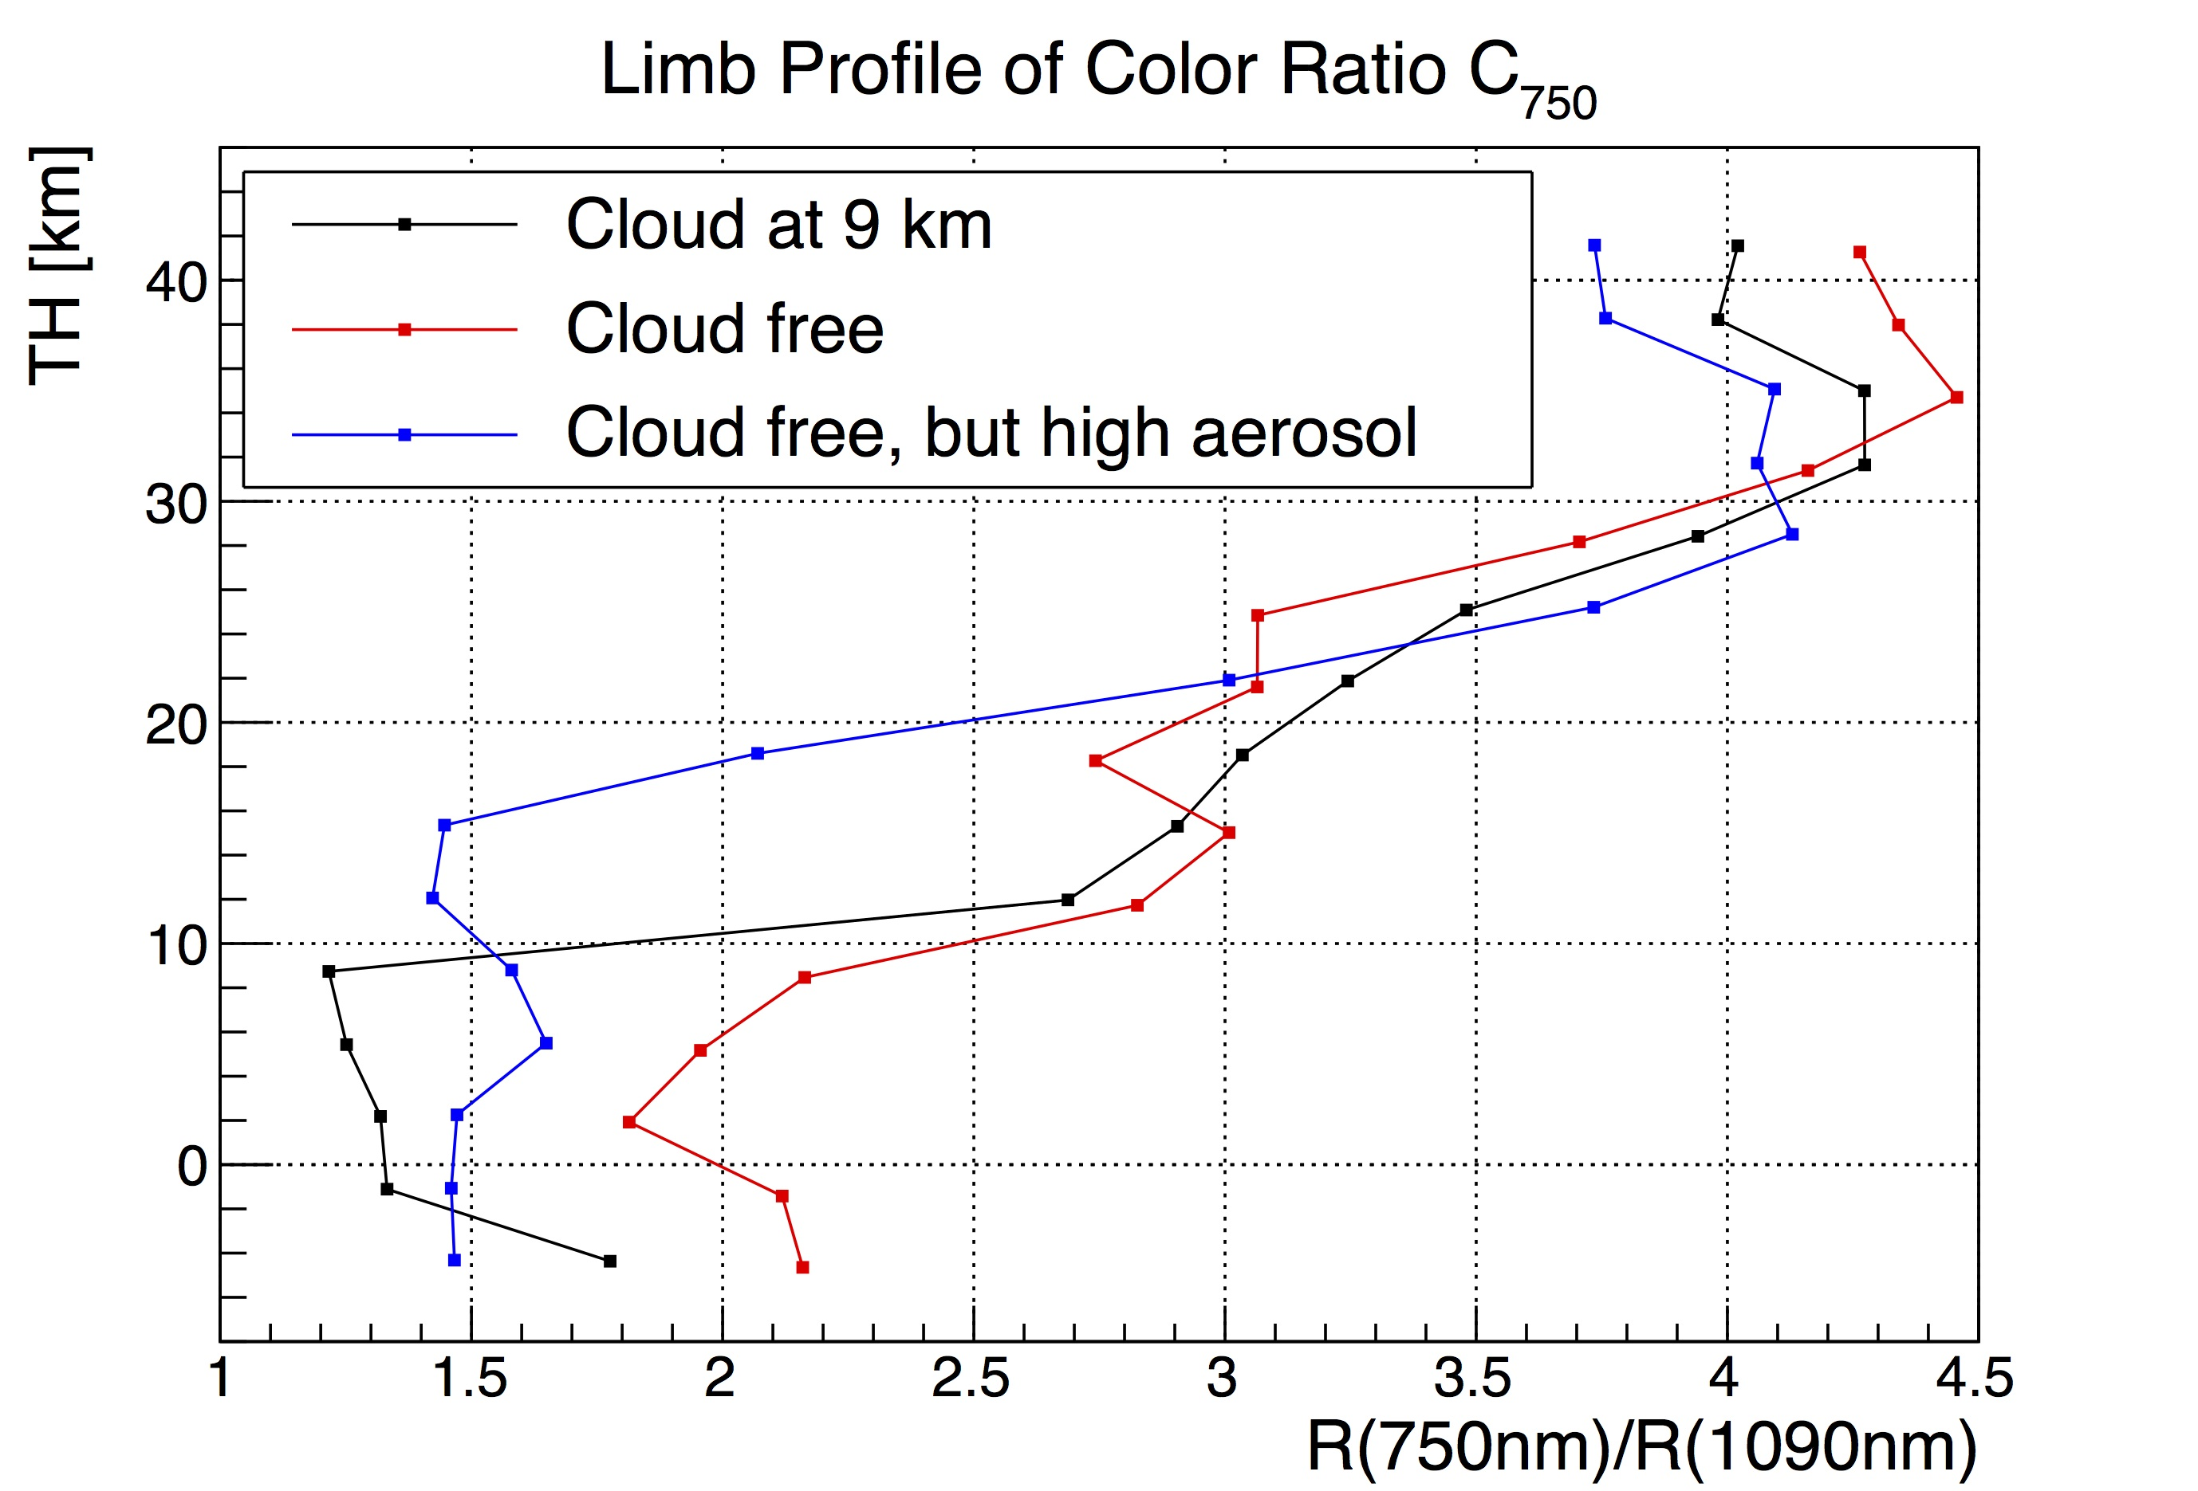
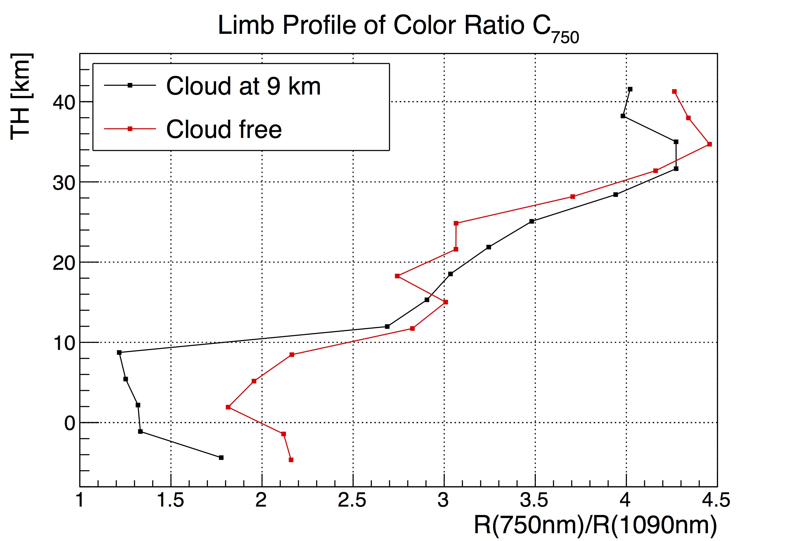
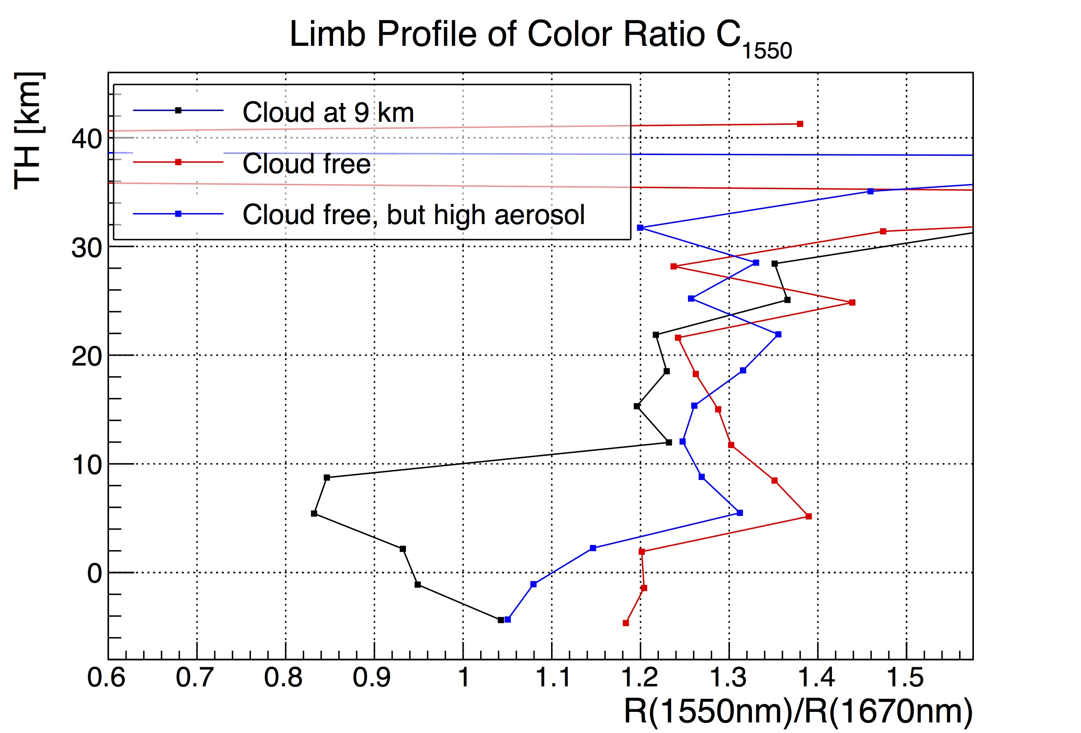
Introduction
Current cloud detection algorithm SCODA (K.U. Eichmann et al., AMTD, 8, 8295-8352, 2015):
Uses ratios (C(TH)/C(TH+1)) of color ratios and fixed thresholds to flag measurements as cloud contaminated and determine “cloud top height”
All Cloud Flag: R(750nm)/R(1090nm)
Ice Cloud Flag: R(1550nm)/R(1670nm)

Slide 3
Introduction
SCODA:
Misidentification of thick aerosol layers with strong gradients as clouds
Fixed threshold seems inadequate, depends on latitude, season (scattering angle), TH (cloud frequency, density), background aerosol (-gradients)
Misses a lot of thin clouds, but, e.g., aerosol retrieval extremely sensitive to even the thinnest clouds
Therefore: try to improve cloud detection
Use the same two color ratios, but concentrate on C₁₅₅₀=R(1550)/R(1670), because less sensitive to aerosols
Do not use gradients
Optimize thresholds, using statistics and model studies

Slide 4
Outline
SCIATRAN simulations of color ratios and conclusions
Distributions of real data
Algorithm concept
Thresholds
Fits
Probabilities
Results

Slide 5
SCIATRAN simulations
1 set with varying albedo/boundary layer/trop./stratospheric aerosol
1 set with clouds at different altitudes in addition
Water clouds: 5-7, 9-11, 11-13, 13-15 km, OD=0.5-50
Ice clouds: 13-15, 15-17, 17-19, OD=0.001-0.5
Each with 2 different size parameters
Investigate color ratio C₇₅₀ (R(750nm)/R(1090nm)) vs. C₁₅₅₀ (R(1550nm)/R(1670nm)) for each tangent height individually (not the gradients w.r.t. TH)

Slide 6
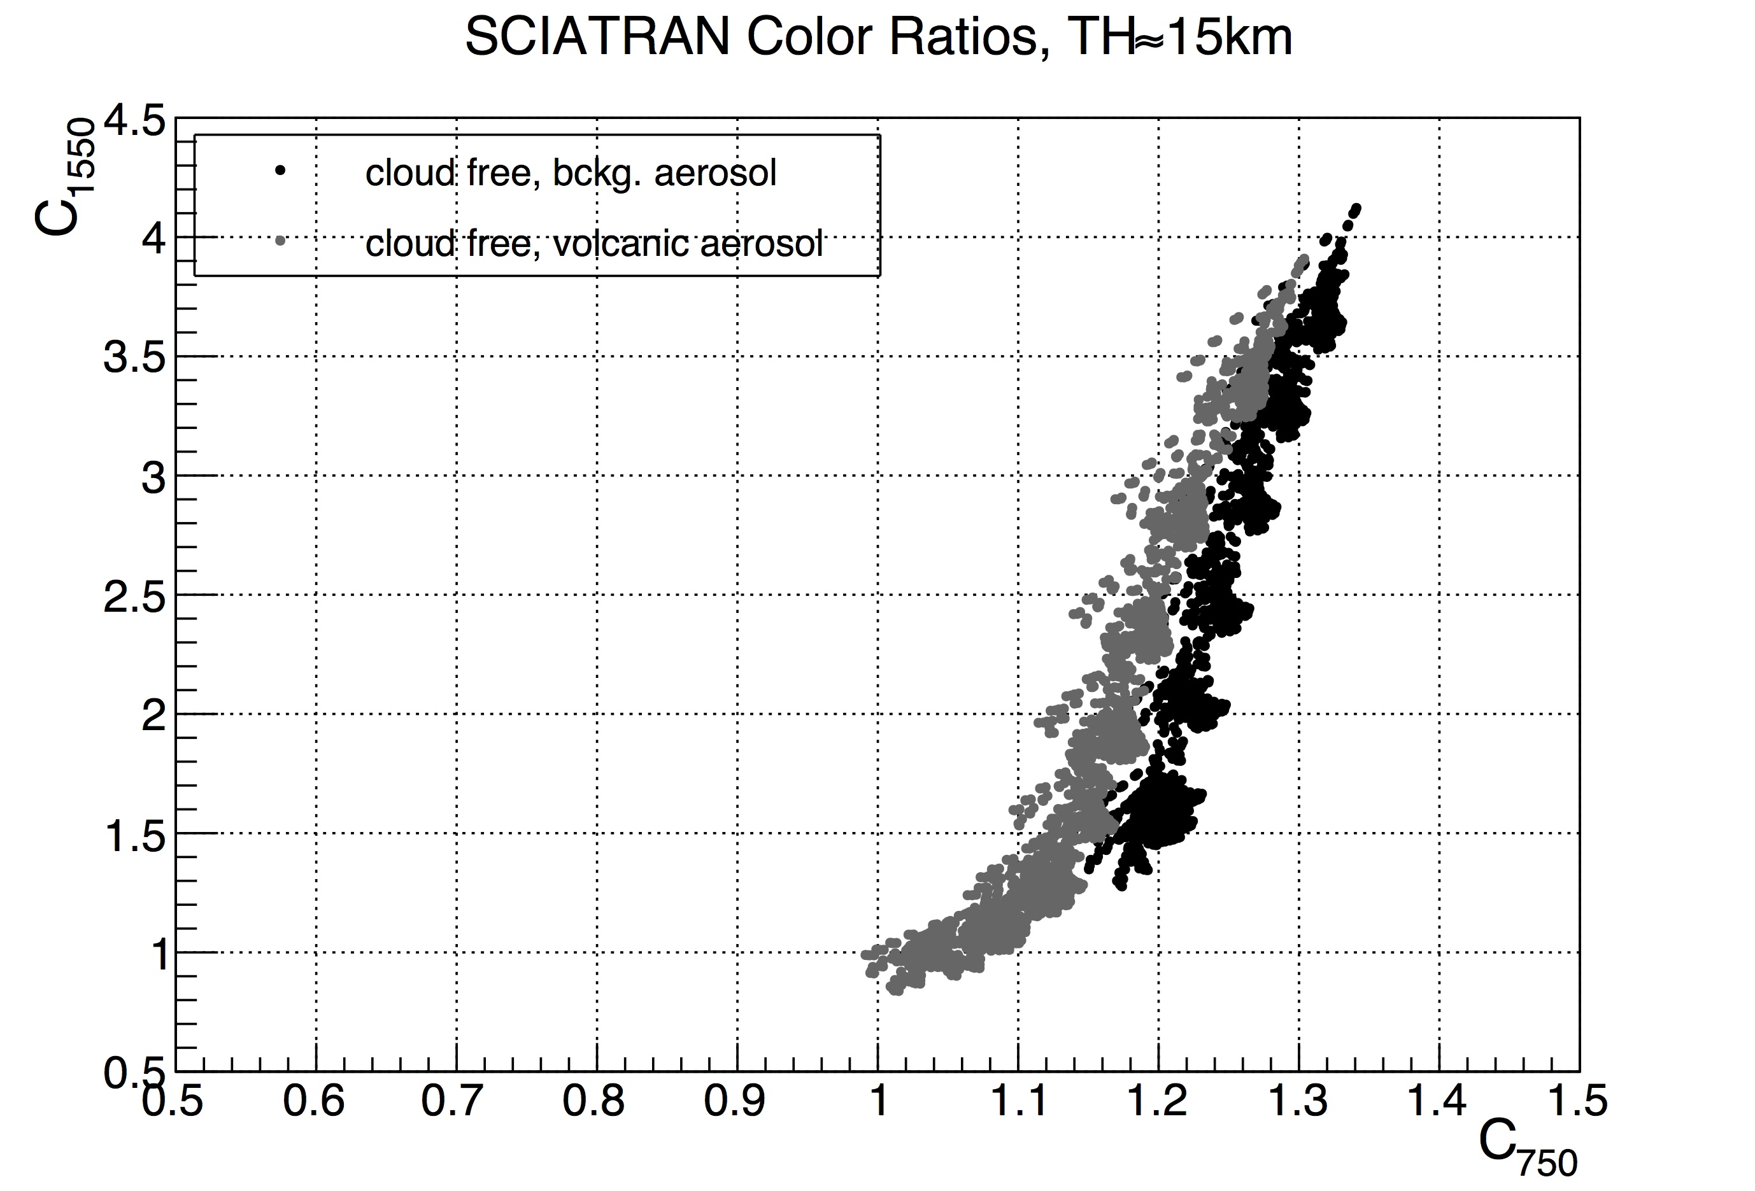
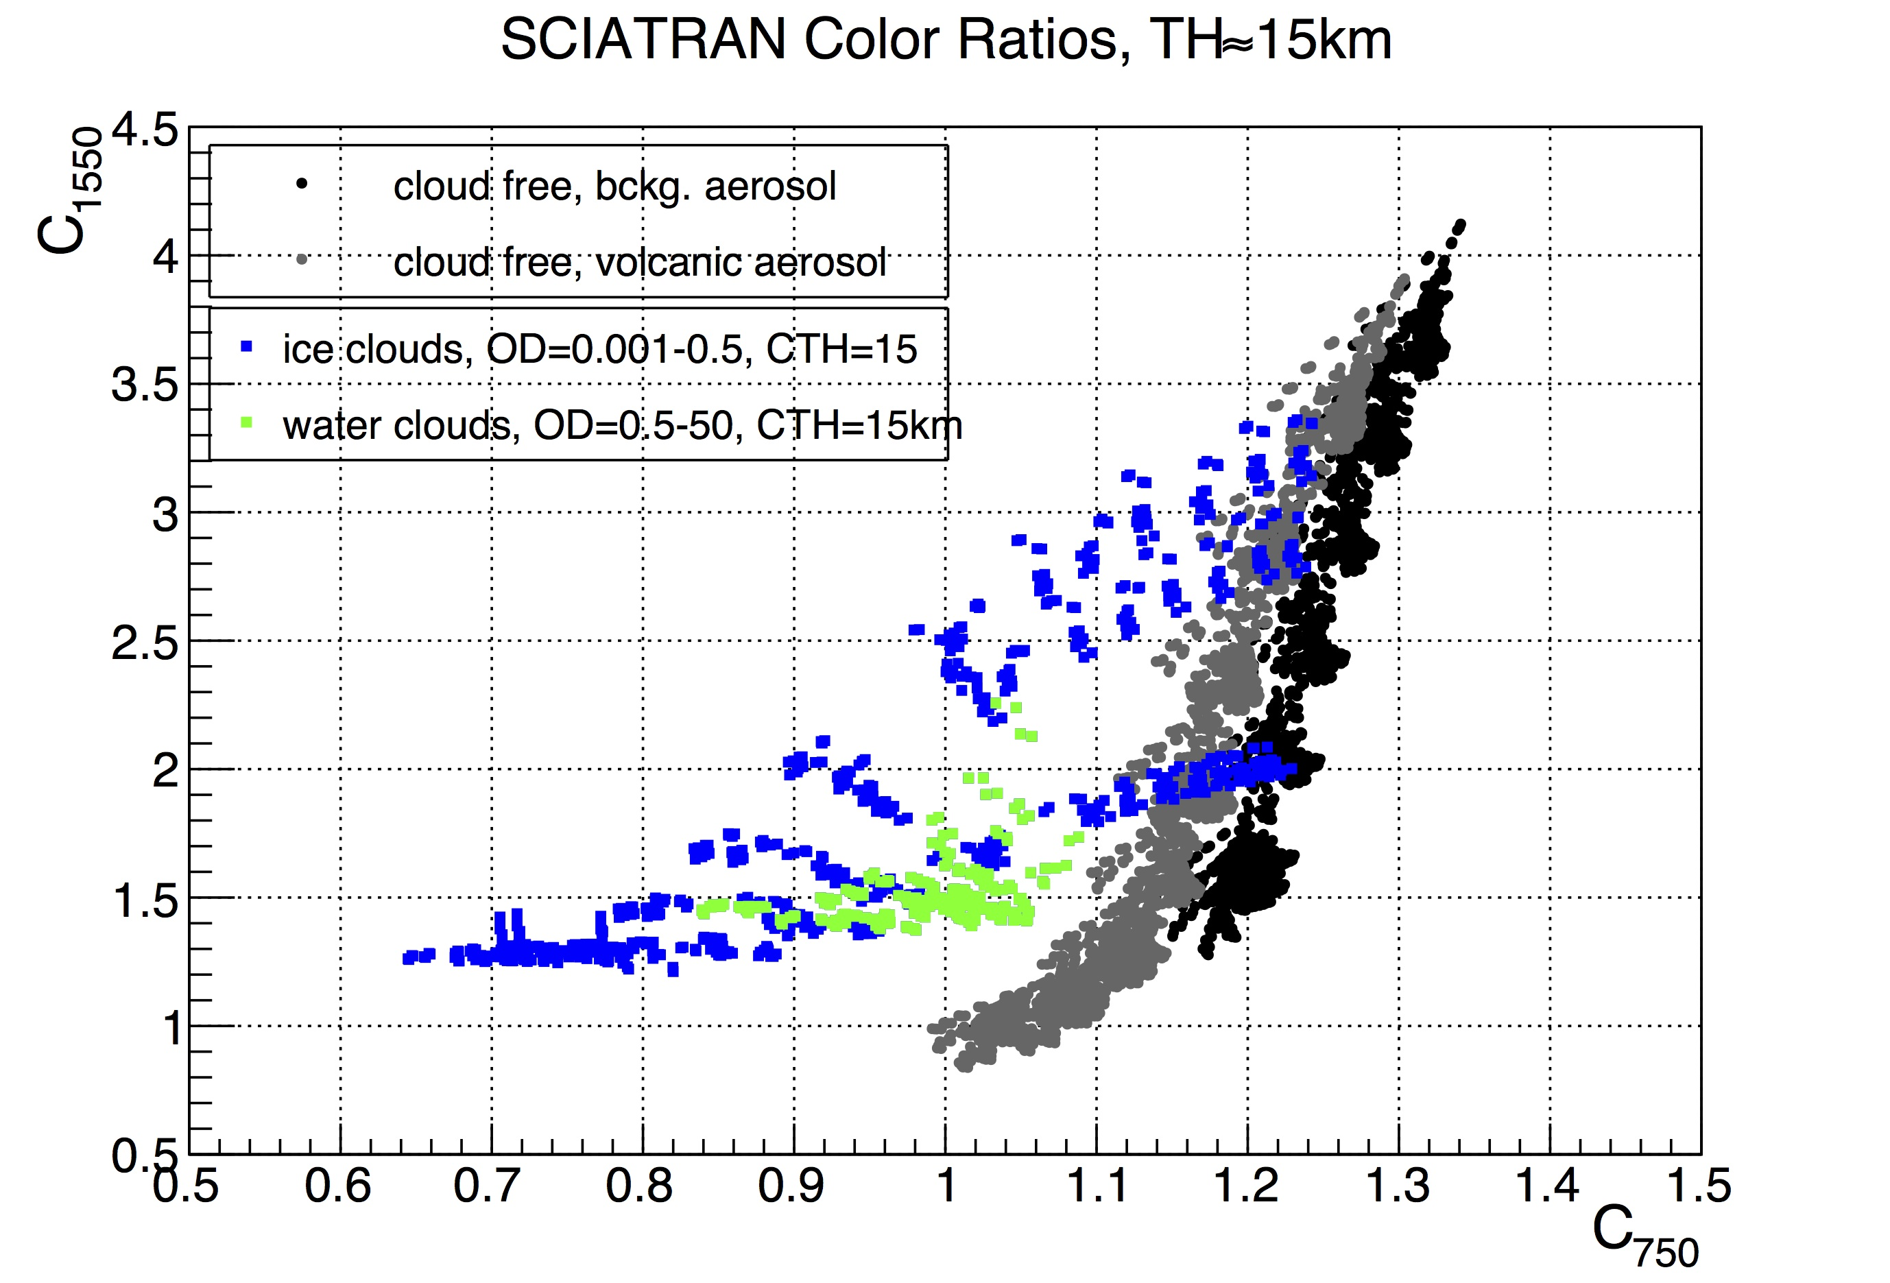
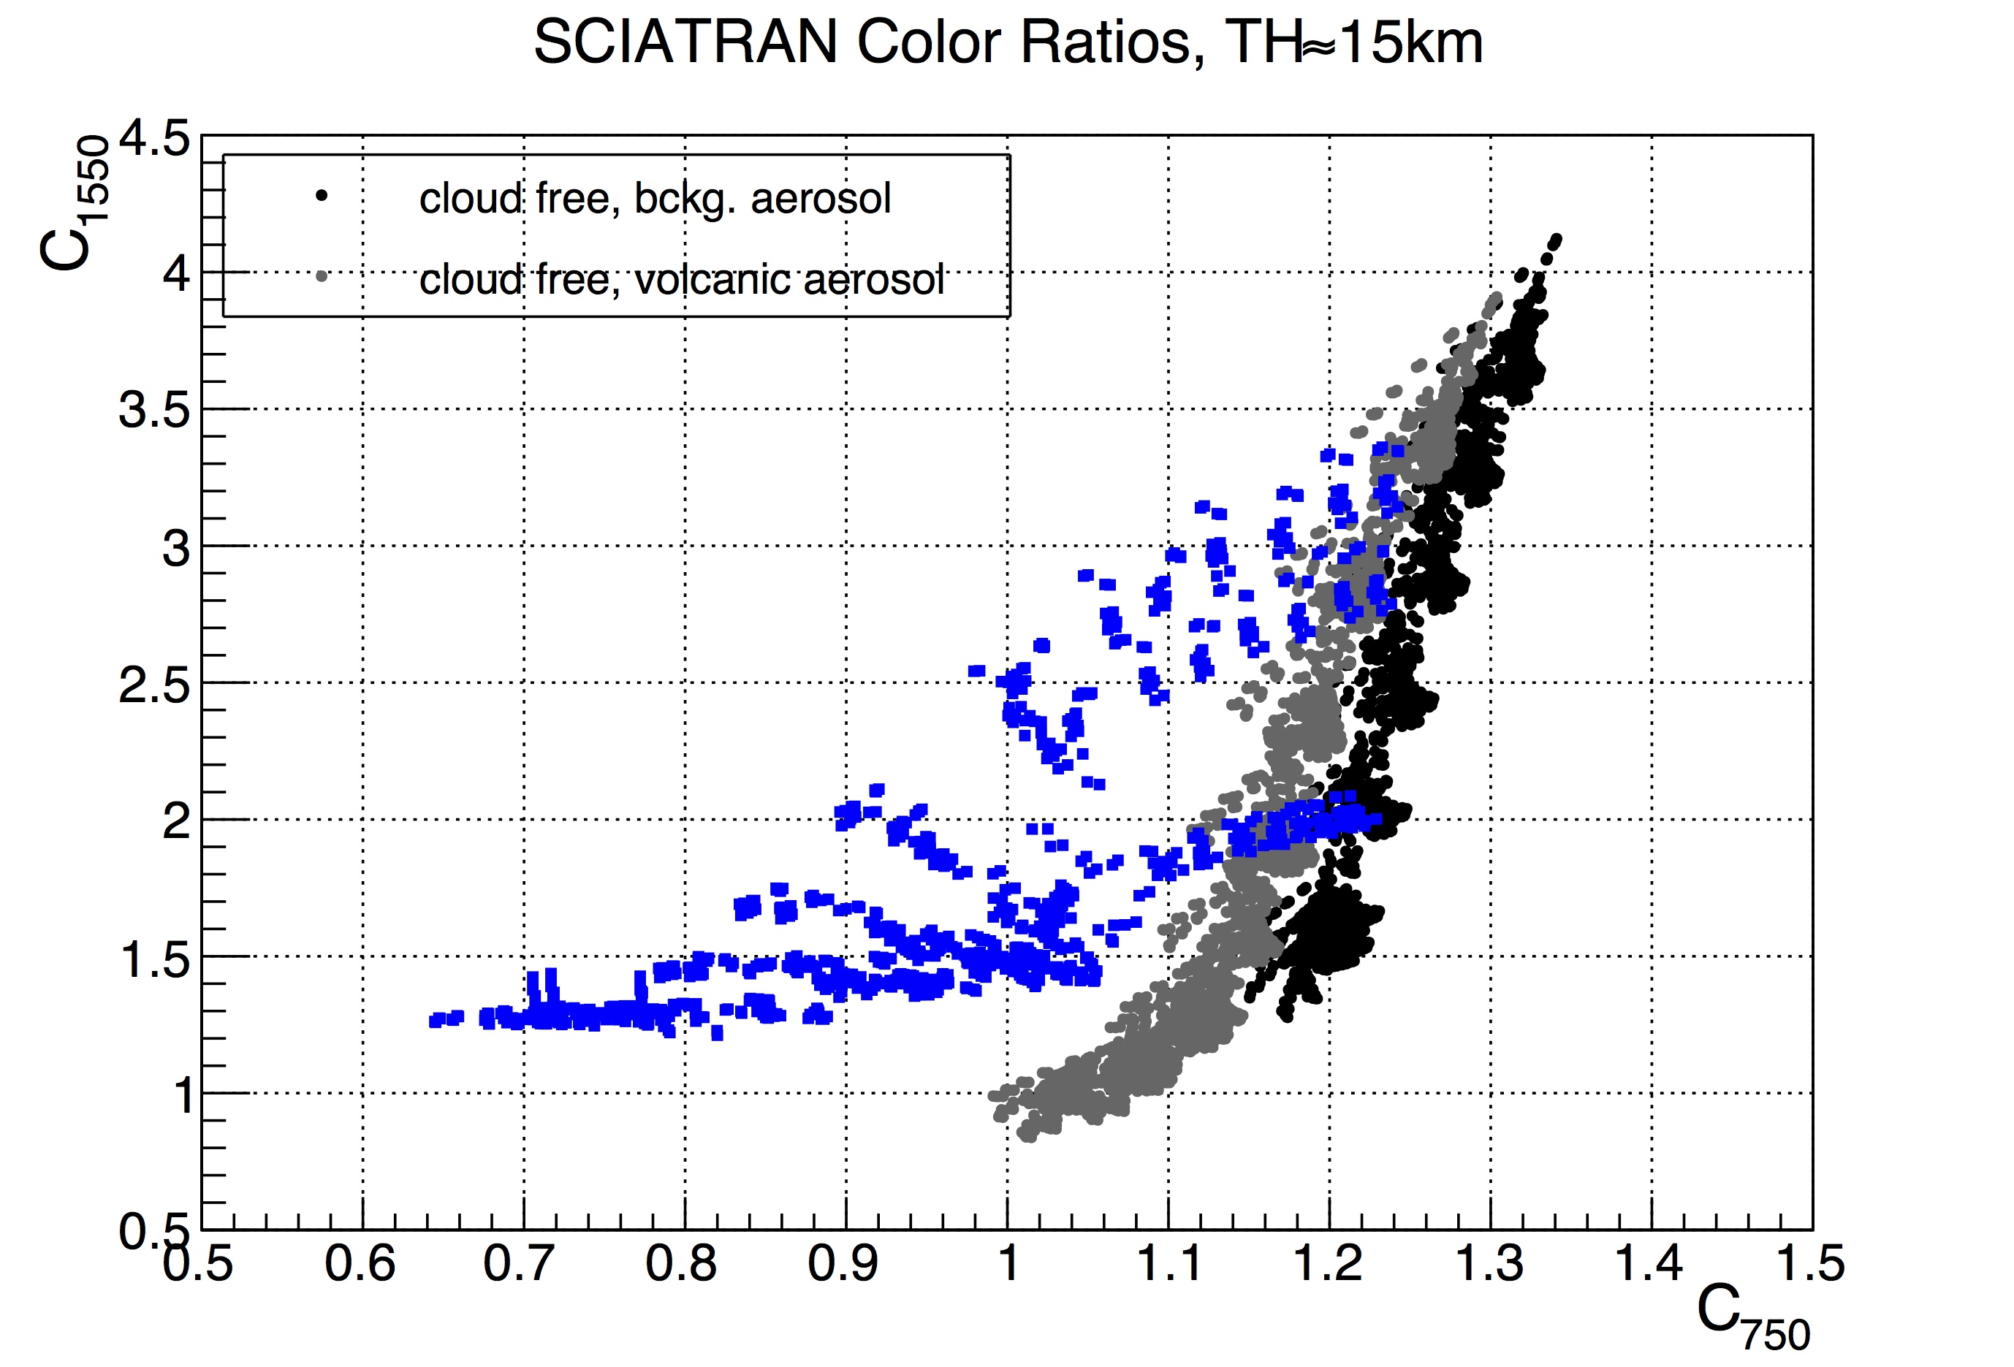
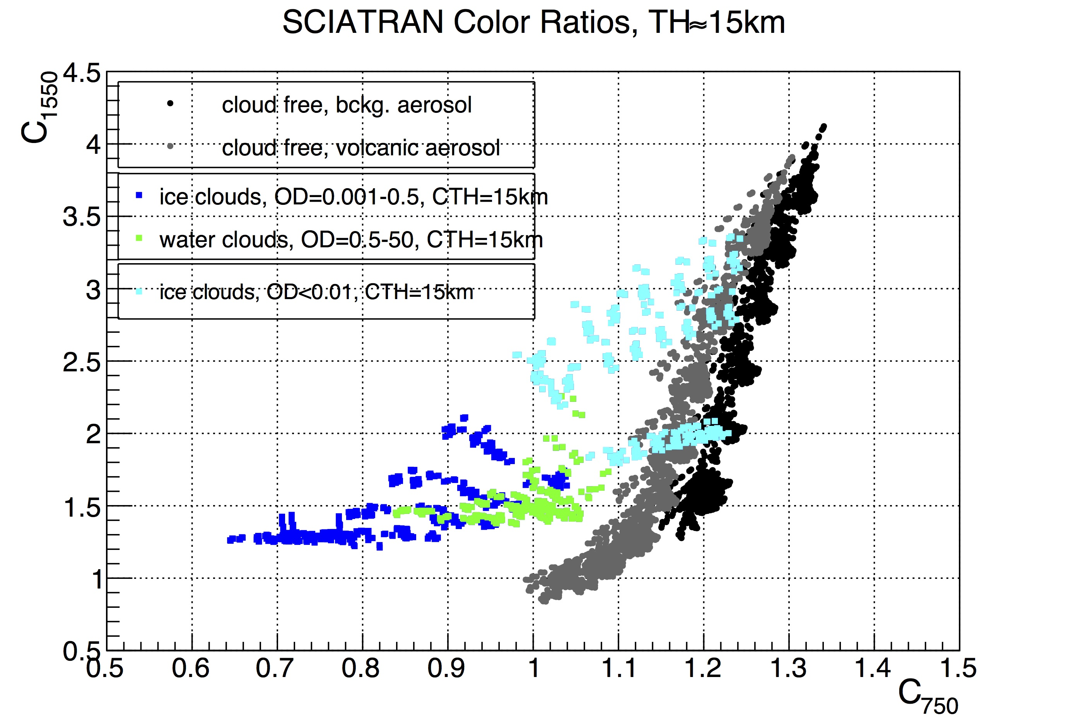
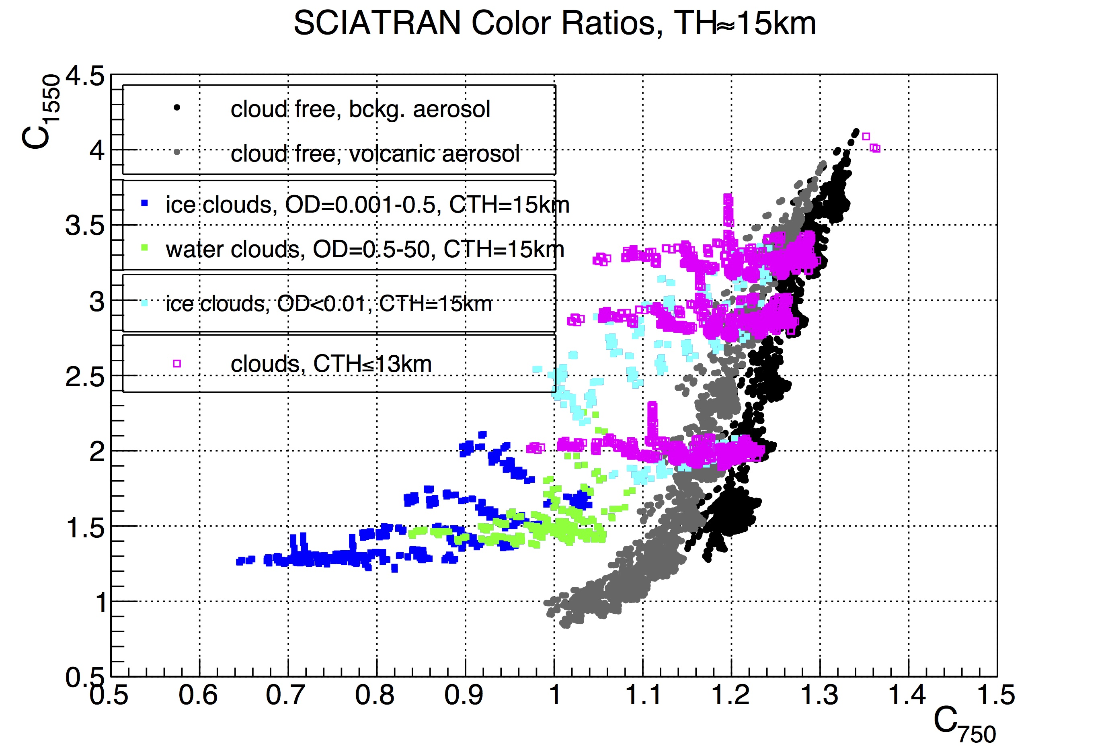
Simulations for TH=15 km
C₇₅₀ vs. C₁₅₅₀:
Varying albedo, tropospheric and stratospheric aerosol optical depth and types
All clouds, CTH=15km
Water clouds
Thin (ice) clouds
Clouds below FoV

Slide 7
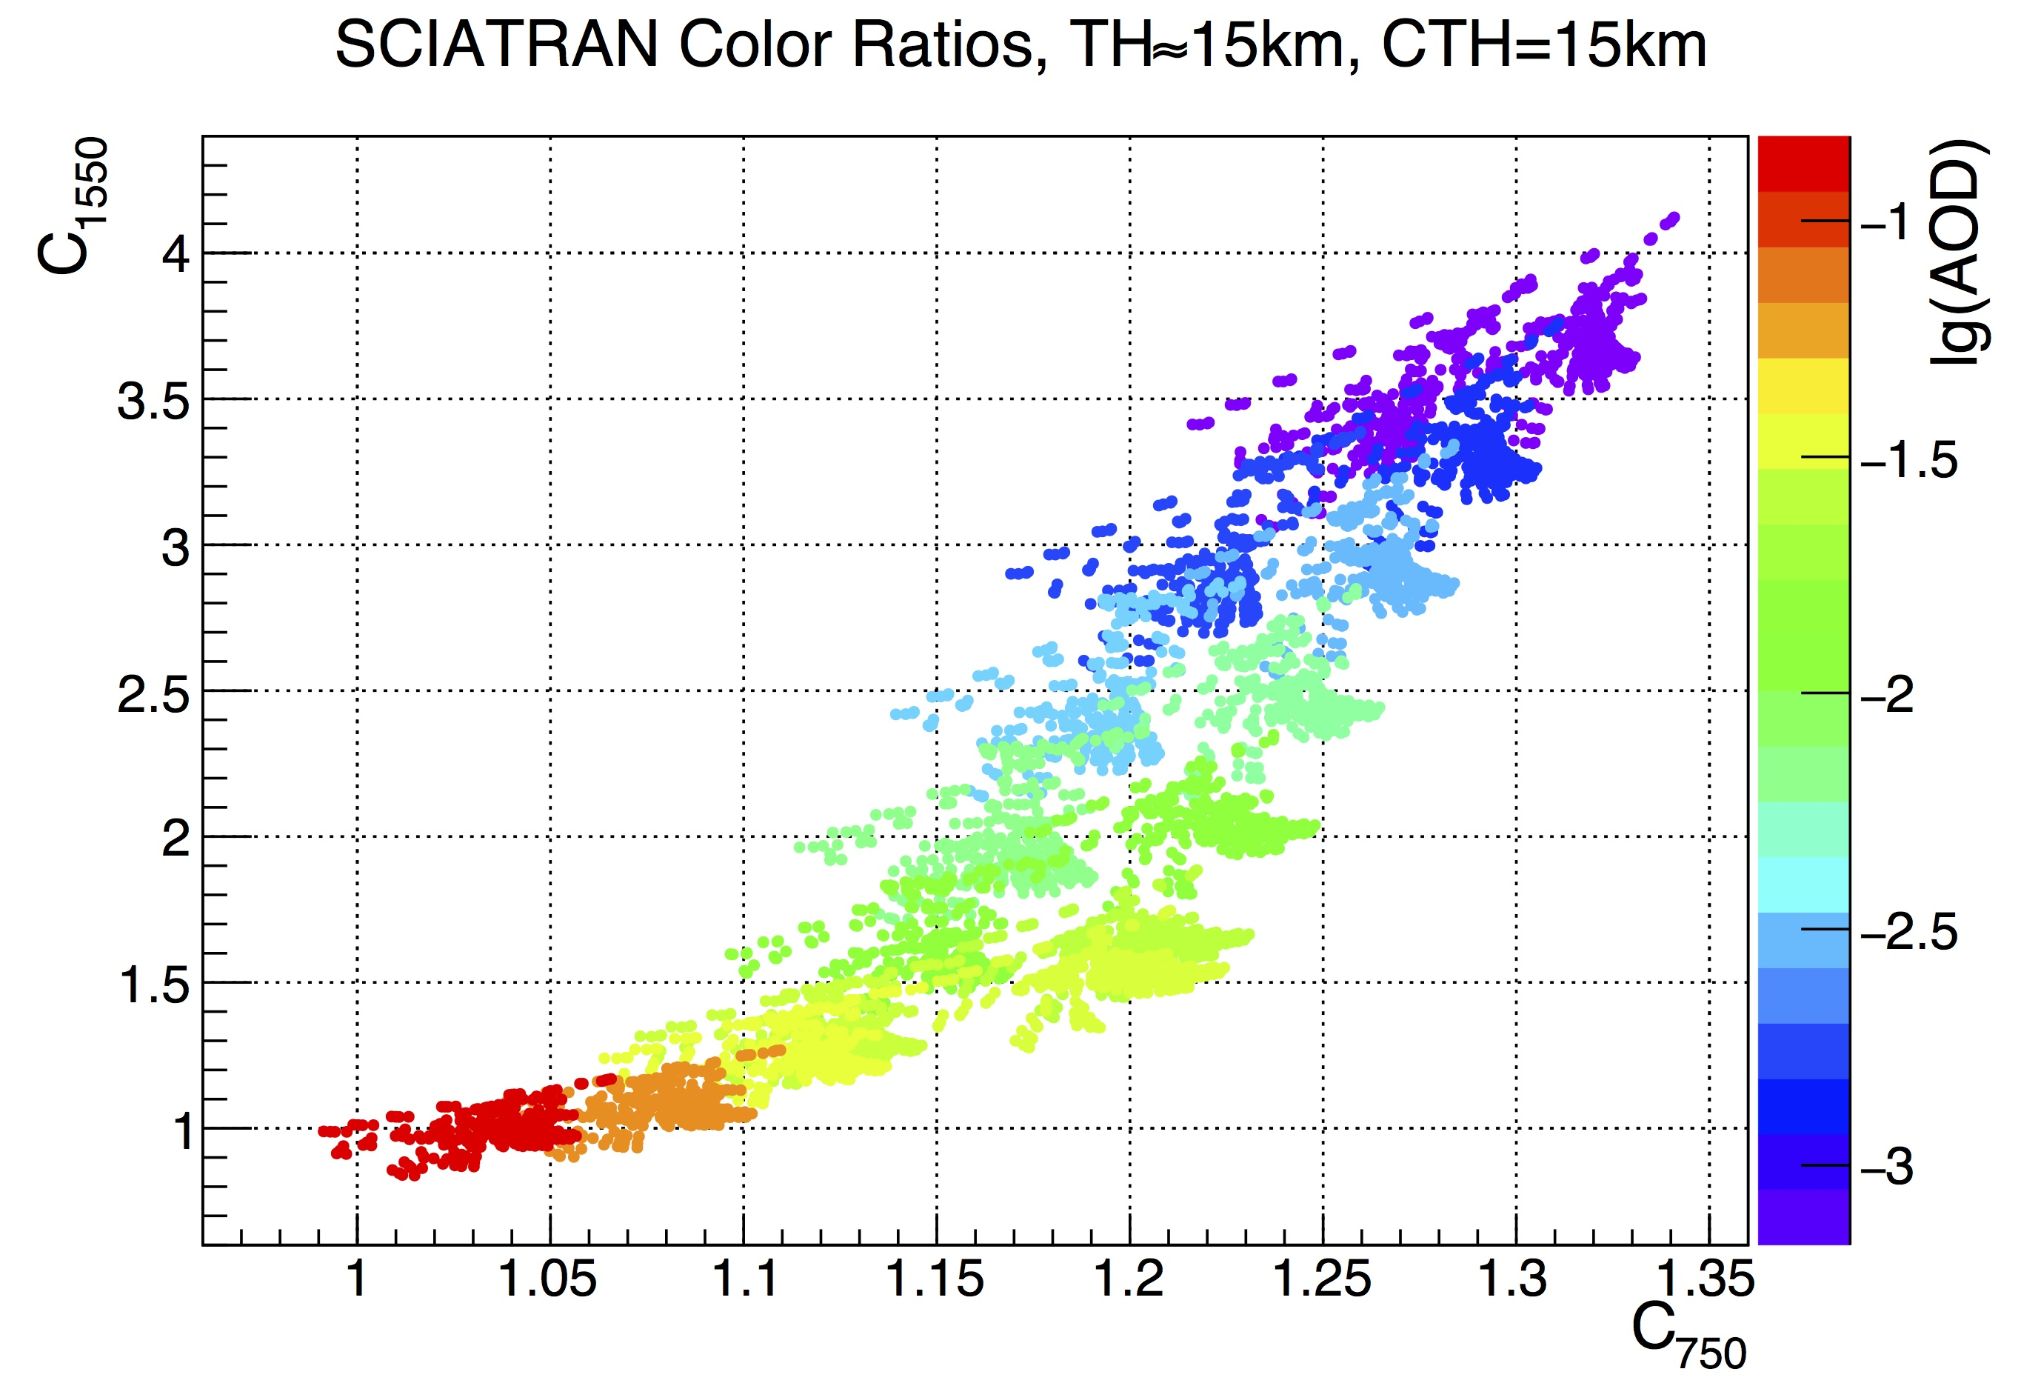
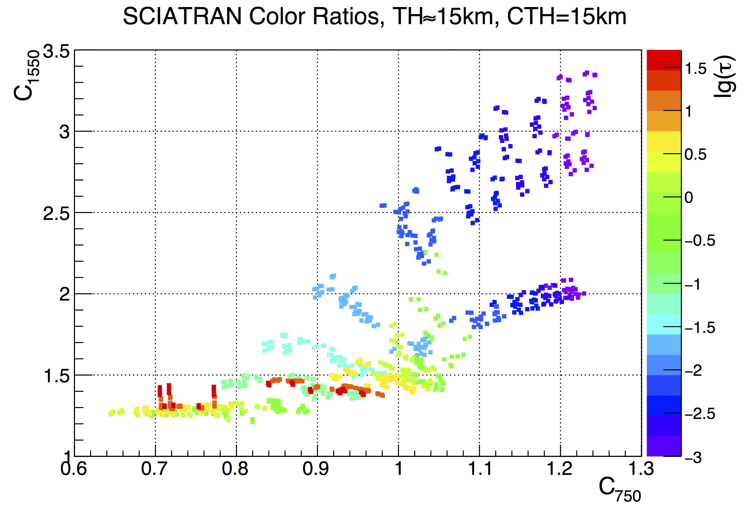
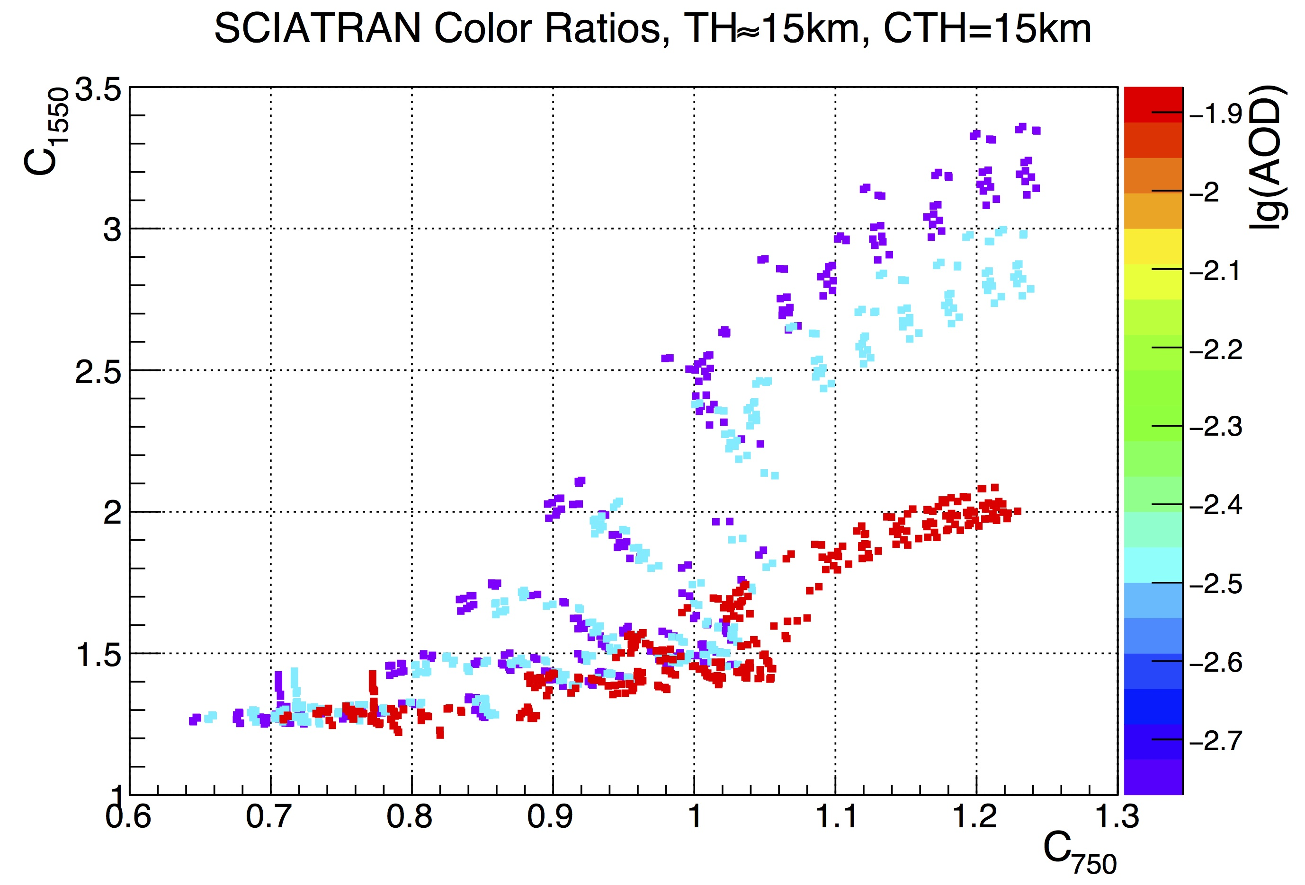
Simulations for TH=15 km
C₇₅₀ vs. C₁₅₅₀
AOD of stratospheric aerosol, pure aerosols
OD of clouds, CTH=15km
Bkg. AOD of clouds, CTH=15km

Slide 8
Simulations for TH=15 km
C₇₅₀ vs. C₁₅₅₀:
Optimized information from C₁₅₅₀ as a function of C₇₅₀!
C₇₅₀ proxy for density
Clouds below FoV are a nasty nuisance, still necessary to check gradients
Density of scatterers
Type of scatterers

Slide 9
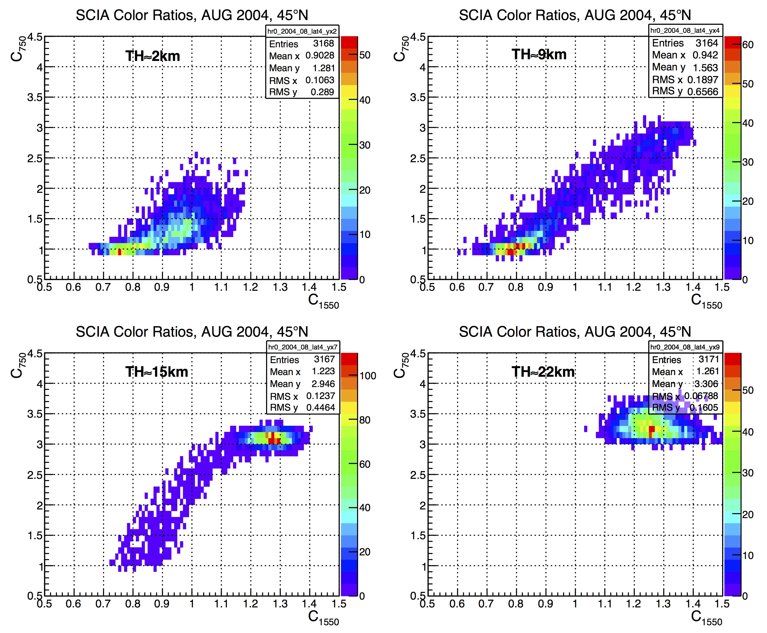
Data Distributions
Examples for 2D data histograms for Aug 2004, 30N-60N

Slide 10
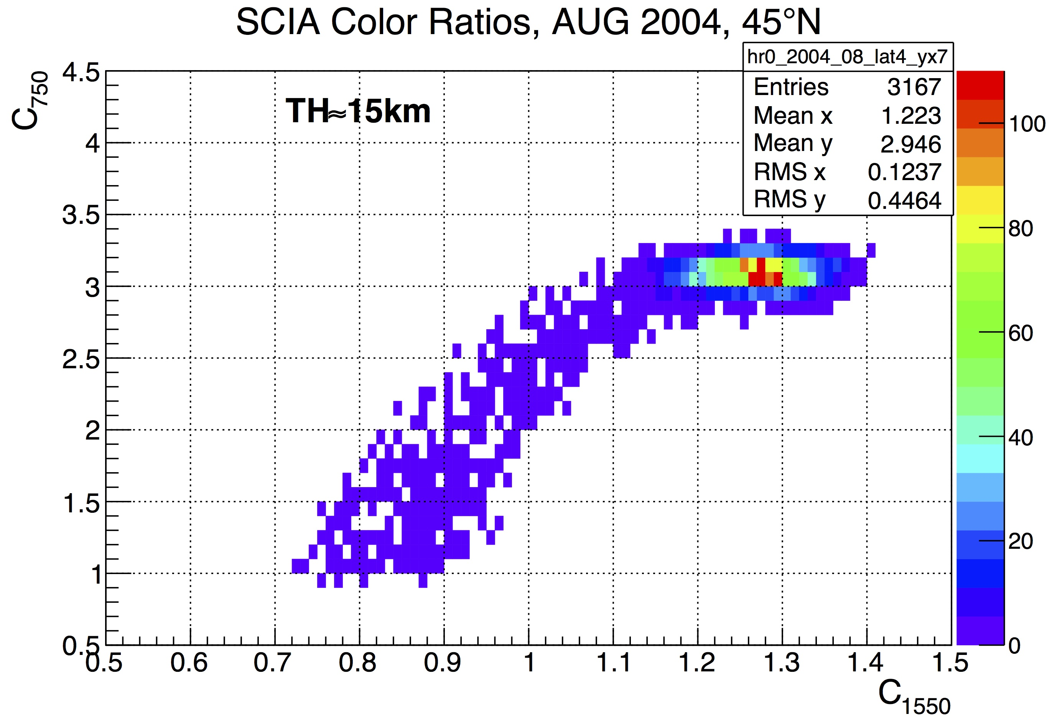
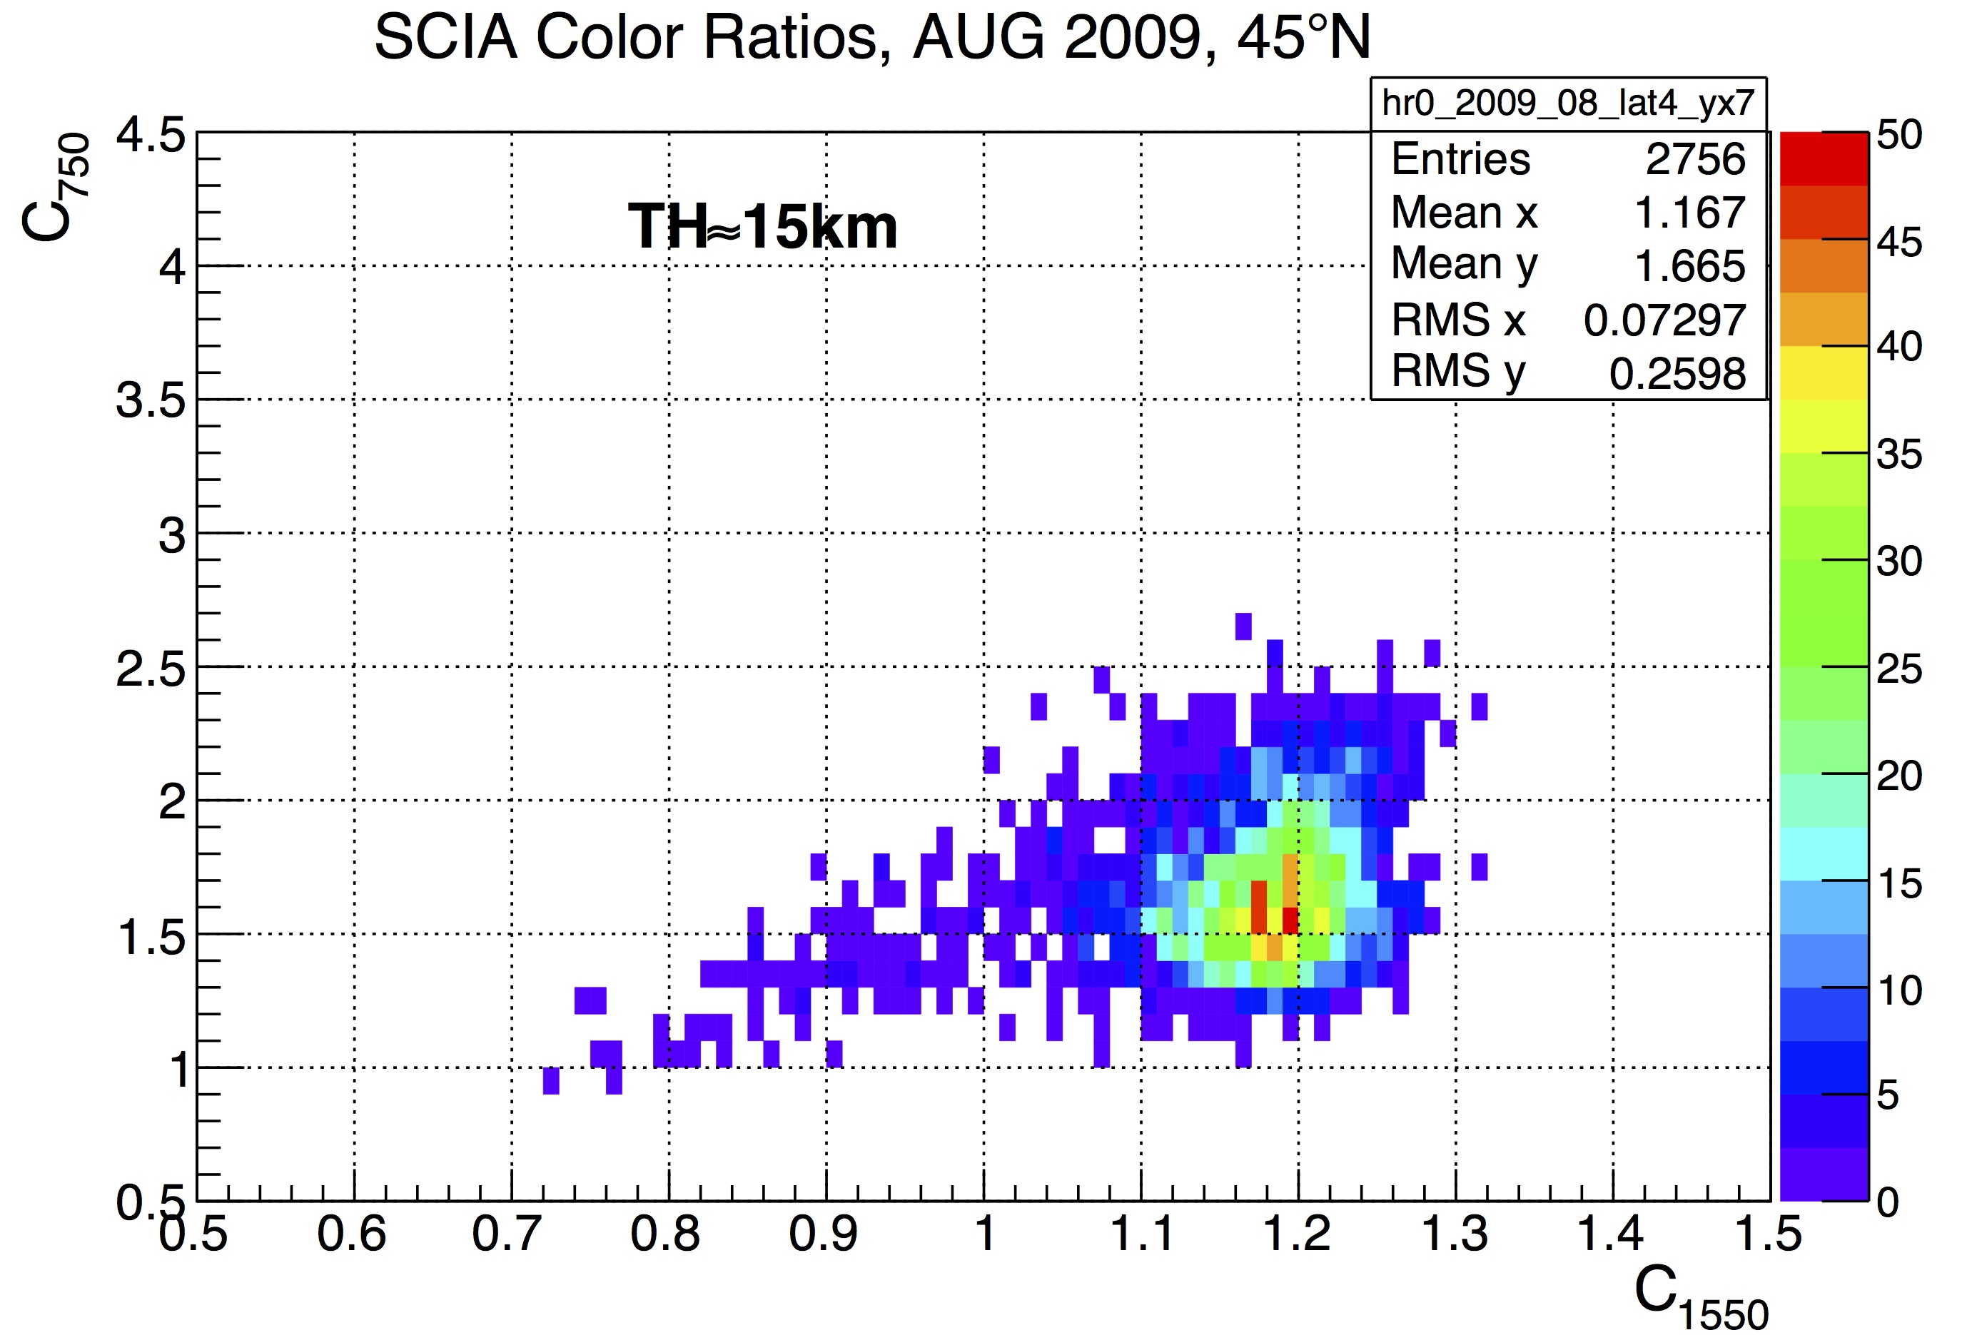
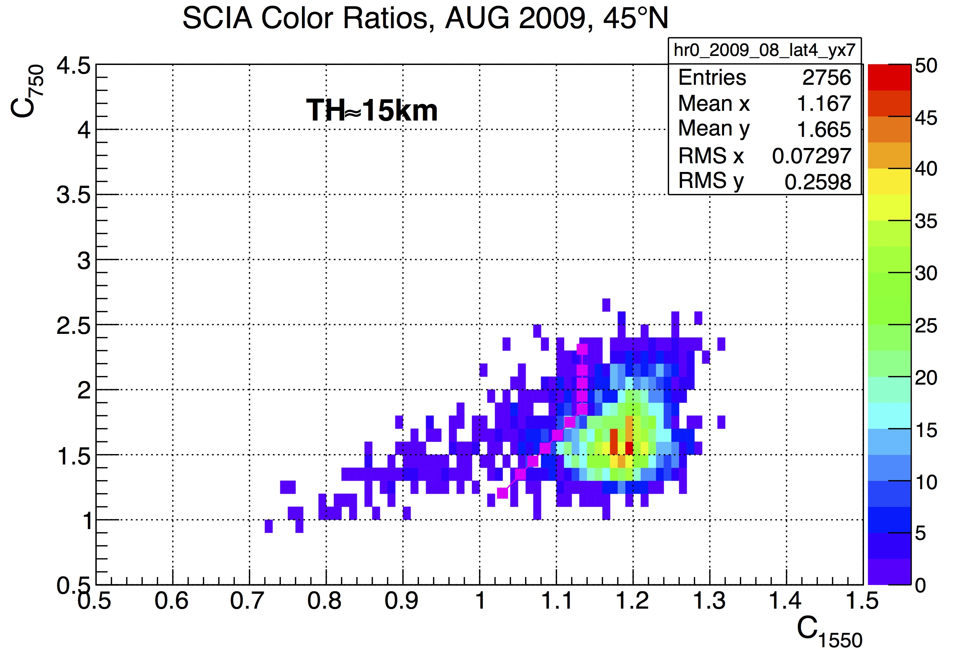
Data Distributions
Volcanic aerosol from Sarychev eruption
To identify clouds:
Find position of “aerosol peak”, - 2*RMS of peak
Then draw a line down from the peak to C₇₅₀=1,C₁₅₅₀≈1(minimum value for aerosol from SCIATRAN)
Fit distribution of C₁₅₅₀ in slices of C₇₅₀ with a series of Gaussians (max. 5 peaks)

Slide 11
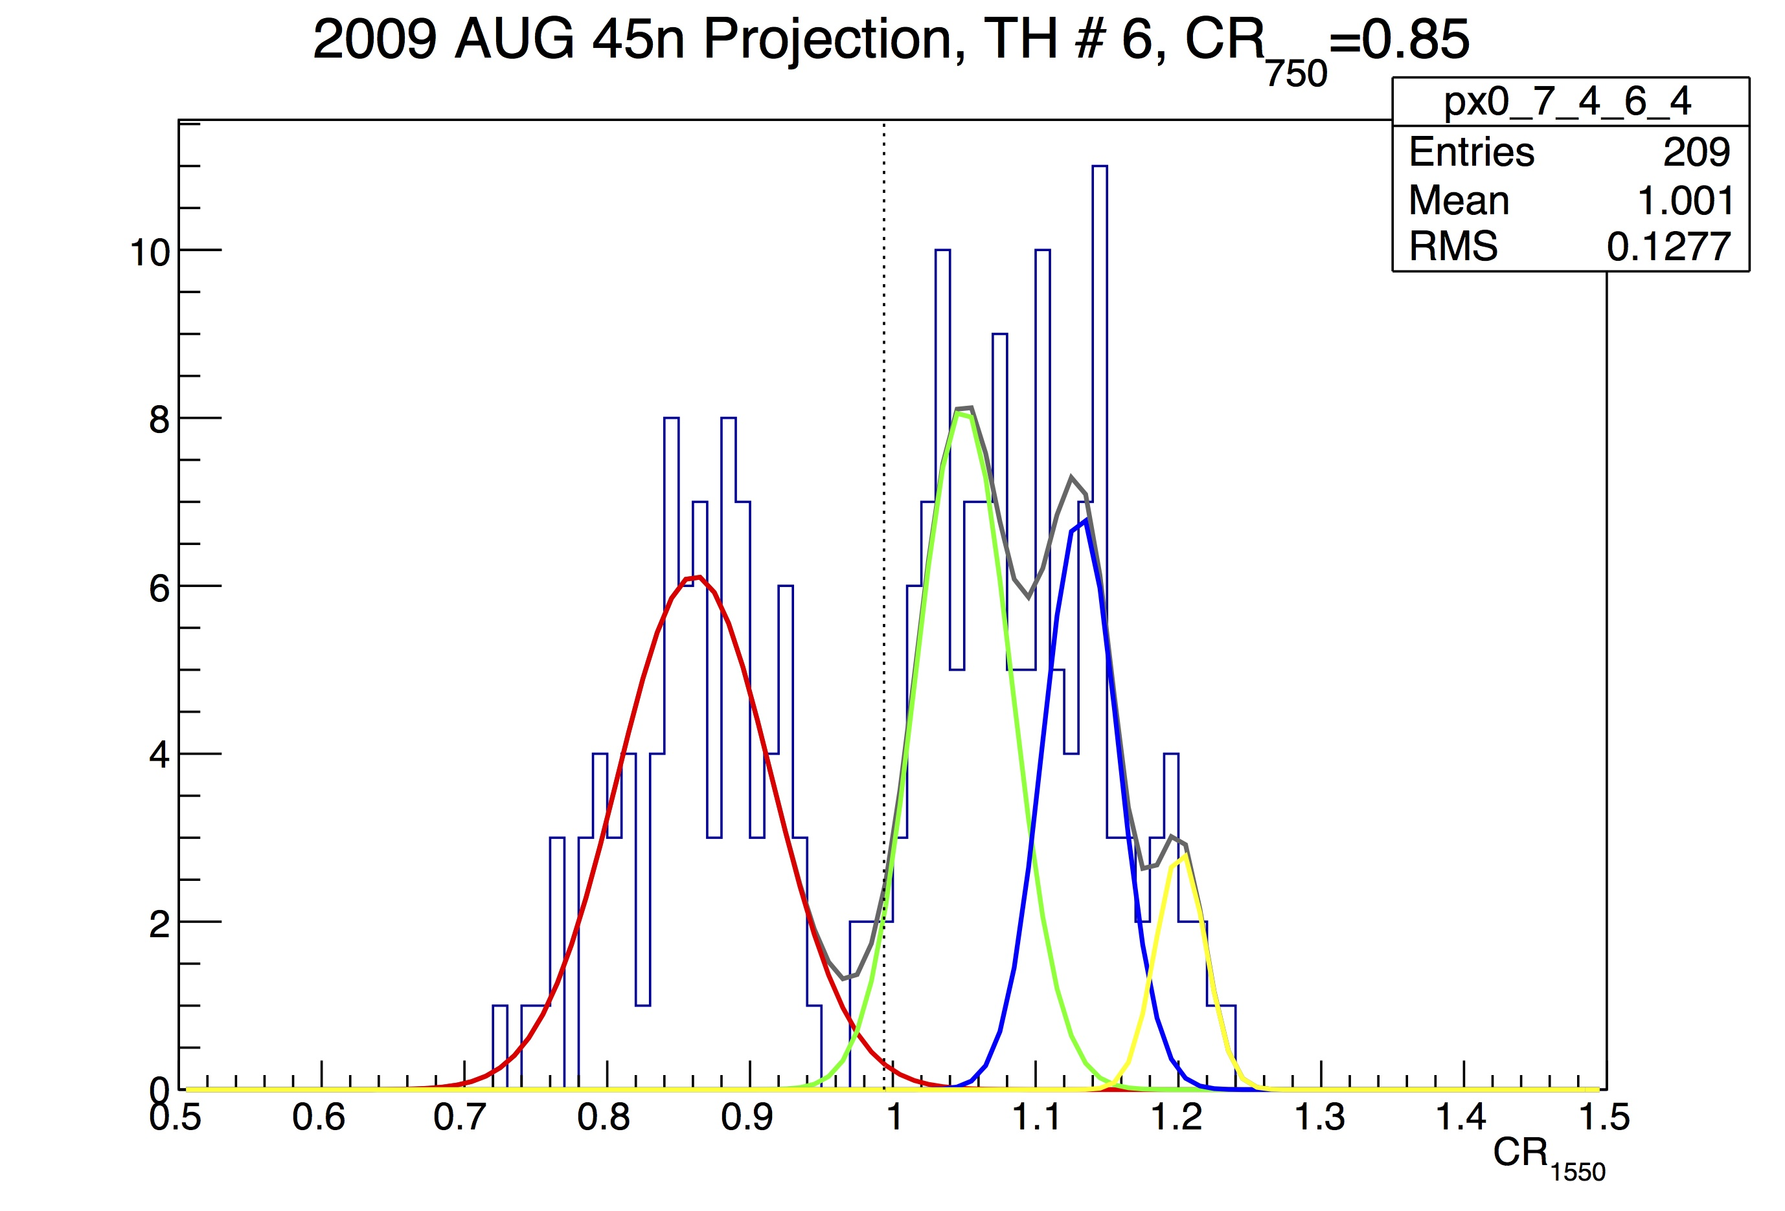
Fits to Data
Example for fits:
2009-08, 45N, 15 km
C₇₅₀≈0.85
Peaks to the left of the line are clouds
Peaks to the right of the line are clouds

Slide 12
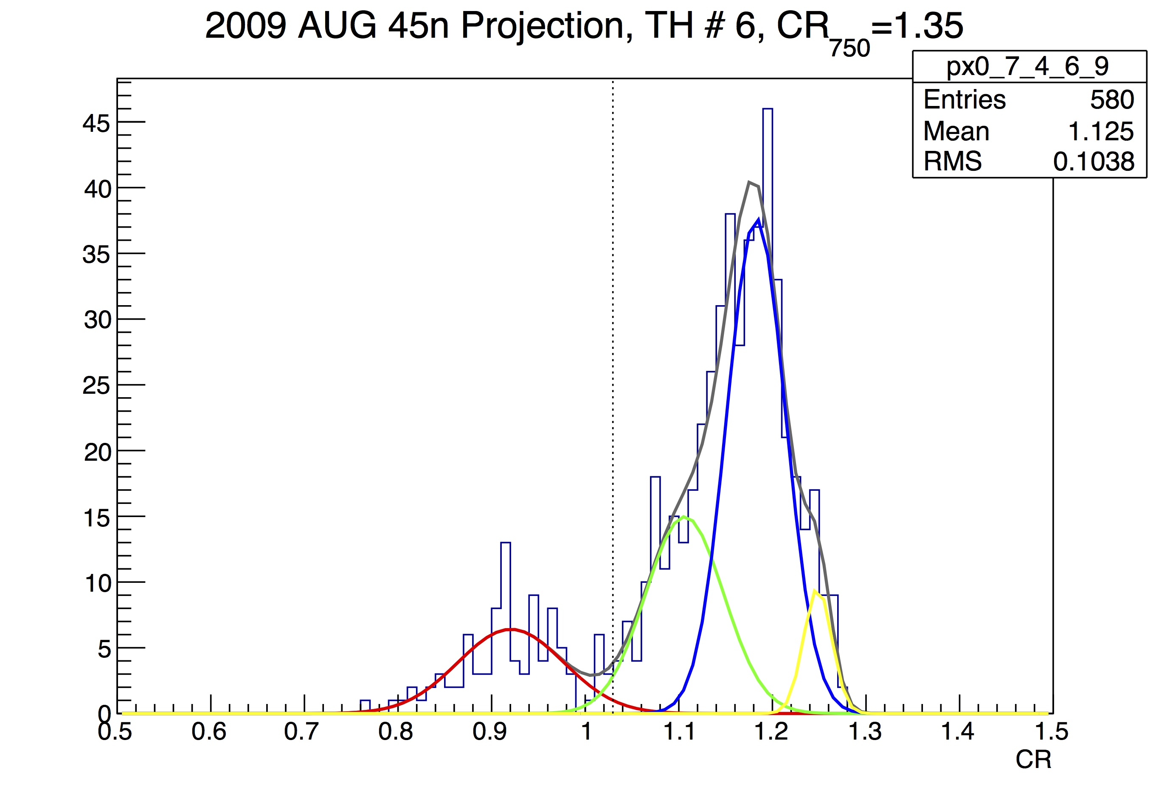
Fits to Data
Example for fits:
2009-08, 45N, 15 km
C₇₅₀≈1.35
Peaks to the left of the line are clouds
Peaks to the right of the line are clouds

Slide 13
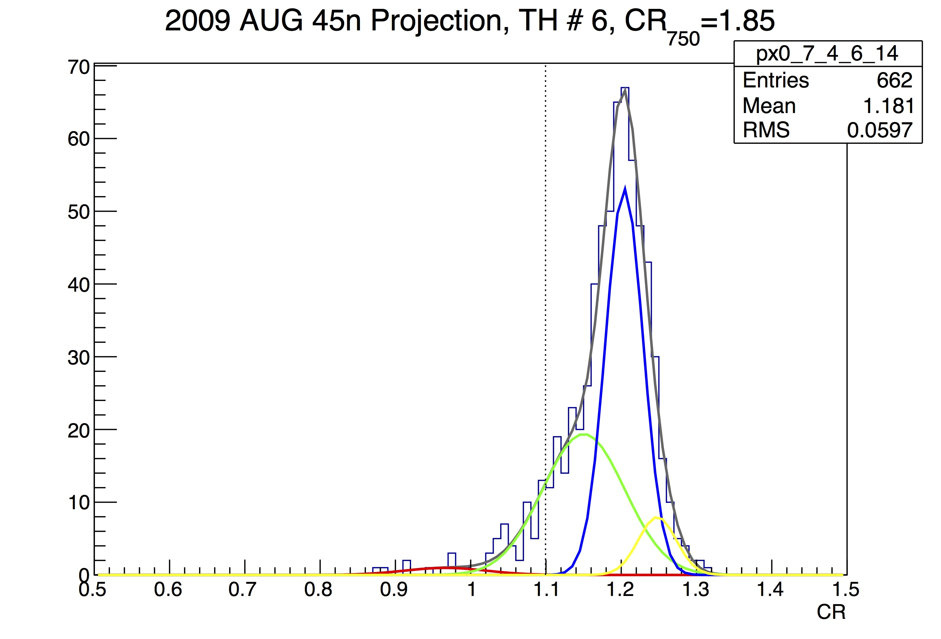
Fits to Data
Example for fits:
2009-08, 45N, 15 km
C₇₅₀≈1.85
Peaks to the left of the line are clouds
Peaks to the right of the line are clouds

Slide 14
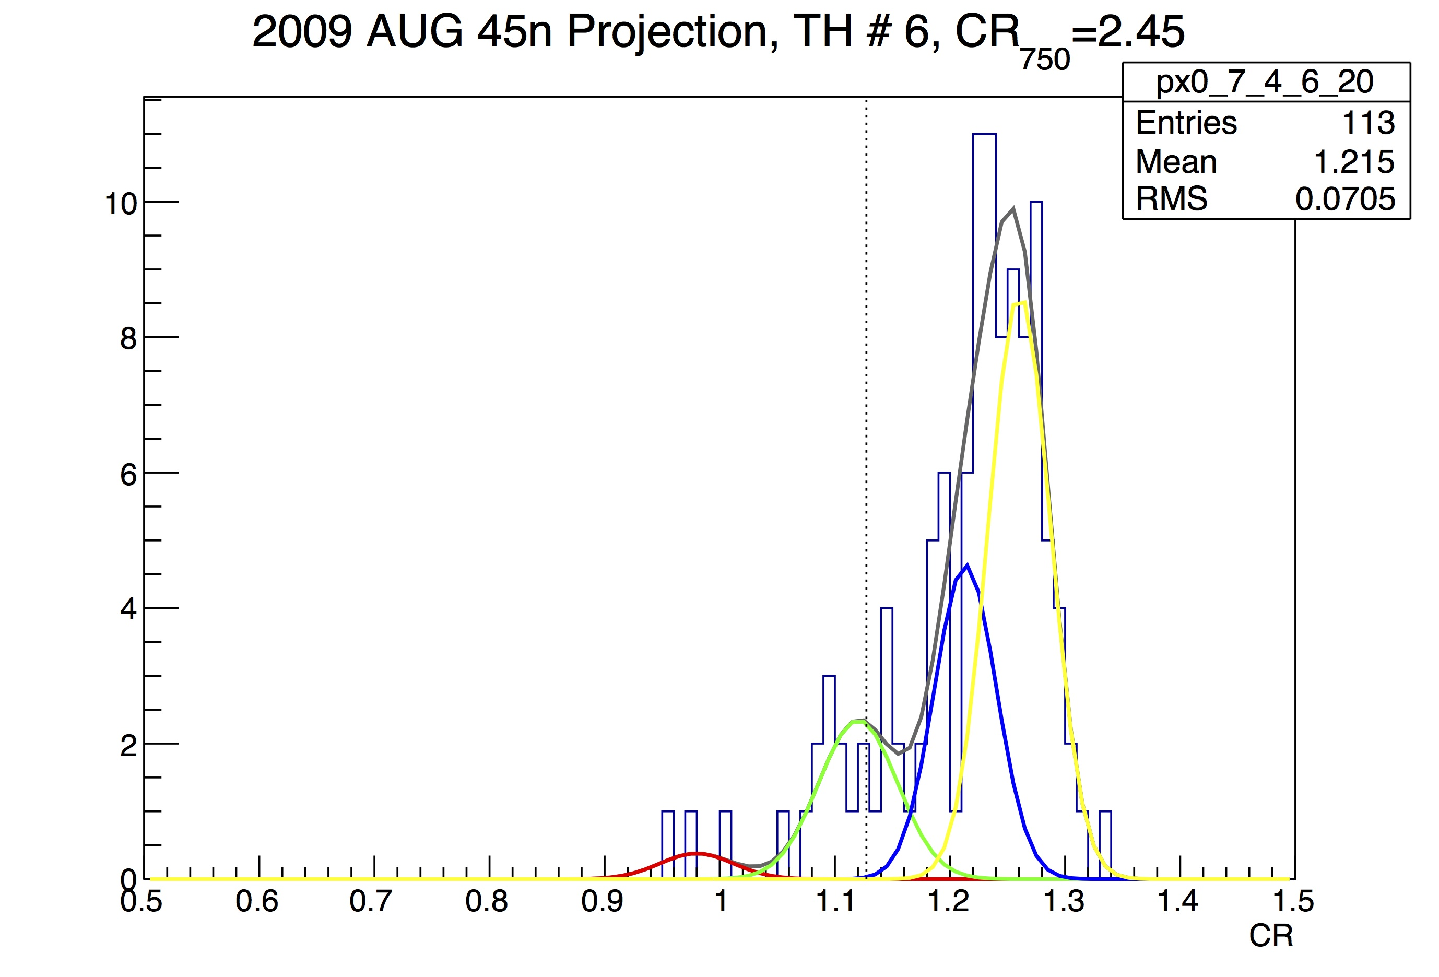
Fits to Data
Example for fits:
2009-08, 45N, 15 km
C₇₅₀≈2.45
Peaks to the left of the line are clouds
Peaks to the right of the line are clouds

Slide 15
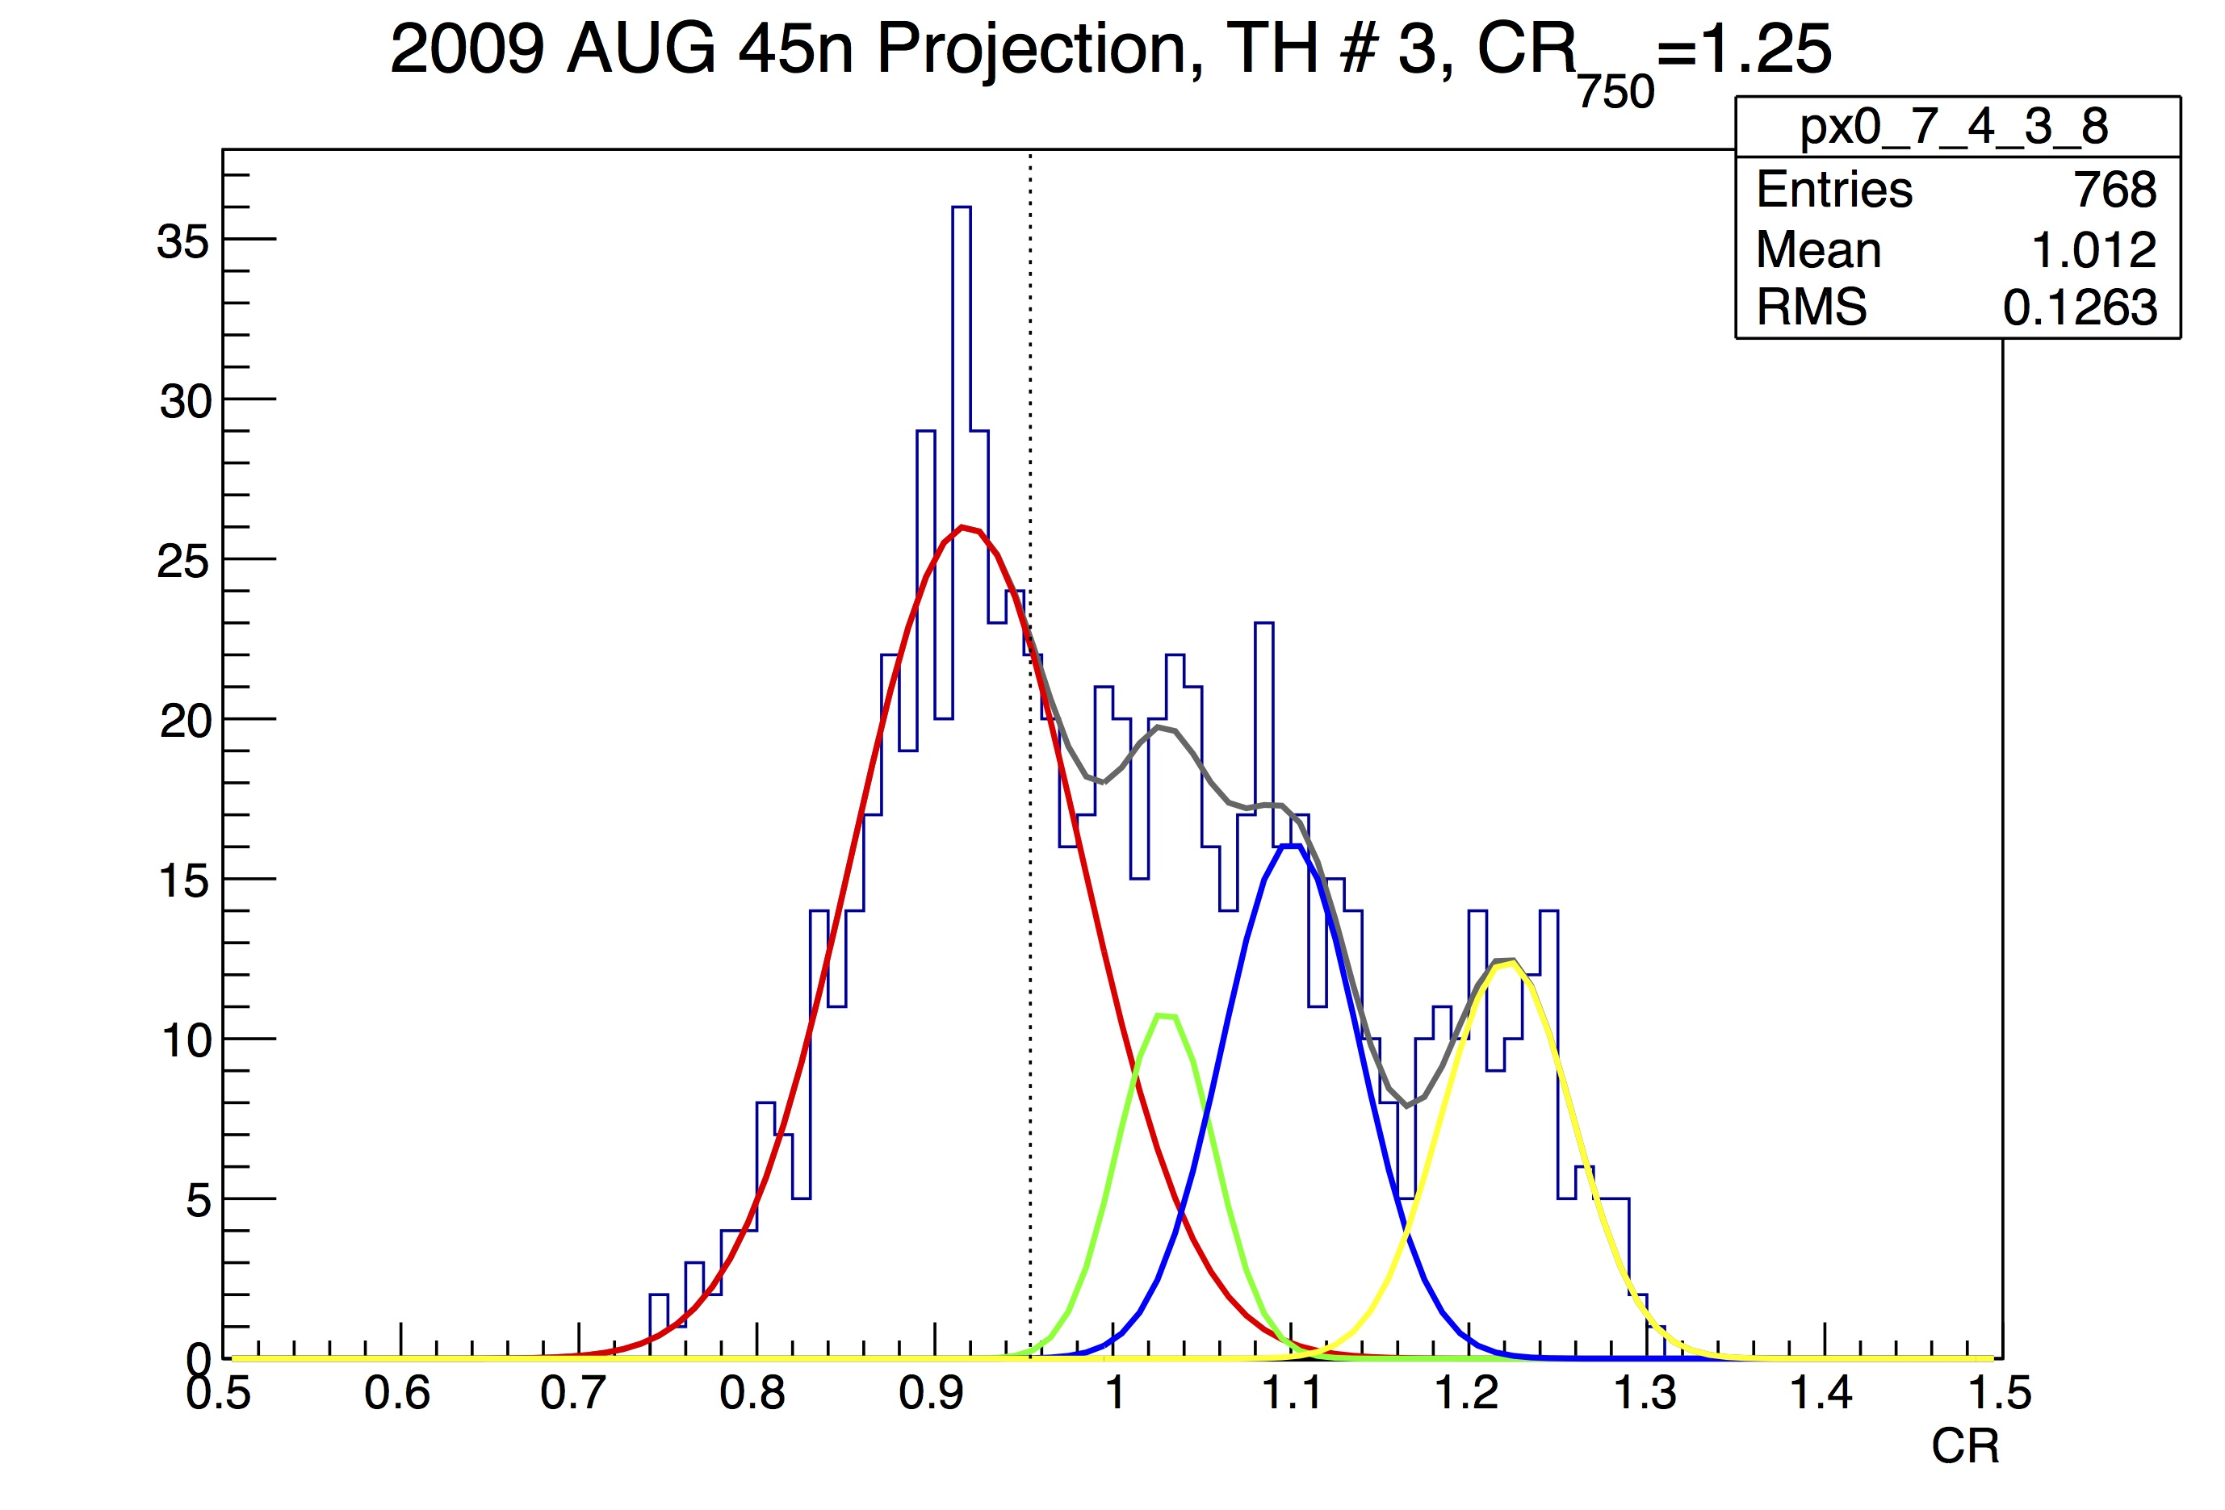
Fits to Data
Example for fits:
2009-08, 45N, 5 km
C₇₅₀≈1.25
Peaks to the left of the line are clouds
Peaks to the right of the line are clouds

Slide 16
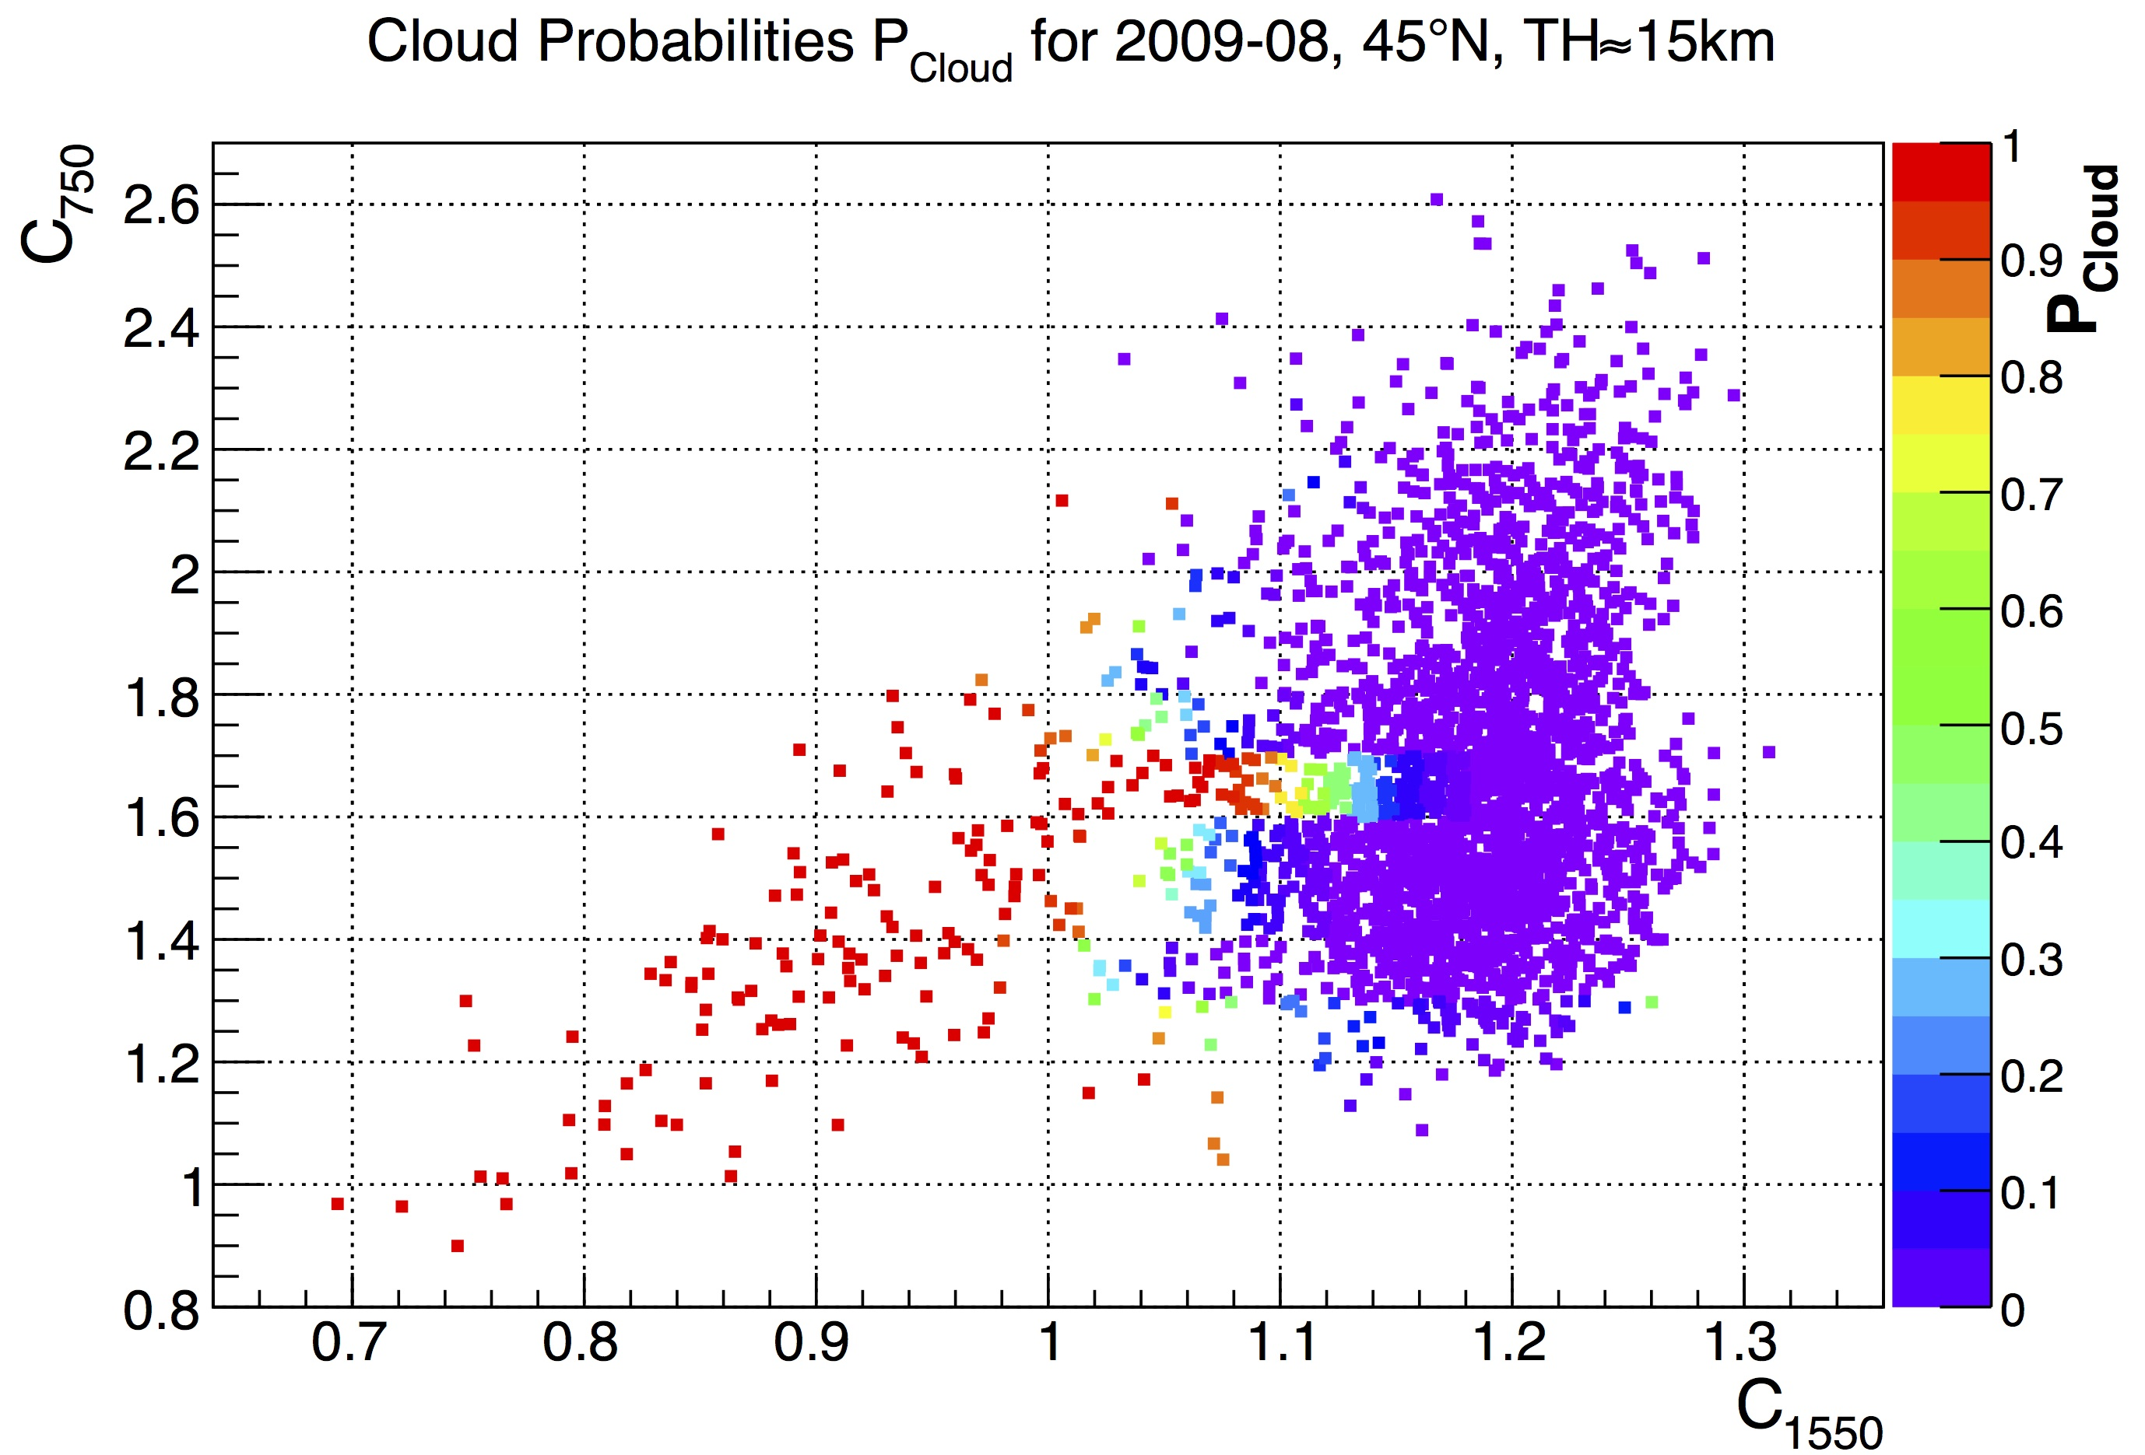
Cloud Probabilities
Conditional probabilities
P_{Cloud}(time, latitude, TH, CR₇₅₀)
All data
30N-60N, 15 km

Slide 17
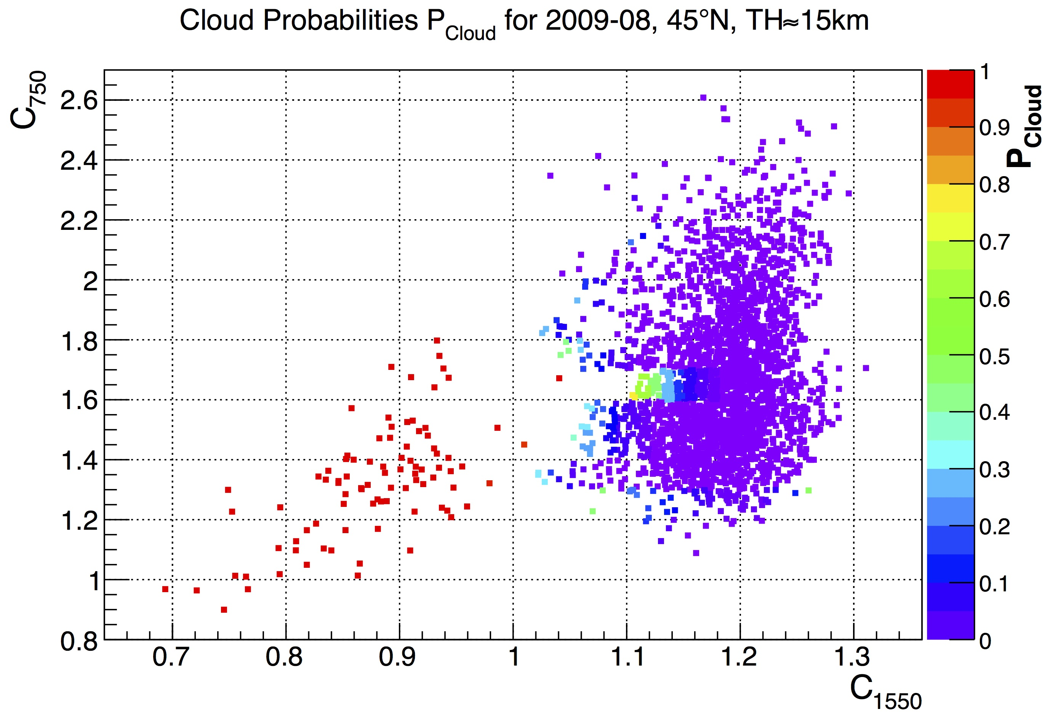
Cloud Probabilities
Conditional probabilities
P_{Cloud}(time, latitude, TH, CR₇₅₀)
Data where cloud is likely below FoV excluded
30N-60N, 15 km

Slide 18
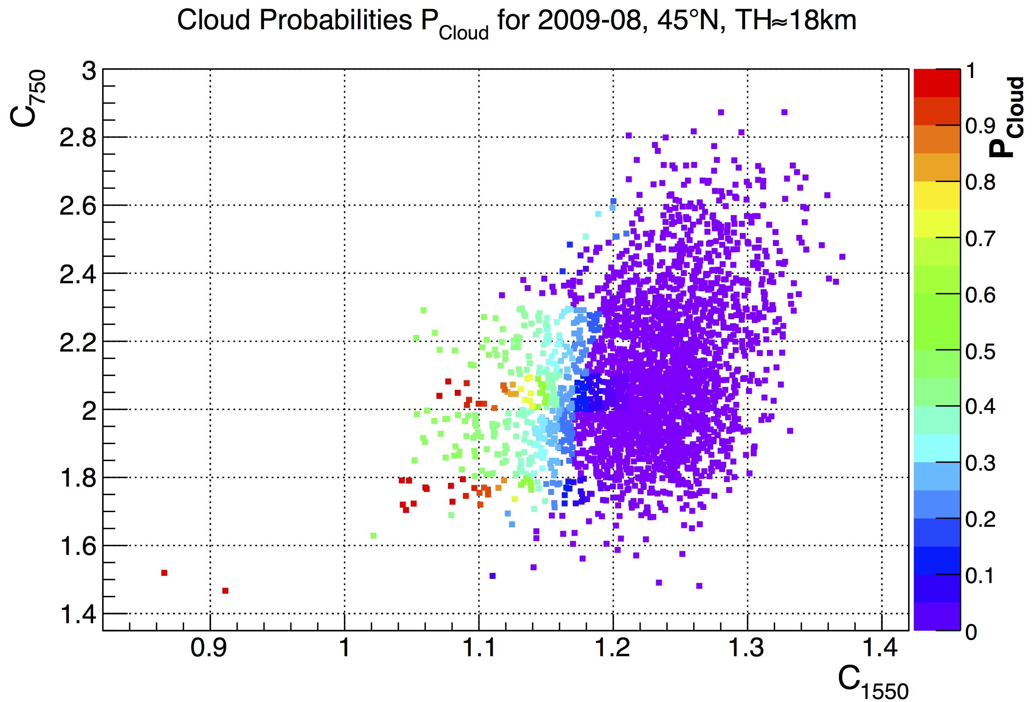
Cloud Probabilities
Conditional probabilities
P_{Cloud}(time, latitude, TH, CR₇₅₀)
All data
30N-60N, 18 km

Slide 19
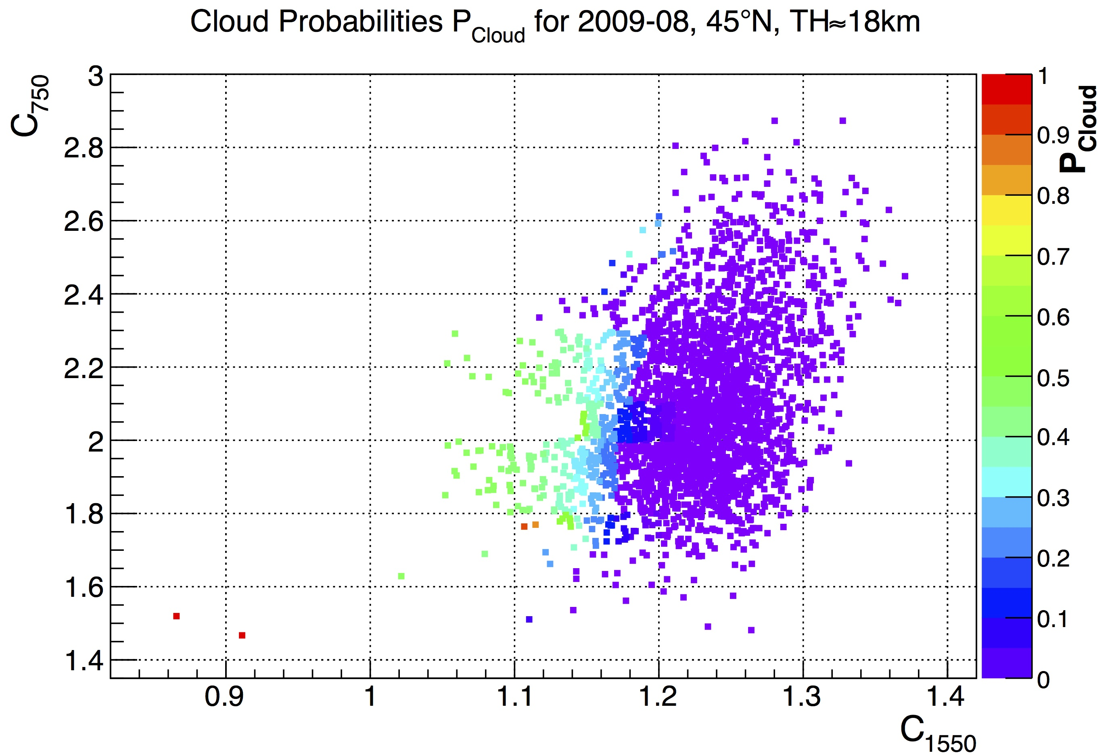
Cloud Probabilities
Conditional probabilities
P_{Cloud}(time, latitude, TH, CR₇₅₀)
Data where cloud is likely below FoV excluded
30N-60N, 18 km

Slide 20
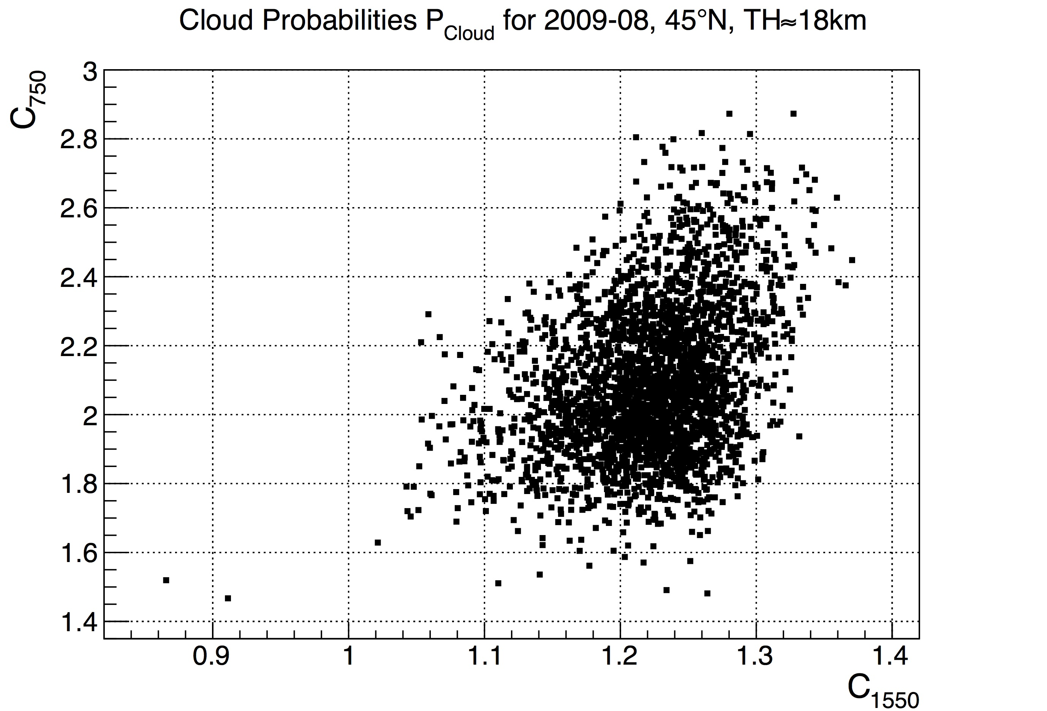
Cloud Probabilities
Conditional probabilities
P_{Cloud}(time, latitude, TH, CR₇₅₀)
30N-60N, 18 km
All data (2871)

Slide 21
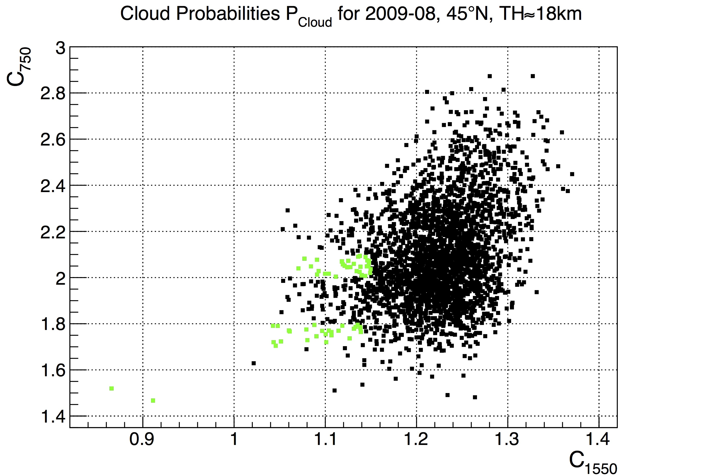
Cloud Probabilities
Conditional probabilities
P_{Cloud}(time, latitude, TH, CR₇₅₀)
30N-60N, 18 km
All data (2871)
P_{Cloud}>0.5 (61)

Slide 22
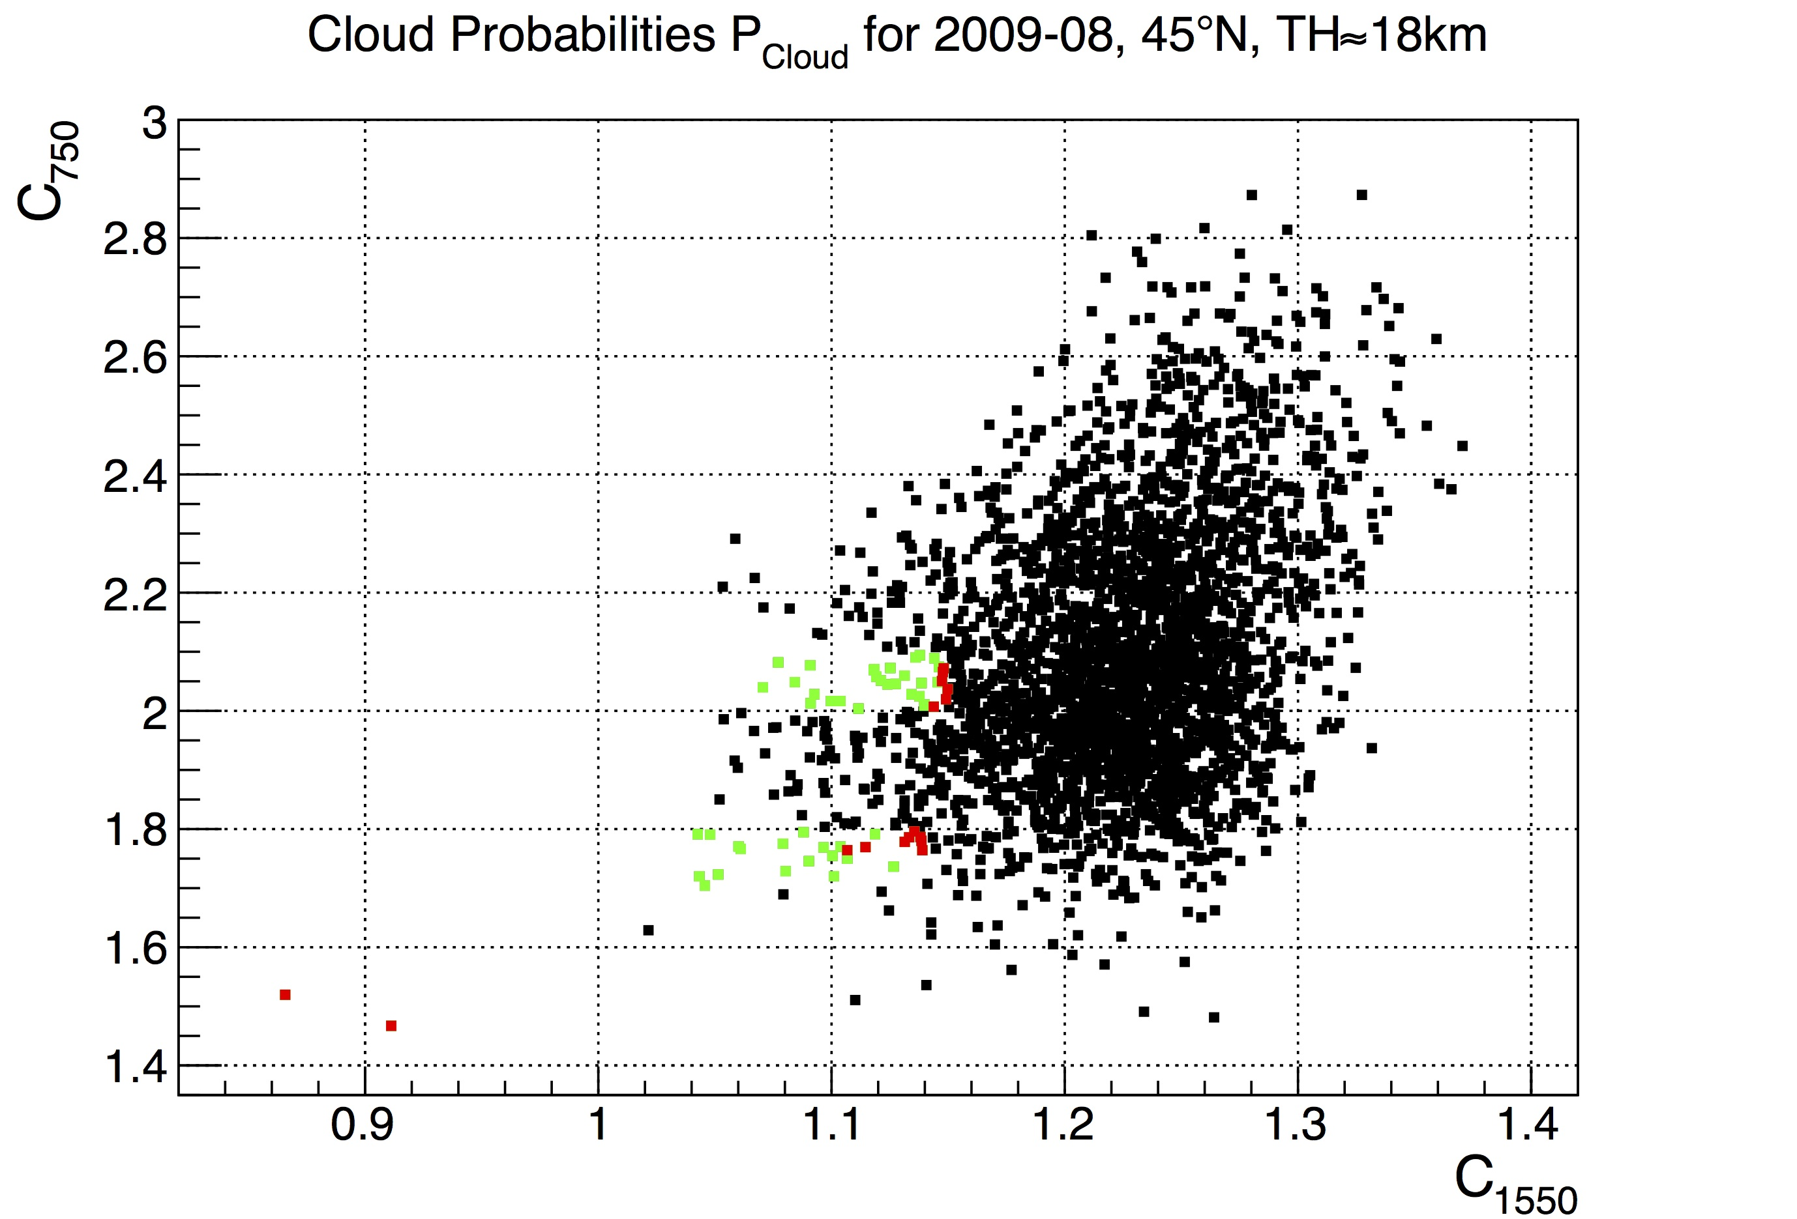
Cloud Probabilities
Conditional probabilities
P_{Cloud}(time, latitude, TH, CR₇₅₀)
30N-60N, 18 km
All data (2871)
P_{Cloud}>0.5 (61)
Flagged as cloud, CTH=18km (16)

Slide 23
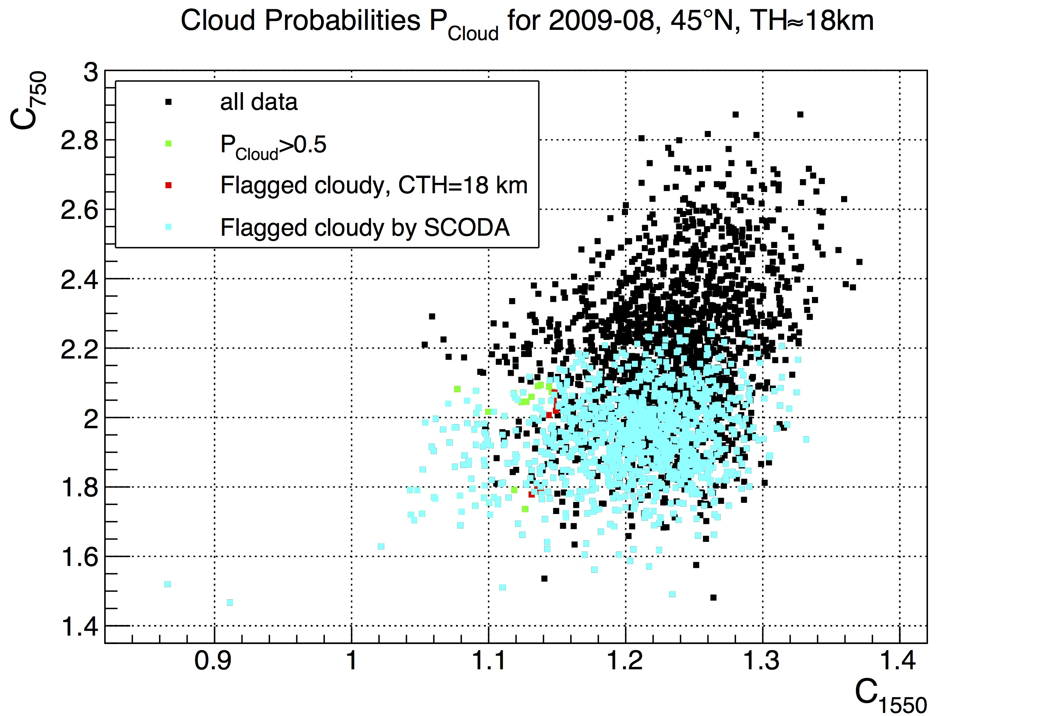
Cloud Probabilities
Conditional probabilities
P_{Cloud}(time, latitude, TH, CR₇₅₀)
30N-60N, 18 km
All data (2871)
P_{Cloud}>0.5 (61)
Flagged as cloud, CTH=18km (16)
Flagged as cloud by SCODA (1112)

Slide 24
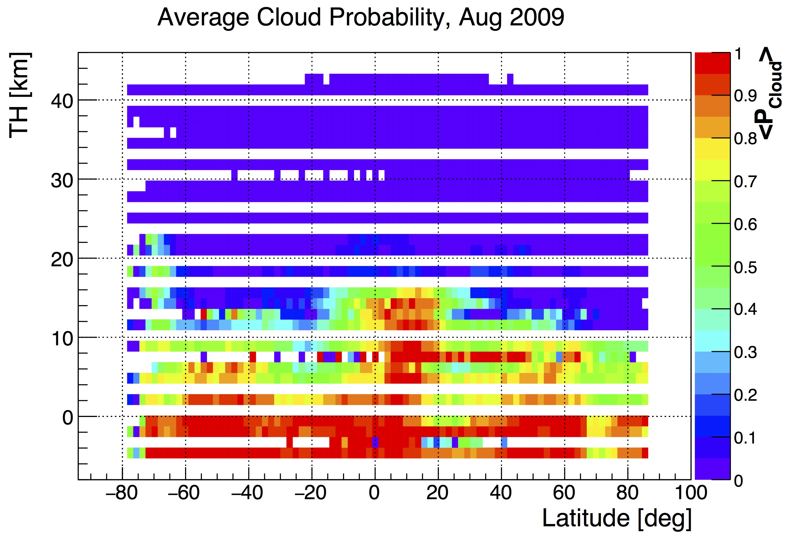
Cloud Statistics

Slide 25
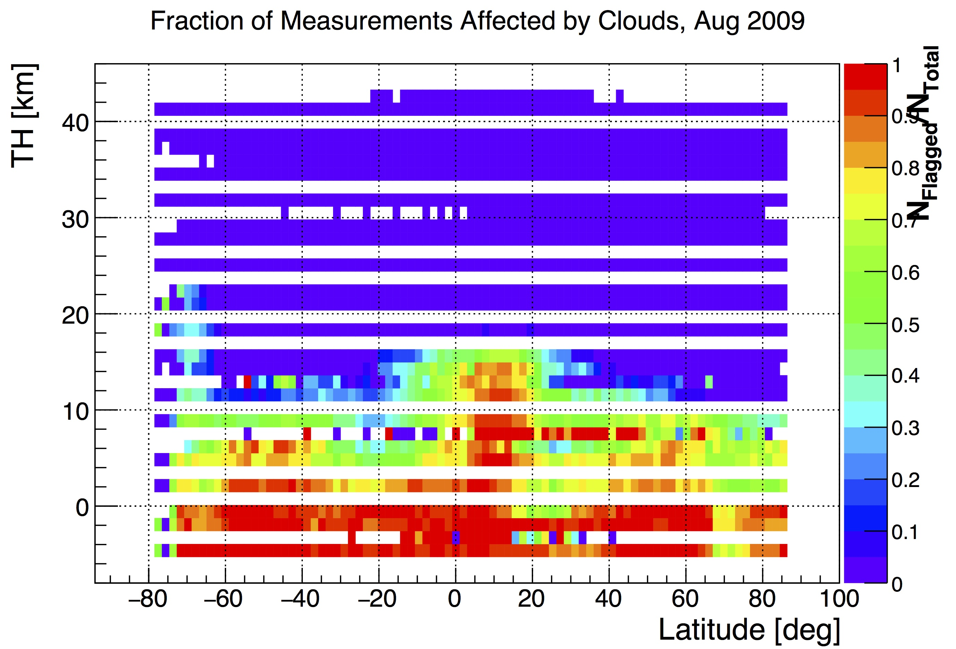
Cloud Statistics
Fraction of measurements flagged with P_{Cloud}>0.5
and all sanity checks passed

Slide 26
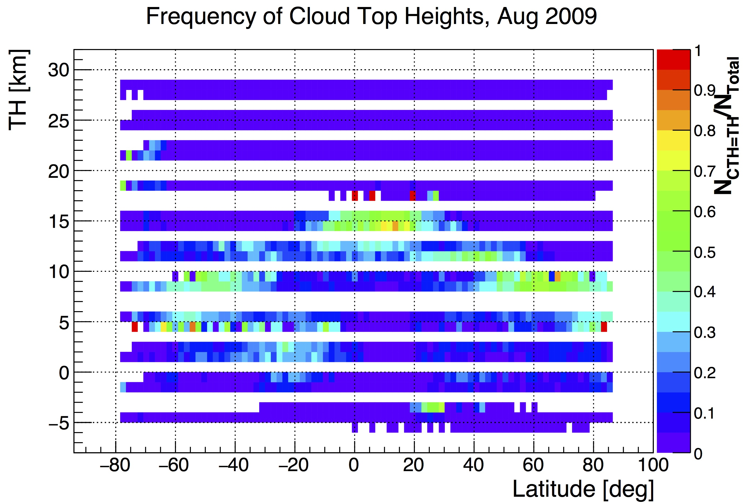
Cloud Statistics
Relative frequency of CTH with P_{Cloud}>0.5 and all sanity checks passed

Slide 27
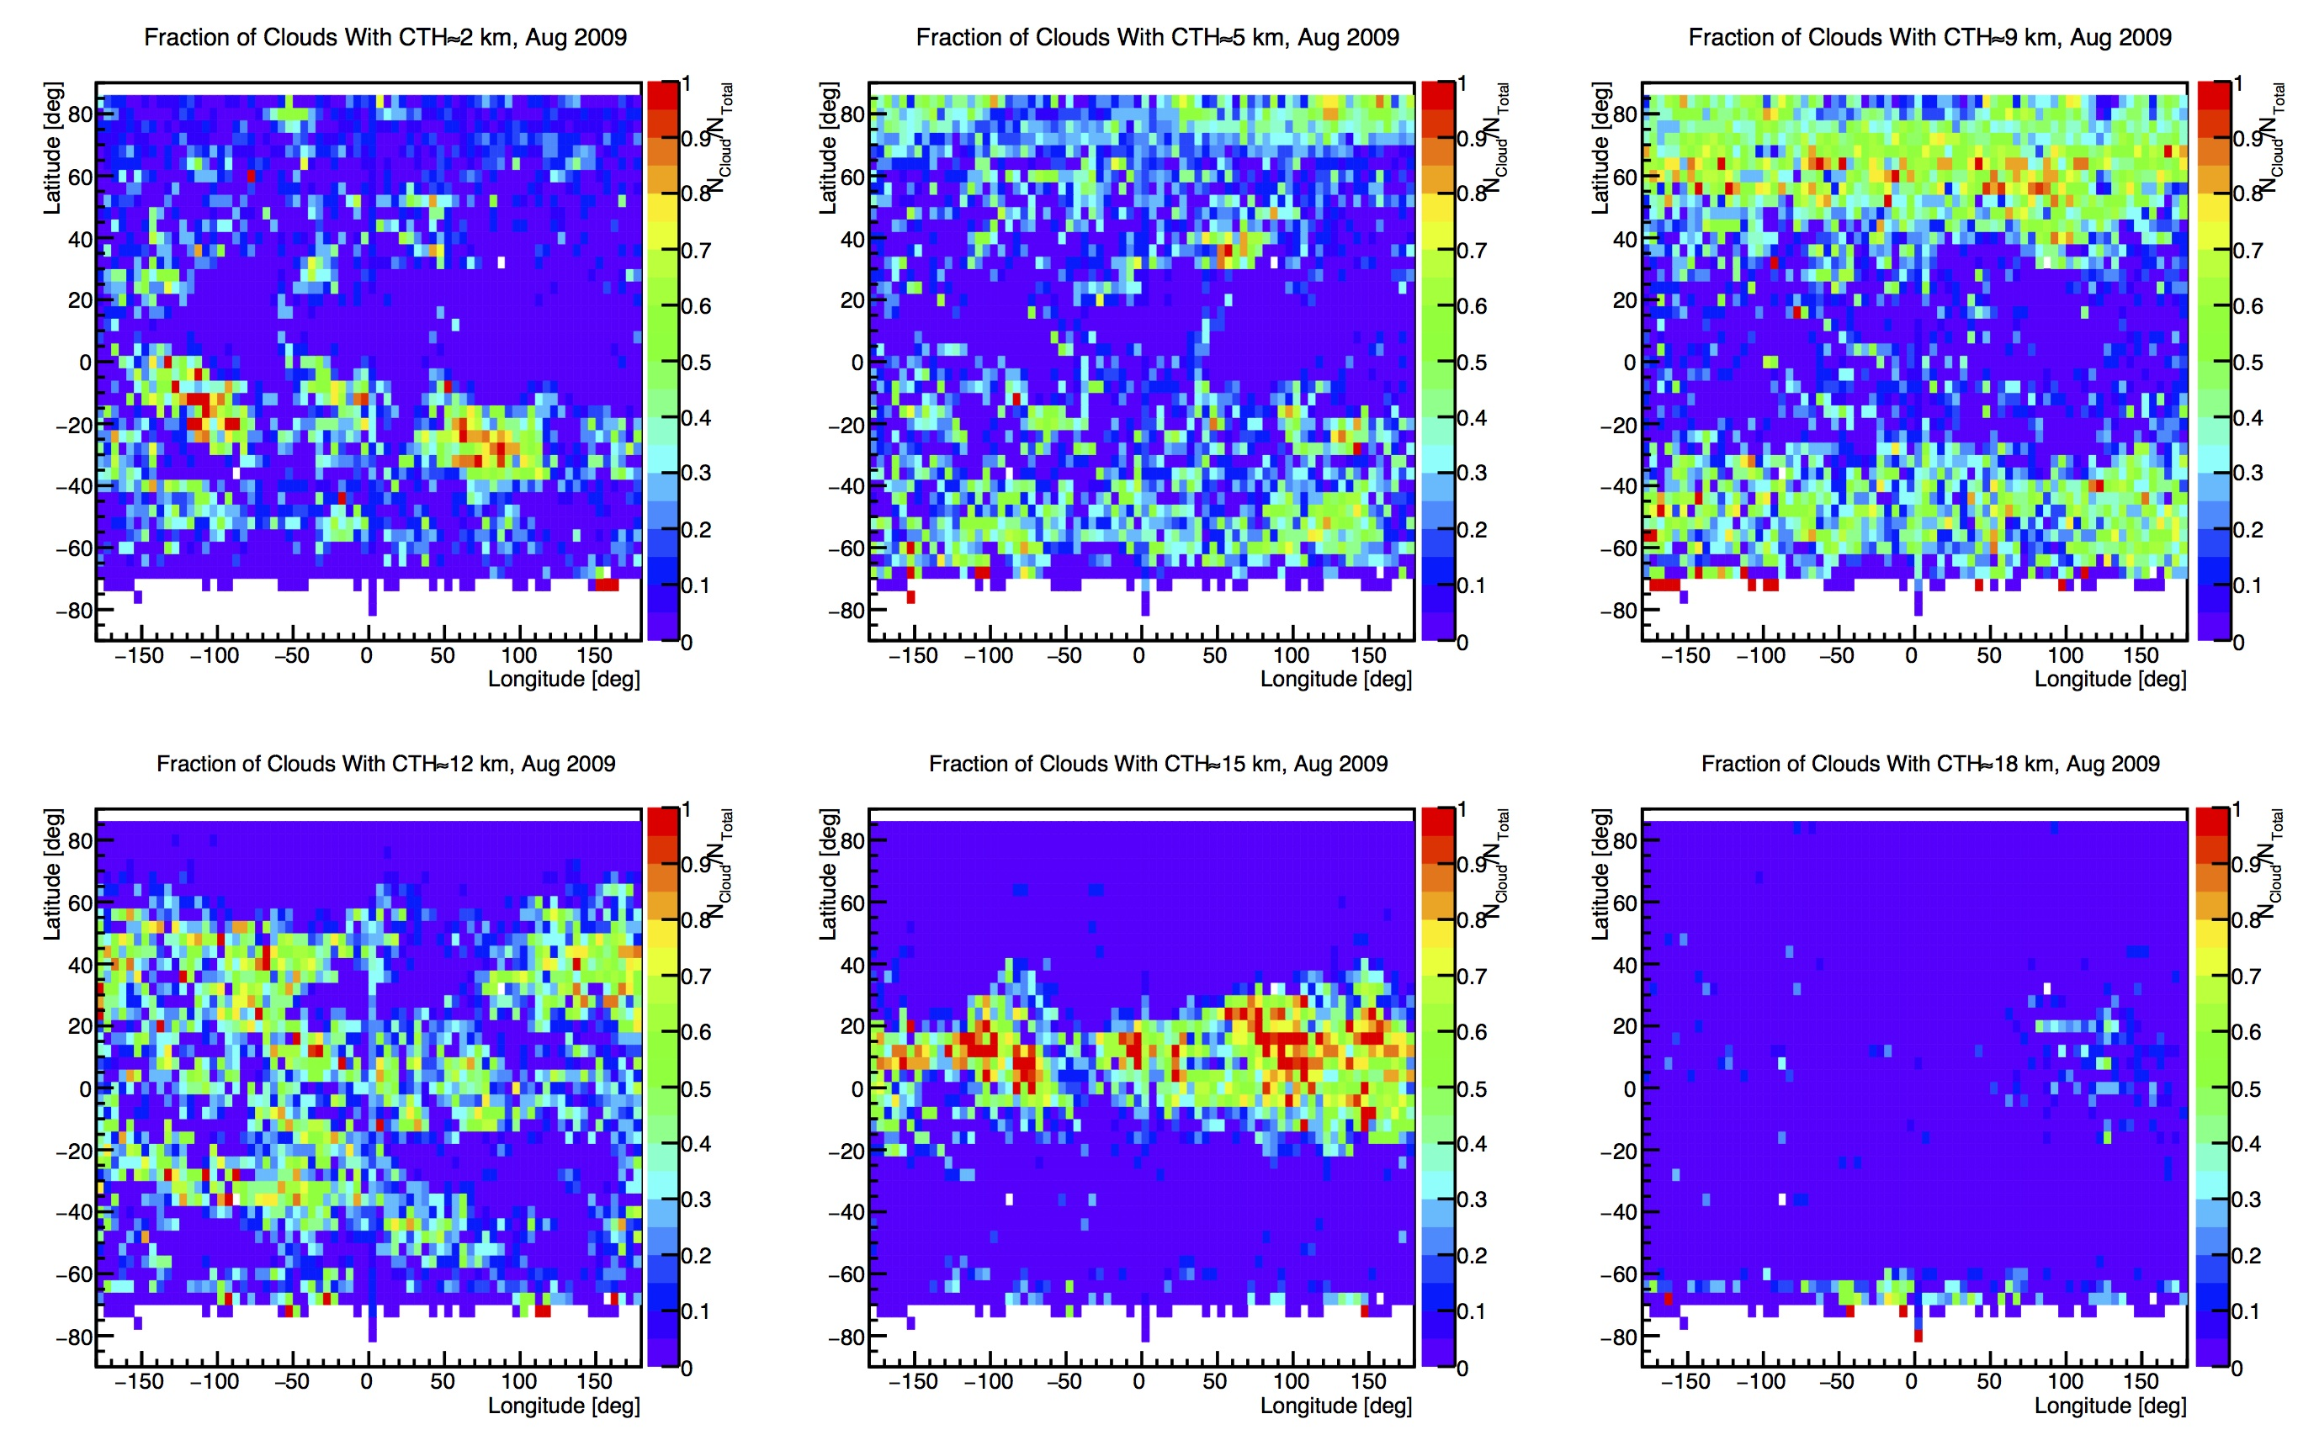
Cloud Statistics
2 km
5 km
9 km
Relative frequency of CTH vs. (Lat, Lon)
12 km
15 km
18 km

Slide 28
Summary
Statistical analysis of color ratio at ~1550 nm increases sensitivity to optically or geometrically thin clouds while decreasing misidentification of thick aerosol layers as clouds
It is now possible to analyze enhanced aerosol periods without the risk of cloud contamination
Cloud data product will include probabilities, possibly additional weights, and cloud top altitude and probability
PSCs: Preliminary check: yes, it is possible to see them, but sensitivity not yet studied
Working on validation and refinement of some technical details

Slide 29
Status
TN almost done
To be delivered to DLR:
Cloud probabilities f(month,lat,TH, Surface, C₁₅₅₀, C₇₅₀)
Statistical parameters: C₇₅₀_Max, C₁₅₅₀_Max, σ₁₅₅₀_Max, C₁₅₅₀_RTM f(month,lat,TH, Surface)
Surface: Land/Ocean/Both
Bad Pixel mask for ch. 6+
Land-Sea mask (if they don’t already have one)

Slide 30
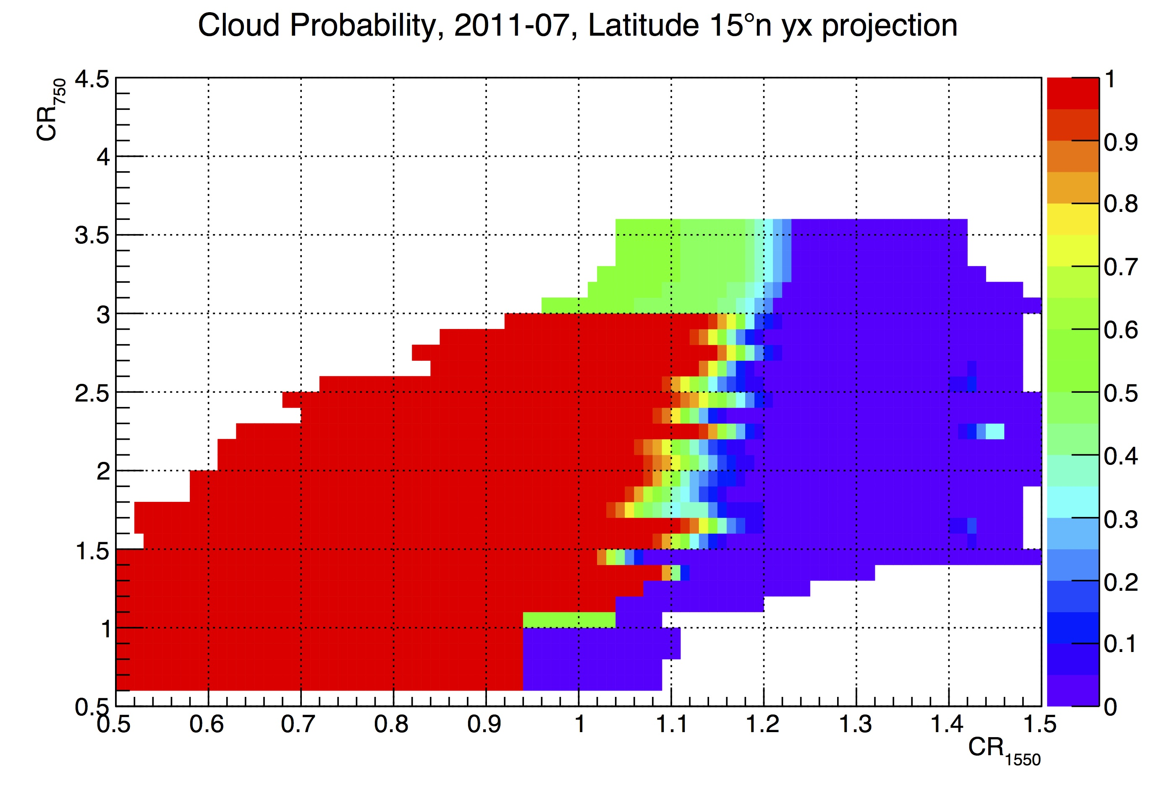
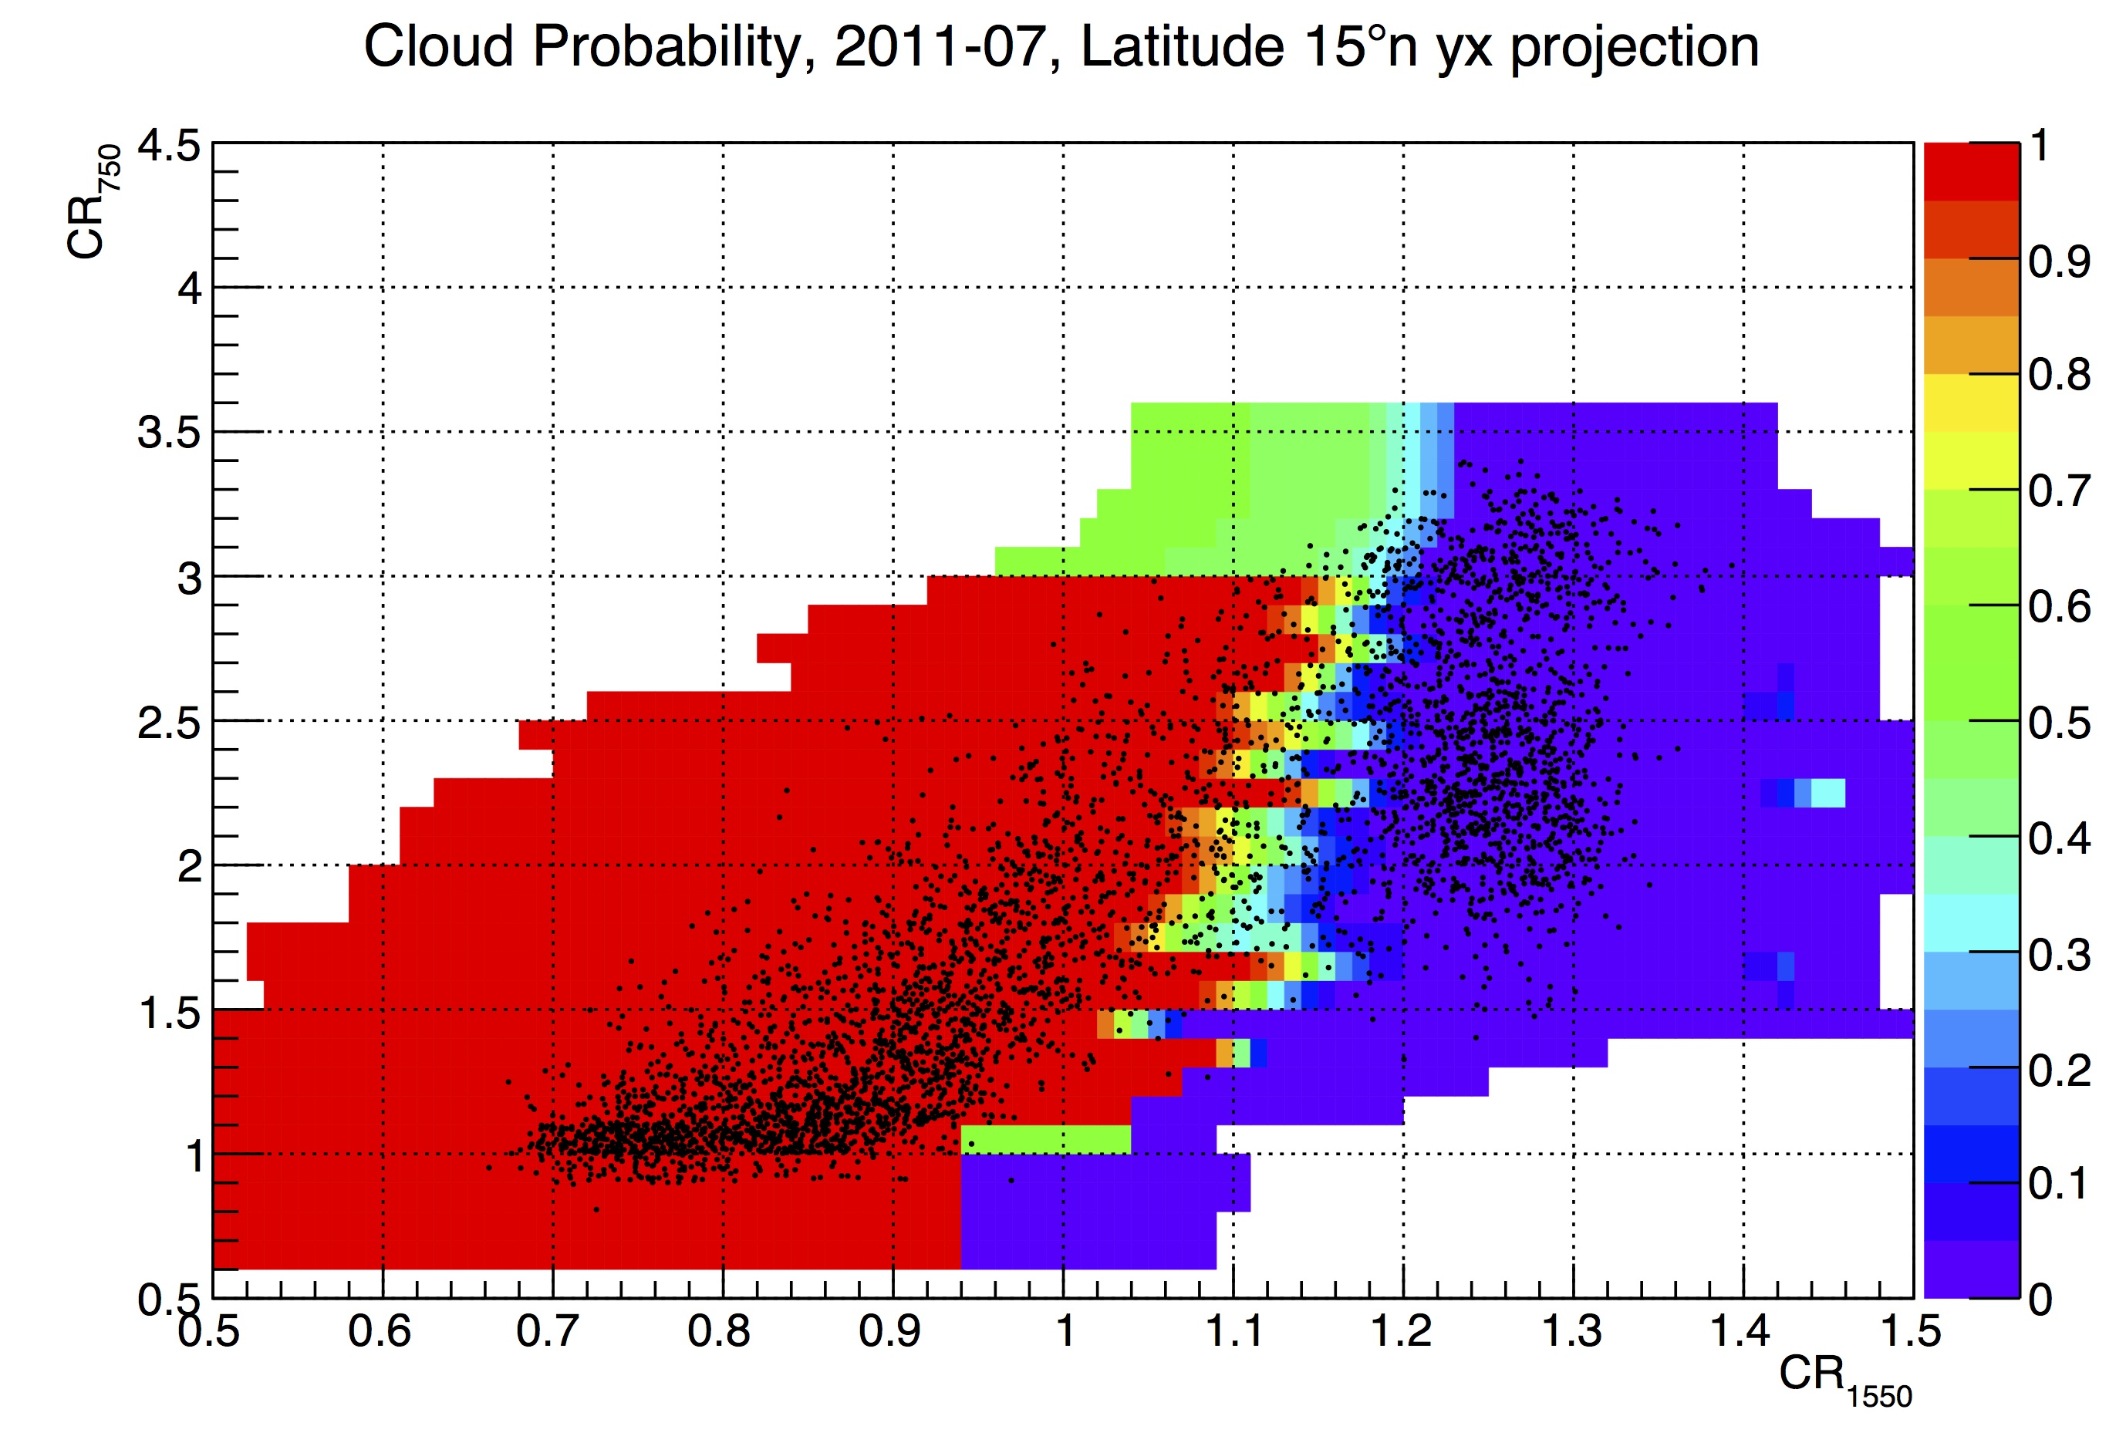
Probability Distributions
2011-07, 15N, Sea, TH=15 km
Color code depicts probability for CR₁₅₅₀ at given CR₇₅₀ to be caused by cloud

Slide 31
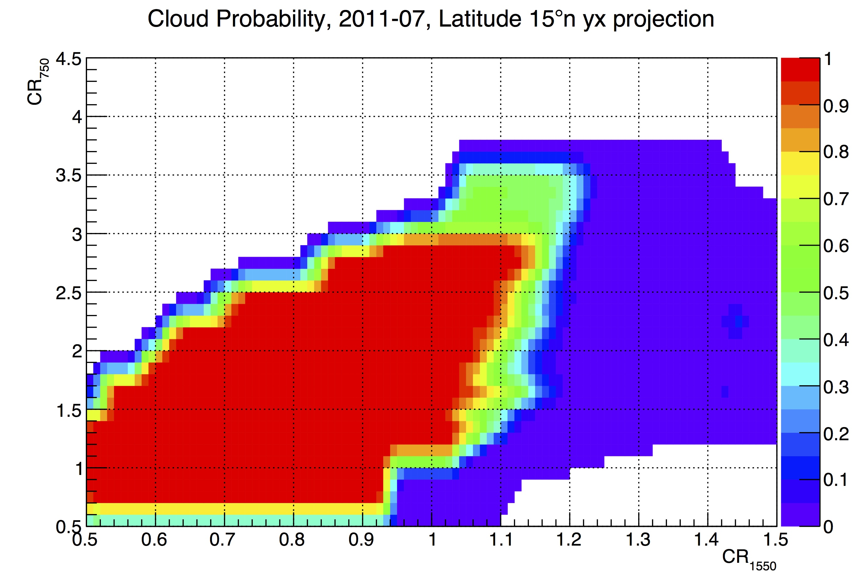
Probability Distributions
2011-07, 15N, Sea, TH=15 km
Color code depicts probability for CR₁₅₅₀ at given CR₇₅₀ to be caused by cloud

Slide 32
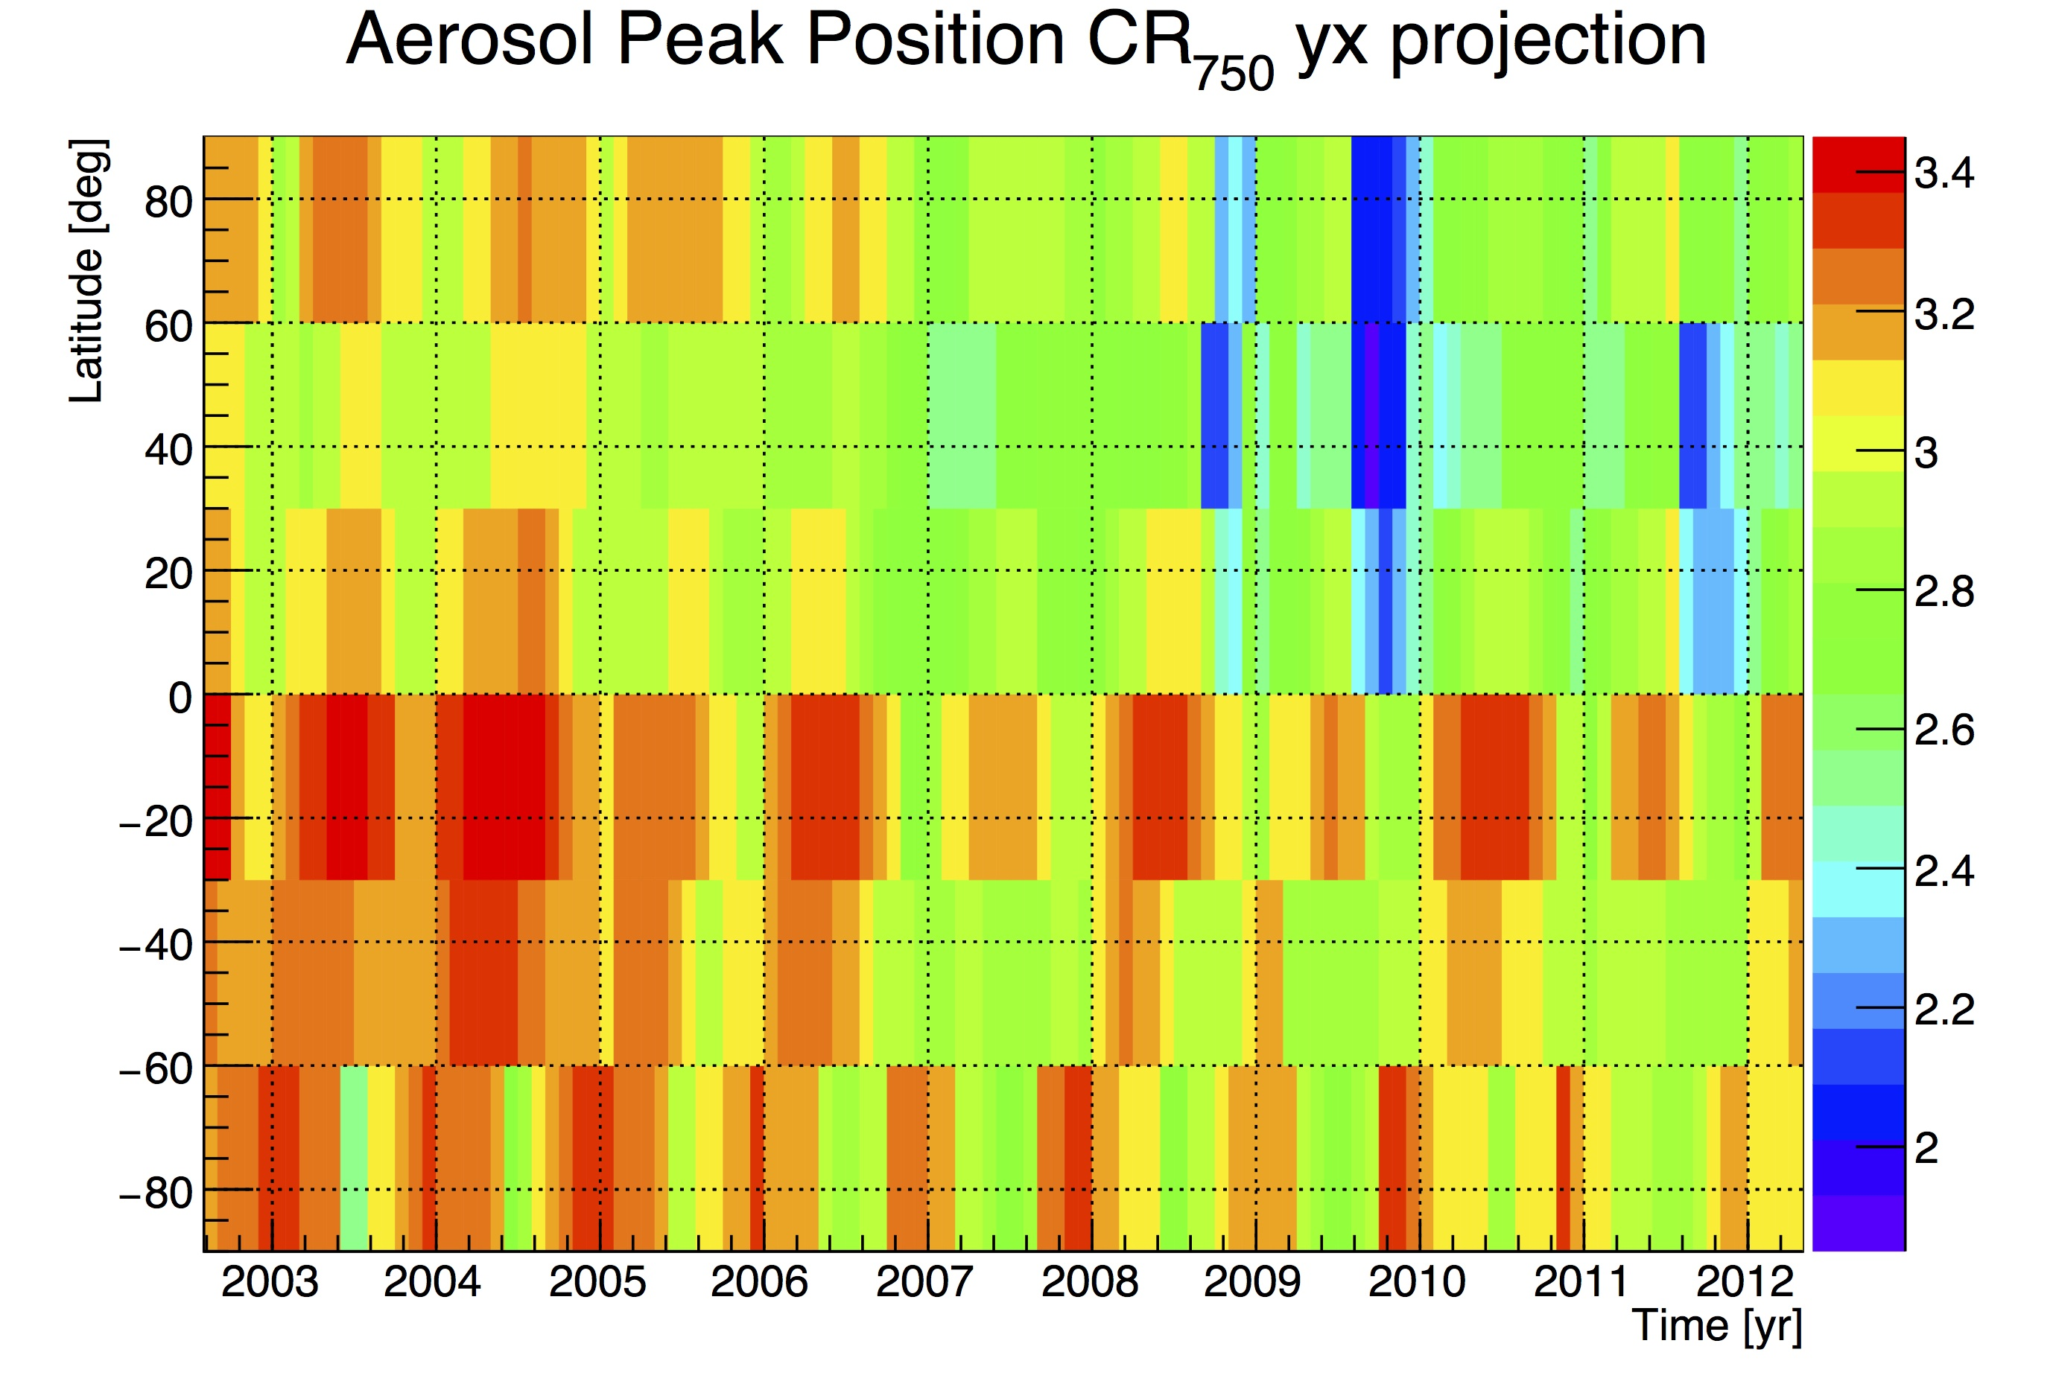
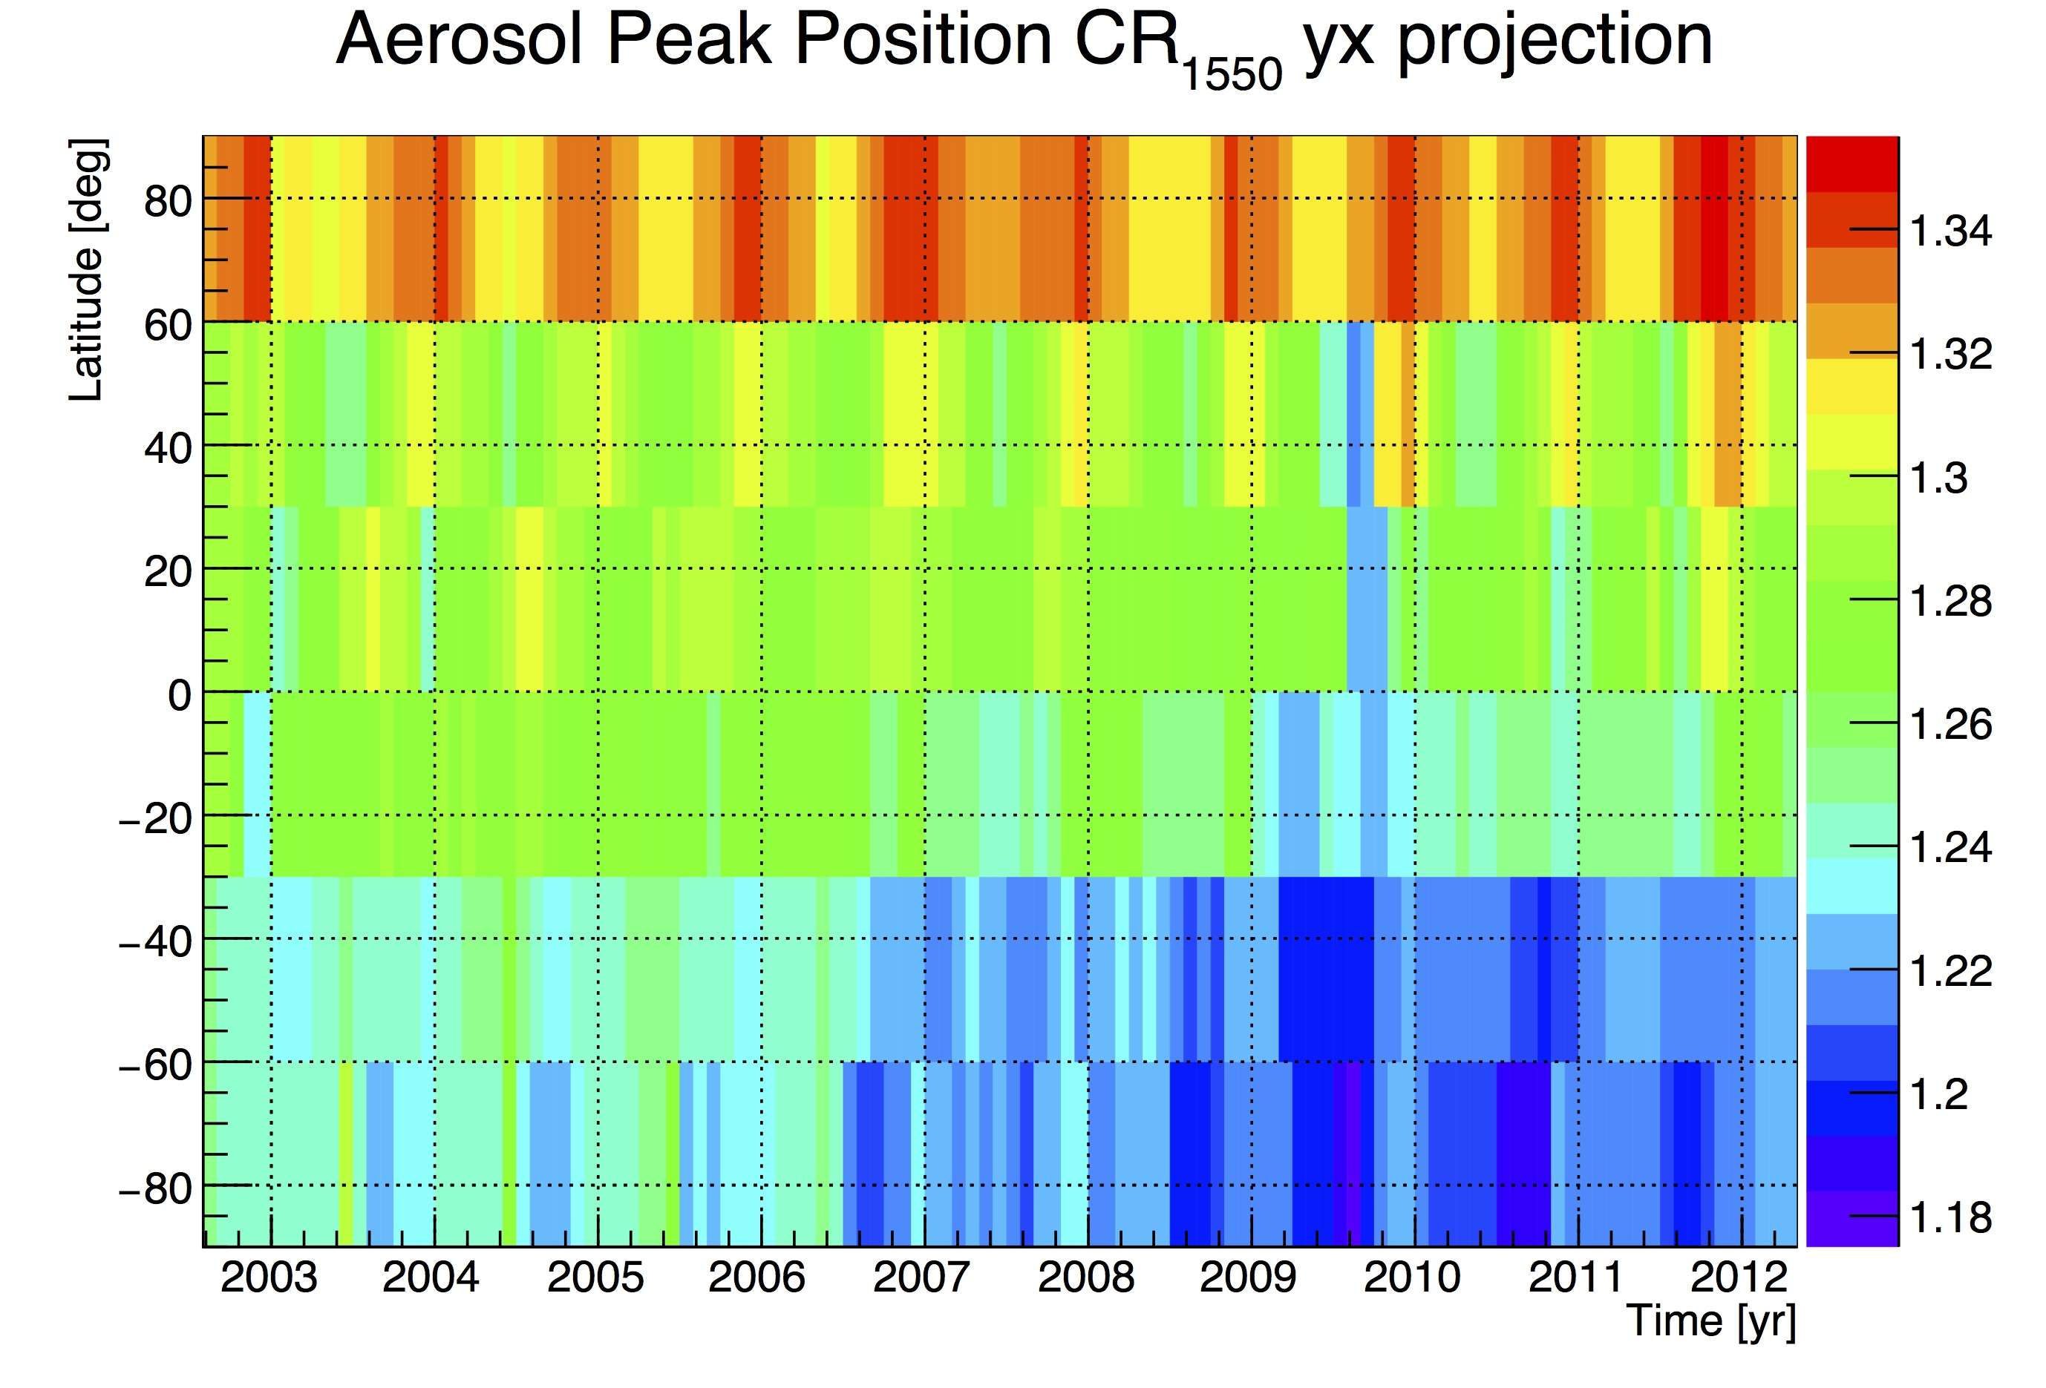
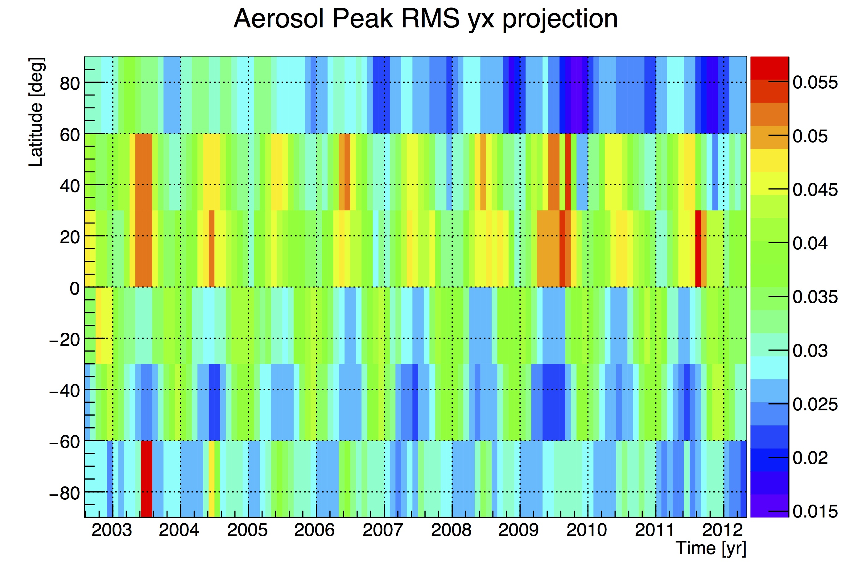
Statistical Parameters
Stats: f(time,lat, TH, Surface)

Slide 33
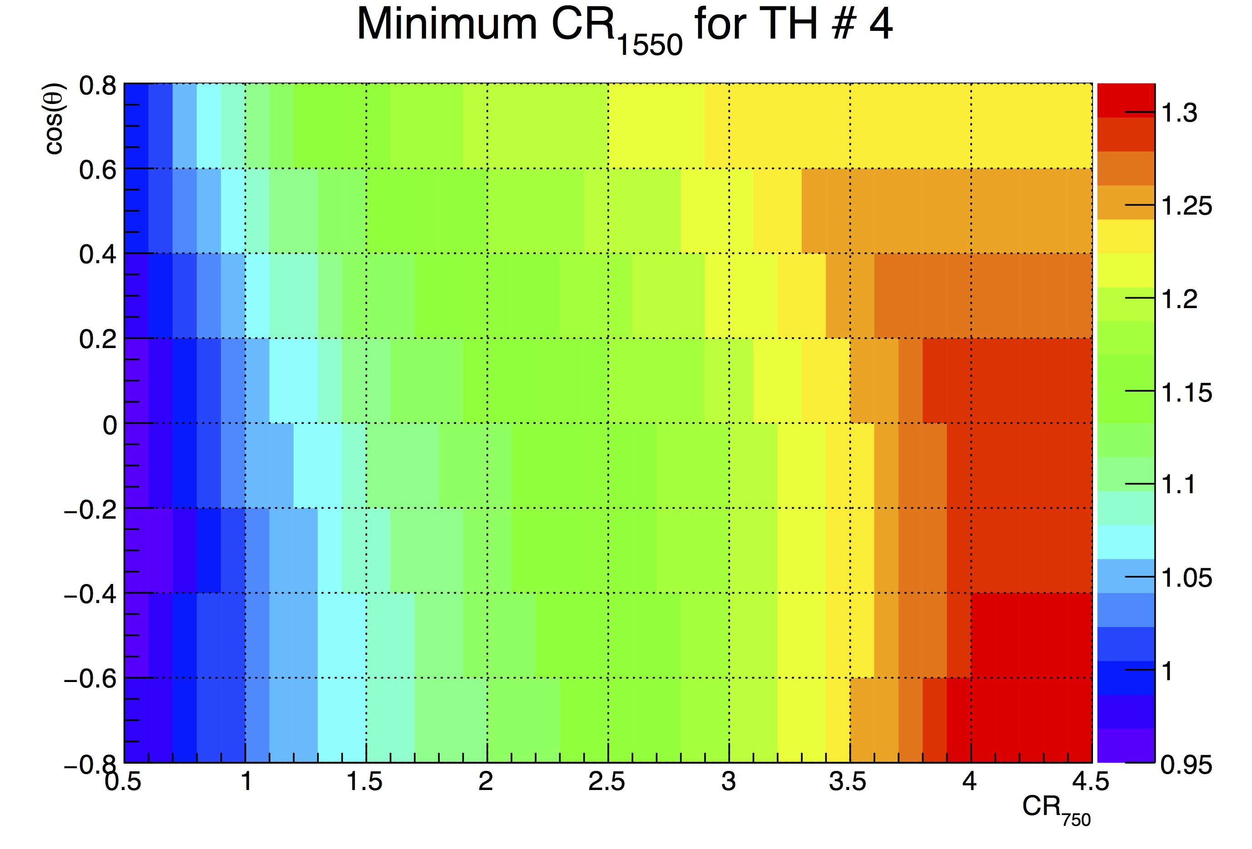
RTM Parameters
RTM Value if f(cos(θ), C₇₅₀) but only the value for C₇₅₀=1 is needed.

Slide 34
Implementation
Algorithm needs determination of an “equivalent” TH step (to correct for different scan patterns)
Additional check on gradients, or rather, C₁₅₅₀ values below current TH necessary
Data product: C₇₅₀, C₁₅₅₀, P_{Cloud}, Cloud-TH (highest TH at which P_{Cloud}>0.5)
Cloud flag (?): P_{Cloud}>0.5
Additional value signaling high aerosol needed, in principle possible from C₇₅₀, but needs some analysis

