Slide 1

Upgrade from SGP V5.02 to V6 .00:
Conclusions from delta-validation of Diagnostic Data Set
D. Hubert, A. Keppens, J. Granville, F. Hendrick, J.-C. Lambert
Belgian Institute for Space Aeronomy (BIRA-IASB)
A. van Gijsel
Royal Netherlands Meteorological Institute (KNMI)
Acknowledgements
NDACC, SHADOZ and GAW PIs
+ staff at stations
ESA, BELSPO

Slide 2

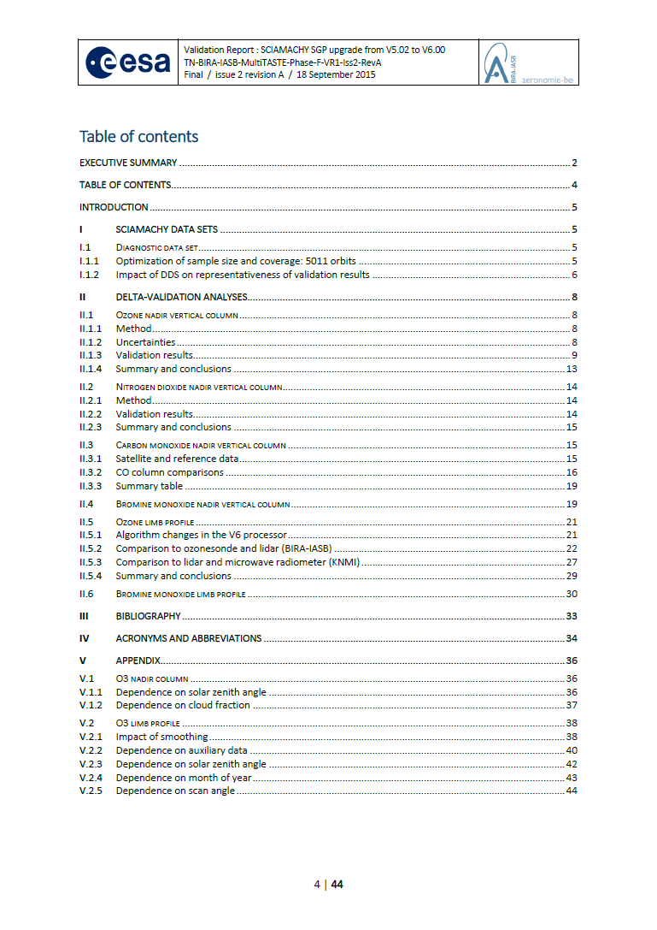
Validation report
Issue 2A circulated to SQWG on 18 Sep 2015

Slide 3
Data sets
SCIAMACHY
SGP 3.01/R complete data set (Aug 2002 – Jan 2010)
SGP 5.02/W complete data set (Aug 2002 – Apr 2012)
SGP 6.00/Y diagnostic data set (Aug 2002 – Apr 2012)
Ground-based instruments
O3 column 36 Dobsons, 32 Brewers, 17 UV-visible spectrometers (GAW, NDACC)
NO2 column 19 UV-visible spectrometers (NDACC)
BrO column 1 UV-visible spectrometers at Harestua (60°N)
CO column 12 FTIRs (NDACC)
O3 profile 79 ozonesondes, 12 lidars, 3 MWRs (GAW, NDACC, SHADOZ)
BrO profile 1 UV-visible spectrometer at Harestua (60°N)

Slide 4
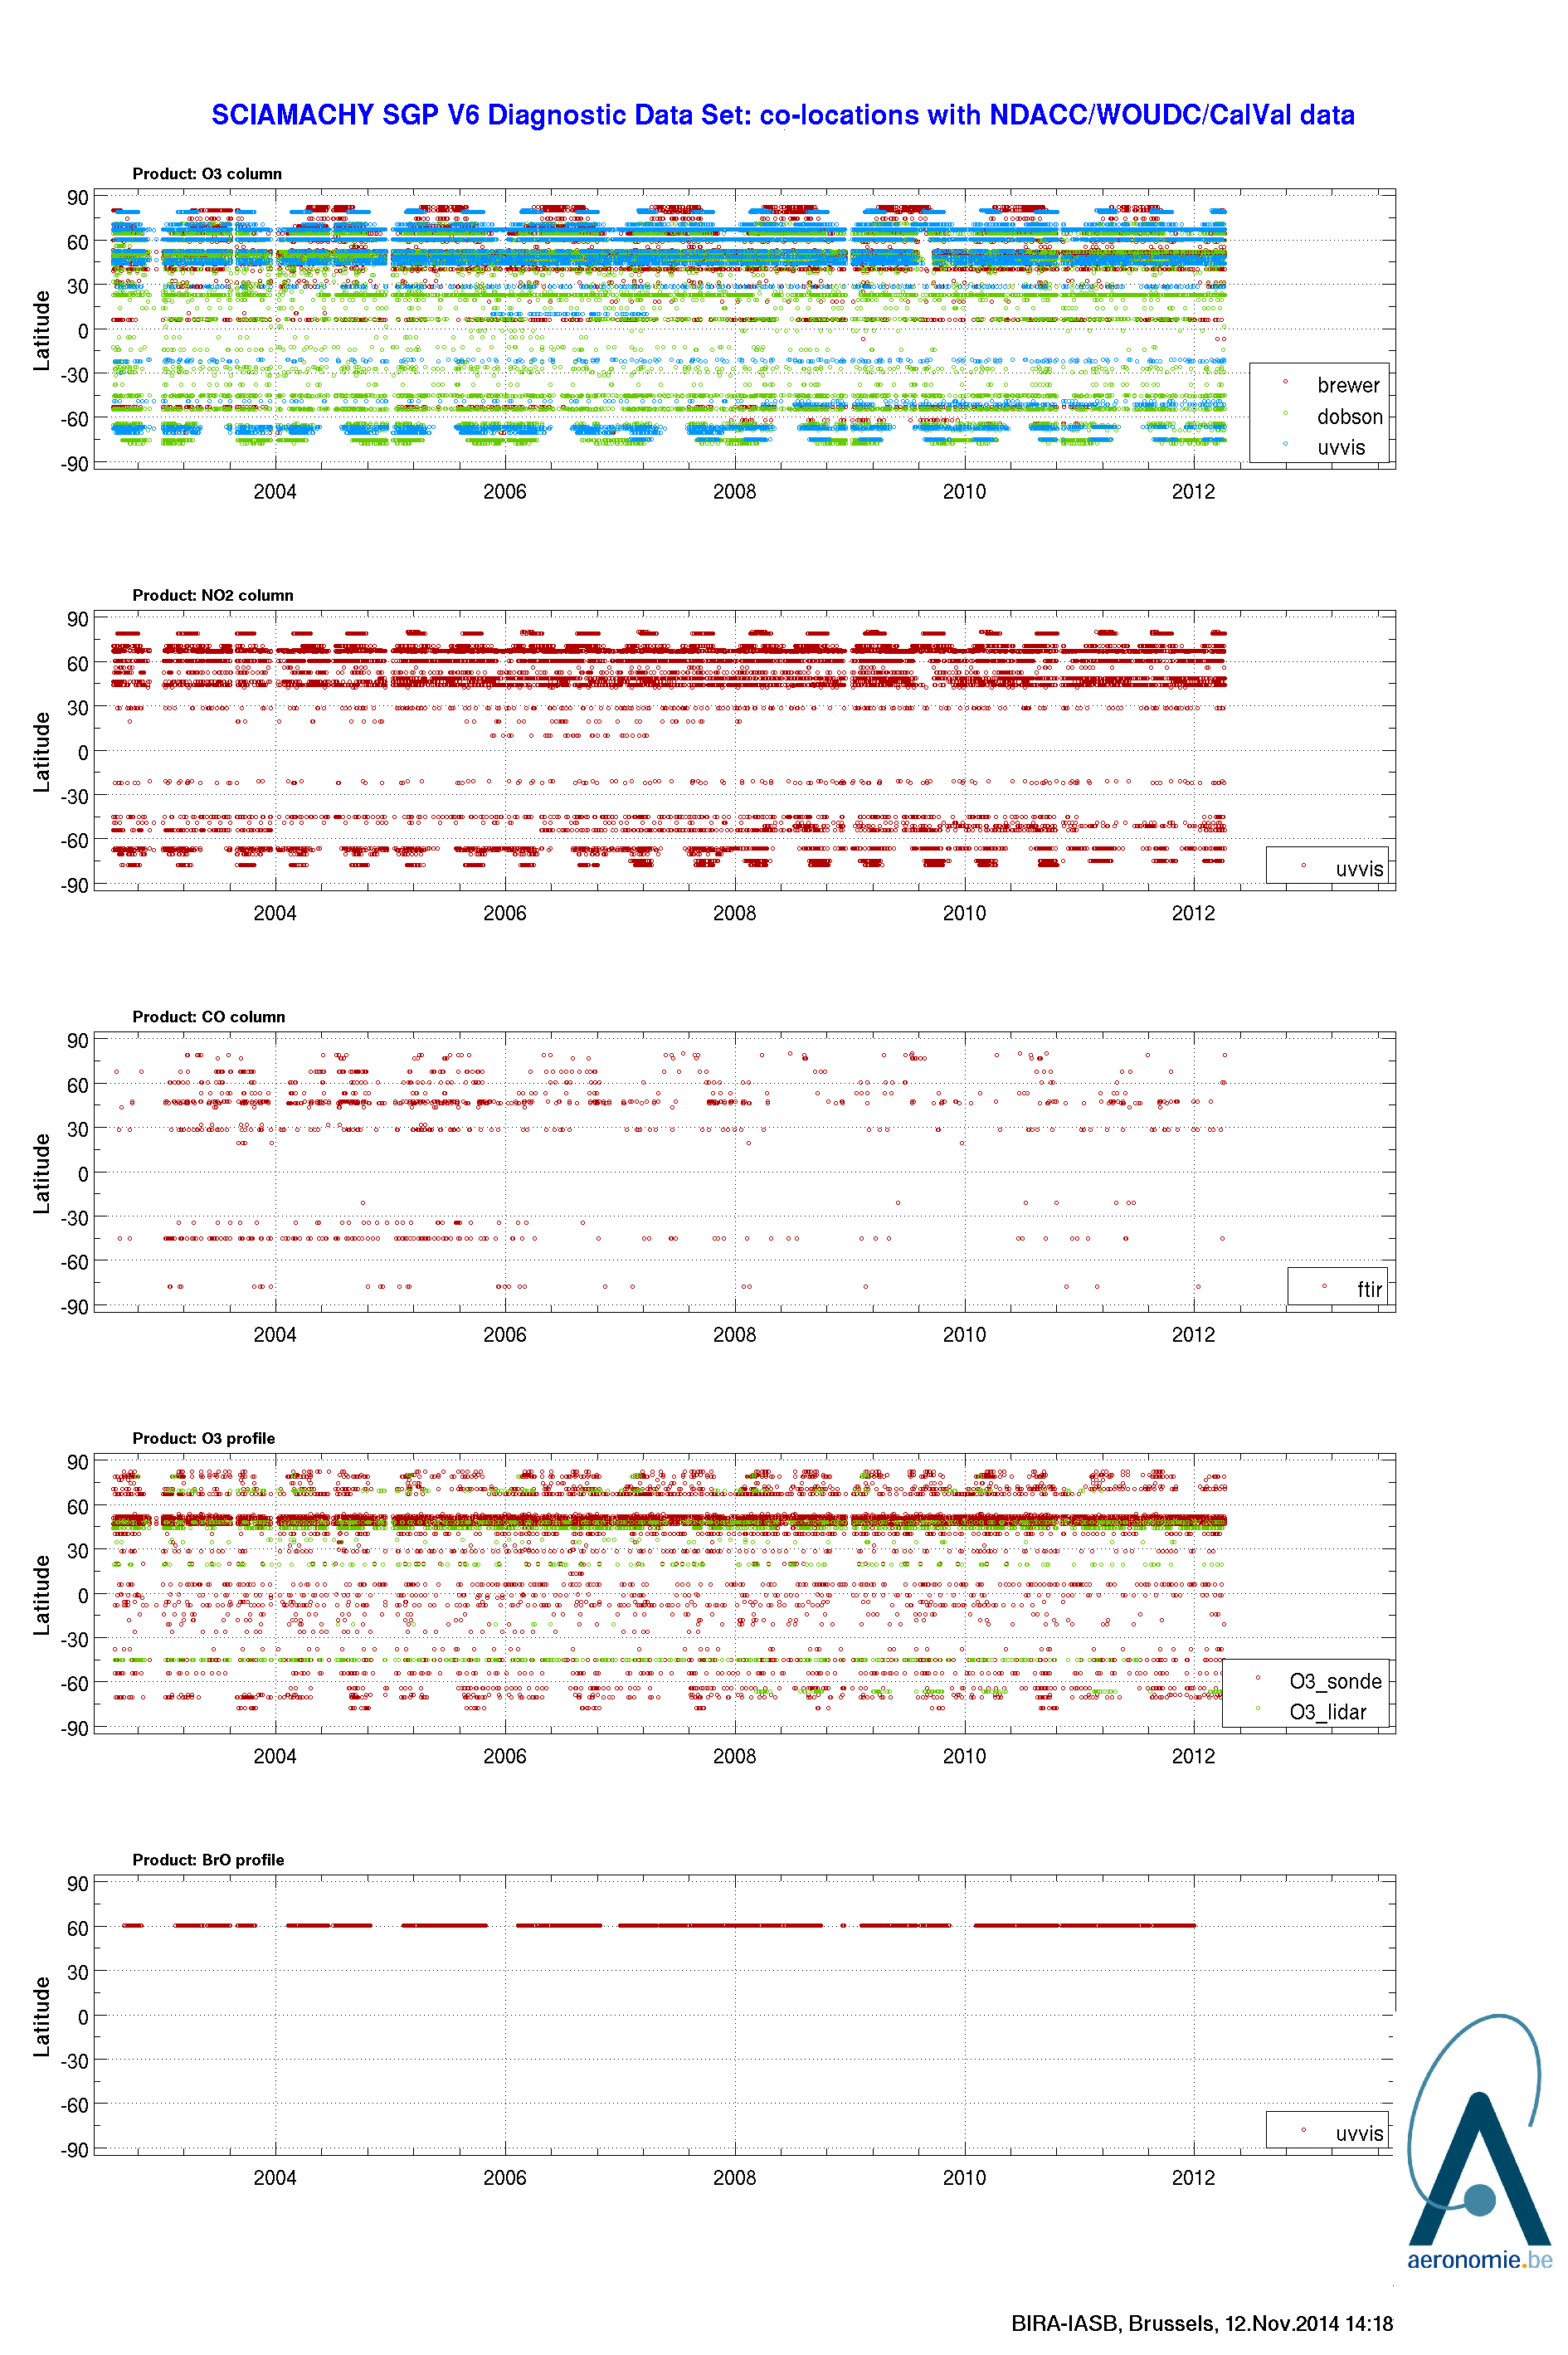
Diagnostic Data Set
Shown: difference in (latitude, time) sampling of SCIAMACHY-ground co-locations for entire mission and Diagnostic Data Set (5011 orbits)
DDS-derived results are generally representative in space and time, except
space: BrO (only one station in Arctic) and CO (1 station in Tropics + Antarctic)
time : less CO data to compare differences in monthly mean
→ full mission should increase precision of bias estimates
O3 column
NO2 column
CO column
O3 profile
BrO column
/ profile

Slide 5
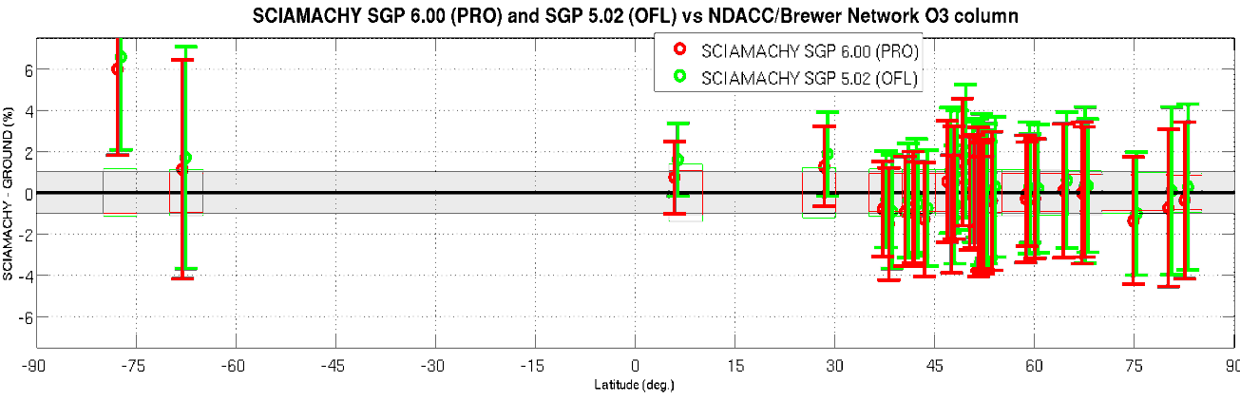
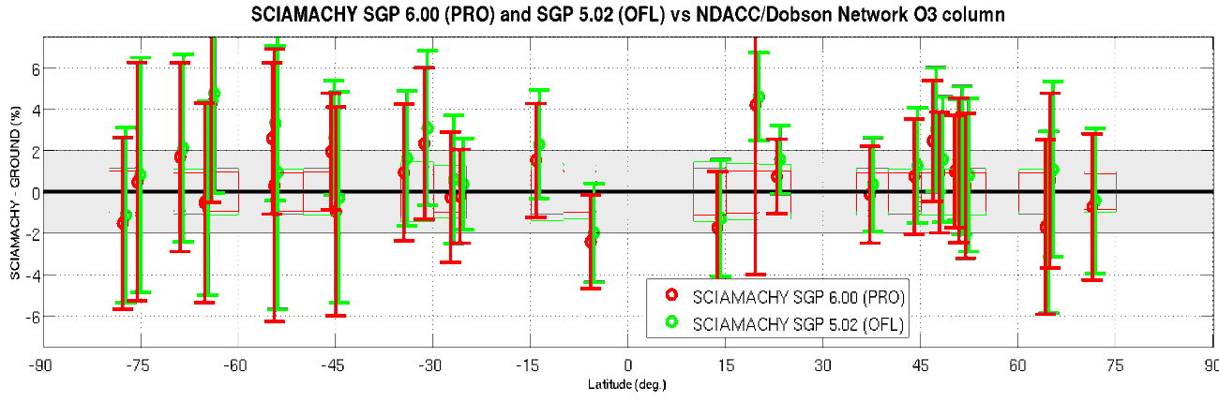
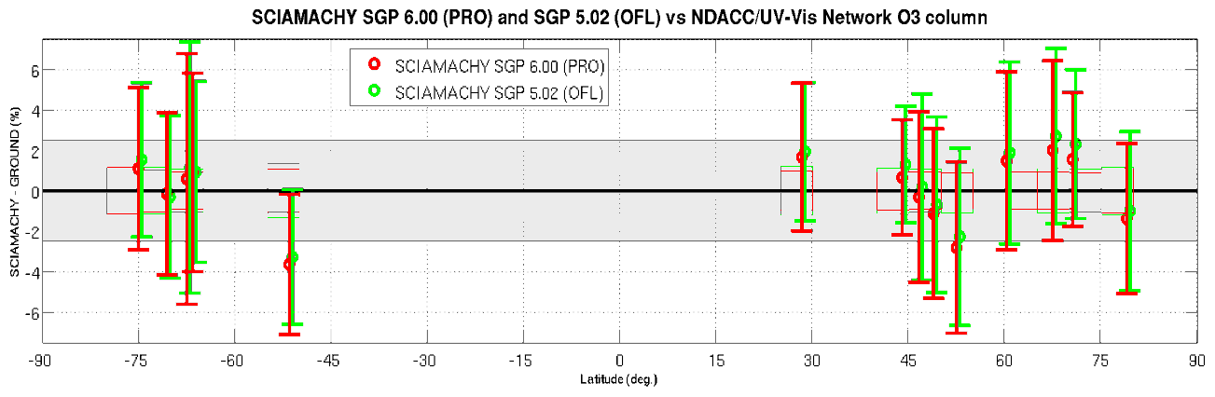
O3 nadir column
Relative to V5, O3 column reduced on average by
0.2-0.6% at most stations
Bias is hereby reduced, now at most +(1-1.5)% (close to GND measurement uncertainties)
No changes in SZA or cloud-dependence of bias
No clear changes in spread

Slide 6
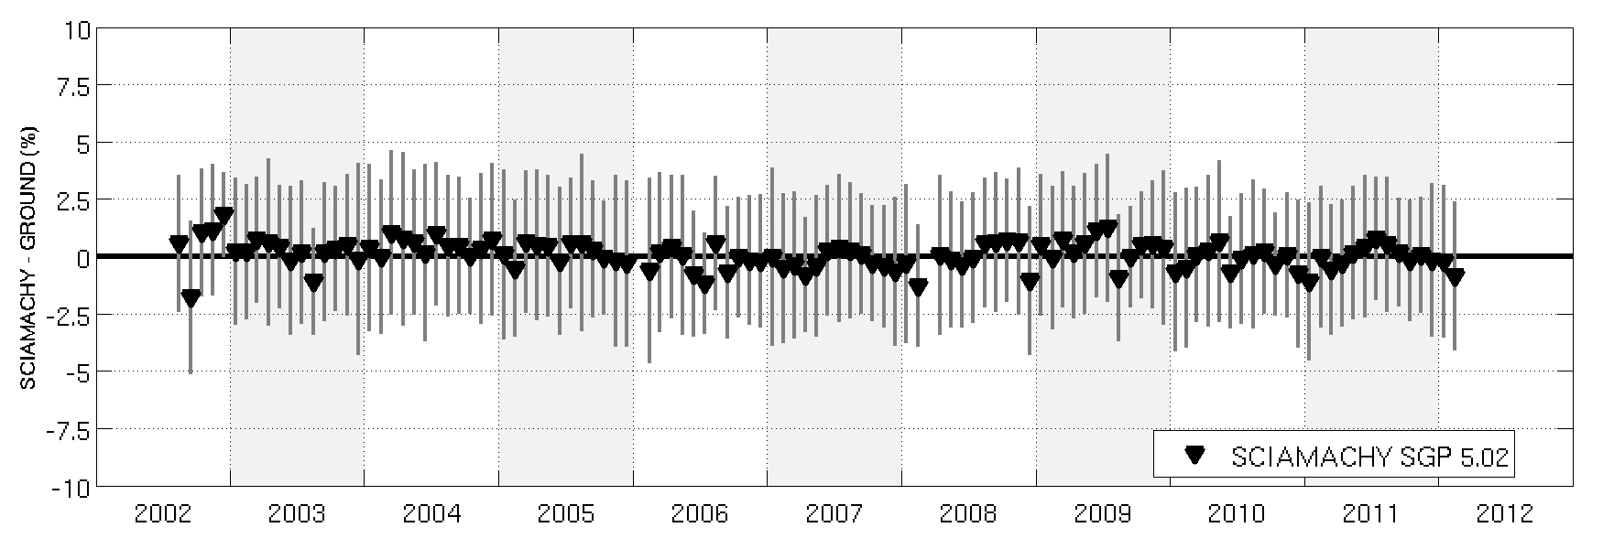
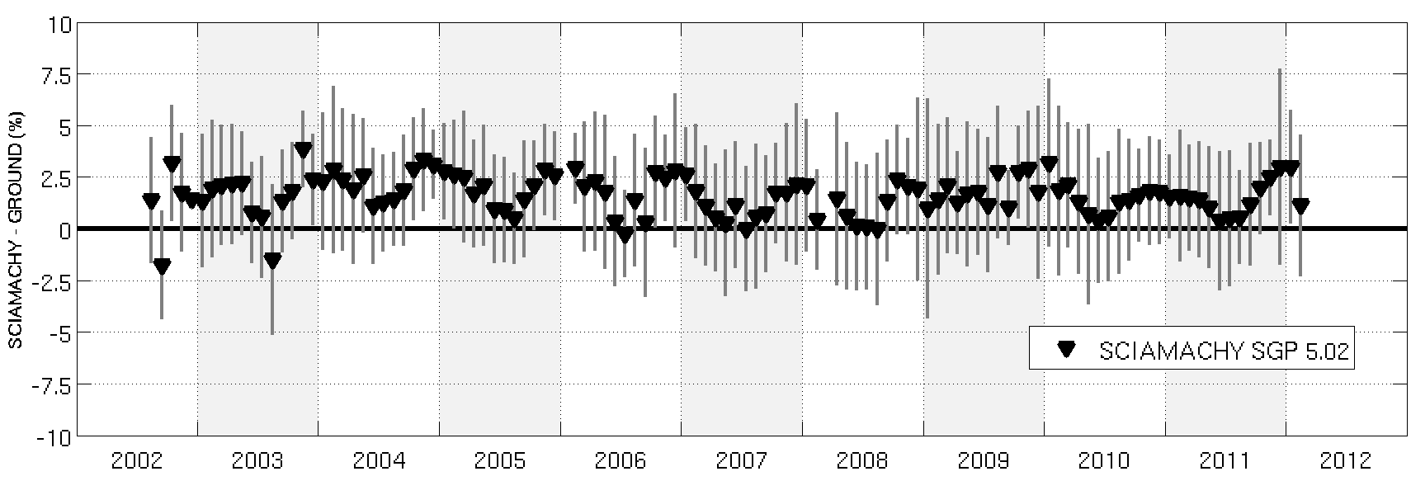
O3 nadir column
However V6 columns exhibit a long-term drift in NH!
It is negative and about 1.5% over mission lifetime
Consistent results for Dobson & Brewer
Not seen for V5
Brewer 30N-60N
Dobson 0N-90N

Slide 7
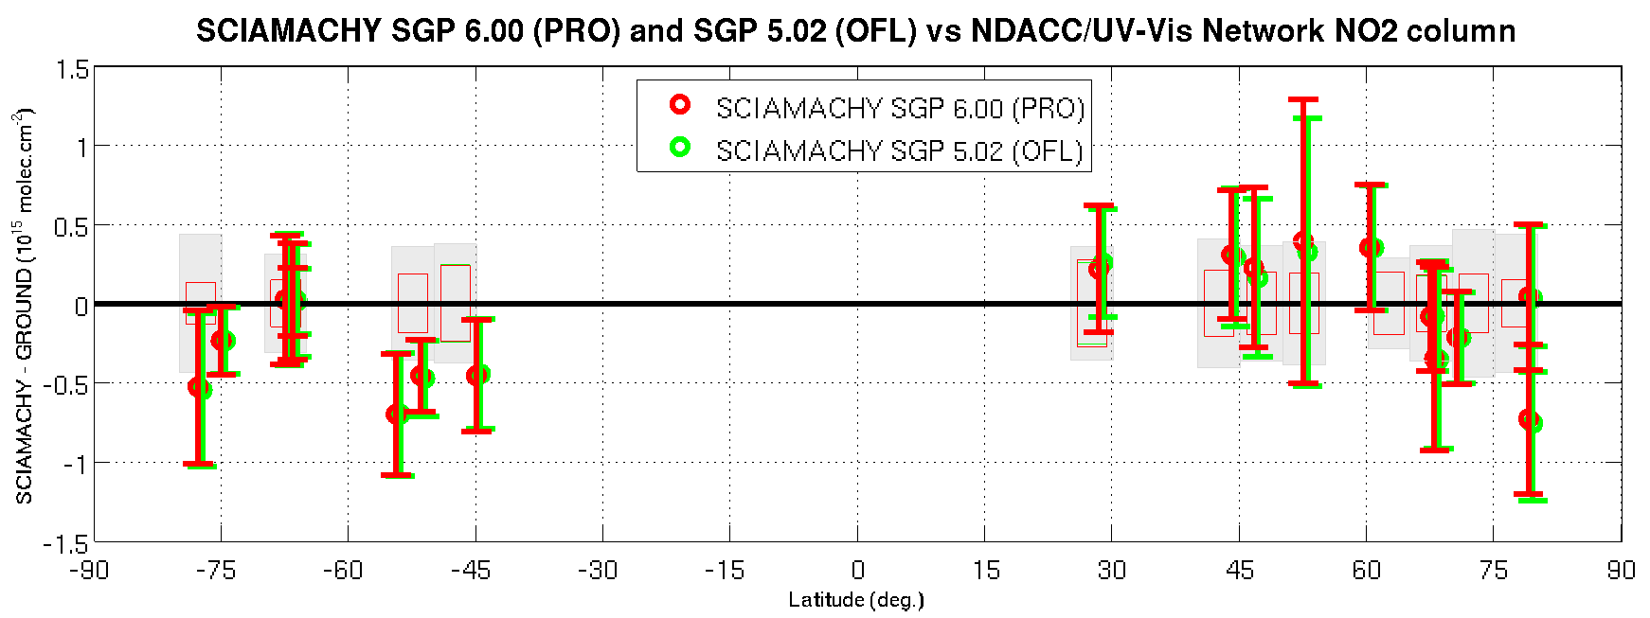
NO2 nadir column
Differences between SGP V6 and V5 are hardly noticeable and well below the detection limit of the ground-based measurements.
Median bias is less than ±4x10¹⁴ molec. cm⁻² (~10-15%) at stations without tropospheric pollution and where the diurnal cycle can be accounted for accurately.
Difference between mid N and mid S bias (~7x10¹⁴ molec. cm⁻²) possibly due to tropospheric pollution and residual diurnal cycle effects.

Slide 8
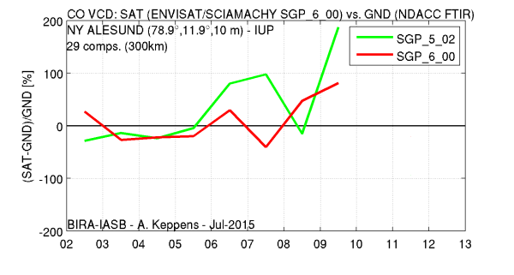
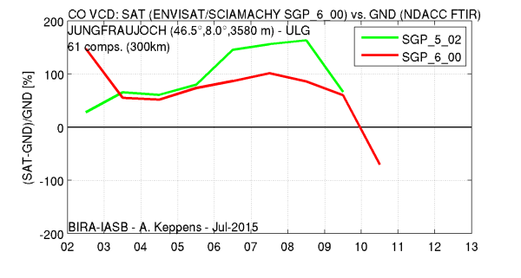
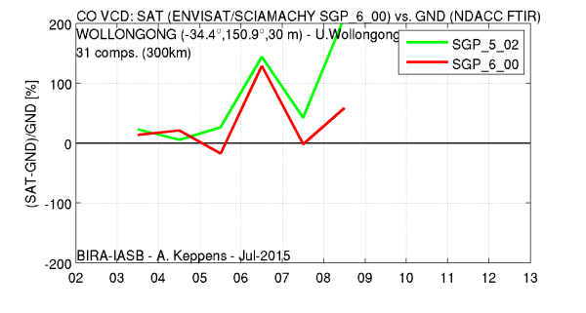
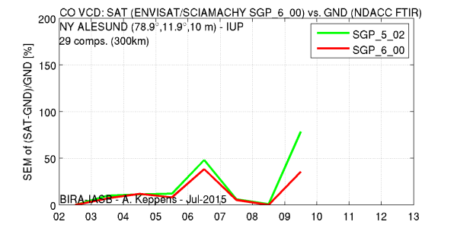
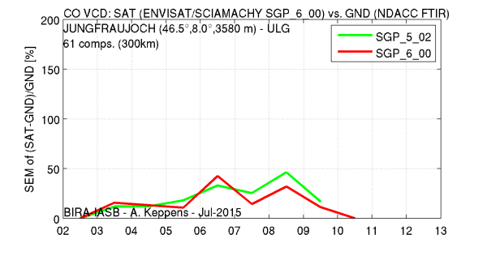
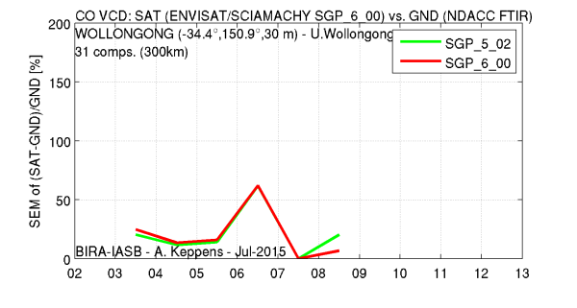
CO nadir column
In general, the yearly bias of V6 is comparable to that of V5,
but appears clearly reduced during 2006-2010 (TBC with more data)
No clear differences in yearly spread between V5 and V6
Large amount of outliers and negatives (even for monthly means…)
Due to large variability no seasonal cycle, decadal trend or meridian dependence can be observed
Product remains inadequate in both precision and accuracy

Slide 9
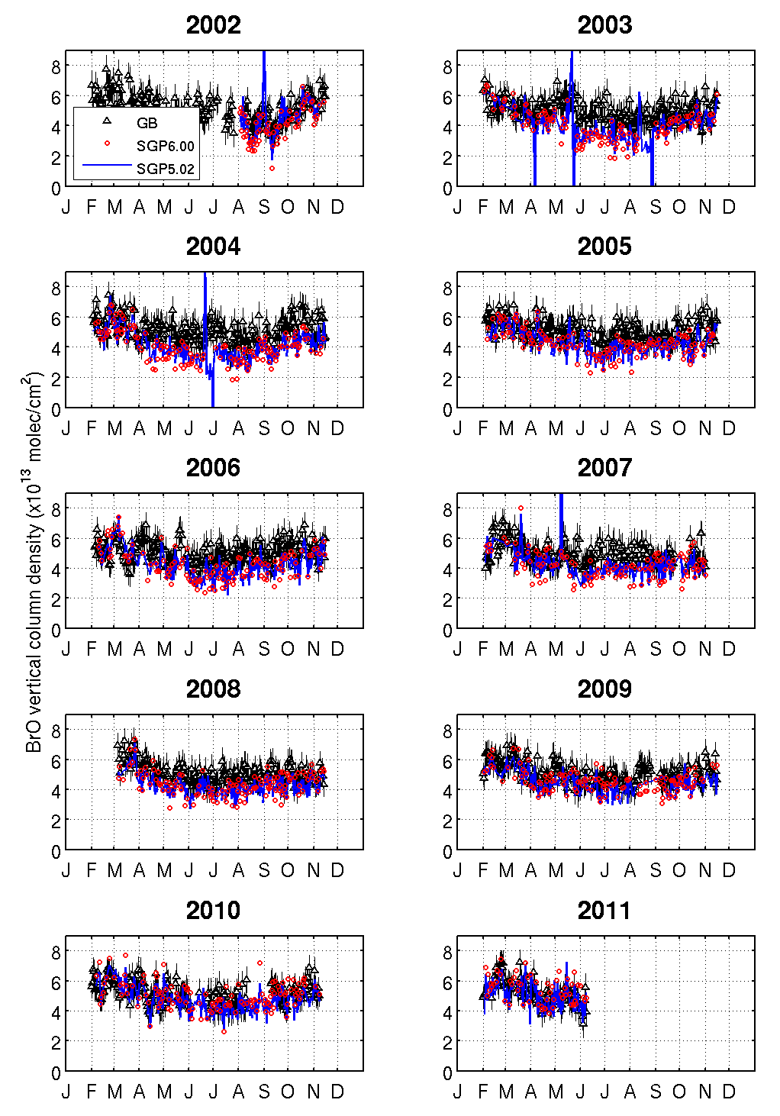
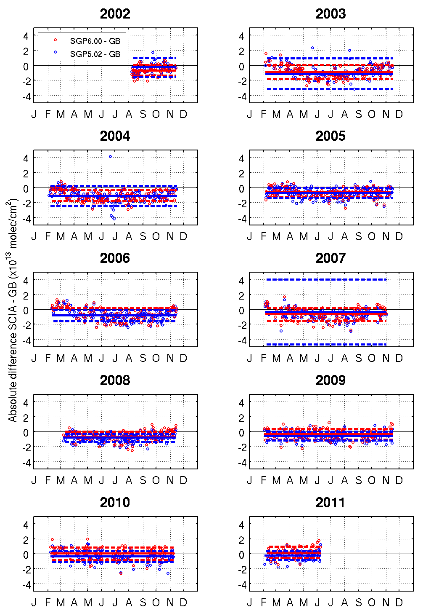
BrO nadir column at Harestua (60°N)
Very similar data quality*
Annual cycle well reproduced
Negative bias reduced by ~0.5% (insignificant)
More outliers in V5 data (2003, 2004, 2007) (?)
* Sampling differences may play a role in above results (V5 = full mission, V6 = DDS)

Slide 10
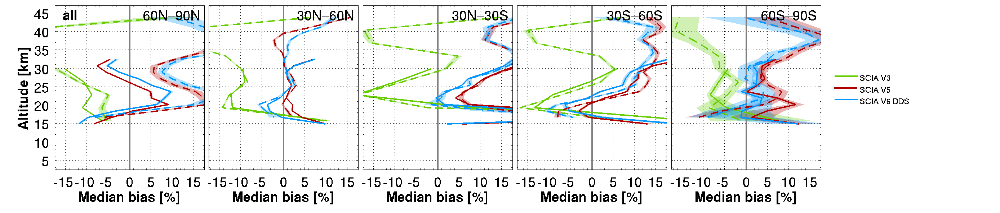
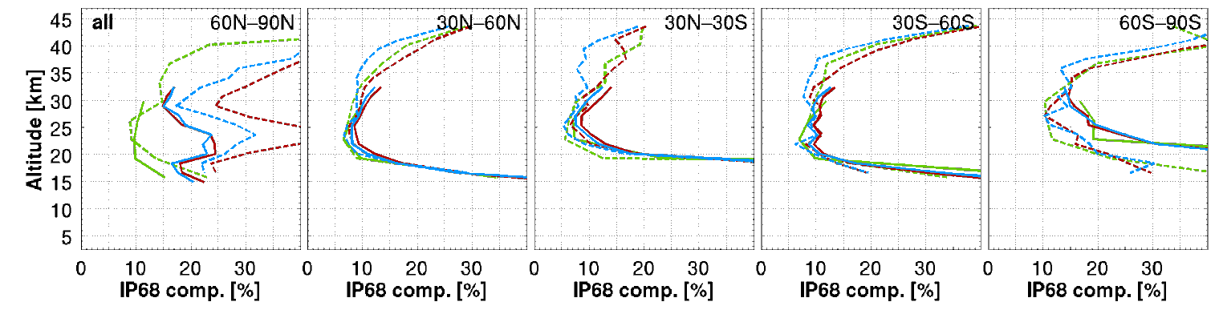
O3 limb profile
UTLS and stratosphere
daan.hubert@aeronomie.be (Aug 2015)
Overall, V5&V6 are very similar, but in parts of the atmosphere clear changes are noted
  Upper stratosphere : reduction in short-term variability
  Arctic : clear improvement of variability
  3-7% less ozone below 30-35km (bias reduction 30N-90S, bias increase 30N-90N)
All major issues remain
① vertical AK introduces large oscillations, ② bias is large and has complex structure,
③ significant degradation of data quality in Arctic MS, ④ clear negative decadal drift in MS, ⑤ impact of pT

Slide 11
O3 limb profile mesosphere (& stratosphere)
Payerne (47N) only MWR
Mauna Loa (20N) MWR+LID
Lauder (45S) MWR+LID
Comparison to three microwave radiometer stations (47°N, 20°N and 45°S)
Consistent results (within 5%) for microwave and lidar over 30-42 km
Positive bias in large part of the mesosphere, less clear above ~60km
No SCIAMACHY V5 data shown
(since only a-priori reported in mesosphere)

Slide 12
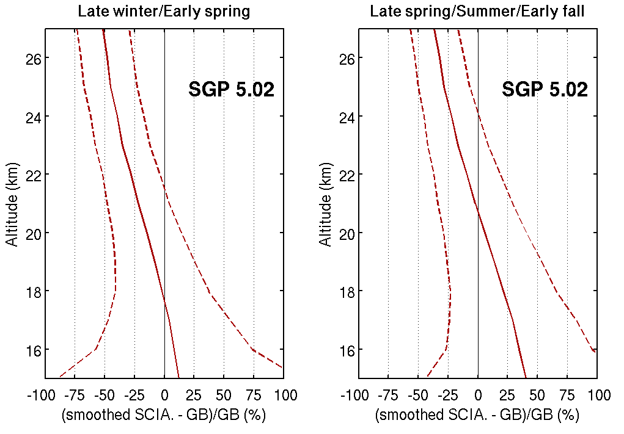
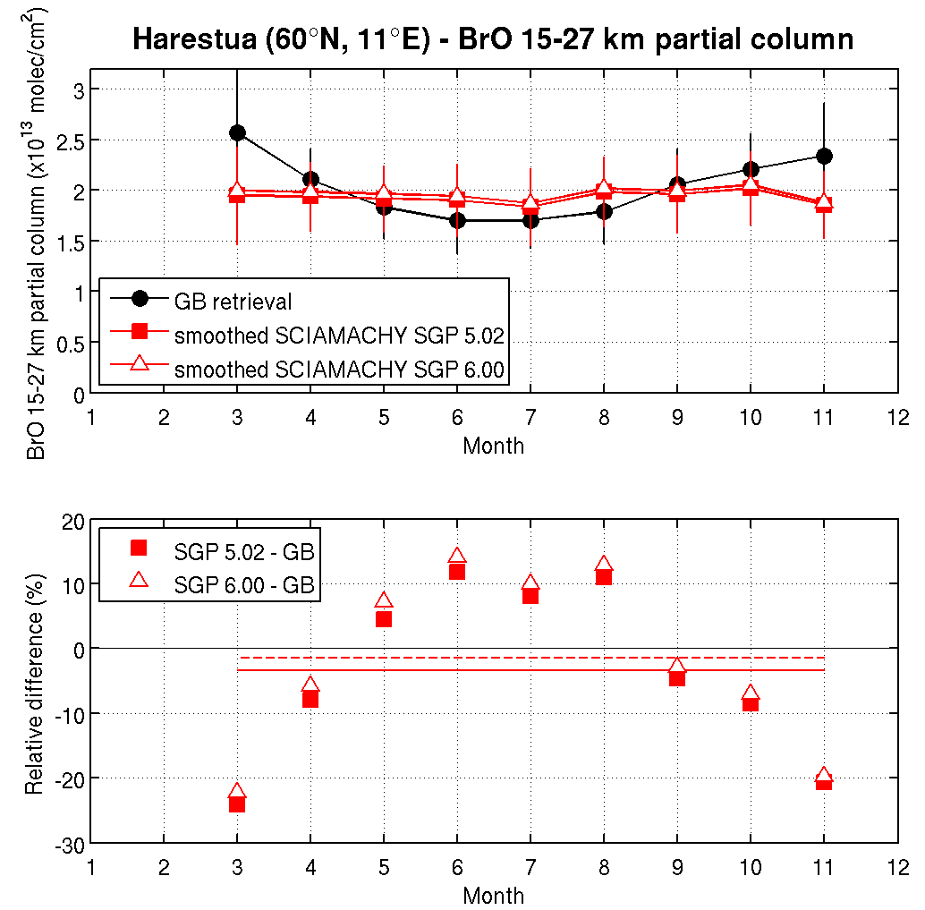
BrO limb profile at Harestua (60°N)
V6 BrO concentrations up to 3% larger than V5
Bias is season- and altitude-dependent
Spread is similar for V5 and V6
Biases are significantly higher than those obtained for the
IUP-Bremen scientific product at the same station (+10/-20%),
see Hendrick et al. (2009)
Similar results for 15-27km partial column
V5 and V6 do not capture the seasonality seen in the ground-based partial columns
This seasonality is well captured by the IUP-Bremen scientific product (Hendrick et al., 2009)

Slide 13
Executive summary
 | O3 column | NO2 column | CO column | BrO column | O3 profile | BrO profile
Change V6 vs V5 | Reduced positive bias Spread is similar Negative drift of 1.5% / dec. at NH middle latitudes | Differences between the two SGP data versions are hardly noticeable and below the detection limit of the ground-based measurements. | Bias clearly reduced during 2006-2010 Spread is similar Major issues not solved | Perhaps slightly better negative bias reduced by 0.5% possibly less outliers. | As expected, V6 is very similar in quality to V5. It has slightly improved bias, short-term variability and estimates of random uncertainty in some regions of the atmosphere. | Very similar: BrO conc. increase by 0-3% spread is quasi unchanged again, no annual cycle. But, quality remains worse than that of scientific product
Maturity evaluation | Representative global | Representative global, except in Tropics | Possible sampling issues, better precision expected for full mission | 1 Arctic station | Representative global, except in mesosphere | 1 Arctic station
Recommendation | Reprocess, if appearance of 1.5% / decade negative drift is acceptable. Clear disclaimer of this in README file. | Reprocess, since no observable degradation relative to V5. | Reprocess, since signs of improved product. Clear disclaimer of major issues in README file. | Reprocess, since no observable degradation relative to V5. | Reprocess, since at least no degradation relative to V5. Clear disclaimer of many major issues in README file. | Reprocess, since no degradation relative to V5. Clear disclaimer of issues in README file.

