Slide 1
L2 Processor: CH4
Our first operational processor's Methane L2 products
Verification strategy:
- Reference year 2004 (w/o anomaly and decontamination orbits)
- Using monthly measurements & maps
- Comparing against exiting Sciamachy data (SRON, IUP Bremen)
- Comparing against ground stations
(TCCON, ESRL)

Slide 2
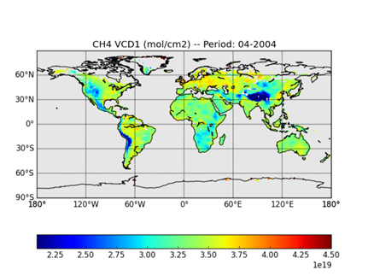
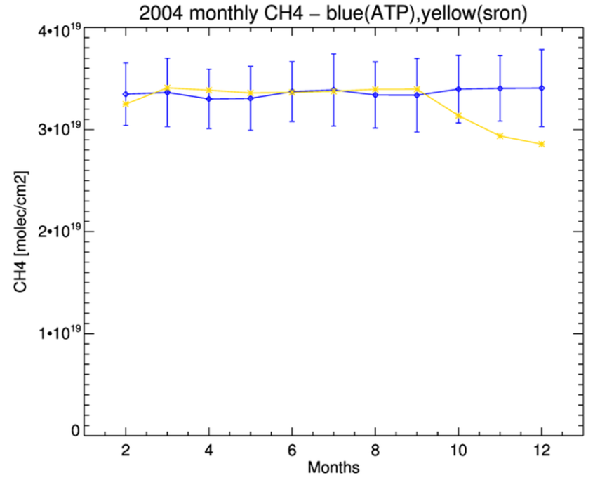
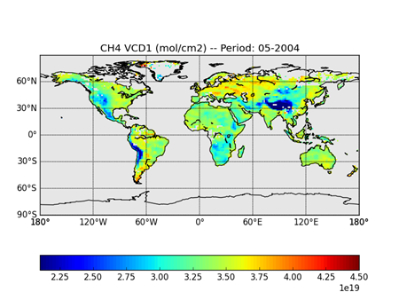
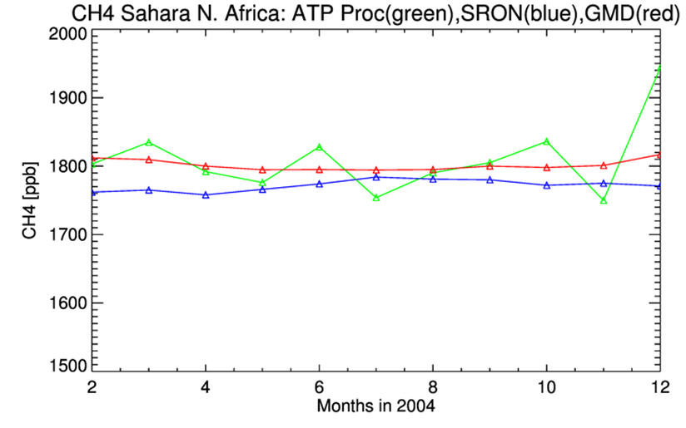
Preliminary Results and Examples for 2004
CH4 monthly averaged VCD: The values are consistent
within ~2.5% until September, but diverge afterwards.
Examples of our CH4 VCD (April and May 2004)
Comparison of xCH4 data between ESRL at Assekrem station and Sciamachy around the station’s geographical area.

Slide 3
Summary
We produced the first DLR version of L2 CH₄ data
Our VCD CH4 data are quite consistent, within error bars, with both SRON and IUP Bremen data for most of the 2004 year.
Our data are also consistent with the ESRL GMD station in the Sahara in North Africa all over the year of 2004.
We are continuously updating and refining our L2 processor’s components

