Slide 1
SCIAMACHY QWG PM6, 21-22 Sept. 2016
Upgrade from SGP V5.02 to V6 .01: Ground-based (delta) validation conclusions
A. Keppens, D. Hubert, J. Granville, F. Hendrick, J.-C. Lambert Royal Belgian Institute for Space Aeronomy (BIRA-IASB)
Acknowledgements
NDACC, SHADOZ and GAW PIs + staff at stations ESA, BELSPO

Slide 2
Data sets
SCIAMACHY
SGP 3.01/R complete data set (Aug 2002 – Jan 2010)
SGP 5.02/W complete data set (Aug 2002 – Apr 2012)
SGP 6.00/Y diagnostic data set (Aug 2002 – Apr 2012)
SGP 6.01/Y complete data set (Aug 2002 – Apr 2012)
Ground-based instruments
O3 column 36 Dobsons, 32 Brewers, 17 UV-visible spectrometers (GAW, NDACC)
NO2 column 19 UV-visible spectrometers (NDACC)
BrO column 1 UV-visible spectrometers at Harestua (60°N)
CO column 13 FTIRs (NDACC)
CH4 column 15 FTIRs (NDACC)
H2O column 47 radiosondes (GAW, NDACC, SHADOZ)
O3 profile 79 ozonesondes, 12 lidars, 2 MWRs (GAW, NDACC, SHADOZ)
BrO profile 1 UV-visible spectrometer at Harestua (60°N)

Slide 3
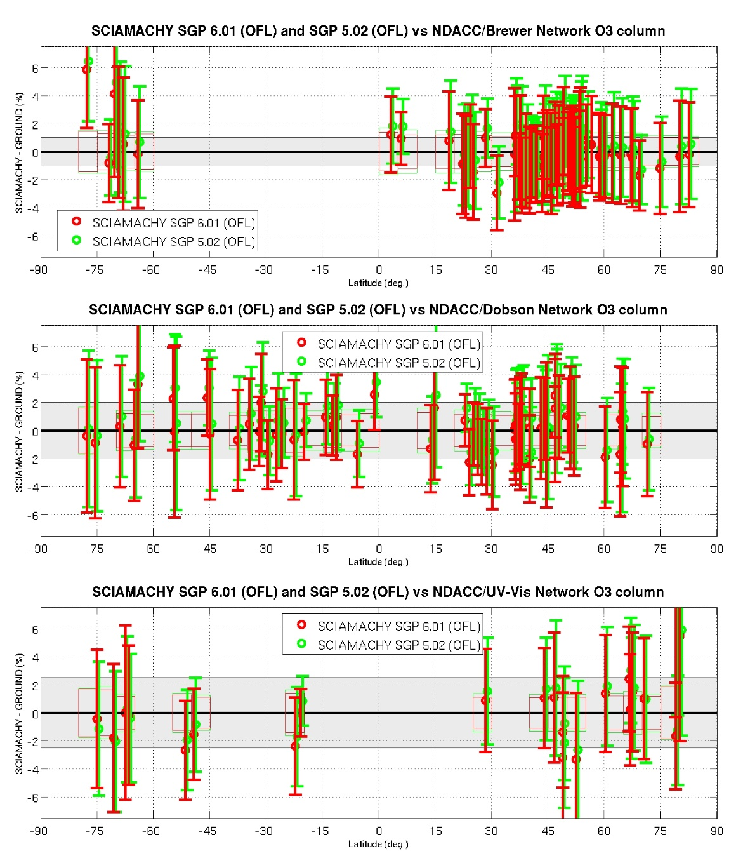
O3 nadir column
Relative to V5, O3 column reduced on average by 0.2-0.6% at most stations
Bias is hereby reduced, now at most +(1-1.5)% (close to GND measurement uncertainties)
No changes in SZA or cloud-dependence of bias
No clear changes in spread

Slide 4
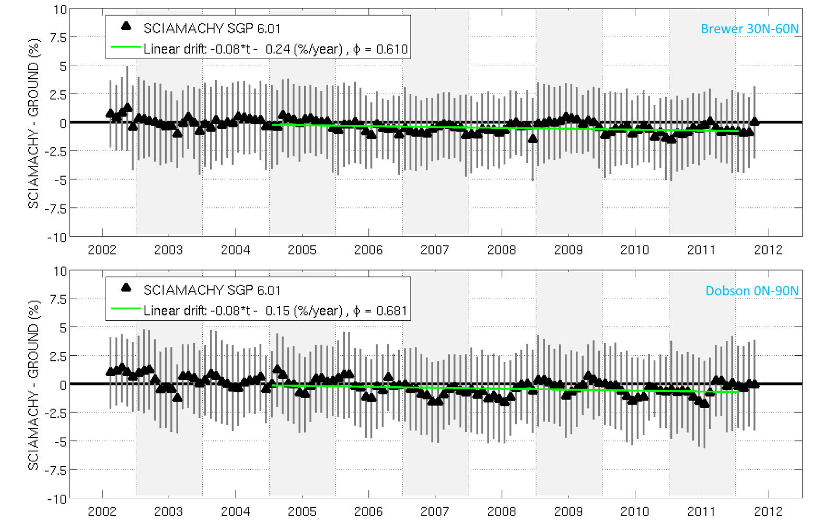
O3 nadir column
However V6 columns exhibit (insign.) long-term drift in NH
It is negative and about 1 % over mission lifetime
Consistent results for Dobson & Brewer
Not seen for V5

Slide 5
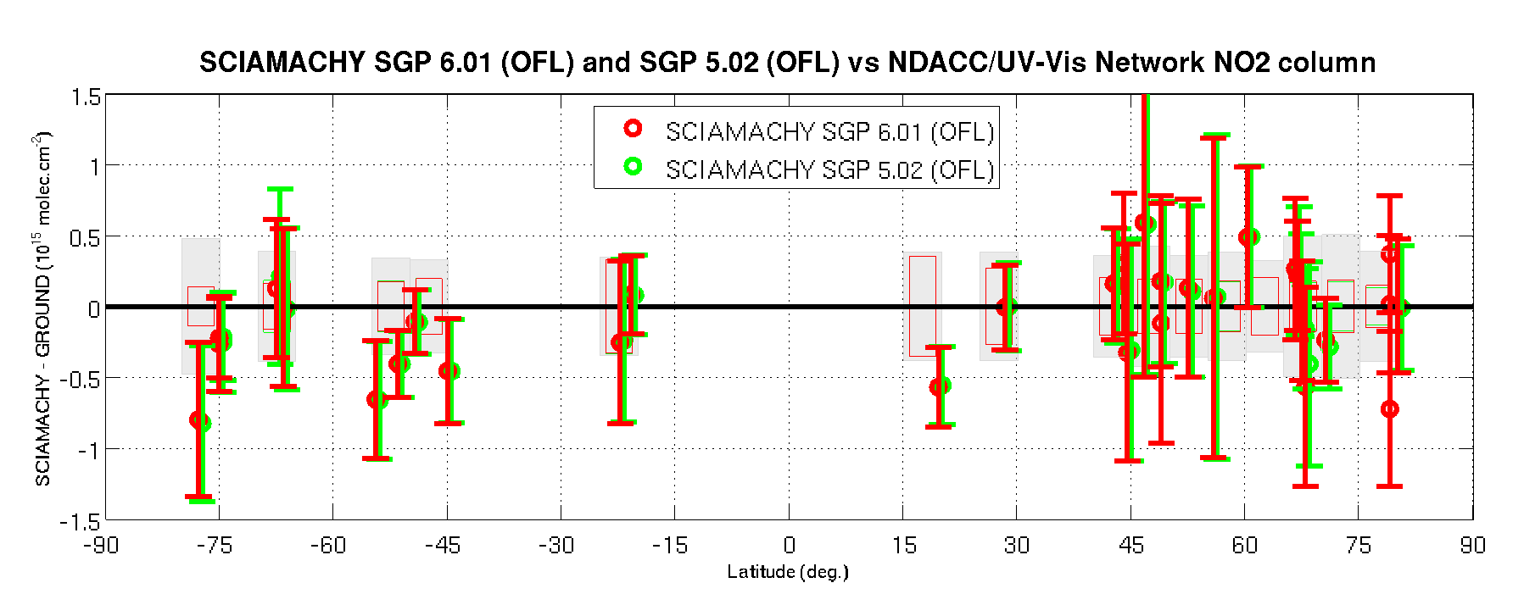
NO2 nadir column
Differences between SGP V6 and V5 are hardly noticeable and well below the detection limit of the ground-based measurements.
Median bias is less than ±4x10¹⁴ molec. cm⁻² (~10-15%) at stations without tropospheric pollution and where the diurnal cycle can be accounted for accurately.
Difference between mid N and mid S bias (~7x10¹⁴ molec. cm⁻²) possibly due to tropospheric pollution and residual diurnal cycle effects.

Slide 6
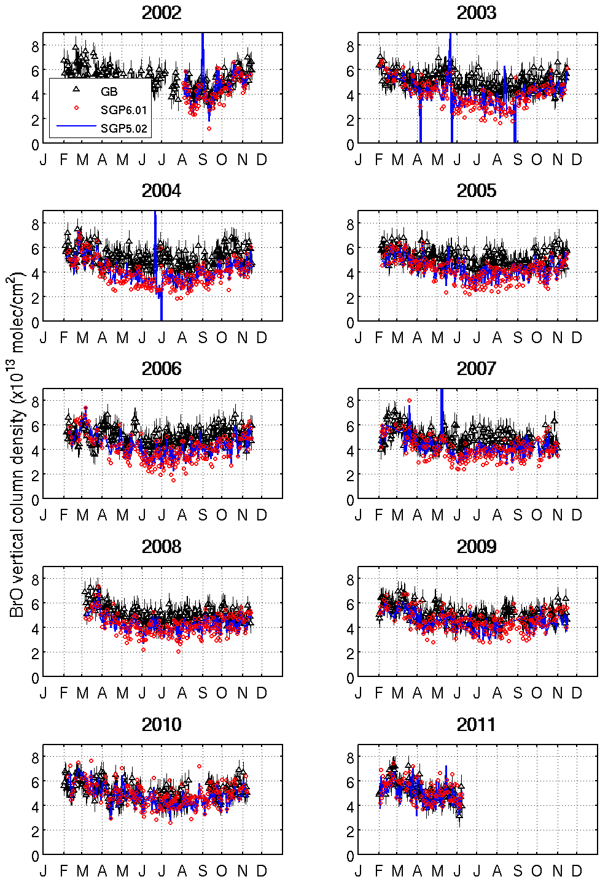
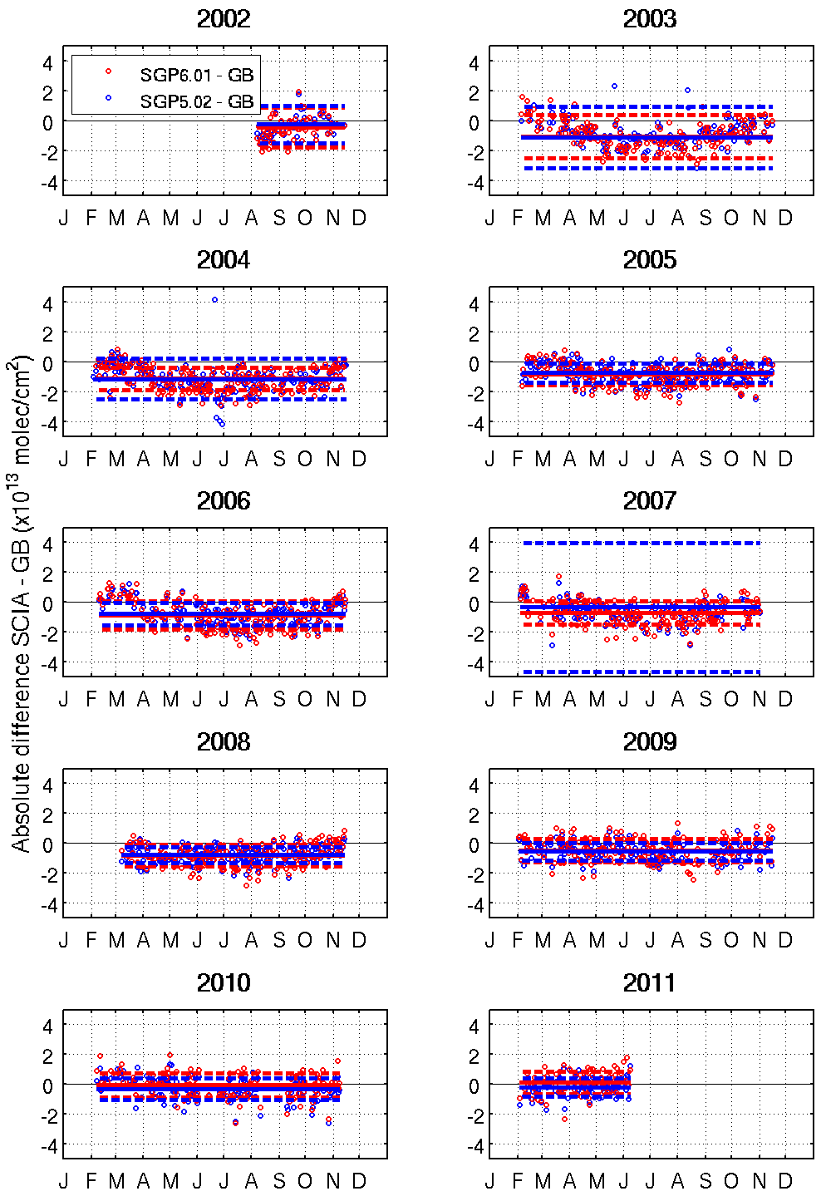
BrO nadir column at Harestua (60°N)
SGP V5/6 show very similar data quality
Annual cycle well reproduced
Similar negative bias
More outliers in V5 data (2003, 2004, 2007) (?)

Slide 7
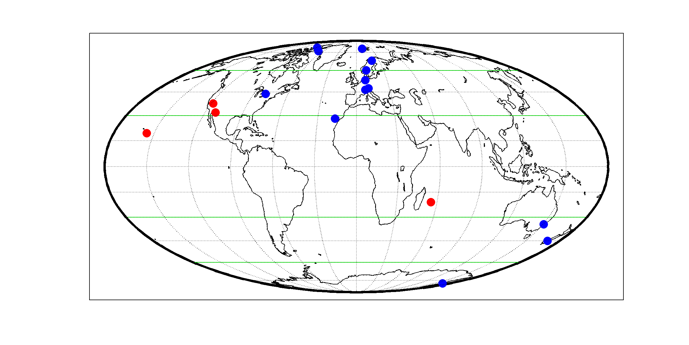
CO & CH4 nadir column
SGP V5.02 and V6.01 delta-validation analysis on the relative difference
of monthly means (neg. MM are omitted)
of co-location pairs within 300 km and within ±3 h at 15 FTIR stations
limited to identical subsets of the satellite data processor versions (for delta)
FTIR station | Lat. | Lon. | Period
Eureka | 79.99 | -85.93 | 2006-2012
Ny-Ålesund | 78.93 | 11.93 | 2002-2012
Thule | 76.53 | -68.74 | 2002-2011
Kiruna | 67.84 | 20.41 | 2002-2012
Harestua | 60.20 | 10.80 | 2002-2012
Bremen | 53.10 | 8.80 | 2002-2012
Zugspitze | 47.42 | 10.98 | 2002-2011
Jungfraujoch | 46.55 | 7.98 | 2002-2012
Toronto | 43.78 | -79.47 | 2004
Mt. Barcroft | 37.58 | -118.24 | 2002
Kitt Peak | 31.90 | -111.60 | 2002-2005
Izaña | 28.30 | -16.50 | 2002-2012
Mauna Loa | 19.53 | -155.58 | 2003-2010
St. Denis | -20.90 | 55.50 | 2004-2011
Wollongong | -34.41 | 150.88 | 2002-2008
Lauder | -45.04 | 169.68 | 2002-2012
Arrival Heights | -77.83 | 166.67 | 2002-2012

Slide 8
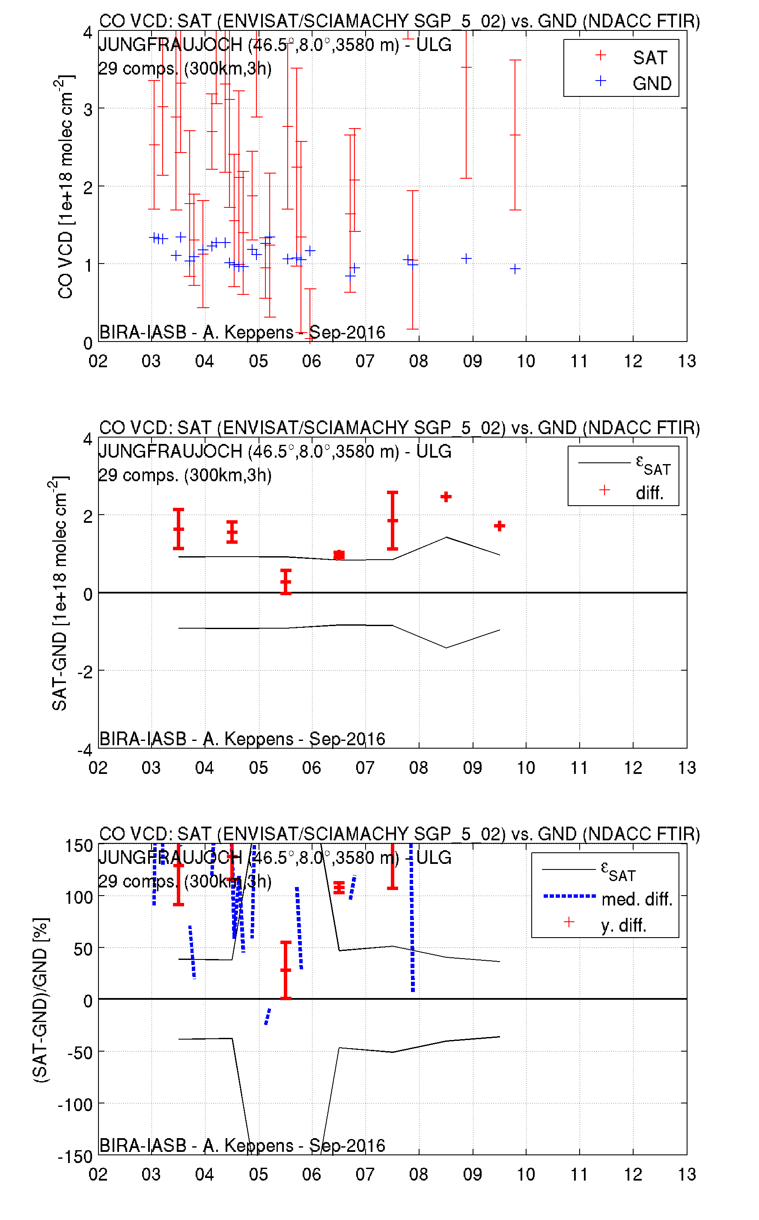
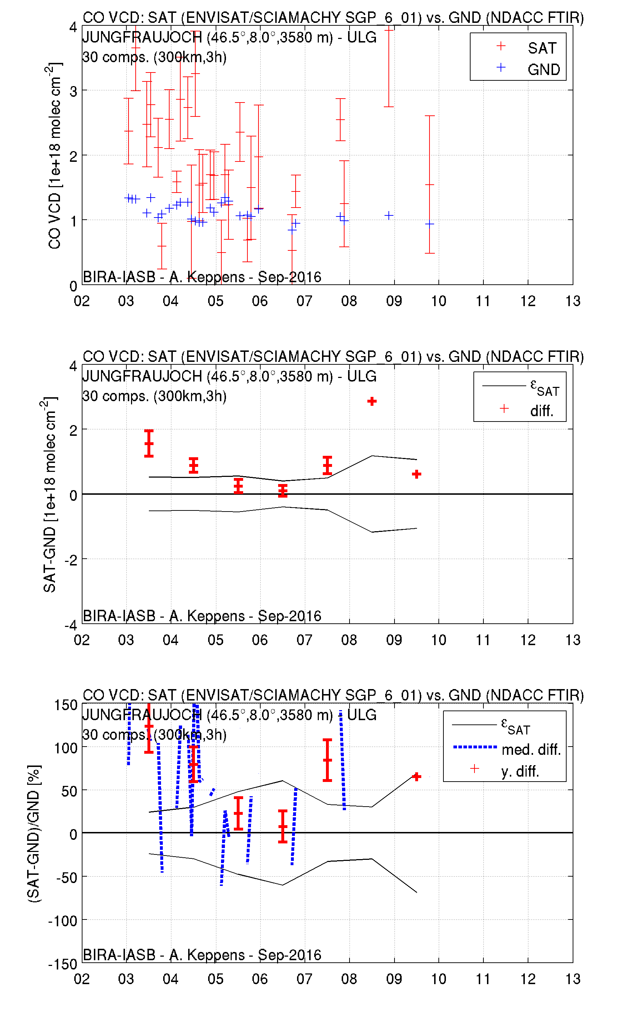
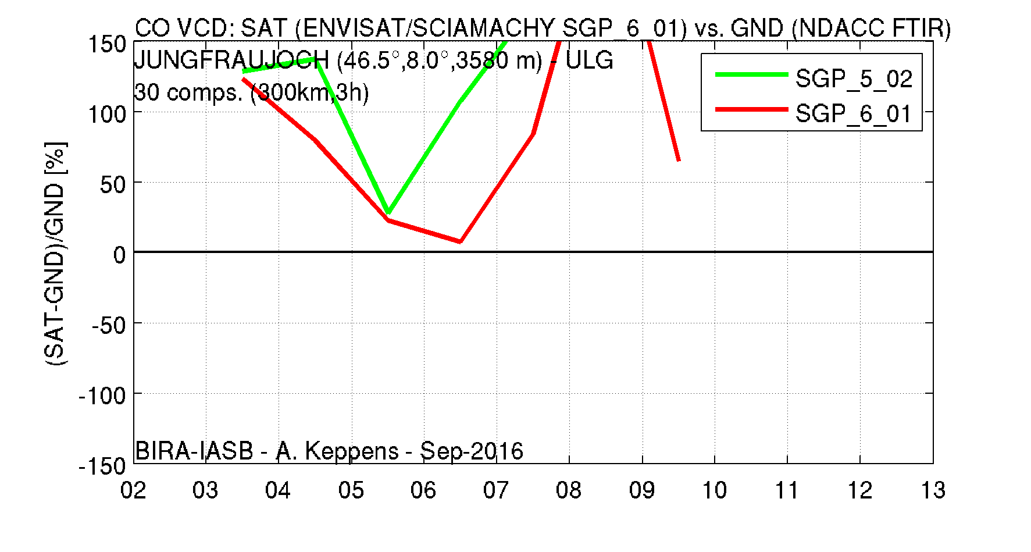
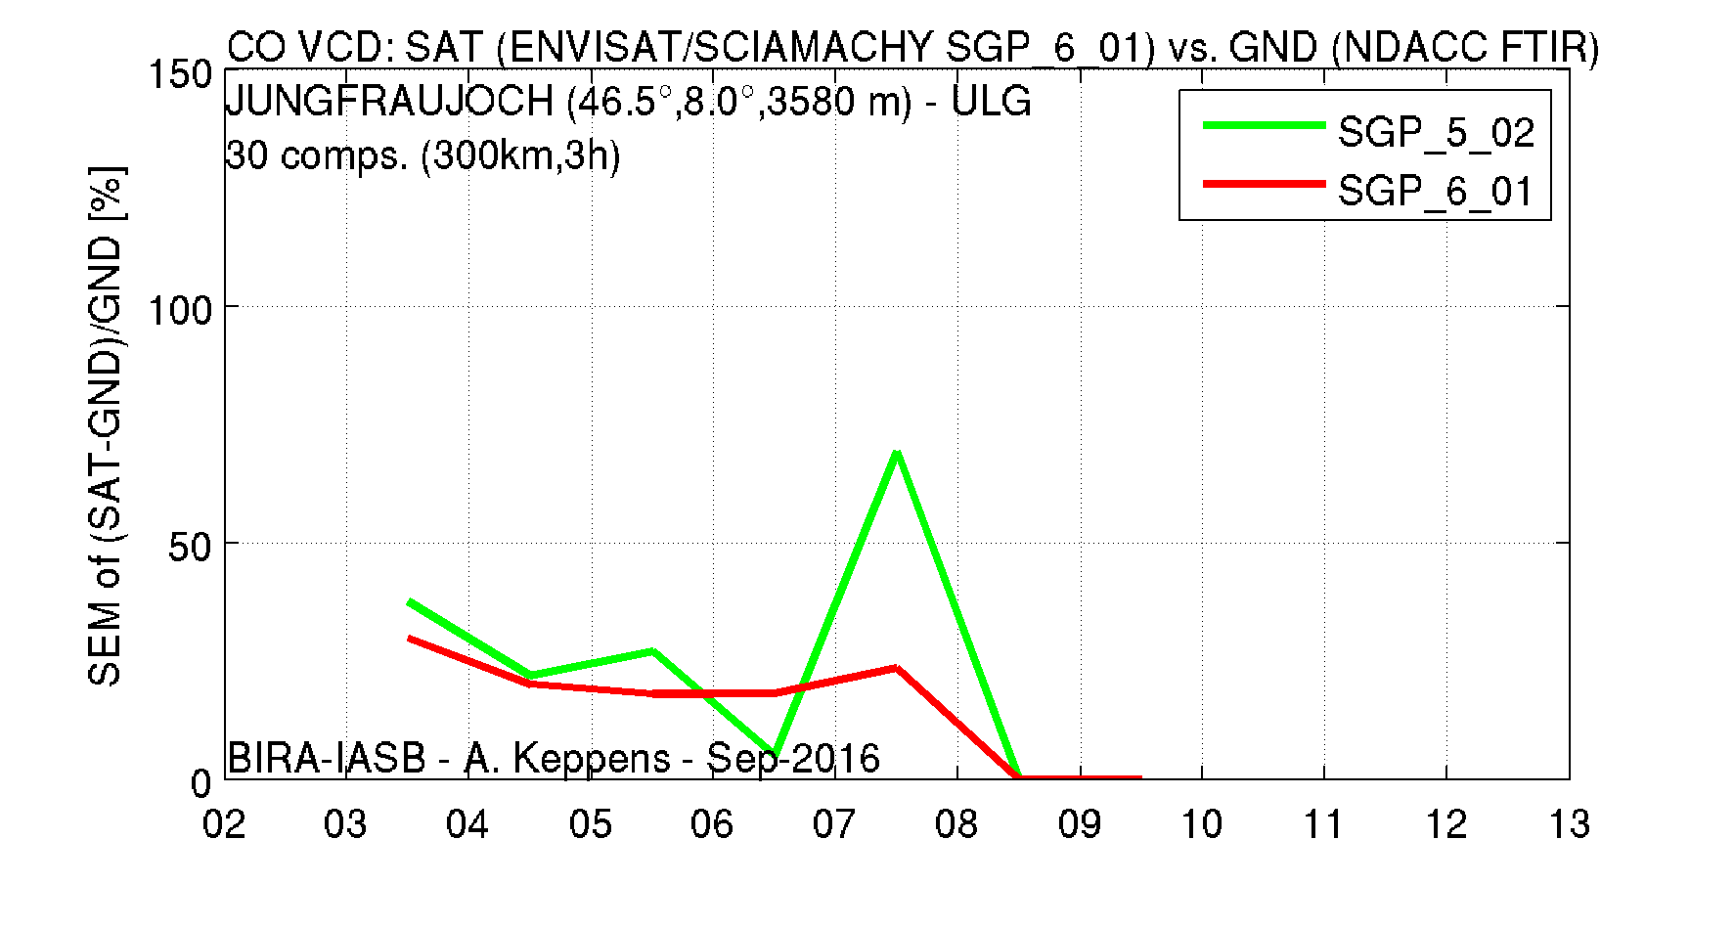
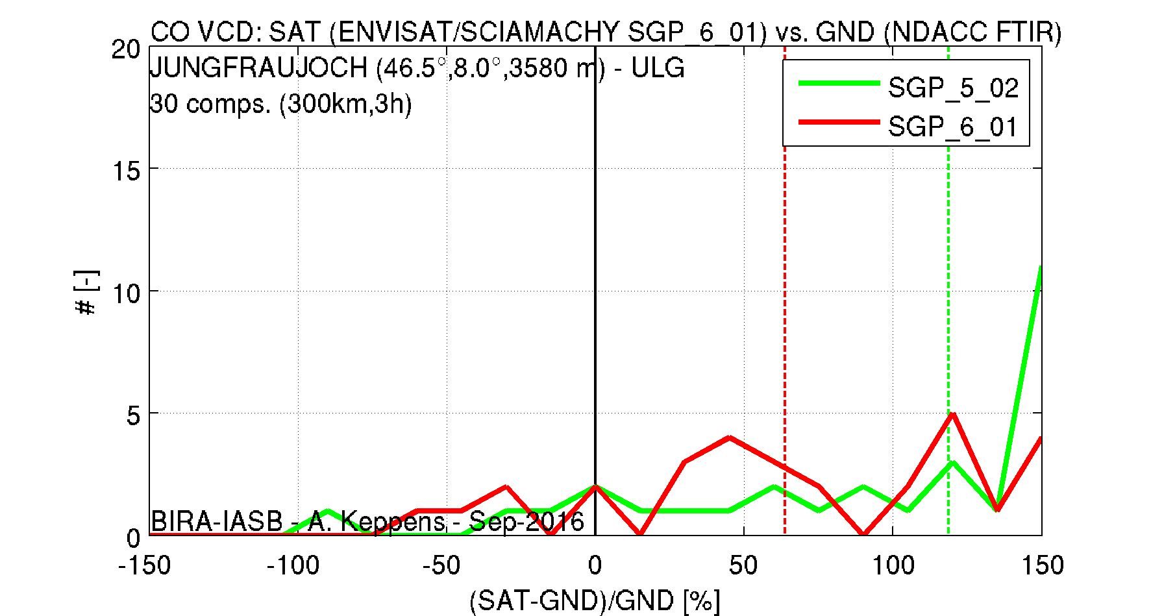
Data and plotting approach
yearly bias
yearly spread
full hist.

Slide 9
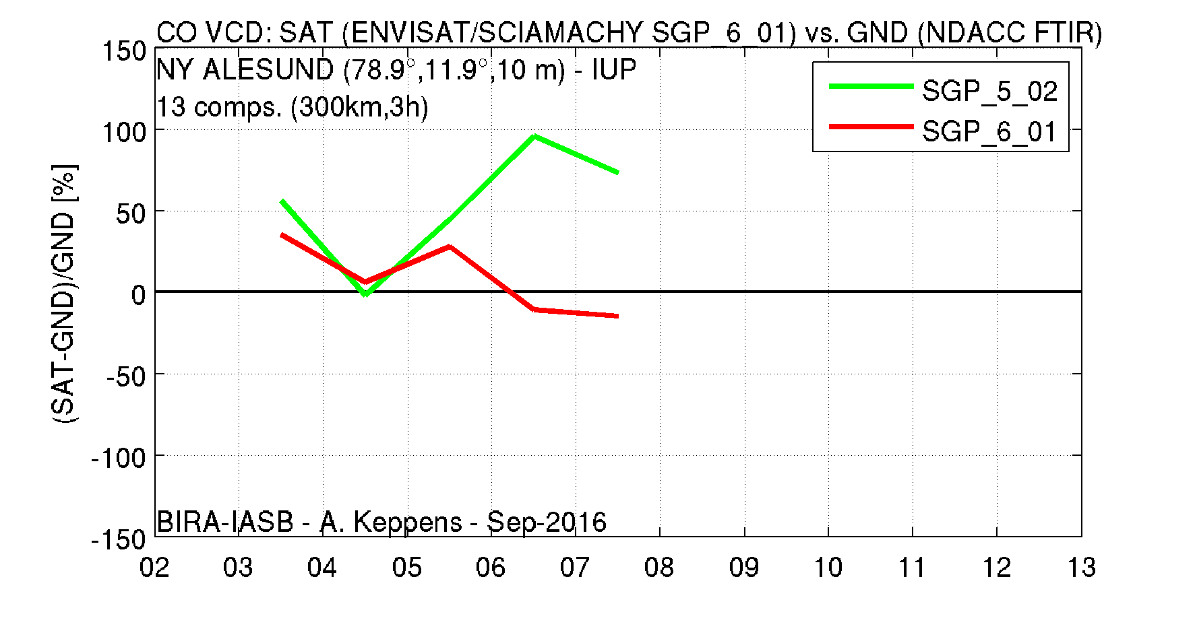
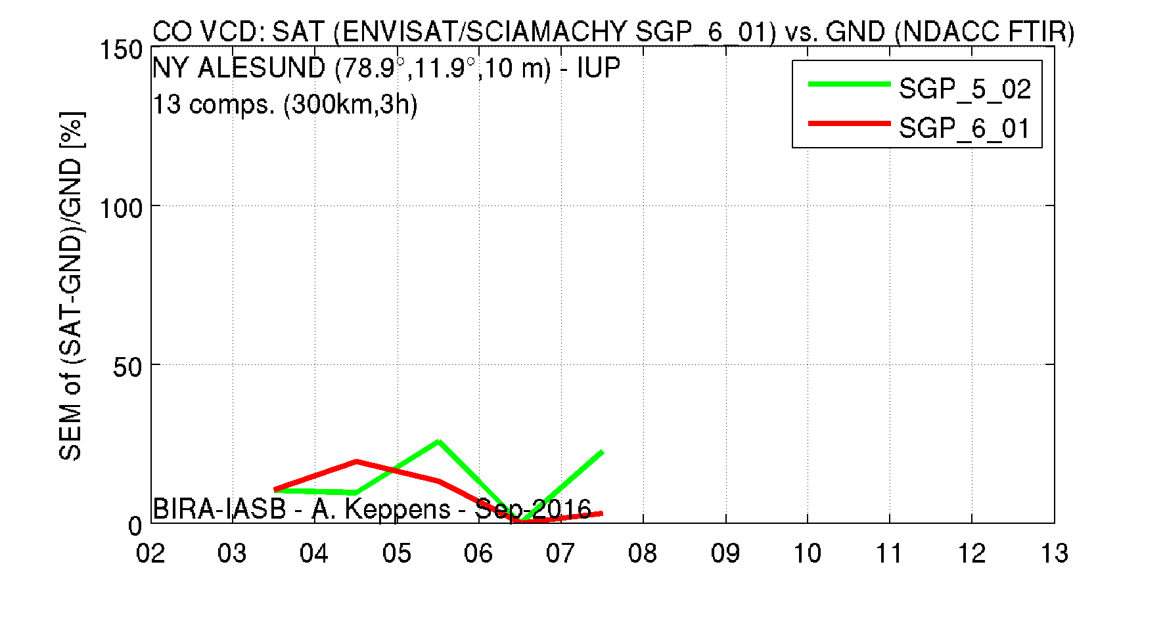
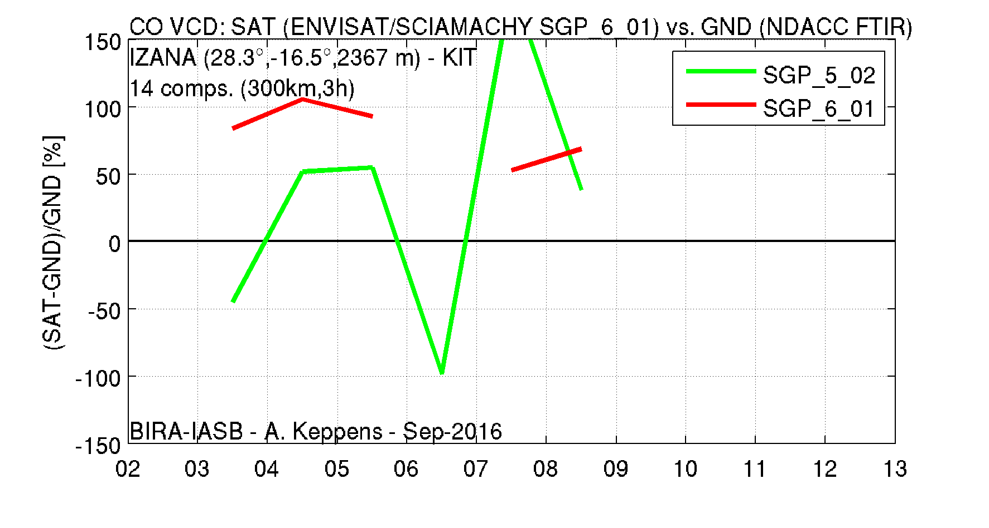
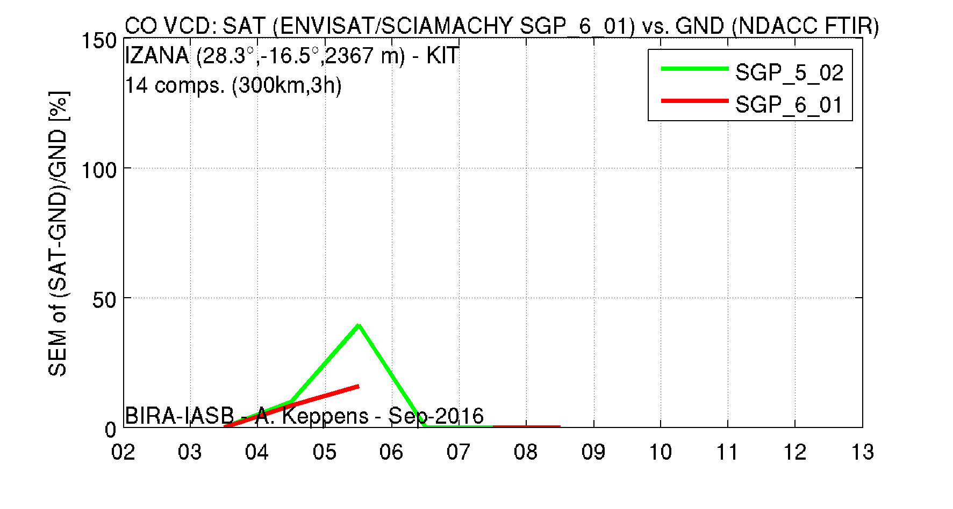
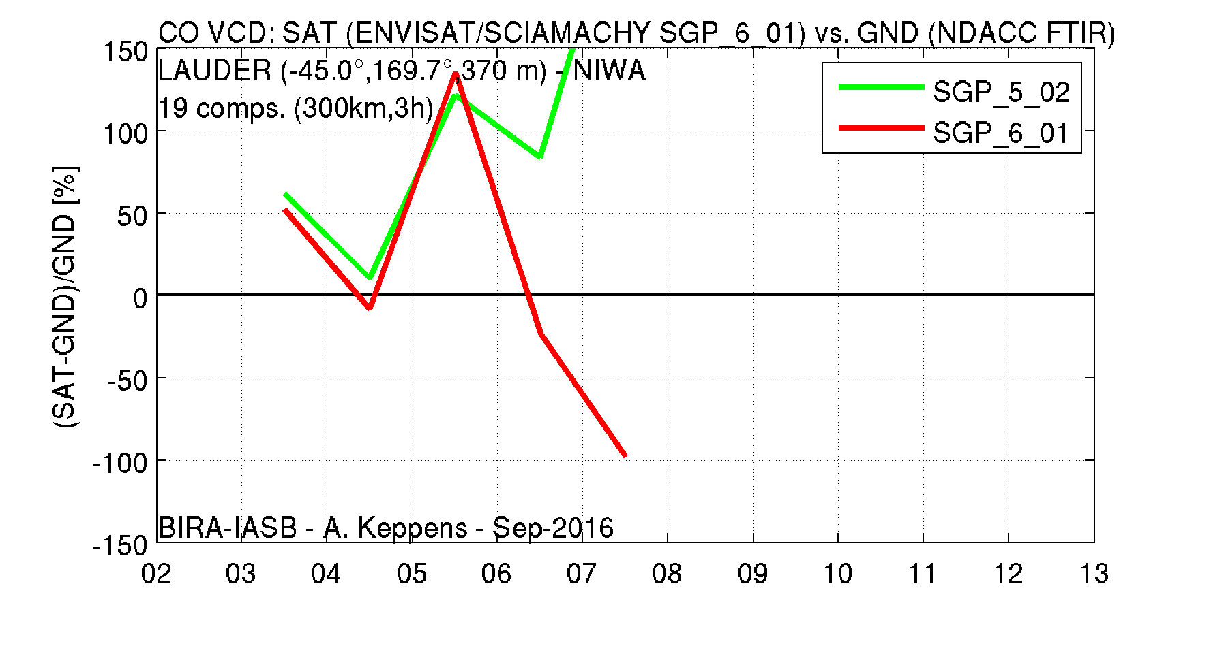
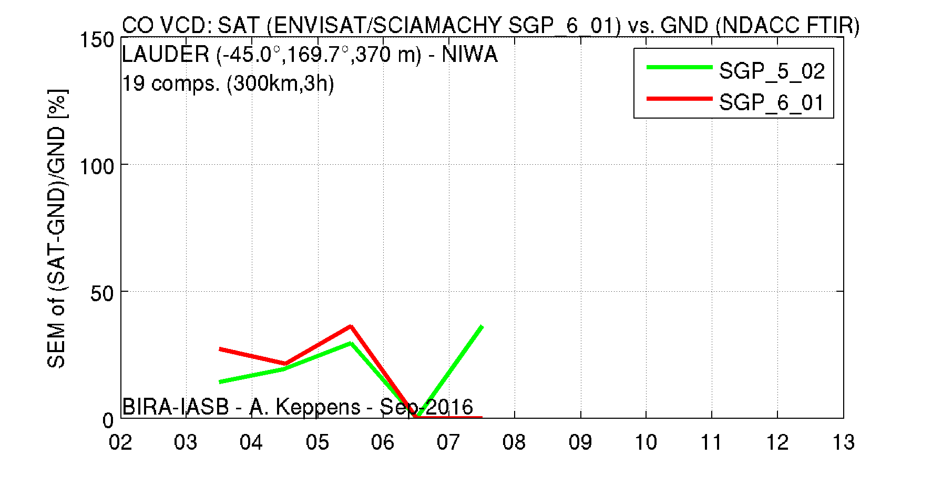
CO nadir col.

Slide 10
CO nadir column
Latitude band | # stations | # MM | Bias SGP V5 - FTIR | Bias SGP V6 - FTIR | Spread SGP V5 & V6
Arctic (60N-90N) | 5 | 32 | 31 % | 10 % | 20 %
Mid-north (30N-60N) | 4 | 174 | 71 % | 50 % | 24 %
Tropics (30N-30S) | 1 | 14 | 40 % | 90 % | 20-40 %
Mid-south (30S-60S) | 2 | 100 | 65 % | 33 % | 30 %
Antarctic (60S-90S) | 1 | 3 | 75 % | 30 % | 35 %
Yearly (and monthly) averaged CO columns strongly positively biased
Large amount of pos. and neg. outliers remains (even for monthly means…)
V5 bias typically significantly increases from 2006/2007 onwards
Yearly bias of V6 is reduced w.r.t. V5 bias from 2006 onwards
Overall V6 bias reduced, up to few 10 % per station
No clear differences in yearly spread between V5 and V6 (20-40 %)
No seasonal cycle, decadal trend or meridian dependence can be observed
Product remains inadequate in both precision and accuracy

Slide 11
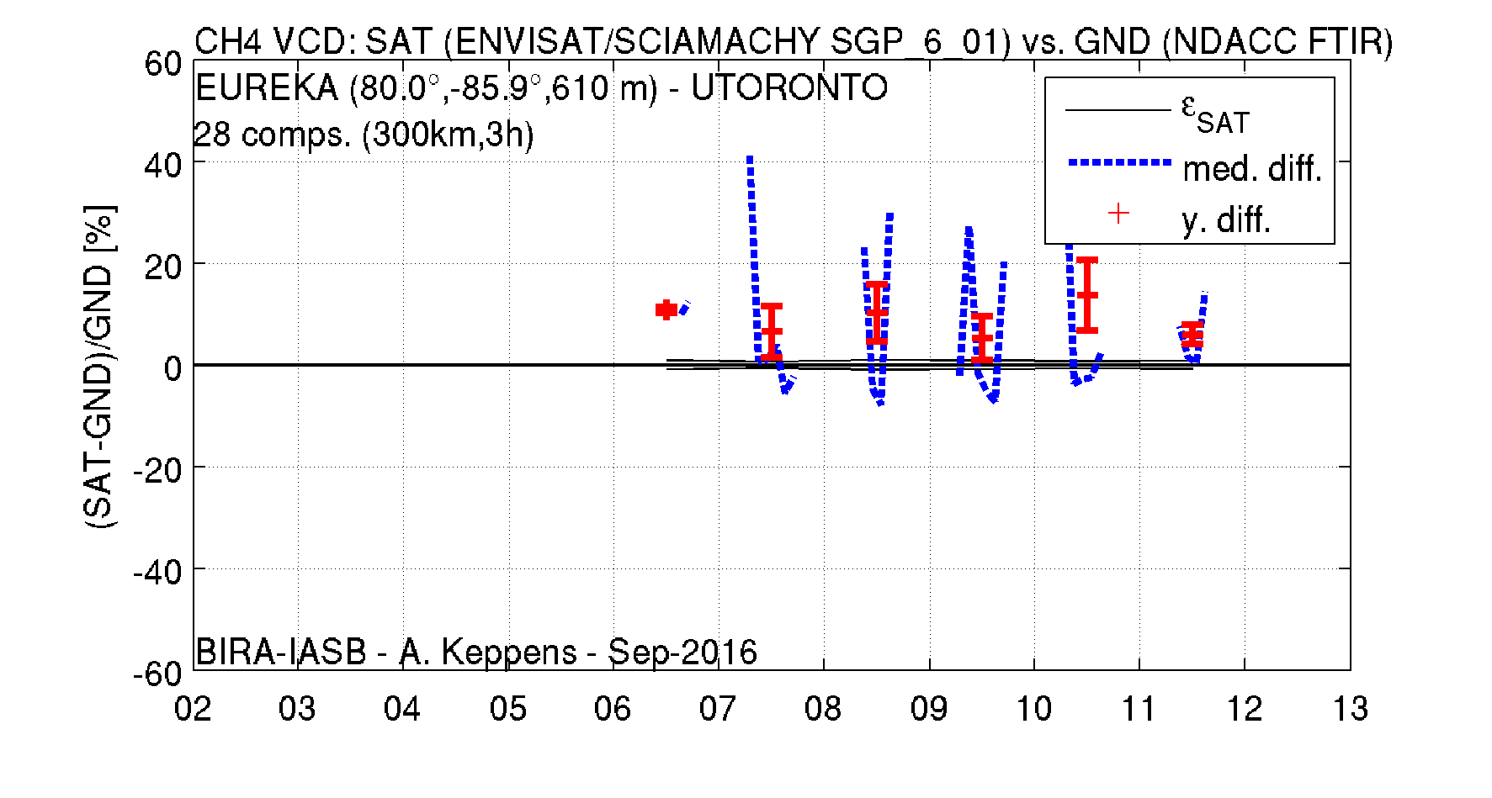
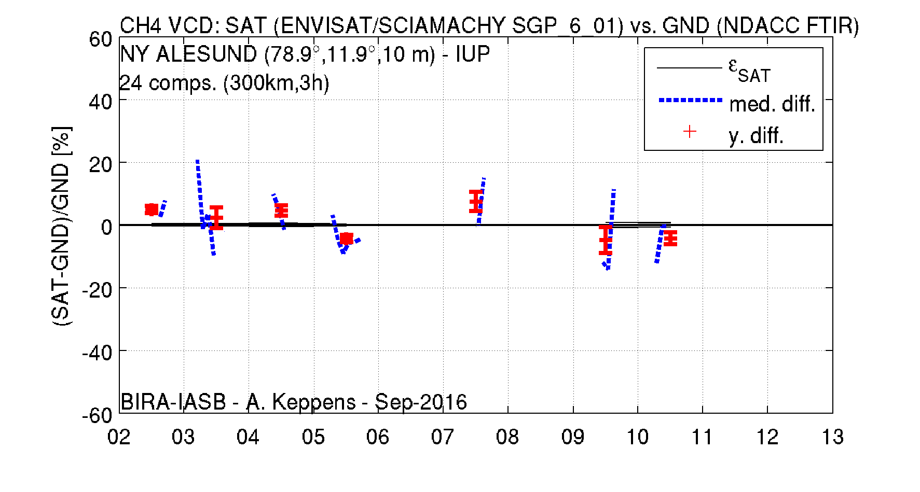
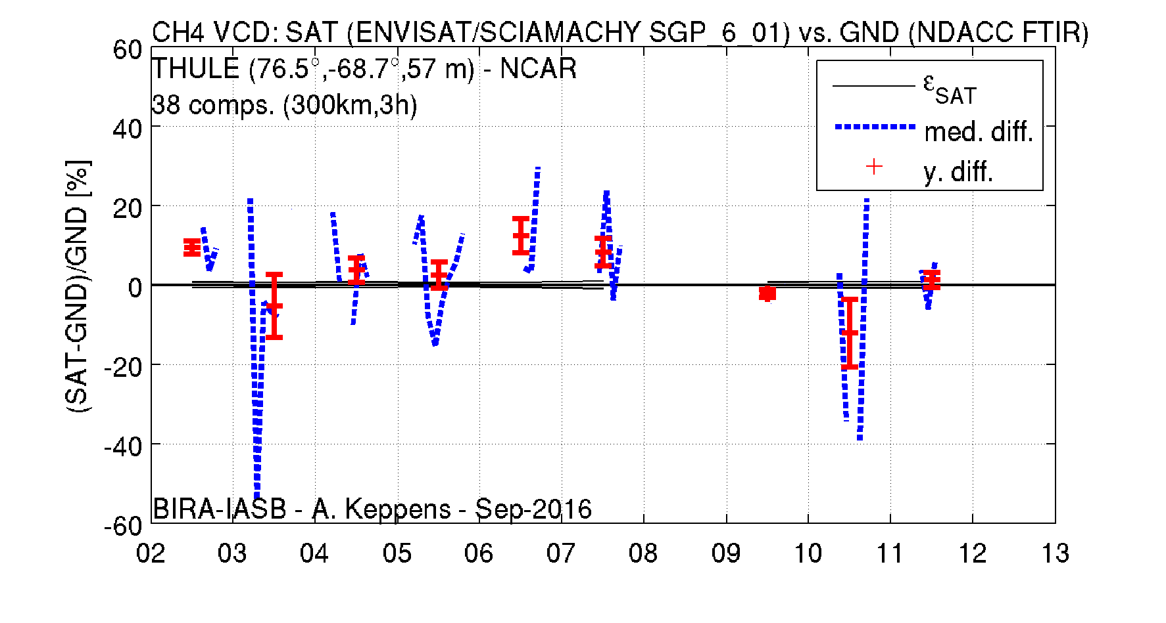
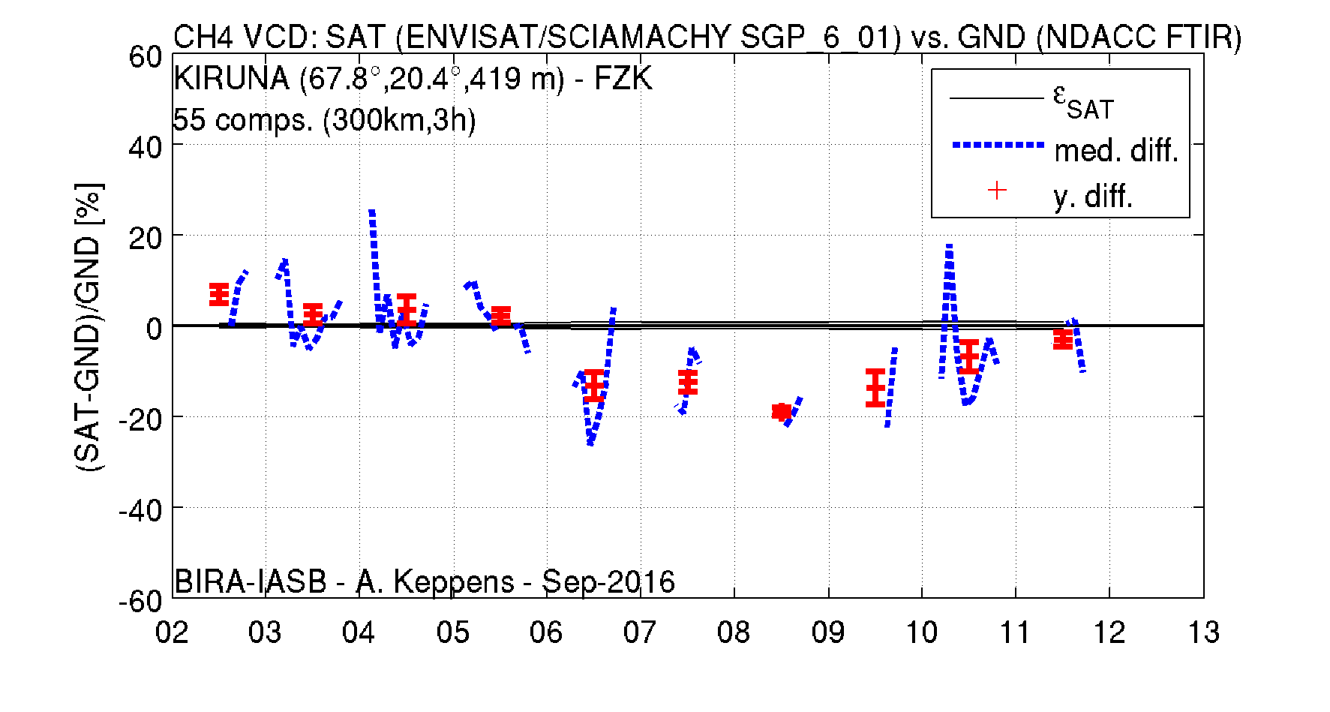
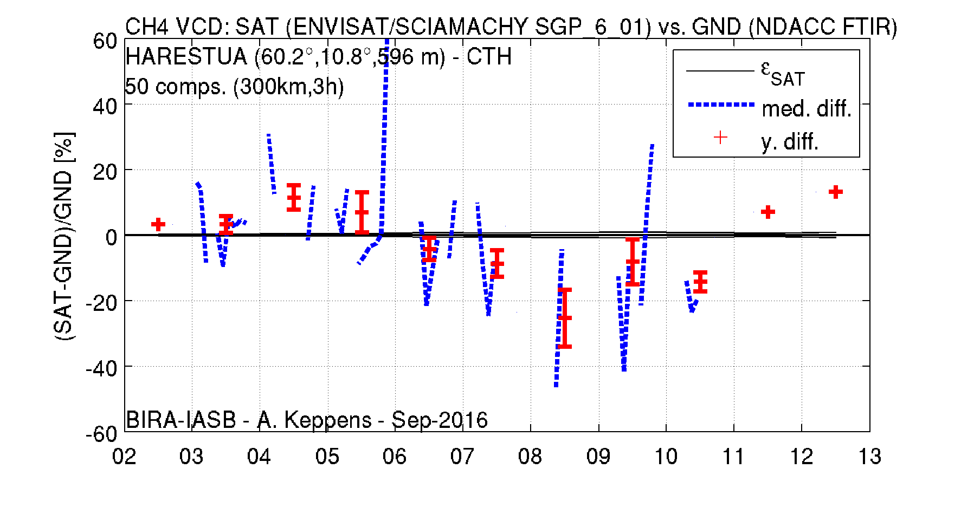
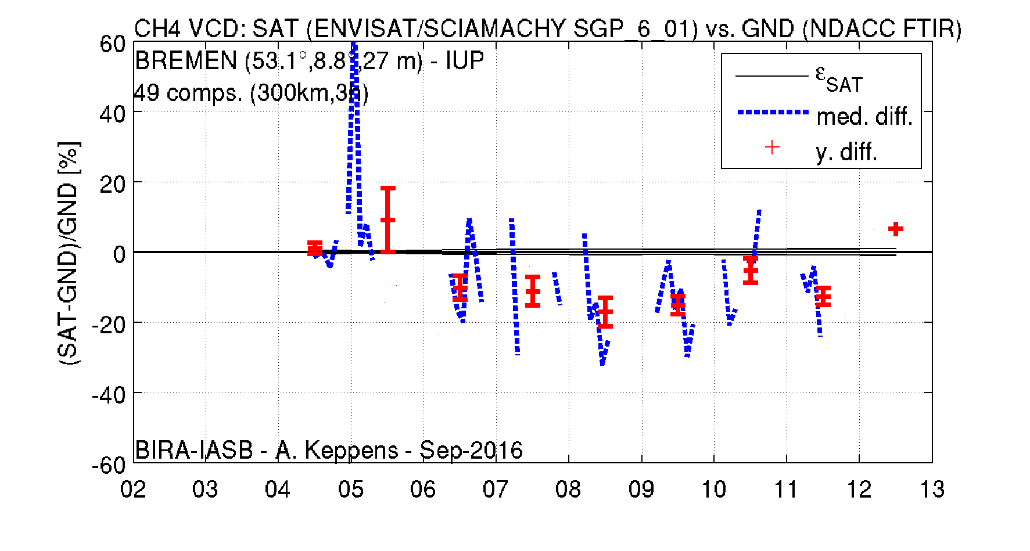
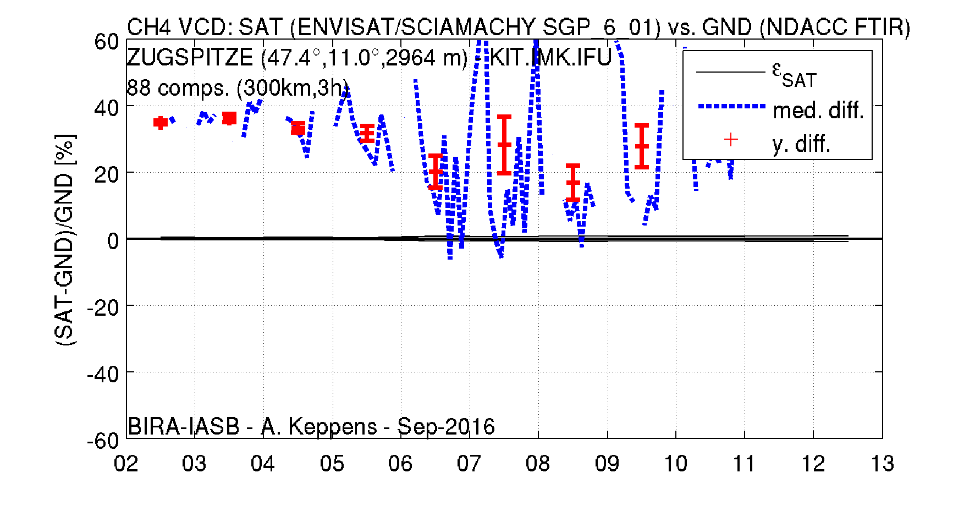
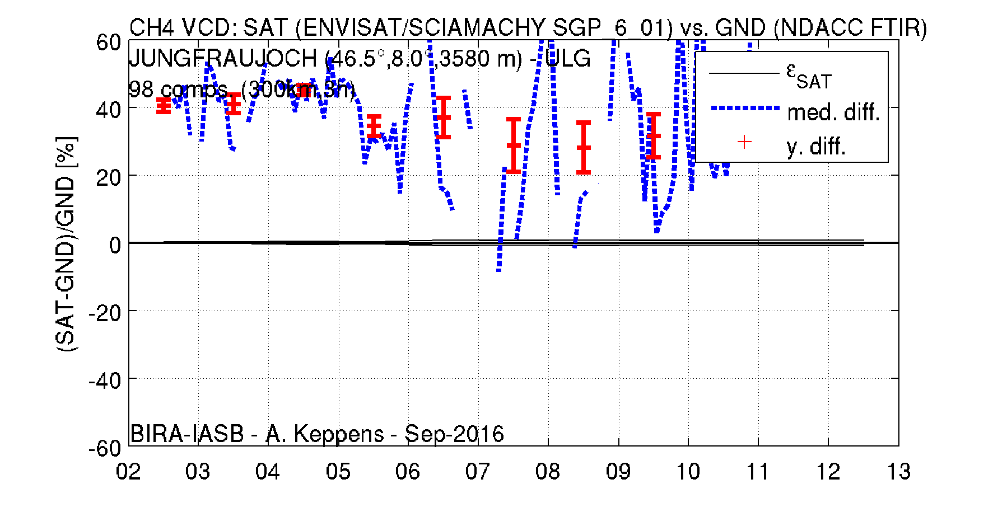
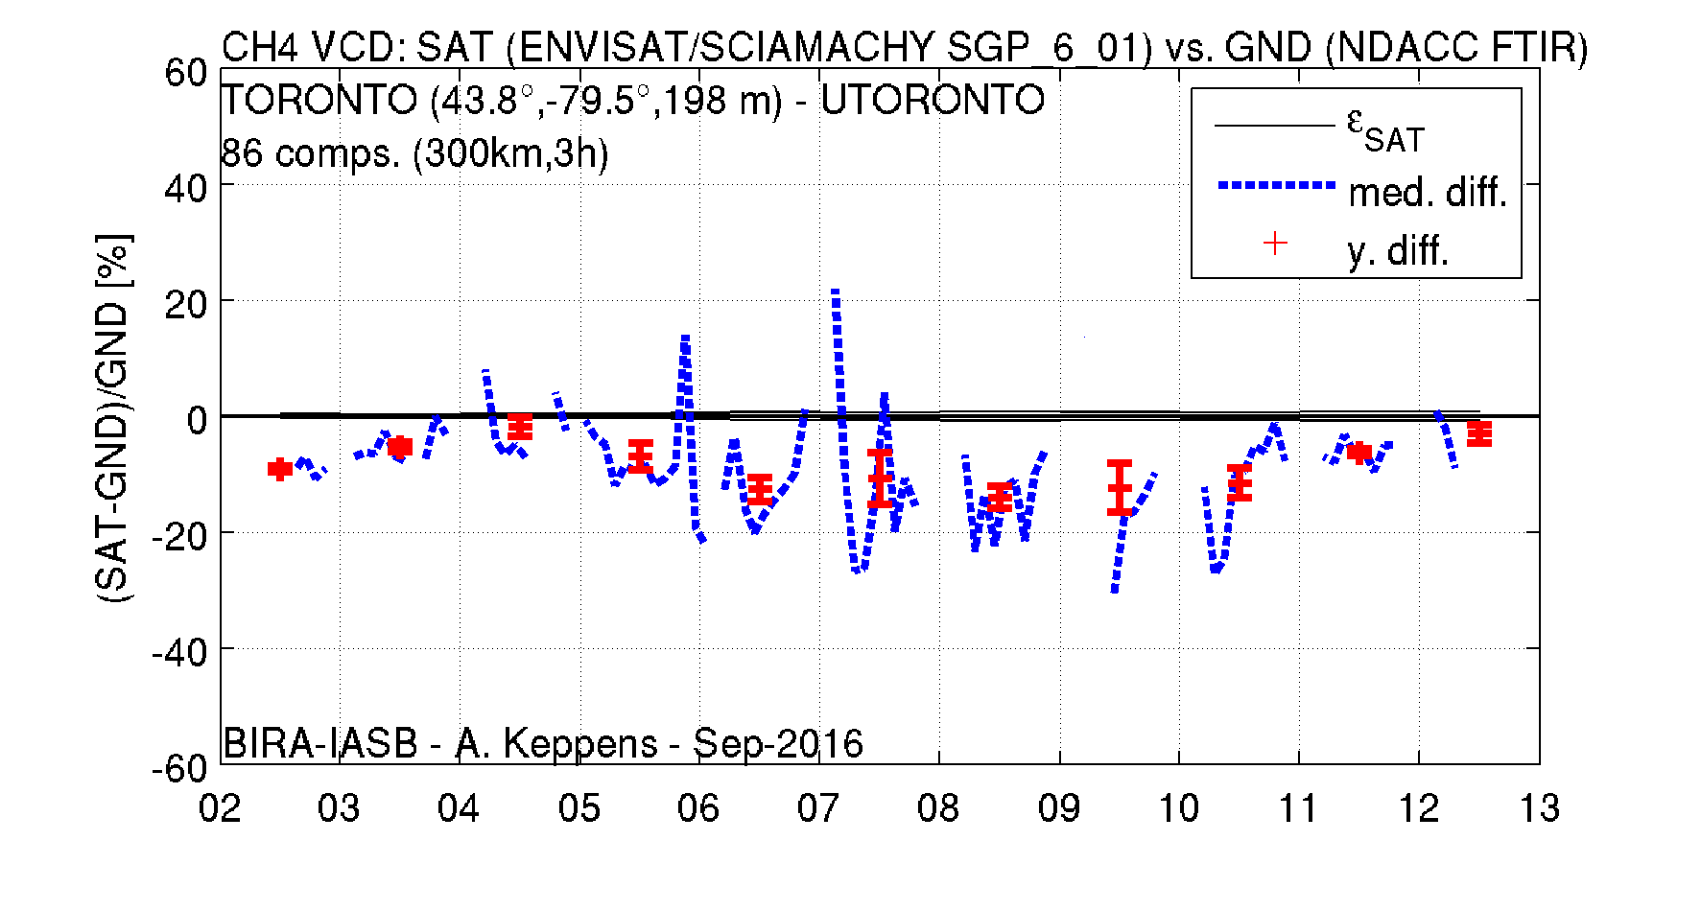
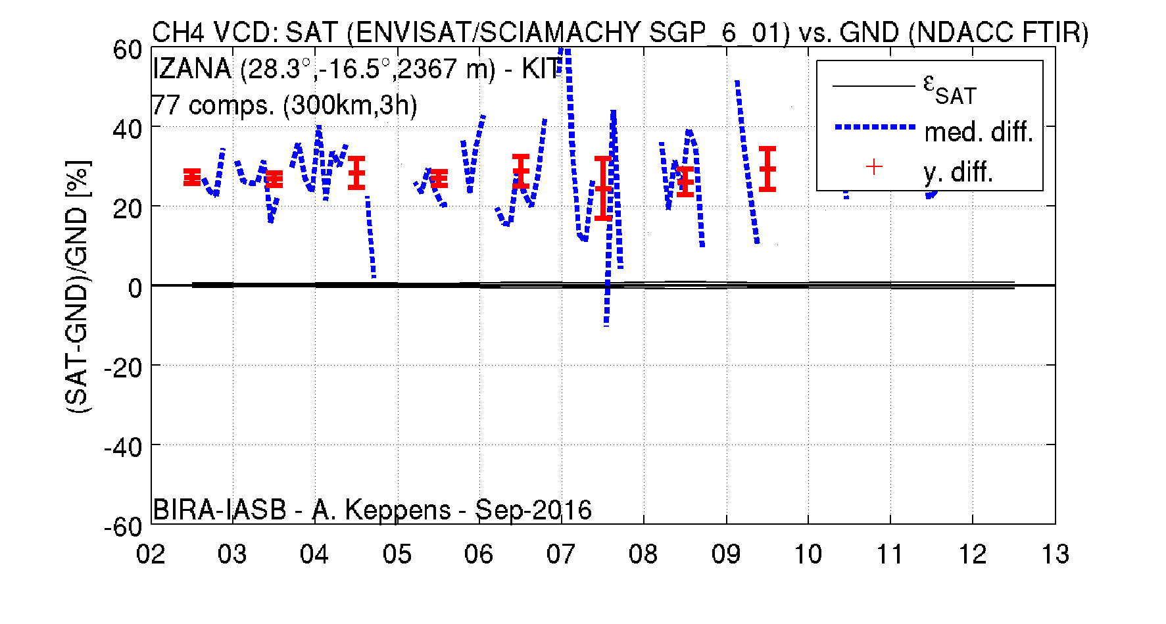
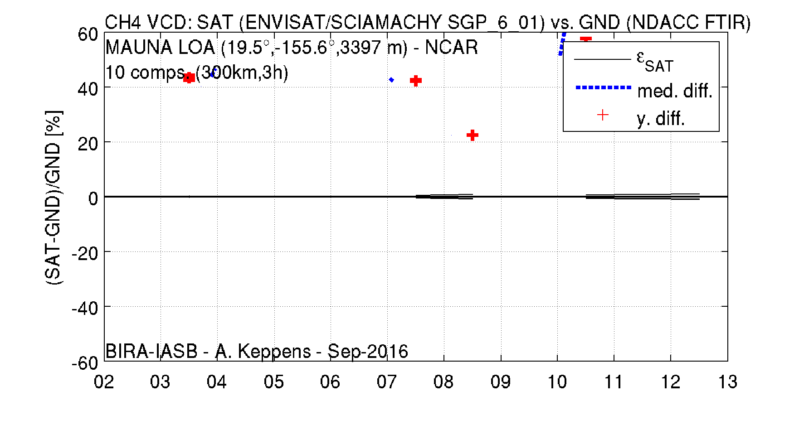
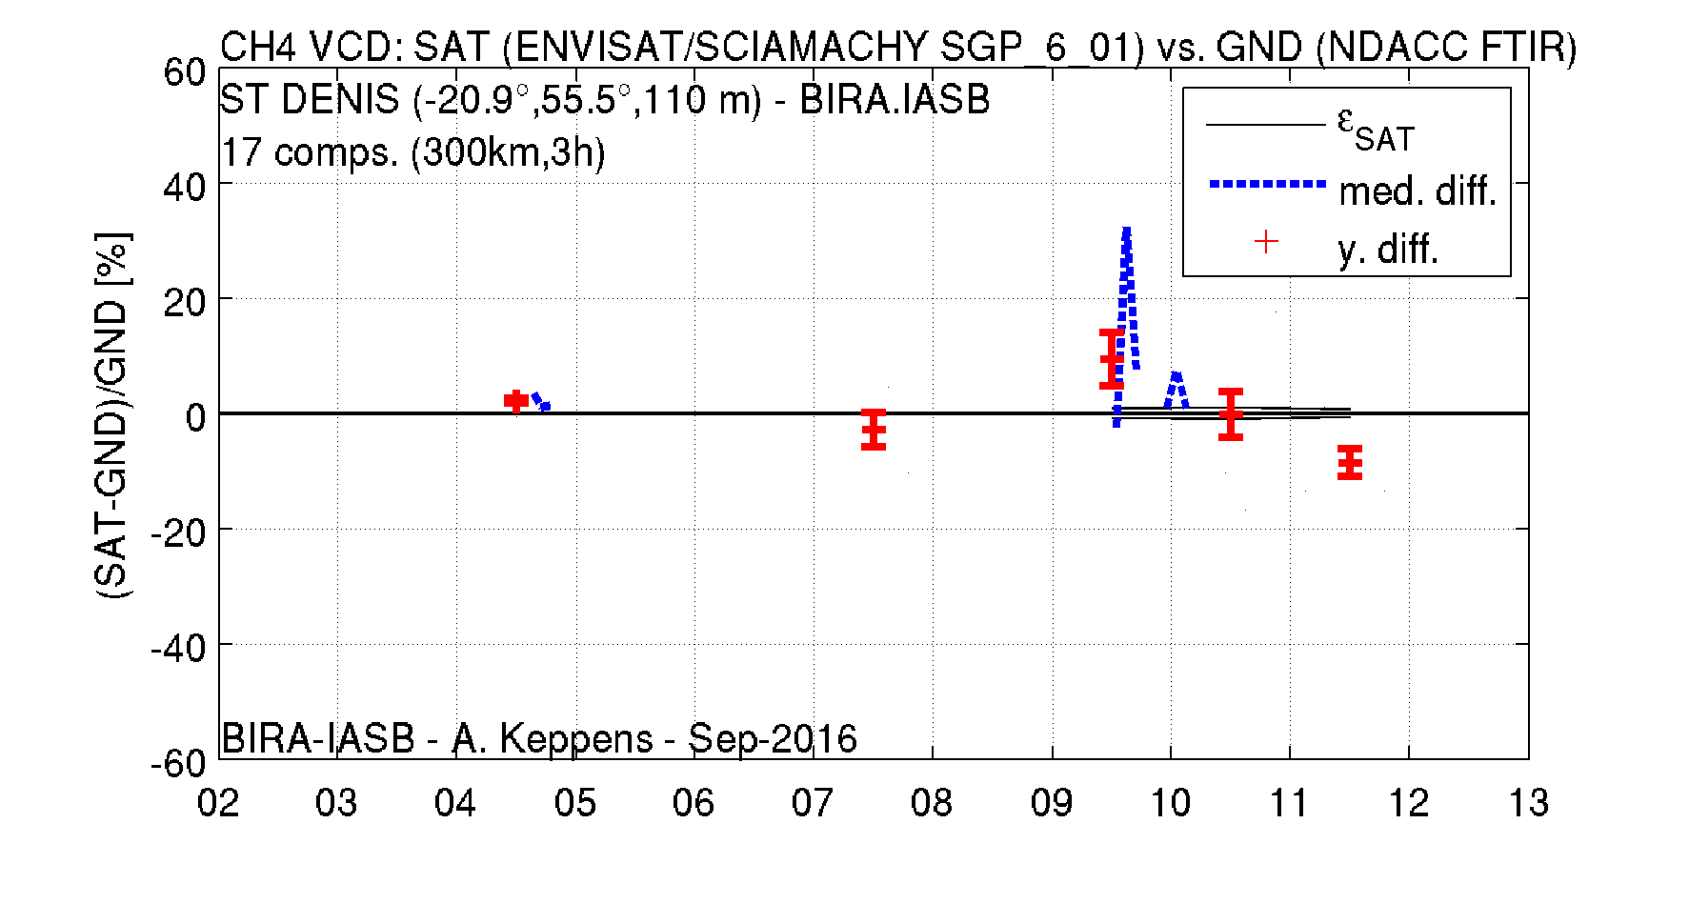
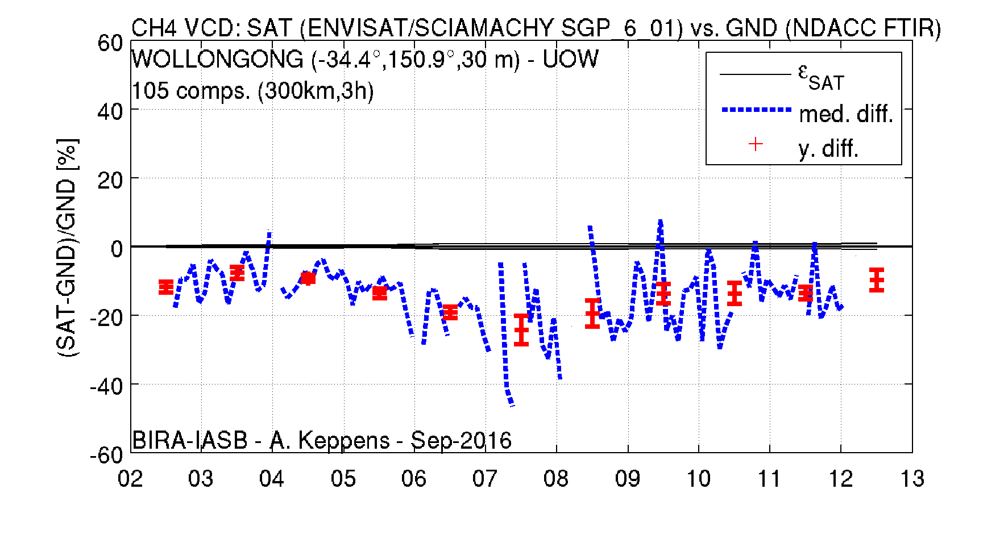
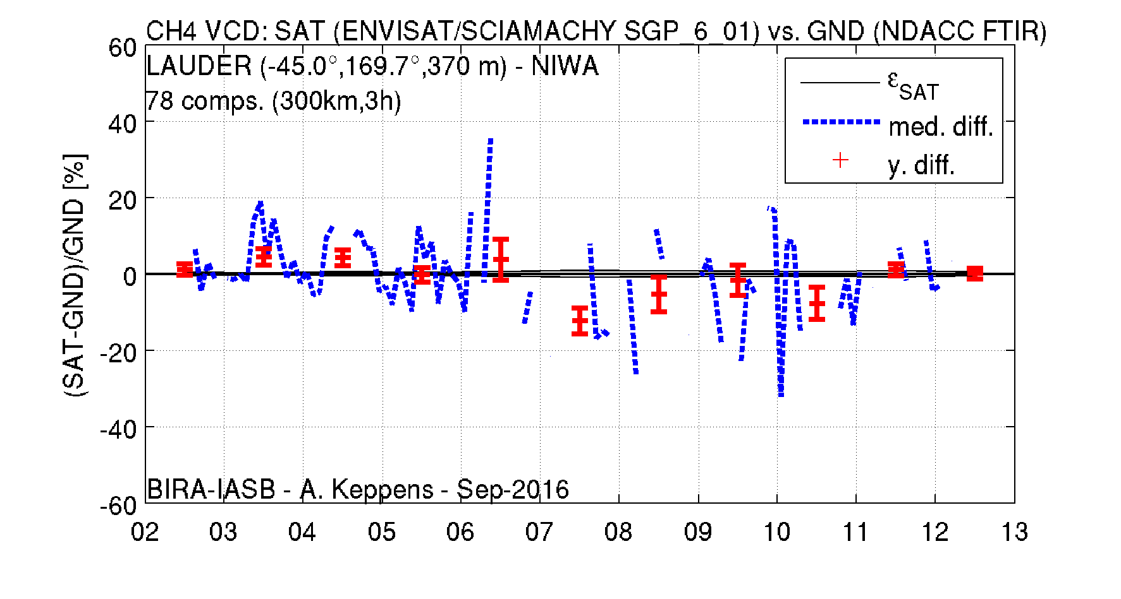
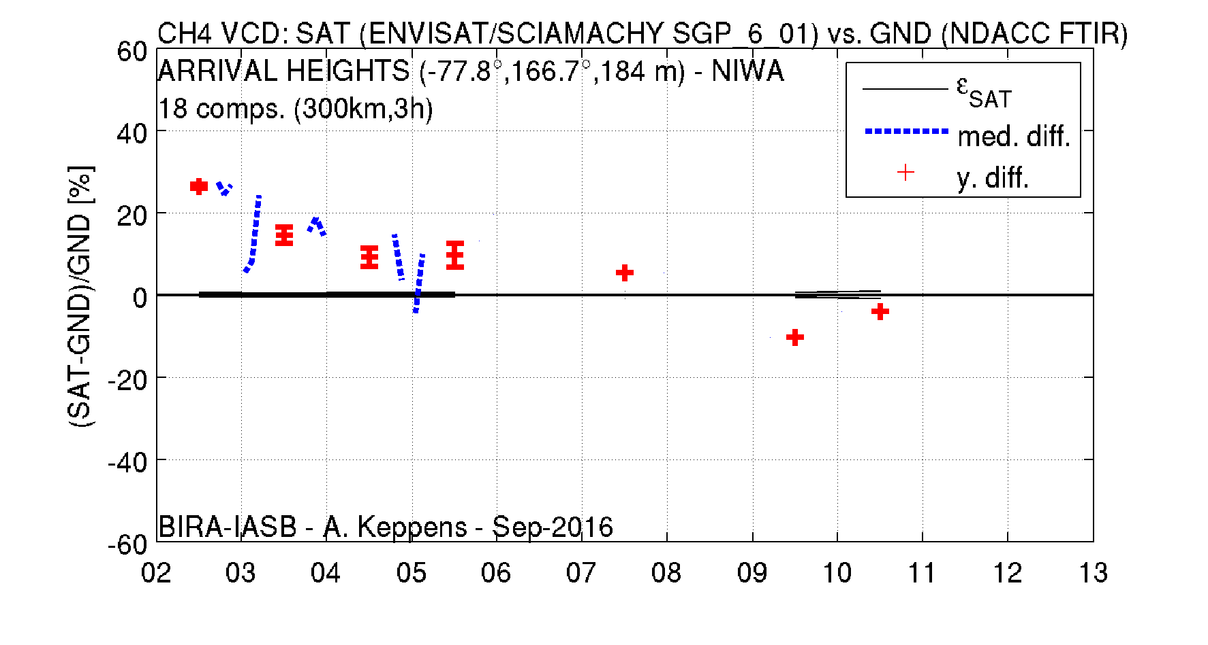
CH4 nadir column

Slide 12
CH4 nadir column
Latitude band | # stations | # MM | Bias SGP V6 - FTIR | Spread SGP V6
Arctic (60N-90N) | 5 | 195 | -1 % | 17 %
Mid-north (30N-60N) | 4 | 321 | 16 % | 20 %
Tropics (30N-30S) | 3 | 104 | 24 % | 17 %
Mid-south (30S-60S) | 2 | 183 | - 8 % | 15 %
Antarctic (60S-90S) | 1 | 18 | 15 % | 20 %
Promising first results…
Yearly biases often insignificant and within random uncertainty
Yet strong and significant seasonal cycle (up to 30 %)
Apparent 3th order trend at (almost) all stations
Stronger bias (overall significant) in Tropics

Slide 13
H2O nadir column Methodology
Pre-processing of radiosonde data
47 stations (attached to ozonesonde, many RS92, but also other models)
Convert relative humidity to VMR
Integrate profile between surface and 10 km
Co-location
Closest SCIA pixel to sonde launch, must be within <50km and <1h
Land pixel pairs (54%) : 5094 cloudy + 571 cloud-free (CF = 0)
Ocean pixel pairs (46%) : 4694 cloudy + 221 cloud-free
Compute median statistics of ΔX = X_{SCIA} – X_{GND} (g cm⁻²)

Slide 14
H2O nadir column Results
Overall very similar quality for SGP 5.02 and 6.01
But: cloud-classification differs → different pixel class-dependent quality indicators
V6 data is generally too dry compared to sonde (by ~0.05 g cm⁻² or 7%), except for cloud-free land pixels where it is too wet (by 0.12 g cm⁻² or 13%).
Increasingly negative bias for AMF correction factor <1.1, especially for cloudy pixels.
Bias & comparison spread vary with season, smallest in local spring.
Bias changes sign around CF=0.15 and around SZA=35°.
SGP 5.02 / 6.01 versus radiosonde |  | Co-located pixels | Median bias |  | Comparison spread
 |  |  | (g cm⁻²) | (%) | (g cm⁻²) | (%)
Land | CF=0 | 1153 / 571 | +0.23 / +0.12 | +20 / +13 | 0.31 / 0.23 | 25 / 23
 | CF>0 | 4403 / 5094 | -0.06 / -0.03 | -9 / -5 | 0.33 / 0.36 | 28 / 29
Ocean | CF=0 | 429 / 221 | -0.06 / -0.01 | -6 / -2 | 0.28 / 0.16 | 17 / 18
 | CF>0 | 4452 / 4694 | -0.07 / -0.08 | -12 / -13 | 0.29 / 0.29 | 31 / 30
All | All | 10437 / 10580 | -0.04 / -0.04 | -6 / -7 | 0.32 / 0.32 | 30 / 29

Slide 15
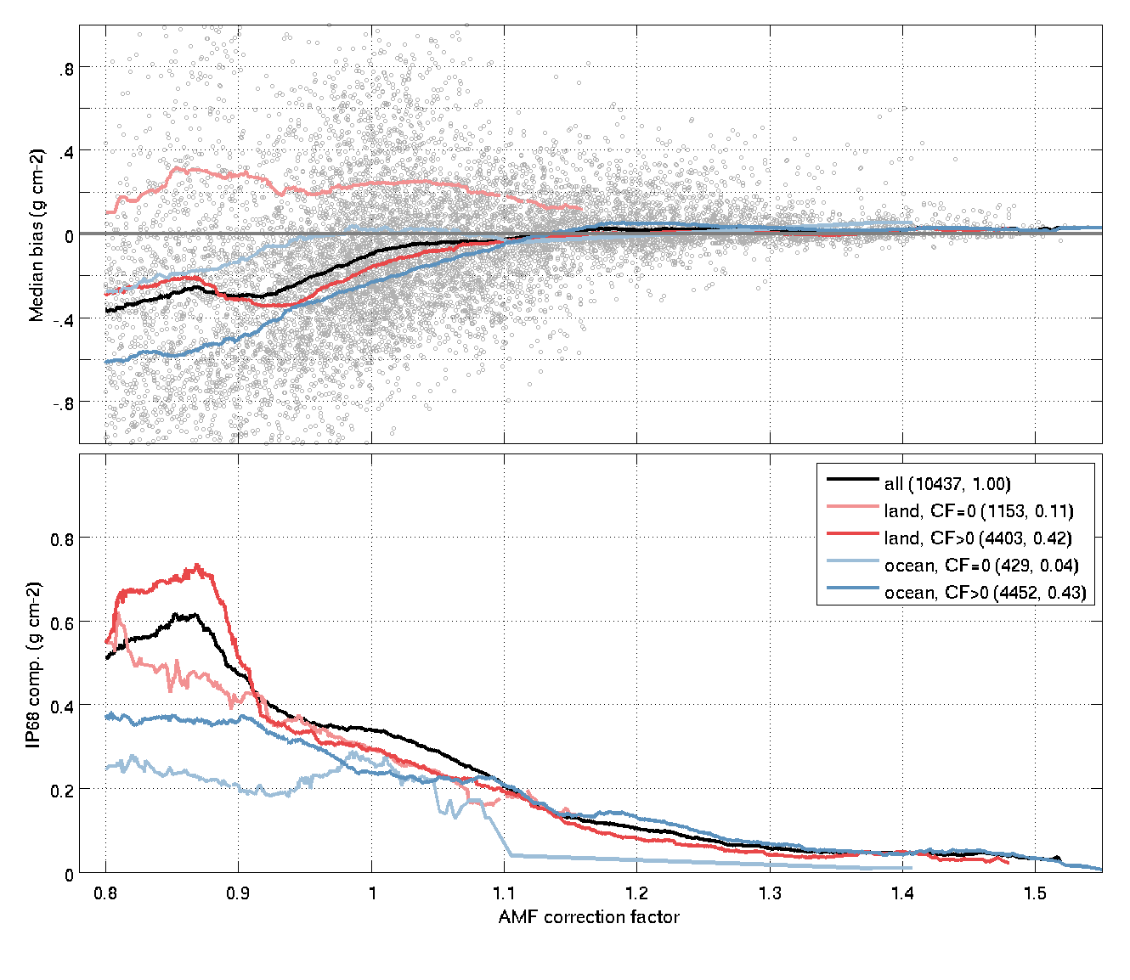
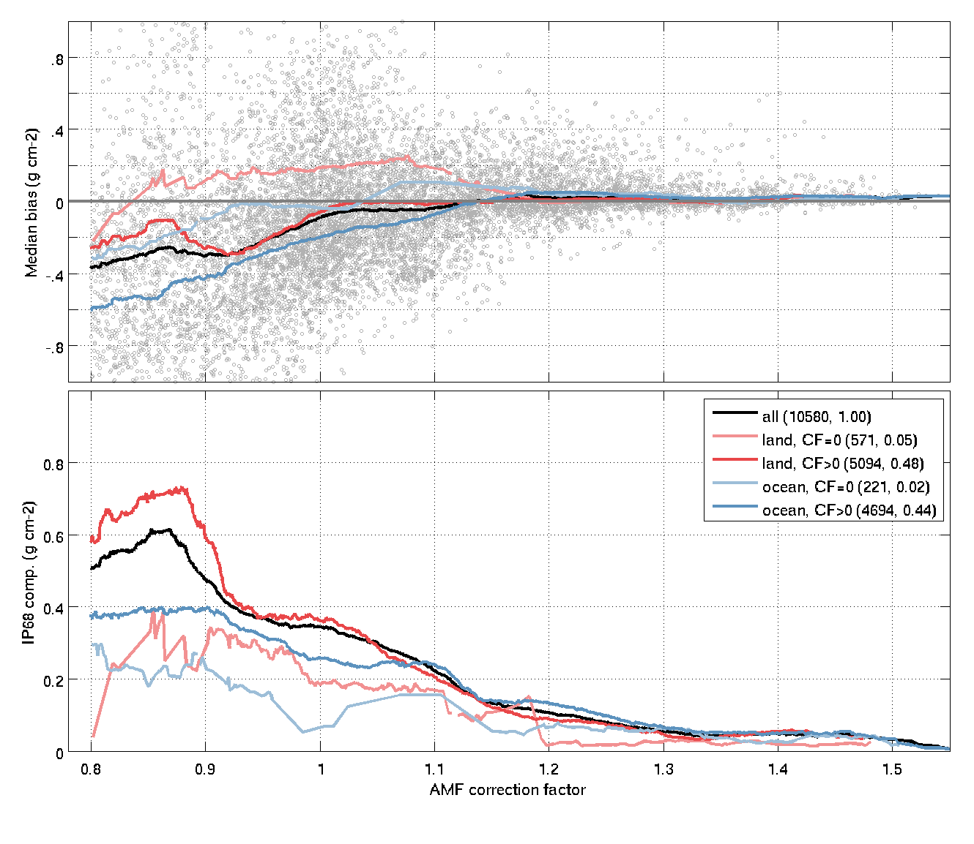
H2O nadir column AMF correction factor
SGP 5.02 full mission
SGP 6.01 full mission
Bias & comparison spread degrade for AMF CF < 1.1, especially for cloudy pixels
No overall changes between SGP V5.02 and V6.01

Slide 16
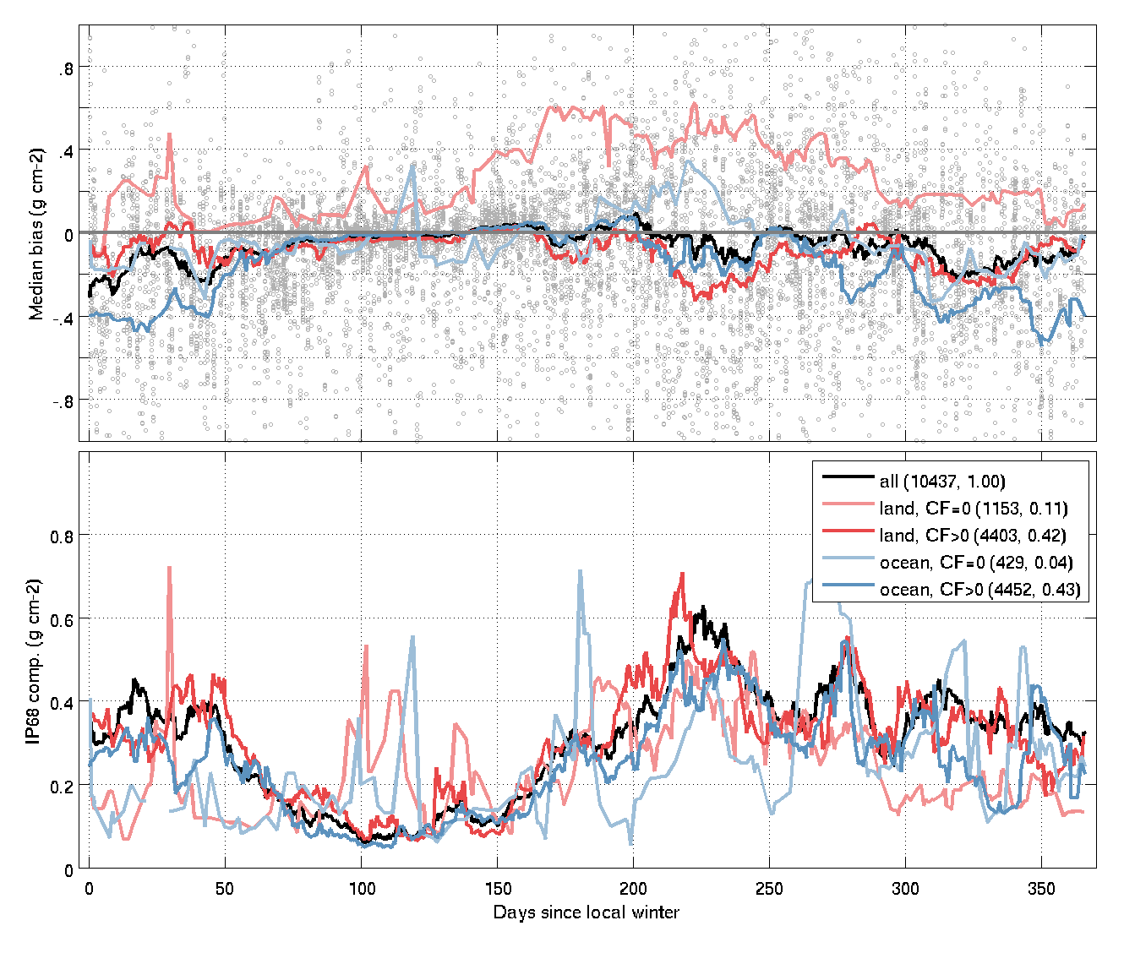
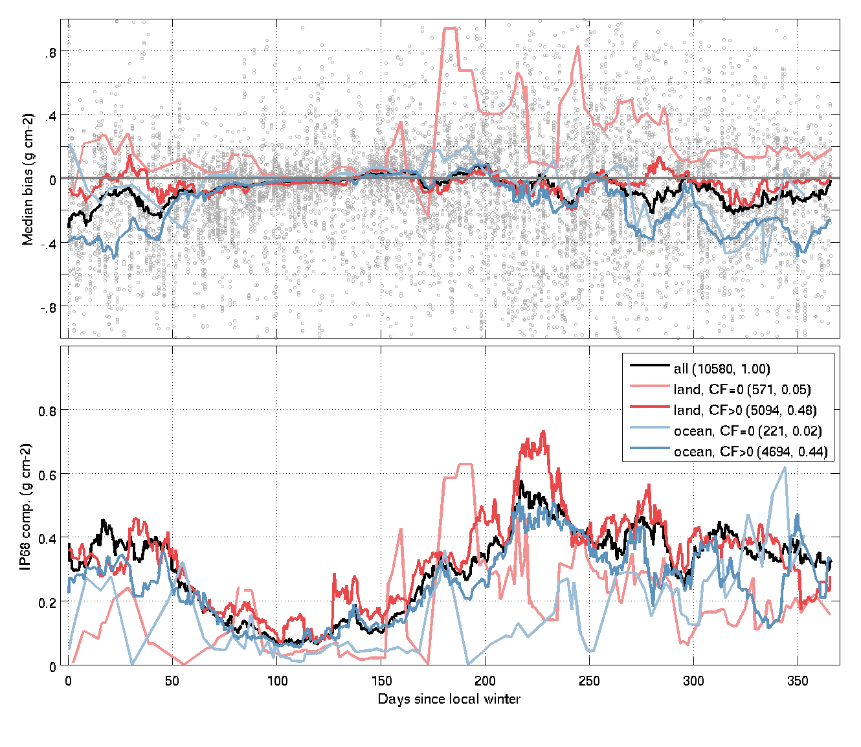
H2O nadir column Days since local winter
SGP 5.02 full mission
SGP 6.01 full mission
Bias & comparison spread lowest in spring, most noisy in summer

Slide 17
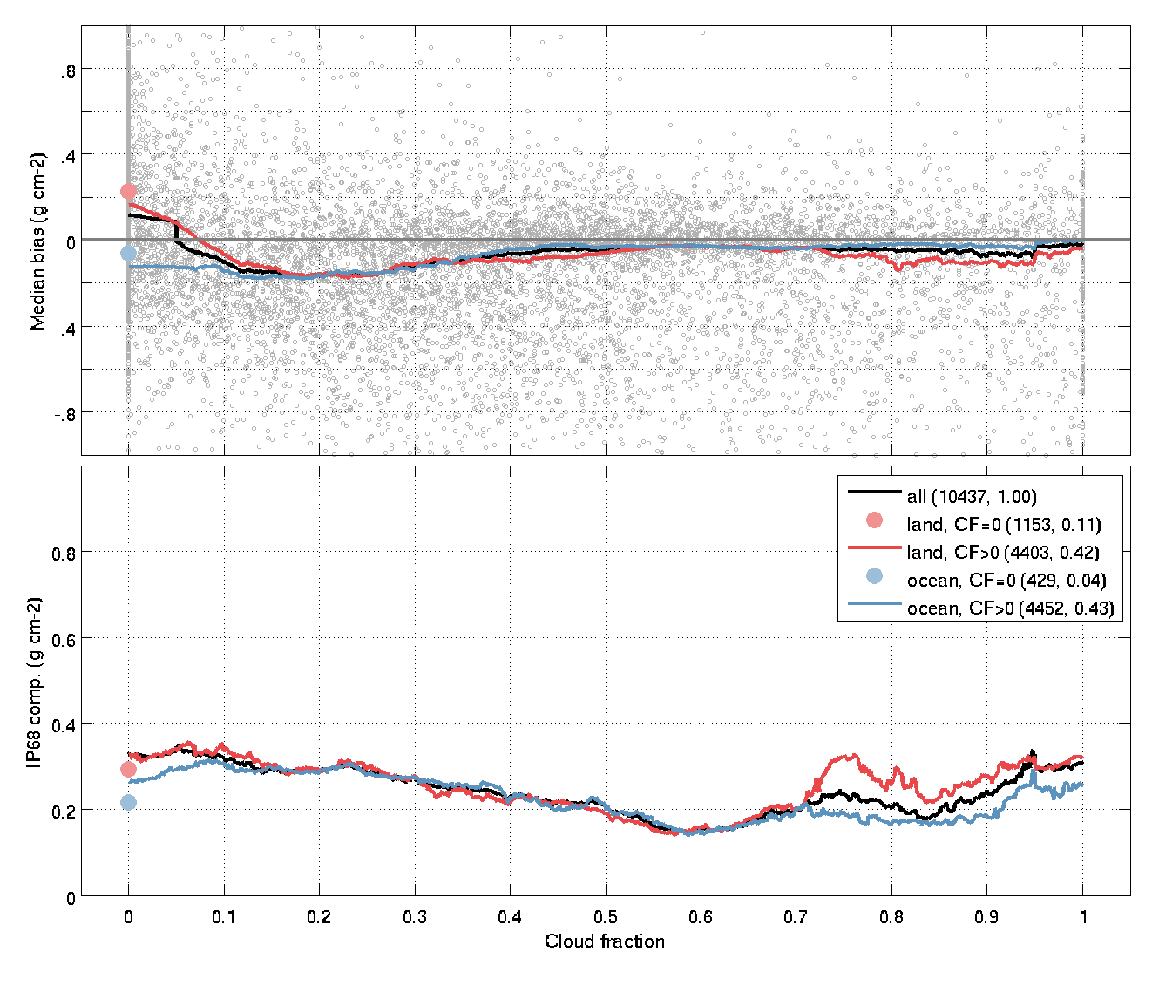
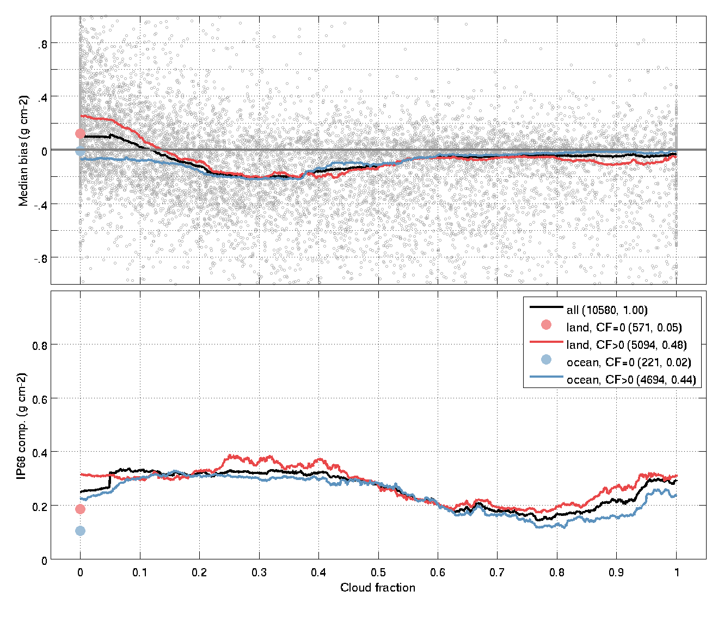
H2O nadir column Cloud fraction
SGP 5.02 full mission
SGP 6.01 full mission
Land pixels too wet for no/light cloud cover
Ocean pixels (slightly) less biased & noisy

Slide 18
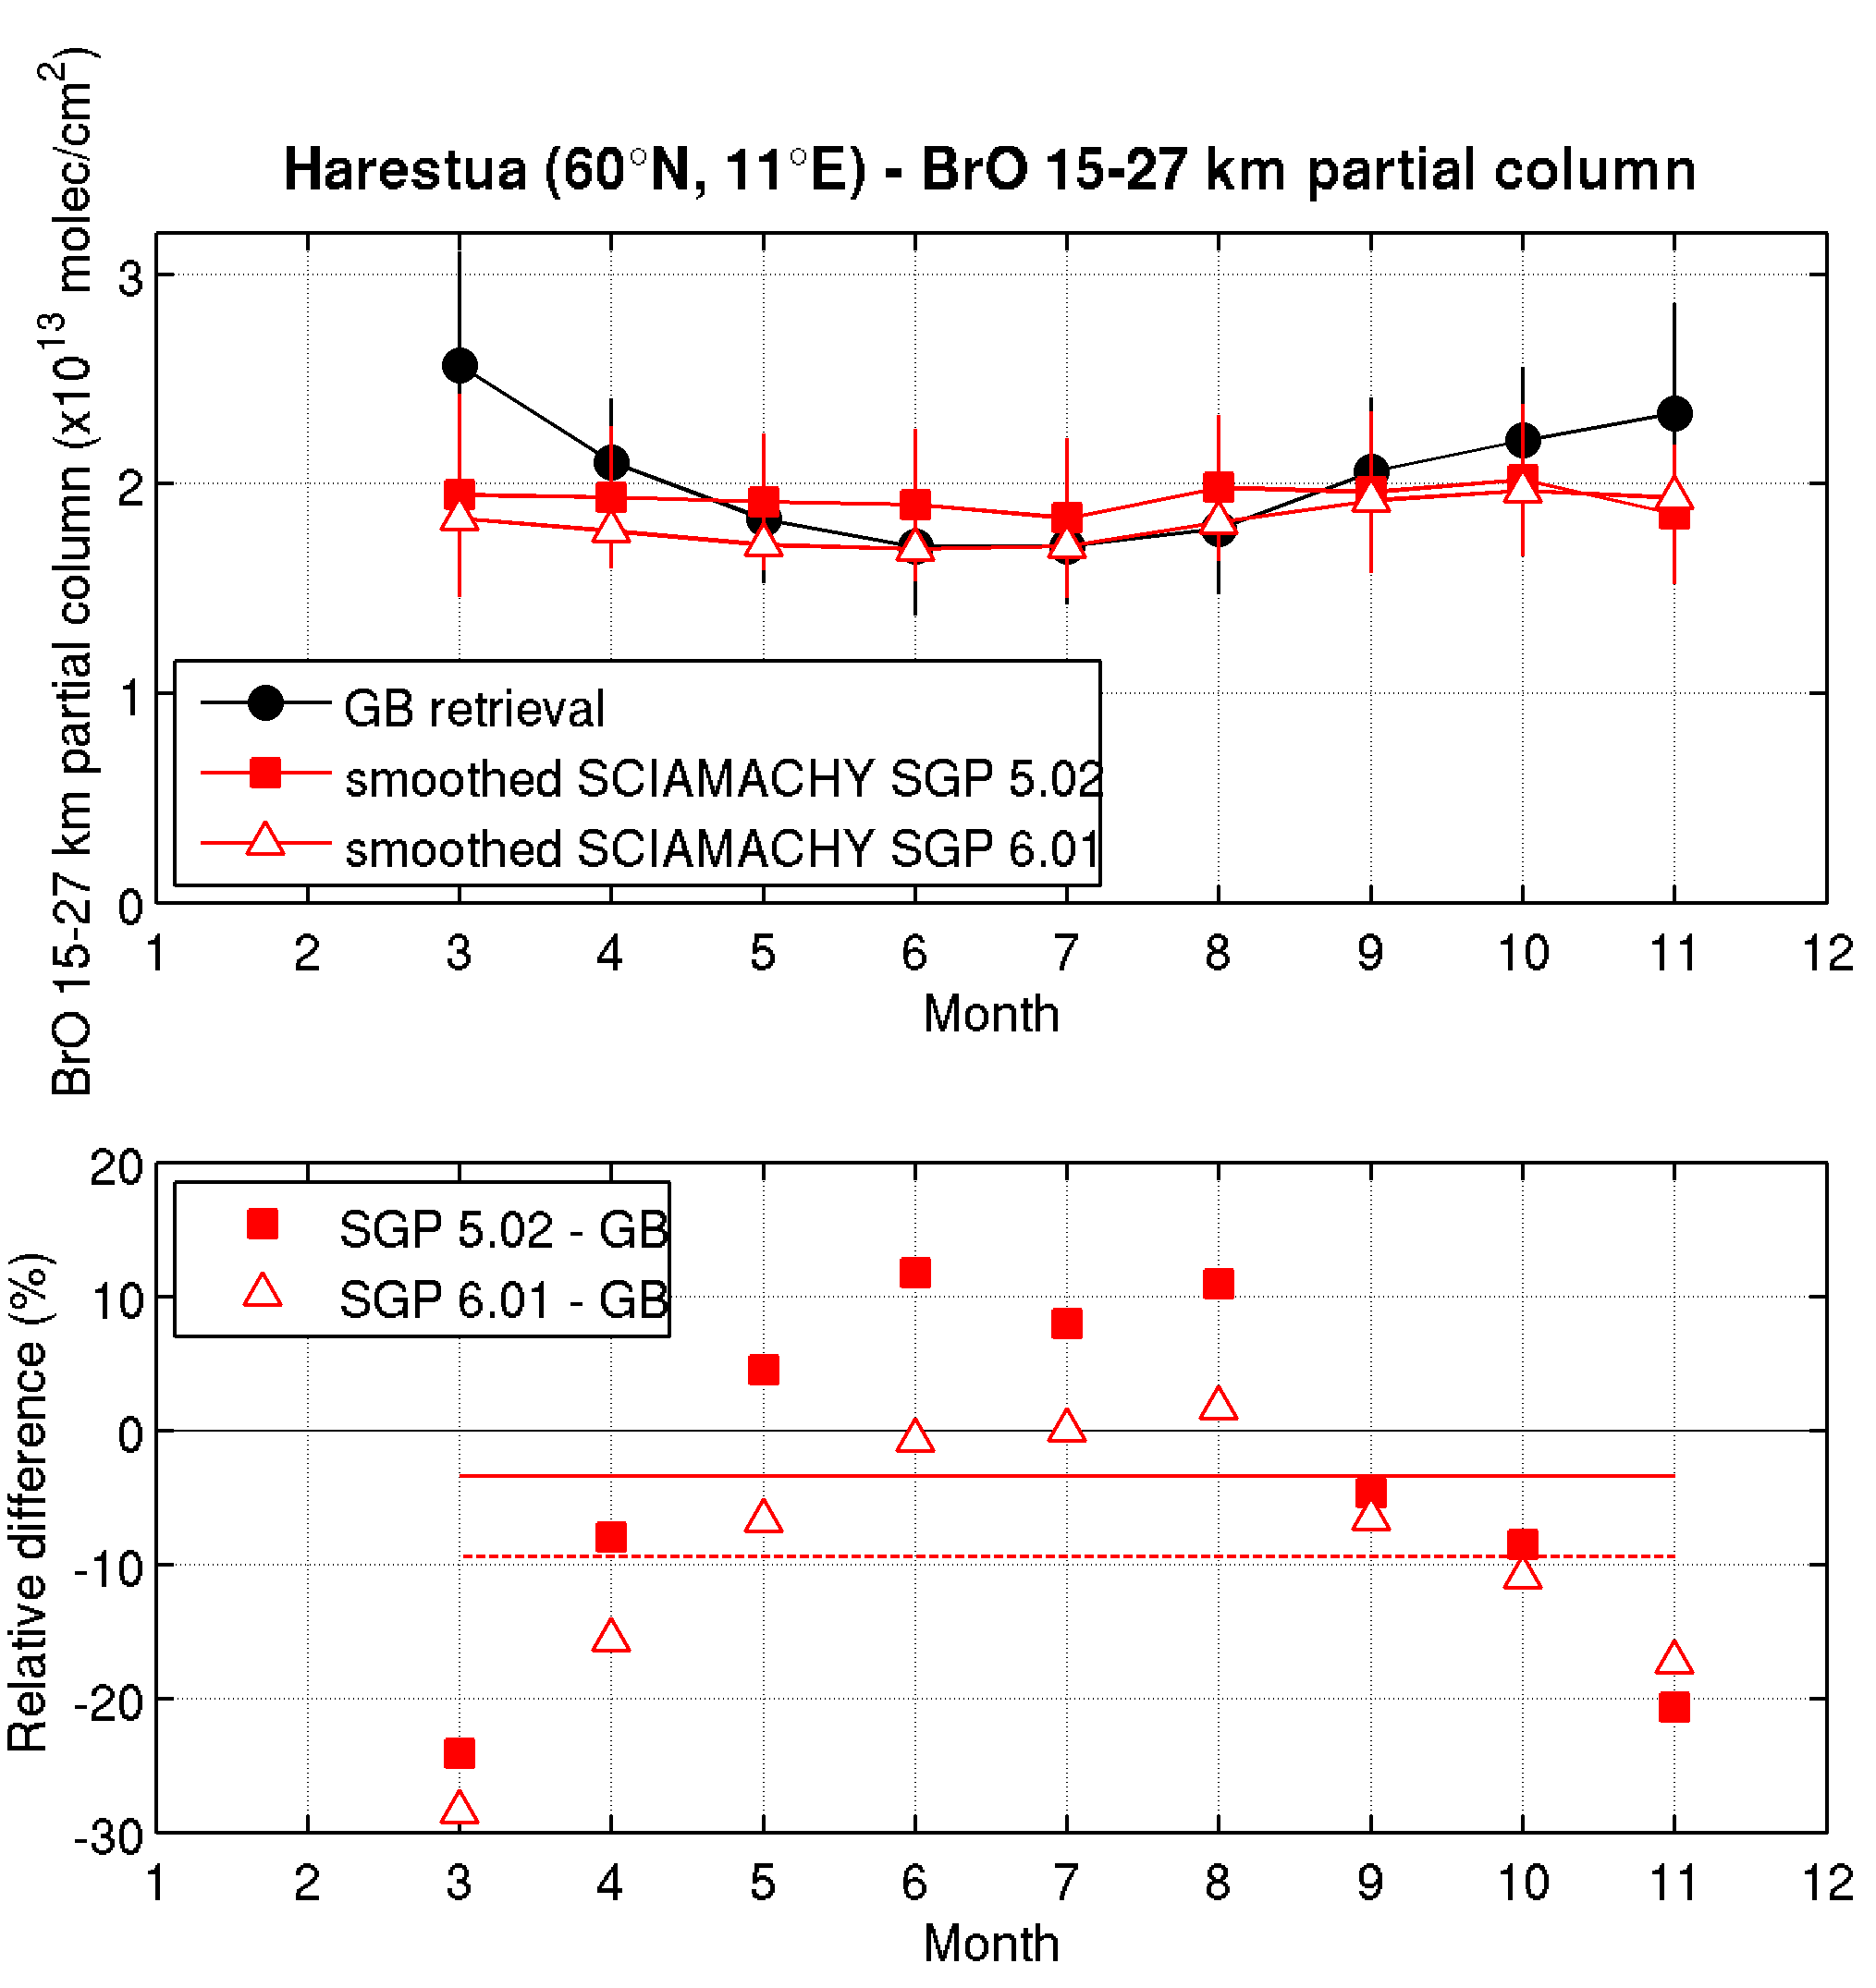
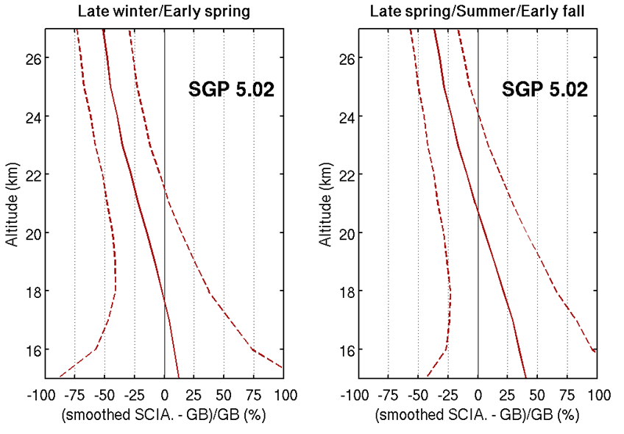
BrO limb profile at Harestua (60°N)
Better agreement between GB and SGP6.01 than with SGP5.02 below ~18km
Spread is also lower for SGP6.01 in this altitude range
Biases are significantly higher than those obtained for the IUP-Bremen scientific product at the same station (+10/-20%), see Hendrick et al. (2009)
Bias larger for SGP6.01 (-9.4±9.6%) than for 5.02 (-3.5±13.4%) but this difference is not significant
V5 and V6 do not capture the seasonality seen in the ground-based partial columns
This seasonality is well captured by the IUP-Bremen scientific product (Hendrick et al., 2009)

Slide 19
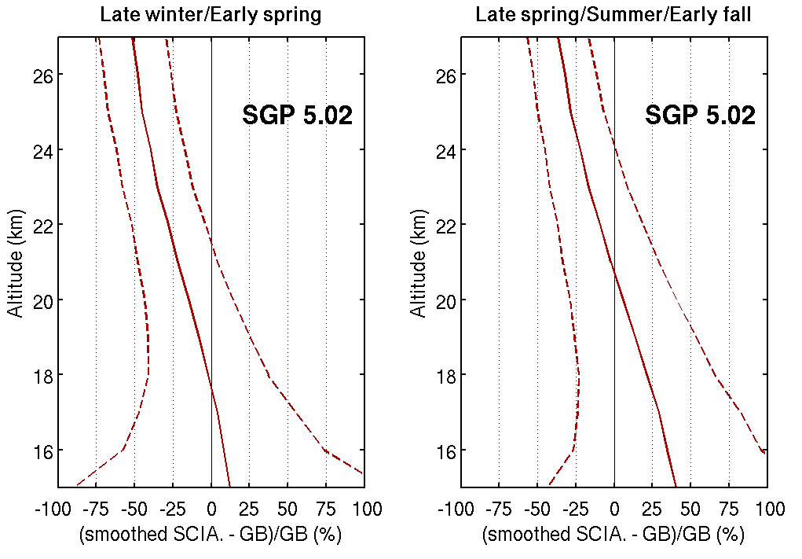
BrO limb profile at Harestua (60°N)
Better agreement between GB and SGP6.01 than with SGP5.02 below ~18km
Spread is also lower for SGP6.01 in this altitude range
Biases are significantly higher than those obtained for the IUP-Bremen scientific product at the same station (+10/-20%), see Hendrick et al. (2009)
Bias larger for SGP6.01 (-9.4±9.6%) than for 5.02 (-3.5±13.4%) but this difference is not significant
V5 and V6 do not capture the seasonality seen in the ground-based partial columns
This seasonality is well captured by the IUP-Bremen scientific product (Hendrick et al., 2009)

Slide 20
O3 limb profile bias
MWR
Mauna Loa
Lauder
V6 mostly smaller (~3-5%) than V5, though differs by latitude & altitude
But, similar bias in mesosphere despite inclusion of UV-band?
Lidar
Sonde

Slide 21
O3 limb profile comparison spread
MWR
Mauna Loa
Lauder
V6 less noisy than V5 in US, elsewhere very similar
But, similar spread in mesosphere despite inclusion of UV-band?
Lidar
Sonde

Slide 22
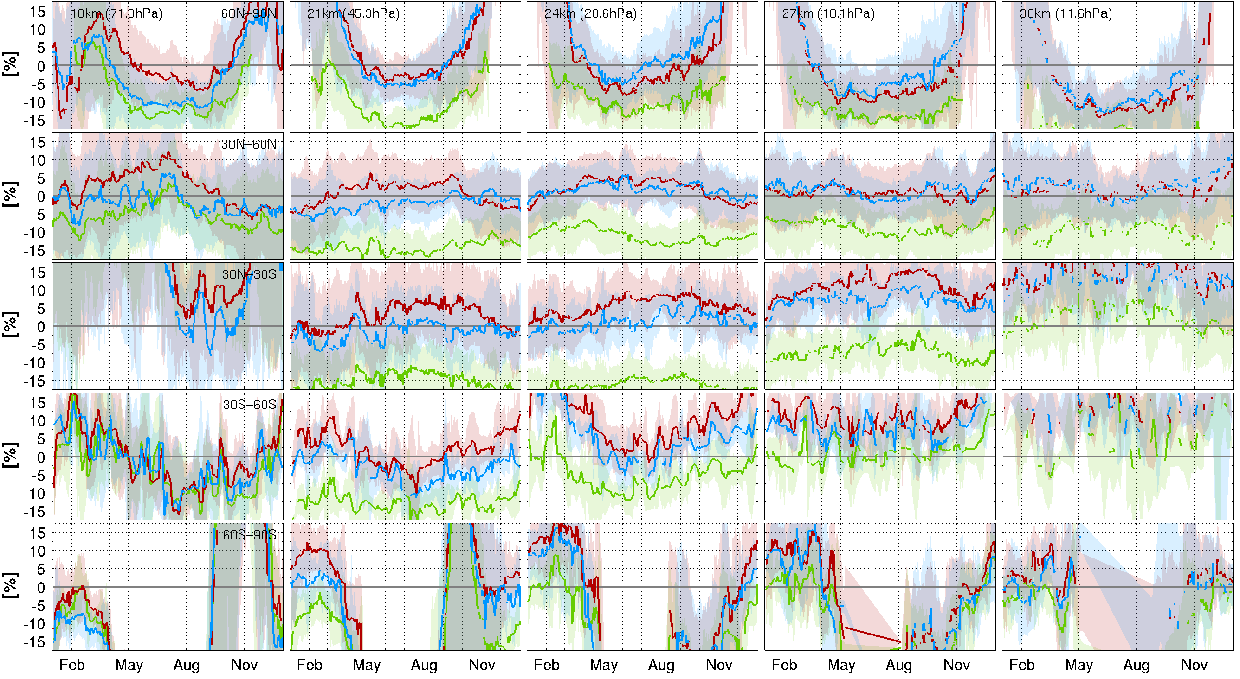
O3 limb profile seasonal cycle (sonde)
Present at all altitudes/latitudes, but most pronounced in Arctic (and Antarctic)

Slide 23
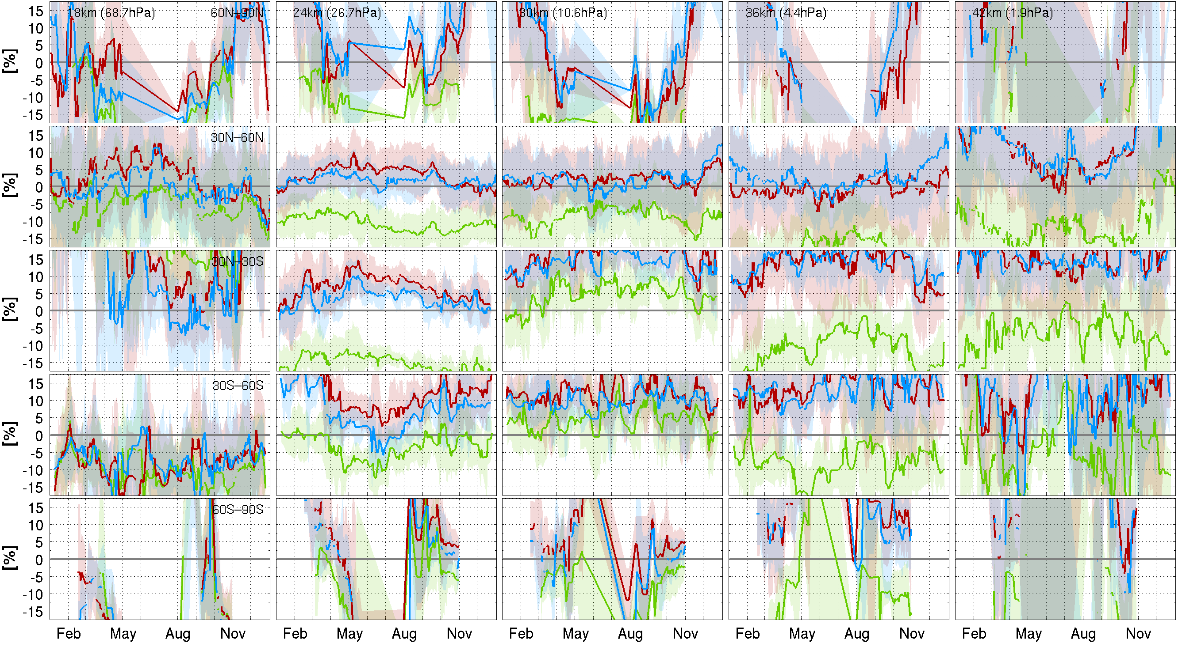
O3 limb profile seasonal cycle (lidar)
Present at all altitudes/latitudes, but most pronounced in Arctic (and Antarctic)

Slide 24
O3 limb profile time series (30N-60N)
18km
24km
30km
36km
42km
Lidar
18km
21km
24km
27km
30km
Sonde

Slide 25
O3 limb profile drift
90N-90S
Changes in long-term behaviour, mainly improvements
<20 km: V6 drift worse than V5
20-30 km: V6 drift not significant, of similar magnitude as V5, but opposite sign
30-45 km: negative drift around 35km significant for V6, but clearly smaller than V5 (3-4% per decade)

Slide 26
Executive summary
 | O3 column | NO2 column | BrO column | CO column | CH4 column | H2O column | O3 profile | BrO profile
Change V6 vs V5 | Reduced positive bias Spread is similar Negative drift of ~1 %/dec. at NH mid-latitudes | Differences between the two SGP data versions are hardly noticeable and below the detection limit of the ground-based measurements | Perhaps slightly better negative bias reduced by 0.5% possibly less outliers. | Bias clearly reduced during 2006-2010 Spread is similar Major issues not solved | Promising first results, yet strong seasonal cycle and trend and bias in Tropics | V6 is very similar to V5, despite strong influence of cloud algorithm. | V6 is very similar to V5. It has slightly improved bias, drift (US), short-term variability, random uncertainty in some parts of atmosphere. | Very similar: conc. increase by 0-3% spread unchanged no annual cycle Q below that of scientific product
Maturity | Representative global | Representative global, except in Tropics | 1 Arctic station only | Possible sampling issues | Possible sampling issues | Representative global | Representative global, except in mesosphere | 1 Arctic station only
Recommendation | Reprocess, if appearance of ~1 %/dec. negative drift is acceptable. Clear disclaimer of this in README file. | Reprocess, since no observable degradation relative to V5. | Reprocess, since no observable degradation relative to V5. | Reprocess, since signs of improved product. Clear disclaimer of major issues in README file. | Process and include, since acceptable first results. Disclaimer of major issues in README file. | Reprocess, since no observable degradation relative to V5. | Reprocess, since at least no observable degradation relative to V5. Clear disclaimer of many major issues in README file. | Reprocess, since no observable degradation relative to V5. Clear disclaimer of issues in README file.

