Slide 1

SCILOV-15
(SCIAMACHY Longterm Validation)
Status
Stefan Bötel, Kai-Uwe Eichmann, Evgenia Galytska, Tina Hilbig, Luca Lelli, Nabiz Rahpoe, Alexei Rozanov, and Mark Weber
Institute of Environmental Physics (IUP), University of Bremen (weber@uni-bremen.de)
SCIAMACHY Quality Working Group Meeting, Bremen, 21-22 September 2016

Slide 2
What is SCILOV?
Validation (and verification) of SCIAMACHY ESA/DLR data products by comparison with other satellite data
  SCIA data products to be validated (L1 V8 and V9, L2 V6 and V7)
  radiances (UV and vis)
  irradiances
  clouds (cf and cth from nadir)
  limb ozone
  limb NO2
  NO2 stratospheric columns
Initial validiation of TROPOMI products (ozone and radiances)

Slide 3
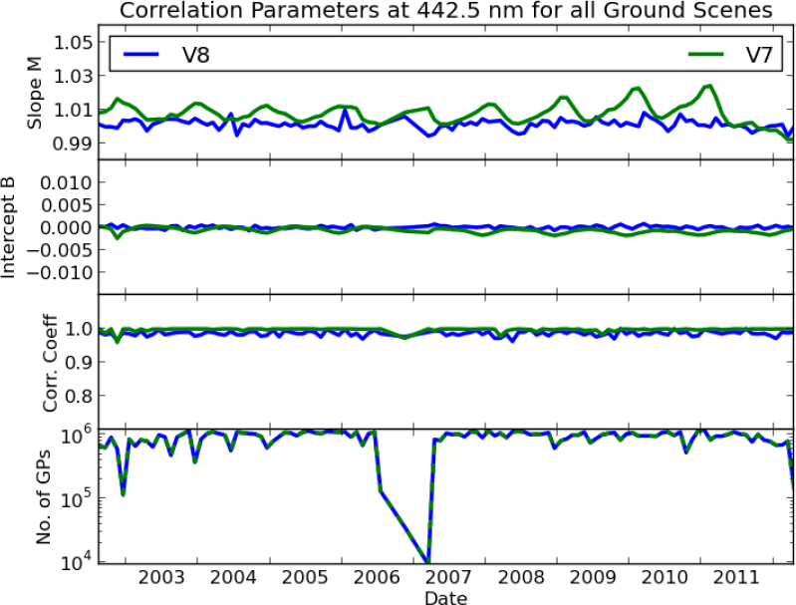
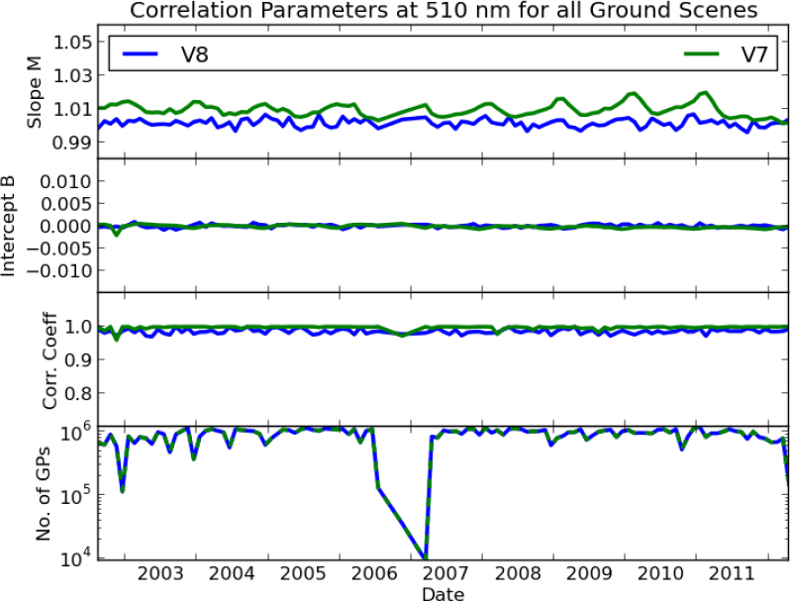
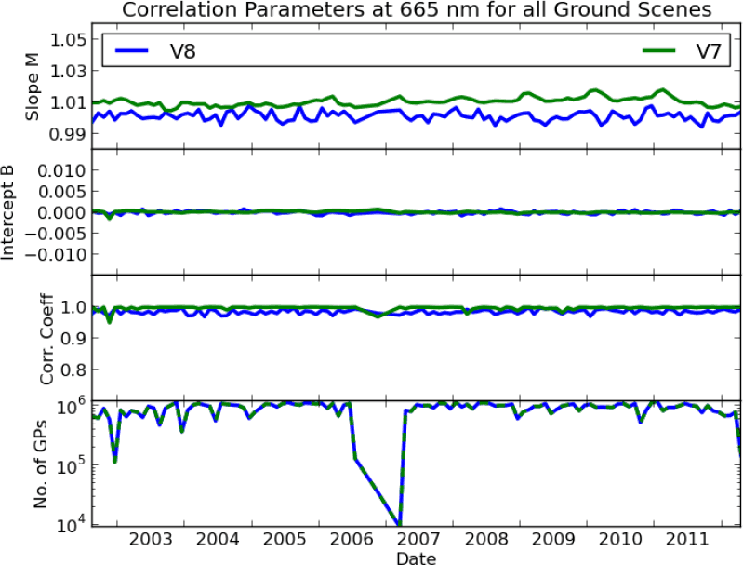
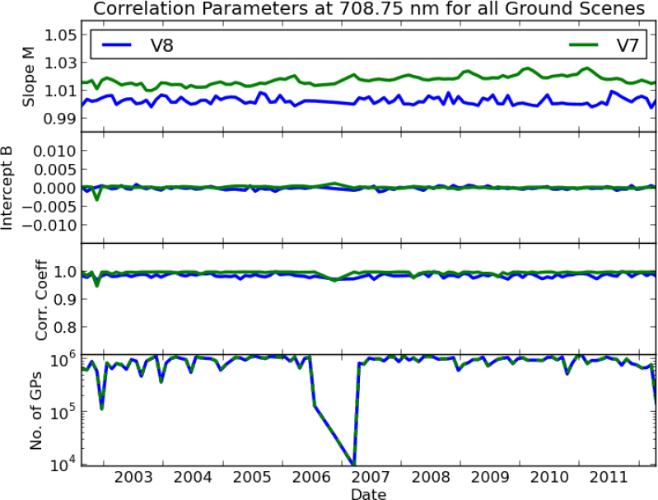
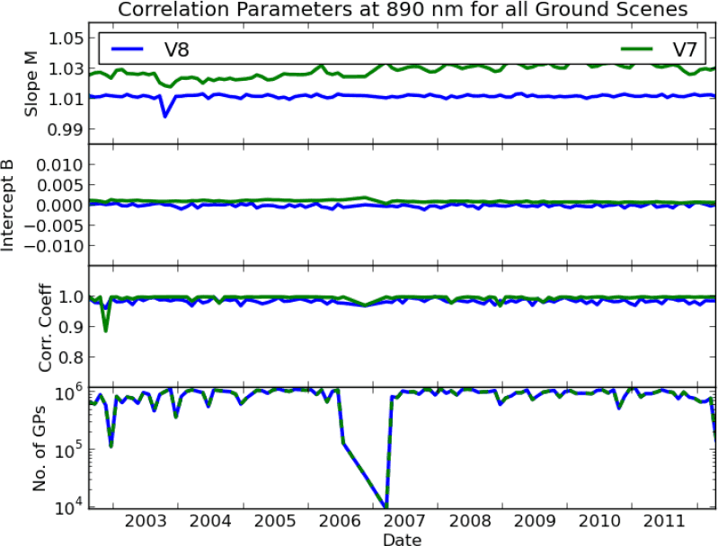
VIS radiances
Comparison of L1 V7 and V8 with MERIS 442.5, 510, 665, 708.75, and 890 nm channels
Separation of Dark (cf < 0.2), bright (cf > 0.2), cloudy (cf>0.98), and all scenes
L1 V8:
slope of correlation within 1% to one-to-one
reduced seasonality
reduced trends
all scenes
Stefan Bötel

Slide 4
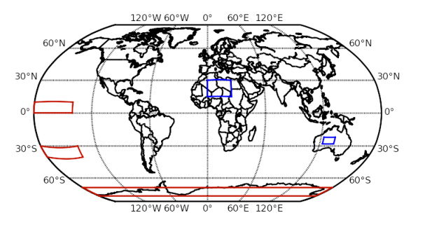
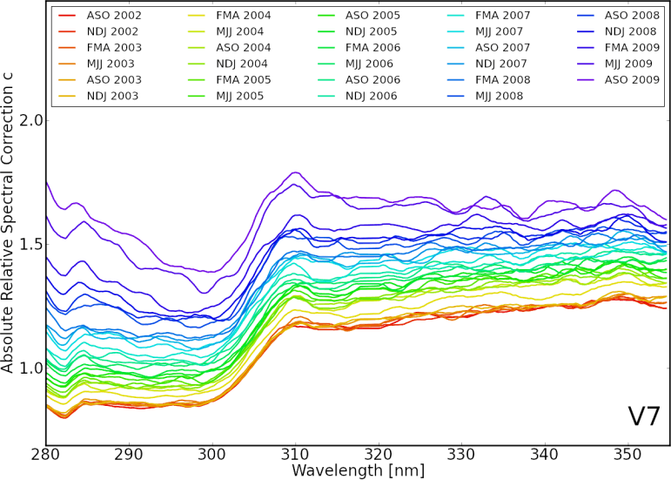
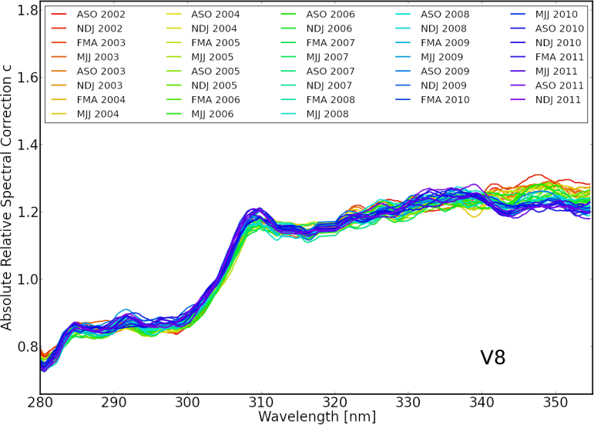
UV radiances (soft calibration)
RTM simulation with climatological profiles scaled to observed total ozone
Averaging over large samples will cancel out variability in O3 profile shape wrt to climatological averages
L1 V8 showing no degradation (as expected from mirror-obm model), however pre- to post-launch changes are not accounted for → L1 V9
Stefan Bötel
w/o m-factor

Slide 5
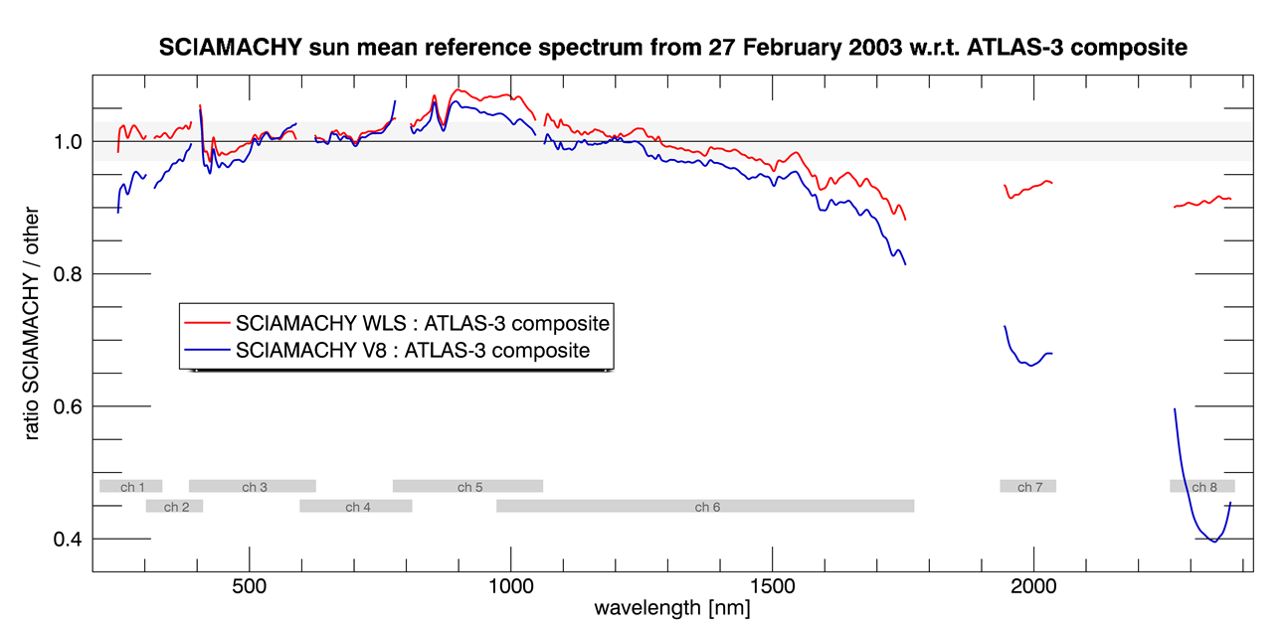
SCIAMACHY Solar Reference Spectrum
Solar Reference Spectrum: SMR from 27 Feb 2003
Level 1B Version 8revised (V9 keydata from March 2016)
Validation with ATLAS-3 composite (Thuillier et al. 2003)
Improvements:
radiometric offset at channel boundaries
icing effect in channel 7, 8
influence of temp. changes (e.g. channel 6+)
radiometric calibration in channel 1 – 3
Tina Hilbig

Slide 6
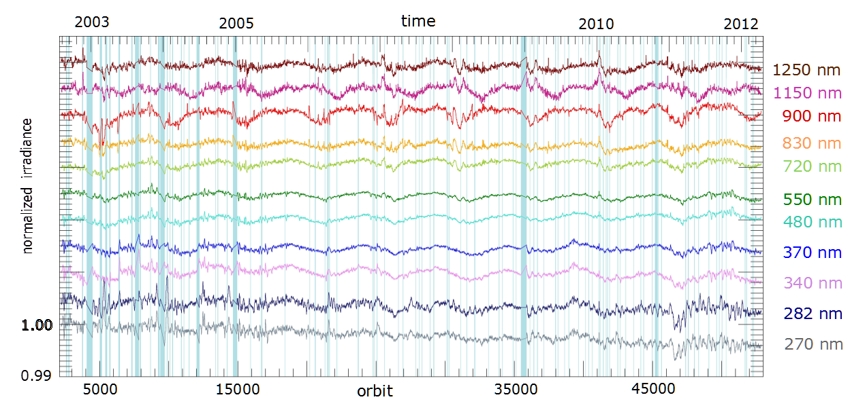
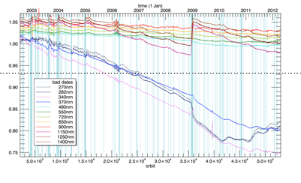
SCIAMACHY Solar irradiance validation
Further plans:
extend comparisons to more solar data ( e.g. ISS SOLSPEC, SIM/SORCE, groundbased: CAVIAR ISPERAD)
  better agreement in NIR / Atlas 3 has NIR bias
Establish degradation corrected SSI time series combined with GOME/GOME-2 (BMBF SCIASOL project)
V7
Tina Hilbig
V8

Slide 7
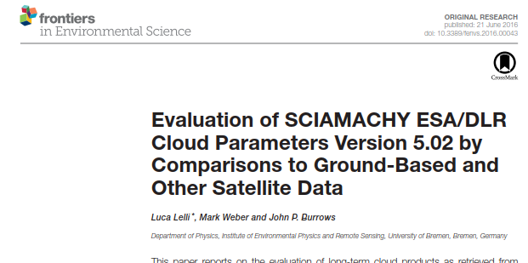
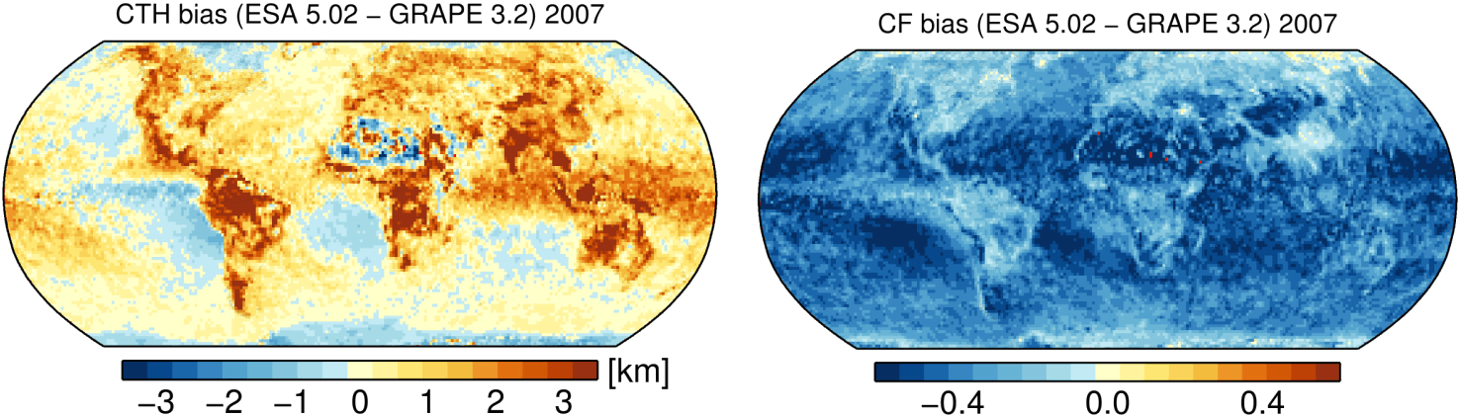
clouds
L2 V6 delta validation in preparation - NN
Luca Lelli
Lelli et al. (2016)

Slide 8
Limb O3 validation
Verification performed (V6 minus V5)
Next steps for full validation:
  Collocation list
  Delta validation by calculating the mean differences of the collocated profiles
  Presentation of first results at ACVE meeting in Oct 2016
Nabiz Rahpoe

Slide 9
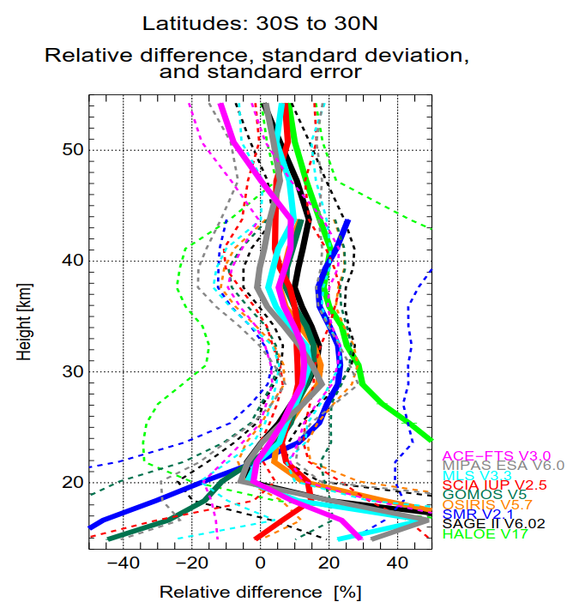
Limb O3 (delta) validation
Within 5% at 25 km at all latitudes
at mid latitude at around 40 km diff. < 7%
Hemispheric difference in sign
Nabiz Rahpoe

Slide 10
NO2 Limb validation
Photochemical conversion of NO2
Satellite measurements
Limb measurements
Occultation measurements
Modeling
Bremen 3D CTM
PRATMO box model
SCIAMACHY
MIPAS
OSIRIS
SAGE-II
Evgenia Galytska

Slide 11
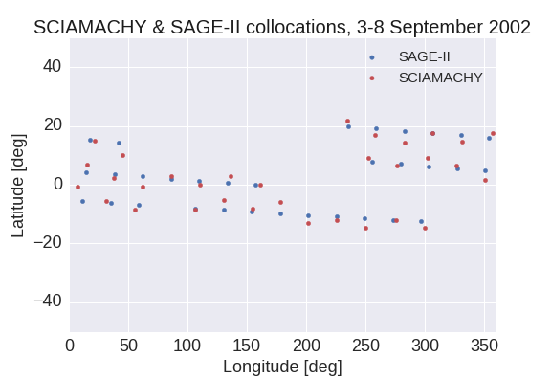
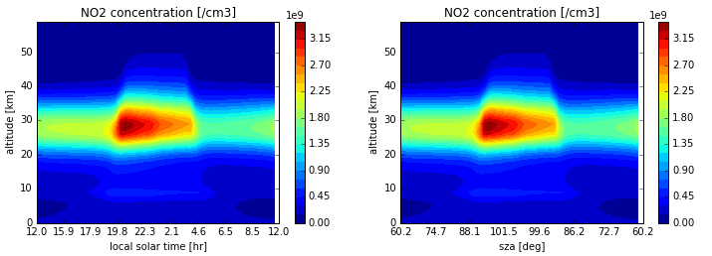
NO2 limb validation
Evgenia Galytska
Definition of collocation criteria
NO₂ diurnal variation for the specific day time and location with PRATMO box model
Presentation at the ACVE meeting in October 2016
Example: collocation criterion for SAGE II (2002-2005)
maximum time difference 8 hours
maximum spatial difference: 5° lat. X 5° lon.
Evgenia Galytska

Slide 12
NO2 total columns
Operational data products from GOME-2, SCIAMACHY, and OMI are to be compared
Validation using GOME-2 and SCIA NO2 scientific data products from IUP as reference
Day time dependency of the NO2 column has to be further examined, depending on the equator crossing time of the satellite, but also on latitude and scan azimuth angle of the measurement.
  afternoon orbits: OMI (1:10 PM), TROPOMI (1:30 PM).
  morning orbits: SCIAMACHY (10:30 AM), GOME-2 (9:30 AM)
Preparation for S5P-mission performance center activities
Kai-Uwe Eichmann

Slide 13
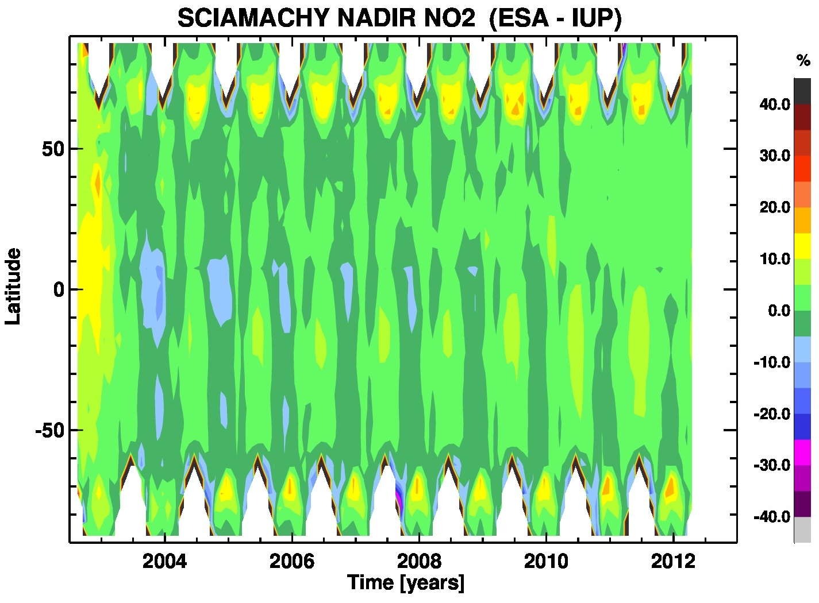
NO2 total columns
Gather and/or write reading routines for GOME-2, SCIAMACHY, and OMI data (50%).
Write overall comparison code that takes into account factors like equator crossing time, latitude, and azimuth angles of the different sensors (10%).
First results will be presented at the ACVE workshop 2016
Kai-Uwe Eichmann
SCIAMACHY ESA L2 V5 minus IUP-DOAS (F.Azam)

Slide 14
Summary
SCIAMACHY L1 V8 radiance validation completed
SCIAMACHY L1 V8/V9 irradiance validation progressing, peer-review publication on SCIAMACHY solar reference spectrum has been drafted
Work in progress on L2 V6 validation:
  Limb O3, Limb NO2 (plus photochemical correction), NO2 column
  first results will be presented at the ACVE workshop 2016
some delays in cloud validation and L1 V9 radiance verification (Stefan Bötel left us and Luca Lelli has other commitments)

