Slide 1
Mirror Model
Ralph Snel
Matthijs Krijger

Slide 8
Solar Irradiance comparison (IUP)

Slide 11
Solar Irradiance comparison (newV9)

Slide 14
Moon albedo

Slide 15
Moon Irradiance

Slide 16
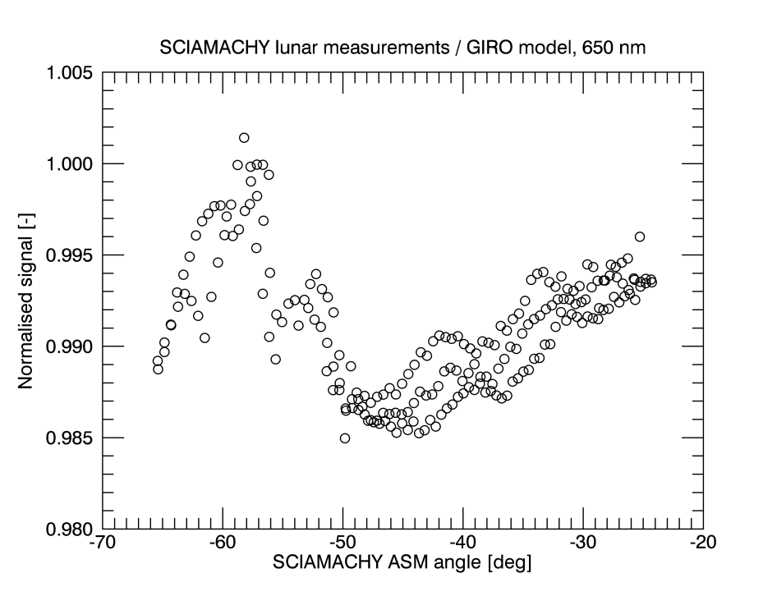
ASM calibration
On-ground
Calibrated

Slide 17
Other instruments

