Slide 1
Iodine Monoxide (IO)
Nadir Scientific Data Product
Anja Schönhardt, Folkard Wittrock,
Andreas Richter, John P. Burrows
IFE/IUP, University of Bremen, Germany

Slide 2
Preface
Iodine monoxide (IO) from SCIAMACHY:
Scientific data product, no operational version
Due to challenges, some settings are different than in standard operational products.

Slide 3
Preface:
Untypical settings in the IO retrieval
Retrieval performed on uncalibrated data (no product improvement when using calibrations so far)
Usage of cluster 14 (otherwise unused, longer integration time)
Reference from Earthshine instead of solar spectrum
No cloud filter
Compilation of temporal averages instead of individual spectra

Slide 4
SCIAMACHY data
Nadir geometry
Visible spectral range
  Channel 3
  Cluster 14 & 15
  Retrieval window 416 – 430 nm
No radiometric calibration
(-cal 1,5 - but wavelength calibration not used)
No cloud screening for maximum data amount
DOAS retrieval method
Average Earthshine reference typ. from Pacific

Slide 5
Background – Earthshine
Earthshine reference (standard):
Daily average above an ocean region (Pacific)
  Latitude 30° - 50° S
  Longitude 150° - 170° W
Alternative Earthshine reference:
Daily average above a continental region (Siberia)
  Latitude 60° - 70° N
  Longitude 80° - 120° E

Slide 6
SCIAMACHY IO data products
→ 1. IO product on NRT data
2. IO product on consolidated data product (U)
3. IO test data based on SCIAMACHY V8 data: Comparison between different calibration settings
  No radiometric calibration (- cal 1,5)
  Full calibration
  Selected calibrations (e.g. without polarisation)
4. IO product based on processor version 8 data will be reprocessed after calibration tests, calibration settings to be determined

Slide 7
Results (NRT, consol U)
IO slant columns retrieved from NRT data for
2003 – 2011
IO vertical columns computed for
  box profiles (1 km, based on assumptions)
  constant albedo values (90% for Polar analyses, 5% for oceans)
Analyses usually based on averaged data / maps
  typically for 3 months (or longer)
Amounts are comparably small
Mostly close to the detection limit

Slide 8
IO – open issues
Interhemispheric gradient
  Larger values on the Southern Hemisphere
  Possible improvement through latitude dependent reference
Usage of selected calibration settings
  No improvements for full calibration using earlier processor versions
  Comparisons between different calibration settings using processor version 8 are currently under investigation

Slide 9
Status: IO product (V8 data)
IO data product based on SCIAMACHY V8 data is currently reprocessed
Test data for >1 year (01/2005 – 05/2006) are fully processed and currently under investigation
First results of calibration tests available
Further results of calibration tests expected during October
Full mission data set will be reprocessed based on the results of current calibration tests
Full IO product expected end of October

Slide 10
Status: IO product (V8 data)
Data quality of IO product based on uncalibrated data overall still better than fully calibrated data
Further improvements expected when using selected calibrations
Influence by selected calibration settings are currently tested
Calibration settings for final IO product will be based on results of these further tests
Scientific IO product will be established on V8 data using either selected or otherwise no calibration settings

Slide 11
Summary
Analyses using processor V8 are currently performed
1 year test data available
Different calibration settings are compared (no/full calibration)
Data quality in most cases better when using no calibration
Full IO data product based on processor V8 using selected calibration settings expected until end of October 2016
Temporal averages (1-3 months) will be produced and made available online
Documentation of algorithm published in ACP (Schönhardt et al., 2008).

Slide 12
END

Slide 13
DOAS retrieval of IO from SCIAMACHY
Differential Optical Absorption Spectroscopy – Settings:
Spectral range: 416 – 430 nm
Trace gases: IO, NO₂ (223K), O₃ (223K)
IO Cross Section: Gómez-Martín et al, 2005
Ring effect, pseudo-absorber, SCIATRAN
Quadratic polynomial
Linear intensity offset
Earthshine reference spectrum

Slide 14
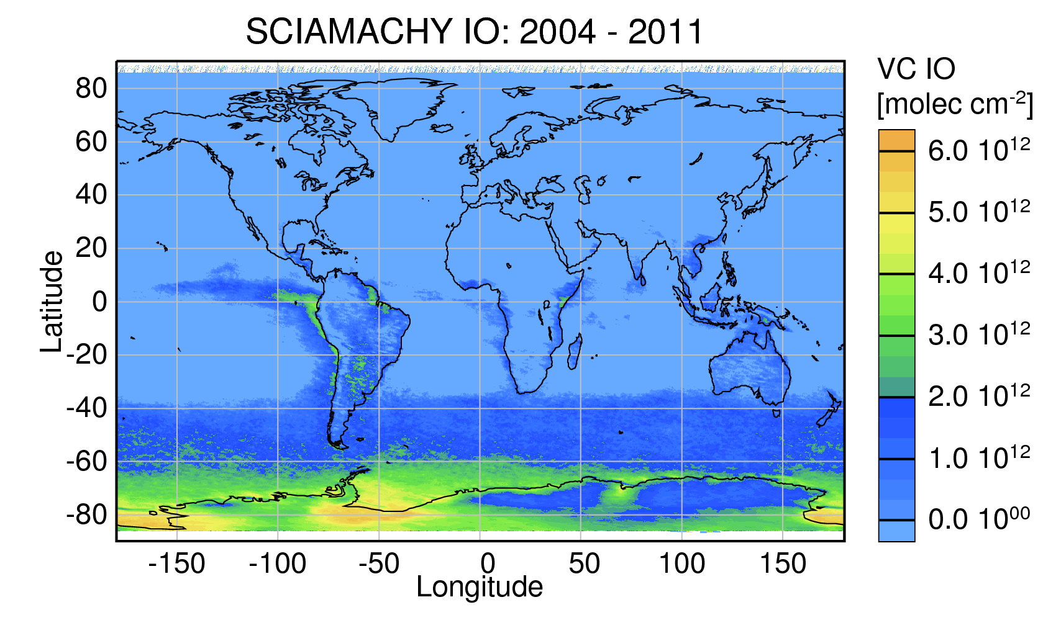
Results: IO global overview

Slide 15
Specific aspects on calibration influence
Comparison of retrieval quality (RMS) between no calibration (NOCAL) and full calibration (ACAL)
RMS_ACAL mostly larger than RMS_NOCAL
RMS_ACAL especially large for specific lines of sight (~9.7°, ~27°)
Slight improvements in RMS using ACAL for specific cases:
  High latitudes >75° on summer hemisphere for some days
  Ice covered areas near Antarctica but only for some days
  Some cloudy pixels

Slide 16
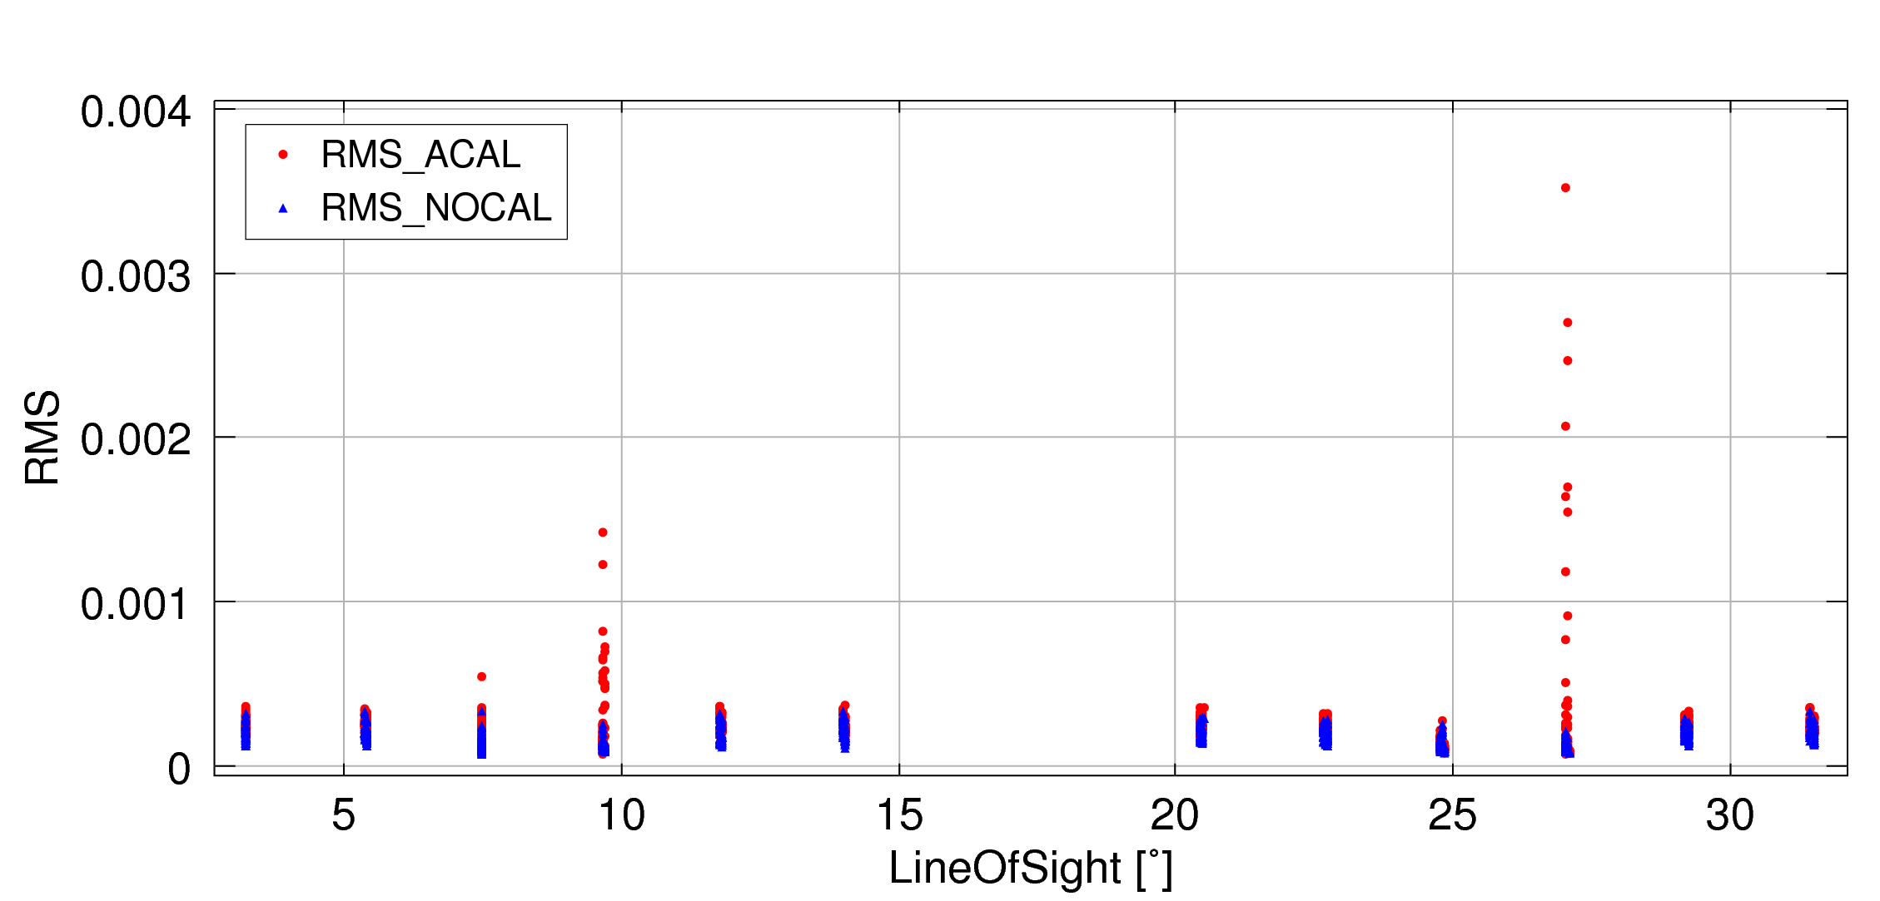
Specific aspects on calibration influence
Orbit 51005115

Slide 17
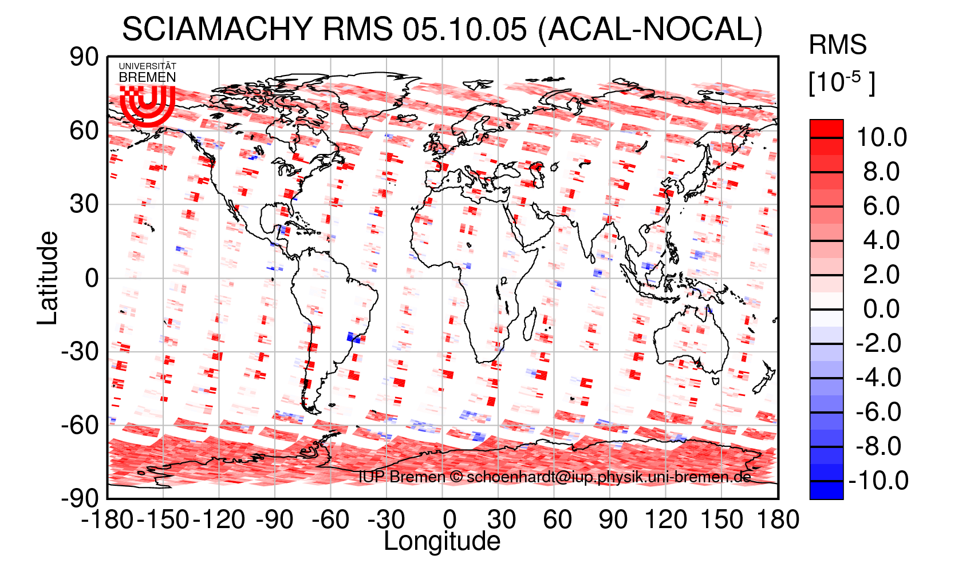
Specific aspects on calibration influence

