Slide 1
Progress on SCIAMACHY Limb aerosol retrieval
E. Malinina¹, A. Rozanov¹, V. Rozanov¹, P. Liebing¹, L. Rieger², J.P. Burrows¹
1- Intitute of Environmental Physics, University of Bremen, Bremen, Germany
2- Institute of Space and Atmospheric Studies, University of Saskatchewan, Saskatoon, Canada

Slide 2
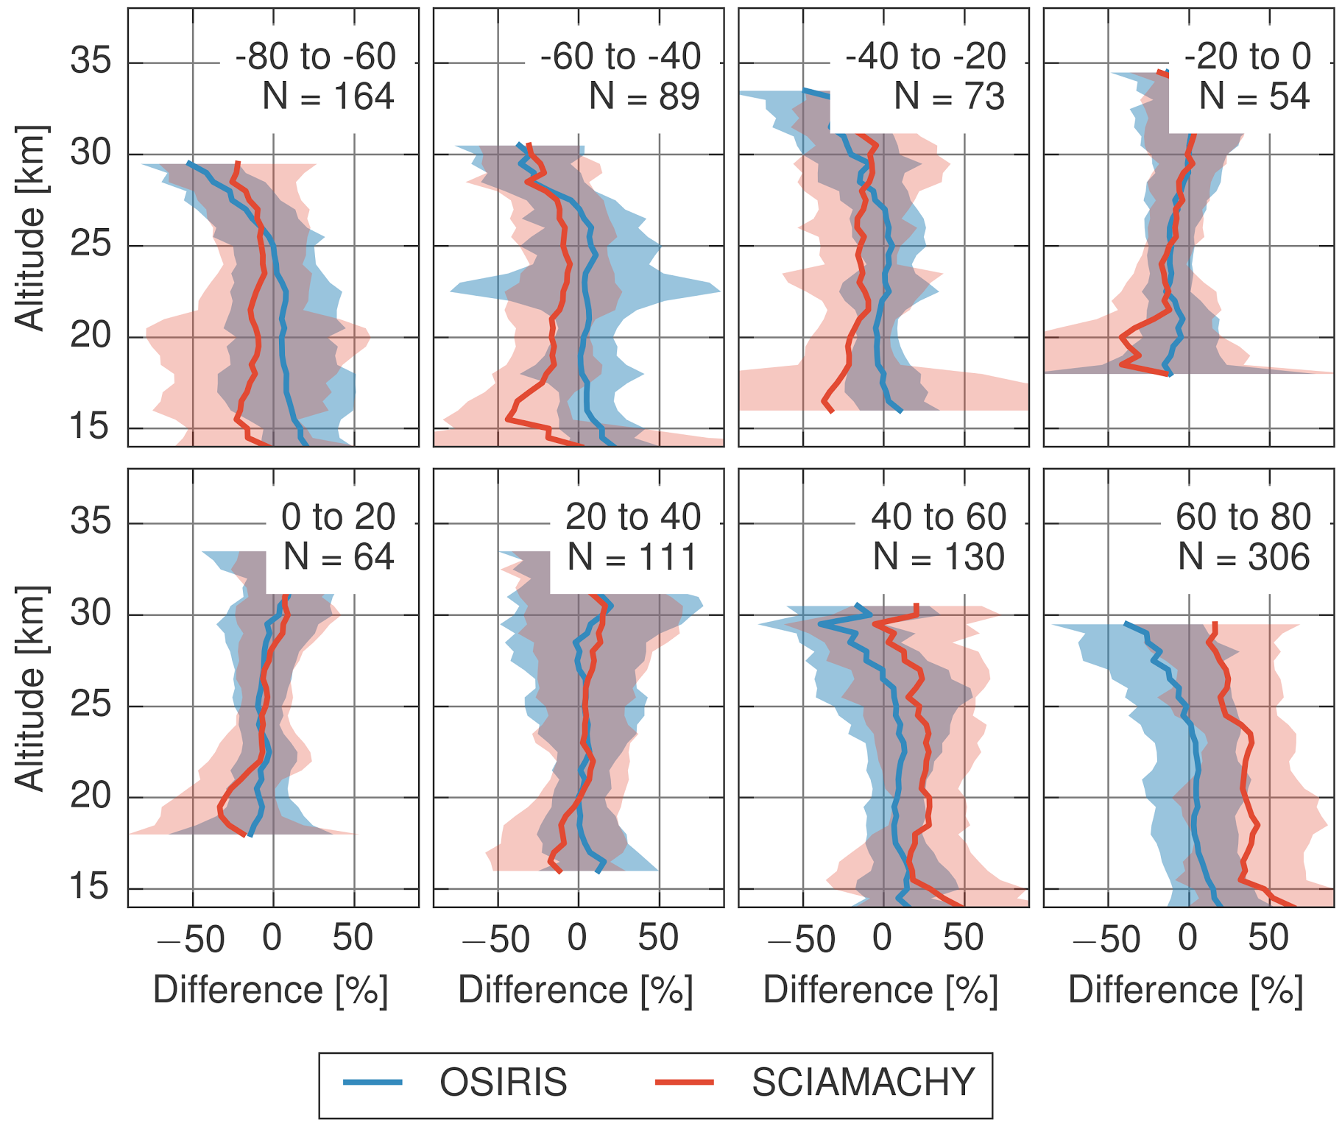
Aerosol Extinction V1.4 Retrieval
Updates to the previous version:
No shorter wavelength normalization
Calculation of extinction on 2 wavelengths: 750 nm an 1090 nm
Changed PSD parameters (r_{g}=0.08mcm , 𝜎_{g} = 1.6 )
Calculations on the measurement grid
Simultaneous albedo retrieval
Changed reference tangent height from 35 km to 38 km
Difference between SCIAMACHY/OSIRIS and SAGEII aerosol extinction
More than a year of data processed yet. The full product should be available in November.
Notes:
No shorter wavelength normalization (470 nm), bacause of the uncertanties, which are coming through it. 750 nm extinction profiles don’t change a lot.
Calculation on 2 wavelength to get the Angtröm coefficient.
Changed PSD parameters, because one of the purposes of this product is the SCIA-OSIRIS intercomparison.
Calculations on the measurement grid to reduce the oscillations caused by clouds
Implemented an effective albedo retrieval based on the limb radiances near the reference tangent height to reduce the surface albedo uncertanties
Changed refernce tangent height, because we saw, that at 35 km there is still an unavoidable aerosol loading and straylight contribution is still small

Slide 3
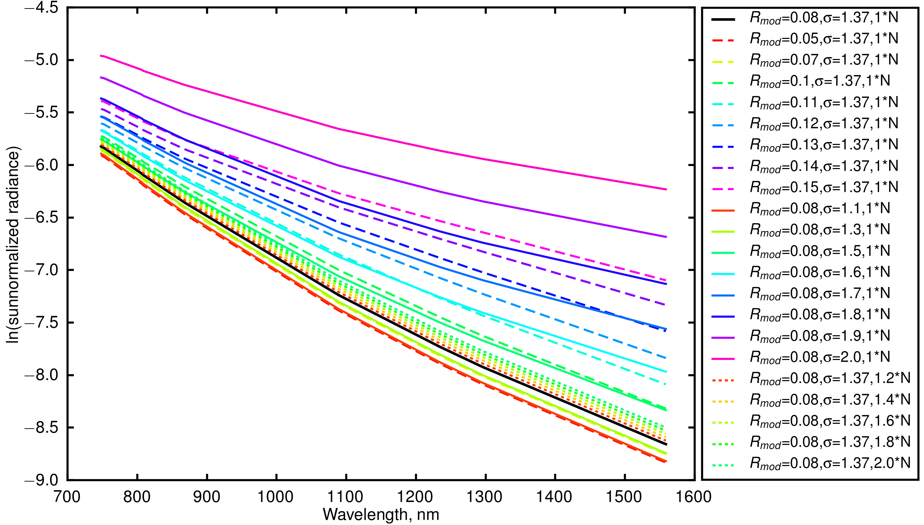
Aerosol PSD Retrieval. Simulations.
Particle size distribution (PSD):
Assumed to be lognormal in the stratosphere
Possibly r, 𝜎 and N could be fitted
Notes:
On this plot logarithms of the sun-normalized modelled limb intensities at TH 28 km are peresented
The simulations with different PSD parameters in the possible range of the parameters
Issues in distinguishing the radiances for smaller values of of mode radius (R_{mod}) and distribution width (𝜎)
Easier to distinguish the radiances with bigger mode radius and distribution width
There is a slight difference among the radiances with different particle number densities (N). These are hard to distinguish as well

Slide 4
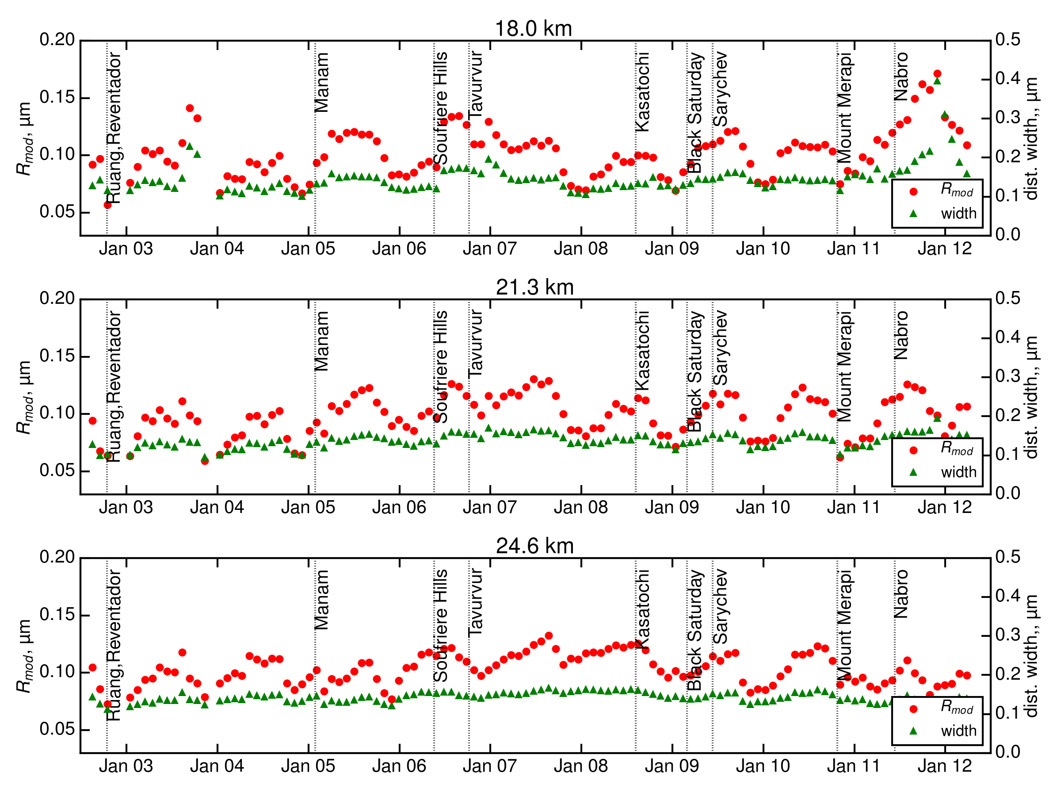
Aerosol PSD Retrieval. Real data.
Notes:
Time series of mode radius and distribution width retrieval in the tropics for the whole SCHIAMACHY measurements period (monthly averaged data)
Here distribution width is defined as 𝜎*R_{med} (median radius)
After the volcanic eruptions significant increase of mode radius and slight increase of the distribution width
Temporal shift in the increased values of the mode radius and decreased values of distribution width with the height→ Brewer-Dobson circulation

Slide 5
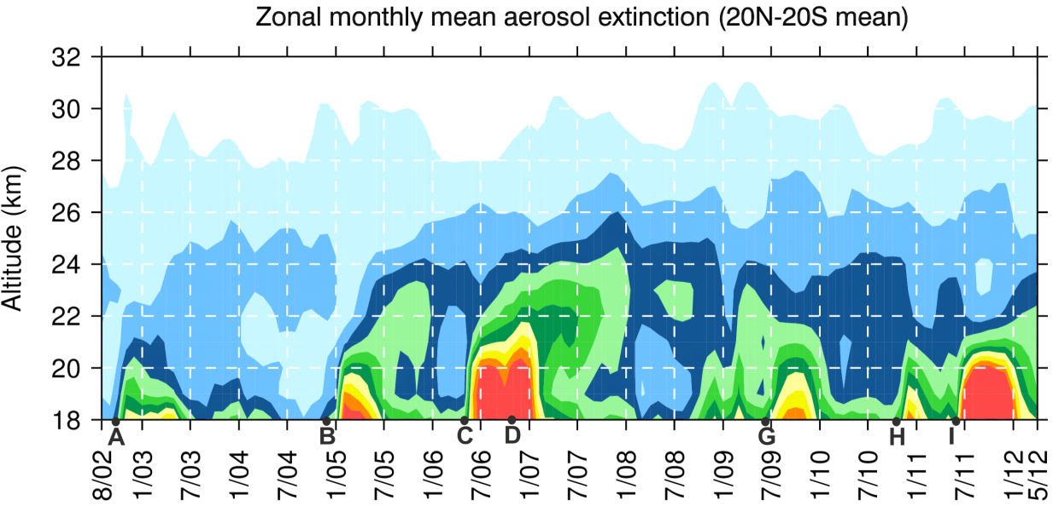
Aerosol PSD Retrieval. Real data.
Volcanic eruptions:
C - Soufriere Hills, May 2006, 16º N
D - Tavurvur, October 2006, 4º S
Retrieved parameters: R_{mod} and 𝜎
Selected region: tropics (10º N - 10º S)
Measurements over ocean
Period: March 2006 - October 2007 → includes background conditions, 2 volcanic eruptions and relaxation period

Slide 6
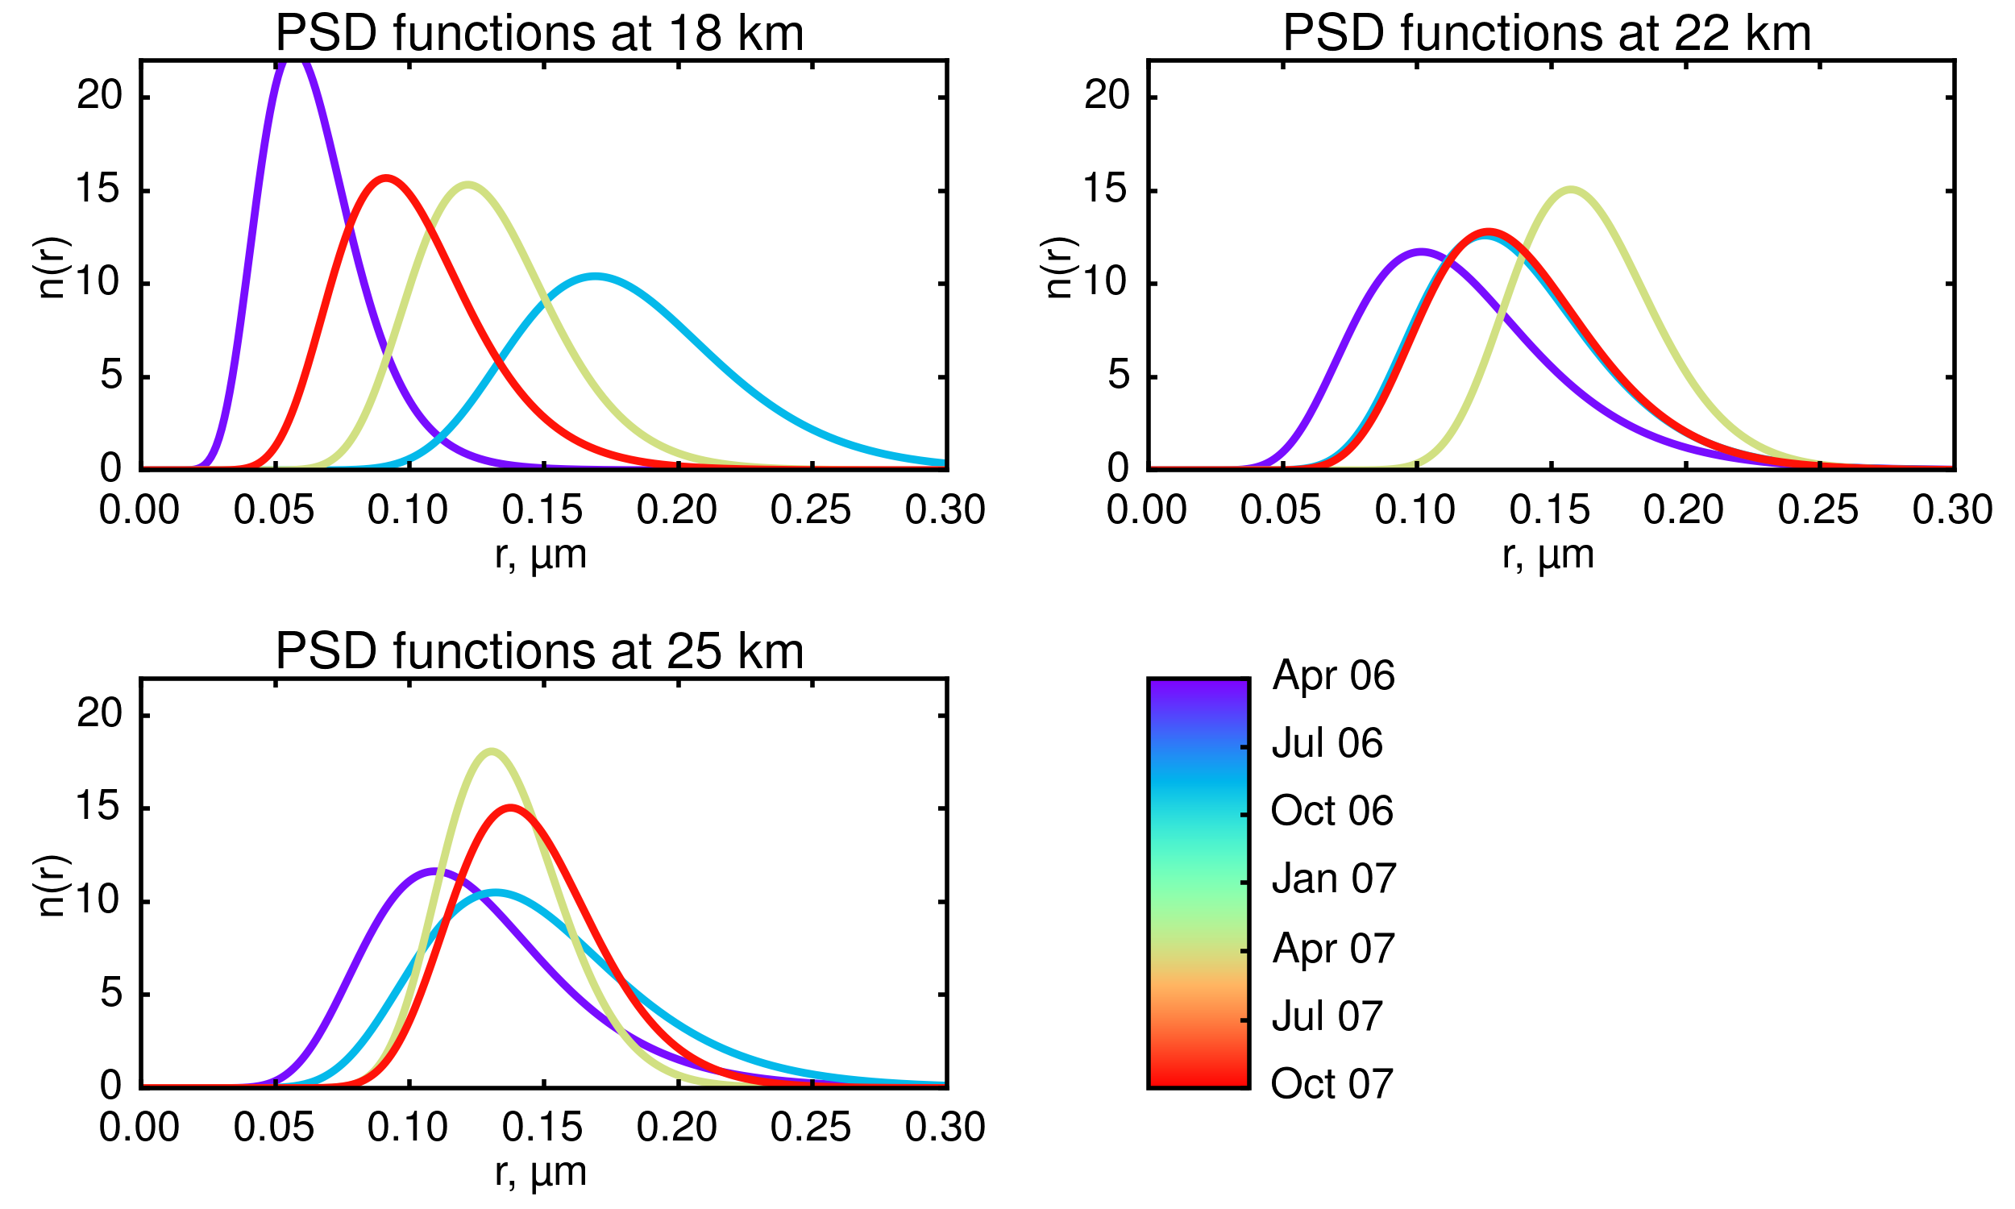
Aerosol PSD Retrieval. Real data.
Soufriere Hills
Tavurvur
Notes:
Evolution of particle size distribution functions on different tangent altitudes before and after volcanic eruptions in May/October 2006 in tropics for the period from
Analysis of the shape of the aerosol particle size distributions shows the widening and shift of the distribution to larger radii after volcanic eruption as well as time delay with the height.

Slide 7
Conclusions and outlook
The calculation of the new aerosol extinction database. Ready ~ beginning of November 2016
Retrieval of mode radius and distribution width from SCIAMACHY limb measurements shows good results
Calculation of aerosol particle size distribution test product for tropics. Ready ~ end of 2016

