Slide 1
SCIAMACHY Limb ozone V3.5: first verification results

Slide 2
New O₃ retrieval version
V2.9
V3.5
6 spectral intervals: 264 – 265, 266.5 – 267.5, 272.5 – 273.8, 276.5 – 278, 282.5 – 284, 289 - 309.5 nm
Contant subtraction for the last three intervals
Tangent height normalization
8 spectral intervals (± 1 nm) centered at 264, 267.5, 273, 283, 286, 288, 290.5, 305 nm
Tangent height normalization
Hartley
(35 – 61 km)
Hartley
(38 – 61 km)
Huggins
Not used
325 – 331 nm
Linear polynomial
Solar normalization
Surface albedo retrieval
Huggins
(31 – 38 km)
Triplet method: 3 spectral intervals (± 1 nm) centered at 525, 589, 675 nm
Tangent height normalization
Chappuis
(8 – 35 km)
495 – 576 nm
Quadratic polynomial
Solar normalization
Surface albedo retrieval
Chappuis
(8 – 31 km)

Slide 3
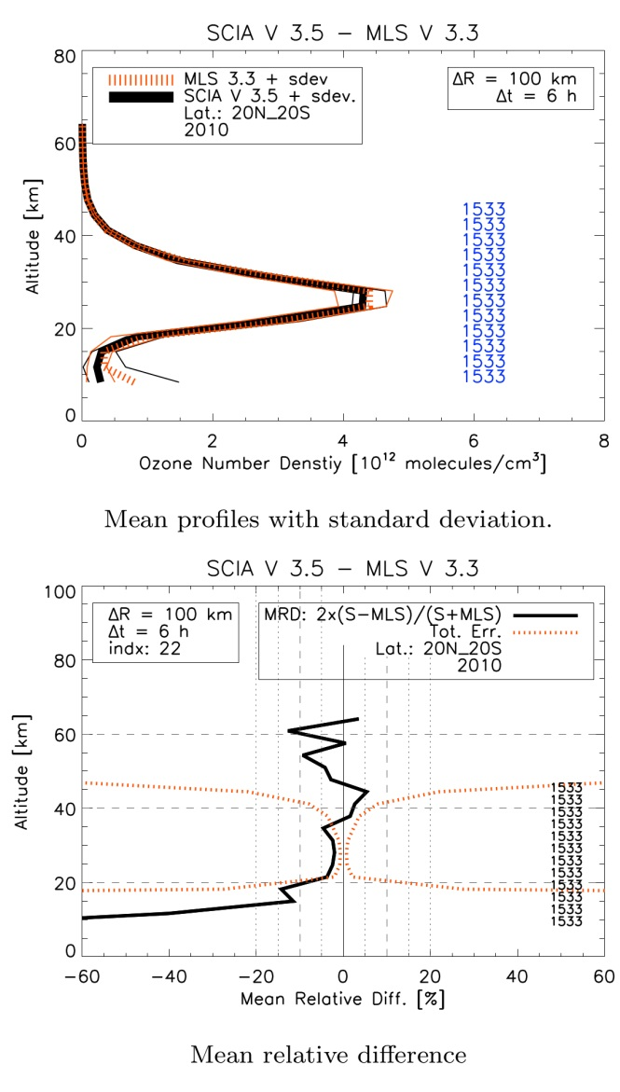
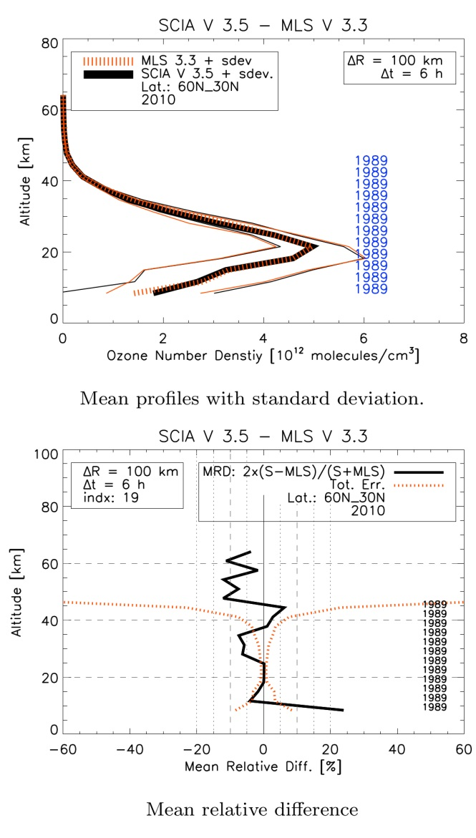
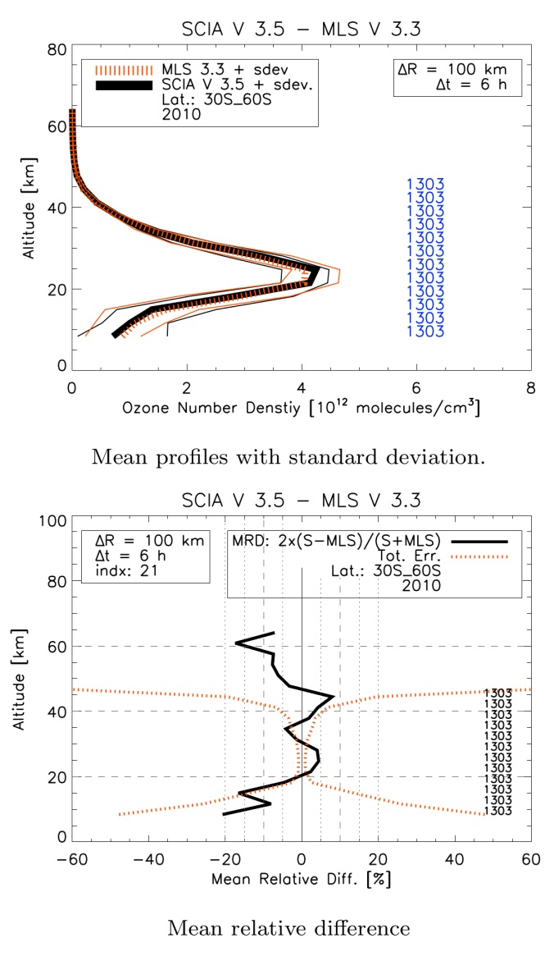
Comparison to MLS: overview
Tropics, 20S -20N
Northern mid-latitudes, 30N – 60N
Southern mid-latitudes. 30S- 60S
Green-blue boxes mark +/-5% range. All data from January to June 2010 are used.

Slide 4
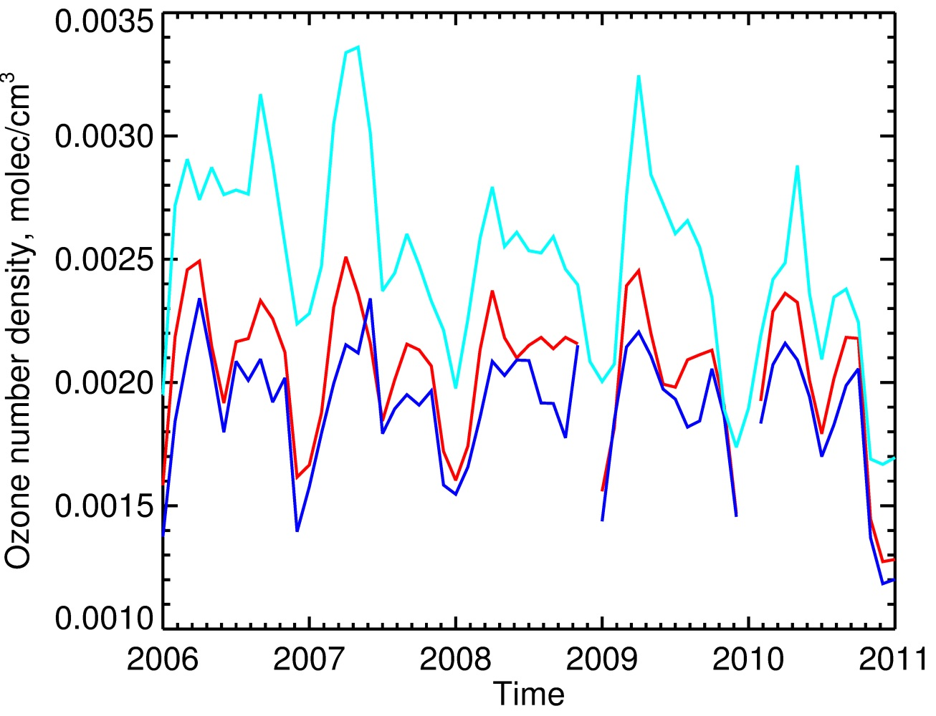
SCIAMACHY ozone V3.5: fixed issues
Monthly mean time series of co-located measurements from SCIAMACHY and MLS at 34 km (tropics)
Artificial drift in the ozone time series around 35 km altitude is not present any more
High bias at 1-5 hPa signal found in V2.9 by Tegtmeier et al. (2013) is significantly reduced.
Unrealistic high amplitude of QBO signal found in V2.9 by Tegtmeier et al. (2013) is fixed.
Blue: MLS Red: SCIAMACHY V3.5 Cyan: SCIAMACHY V2.9
20ºS - 20ºN

Slide 5
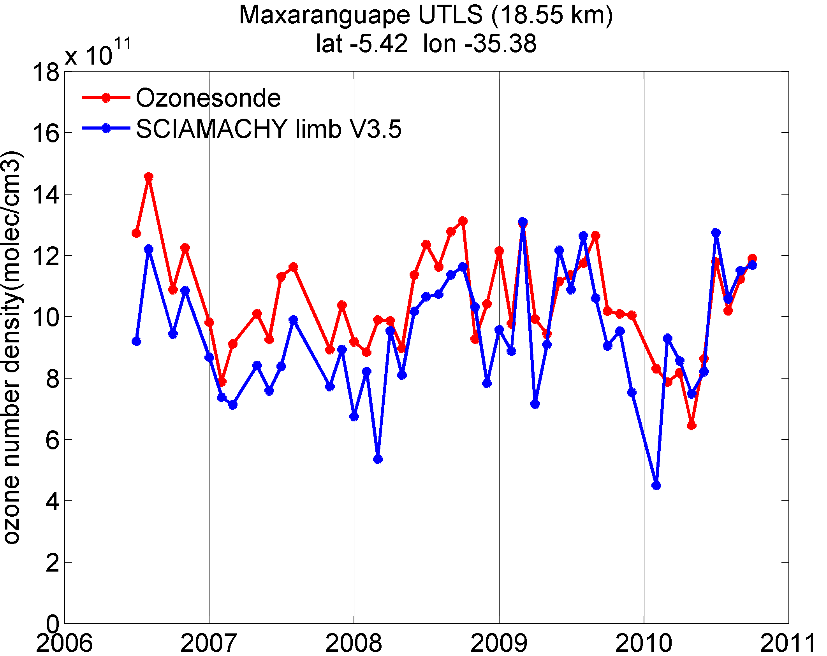
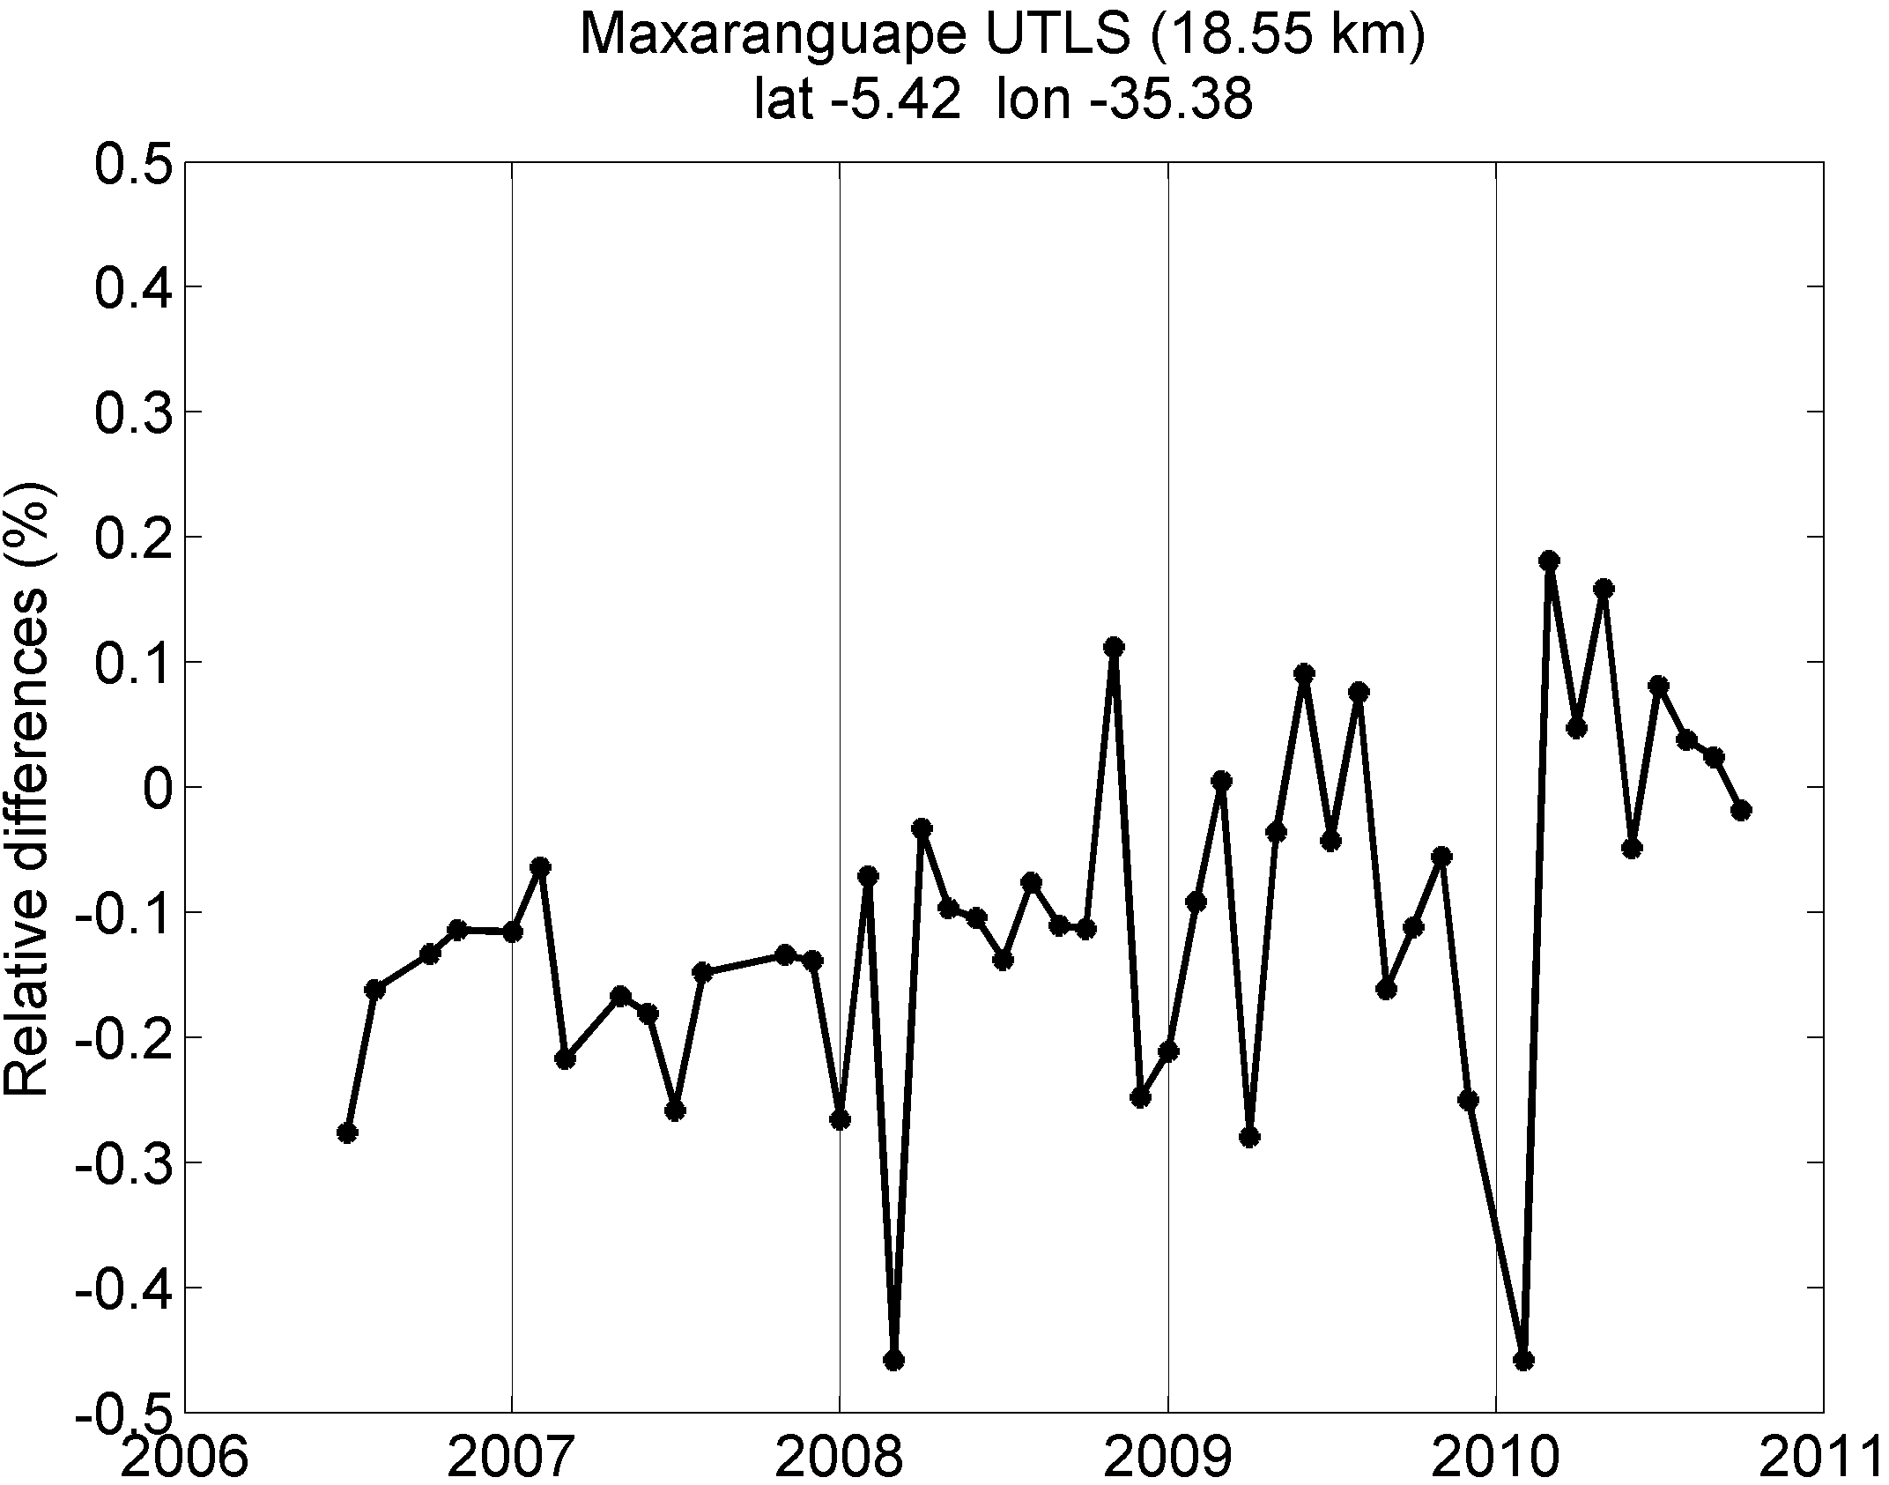
Comparison to ozone sondes: tropical UTLS
Monthly mean time series of co-located measurements from SCIAMACHY and ozone sonde at Maxaranguape (Natal) station (5.4ºS, 35.4ºW)
WOUDC data set (collocation criteria 5º in longitude, 10º in longitude, 24 h)
at 18.5 km
Mean relative differences
20ºS - 20ºN

Slide 6
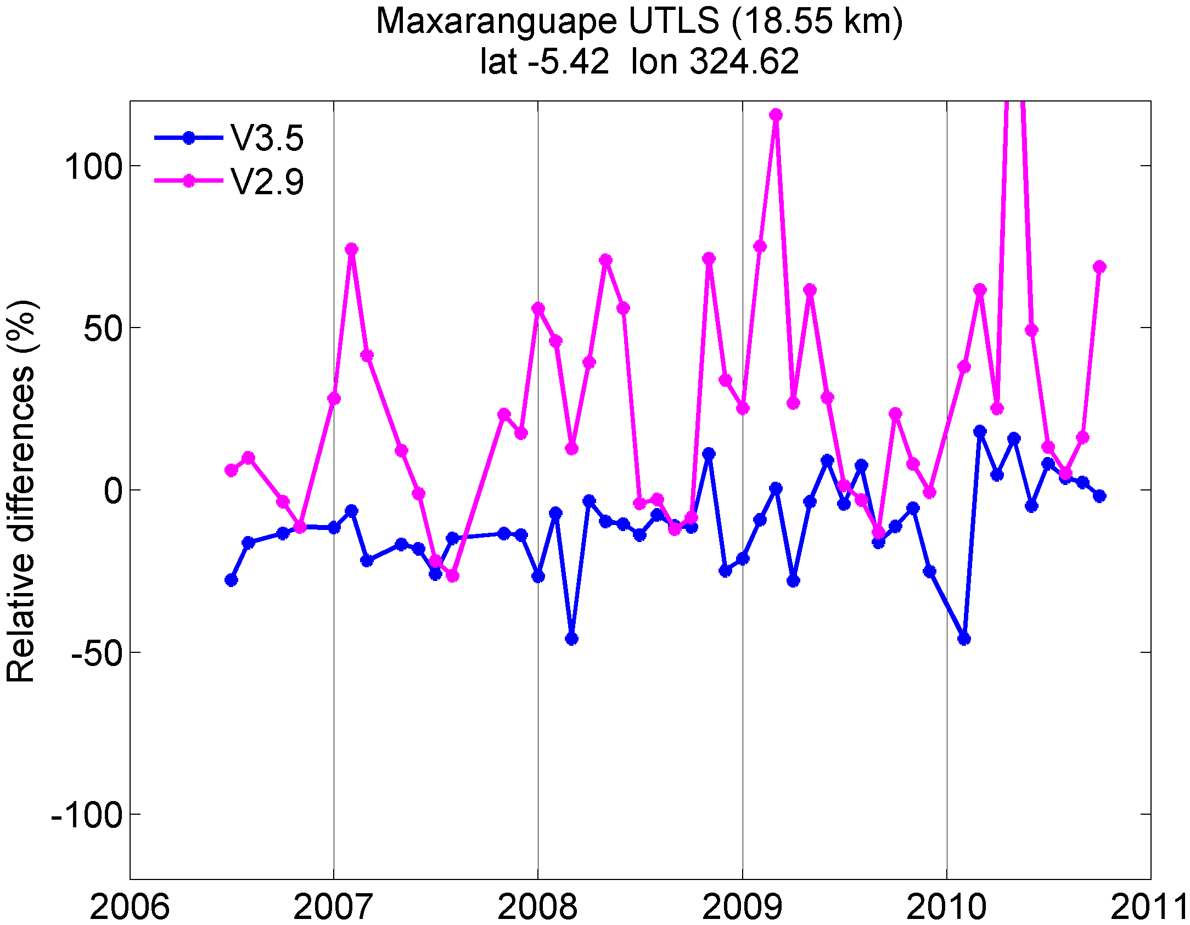
Comparison to ozone sondes: tropical UTLS
Monthly mean time series of co-located measurements from SCIAMACHY and ozone sonde at Maxaranguape (Natal) station (5.4ºS, 35.4ºW).
18.5 km
Mean relative differences
20ºS - 20ºN

Slide 7
Comparison to ozone sondes: tropical UTLS
Average over all colocations for 2006 – 2011 at 18.5 km
West
Longitude
East
20ºS - 20ºN

Slide 8
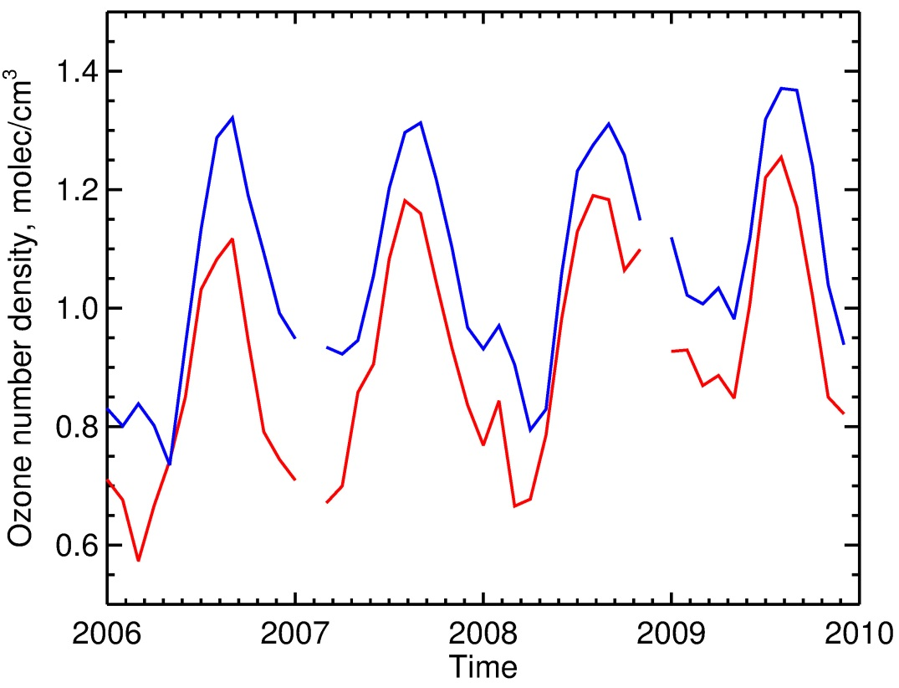
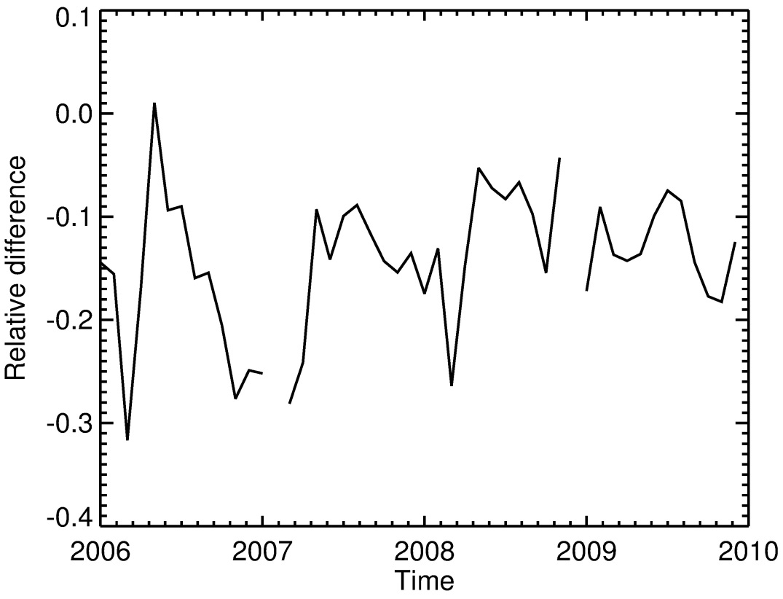
Comparison to MLS: tropical UTLS
Monthly zonal mean time series of co-located measurements from SCIAMACHY and MLS (v3.3), 5ºS – 5ºN.
18.5 km
Mean relative differences
Blue: MLS Red: SCIAMACHY
20ºS - 20ºN

Slide 9
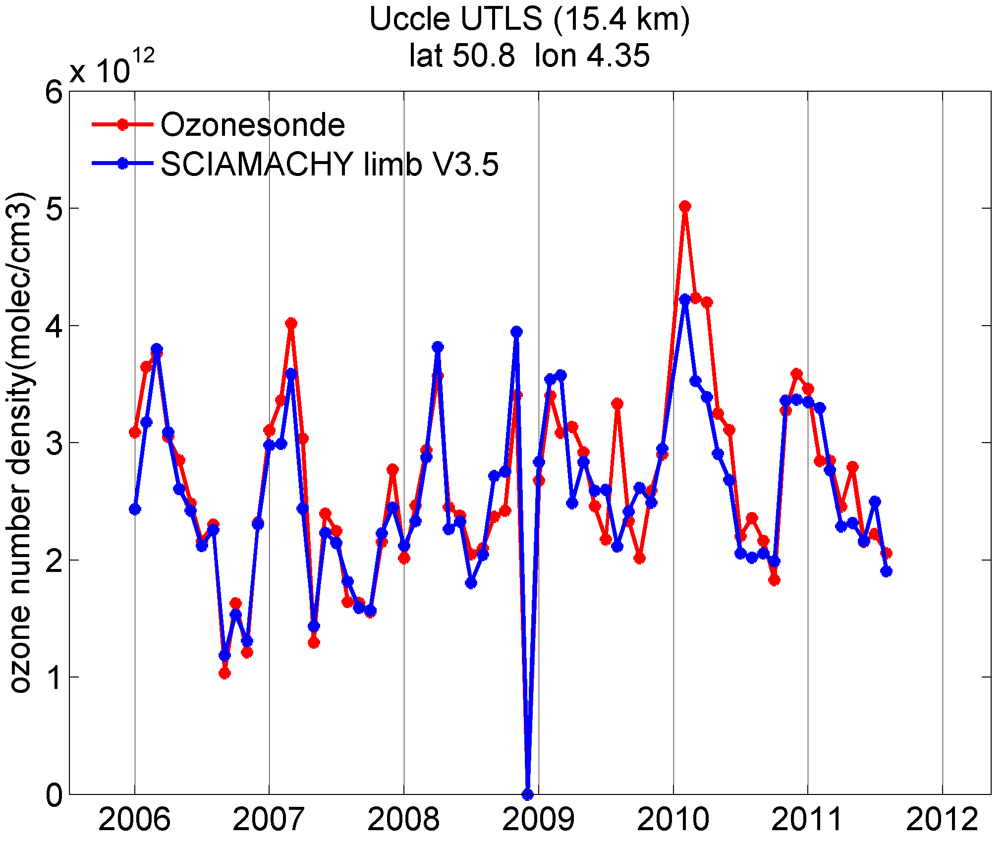
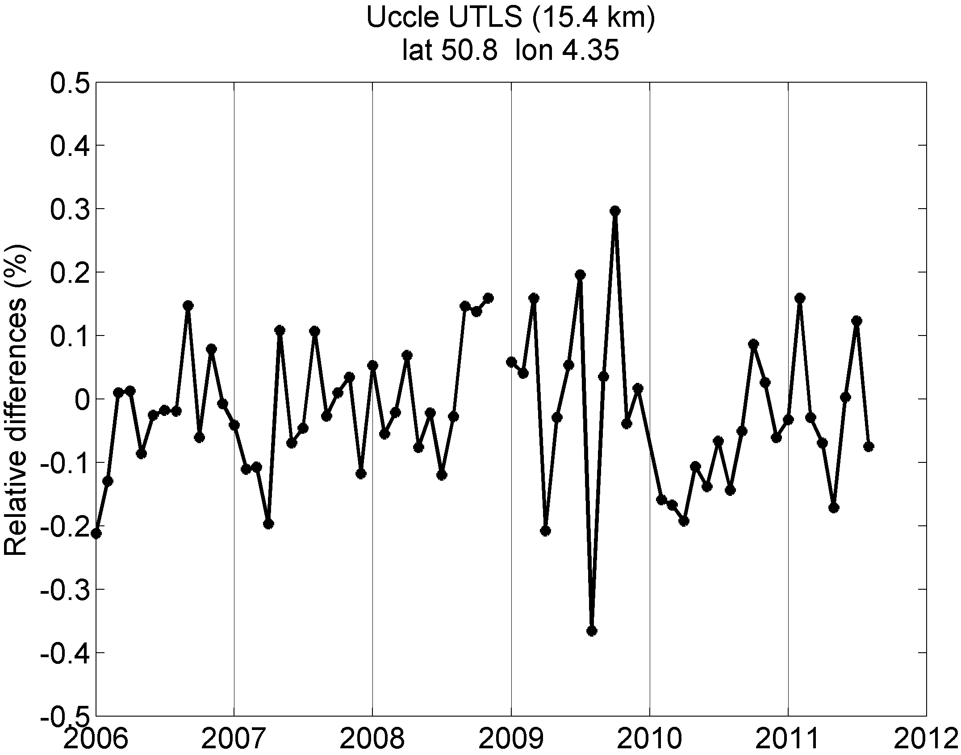
Comparison to ozone sondes: mid-latitude UTLS
Monthly mean time series of co-located measurements from SCIAMACHY and ozone sonde at Uccle station (51ºN, 4ºE).
15.4 km
Mean relative differences
40ºN - 60ºN

Slide 10
Comparison to ozone sondes: mid-latitudes UTLS
Average over all colocations for 2006 – 2011 at 15.4 km
West
Longitude
East
40ºN - 60ºN

Slide 11
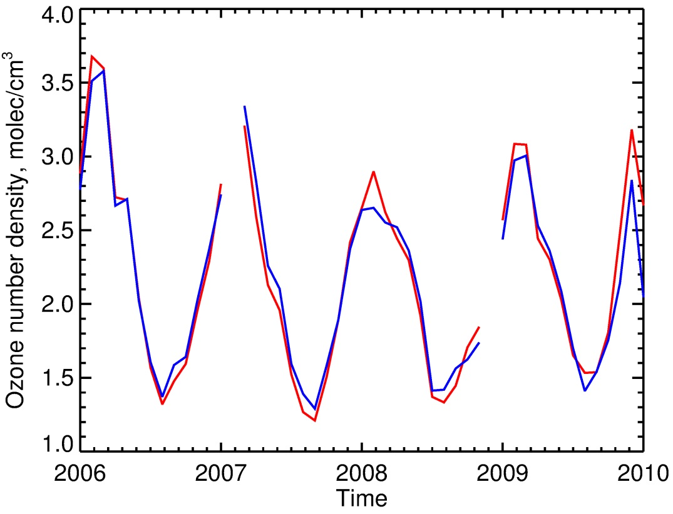
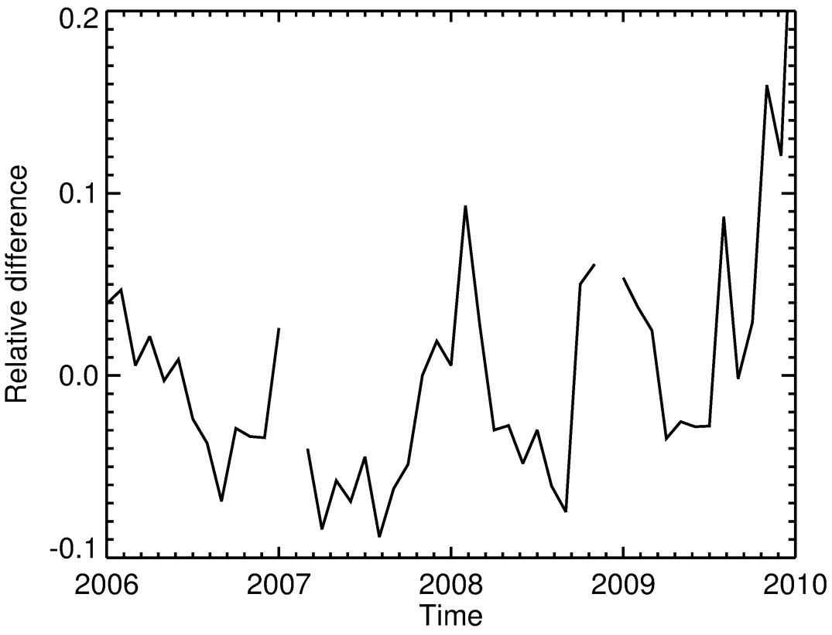
Comparison to MLS: mid-latitudes UTLS
Monthly zonal mean time series of co-located measurements from SCIAMACHY and MLS (v3.3), 40ºN – 50ºN.
15.4 km
Mean relative differences
Blue: MLS Red: SCIAMACHY
40ºN - 60ºN

Slide 12
Conclusions
Agreement with MLS within 5% between 20 and 40, within 10% between 40 and 60 km, and within 20% below 20 km in the extratropics.
UTLS ozone amounts in tropics and mid-latitudes agree generally within 10% with ozone sonde data.
The following issues identified in V2.9 are fixed:
Artificial drift in the ozone time series around 35 km altitude is not present any more
High bias at 1-5 hPa signal found in V2.9 by Tegtmeier et al. (2013) is significantly reduced.
Unrealistic high amplitude of QBO signal found in V2.9 by Tegtmeier et al. (2013) is fixed.

